Slide 1
Abdominal incisions

Slide 2
Layers of the anterior abdominal wall:
It is formed of the following layers:
1. Skin
4. Abdominal muscles.
6. Extraperitoneal fat
2&3. superficial fascia (no deep fascia).
5. Fascia transversalis
7. Parietal peritoneum.

Slide 3
When planning a skin incision, five factors should be considered (criteria for ideal incision):
Skin tension lines (Langer’s lines): These lines represent the orientation of the dermal collagen fibers and any incision placed parallel to these lines result in a better scar (for maximal wound strength and minimal scaring).

Slide 4
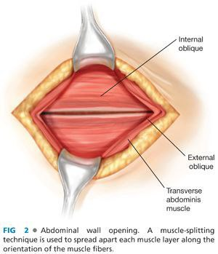
2) Anatomical structure: incisions should avoid bony prominences and crossing skin creases if possible, and take into consideration underlying structures, such as nerves and vessels.
3) Cosmetic factors: any incision should be made bearing in mind the ultimate cosmetic result, especially in exposed parts of the body, as an incision is the only part of the operation the patient sees.
4) Adequate access for the procedure: the incision must be functionally effective for the procedure in hand as any compromise purely on cosmetic grounds may render the operation ineffective or even dangerous.
5) muscle should be split not cut, and being easily opened and closed

Slide 5
Types of incisions:

Slide 6
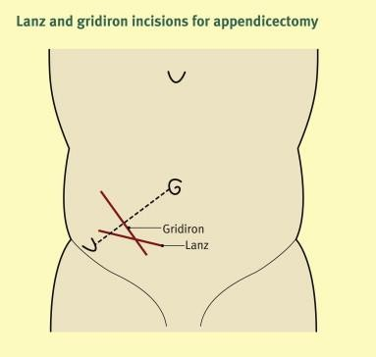
1-Gridiron and lanz incisions:
-The gridiron and lanz incisions are both incisions that can be used to access the appendix predominantly for appendectomy.
-The incisions cut through: -
Skin
subcutaneous fat and fascia 3-external and internal oblique 4-transversus abdominis
5-transversalis fascia.
The risk of injury to the
Ilioinguinal and iliohypogastric nerves.
-Disadvantages include:-

Slide 7
-The lanz incision is a transverse incision while the gridiron (mcburney incision) is oblique.
-Gridiron incision is oriented along the Langer Lines and it is muscle splitting incision.
-the lans incision produces much more aesthetically pleasing results as the scar is hidden beneath the bikini line.

Slide 8
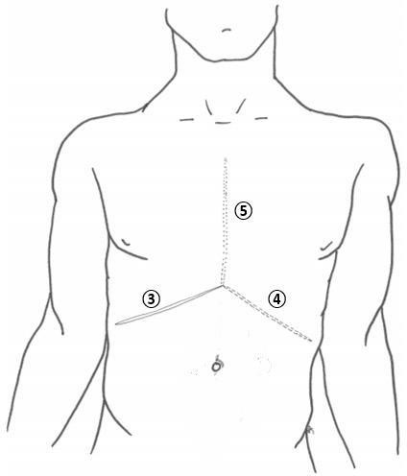
2-Kocher incision:
-An incision made parallel to the right subcostal margin to access the underlying liver and biliary tree (3 on its own).
-It may be mirrored on the contralateral side to provide access to the spleen or performed bilaterally.
-Indications of the kocher incision: gall bladder and biliary tract operation (usually open cholecystectomy
Kocher incision
chevron incision (Rooftop) Mercedes Benz incision
3 represent
3+4 represent
3+4+5 represent

Slide 9
-Kocher cuts through:
Skin
subcutaneous fat and fascia
Lateral half: External oblique / Internal oblique / Transversis abdominis
Medial half: anterior rectus sheath
/Rectus abdominis / posterior rectus sheath
Transversalis fascia*
Extraperitoneal fat 7-peritoneum
Disadvantages include:-
may be used for oesophagectomy, gastrectomy, bilateral adrenalectomy, hepatic resections, or liver transplantation.
may be used for the same indications as the Chevron incision, and diaphragmatic hernia, However classically seen in liver transplantation.
-The risk of injuring the superior epigastric vessels, and lateral
extension of the incision risks
disruption of intercostal nerves.
Chevron incisions
Mercedes Benz

Slide 10
3-Midline laparotomy:
-Incision down the middle of abdomen along and through the linea Alba. (Upper or lower midline).
-commonly used for procedures requiring emergency laparotomy, such as: faecal peritonitis secondary to malignant intestinal perforation, ischaemic bowel, trauma.
-This incision generally provides the best visualization and intra- abdominal access.
-Immediate complications of a midline laparotomy incision may include anaesthetic difficulties, haemodynamic instability,
primary haemorrhage from cut vessels and iatrogenic injury to surrounding tissues and viscera.

Slide 11
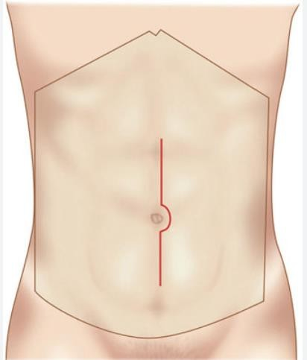
-It will encounter the following layers of tissue:
Skin
Subcutaneous fatty layer (Camper’s fascia) 3-Membranous fascia (Scarpa’s)
Linea Alba* Transversalis fascia
Preperitoneal fat
Parietal peritoneum
patients experiencing more pain than they would from a transverse incision, particularly during deep breathing postoperatively, and the incision is
perpendicular to the Langer’s skin tension Lines resulting in poorer cosmesis.
Disadvantages include

Slide 14
Complications of abdominal surgical incisions:
-Wound complications are important causes of early and late postoperative morbidity following laparotomy.
-Surgical wounds in normal, healthy individuals heal through an orderly sequence of physiologic events that includes inflammation, epithelialization, fibroplasia, and maturation.
-Mechanical failure or failure of wound healing at the surgical site can lead to disruption of the closure leading to:
seroma, hematoma, wound dehiscence, or hernia.
Other complications include surgical site infection and nerve injury.

