Slide 1
SHOULDER JOINT
Dr. Dalia M. Biram

Slide 3
In each joint we will discuss the following:
Type of joint.
Articular surfaces.
Capsule (covers margins of articular surfaces).
Synovial membrane (lines the inner of the capsule).
Ligaments related.
Movements and muscles producing it.
Nerve supply (from NS of surrounding MS)

Slide 4
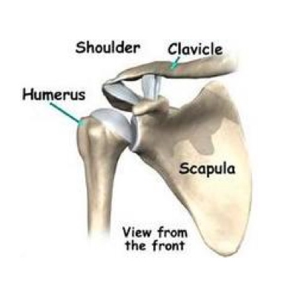
Type:
Synovial, polyaxial, ball & socket
Articular surface:
Head of humerus
Glenoid cavity of scapula
*Each of the articular surfaces is covered by hyaline cartilage.
*The glenoid cavity is deepened by a fibro-cartilaginous rim; labrum glenoidal.

Slide 5
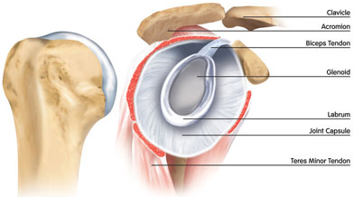
hyaline cartilage.
labrum glenoidal.

Slide 6
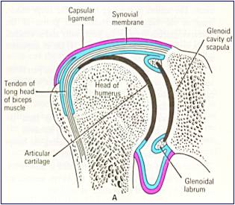
Capsule
attached to the margins of the glenoid cavity outside the labrum glenoidal.
Laterally is attached to the anatomical neck of the humerus, except inferiorly where it extends about 1 cm to the shaft.

Slide 7
Synovial membrane
-It lines all the structures inside the capsule of the shoulder joint EXCEPT the articular cartilage.
-It forms a tubular sheath around the tendon of long head of biceps, so it is an intra-capsular, extra-synovial structure.

Slide 8
LIGAMENTS RELATED TO SHOULDER JOINT(---- humeral)
1- False ligaments:
glenohumeral ligaments (Thickenings of the Capsule )
2- True ligaments:
Coraco-humeral ligament.
Transverse humeral ligament (bridges over the bicipital groove).

Slide 13
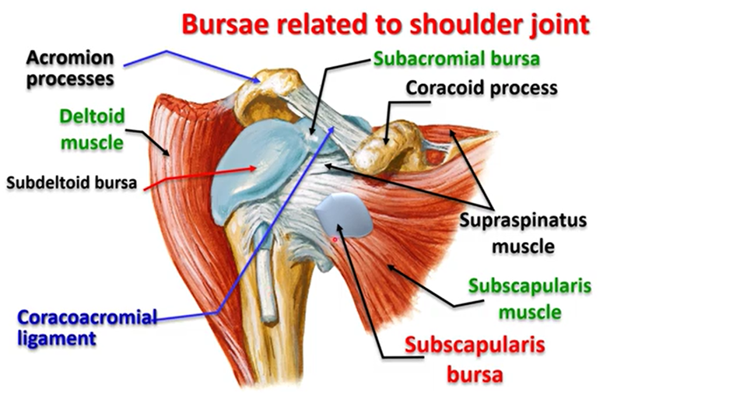

Slide 14
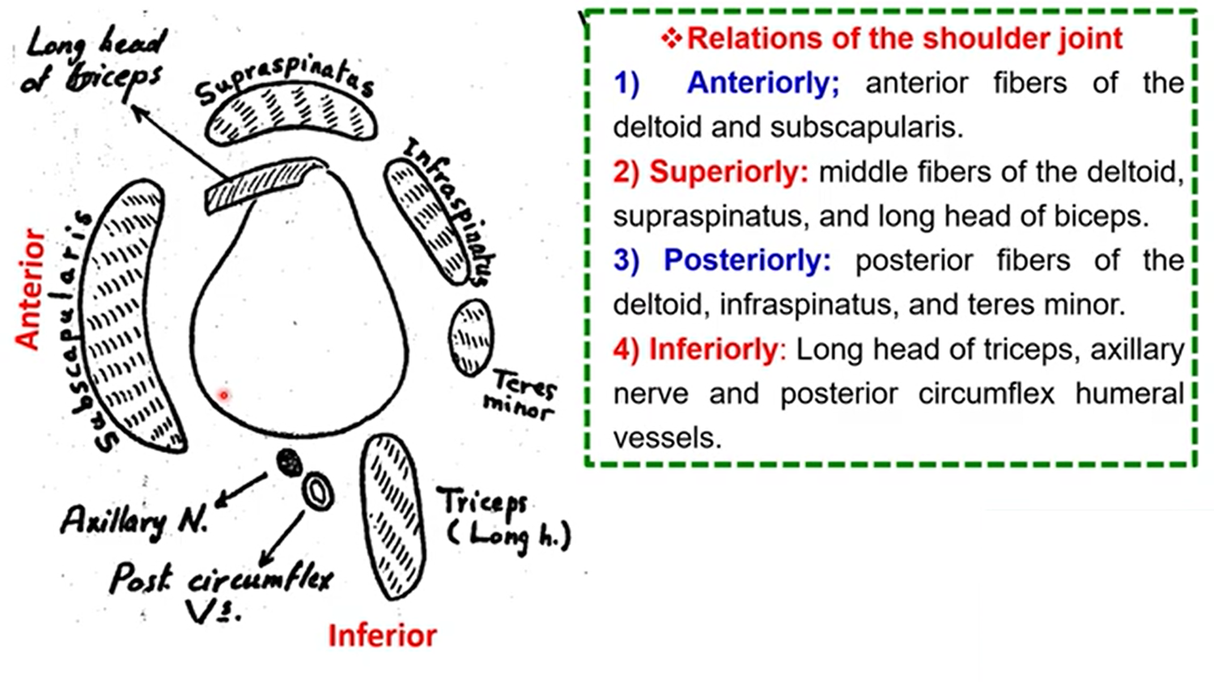

Slide 19
AXILLARY NERVE
It arises from the posterior cord of the brachial plexus.
It passes backwards through the quadrangular space to turn around the surgical neck of the humerus.
root value :c5,c6
Branches:
Muscular branches: to the deltoid and teres minor muscle.
Cutaneous branch: Upper lateral cutaneous nerve of the arm which supplies the skin over the lower half of the deltoid.

Slide 20
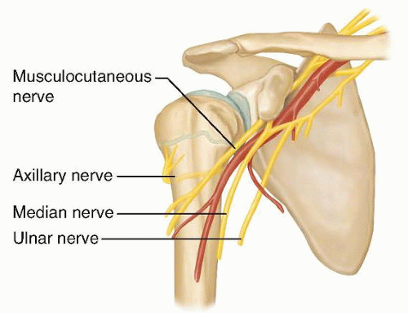

Slide 21
In case of fracture surgical neck humerus, the axillary nerve will be injured which will result in:
Weakness of abduction of the arm.
Wasting of the deltoid muscle (flat shoulder).
Loss of sensation over the lower half of deltoid.

