Slide 1
ECG

Slide 2
How to Read an ECG

Slide 3
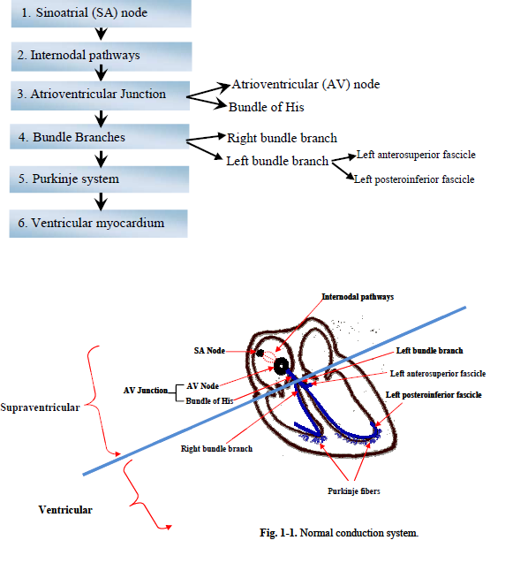
Automaticity/ Conductivity

Slide 4
Electrocardiographic Waves, Intervals, and Segments

Slide 5
Electrocardiographic Waves, Intervals, and Segments

Slide 6
ECG Paper
Horizontal measurement represents the time. (i.e., Duration measured in seconds ).

Slide 7
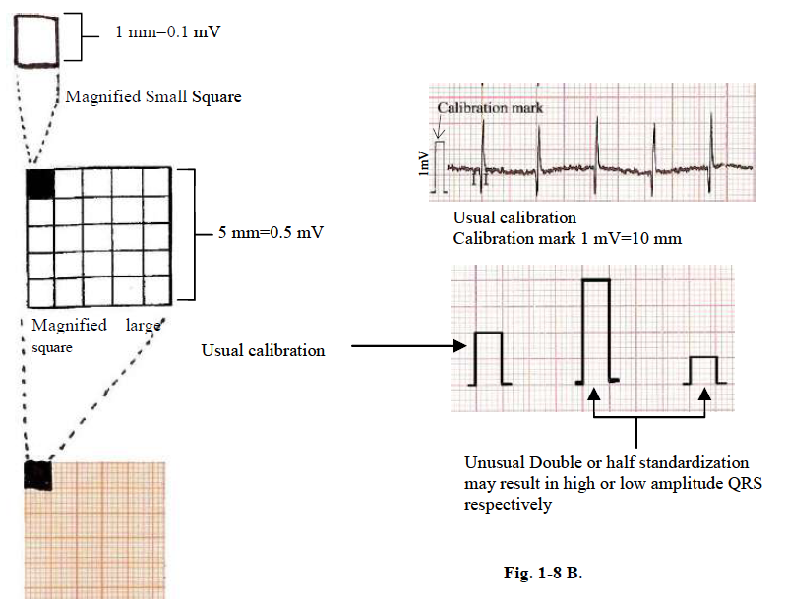

Slide 8
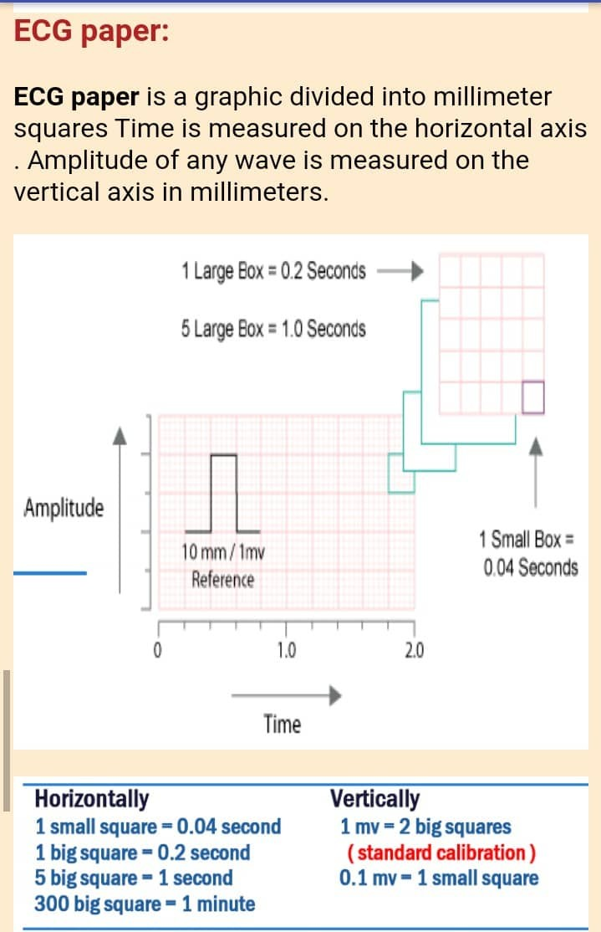

Slide 11
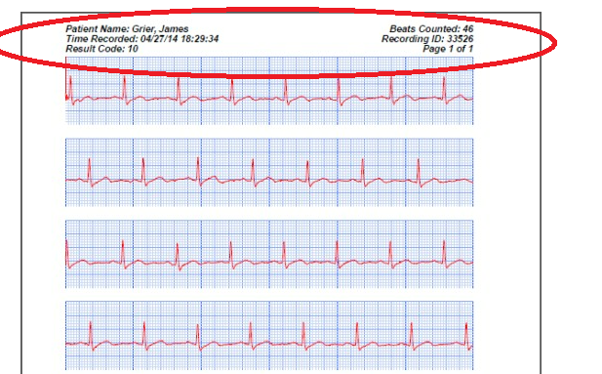

Slide 12
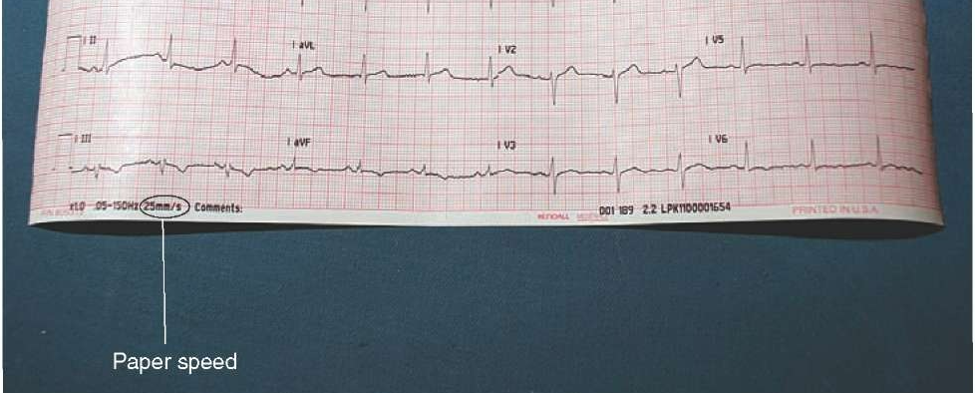

Slide 13
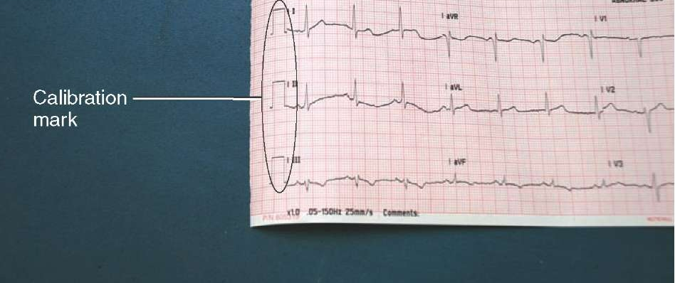

Slide 14
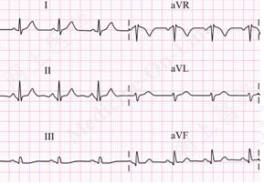

Slide 15
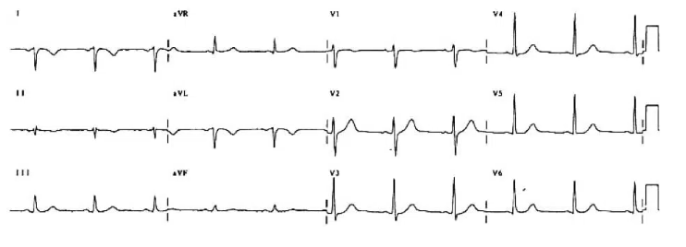

Slide 17
REG

Slide 18
REG : 1500 /12 , 20 *6

Slide 19
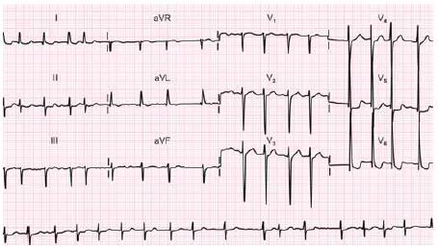
IRREG

Slide 20
approach to diagnose common Tachy/bradyarrhythmias

Slide 21
NSR

Slide 22
Premature contractions

Slide 23
Tachycardia

Slide 24
Narrow complex/REG

Slide 27
NCT/REG

Slide 28
NCT/IREG

Slide 29
WCT/REG

Slide 30
WCT/REG

Slide 31
WCT/IREG

Slide 32
Bradycardia

Slide 34
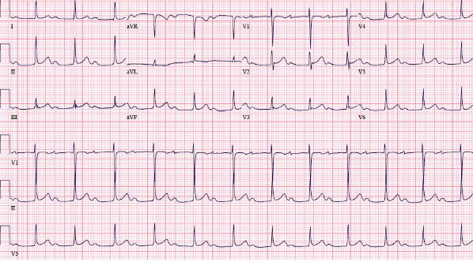

Slide 35
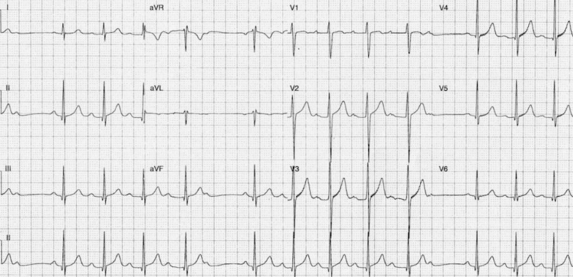

Slide 38
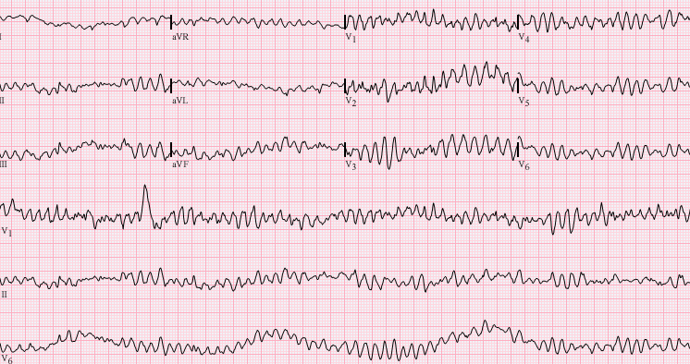

Slide 40
What is the Axis? (Leads I, II and III shown)
I
II
III
1. 2. 3. 4. 5. 6.

Slide 41
What is the Axis? (Leads I, II and III shown)
I
II
III
Normal Left Normal Right Left Right

Slide 42
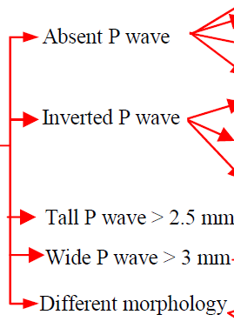

Slide 43
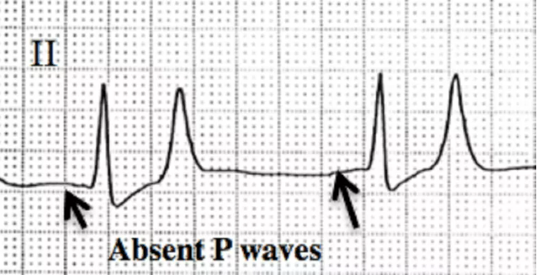
Abscent

Slide 44
Inverted

Slide 47
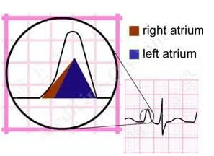
RAE

Slide 48
RAE

Slide 49
LAE

Slide 50
LAE

Slide 51
Different morphology

Slide 52
PR

Slide 53
Long PR

Slide 54
Short PR

Slide 55
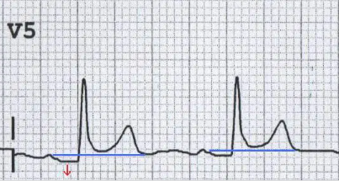
PR depression

Slide 56
PR interval

Slide 57
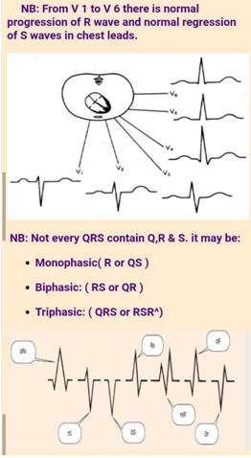
6- QRS complex
Represent Ventricular depolarization
Q wave : an initially negative deflection of the QRS complex
Width < 1mm , Height <1/4 the next R wave
R wave : The only +ve deflection in the QRS complex
Width < 2-3mm , Height: 1-5 high sequares
S wave : A negative deflection after an R wave is called an S wave

Slide 58
Q wave

Slide 59
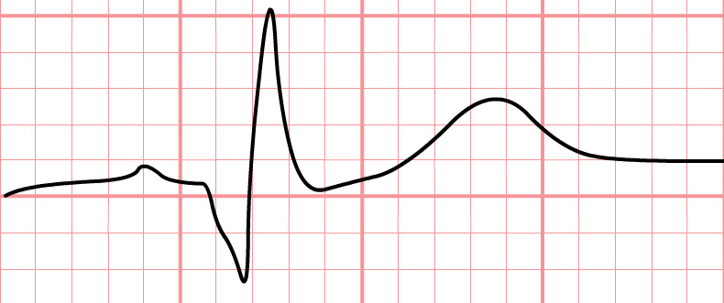
Q wave

Slide 60
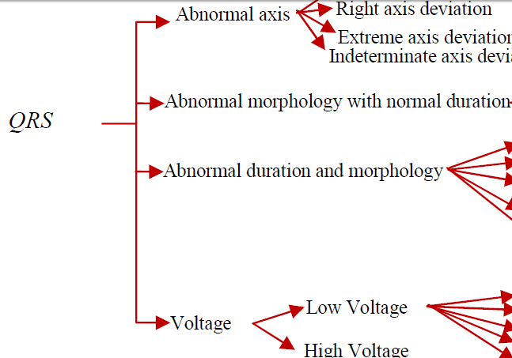

Slide 61
Axis
Normal
RAD/LAD
Northeast

Slide 62
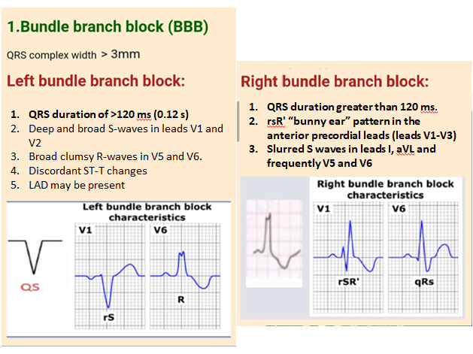

Slide 63
RBBB

Slide 64
LBBB

Slide 65
RBBB

Slide 66
LBBB

Slide 68
LVH

Slide 69
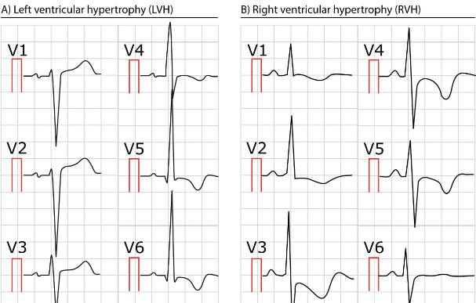

Slide 72
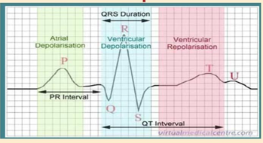

Slide 73
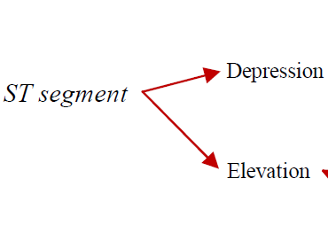

Slide 74
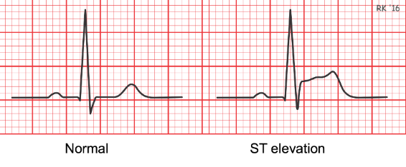

Slide 75
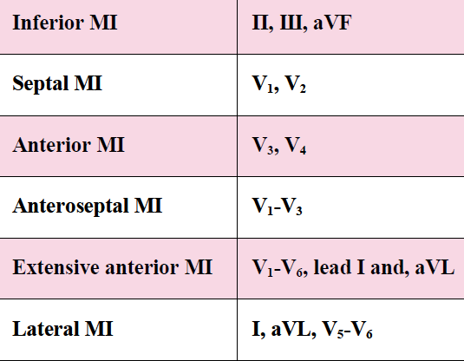

Slide 80
T wave

Slide 82
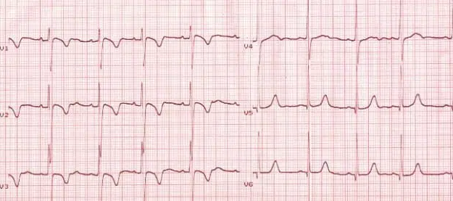

Slide 83
9-QT interval

Slide 85
Prolonged QT interval

