Slide 1
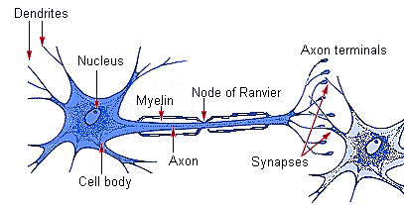
Peripheral nervous system
Prof.Dr . Hala Fouad El-mazar

Slide 2
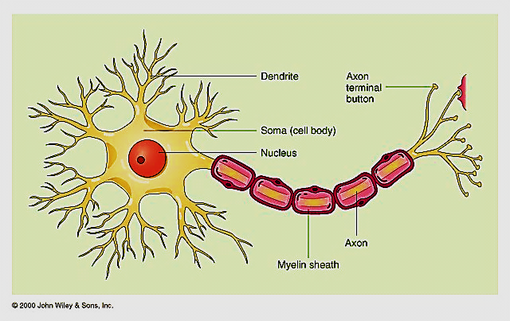
Structure of the neuron ( nerve cell)
consist of the following main parts:
Cell body (perikaryon)
Dendrites
Axon hillock
Axon
Axonal terminals
Knobs
Synapse

Slide 3
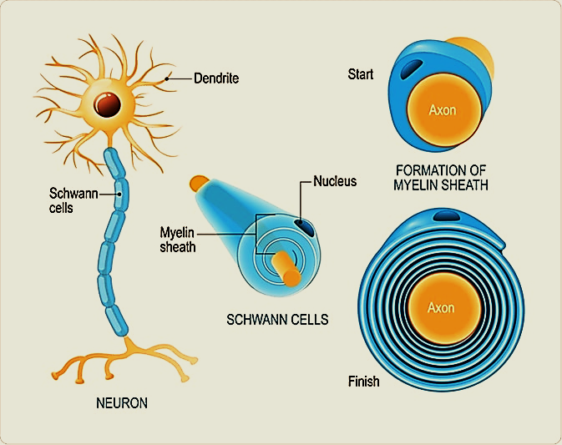
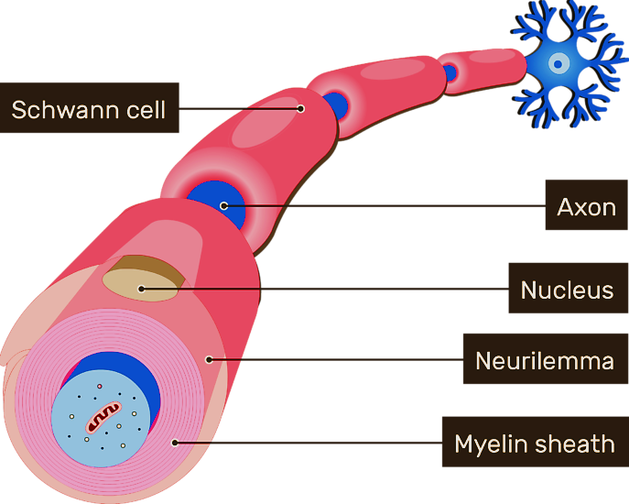
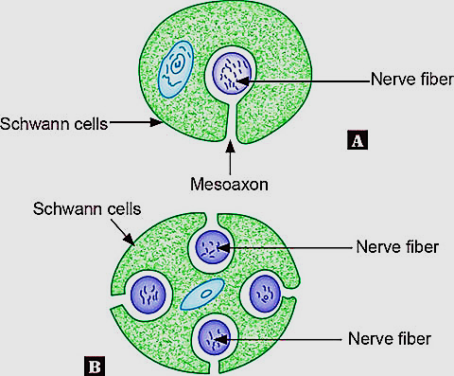
* Axon are enveloped by sheath of
Schwann cells
* The cells may or may not form
myelin around the axon thus
*myelinated or unmyelinated nerves
* Axolemma: plasma membrane around nerve cell
* Neurilemma : plasma membrane of Schwan cells that present over myelinated axon

Slide 4
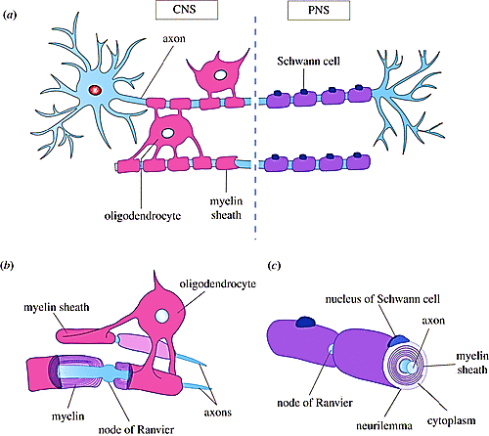
Axolemma transfer signals between neuron & its Schwan cells that control the proliferative & myelin producing function of Schwan cells as well as axon size
Glial cells found in PNS are 2 types: Schwan cells & Satellite cells. Schwan found in close contact with axons of PNS, While satellite are found within ganglia in close association with nerve cell bodies
Q: Myelin of CNS is formed by?
The myelin sheath of oligodendrocytes
don’t have neurilemma because excess
cytoplasm is directed centrally
toward oligodendrocyte cell body

Slide 5
Myelin
White fatty material (80% lipid and 20% protein) covering axons in PNS
Formed by Schwann cells which are glial cells
consists of many layers of modified cell membranes of Schwan cells which have high lipid content. The plasma membrane wraps around the axon. Then the layers of the membranes unit and form myelin
Protects and insulates the nerve cell and increase the transmission rate of nerve impulses

Slide 6
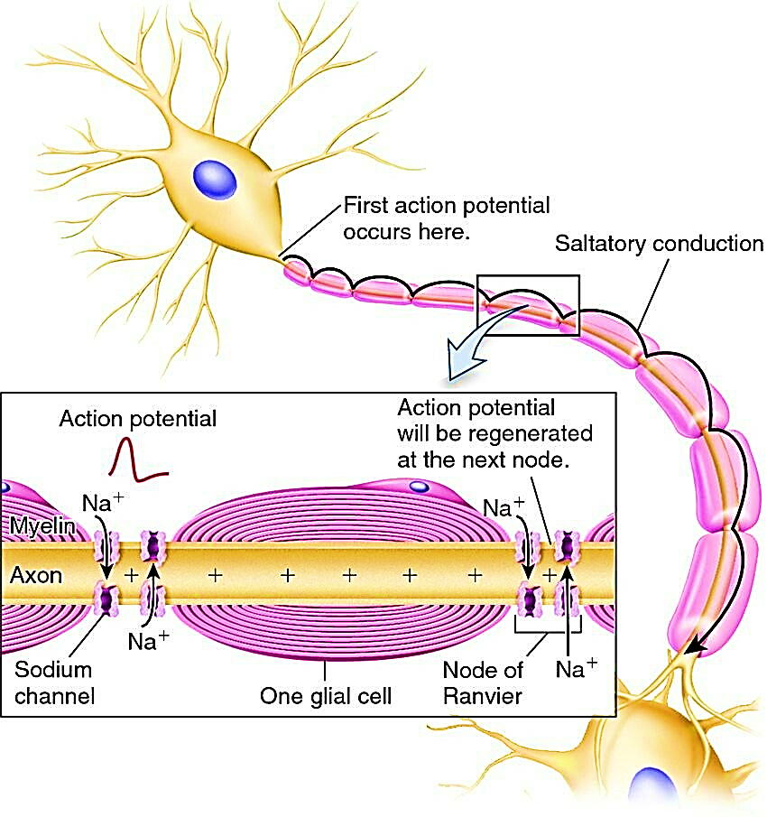
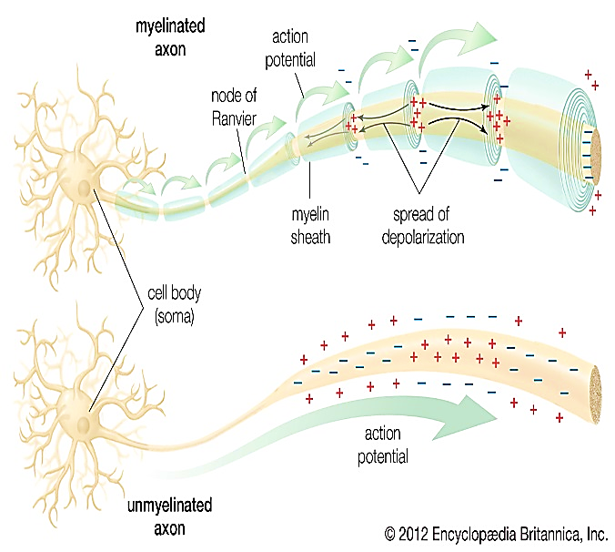
Node of Ranvier (NOR) increases conduction velocity of action potential ( rate of transmission of impulse).
action potentials "jump" between Nodes of Ranvier→
Saltatory conduction:
Cuz depolarization can not occur at the cells making up the myelin sheath, the wave of depolarization can only occur at the Nodes of Ranvier. Thus, action potentials appear to jump from node to node when travelling down an axon

Slide 7
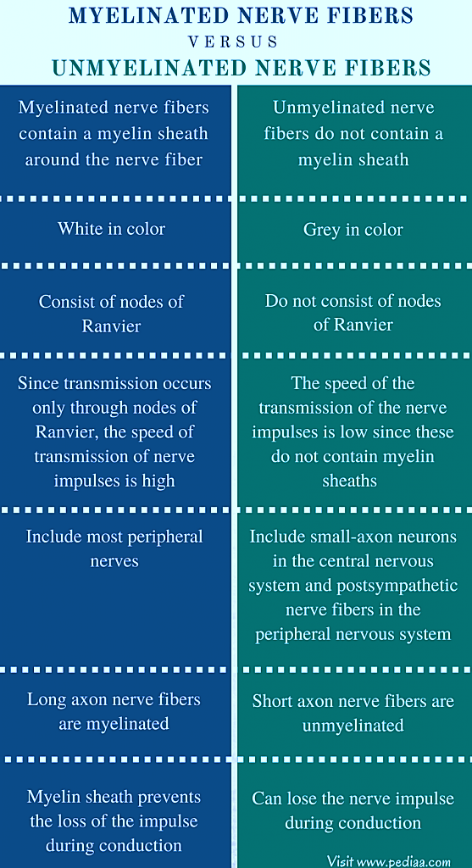
Myelinated vs Unmyelinated nerve fibers

Slide 8
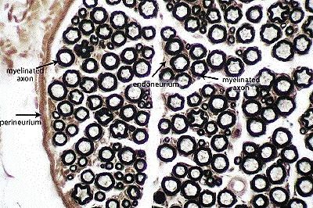
Myelinated axons are visible in this cross-section of a peripheral nerve. Osmic acid is used to stain the myelin

Slide 9
Functional classification of neuron
Based on the direction of conduction of impulses
Afferent (Sensory) neuron: conduct impulses (stimuli) toward CNS
Interneuron (association neurons): lie entirely in the CNS. Interposed between sensory and motor neurons, perform integrative function
Efferent (Motor) neuron: they transmit the appropriate response from the CNS to an end organ (muscle & glands) to carry out the body’s response to stimuli

Slide 10
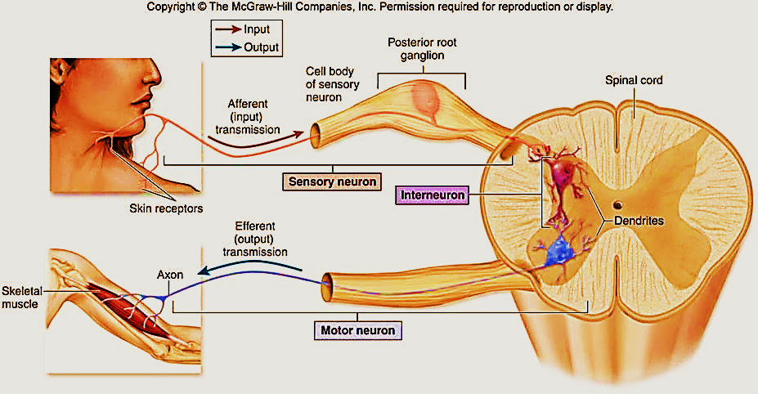

Slide 11
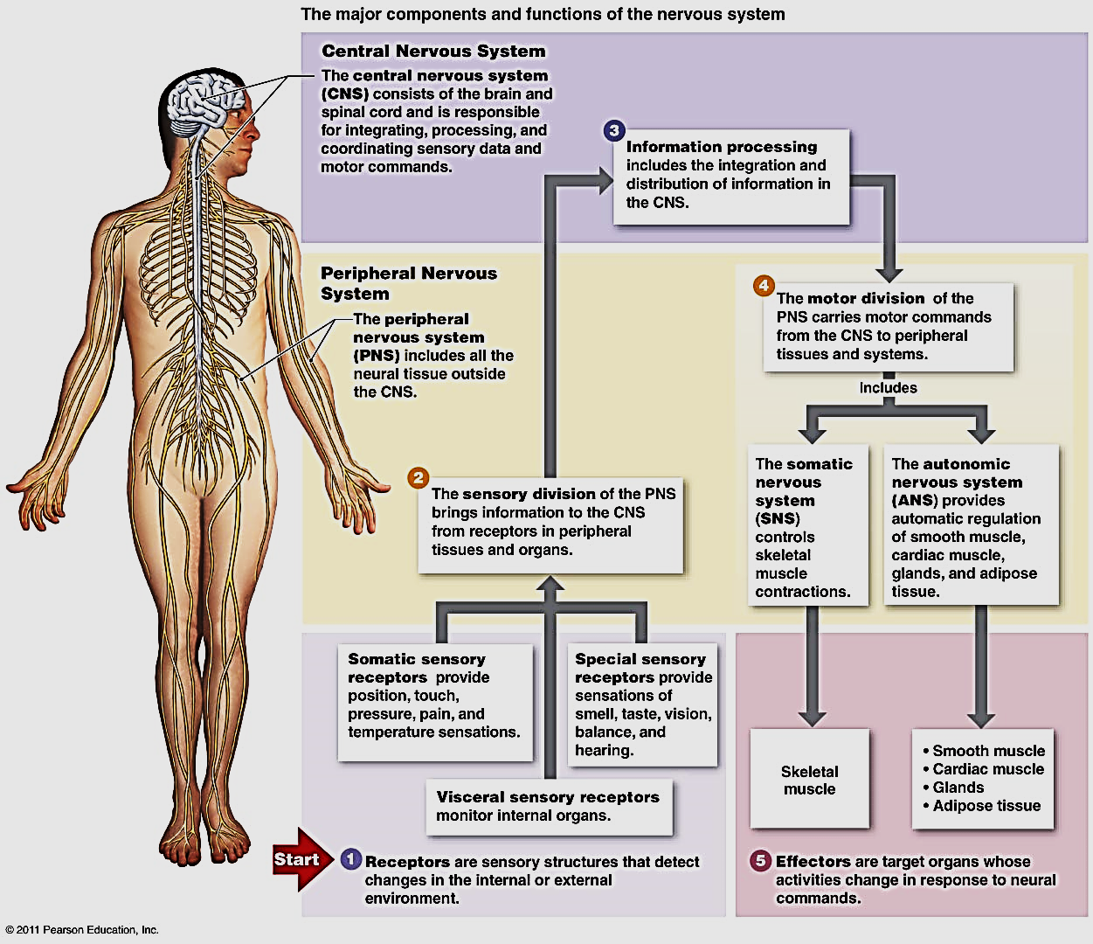

Slide 12
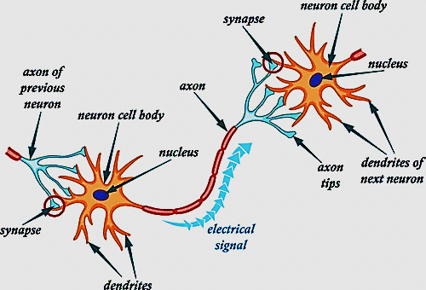
synapse
Sites of functional contact between neurons or between neurons & target effector cell e.g. muscle cell or gland cell
At Synapse unidirectional transmission of nerve impulses occurs.

Slide 13
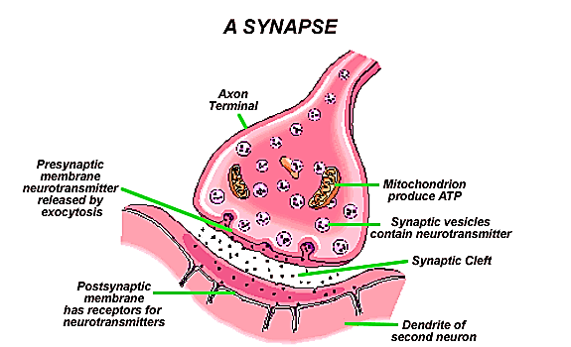
Structure of synapse
1- Presynaptic axon terminal (terminal knob):
which has vesicles that contain
Neurotransmitters, ↑
mitochondria
2- Synaptic cleft: narrow space
between presynaptic &
postsynaptic membranes
3- Postsynaptic cell membrane: which
has receptors for the chemical transmitters

Slide 14
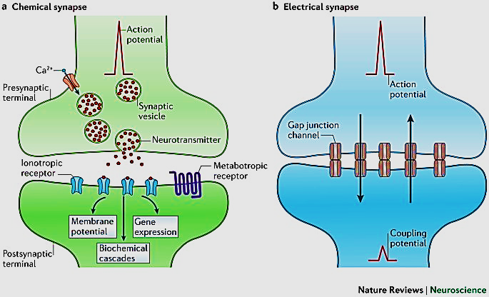
Methods of signal transmission:
1- Chemical synapses: neurotransmitters e.g motor end plate
2- Electrical synapses: gap junction (ionic signals) e.g. cardiac muscles

Slide 15
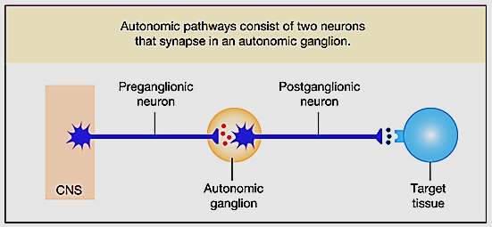
Ganglia
Ovoid structures contain aggregations of nerve cell bodies & satellite cells supported by CT
They serve as relay station to transmit nerve impulse, one nerve enters & another exit from each ganglia
They are two types: up to the direction of n. impulses
Sensory ganglia (sensory) : spinal & cranial ganglia
Autonomic ganglia (motor) : sympathetic or parasym. gan.

Slide 16
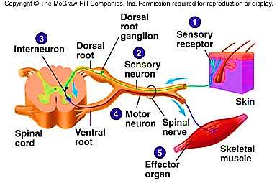
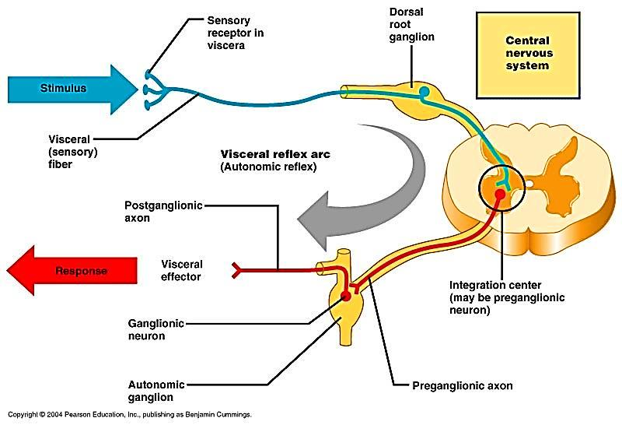
Sensory ganglion
Autonomic ganglion

Slide 17
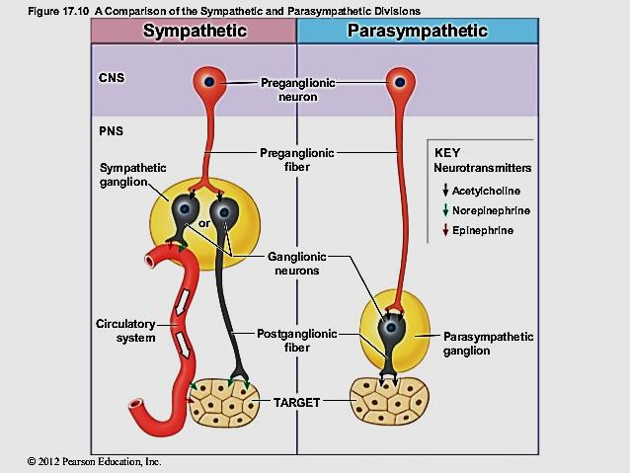
Sympathetic vs Parasympathetic ganglion

Slide 18
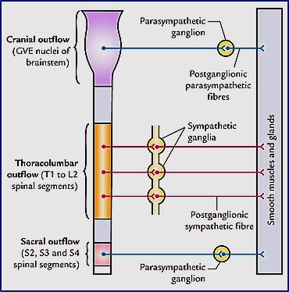
Sympathetic is thoraco-lumber outflow:
Thoraco: T1 – T12
Lumbar :L 1- 2/3
Postganglionic fibers → Epinephrine
Ganglia close to spinal cord → sympathetic chain
Lots of post- ganglionic branching so that multiple organs can be controlled & adrenergic
Parasympathetic is cranio-sacral out flow:
Cranial: 3,7,9, & 10
Sacral: S 2-4
Post- ganglionic fibers → Ach
Ganglia near or within target organs
Very little post- ganglionic branching & cholinergic

Slide 19
Sensory ganglia
Autonomic ganglia
Sensory ganglia
carry afferent impulses to CNS
Example:
Cranial ganglia e cranial nerves
Dorsal root g. e spinal nerves
Nerve cell bodies are:
Rounded shape(unipolar)
Covered with thick capsule
Large , few in numbers
Central nuclei
Arranged in groups between the fibers
Motor ganglia
Carry efferent impulses from CNS
Sympathetic ganglia
Parasympathetic ganglia
Multipolar
Thin capsule
Small , numerous
Eccentric nuclei
Scattered , no groups

Slide 20
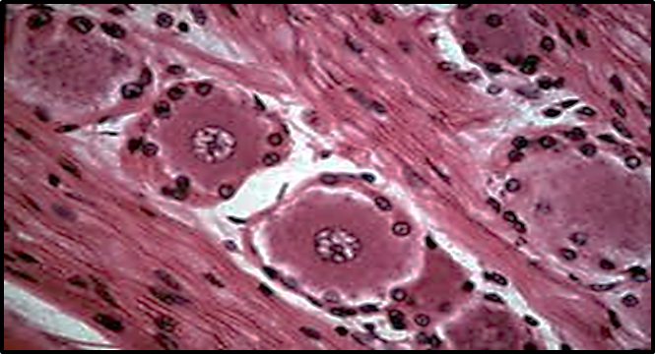
Spinal ganglia
The groups of cells are separated with myelinated nerve fibers
satellite cells are more around each nerve cell
Sympathetic ganglia
The cells are separated with non/ little mylinated nerve fibers
satellite cells are less

Slide 21
Nerve endings
They are either:
A- At Receptors: receive external or internal stimuli & convert them to nerve impulses → CNS
They are classified into:
Exteroceptors: external stimuli- epithelium
Proprioceptors: stimuli from muscles & tendons
Interoceptors : stimuli in viscera & blood vessels
B- At Effectors: carry impulses from CNS to muscles or glands

Slide 22
- Location of receptors
Receptors in epithelium:
Free nerve endings plexus of bonnet Merkle tactile disc Neuroepithelium endings
Receptors in muscular tissue:
Muscle spindle
Receptors in CT: Free nerve endings Meissner corpuscle Krause end bulb Pacinian copuscle
Ruffini’s end organ
Golgi tendon organ (tendon spindle
Classification of receptors

Slide 23
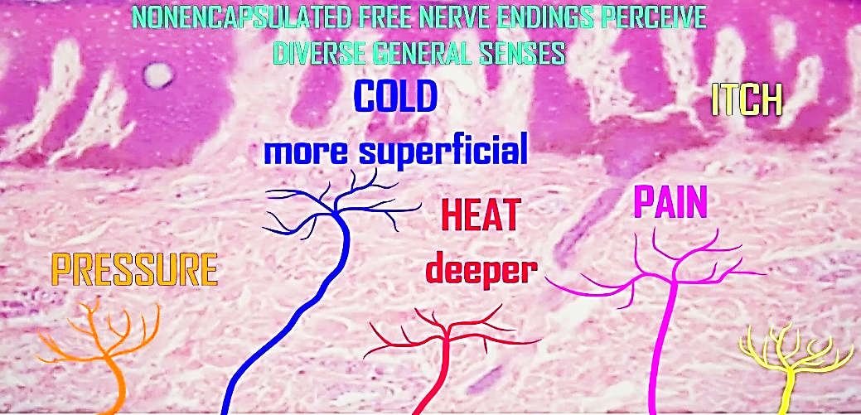
1- Free nerve endings
They are receptors for pain & temperature
Simplest receptors &
Widely distributed
throughout the body
Are unmyelinated sensory nerve fibers which penetrate the basement membrane of an epithelium to end freely in-between epithelial cells
Sites: epidermis of skin, corneal ,conjunctiva & oral cavity

Slide 24
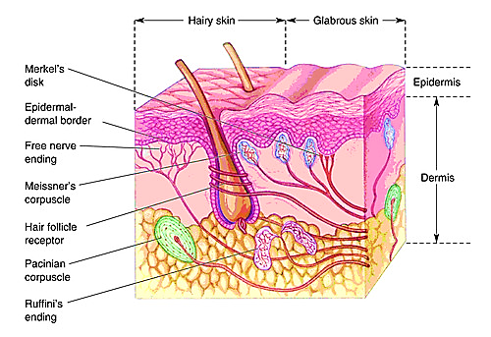
2- Root hair plexus
A web of free nerve endings, form basket – like structure around the base of hair follicles
Function: mechanoreceptors for touch sensation .it sends and receives nerve impulses to and from the brain when hair moves

Slide 25
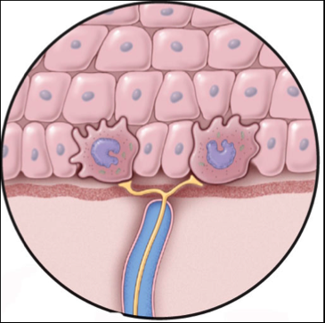
3- Merkel Tactile disc
They are mechanoreceptors detect touch & pressure
Present in epidermis ( superficial) of the skin of soles & palms(fingers .. Tactile discrimination, sophisticated sensory tasks)
In association with Merkel cells (modified epithelial cells) of the epidermis
The Afferent nerve fiber lose
its Myelin, penetrates the
basement membrane &
terminate as a disc (cup)around
Merkel cells
Epidermis
Merkel cells
Tactile disc

Slide 26
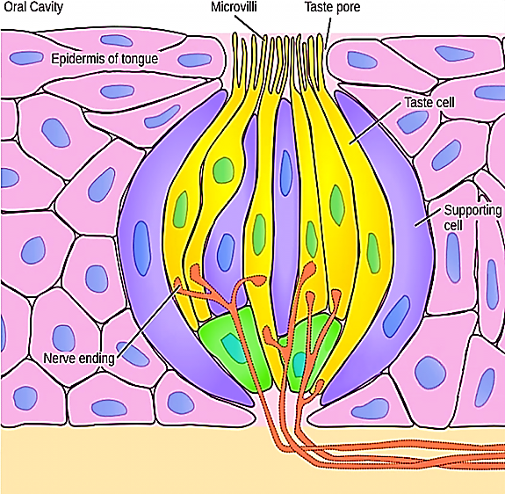
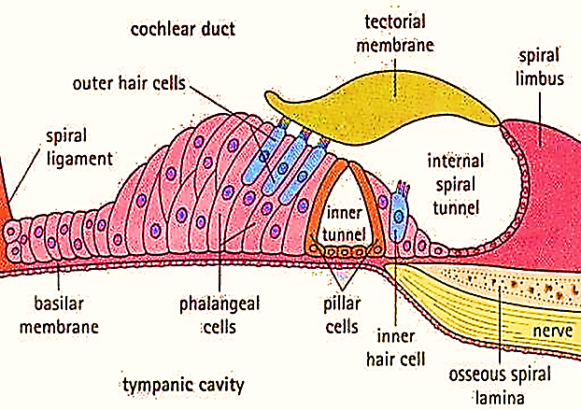
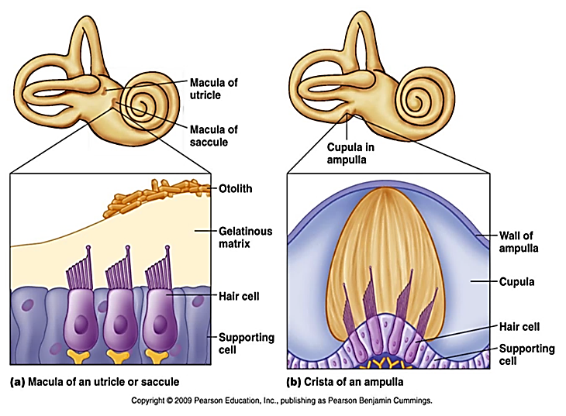
4- Neuroepithelium endings
Taste buds / tongue
Olfactory epithelium / nose
Organ of Corti / ear
Macula utriculi, macula sacculi &
crista ampullaris for equilibrium/ ear
Photoreceptors / retina

Slide 27
Nerve endings in connective tissue

Slide 28
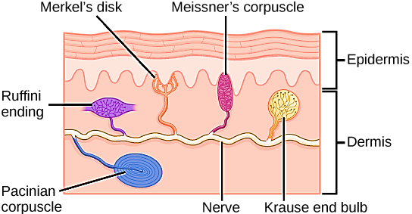
1- Meissner’s corpuscles
Oval shape, encapsulated structures present in the dermal papillae (deep) of skin that is especially sensitive as tips of fingers (Hairless skin)
They detect light touch ( mechanoreceptors) & Low frequency vibration

Slide 29
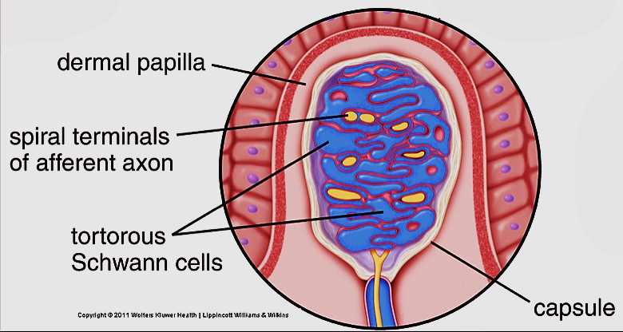
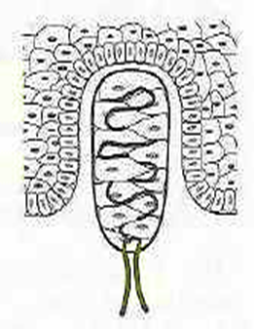
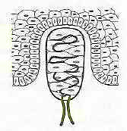
The corpuscle is formed of transversely arranged cells. Collagenous fibers anchor the corpuscle to the dermo-epideral junction
The aff axon enter the corpuscle after losing its myelin &spiral up between the cell layers until it ends at upper pole of corpuscle

Slide 30
2- Ruffini corpuscles
Fusiform encapsulated structures
Found deep in the dermis of skin especially in the sole
Detect pressure (mechanoreceptors)

Slide 31
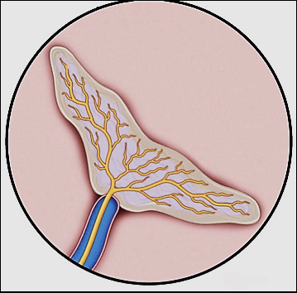
Inside the capsule there is a fluid & collagenous fibers
The aff nerve fiber lose its myelin penetrates the side of the corpuscle & breaks up into fine branches
Ruffini’s corpuscle

Slide 32
3- Krause end bulbs
Rounded structures, encapsulated
Found deep in the dermis of the skin
Detect touch/ cold ( mechano/ thermo receptors)

Slide 33
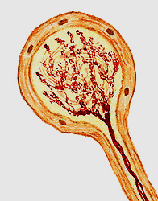
The aff. nerve fiber penetrate the corpuscles after losing its myelin and breaks up into fine branches terminate with coiled ends
Krause’s end bulb

Slide 34
4- Pacinian corpuscles
Large oval encapsulated structures
Found deep in dermis ,periosteum of bone, joint capsule, & C.T. of some organs as pancreas
Detect deep touch (mechanoreceptors), high frequency vibration, pressure
It is one of the proprioceptors

Slide 35
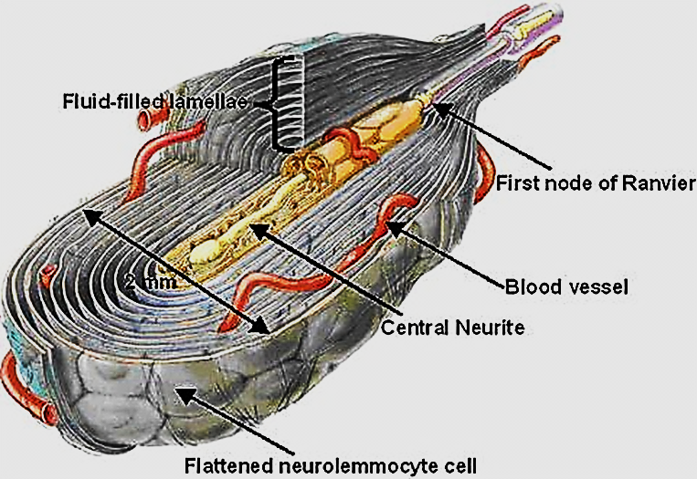
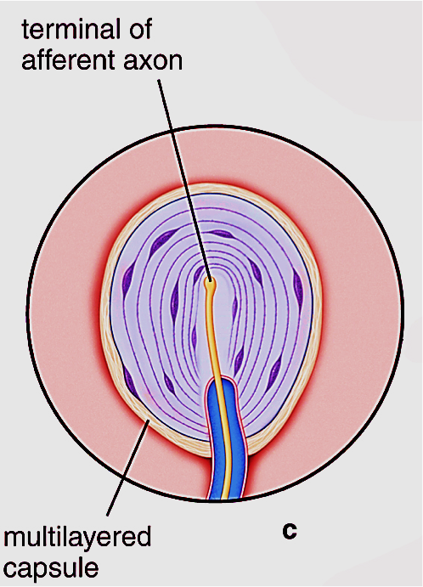
It is formed of 20-50 thin, concentric lamellae of flat Schwan –like cells separated by narrow spaces filled e gel – like material
The aff. nerve fiber Lose its myelin, enter the corpuscle at one pole then runs along its longitudinal axis to end in small expansions
Corpuscle resemble sliced onion in L. section

Slide 36
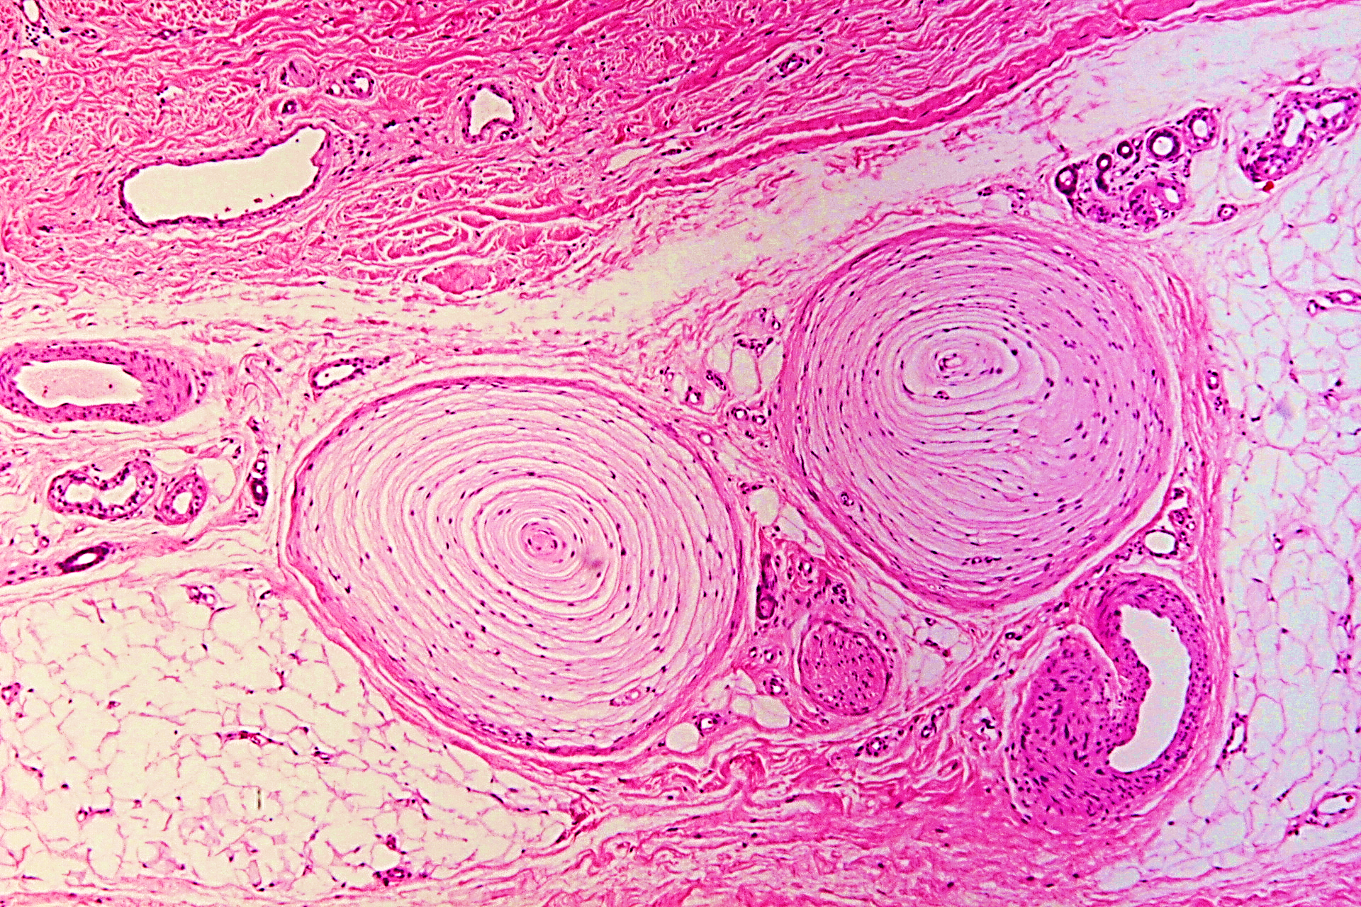
Pacinian corpuscles

Slide 37
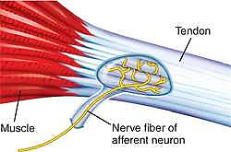
5- Golgi Tendon organ (tendon spindle)
Found in tendons near the insertion of the ms fibers
They detect tensions within tendons When muscle contract
( proprioceptors)
Sensory nerve
penetrates the capsule
of the tendon spindle
to end around the
collagen bundles to
detect tension of tendons

Slide 38
Muscle spindles
Proprioceptors within the skeletal muscles (lie parallel to its fibers)
Responsible for regulation of muscle tone, movement, body posture
More numerous in muscles involved with fine movements

Slide 39
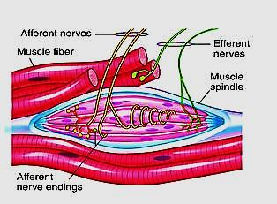
Fusiform structures enclosed by stretchable CT capsule containing fluid filled space
The space contains a few (2-12) thin skeletal ms. fibers intrafusal fibers
Several sensory nerve fibers penetrate each ms spindle & wrap around individual intrafusal fibers

Slide 40
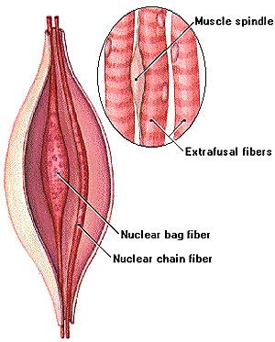
The intrafusal fibers are 2 types:
The nuclear bag fibers: are few in number but thicker & longer. They have distended central nuclear area.
The nuclear chain fibers: are numerous but thinner & shorter. The nuclei are arranged in row a (like a chain)

Slide 41
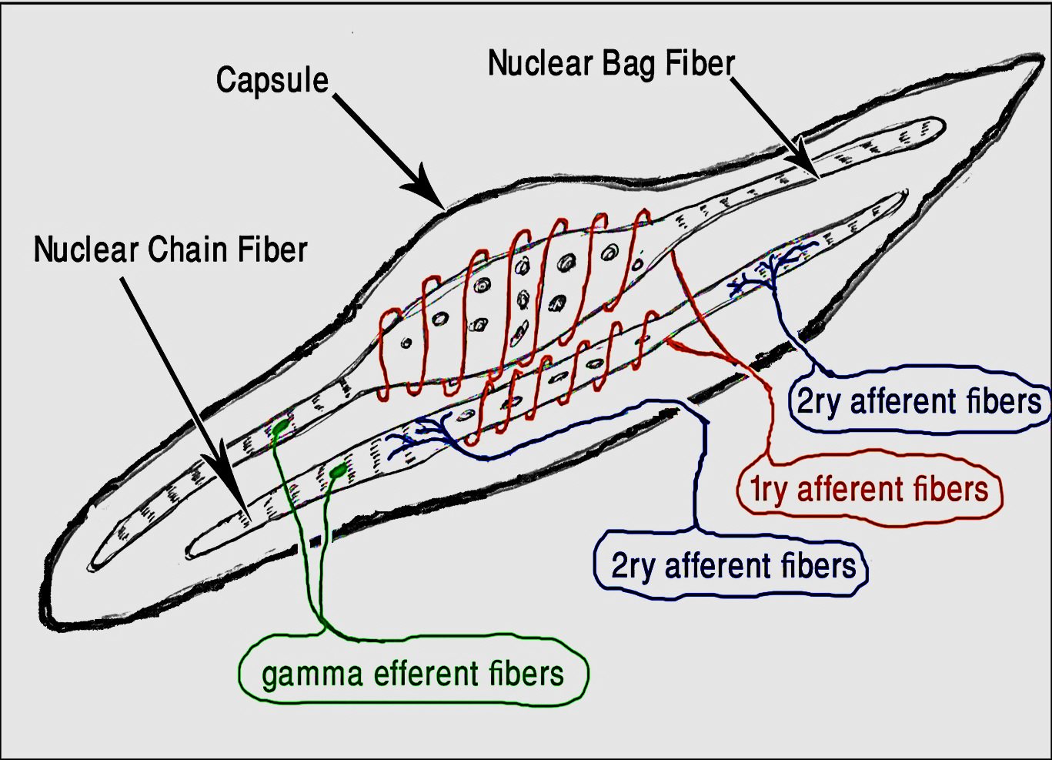
intrafusal fibers are supplied with sensory and motor nerve fibers.
The Sensory ( afferent) fibers
The nuclear bag fiber is supplied with a sensory nerve fiber which end around its center and called 1ry sensory fiber (annulospiral)
The nuclear chain fiber is supplied by 1ry sensory (annulospiral) at its center and two 2ry sensory (flower spray) one at each end
The motor (efferent) fibers:
Enter the capsule to supply the contractile ends of the intrafusal fibers (gamma motor fibers)

Slide 42
Thank you

