Slide 1
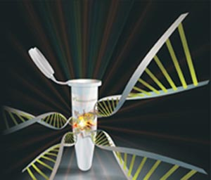
Genomic DNA Extraction
Dr. Nesrin Mwafi
Biochemistry & Molecular Biology Department
Faculty of Medicine, Mutah University

Slide 2
Part I
Introduction

Slide 3
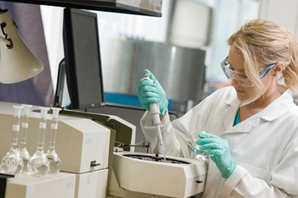
Extraction of DNA
DNA Extraction: is a process of isolation and purification of DNA from a sample using a combination of physical and chemical methods
Routine procedure widely used in:
Molecular biology labs (scientific research labs) for
example to study a
gene involved in a
cancer

Slide 4
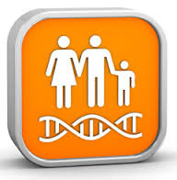
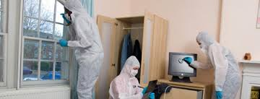
Extraction of DNA
2. Genetic testing is used to diagnose or rule out suspected genetic or inherited diseases. Also to identify disease carriers or to predict those at high risk for specific conditions
3. Forensic analyses to gather evidences from the crime scene that can be used in the court
Crime Scene Investigation (CSI)

Slide 5
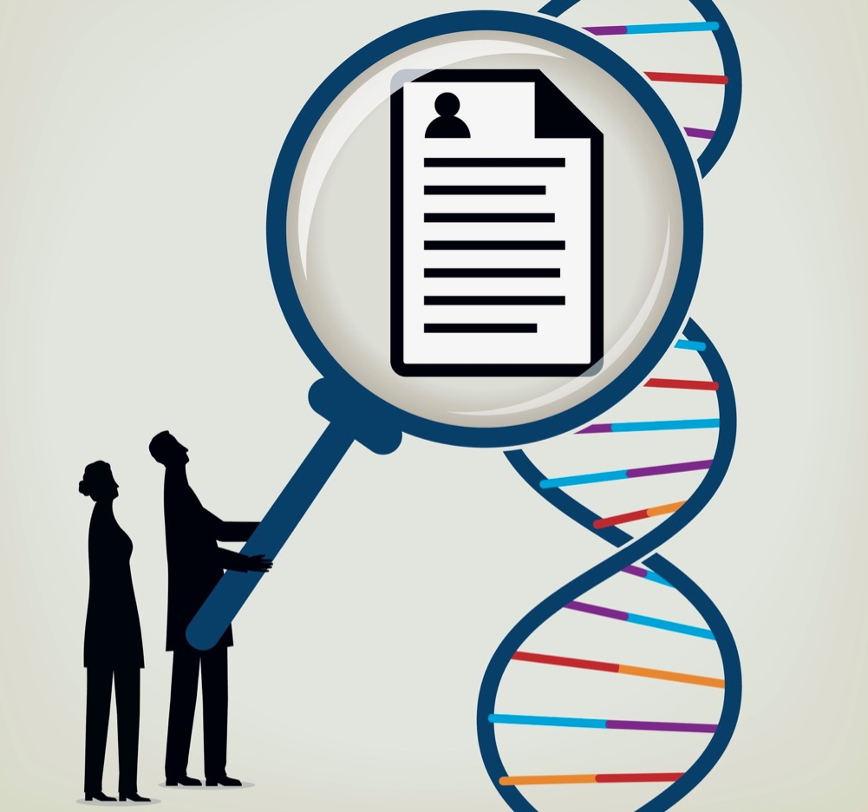
DNA Fingerprinting
DNA fingerprinting (DNA profiling or typing): is a technique to identify individuals by features of their DNA
99% of Human DNA sequences are identical in every person. Only1% of our DNA sequences that make us unique
DNA profiles: are small set of DNA variations that are very likely to be different in all unrelated individuals (except identical twins)
DNA fingerprinting is used in criminal investigations and paternity or parentage testing

Slide 6
DNA Fingerprinting
https://www.youtube.com/watch?v=DiX5fPL4YGU

Slide 7
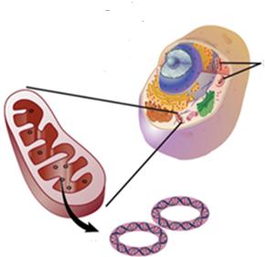
Types of DNA
We need cells to isolate DNA. In eukaryotes like human (Homo sapiens), genomic DNA is found inside the nucleus of every cell (exceptions like the anucleated RBCs ). Also, DNA is found within mitochondria (mitochondrial DNA), the energy producing organelles
Mitochondrial DNA is 16Kbp small circular dsDNA (2-10 copies) codes for 37 genes (inherited from mother)
Genomic DNA contains genetic data of organism with size of 300 million bp and codes for 25,000 genes arranged on 23 chromosomes (haploid cell, gametes/sex cells)
Chromosomal DNA
Mitochondrial DNA

Slide 8
Types of DNA
Somatic cell (diploid) consists of 23 pairs of chromosomes (46 chromosomes) code for different 25,000 genes (duplicate, one copy from each parent) with total size of 600 million bp
Genomic DNA is inherited from both parents (half from the mother and half from the father)
In diploid cell, if DNA is laid out end to end, the total length will be approximately 2 meters
We have enough DNA to make 70 round trips from earth to sun
Human genome project (1990-2003)

Slide 9
DNA Packaging
DNA is arranged into three different levels of organization:
Nucleosome: DNA is wrapped around histone proteins (octamer)
Chromatin fibers: nucleosomes coil and form loops
Chromosomes: chromatin fiber is further condensed

Slide 10
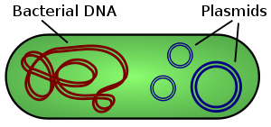
Bacterial DNA
In prokaryotes like bacterial cells, there are a single circular chromosome (bacterial DNA) found in the cytoplasm (with size of 5 million bp)
Extrachromosomal DNA called plasmid also found in the cytoplasm:
Small circular dsDNA (e.g. A.B resistance genes)
Replicate independently of chromosomal DNA
Hundred of copies of single plasmid
Synthetically modified plasmids are used as vectors

Slide 11
DNA Extraction Kits
Obtaining high quality (purity) and quantity (concentration/amount) of intact DNA (not degraded) is often the first and most critical step in many fundamental molecular biology applications, such as DNA cloning, sequencing, PCR and electrophoresis
Different kinds of kits are available from different companies: Qiagen, Invitrogen, Promega and Bio Basic Inc.

Slide 12
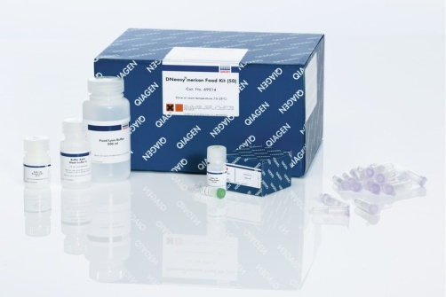
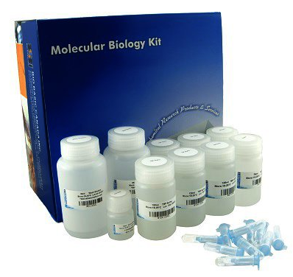
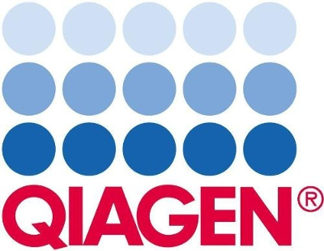
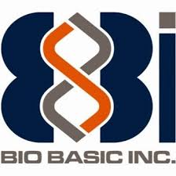
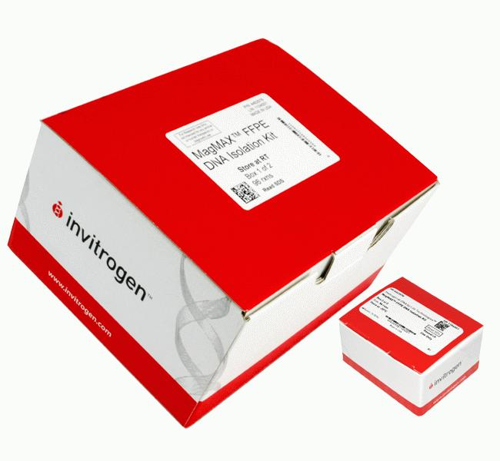
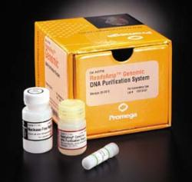
DNA Extraction Kits

Slide 13
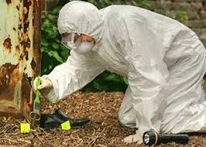
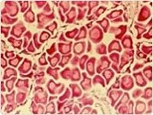
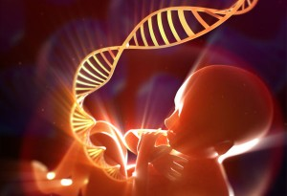
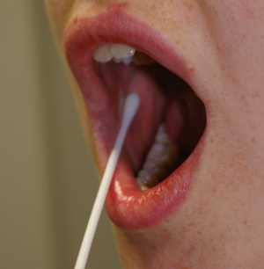
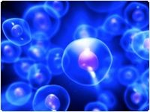
DNA Isolation from Various Samples
DNA can be extracted from variety of samples:
Human Samples
Tissues
Forensic Sample
Prenatal genetic testing
Cells
Buccal swab

Slide 14
Human Samples
Genomic material can be extracted from different human samples like cells or tissues (extraction from the liver tissue is easier than spleen or brain tissues depending on the biochemical nature of that tissue)
Buccal swab (cheek cells) is the most convenient and easiest way (non-invasive) because squamous epithelial cells divide every 24 hours
Fetal sample (screening/diagnostic): cells of the placenta (in late first trimester) or from amniotic fluid (in second trimester)

Slide 15
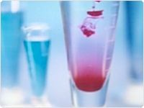
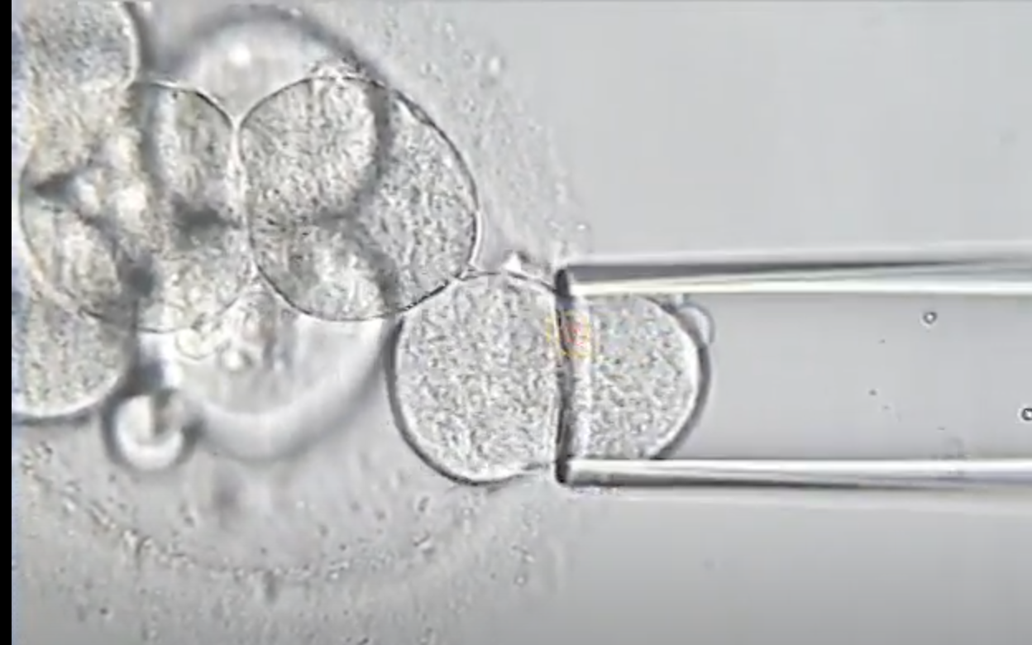
DNA Isolation from Various Samples
DNA can be extracted from variety of samples:
Human Samples
Blood
Tissues
Forensic Sample
Prenatal genetic testing
Cells
Buccal swab
Preimplantation Genetic Diagnosis (PGD)
Preimplantation genetic diagnosis (PGD)

Slide 16
Human Samples
In vitro fertilization (IVF): is a technique of doing fertilization of eggs in the lab.
One cell sample can be taken from the zygote for genetic testing
Blood sample is more common although RBCs are anucleated
After centrifugation of the sample, we take the buffy coat layer containing the WBCs

Slide 17
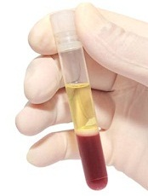
Blood Sample
Plasma (55% of total blood)
Proteins, electrolytes, clotting factors, hormones , etc…
centrifugation
Buffy coat (<1% of total blood)
contains WBC’s
RBC’s (45% of total blood)

Slide 18
Human Samples
In vitro fertilization (IVF): is a technique of doing fertilization of eggs in the lab.
A one cell sample can be taken from the zygote for genetic testing
Blood sample is more common although RBCs are anucleated
After centrifugation of the sample, we take the buffy coat layer containing the WBCs
Nowadays, there are kits available for extraction of DNA from whole blood sample

Slide 19
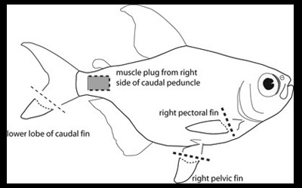
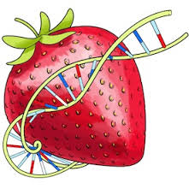
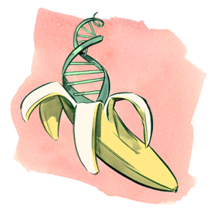
DNA Isolation from Various Samples
Animal cells/tissues (e.g. zebrafish fins)
Genotyping for fishes
Plant material (e.g. banana and strawberry)
Plant cell wall
High levels of polysaccharides and polyphenols present in plant tissue so negatively affects the quality of extracted DNA and may inhibit downstream reactions

Slide 20
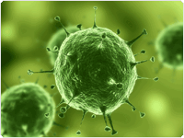
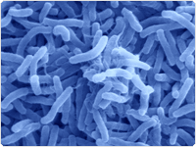
DNA Isolation from Various Samples
Viral and Bacterial cells
Nasal swab like COVID-19
Oral swab (throat)
Blood sample (serum)
Stool sample
Viral cells
Bacterial cells

Slide 21
DNA Isolation from Various Samples
Plasmid DNA (containing the gene of interest)
After transformation of bacterial cells (competent cells), the amplified plasmid is extracted using different types of kits
Miniprep (50-100 µg) kits
Midiprep (100-350 µg) kits
Maxiprep (500-850 µg) kits
The purified plasmid is stored as stock at -20 ̊C

