Slide 1
Respiratory System Module
1st Semester 2023-2024
Thoracic Cage
Intercostal muscles
Dr. Aiman Qais Afar
Surgical Anatomist
College of Medicine / University of Mutah
2023-2024
Wednesday 11 October 2023

Slide 2
The Thoracic Wall
The thorax (or chest) is the region of the body between the neck and the abdomen.
It is flattened in front and behind but rounded at the sides.
The framework of the walls of the thorax, which is referred to as the thoracic cage

Slide 3
Thoracic Cage
The thoracic wall is formed posteriorly by the thoracic part of the vertebral column;
anteriorly by the sternum and costal cartilages.
laterally by the ribs and intercostal spaces;
superiorly by the suprapleural membrane; and
inferiorly by the diaphragm, which separates the thoracic cavity from the abdominal cavity.

Slide 4
Thoracic Cage
Sternum
lies in the midline of the anterior chest wall.
It is a flat bone that can be divided into three parts: manubrium sterni ,
body of the sternum, and xiphoid process.

Slide 5
Sternum
The manubrium is the upper part of the sternum.
It articulates with the body of the sternum at the manubriosternal joint,
and articulates with the clavicles and with the first costal cartilage and the upper part of the second costal cartilages on each side
It lies opposite the third and fourth thoracic vertebrae

Slide 6
Sternum
The body of the sternum
Articulates above with the manubrium at the manubriosternal joint
And below with the xiphoid process at the xiphisternal joint.
On each side it articulates with the second to the seventh costal cartilages

Slide 7
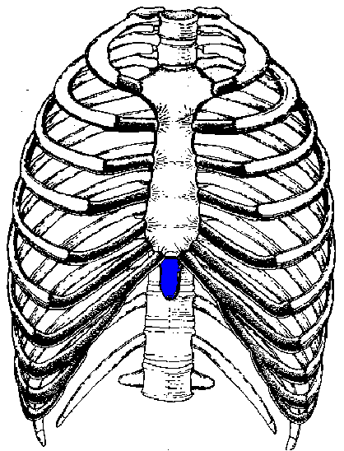
Sternum
The xiphoid process
Is a thin plate of cartilage that becomes ossified at its proximal end during adult life.
No ribs or costal cartilages are attached to it.

Slide 8
Sternum
The sternal angle (angle of Louis).
formed by the articulation of the manubrium with the body of the sternum,.
The transverse ridge lies at the level of the second costal cartilage.
The point from which all costal cartilages and ribs are counted.

Slide 9
Sternum
The sternal angle lies opposite the intervertebral disc between the fourth and fifth thoracic vertebrae.
The xiphisternal joint lies opposite the body of the ninth thoracic vertebra

Slide 10
Sternum
Thoracic Cage
Sternal Biopsy
The sternal body is often used for bone marrow needle biopsy because of its breadth and subcutaneous position.
The needle pierces the thin cortical bone and enters the vascular spongy bone.
Sternal biopsy is commonly used to obtain specimens of marrow for transplantation and for detection of metastatic cancer and blood dyscrasias (abnormalities)

Slide 11
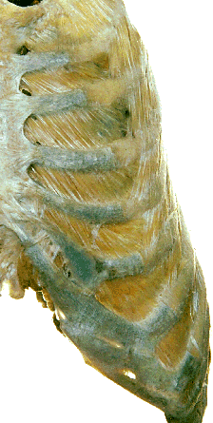
Thoracic Cage
Ribs
There are 12 pairs of ribs, all of which are attached posteriorly to the thoracic vertebrae
The ribs are divided into three categories:

Slide 12
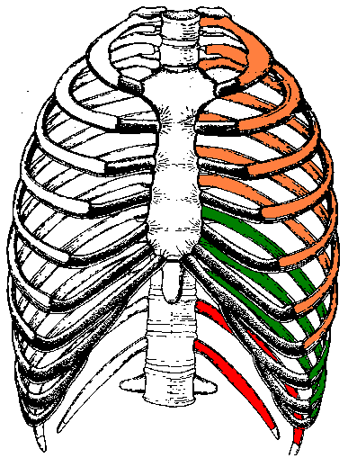
True ribs: The upper seven pairs are attached anteriorly to the sternum by their costal cartilages.
False ribs: The 8th, 9th, and 10th pairs of ribs are attached anteriorly to each other and to the 7th rib by means of their costal cartilages and small synovial joints.
Floating ribs: The 11th and 12th pairs have no anterior attachment
Thoracic Cage

Slide 13
Typical Rib
A typical rib is a long, twisted, flat bone having a rounded, smooth superior border and a sharp, thin inferior border .The inferior border overhangs and forms the costal groove, which accommodates the intercostal vessels and nerve. The anterior end of each rib is attached to the corresponding costal cartilage.

Slide 14
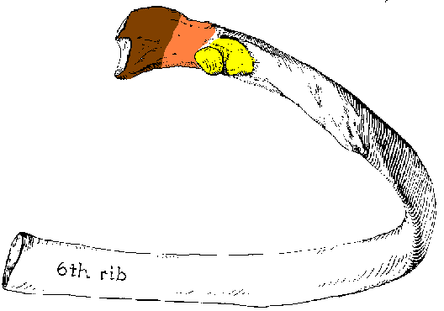
Typical Rib
The typical rib has a head, neck, tubercle, shaft, and angle .
The neck is a constricted portion situated between the head and the tubercle.
head
neck
tubercle
and a shaft

Slide 15
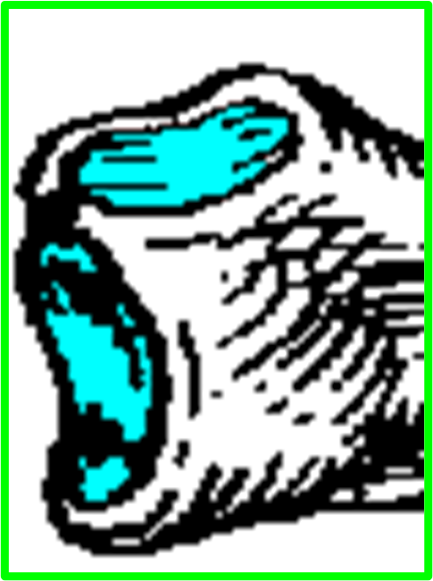
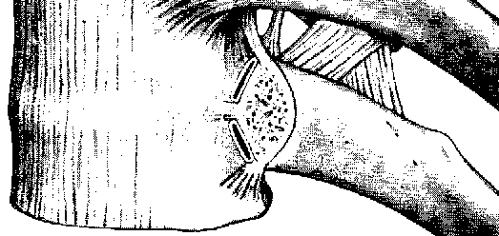
The head of the typical rib
is the posterior end of the rib
is wedge-shaped
carries two articular facets
The head has two facets for articulation with the numerically corresponding vertebral body and that of the vertebra immediately above .
X1
Intervertebral disc
X
X

Slide 16
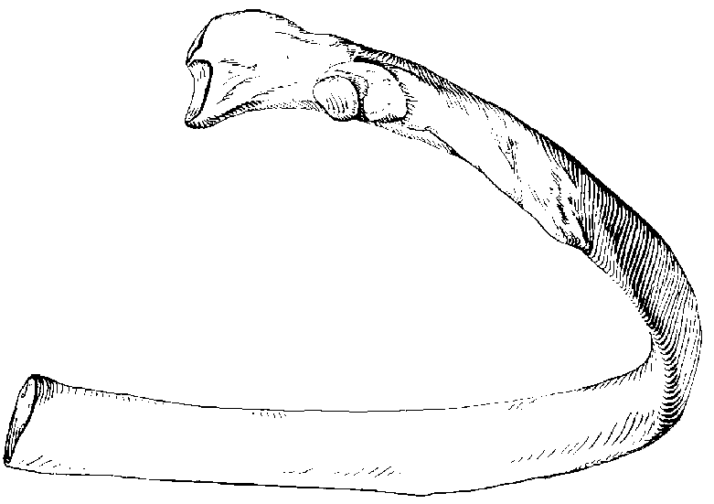
The shaft
Is lateral to the tubercle
primarily it is directed posteriorly
then it bends sharply anteriorly
The angle
The point of greatest change in curvature is :
The angle of a rib is its weakest part where it tends to fracture.

Slide 17
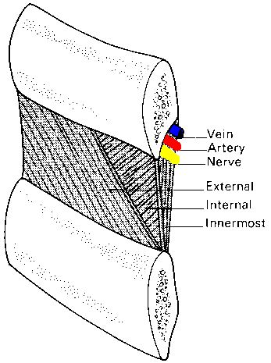
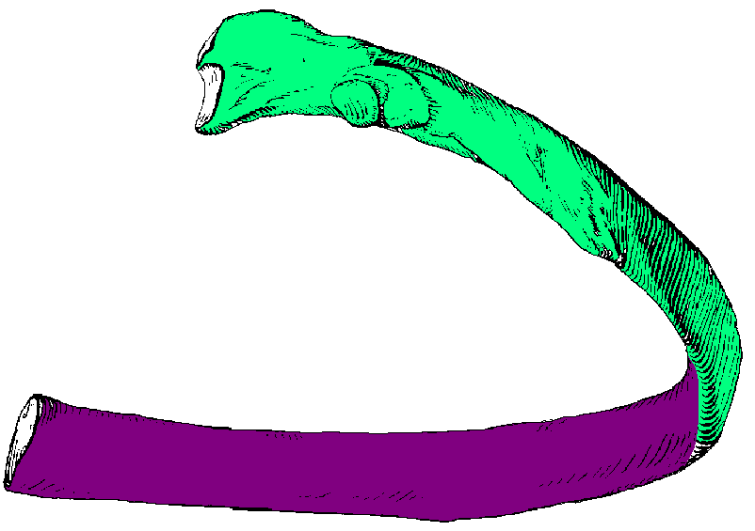
Typical ribs (3-10) Have
External and Internal surfaces
Superior and Inferior borders
The inferior border is sharp and extends inferior to the costal groove on the internal surface of the shaft so that it protects the:
intercostal neurovascular bundle located in the costal groove.

Slide 18
Atypical ribs
(1st, 2nd, and 11th-12th) are dissimilar :

Slide 19
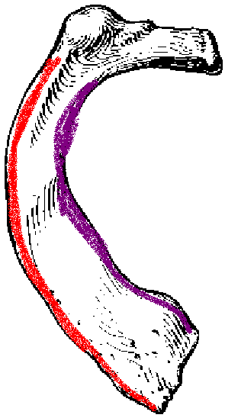
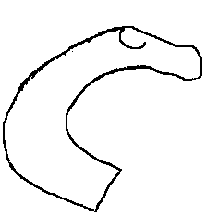
The first rib
is the broadest and most curved rib
Its head carries a single facet for articulation with the body of T1 vertebra
The neck slopes up from the head towards the shaft
The shaft has inner and outer borders

Slide 20
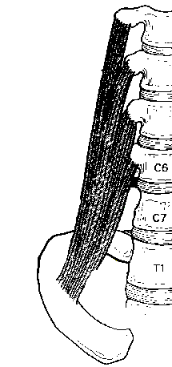
The first rib
The shaft has superior and inferior surfaces
The superior surface carries a prominent scalene tubercle on its inner border for the insertion of scalenus anterior muscle

Slide 21
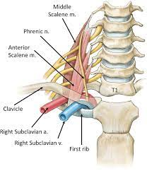
The first rib
The subclavian vein crosses anterior to scalene tubercle,
while the subclavian artery and the inferior trunk of the brachial plexus pass posterior to it

Slide 22
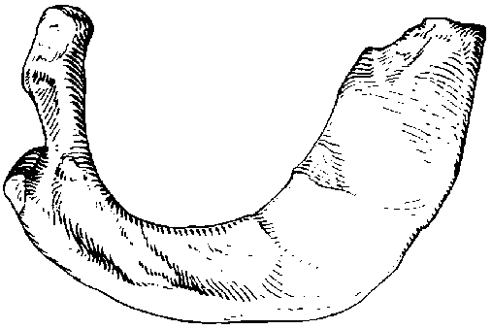
The second rib
Is longer than the first rib
is characterized by the presence of a tuberosity for the attachment of serratus anterior muscle
1
2

Slide 23
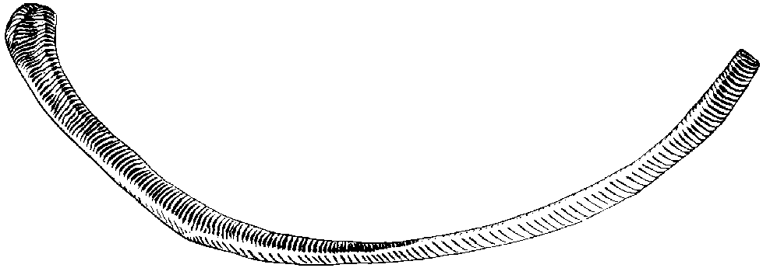
Sternal angle
It is here that the second costal cartilage joins the sternum
It is the starting place where the physician counts the ribs to use them as landmarks.
The 11th & 12th ribs
12
11
are short and carry a single facet on the head
have neither neck nor tubercle

Slide 24
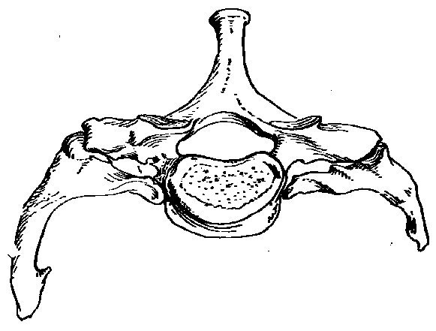
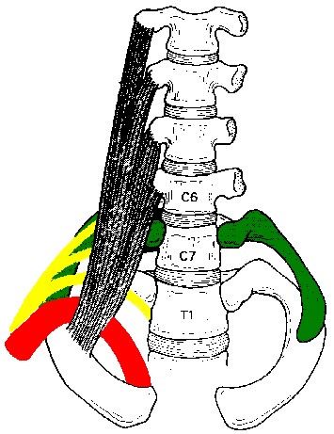
Cervical rib
may articulate with the transverse process of C7 vertebra which is directed downward
C7
May be symptomless or may cause neurovascular symptoms in the upper limb due to stretching or compression related to structures on the superior surface of the first rib

Slide 25
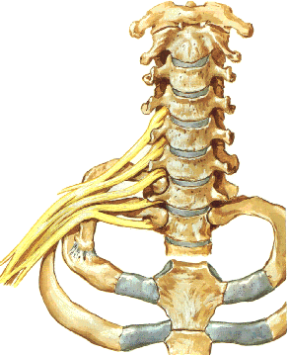
Cervical rib
symptoms may be produced by compression
Vascular symptoms:
The cervical rib compresses the subclavian artery.
Note the poststenotic dilatation
symptoms may be produced by stretching
Neurological symptoms:
The cervical rib stretches the brachial plexus.

Slide 26
Intercostal Spaces
The spaces between the ribs contain three muscles of respiration:
the external intercostal, the internal intercostal, and
the innermost intercostal muscle.
The innermost intercostal muscle is lined internally by the endothoracic fascia, which is lined internally by the parietal pleura.

Slide 27
Intercostal Spaces
The intercostal
nerves and blood vessels run between the intermediate and
deepest layers of muscles
They are arranged in
the following order from above downward: intercostal vein,
intercostal artery, and intercostal nerve (i.e., VAN).

Slide 28
External intercostal
forms the most superficial layer
Its fibers are directed downwards and forward (same direction of external oblique muscle of the abdomen)
from the inferior border of the rib above to the superior border of the rib below
External oblique
External intercostal

Slide 29
The external intercostal muscle extends from the rib tubercle behind to the costochondral junction in front
Anteriorly the external intercostal muscle is replaced by an aponeurosis (thin flat tendon), the anterior (external) intercostal membrane

Slide 30
Internal intercostal
forms the intermediate layer
Its fibers are directed dawnwards and backwards (same direction of the internal oblique muscle of the)
Extends from the costal groove of the rib above to the upper border of the rib below
Internal intercostal
Internal oblique

Slide 31
Internal intercostal
the fibers of the internal intercostal are therefore at right angles to those of the external intercostal

Slide 32
Internal intercostal
The internal intercostal extends from the side of the sternum in front to the angles of the ribs behind
The internal intercostal muscle is replaced by an aponeurosis, the posterior (internal) intercostal membrane

Slide 33
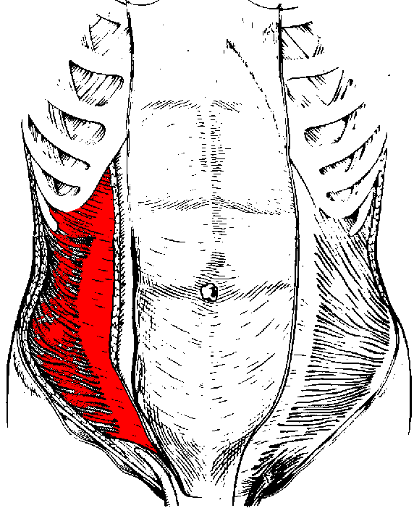
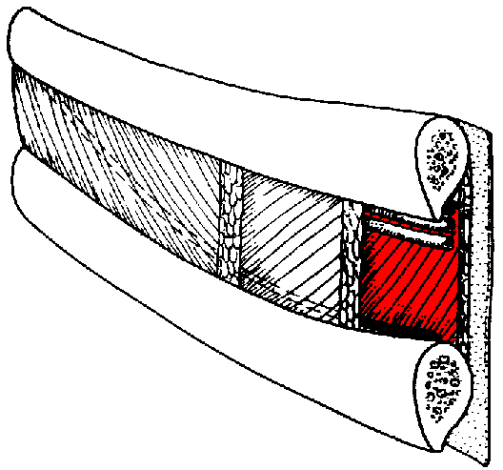
Innermost intercostal
Extends between internal surfaces of adjacent
Innermost intercostal
transversus abdominis
It corresponds to the transversus abdominis muscle of the anterior abdominal wall

Slide 34
Innermost intercostal
The innermost intercostal fibers cover the middle 2/4th of the intercostal spaces
Innermost
intercostal

Slide 35
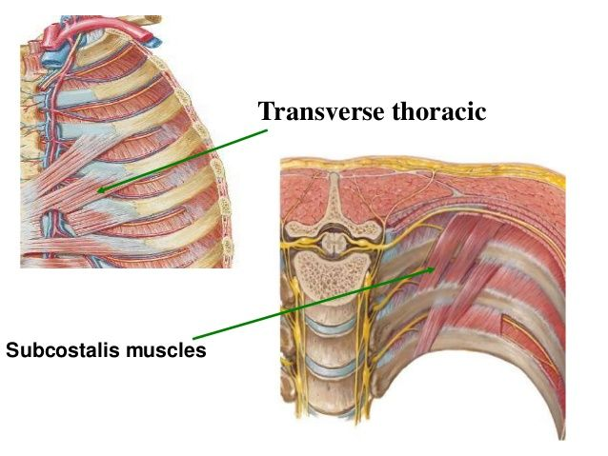
Subcostalis & Transversus Thoracis
Lie in a deeper plane than the innermost intercostal
their fibers cross more than one intercostal space

Slide 36
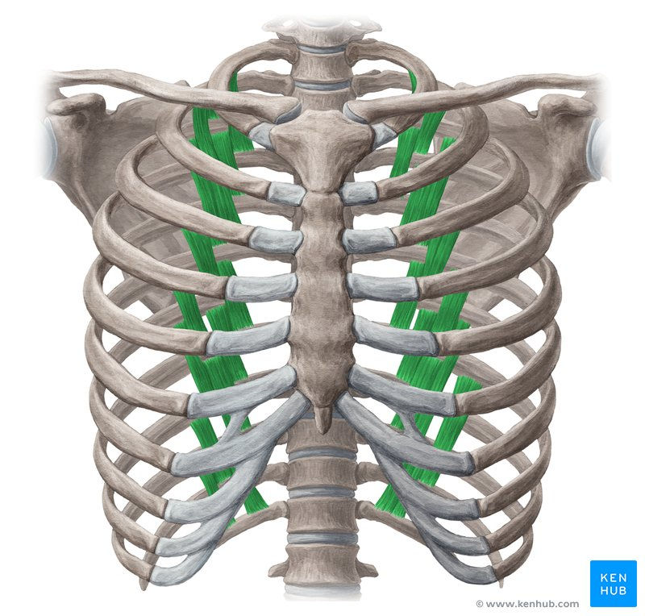
Subcostalis
The Subcostalis slips are located near the angles of the ribs mainly in the lower intercostal spaces
Their fibers run parallel with those of the innermost intercostal

Slide 37
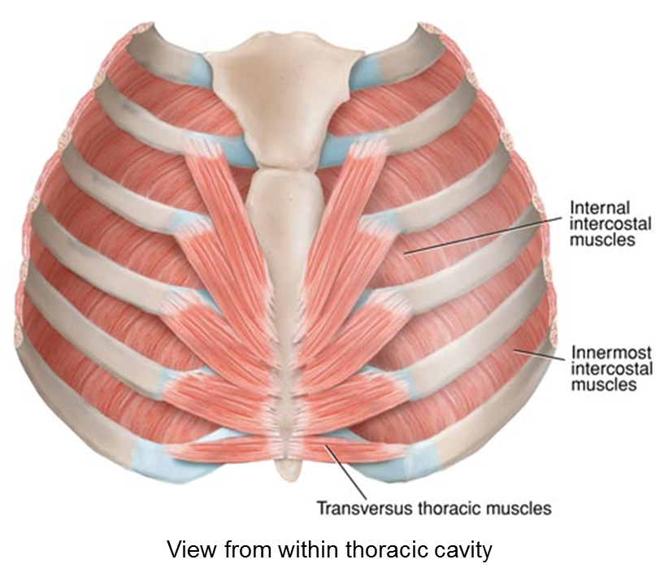
Transversus thoracis
Is also called sternocostalis since its fibers extend from the lower 1/3rd of the posterior surface of the sternum and the costal cartilages of the lower true ribs to the internal surfaces of the upper costal cartilages
Its fibers have different obliquity
the lower fibers are horizontal and become continuous with the transversus abdominis muscle, hence the name transversus thoracis

Slide 38
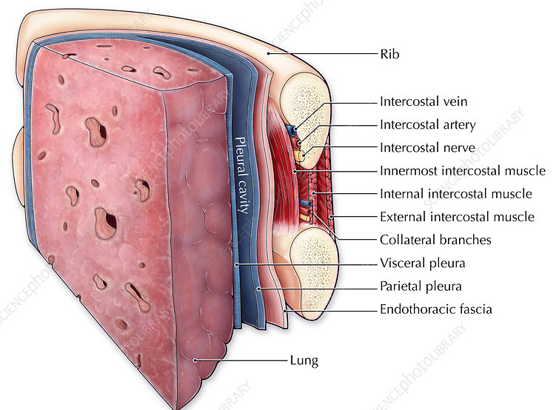
Endothoracic fascia
The innermost intercostal, Subcostalis, and transversus thoracis separate the intercostal neurovascular bundle from the layer of fascia external to the pleura called the endothoracic fascia

Slide 39
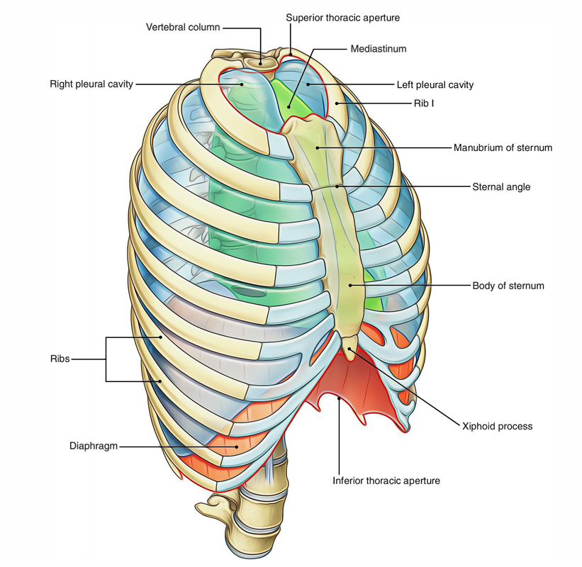
Openings of the Thorax
The chest cavity communicates with the root of the neck through an opening called the thoracic outlet.
The opening is bounded posteriorly by the 1st thoracic vertebra,
laterally by the medial borders of the 1st ribs
and their costal cartilages,
and anteriorly by the superior border of the manubrium sterni.

Slide 40
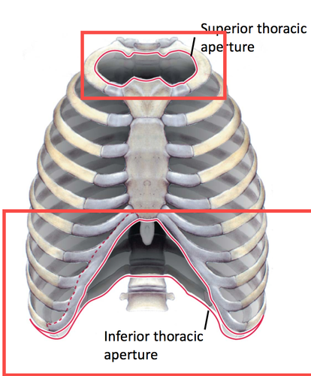
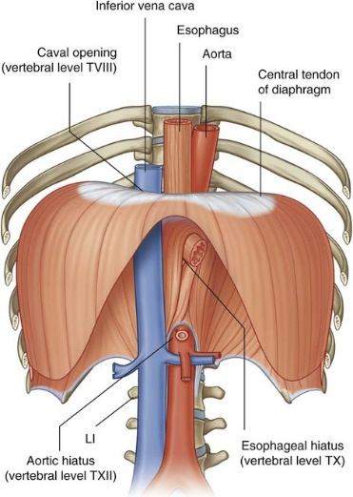
Openings of the Thorax
The thoracic cavity communicates with the abdomen through a large opening.
The opening is bounded posteriorly by the 12th thoracic vertebra, laterally by the curving costal margin, and anteriorly by the xiphisternal joint.

Slide 41
Superior view of typical thoracic vertebrae
From 2nd - 9th
Body
Characters of typical thoracic vertebrae
I- Two demifacets (large superior & small inferior) on each side of body:
2- An articular facet on transverse process.
3- Body is heart shaped.
4- Spine is long and directed backwards and downwards
Vertebral foramen
Pedicle
Lamina
Transverse process
Spine

Slide 42
Lateral view
Superior articular process and its facet articulates with inferior articular processes of the vertebra above
Superior costal facet articulates with head of same numerically corresponding rib
costal facet of transverse process articulates with tubercle of the same numerically corresponding rib
Inferior costal facet articulates with head of the next rib
Inferior articular process and facet

Slide 43
The 1st Th. vertebrae
Facet on transverse process articulates with tubercle of the 1st rib
Upper complete facet on the side of body articulates with the head of the 1st rib
Lower demifacet on the side of body articulates with the head of the 2nd rib
Spine is thick, long and nearly horizontal

Slide 44
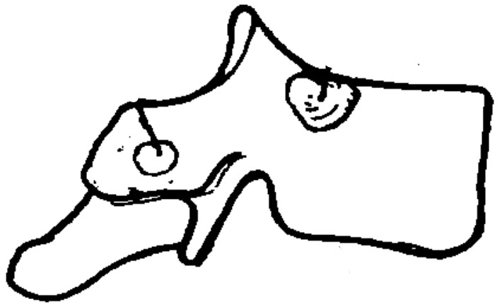
The 10th Th. vertebrae
Facet on transverse process articulates with tubercle of the 10th rib, may be absent
Upper complete facet on the side of body articulates with the head of the 10th rib
10th
NO inferior demifacet

Slide 45
The 11th & 12th Th. vertebrae
Complete circular facet close to upper border of the body, articulates with head of 11th rib
Articular facet of Inferior articular process directed forward
11th
Complete circular facet away from upper border of body and extending on the pedicle, articulates with head of 12th rib
Transverse process has no articular facet
12th
Articular facet of Inferior articular process directed laterally

Slide 46
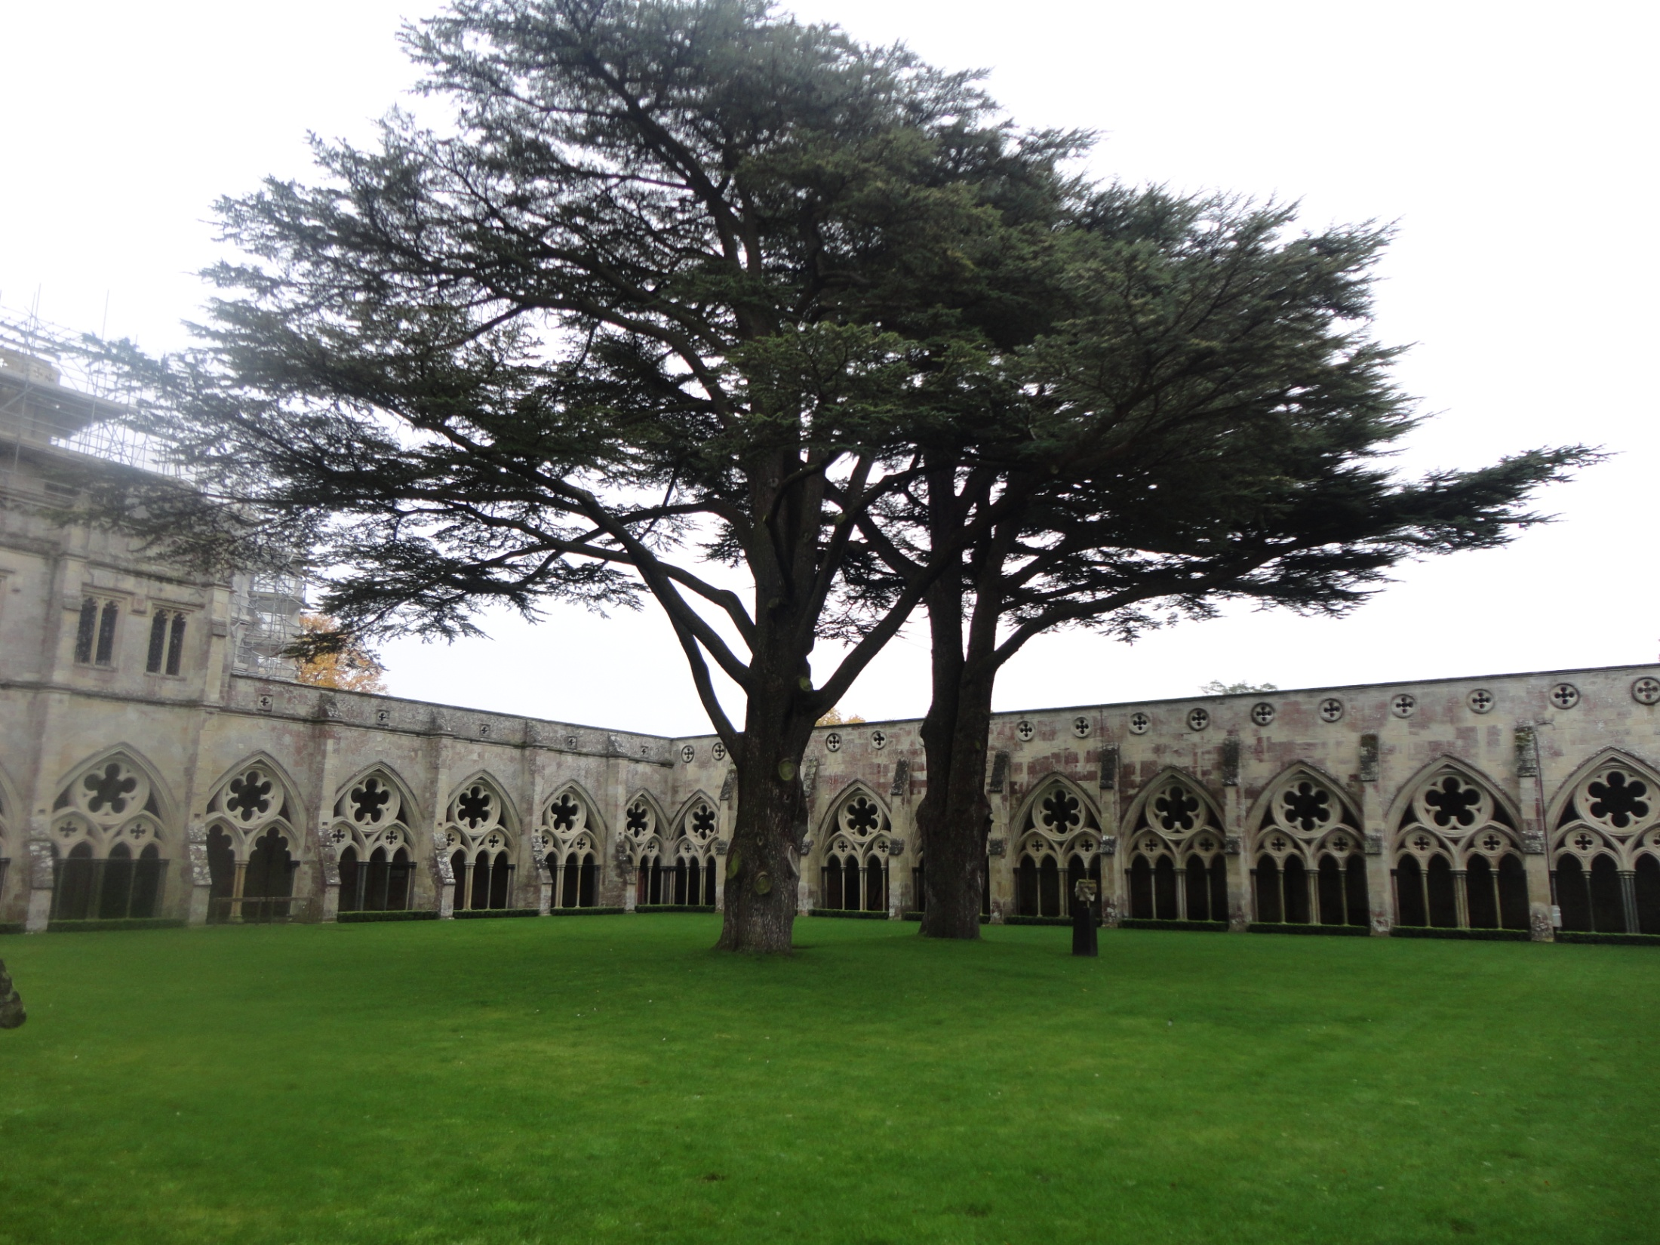
Clinical Anatomist

