Slide 1
Diabetes Mellitus
Dr Abeer Habarneh
Family medicine specialist
RMS

Slide 2
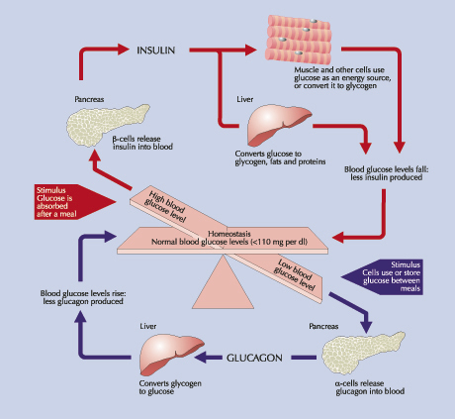

Slide 3
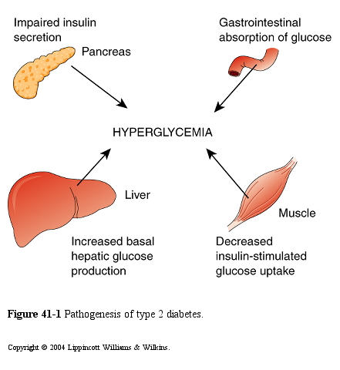

Slide 4
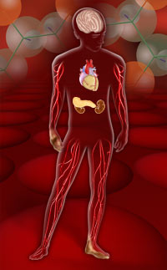
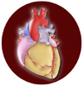
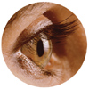
DIABETES MELLITUS
Diabetes
Mellitus
Definition
Classification
Lab diagnosis
Treatments
Complications

Slide 5
Diabetes Mellitus
Definition
A metabolic disorder of multiple aetiology characterized by chronic hyperglycaemia with disturbances of carbohydrate, fat and protein metabolism resulting from defects in insulin secretion, insulin action or both .

Slide 6
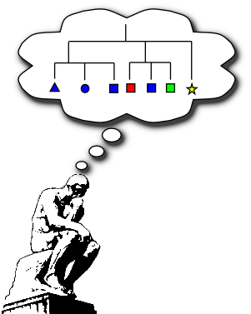
Classification

Slide 7
Type 1
Type 2
Other
Gestational
Classification of DIABETES MELLITUS

Slide 8
Type 1
β-Cell destruction
Absolute insulin deficiency
Type 2
Other
Gestational
Autoantibodies
Classification of DIABETES MELLITUS
Islet cell autoantibodies
Insulin autoantibodies
Glutamic acid decarboxylase autoantibodies
Tyrosine phosphatase IA-2 and IA-2B b autoantibodies

Slide 9
Type 1
Type 2
Other
Gestational
Classification of DIABETES MELLITUS
Insulin resistance with an insulin secretary defect
Relative insulin deficiency

Slide 10
Type 1
Type 2
Other
انسى
Gestational
Classification of DIABETES MELLITUS
Associated with secondary conditions
Genetic disease of β-cell function and insulin action
Pancreatic disease
Endocrine disease
Drug or chemical induced
Insulin receptor abnormalities
Other genetic syndromes
Notes:
I. Type 1 diabetes (-cell destruction, usually leading to absolute insulin deficiency)
A. Immune-mediated
B. Idiopathic
II. Type 2 diabetes (may range from predominantly insulin resistance with
relative insulin deficiency to a predominantly insulin secretory defect
with insulin resistance)
III. Other specific types of diabetes
A. Genetic defects of -cell function characterized by mutations in:
1. Hepatocyte nuclear transcription factor (HNF) 4 (MODY 1)
2. Glucokinase (MODY 2)
3. HNF-1 (MODY 3)
4. Insulin promoter factor (IPF) 1 (MODY 4)
5. HNF-1 (MODY 5)
6. NeuroD1 (MODY 6)
7. Mitochondrial DNA
8. Proinsulin or insulin conversion
B. Genetic defects in insulin action
1. Type A insulin resistance
2. Leprechaunism
3. Rabson-Mendenhall syndrome
4. Lipodystrophy syndromes
C. Diseases of the exocrine pancreas—pancreatitis, pancreatectomy,
neoplasia, cystic fibrosis, hemochromatosis, fibrocalculous pancreatopathy
D. Endocrinopathies—acromegaly, Cushing’s syndrome, glucagonoma,
pheochromocytoma, hyperthyroidism, somatostatinoma, aldosteronoma
E. Drug- or chemical-induced—Vacor, pentamidine, nicotinic acid,
glucocorticoids, thyroid hormone, diazoxide, -adrenergic agonists,
thiazides, phenytoin, -interferon, protease inhibitors, clozapine,
beta blockers
F. Infections—congenital rubella, cytomegalovirus, coxsackie
G. Uncommon forms of immune-mediated diabetes—“stiff-man”
syndrome, anti-insulin receptor antibodies
H. Other genetic syndromes sometimes associated with diabetes—
Down’s syndrome, Klinefelter’s syndrome, Turner’s syndrome,
Wolfram’s syndrome, Friedreich’s ataxia, Huntington’s chorea,
Laurence-Moon-Biedl syndrome, myotonic dystrophy, porphyria,
Prader-Willi syndrome
IV. Gestational diabetes mellitus (GDM)

Slide 11
Other Specific Types of Diabetes Mellitus
Maturity-onset diabetes of the young (MODY)
Autosomal dominant and an age at onset of 25 years or younger.
Non-obese and impaired glucose-induced secretion of insulin.
Mutations of a transcription factor that regulates islet gene expression.
Notes:
This subgroup is a relatively rare monogenic disorder characterized by non–insulin-dependent diabetes with autosomal dominant inheritance and an age at onset of 25 years or younger. Patients are nonobese, and their hyperglycemia is due to impaired glucose-induced secretion of insulin. Six types of MODY have been described. Except for MODY 2, in which a glucokinase gene is defective, all other types involve mutations of a nuclear transcription factor that regulates islet gene expression.
MODY 2 is quite mild, associated with only slight fasting hyperglycemia and few if any microvascular diabetic complications. It generally responds well to hygienic measures or low doses of oral hypoglycemic agents. MODY 3—the most common form—accounts for two-thirds of all MODY cases. The clinical course is similar to that of idiopathic type 2 diabetes in terms of microangiopathy and failure to respond to oral agents with time.

Slide 12
Type 1
Type 2
Other
Gestational
Classification of DIABETES MELLITUS
Glucose intolerance during pregnancy due to metabolic and hormonal changes

Slide 13
Type 1 dm
Notes:
Custom animation effects: spotlight text
(Intermediate)
To reproduce the text effects on this slide, do the following:
On the Home tab, in the Slides group, click Layout, and then click Blank.
On the Insert tab, in the Text group, click Text Box, and then on the slide, drag to draw the text box.
Enter text in the text box and select the text. On the Home tab, in the Font group, do the following:
In the Font list, select Arial Black.
In the Font Size box, enter 50.
Click Bold.
On the Home tab, in the Paragraph group, click Center to center the text in the text box.
Select the text box. Under Drawing Tools, on the Format tab, in bottom right corner of the WordArt Styles, click the Format Text Effects dialog box launcher. In the Format Text Effects dialog box, click Text Fill in the left pane, select Gradient fill in the Text Fill pane, and then do the following:
In the Type list, select Linear.
Click the button next to Direction, and then click Linear Down (first row, second option from the left).
Under Gradient stops, click Add or Remove until two stops appear in the drop-down list.
Also under Gradient stops, customize the gradient stops that you added as follows:
Select Stop 1 from the list, and then do the following:
In the Stop position box, enter 0%.
Click the button next to Color, and then under Theme Colors click Black, Text 1, Lighter 35% (third row, second option from the left).
Select Stop 2 from the list, and then do the following:
In the Stop position box, enter 100%.
Click the button next to Color, and then under Theme Colors click Black, Text 1 (first row, second option from the left).
Also in the Format Text Effects dialog box, click 3-D Format in the left pane, and then do the following in the 3-D Format pane:
Under Bevel, click the button next to Top, and then under Bevel click Circle (first row, first option from the left). Next to Top, in the Width box, enter 10 pt, and in the Height box, enter 2.5 pt.
Under Depth, click the button next to Color, and then select Automatic.
Under Contour, click the button next to Color, click More Colors, and then in the Colors dialog box, on the Custom tab, enter values for Red: 68, Green: 113, Blue: 166. In the Size box, enter 0.5 pt.
Under Surface, click the button next to Material, and then under Standard click Metal (fourth option from the left). Click the button next to Lighting, and then under Neutral click Contrasting (second row, second option from the left). In the Angle box, enter 75°.
Under Drawing Tools, on the Format tab, in the WordArt Styles group, click Text Effects, point to Reflection, and then under Reflection Variations click Half Reflection, touching (first row, second option from the left).
Drag the text box above the middle of the slide.
On the Home tab, in the Drawing group, click Arrange, point to Align, and then do the following:
Click Align to Slide.
Click Align Center.
To reproduce the background effects on this slide, do the following:
Right-click the slide background area, and then click Format Background. In the Format Background dialog box, click Fill in the left pane, select Gradient fill in the Fill pane, and then do the following:
In the Type list, select Radial.
Click the button next to Direction, and then click From Center (third option from the left).
Under Gradient stops, click Add or Remove until two stops appear in the drop-down list.
Also under Gradient stops, customize the gradient stops that you added as follows:
Select Stop 1 from the list, and then do the following:
In the Stop position box, enter 0%.
Click the button next to Color, and then under Theme Colors click White, Background 1, Darker 5% (second row, first option from the left).
Select Stop 2 from the list, and then do the following:
In the Stop position box, enter 100%.
Click the button next to Color, and then under Theme Colors click Black, Text 1, Lighter 35% (third row, second option from the left).
To reproduce the shape effects on this slide, do the following:
On the Home tab, in the Drawing group, click Shapes, and then under Basic Shapes click Oval (first row, second option from the left). On the slide, drag to draw an oval.
Select the oval. Under Drawing Tools, on the Format tab, in the Size group, do the following:
In the Shape Height box, enter 1.1”.
In the Shape Width box, enter 2.31”.
With the oval still selected, on the Home tab, in the bottom right corner of the Drawing group, click the Format Shape dialog box launcher. In the Format Shape dialog box, click Fill in the left pane, select Gradient fill in the Fill pane, and then do the following:
In the Type list, select Radial.
Click the button next to Direction, and then click From Center (third option from the left).
Under Gradient stops, click Add or Remove until three stops appear in the drop-down list.
Also under Gradient stops, customize the gradient stops that you added as follows:
Select Stop 1 from the list, and then do the following:
In the Stop position box, enter 0%.
Click the button next to Color, and then under Theme Colors click White, Background 1 (first row, first option from the left).
In the Transparency box, enter 21%.
Select Stop 2 from the list, and then do the following:
In the Stop position box, enter 51%.
Click the button next to Color, and then under Theme Colors click White, Background 1 (first row, first option from the left).
In the Transparency box, enter 73%.
Select Stop 3 from the list, and then do the following:
In the Stop position box, enter 100%.
Click the button next to Color, and then under Theme Colors click Black, Text 1 (first row, first option from the left).
In the Transparency box, enter 100%.
Under the Drawing Tools, on the Format tab, in the Shapes Styles group, do the following:
Click the arrow next to Shape Outline, and then click No Outline.
Click Shape Effects, point to Soft Edges, and then click 25 Point.
On the slide, drag the oval until it is centered on the first letter in the text box.
To reproduce the animation effects on this slide, do the following:
On the Animations tab, in the Animations group, click Custom Animation.
On the slide, select the oval. In the Custom Animation task pane, do the following:
Click Add Effect, point to Entrance, and then click More Effects. In the Add Entrance Effect dialog box, under Subtle, click Fade.
Select the animation effect (fade entrance effect for the oval). Under Modify: Fade, do the following:
In the Start box, select With Previous.
In the Speed box, select Fast.
On the slide, select the oval. In the Custom Animation task pane, do the following:
Click Add Effect, point to Exit, and then click More Effects. In the Add Exit Effect dialog box, under Subtle, click Fade.
Select the second animation effect (fade exit effect for the oval). Click the arrow to the right of the animation effect, and then click Timing. In the Fade dialog box, on the Timing tab, do the following:
In the Start list, select With Previous.
In the Delay box, enter 4.
In the Speed list, select 1 seconds (Fast).
On the slide, select the oval. In the Custom Animation task pane, do the following:
Click Add Effect, point to Entrance, and then click More Effects. In the Add Entrance Effect dialog box, under Subtle, click Fade.
Select the third animation effect (fade entrance effect for the oval). Click the arrow to the right of the animation effect, and then click Timing. In the Fade dialog box, on the Timing tab, do the following:
In the Start list, select With Previous.
In the Delay box, enter 5.
In the Speed list, select 1 seconds (Fast).
On the slide, select the oval. In the Custom Animation task pane, do the following:
Click Add Effect, point to Exit, and then click More Effects. In the Add Exit Effect dialog box, under Subtle, click Fade.
Select the fourth animation effect (fade exit effect for the oval). Click the arrow to the right of the animation effect, and then click Timing. In the Fade dialog box, on the Timing tab, do the following:
In the Start list, select With Previous.
In the Delay box, enter 7.
In the Speed list, select 1 seconds (Fast).
On the slide, select the oval. In the Custom Animation task pane, do the following:
Click Add Effect, point to Motion Paths, and then click Right.
Select the fifth animation effect (motion path for the oval). Click the arrow to the right of the animation effect, and then click Effect Options. In the Fade dialog box, do the following:
On the Effect tab, under Path, select Auto-reverse.
On the Timing tab, do the following:
In the Start list, select With Previous.
In the Delay box, enter 0.
In the Speed list, select 2 seconds (Medium).
In the Repeat list, select 2.
On the slide, select the motion path. Point to the endpoint (red arrow) of the motion path until the cursor becomes a two-headed arrow, press and hold SHIFT, and then drag the endpoint to the center of the last letter in the text box.

Slide 14
Type I Diabetes Cell

Slide 15
Type 1 dm
Polyuria, polydipsia, and weight loss associated with RPG200 mg/dL.
Islet autoantibodis are frequently present.
FPG>126 mg/dl more than one occasion
This form of diabetes is immune-mediated in over 90% of cases and idiopathic in less than 10%.
Notes:
Custom animation effects: curve up and grow
(Intermediate)
To reproduce the first rectangle on this slide, do the following:
On the Home tab, in the Slides group, click Layout, and then click Blank.
On the Home tab, in the Drawing group, click Shapes, and then under Rectangles click Rounded Diagonal Corner Rectangle (ninth option from the left). On the slide, drag to draw a rounded rectangle.
Drag the yellow diamond adjustment handle to the left to reduce the size of the corner radius.
Select the rounded rectangle. Under Drawing Tools, on the Format tab, in the Size group, do the following:
In the Shape Height box, enter 2.33”.
In the Shape Width box, enter 2.32”.
On the Home tab, in the Drawing group, click the arrow next to Shape Fill, and select No Fill.
On the Home tab, in the Drawing group, click Shape Effects, point to Reflection, under Reflection Variations, select Tight Reflection, touching (first row, first option from the left).
On the Home tab, in the bottom right corner of the Drawing group, click the Format Shape dialog box launcher.
In the Format Shape dialog box, in the left pane click Line Color, and then in the Line Color pane select Solid Line. Click the button next to Color, click More Colors, and then in the Colors dialog box, on the Custom tab, enter values for Red: 137, Green: 227, Blue: 231.
Also in the Format Shape dialog box, in the left pane, click Line Style. In the Line Style pane, do the following:
In the Width box, enter 10 pt.
In the Cap type list, select Round.
Also in the Format Text Effects dialog box, in the left pane, click 3-D Format. In the 3-D Format pane, do the following:
Under Bevel, click the button next to Top, and then under Bevel click Circle (first row, first option from the left). Next to Top, in the Width box, enter 10 pt, and in the Height box, enter 10 pt.
Under Contour, click the button next to Color, and then under Theme Colors click Olive Green, Accent 3, Lighter 60% (third row, seventh option from the left).
Under Surface, click the button next to Material, and then under Standard click Matte (first row, first option from the left). Click the button next to Lighting, and then under Neutral click Soft (first row, third option from the left). In the Angle box, enter 315°.
Right-click the rounded rectangle, and then click Edit Text.
Enter text in the text box, select the text, and then on the Home tab, in the Font group, select Gills Sans MT Condensed from the Font list, and select 28 from the Font Size list.
On the Home tab, in the Paragraph group, click Center to center the text.
To reproduce the animation effects for the first rectangle on this slide, do the following:
On the Animations tab, in the Animations group, click Custom Animation.
On the slide, select the round diagonal corner rectangle. In the Custom Animation task pane, do the following:
Click Add Effect, point to Entrance, and then click More Effects. In the Add Entrance Effect dialog box, under Exciting, click Curve Up.
Select the animation effect (curve-up effect for the rectangle), and under Modify Curve Up, do the following:
In the Start list, select With Previous.
In the Speed list, select Fast.
On the slide, select the round diagonal corner rectangle. In the Custom Animation task pane, do the following:
Click Add Effect, point to Emphasis, and then click More Effects. In the Add Emphasis Effect dialog box, under Basic, click Grow/Shrink.
Select the second animation effect (grow/shrink effect for the rectangle). Click the arrow next to the selected effect, and then click Effect Options. In the Grow/Shrink dialog box, do the following:
On the Effect tab, do the following:
In the Size list, in the Custom box, enter 5, and then press ENTER. Also in the Size list, select Vertical.
Select Auto-reverse.
On the Timing tab, do the following:
In the Start list, select With Previous.
In the Speed list, select Very Fast.
To reproduce the second and third rectangle on this slide with animation effects, do the following:
On the slide, select the rounded rectangle.
On the Home tab, in the Clipboard group, click the arrow under Paste, and then click Duplicate. Drag the second rounded rectangle next to the first rounded rectangle. Repeat this process one more time for a total of three rectangles.
On the Animations tab, in the Animations group, click Custom Animation.
In the Custom Animation task pane, do the following:
Press and hold CTRL, and then select the third and fourth animation effects (curve up effect and grow/shrink effect for the second rectangle). Click the arrow next to one of the selected effects, and then click Timing. In the Effect Options dialog box, on the Timing tab, in the Delay box, enter 0.5.
Press and hold CTRL, and then select the fifth and sixth animation effects (curve up effect and grow/shrink effect for the third rectangle). Click the arrow next to one of the selected effects, and then click Timing. In the Effect Options dialog box, on the Timing tab, in the Delay box, enter 1.
To reproduce the background on this slide, do the following:
On the Home tab, in the Drawing group, click Shapes, and then under Rectangles click Rectangle (first option from the left). On the slide, drag to draw a rectangle.
Select the rectangle. Under Drawing Tools, on the Format tab, in the Size group, do the following:
In the Shape Height box, enter 1.62”.
In the Shape Width box, enter 10”.
Under Drawing Tools, on the Format tab, in the bottom right corner of the Shape Styles group, click the Format Shape dialog box launcher.
In the Format Shape dialog box, click Fill in the left pane, select Solid fill in the Fill pane, and then do the following:
Click the button next to Color, click More Colors, and then in the Colors dialog box, on the Custom tab, enter values for Red: 137, Green: 227, Blue: 231.
In the Transparency box, enter 70%.
Also in the Format Shape dialog box, in the left pane, click Line Color, and in the Line Color pane, select No line.
Drag the rectangle into the middle of the slide.
On the Home tab, in the Drawing group, click Shapes, and then under Rectangles click Round Diagonal Corner Rectangle (ninth option from the left). On the slide, drag to draw a rectangle.
Select the round diagonal corner rectangle. Under Drawing Tools, on the Format tab, in the Size group, do the following:
In the Shape Height box enter 0.44”.
In the Shape Width box enter 0.44”.
Under Drawing Tools, on the Format tab, in the Shape Styles group, click the Format Shape dialog box launcher. In the Format Shape dialog box, click Fill in the left pane, select Solid fill in the Fill pane, and then do the following:
Click the button next to Color, and then under Theme Colors click White, Background 1, Darker 5% (second row, first option from the left).
In the Transparency box, enter 60%.
Also in the Format Shape dialog box, in the left pane, click Line Color, and in the Line Color pane, select No line.
Select the round diagonal corner rectangle. On the Home tab, in the Clipboard group, click the arrow under Paste, and then click Duplicate. Repeat this process until there is a total of seven round diagonal corner rectangles.
On the slide, press and hold CTRL and select the seven round diagonal corner rectangles. On the Home tab, in the Drawing group, click Arrange, point to Align, and do the following:
Click Align Selected Objects.
Click Align Top.
Click Distribute Horizontally.
Right-click the slide background area, and then click Format Background. In the Format Background dialog box, click Fill in the left pane, select Gradient fill in the Fill pane, and then do the following:
In the Type list, select Linear.
Click the button next to Direction, and then click Linear Diagonal (second row, third option from the left).
Under Gradient stops, click Add or Remove until two stops appear in the drop-down list.
Also under Gradient stops, customize the gradient stops that you added as follows:
Select Stop 1 from the list, and then do the following:
In the Stop position box, enter 50%.
Click the button next to Color, and then click White, Background 1 (first row, first option from the left).
Select Stop 2 from the list, and then do the following:
In the Stop position box, enter 100%.
Click the button next to Color, and then click More Colors. In the Colors dialog box, on the Custom tab, enter values for Red: 204, Green: 244, Blue: 248.

Slide 16
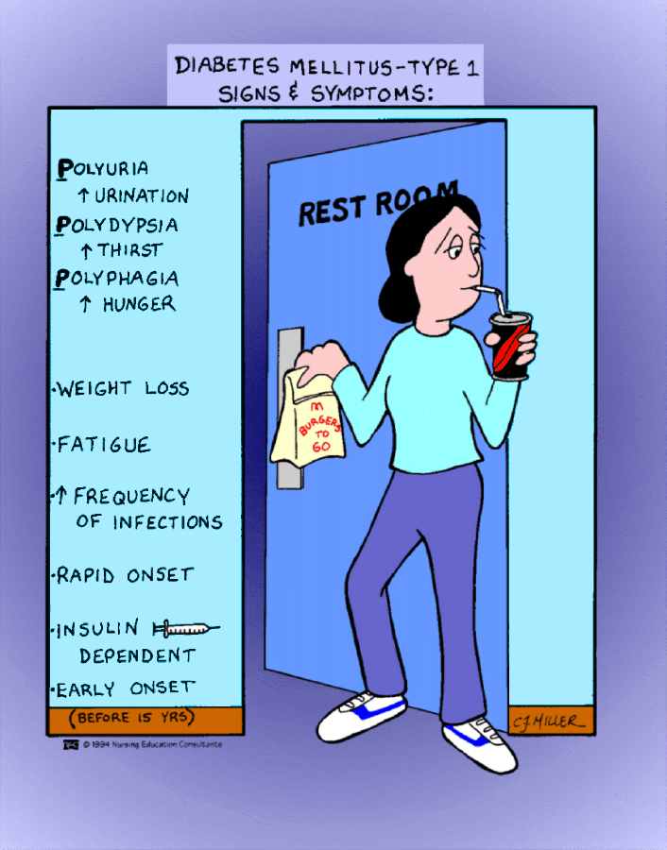

Slide 17
Type II Diabetes
IR

Slide 18
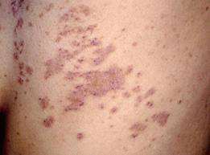
Type 2 Diabetes Mellitus
Most patients are over 30 years of age and obese.
Polyuria and polydipsia.
Candidal vaginitis in women may be an initial manifestation.
Many patients have few or no symptoms.
Hypertension, dyslipidemia, and atherosclerosis are often associated.
Ketonuria and weight loss generally are uncommon at time of diagnosis.

Slide 19
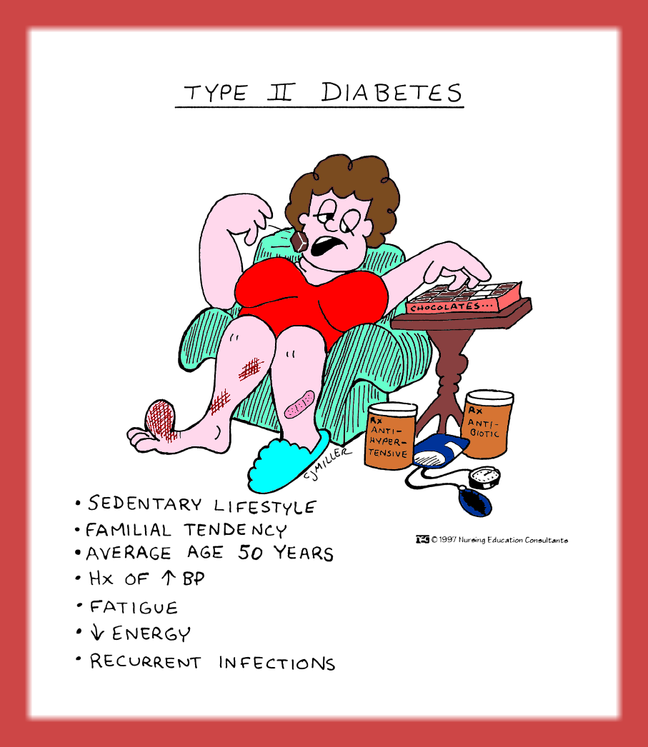

Slide 20
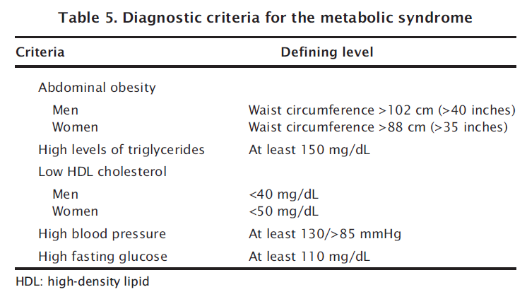
مطلوب
Notes:
Metabolic syndrome
Often a person with abnormal glucose tolerance (IGT or diabetes) will be found
to have at least one or more of the other cardiovascular disease risk factors such
as hypertension, central (upper body) obesity, and dyslipidaemia. This clustering
has been labelled diversely as the metabolic syndrome, syndrome X, or the insulin
resistance syndrome [21]. Epidemiological studies confirm that this syndrome occurs
commonly in a wide variety of ethnic groups including Caucasians, Afro-Americans,
Mexican-Americans, Asian Indians, Chinese, Australian Aborigines, Polynesians and
Micronesians. In 1988, Dr Gerald Reaven focused attention on this cluster, naming it
Syndrome X. Central obesity was not included in the original description, so the term
metabolic syndrome is now favoured. Alone, each component of the cluster conveys
increased cardiovascular disease risk, but as a combination they become much more
powerful. This means that the management of persons with hyperglycaemia and other
features of the metabolic syndrome should focus not only on blood glucose control but
also include strategies to reduce the impact of other cardiovascular disease risk factors.
The metabolic syndrome with normal glucose tolerance identifies the subject as a
member of a group at very high risk of future diabetes. Thus, vigorous early management
of the syndrome may have a significant impact on the prevention of both diabetes and
cardiovascular disease, especially as it is well documented that the features of the metabolic
syndrome can be present for up to 10 years before glycaemic disorder is detected.
Diagnosis of metabolic syndrome
At least three of the five criteria shown in Table 5 must be met to diagnose metabolic
syndrome.
Several other components of the metabolic syndrome have been described (e.g.
hyperuricaemia, coagulation disorders) but are not considered criteria for its diagnosis.
Metabolic syndrome
Often a person with abnormal glucose tolerance (IGT or diabetes) will be found
to have at least one or more of the other cardiovascular disease risk factors such
as hypertension, central (upper body) obesity, and dyslipidaemia. This clustering
has been labelled diversely as the metabolic syndrome, syndrome X, or the insulin
resistance syndrome [21]. Epidemiological studies confirm that this syndrome occurs
commonly in a wide variety of ethnic groups including Caucasians, Afro-Americans,
Mexican-Americans, Asian Indians, Chinese, Australian Aborigines, Polynesians and
Micronesians. In 1988, Dr Gerald Reaven focused attention on this cluster, naming it
Syndrome X. Central obesity was not included in the original description, so the term
metabolic syndrome is now favoured. Alone, each component of the cluster conveys
increased cardiovascular disease risk, but as a combination they become much more
powerful. This means that the management of persons with hyperglycaemia and other
features of the metabolic syndrome should focus not only on blood glucose control but
also include strategies to reduce the impact of other cardiovascular disease risk factors.
The metabolic syndrome with normal glucose tolerance identifies the subject as a
member of a group at very high risk of future diabetes. Thus, vigorous early management
of the syndrome may have a significant impact on the prevention of both diabetes and
cardiovascular disease, especially as it is well documented that the features of the metabolic
syndrome can be present for up to 10 years before glycaemic disorder is detected.
Table 5. Diagnostic criteria for the metabolic syndrome
Criteria Defining level
Abdominal obesity
Men Waist circumference >102 cm (>40 inches)
Women Waist circumference >88 cm (>35 inches)
High levels of triglycerides At least 150 mg/dL
Low HDL cholesterol
Men <40 mg/dL
Women <50 mg/dL
High blood pressure At least 130/>85 mmHg
High fasting glucose At least 110 mg/dL
Diagnosis of metabolic syndrome
At least three of the five criteria shown in Table 5 must be met to diagnose metabolic
syndrome.
Several other components of the metabolic syndrome have been described (e.g.
hyperuricaemia, coagulation disorders) but are not considered criteria for its diagnosis.

Slide 21
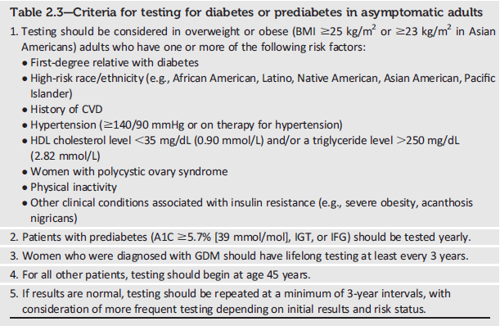
Testing for Diabetes or Prediabetes in Asymptomatic Adults
Notes:
Because Table 2.3 was called out in the recommendation highlighted in the previous slide, lets take a quick look at the criteria for testing for diabetes or prediabetes in asymptomatic adults. As shown here, the criteria are as follows:
1. Testing should be considered in overweight or obese (BMI ≥25 kg/m2 or ≥23 kg/m2 in Asian Americans) adults who have one or more of the following risk factors:
First-degree relative with diabetes
High-risk race/ethnicity (e.g., African American, Latino, Native American, Asian American, Pacific Islander)
History of CVD
Hypertension (≥140/90 mmHg or on therapy for hypertension)
HDL cholesterol level <35 mg/dL (0.90 mmol/L) and/or a triglyceride level >250 mg/dL (2.82 mmol/L)
Women with polycystic ovary syndrome
Physical inactivity
Other clinical conditions associated with insulin resistance (e.g., severe obesity, acanthosis nigricans)
2. Patients with prediabetes (A1C ≥5.7% [39 mmol/mol], IGT, or IFG) should be tested yearly.
3. Women who were diagnosed with GDM should have lifelong testing at least every 3 years.
4. For all other patients, testing should begin at age 45 years.
5. If results are normal, testing should be repeated at a minimum of 3-year intervals, with consideration of more frequent testing depending on initial results and risk status.
[SLIDE]
21
Reference
American Diabetes Association. Standards of medical care in diabetes—2014. Diabetes Care 2014;37(suppl 1):S15; Table 2

Slide 22
Risk factors for Prediabetes and T2D
Notes:
This slide shows the ADA’s list of risk factors for prediabetes and type 2 diabetes. If asymptomatic adults who are overweight or obese have one or more of the risk factors shown here, then they are candidates for testing for prediabetes and type 2 diabetes using the FPG, OGTT, or A1C test. Alternately, screening tools, such as ADA’s risk test, available at www.diabetes.org/are-you-at-risk can also identify patients who should be tested for prediabetes and type 2 diabetes.
[SLIDE]
22

Slide 23
Clinical Features

Slide 24
The symptoms of diabetes

Slide 25
Clinical features of diabetes at diagnosis.
 | Type 1 Diabetes | Type 2 Diabetes
Polyuria and thirst | ++ | +
Weakness or fatigue | ++ | +
Polyphagia with weight loss | ++ | –
Recurrent blurred vision | + | ++
Vulvovaginitis or pruritus | + | ++
Peripheral neuropathy | + | ++
Nocturnal enuresis | ++ | –
Often asymptomatic | – | ++
Notes:
Patients with type 1 diabetes have a characteristic symptom complex. An absolute deficiency of insulin results in accumulation of circulating glucose and fatty acids, with consequent hyperosmolality and hyperketonemia.
Patients with type 2 diabetes may or may not have characteristic features. The presence of obesity or a strongly positive family history for mild diabetes suggests a high risk for the development of type 2 diabetes.
Symptoms and Signs
Type 1 diabetes
Increased urination is a consequence of osmotic diuresis secondary to sustained hyperglycemia. This results in a loss of glucose as well as free water and electrolytes in the urine. Thirst is a consequence of the hyperosmolar state, as is blurred vision, which often develops as the lenses are exposed to hyperosmolar fluids.
Weight loss despite normal or increased appetite is a common feature of type 1 when it develops subacutely. The weight loss is initially due to depletion of water, glycogen, and triglycerides; thereafter, reduced muscle mass occurs as amino acids are diverted to form glucose and ketone bodies.
Lowered plasma volume produces symptoms of postural hypotension. Total body potassium loss and the general catabolism of muscle protein contribute to the weakness.
Paresthesias may be present at the time of diagnosis, particularly when the onset is subacute. They reflect a temporary dysfunction of peripheral sensory nerves, which clears as insulin replacement restores glycemic levels closer to normal, suggesting neurotoxicity from sustained hyperglycemia.
When absolute insulin deficiency is of acute onset, the above symptoms develop abruptly. Ketoacidosis exacerbates the dehydration and hyperosmolality by producing anorexia and nausea and vomiting, interfering with oral fluid replacement.
The patient's level of consciousness can vary depending on the degree of hyperosmolality. When insulin deficiency develops relatively slowly and sufficient water intake is maintained, patients remain relatively alert and physical findings may be minimal. When vomiting occurs in response to worsening ketoacidosis, dehydration progresses and compensatory mechanisms become inadequate to keep serum osmolality below 320–330 mosm/L. Under these circumstances, stupor or even coma may occur. The fruity breath odor of acetone further suggests the diagnosis of diabetic ketoacidosis.
Hypotension in the recumbent position is a serious prognostic sign. Loss of subcutaneous fat and muscle wasting are features of more slowly developing insulin deficiency. In occasional patients with slow, insidious onset of insulin deficiency, subcutaneous fat may be considerably depleted.
Type 2 diabetes
While many patients with type 2 diabetes present with increased urination and thirst, many others have an insidious onset of hyperglycemia and are asymptomatic initially. This is particularly true in obese patients, whose diabetes may be detected only after glycosuria or hyperglycemia is noted during routine laboratory studies. Occasionally, type 2 patients may present with evidence of neuropathic or cardiovascular complications because of occult disease present for some time prior to diagnosis. Chronic skin infections are common. Generalized pruritus and symptoms of vaginitis are frequently the initial complaints of women. Diabetes should be suspected in women with chronic candidal vulvovaginitis as well as in those who have delivered large babies (> 9 lb, or 4.1 kg) or have had polyhydramnios, preeclampsia, or unexplained fetal losses.
Obese diabetics may have any variety of fat distribution; however, diabetes seems to be more often associated in both men and women with localization of fat deposits on the upper segment of the body (particularly the abdomen, chest, neck, and face) and relatively less fat on the appendages, which may be quite muscular. Standardized tables of waist-to-hip ratio indicate that ratios of "greater than 0.9" in men and "greater than 0.8" in women are associated with an increased risk of diabetes in obese subjects. Mild hypertension is often present in obese diabetics. Eruptive xanthomas on the flexor surface of the limbs and on the buttocks and lipemia retinalis due to hyperchylomicronemia can occur in patients with uncontrolled type 2 diabetes who also have a familial form of hypertriglyceridemia.

Slide 26
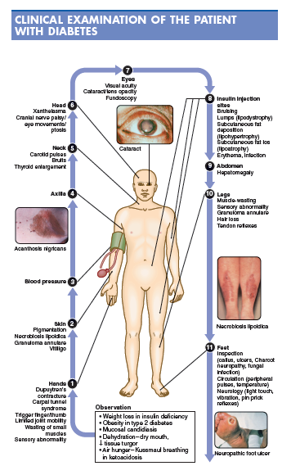

Slide 27
Investigations

Slide 28
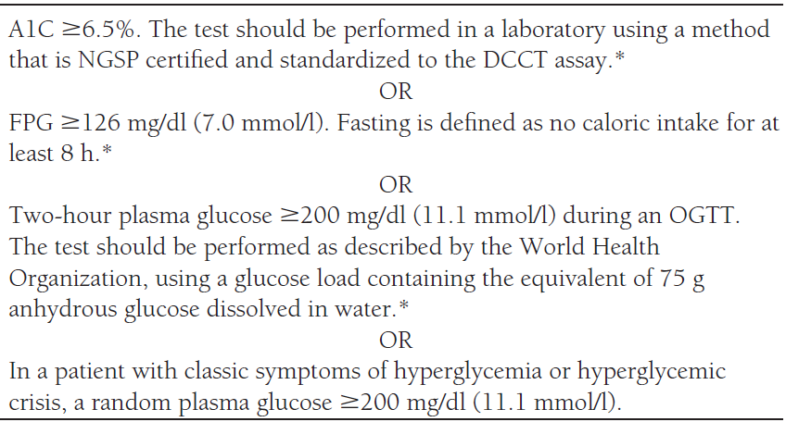
Notes:
National Glycohemoglobin Standardization Program (NGSP) and standardized or traceable to the Diabetes Control and Complications Trial (DCCT)

Slide 29
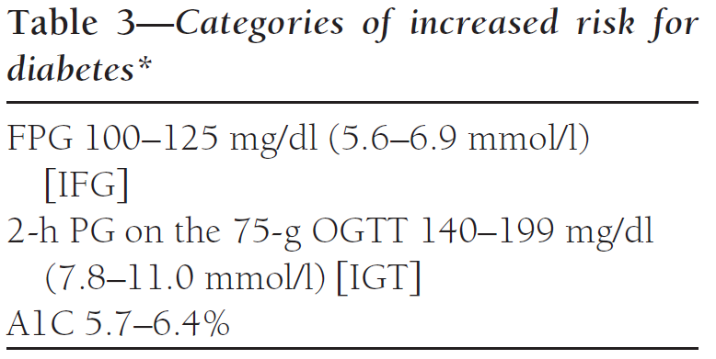
Pre Diabetes

Slide 30
Prediabetes & Diabetes
Fasting glucose
100mg/dl
125 mg/dl
prediabetes
diabetes
normoglycemic
2hr Plasma glucose
140 mg/dl
199 mg/dl
Prediabetes is a condition in which the blood sugar level is higher than normal,
but not high enough to be classified as diabetes

Slide 31
Laboratory Findings
Urinalysis
Glucosuria
Paper strip impregnated with glucose oxidase and a chromogen system
Sensitive to as little as 0.1% glucose in urine.
A normal renal threshold for glucose as well as reliable bladder emptying is essential for interpretation.
Notes:
Table 1. Values for diagnosis of diabetes mellitus and other categories of hyperglycaemia
Glucose concentration, mmol l–1 (mg dl–1)
Whole blood Plasma*
Venous Capillary Venous
Diabetes Mellitus:
Fasting ³ 6.1 (³ 110) ³ 6.1 (³ 110) ³ 7.0 (³ 126)
or
2-h post glucose load
or both
³ 10.0 (³ 180) ³ 11.1 (³ 200) ³ 11.1 (³ 200)
Impaired Glucose Tolerance (IGT):
Fasting (if measured) < 6.1 (< 110) < 6.1 (< 110) < 7.0 (< 126)
and
2-h post glucose load ³ 6.7 (³ 120) and ³ 7.8 (³ 140) and ³ 7.8 (³ 140) and
< 10.0 (< 180) < 11.1 (< 200) < 11.1 (< 200)
Impaired Fasting Glycaemia (IFG):
Fasting ³ 5.6 (³ 100) and ³ 5.6 (³ 100) and ³ 6.1 (³ 110) and
< 6.1 (< 110) < 6.1 (< 110) < 7.0 (< 126)
and (if measured)
2-h post glucose load < 6.7 (< 120) < 7.8 (< 140) < 7.8 (< 140)
* Corresponding values for capillary plasma are: for Diabetes Mellitus, fasting ³ 7.0 (³ 126), 2-h ³ 12.2 (³ 220); for Impaired Glucose Tolerance,fasting < 7.0 (< 126) and
2-h ³ 8.9 (³ 160) and < 12.2 (< 220); and for Impaired Fasting Glycaemia ³ 6.1 (³ 110) and < 7.0 (< 126) and if measured, 2-h < 8.9 (< 160).
For epidemiological or population screening purposes, the fasting or 2-h value after 75 g oral glucose may be used alone. For clinical purposes, the diagnosis of diabetes
should always be confirmed by repeating the test on another day unless there is unequivocal hyperglycaemia with acute metabolic decompensation or obvious
symptoms.
Glucose concentrations should not be determined on serum unless red cells are immediately removed, otherwise glycolysis will result in an
unpredictable under-estimation of the true concentrations. It should be stressed that glucose preservatives do not totally prevent glycolysis.
If whole blood is used, the sample should be kept at 0-4 °C or centrifuged immediately, or assayed immediately.

Slide 32
Laboratory Findings
Urinalysis
Ketonuria
By nitroprusside tests (Acetest or Ketostix).
Do not detect β-hydroxy butyric acid
Notes:
Ketouria may be due to bacteruria
Repeat
Urine culture

Slide 33
Laboratory Findings
Blood testing procedures
Glucose tolerance test
Normal carbohydrate diet for 3 days
Overnight fast on the day of the test
FPG is drawn
Give 75gm of anhydrous glucose in about 300ml of water
Blood & urine specimens are collected at half hourly for 2hours
A curve is plotted for time against blood glucose
Notes:
Recommendation 6
The oral glucose tolerance test (OGTT) should be retained as a diagnostic
test for the following reasons
fasting plasma glucose alone fails to diagnose approximately 30% of
cases of previously undiagnosed diabetes
an OGTT is the only means of identifying people with IGT
an OGTT is frequently needed to confirm or exclude an abnormality
of glucose tolerance in asymptomatic people
An OGTT should be used in individuals with fasting plasma glucose
6.1–6.9mmol/l (110–125mg/dl) to determine glucose tolerance status.
Recommendation 7
Currently HbA1c is not considered a suitable diagnostic test for diabetes
or intermediate hyperglycaemia.

Slide 34
Laboratory Findings
Blood testing procedures
Glucose tolerance test
Criteria for laboratory confirmation of diabetes mellitus
The Diabetes Expert Committee criteria for evaluating the standard oral glucose tolerance test.¹
 | Normal Glucose Tolerance | Impaired Glucose Tolerance | Diabetes Mellitus
Fasting plasma glucose (mg/dL) | < 110 | 110–125 | ≥126
Two hours after glucose load (mg/dL) | < 140 | ≥140–199 | ≥200
Notes:
Federation of Clinical Chemistry (IFCC) recommendation that all glucose
measuring devices report in plasma values57.
Measurement differences may also arise depending on the site of collection
of the blood sample. Venous and capillary samples will give the same
result in the fasting state but in the non-fasting state capillary will give
higher results than venous samples.
The processing of the sample after collection is important to ensure accurate
measurement of plasma glucose. This requires rapid separation of
the plasma after collection (within minutes) but it is recognised that this
seldom occurs. Collection into a container with glycolytic inhibitors (eg
NaF) is only partially effective. A minimum requirement is that the sample
should be placed immediately in ice-water after collection and before
separating but even so separation should be within 30min58.
Recommendation 5 1. Venous plasma glucose should be the standard method for measuring
and reporting. However in recognition of the widespread use of capillary
sampling, especially in under-resourced countries, conversion
values for capillary plasma glucose are provided for post- load glucose
values. Fasting values for venous and capillary plasma glucose are
identical.
2. Glucose should be measured immediately after collection by near
patient testing, or if a blood sample is collected, plasma should
be immediately separated, or the sample should be collected into
a container with glycolytic inhibitors and placed on ice-water until
separated prior to analysis.

Slide 35
Summary of Diagnostic criteria for diabetes
Blood Glucose Parameter | HbA1c | FPG | PPPG
Normal | < 5.7% | < 100 mg/dl | < 140 mg/dl
Pre-diabetes | 5.7 - 6.5 | 100-125 mg/dl (IFG) | 140-199 mg/dl (IGT)
Diabetes | ≥ 6.5% | 126 mg/dl or above | 200 mg/dl or above

Slide 36
Laboratory Findings
Blood testing procedures
Glycated hemoglobin (hemoglobin A₁) measurements
The major form of HbA₁ is hemoglobin A_{1c} (HbA_{1c}) where glucose is the carbohydrate.
The remaining HbA₁ species contain fructose-1,6 diphosphate (HbA_{1a1}); glucose-6-phosphate (HbA_{1a2}); and unknown carbohydrate moiety (HbA_{1b}).
Notes:
Glycated hemoglobin (hemoglobin A₁) measurements
Hemoglobin becomes glycated by ketoamine reactions between glucose and other sugars and the free amino groups on the and chains. Only glycation of the N-terminal valine of the beta chain imparts sufficient negative charge to the hemoglobin molecule to allow separation by charge dependent techniques. These charge separated hemoglobins are collectively referred to as hemoglobin A₁ (HbA₁). The major form of HbA₁ is hemoglobin A_{1c} (HbA_{1c}) where glucose is the carbohydrate. HbA_{1c} comprises 4–6% of total hemoglobin A₁. The remaining HbA₁ species contain fructose-1,6 diphosphate (HbA_{1a1}); glucose-6-phosphate (HbA_{1a2}); and unknown carbohydrate moiety (HbA_{1b}). The hemoglobin A_{1c} fraction is abnormally elevated in diabetic persons with chronic hyperglycemia. Methods for measuring HbA_{1c} include electrophoresis, cation-exchange chromatography, boronate affinity chromatography, and immunoassays. Office-based immunoassays using capillary blood give a result in about 9 minutes and this allows for immediate feedback to the patients regarding their glycemic control.
Since glycohemoglobins circulate within red blood cells whose life span lasts up to 120 days, they generally reflect the state of glycemia over the preceding 8–12 weeks, thereby providing an improved method of assessing diabetic control. The HbA_{1c} value, however, is weighted to more recent glucose levels (previous month) and this explains why significant changes in HbA_{1c} are observed with short-term (1 month) changes in mean plasma glucose levels. Measurements should be made in patients with either type of diabetes mellitus at 3- to 4-month intervals so that adjustments in therapy can be made if HbA_{1c} is either subnormal or if it is more than 2% above the upper limits of normal for a particular laboratory. In patients monitoring their own blood glucose levels, HbA_{1c} values provide a valuable check on the accuracy of monitoring. In patients who do not monitor their own blood glucose levels, HbA_{1c} values are essential for adjusting therapy. Data from the Diabetes Control and Complications Trial (DCCT) showed that there is a linear relationship between the HbA_{1c} and the mean of seven-point capillary blood glucose profiles (preprandial, postprandial, and bedtime). Thus, mean plasma glucose levels of 170, 205, 240, and 275 mg/dL approximately correlate with HbA_{1c} values of 7%, 8%, 9%, and 10%, respectively. Use of HbA_{1c} for screening is controversial. Sensitivity in detecting known diabetes cases by HbA_{1c} measurements is only 85%, indicating that diabetes cannot be excluded by a normal value. On the other hand, elevated HbA_{1c} assays are fairly specific (91%) in identifying the presence of diabetes.
The accuracy of HbA_{1c} values can be affected by hemoglobin variants or derivatives; the effect depends on the specific hemoglobin variant or derivative and the specific assay used. Immunoassays that use an antibody to the glycated amino terminus of globin do not recognize the terminus of the globin of hemoglobin F. Thus, in patients with high levels of hemoglobin F, immunoassays give falsely low values of HbA_{1c}. Cation-exchange chromatography separates hemoglobin species by charge differences. Hemoglobin variants that co-elute with HbA_{1c} can lead to an overestimation of the HbA_{1c} value. Chemically modified derivatives of hemoglobin such as carbamoylation (in renal failure) or acetylation (high-dose aspirin therapy) can similarly co-elute with HbA_{1c} by some assay methods.
Any condition that shortens erythrocyte survival or decreases mean erythrocyte age (eg, recovery from acute blood loss, hemolytic anemia) will falsely lower HbA_{1c} irrespective of the assay method used. Alternative methods such as fructosamine (see below) should be considered for these patients. Vitamins C and E are reported to falsely lower test results possibly by inhibiting glycation of hemoglobin.

Slide 37
A1C: New Recommendations
To avoid misdiagnosis or missed diagnosis, the A1C test should be performed using a method that is certified by the NGSP and standardized to the Diabetes Control and Complications Trial (DCCT) assay. B
Marked discordance between measured A1C and plasma glucose levels should raise the possibility of A1C assay interference due to hemoglobin variants (i.e., hemoglobinopathies) and consideration of using an assay without interference or plasma blood glucose criteria to diagnose diabetes. B
In conditions associated with increased red blood cell turnover, such as sickle cell disease, pregnancy (second and third trimesters), hemodialysis, recent blood loss or transfusion, or erythropoietin therapy, only plasma blood glucose criteria should be used to diagnose diabetes. B
Notes:
As a result of recent evidence describing potential limitations in A1C measurements due to hemoglobin variants, assay
interference, and conditions associated with red blood cell turnover, additional recommendations were added to clarify
the appropriate use of the A1C test generally and in the diagnosis of diabetes in these special cases
[SLIDE]
37
Reference
American Diabetes Association. Standards of medical care in diabetes—2014. Diabetes Care 2014;37(suppl 1):S14

Slide 38
Complications
Acute complications:
DKA in type 1 D.M.
HHS in type 2 D.M.
Hypoglycemia

Slide 39
Complications
Chronic complications:
Microvascular:
Diabetic nephropathy.
Diabetic retinopathy.
Diabetic neuropathy.
Macrovascular:
CAD
CVA
PVD
Others: e.g. Musculoskeletal.

Slide 40
Diabetic Retinopathy: Recommendations
To reduce the risk or slow the progression of diabetic retinopathy:
Optimize glycemic control. A
Optimize blood pressure and serum lipid control. A
Notes:
Diabetic retinopathy is a highly specific vascular complication of both type 1 and type 2 diabetes, with prevalence strongly related to duration of diabetes. It’s the most frequent cause of new cases of blindness among adults aged 20–74 years
Glaucoma, cataracts, and other disorders of the eye occur earlier and more frequently in people with diabetes
In addition to duration of diabetes, other factors that increase the risk of, or are associated with, retinopathy include chronic hyperglycemia, the presence of nephropathy, and hypertension.
The first line of defense against diabetic retinopathy, to reduce the risk or slow its progression, is to optimize glycemic control, blood pressure, and serum lipid control.
[SLIDE]
40
References
American Diabetes Association. Standards of medical care in diabetes—2014. Diabetes Care 2014;37(suppl 1):S44–S45
Klein R. Hyperglycemia and microvascular and macrovascular disease in diabetes. Diabetes Care 1995;18:258–268
Estacio RO, McFarling E, Biggerstaff S, Jeffers BW, Johnson D, Schrier RW. Overt albuminuria predicts diabetic retinopathy in Hispanics with NIDDM. Am J Kidney Dis 1998;31:947–953
Leske MC, Wu SY, Hennis A, et al., for the Barbados Eye Study Group. Hyperglycemia, blood pressure, and the 9-year incidence of diabetic retinopathy: the Barbados Eye Studies. Ophthalmology 2005;112:799–805

Slide 41
Diabetic Retinopathy: Recommendations (2)
Screening:
Initial dilated and comprehensive eye مهم examination by an ophthalmologist or optometrist:
Adults with type 1 diabetes, within 5 years of diabetes onset. B
Patients with type 2 diabetes at the time of diabetes diagnosis. B
Notes:
As far as screening for diabetic retinopathy, your patients with diabetes should have a dilated and comprehensive eye exam by an ophthalmologist or optometrist.
Because retinopathy is estimated to take at least 5 years to develop after the onset of hyperglycemia, patients with type 1 diabetes should have an initial dilated and comprehensive eye examination within 5 years after the diagnosis of diabetes
Patients with type 2 diabetes who may have had years of undiagnosed diabetes and have a significant risk of prevalent diabetic retinopathy at the time of diagnosis should have an initial dilated and comprehensive eye examination at the time of diagnosis.
Results of eye examinations should be documented and transmitted to the referring health care professional.
[SLIDE]
41
Reference
American Diabetes Association. Standards of medical care in diabetes—2014. Diabetes Care 2014;37(suppl 1):S44

Slide 42
D. Nephropathy
It starts with glomerular hyperfiltration, proceeding to microalbuminuria, gross proteinuria, nephrotic syndrome and CRF
According to estimated GFR

Slide 43
Diabetic Kidney Disease (DKD): Recommendations (2)
Treatment
Optimize glucose control to reduce the risk or slow progression of DKD. A
Optimize blood pressure control to reduce the risk or slow progression of DKD. A
For people with nondialysis-dependent DKD, dietary protein intake should be ~0.8 g/kg body weight per day (the recommended daily allowance). For patients on dialysis, higher levels of dietary protein intake should be considered. B
Notes:
The following series of slides will outline 2018 recommendations related to the treatment of DKD. The recommendations are as follows:
Optimize glucose control to reduce the risk or slow progression of DKD. A
Optimize blood pressure control to reduce the risk or slow progression of DKD. A
For people with nondialysis-dependent DKD, dietary protein intake should be ~0.8 g/kg body weight per day (the recommended daily allowance). For patients on dialysis, higher levels of dietary protein intake should be considered. B
[SLIDE]
43
References
American Diabetes Association. Standards of medical care in diabetes—2014. Diabetes Care 2014;37(suppl 1):S42–S43
The Diabetes Control and Complications (DCCT) Research Group. Effect of intensive therapy on the development and progression of diabetic nephropathy in the Diabetes Control and Complications Trial. Kidney Int 1995;47:1703–1720
UK Prospective Diabetes Study (UKPDS) Group. Effect of intensive blood-glucose control with metformin on complications in overweight patients with type 2 diabetes (UKPDS 34). Lancet 1998;352:854–865
UK Prospective Diabetes Study Group. Tight blood pressure control and risk of macrovascular and microvascular complications in type 2 diabetes: UKPDS 38. BMJ 1998;317:703–713

Slide 44
Diabetic Kidney Disease (DKD): Recommendations (3)
Treatment
In nonpregnant patients with diabetes and hypertension, either an ACE inhibitor or ARB is recommended for those with modestly elevated urinary albumin-to-creatinine ratio (UACR) (30–299 mg/g creatinine) B and is strongly recommended for those with UACR ≥300 mg/g creatinine and/or eGFR <60 mL/min/1.73m². A
Notes:
In nonpregnant patients with diabetes and hypertension, either an ACE inhibitor or ARB is recommended for those with modestly elevated urinary albumin-to-creatinine ratio (30–299 mg/g creatinine) B and is strongly recommended for those with urinary albumin-to-creatinine ratio ≥300 mg/g creatinine and/or eGFR <60 mL/min/1.73m². A
[SLIDE]
44
References
American Diabetes Association. Standards of medical care in diabetes—2014. Diabetes Care 2014;37(suppl 1):S42–S43
The Diabetes Control and Complications (DCCT) Research Group. Effect of intensive therapy on the development and progression of diabetic nephropathy in the Diabetes Control and Complications Trial. Kidney Int 1995;47:1703–1720
UK Prospective Diabetes Study (UKPDS) Group. Effect of intensive blood-glucose control with metformin on complications in overweight patients with type 2 diabetes (UKPDS 34). Lancet 1998;352:854–865
UK Prospective Diabetes Study Group. Tight blood pressure control and risk of macrovascular and microvascular complications in type 2 diabetes: UKPDS 38. BMJ 1998;317:703–713

Slide 45
Diabetic Kidney Disease (DKD): Recommendations (4)
Treatment
Periodically monitor serum creatinine and potassium levels for the development of increased creatinine or changes in potassium when ACE inhibitors, ARBs, or diuretics are used. B
Continued monitoring of UACR in patients with albuminuria treated with an ACE inhibitor or ARB is reasonable to assess the response to treatment and progression of DKD. E
Notes:
Periodically monitor serum creatinine and potassium levels for the development of increased creatinine or changes in potassium when ACE inhibitors, ARBs, or diuretics are used. B
Continued monitoring of UACR in patients with albuminuria treated with an ACE inhibitor or ARB is reasonable to assess the response to treatment and progression of DKD. E
[SLIDE]
45
References
American Diabetes Association. Standards of medical care in diabetes—2014. Diabetes Care 2014;37(suppl 1):S42–S43
The Diabetes Control and Complications (DCCT) Research Group. Effect of intensive therapy on the development and progression of diabetic nephropathy in the Diabetes Control and Complications Trial. Kidney Int 1995;47:1703–1720
UK Prospective Diabetes Study (UKPDS) Group. Effect of intensive blood-glucose control with metformin on complications in overweight patients with type 2 diabetes (UKPDS 34). Lancet 1998;352:854–865
UK Prospective Diabetes Study Group. Tight blood pressure control and risk of macrovascular and microvascular complications in type 2 diabetes: UKPDS 38. BMJ 1998;317:703–713

Slide 46
Diabetic Kidney Disease (DKD): Recommendations (5)
Treatment
An ACE inhibitor or an ARB is not recommended for the primary prevention of DKD in patients with diabetes who have normal blood pressure, normal UACR (<30 mg/g creatinine), and normal eGFR. B
When eGFR rate is <60 mL/min/1.73m², evaluate and manage potential complications of DKD. E
Notes:
An ACE inhibitor or an ARB is not recommended for the primary prevention of DKD in patients with diabetes who have normal blood pressure, normal UACR (<30 mg/g creatinine), and normal eGFR. B
When eGFR rate is <60 mL/min/1.73m², evaluate and manage potential complications of DKD. E
[SLIDE]
46
References
American Diabetes Association. Standards of medical care in diabetes—2014. Diabetes Care 2014;37(suppl 1):S42–S43
The Diabetes Control and Complications (DCCT) Research Group. Effect of intensive therapy on the development and progression of diabetic nephropathy in the Diabetes Control and Complications Trial. Kidney Int 1995;47:1703–1720
UK Prospective Diabetes Study (UKPDS) Group. Effect of intensive blood-glucose control with metformin on complications in overweight patients with type 2 diabetes (UKPDS 34). Lancet 1998;352:854–865
UK Prospective Diabetes Study Group. Tight blood pressure control and risk of macrovascular and microvascular complications in type 2 diabetes: UKPDS 38. BMJ 1998;317:703–713

Slide 47
Diabetic Kidney Disease (DKD): Recommendations (6)
Treatment
Patients should be referred for evaluation for renal replacement treatment if they have an eGFR <30 mL/min/1.73m². A
Promptly refer to a physician experienced in the care of kidney disease for uncertainty about the etiology of kidney disease, difficult management issues, and rapidly progressing kidney disease. B
Notes:
Patients should be referred for evaluation for renal replacement treatment if they have an eGFR <30 mL/min/1.73m². A
Promptly refer to a physician experienced in the care of kidney disease for uncertainty about the etiology of kidney disease, difficult management issues, and rapidly progressing kidney disease. B
[SLIDE]
47
References
American Diabetes Association. Standards of medical care in diabetes—2014. Diabetes Care 2014;37(suppl 1):S42–S43
The Diabetes Control and Complications (DCCT) Research Group. Effect of intensive therapy on the development and progression of diabetic nephropathy in the Diabetes Control and Complications Trial. Kidney Int 1995;47:1703–1720
UK Prospective Diabetes Study (UKPDS) Group. Effect of intensive blood-glucose control with metformin on complications in overweight patients with type 2 diabetes (UKPDS 34). Lancet 1998;352:854–865
UK Prospective Diabetes Study Group. Tight blood pressure control and risk of macrovascular and microvascular complications in type 2 diabetes: UKPDS 38. BMJ 1998;317:703–713

Slide 48
Diabetic Neuropathy

Slide 49
بنعطيهم B12

Slide 50
Neuropathy: Recommendations (2)
Treatment:
Optimize glucose control to prevent or delay the development of neuropathy in patients with T1DM A and to slow the progression in patients with T2DM. B
Assess and treat patients to reduce pain related to DPN B and symptoms of autonomic neuropathy and to improve quality of life. E
Either pregabalin or duloxetine are recommended as initial pharmacologic treatments for neuropathic pain in diabetes. A
Notes:
Near-normal glycemic control, implemented early in the course of diabetes, has been shown to effectively delay or prevent the development of DPN and cardiovascular autonomic diabetes in patients with type 1 diabetes.
While the evidence for the benefit of near-normal glycemic control is not as strong for type 2 diabetes, some studies have demonstrated a modest slowing of progression without reversal of neuronal loss.
Recommendations for treatment of neuropathy in patients with diabetes include:
Optimize glucose control to prevent or delay the development of neuropathy in patients with T1DM A and to slow the progression in patients with T2DM. B [CLICK]
Assess and treat patients to reduce pain related to DPN B and symptoms of autonomic neuropathy and to improve quality of life. E [CLICK]
Either pregabalin or duloxetine are recommended as initial pharmacologic treatments for neuropathic pain in diabetes. A [CLICK]
[SLIDE]
50
References
American Diabetes Association. Standards of medical care in diabetes—2014. Diabetes Care 2014;37(suppl 1):S46
Ismail-Beigi F, Craven T, Banerji MA, et al for the ACCORD Trial Group. Effect of intensive treatment of hyperglycaemia on microvascular outcomes in type 2 diabetes: an analysis of the ACCORD randomised trial. Lancet 2010;376:419–430
Bril V, England J, Franklin GM, et al for the American Academy of Neurology; American Association of Neuromuscular and Electrodiagnostic Medicine; American Academy of Physical Medicine and Rehabilitation. Evidence-based guideline: treatment of painful diabetic neuropathy: report of the American Academy of Neurology, the American Association of Neuromuscular and Electrodiagnostic Medicine, and the American Academy of Physical Medicine and Rehabilitation. Neurology 2011;76:1758–1765

Slide 51
Foot Care
Appropriate foot care practices are important in diabetes care for a number of reasons:
Foot ulcers and amputation are common and represent major causes of morbidity and mortality.
Early recognition and treatment of feet at risk for ulcers and amputation can delay or prevent adverse outcomes.
Notes:
Appropriate foot care practices are important in diabetes care for a number of reasons: [CLICK]
Foot ulcers and amputation are common and represent major causes of morbidity and mortality. [CLICK]
Early recognition and treatment of feet at risk for ulcers and amputation can delay or prevent adverse outcomes. [CLICK]
[SLIDE]
51
Reference
American Diabetes Association. Standards of medical care in diabetes—2014. Diabetes Care 2014;37(suppl 1):S45

Slide 52
Foot Care: Risk Of Ulcer and Amputation انسى
Risk of ulcers or amputations is increased in people with the following risk factors:
Poor glycemic control
Peripheral neuropathy with loss of protective sensation (LOPS)
Cigarette smoking
Foot deformities
Preulcerative callus or corn
PAD
History of foot ulcer
Amputation
Visual impairment
DKD (especially patients on dialysis)
Notes:
Risk of ulcers or amputations is increased in people with the following risk factors:
Poor glycemic control
Peripheral neuropathy with loss of protective sensation (LOPS)
Cigarette smoking
Foot deformities
Preulcerative callus or corn
PAD
History of foot ulcer
Amputation
Visual impairment
DKD (especially patients on dialysis)
[SLIDE]
52
Reference
American Diabetes Association. Standards of medical care in diabetes—2014. Diabetes Care 2014;37(suppl 1):S45

Slide 53
Foot Care: Recommendations (2)
The examination should include inspection of the skin, assessment of foot deformities, neurologic assessment (10-g monofilament testing with at least one other assessment: pinprick, temperature, vibration), and vascular assessment including pulses in the legs and feet. B
Patients with symptoms of claudication or decreased or absent pedal pulses should be referred for ABI and for further vascular assessment as appropriate. C
Notes:
The examination should include inspection of the skin, assessment of foot deformities, neurologic assessment (10-g monofilament testing with at least one other assessment: pinprick, temperature, vibration), and vascular assessment including pulses in the legs and feet. B
Patients with symptoms of claudication or decreased or absent pedal pulses should be referred for ABI and for further vascular assessment as appropriate. C
[SLIDE]
53
Reference
American Diabetes Association. Standards of medical care in diabetes—2014. Diabetes Care 2014;36(suppl 1):S47–S48

Slide 54
Foot Care: Recommendations (4)
Provide general preventive foot self-care education to all patients with diabetes. B
The use of specialized therapeutic footwear is recommended for high-risk patients with diabetes including those with severe neuropathy, foot deformities, or history of amputation. B
Notes:
Provide general preventive foot self-care education to all patients with diabetes. B
The use of specialized therapeutic footwear is recommended for high-risk patients with diabetes including those with severe neuropathy, foot deformities, or history of amputation. B
[SLIDE]
54
Reference
American Diabetes Association. Standards of medical care in diabetes—2014. Diabetes Care 2014;36(suppl 1):S47–S48

Slide 55
Foot Care: Recommendations (5)
To perform the 10-g monofilament test, place the device perpendicular to the skin; Apply pressure until monofilament buckles.
Hold in place for 1 second & release.
The monofilament test should be performed at the highlighted sites while the patient’s eyes are closed.
Notes:
This slide illustrates how to perform the 10-g monofilament test
Upper panel
To perform the 10-g monofilament test, place the device perpendicular to the skin, with pressure applied until the monofilament buckles
Hold in place for 1 second and then release
Lower panel
The monofilament test should be performed at the highlighted sites while the patient’s eyes are closed
[SLIDE]
55
References
American Diabetes Association. Standards of medical care in diabetes—2014. Diabetes Care 2014;37(suppl 1):S39
Boulton AJ, Armstrong DG, Albert SF, et al., for the American Diabetes Association, American Association of Clinical Endocrinologists. Comprehensive foot examination and risk assessment: a report of the task force of the foot care interest group of the American Diabetes Association, with endorsement by the American Association of Clinical Endocrinologists. Diabetes Care 2008;31:1679–1685

Slide 56
Management 0f Diabetes (oral hypoglycemic agents) مطلوب

Slide 57
A. Education
• include lifestyle changes,
smoking cessation,
home monitoring,
management of blood pressure and lipids,
medication effects and side effects,
and skin and foot care..

Slide 58
B. Nutrition
• Individualization of nutrition therapy is necessary to achieve glucose and lipid goals, health, and well-being.
• A Mediterranean-style diet is recommended with limited alcohol, decreased fat and overall calorie intake, leading to a modest weight loss of 10–15%.
• When combined with abstinence from tobacco, it can lower mortality by 50%.
• Individuals receiving fixed daily doses of insulin should try to maintain a consistent daily caloric intake.
• Those on intensive insulin therapy should adjust their insulin according to the carbohydrate content of their meals.

Slide 59
:C. Exercise
▪ increases strength and endurance.
▪ increase HDL cholesterol.
▪ Increase insulin sensitivity.
▪ reduces stress.
▪ improves circulation, digestion, sleep, energy levels, and selfesteem.
▪ controls appetite and reduces weight, and lowers heart rate, blood pressure, lipid levels, and blood glucose, thereby delaying the onset of diabetes and reducing the risk of cardiovascular disease.
❑ Prescribe a regular exercise program adapted to complications for all patients including moderate aerobic or physical activity for 20–60 minutes most days with resistance training twice a week.

Slide 60
D. Home Glucose Monitoring
• The American Diabetes Association (ADA) has recommended that all patients with diabetes perform home glucose monitoring.
• Patients who are using insulin, sulfonylureas, or corticosteroids, or are changing therapy should monitor frequently

Slide 61
Pharmacologic therapy

Slide 62
E. Pharmacologic therapy
المطلوب منا metformin
• In most cases, therapy is begun with one medication and dosage is increased before adding a second, but two may be synergistic.
• Efficacy is variable between drugs and individuals, but expected lowering of HbA1c is 0.5–2.0%.
• Choices of medication should be made to maximize efficacy and minimize side effects .
• When patients with type 2 diabetes present with A1c > 9% ,insulin can be used initially in combination with an oral medication to lower glucose levels to a manageable level.

Slide 63
Glycemic Recommendations for Nonpregnant Adults With Diabetes
A1C <7.0%
Preprandial capillary plasma glucose 80–130 mg/dL
Peak postprandial capillary plasma glucose less than 180mg/dl
End stage cancer / old pt // comorbidities / careless // how don’t fell hypoglycemia هدول ما بشد عليهم
Postprandial glucose may be targeted if A1C goals are not met despite reaching preprandial glucose goals.
Postprandial glucose measurements should be made 1–2 h after the beginning of the meal, generally peak levels in patients with diabetes

Slide 64
Glycemic Recommendations for pregnant Adults With Diabetes
A1c target is less than 6
Fasting glucose level less than 90mg/dl
Peak postprandial capillary plasma glucose < or = 120 mg/dl.

Slide 65
:Biguanides.
• Metformin (Glucophage) 500-2500 mg/dl.
• Metformin XR (Glucophage XR) 500-2000 mg/dl.
لا يستخدم لتقليل الوزن
Taken Daily or BID.
❑ Mechanism of action:
• Decrease gluconeogenesis in liver.
• Increase insulin sensitivity.
❑ Advantages:
• Decreases mortality.
• No hypoglycemia.
• Lowers insulin levels.
• Possible weight loss.
• Improves lipids and endothelial function.

Slide 66
Side effects and precautions:
Nausea and diarrhea. (GI upset)
Hold before and after IV contrast for approximately 48 hours .
Stop if creatinine > 1.4 mg/dL or more in women and 1.5 mg/dL or more in men.
Caution with CHF and hepatic dysfunction

Slide 67
Metformin is the initial choice in type 2 diabetes (especially with obesity), and it should be continued if possible when insulin is added.
• It is used in metabolic syndrome to delay the onset of diabetes.
• Metformin decreases circulating androgen levels and increase rates of ovulation in women with polycystic ovarian syndrome.
• Is the only approved oral hypoglycemic for children.
• Because it is associated with lactic acidosis (mortality 50%), metformin cannot be used in patients with renal insufficiency or when using IV contrast material.
• It is a category B in pregnancy and can be used in children but not while breastfeeding.
• Metformin may induce vitamin B12 malabsorption, so regular B12 monitoring is advised.

Slide 68
Sulfonylureas.
• Glipizide(Glucotrol) 5-40 md/dl.
• Glipizide XL (Glucotrol XL) 2. 5-20 mg/dl.
• Glyburide (DiaBeta, Micronase) 2.5-20 mg/dl.
• Glyburide micronized (Glynase) 1-8 mg/dl.
• Glimeperide (Amaryl) 1-6 mg/dl. اعرفه
• Taken daily or BID.
❑ Mechanism of action:
• Induce insulin secretion from pancreatic B cells (secretagogue).
❑ Advantages:
• Can be used in renal failure except Glyburide.
• Can be used in hepatic failure.

Slide 69
Side effects and precaution:
• Hypoglycemia.
• Weight gain.
▪ They should be taken with in 30 min before meals to induce insulin secretion.
▪ Approximately 20% of patients will not respond, and sulfonylureas lose efficacy over time.
▪ Glyburide has the greatest potential for hypoglycemia and cannot be used in renal failure, but it is a category B in pregnancy.
▪ In patients who are not responding at one half the maximum dose, an alternative agent or combination therapy should be considered.

Slide 70
3. Meglitinides: انسى
• Repaglinide (Prandin) 1.5-16 mg/dl.
• Natiglinide (Starlix) 180-360 mg/dl.
• Taken TID .
❑ Mechanism of action:
• induce secretion of insulin from pancreatic beta cells (secretagogue).
❑ Advantages:
• Rapid onset.
• Short half-life.
• Can be used in renal insufficiency

Slide 71
Side Effects and precaution:
• Caution in hepatic insufficiency.
• Hypoglycemia .
❑ These rapid-acting medications are taken only with meals and are useful in patients whose fasting glucose levels are well controlled but who have high postprandial values or for patients who eat few or irregular meals.
❑ The mechanism of action of the Meglitinides closely resembles that of the sulfonylureas. The Meglitinides stimulate the release of insulin from the pancreatic beta cells.

Slide 72
Thiazolidinediones(Glitazones ,.4 TZD) انسى
• Pioglitazone (Actos) 15-45 mg/dl.
• Rosiglitazone (Avandia) 4-5 mg/dl.
• Daily dosing.
❑ Mechanism of action:
• Insulin sensitizers in muscle and adipose tissue.
❑ Side effects and precaution:
• Do not use in class III or IV heart failure.
• Monitor liver function test.
• Edema.
• Weight gain .
❑ Advantages:
• Not associated with hypoglycemia when is used as monotherapy.

Slide 73
These agents are useful as an adjunct medication or with marked insulin resistance.
• Pioglitazone decreases triglyceride levels by 33% and increases HDL ,but improvement in outcomes has not been shown.
• It may take 12 weeks for the medication to reach its maximum potential, so dosage should be increased only after several weeks.
• They are teratogenic in rats, and are not recommended for use in pregnancy or in children.
• Pioglitazone(Actos) has been shown to increase the risk of bladder cancer and of distal limb fractures in women.
• In patients receiving insulin therapy, the addition of a thiazolidinedione has resulted in significant reductions in daily insulin requirements.

Slide 74
:α-Glucosidase inhibitors.
• Acarbose (Precose) 75-300mg/dl.
• Miglitol (Glyset) 75-300 mg/dl.
• TID dosing.
❑ Mechanism of action:
• Inhibit break down of disaccharides.
• Delay carbohydrate absorption in brush border of small intestine.
• Flattening the postprandial glycemic curve.
❑ Advantages:
• No hypoglycemia

Slide 75
Side effects and precaution:
• Flatulence, abdominal pain .
• Contraindicated with GI disorders
. • Contraindicated with cirrhosis.
• Contraindicated when Cr>2mg/dl.

Slide 76
Taken only with meals, they blunt postprandial hyperglycemia.
• Therapy should be initiated at a low dose and increased slowly to minimize side effects.
• Efficacy is altered with digestive enzymes, antacids, or cholestyramine.
• Serum transaminase levels must be followed every 3 months for the first year.
• They have been linked to pancreatitis

Slide 77
DPP4 inhibitors(DiPeptidyl Peptidase-4. inhibitor)
• Sitagliptin (Januvia) 100 mg/dl (25-50 renal impairment).
• Saxagliptin (Onglyza) 2.5-5 mg/dl.
• Linagliptin (Tradjenta) 5 mg/dl (long half-life). • Alogliptin (Nesina) 25-400 mg/dl.
• Daily dosing .
❑ Mechanism of action:
• Block the breakdown of natural incretins.
❑ Advantages:
• No hypoglycemia

Slide 78
They are well tolerated with once-daily dosing.
• They do carry a risk for pancreatitis.
❑ Side effects and precaution:
• Nausea and vomiting.
• Must decrease dose in renal impairment.

Slide 79
Incretin mimetics( Glucagon-like peptide -1 receptor agonist ,GLP-1 receptor agonists)
• Exenatide (Byetta) 5-10 μg (70/week)
. • Liraglutide (Victoza) 0.6-1.8 μg (once daily).
• Pramlintide (Symlin) 15-120 μg.
• Albiglutide (Tanzeum) 30-50 mg/week (once weekly).
• Dulaglutide 0.75-15 mg/week (once weekly).
• Taken SC (subcutaneous).
❑ Mechanism of action:
• Enhance glucose-dependent insulin secretion.
• Suppress inappropriate glucagon secretion and slow gastric emptying.

Slide 80
Advantages:
• Early satiety .
• Weight loss.
❑ Side effects and precaution:
• Nausea and vomiting.
• Exenatide associated with hemorrhagic or necrotizing pancreatitis.

Slide 81
They also increase the risk of T-cell thyroid
tumors.
• Exenatide is a GLP1 analog derived from Gila monster saliva and is given prior to morning and evening meals.
• It is used as an adjunct to metformin, sulfonylureas, or thiazolidinediones.
• Pramlintide is an analog of human amylin, given with insulin prior to meals

Slide 82
SGLT-2 inhibitors(Sodium-glucose cotransporter- 2 inhibitors):
• Canagliflozin (Invokana) 100-300 mg/dl.
• Dapagliflozin (farxiga) 5-10 mg/dl.
• Empagliflozin (Jardiance)
• Taken Daily.
❑ Mechanism of action:
• Block renal reabsorption of glucose, causing urinary excretion .

Slide 83
Advantages:
• Induce weight reduction.
• Lower systolic blood pressure.
❑ Side effects and precaution:
• They reduce intravascular volume and may induce postural hypotension (orthostatic hypotension)
• Increasing urinary tract infections and vaginal yeast infections.

Slide 86
Combination Therapy.
• Combining drugs with different mechanisms of action is most efficacious, but caution must be exercised in combining drugs with similar side effects (TZDs and α-glucosidase inhibitors are both hepatotoxic).
• Metformin can be combined with any of the other medications, and there are now multiple commercial combinations of metformin, thiazolidinediones, sulfonylureas, and DPP4 inhibitors

Slide 88
Not used in renal insufficiency
α-Glucosidase inhibitors
DPP4 inhibitors
.Biguanides

Slide 89
Cause w loss?
Biguanides
SGLT-2 inhibitors
Incretin mimetics

Slide 90
Cause w gain?
Sulfonylureas
Thiazolidinediones

Slide 91
Decrease mortality?
metformin

Slide 92
Not given in GI disorders
α-Glucosidase inhibitors

Slide 93
Not causing hypoglycemia?
α-Glucosidase inhibitors
DPP4 inhibitors
.Biguanides
Thiazolidinediones

Slide 94
Causing hypoglycemia?
Sulfonylureas
Meglitinides

Slide 95
Can cause pancreatitis
α-Glucosidase inhibitors
DPP4 inhibitors
Incretin mimetics

Slide 96
Avoided in hepatic diseases
α-Glucosidase inhibitors
.Biguanides
Thiazolidinediones
Meglitinides

Slide 97
:Insulin
Type 1 // planed for surgery
When to initiate Insulin in type 2 DM?
• Initial A1 level > 9 %.
• If diabetes is uncontrolled despite optimal oral glycemic therapy.
• If the patient is in a catabolic state (losing weight).

