Slide 1
aborajooh emad aref MD,General Surgery GI AND Minimally Invasive Surgery IMRCS JB and AB1
Shock

Slide 3
Outline
Definitions
Types of Shock
Resuscitation
Management principles

Slide 4
Shock
Circulatory failure leading to inadequate perfusion and delivery of oxygen to vital organs
Blood Pressure is often used as an indirect estimator of tissue perfusion
Oxygen delivery is an interaction of Cardiac Output, Blood Volume, Systemic Vascular Resistance

Slide 5
Hypotension
In Adults:
systolic BP ≤ 90 mm Hg
mean arterial pressure ≤ 60 mm Hg
⇩ systolic BP > 40 mm Hg from the patient’s baseline pressure

Slide 6
Pathophysiology
ATP + H₂O ⇒ ADP + P_{i} + H⁺ + Energy
Acidosis results from the accumulation of acid when during anaerobic metabolism the creation of ATP from ADP is slowed.
H⁺ shift extracellularly and a metabolic acidosis develops

Slide 7
Pathophysiology (2)
ATP production fails, the Na⁺/K⁺ pump fails resulting in the inability to correct the cell electronic potential.
Cell swelling occurs leading to rupture and death.
Oxidative Phosphorylation stops & anaerobic metabolism begins leading to lactic acid production.

Slide 8
O₂ Delivery - volume of gaseous O₂ delivered to the LV/min.
O₂ Consumption - volume of gaseous O₂ which is actually used by the tissue/min.
O₂ Demand - volume of O₂ actually needed by the tissues to function in an aerobic manner
Demand > consumption = anaerobic metabolism

Slide 9
Mixed Venous Oxygenation
Used as a main marker of end organ perfusion and oxygen delivery
True mixed venous is drawn from the pulmonary artery (mixing of venous blood from upper and lower body)
Often sample will be drawn from central venous catheter (superior vena cava, R atrium)

Slide 10
Mixed Venous Oxygenation
Normal oxygen saturation of venous blood 68% – 77%
Low S_{CV}O₂
Tissues are extracting far more oxygen than usual, reflecting sub-optimal tissue perfusion (and oxygenation)
Following trends of S_{CV}O₂ to guide resuscitation (fluids, RBC, inotropes, vasopressors)

Slide 11
Physiologic Determinants
Global tissue perfusion is determined by:
Cardiac output (CO)
CO = Heart rate (HR) times Stroke Volume (SV)
SV = function of Preload, Afterload, Contractility
Systemic vascular resistance (SVR)
Variables: Length, Inverse of Diameter, Viscosity

Slide 12
Cardiac Index Example
PATIENT A
60 yo male
50 kg
CO = 4.0 L/min
BSA = 1.86
CI = 2.2 L/min/m²
PATIENT B
60 yo male
150 kg
CO = 4.0 L/min
BSA = 2.64
CI = 1.5 L/min/m²

Slide 13
Resuscitation Goals
CI = 4.5 L/min/m²
Oxygen Delivery (DO₂I) = 600 mL/min/m²
< 400 is bad sign
Oxygen Consumption (VO₂I) = 170 mL/min/m²
If VO₂I < 100 suggest tissues are not getting enough oxygen
Maintain a mean arterial pressure of 60 (1/3 systolic + 2/3 diastolic)
Keep O₂ sats >92%, intubate if neccesary

Slide 14
CVP
CVP of SVC at level of right atrium
pre-load “assessment”
normal 4 - 10 mm Hg

Slide 15
Pulmonary Artery Catheter

Slide 16
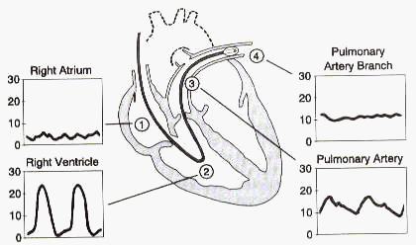

Slide 17
Waveform Analysis
A wave - atrial systole
C wave - tricuspid valve closure at ventricular systole
V wave - venous filling of right atrium

Slide 18
Hemodynamic Calculations
Parameter Normal
Cardiac Index (CI) 2.8 - 4.2
Stroke Volume Index (SVI) 30 - 65
Sys Vasc Resistance Index (SVRI) 1600 - 2400
Left Vent Stroke Work Index (LVSWI) 43 - 62

Slide 19
“Shock is a symptom of its cause.”

Slide 20
Types of Shock
HYPOVOLEMIC
CARDIOGENIC
DISTRIBUTIVE
OBSTRUCTIVE

Slide 21
Common Features of Shock
Hypotension (not an absolute requirement)
SBP < 90mm Hg, not seen in “preshock”
Cool skin
Vasoconstrictive mechanisms to redirect blood from periphery to vital organs
Exception is warm skin in early distrib. shock
Oliguria (↓kidney perfusion)
Altered mental status (↓brain perfusion)
Metabolic acidosis

Slide 22
Work-up
History to determine etiology
Bleeding (recent surgery, trauma, GI bleed)
Allergies or prior anaphylaxis
Sx consistent with pancreatitis, EtOH history
Hx of CAD, MI, current chest pain
Physical examination
Mucous membranes, JVD, lung sounds, cardiac exam, abdomen, rectal (blood), neuro exam, skin (cold or warm)
Labs/Tests directed toward suspected dx

Slide 23
Hypovolemic Shock
Reduced circulating blood volume with secondary decreased cardiac output
Causes
hemorrhage
vomiting
diarrhea
dehydration
third-space loss
burns
Signs
⇩ cardiac output
⇩ PAOP
⇧ SVR

Slide 24
Presentation of Hypovolemic Shock
Hypotensive
flat neck veins
clear lungs
cool, cyanotic extremities
evidence of bleeding?
Anticoagulant use
trauma, bruising
oliguria

Slide 25
Classes of Hypovolemic Shock

Slide 26
SHOCK/HYPOVOLEMIA
FLUIDS… FLUIDS… FLUIDS…
BLOOD & PRODUCTS TRANSFUSION
CORRECT
ACIDOSIS
COAGULOPATHY
HYPOTHERMIA

Slide 27
Initial Resuscitation
CVP: 8- 12 mm Hg
MAP ≥ 65 mm Hg
UOP ≥ 0.5 cc/kg/hr
Mixed venous Oxygen Sat ≥ 70%
Consider:
Transfusion to Hb ≥ 10
Dobutamine up to 20 μg/kg/min

Slide 28
Treatment
Reverse hypovolemia vs. hemorrhage control
Crystalloid vs. Colloid
Pressors?

Slide 29
Cardiogenic Shock, intracardiac
Myocardial Injury or Obstruction to Flow
Arrythymias
valvular lesions
AMI
Severe CHF
VSD
Hypertrophic Cardiomyopathy
Signs
⇩ cardiac output
⇧ PAOP
⇧ SVR
⇩ left ventricular stroke work (LVSW)

Slide 30
Cardiogenic Shock, extracardiac (Obstructive)
Pulmonary Embolism
Cardiac Tamponade
Tension Pneumothorax
Presentation will be according to underlying disease process.

Slide 31
Treatment
Improve myocardial function, C.I. < 3.5 is a risk factor
Catheterization if ongoing ischemia
Fluids first guided by CVP & PAOP, then cautious pressors
aortic DIASTOLIC pressures drives coronary perfusion (DBP-PAOP = Coronary Perfusion Pressure) GOAL - Coronary PP > 50 mm Hg
If inotropes and vasopressors fail, intra-aortic balloon pump

Slide 32
Cardiogenic Shock
Preload augmentation - Consider Fluids
Contractility
dopamine
dobutamine
phosphodiesterase inhibitor
Afterload reduction
nitroglycerin
dobutamine

Slide 33
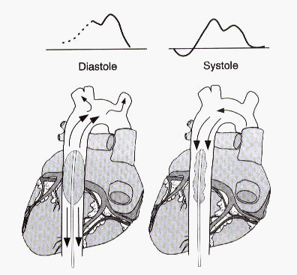
Intra-Aortic Balloon Pump

Slide 34
Distributive Shock
Types
Sepsis
Anaphylactic
Acute adrenal insufficiency
Neurogenic
Signs
± cardiac output
± PAOP
SVR

Slide 35
Management of Septic Shock
Early goal directed therapy
Identification of source of infection
Broad Spectrum Antibiotics
IV fluids
Vasopressors
Steroids ??
Recombinant human activated protein C ( Xygris)
Bicarbonate if pH < 7.1

Slide 39
qSOFA (Quick SOFA) Criteria
Respiratory rate ≥22/min
Altered mentation
Systolic blood pressure ≤100 mm Hg

Slide 40
Terms and Definitions
Sepsis is defined as life-threatening organ dysfunction caused by a dysregulated host response to infection.
Organ dysfunction can be identified as an acute change in total SOFA score ≥2 points consequent to the infection.
Septic shock is a subset of sepsis in which underlying circulatory and cellular/metabolic abnormalities are profound enough to substantially increase mortality.
Patients with septic shock can be identified with a clinical construct of sepsis with persisting hypotension requiring vasopressors to maintain MAP ≥65 mm Hg and having a serum lactate level >2 mmol/L (18 mg/dL) despite adequate volume resuscitation. With these criteria, hospital mortality is in excess of 40%.

Slide 41
Steroid Use in Sepsis
Refractory shock 200-300 mg/day of hydrocortisone in divided doses for 7 days
ACTH test
Once septic shock resolves, taper dose
Add fludrocortisone 50 μg po q day

Slide 42
Sepsis
Fluids
Correct the cause
Antibiotics
Debridement
Vasopressors
Phenylephrine
Levophed

Slide 43
Adrenal Crisis Distributive Shock
Causes
Autoimmune adrenalitis
Adrenal apoplexy = B hemorrhage or infarct
heparin may predispose
Steroids may be lifesaving in the patient who is unresponsive to fluids, inotropic, and vasopressor support.

Slide 44
Summary
Type PAOP C.O. SVR
HYPOVOLEMIC ↓ ↓ ↑
CARDIOGENIC ↑ ↓ ↑
DISTRIBUTIVE ↓ or N varies ↓
OBSTRUCTIVE ↑ ↓ ↑

Slide 45
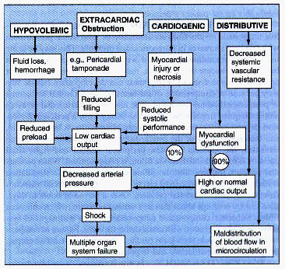

Slide 46
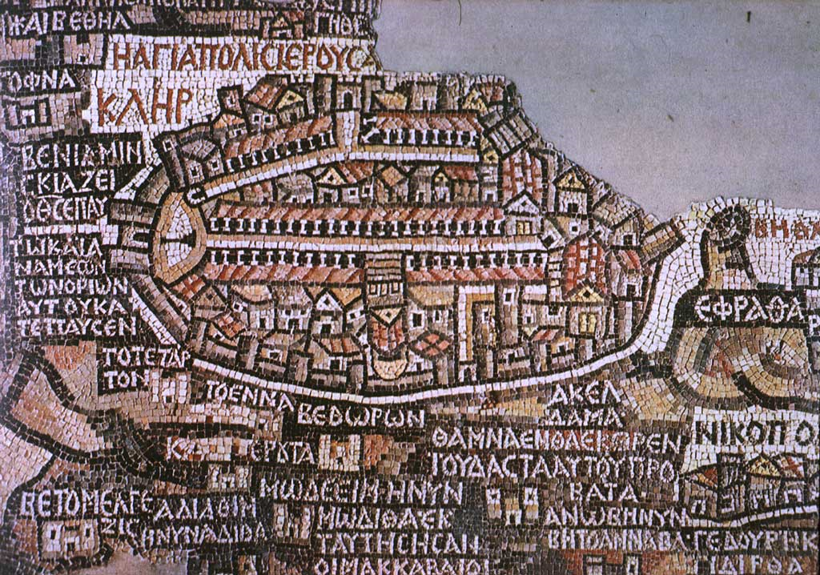

Slide 47
Vasopressors
Assure adequate fluid volume
Administer via CVL
Do not use dopamine for renal protection
Requires arterial line placement
Vasopressin:
Refractory shock
Infusion rate 0.01 – 0.04 Units/min

Slide 48
Vasopressor Agents?
Augments contractility, after preload established, thus improving cardiac output.
Risk tachycardia and increased myocardial oxygen consumption if used too soon
increased C.I. improves global perfusion

Slide 49
Vasopressors & Inotropic Agents
Dopamine
Dobutamine
Norepinephrine
Epinephrine
Amrinone

Slide 50
Dopamine
Low dose (0.5 - 2 μg/kg/min) = dopaminergic
Moderate dose (3-10 μg/kg/min) = β-effects
High dose (> 10 μg/kg/min) = α-effects
SIDE EFFECTS
tachycardia
> 20 μg/kg/min Δ to norepinephrine

Slide 51
Dobutamine
β-agonist
5 - 20 μg/kg/min
potent inotrope, variable chronotrope
caution in hypotension (inadequate volume) may precipitate tachycardia or worsen hypotension

Slide 52
Norepinephrine
Potent α-adrenergic vasopressor
Some β-adrenergic, inotropic, chronotropic
Dose 1 - 100 μg/min
Unproven effect with low-dose dopamine to protect renal and mesenteric flow.

Slide 53
Epinephrine
α- and β-adrenergic effects
potent inotrope and chronotrope
dose 1 - 10 μg/min
increases myocardial oxygen consumption particularly in coronary heart disease

Slide 54
Amrinone
Phosphodiesterase inhibitor, positive inotropic and vasodilatory effects
increased cardiac stroke output without an increase in cardiac stroke work
most often added with dobutamine as a second agent
load dose = 0.75 -1.5 mg/kg → 5 - 10 μg/kg/min drip
main side-effect - thrombocytopenia

