Slide 1
Urinary Tract Infections (UTIs)
*Presented by:
Amal Jameel & Mahd Foqahaa
*Under Guidance by:
Dr Ahmad Mdallal

Slide 2
**Definition and Epidemiology
UTIs: Is a term to describe acute cystitis and urethritis caused by a microorganism
In healthy human-beings, all urinary tract is sterile except the lower end of urethra (bacterial colonization is confined to there)
UTIs are of commonest disorders with varying presentations between genders:
Are more common in females than males because:
Shorter urethra in females that assists the ascent of bacteria into bladder
Prostatic secretions in males contain bactericidal components
In females: Prevalence is about 3% at the age of 20, this prevalence gets increased by a 1% in each subsequent decade.
In males: UTIs are uncommon in males except in the First year of life and in men above 60 years as urine outflow is obstructed by prostatic hypertrophy

Slide 5
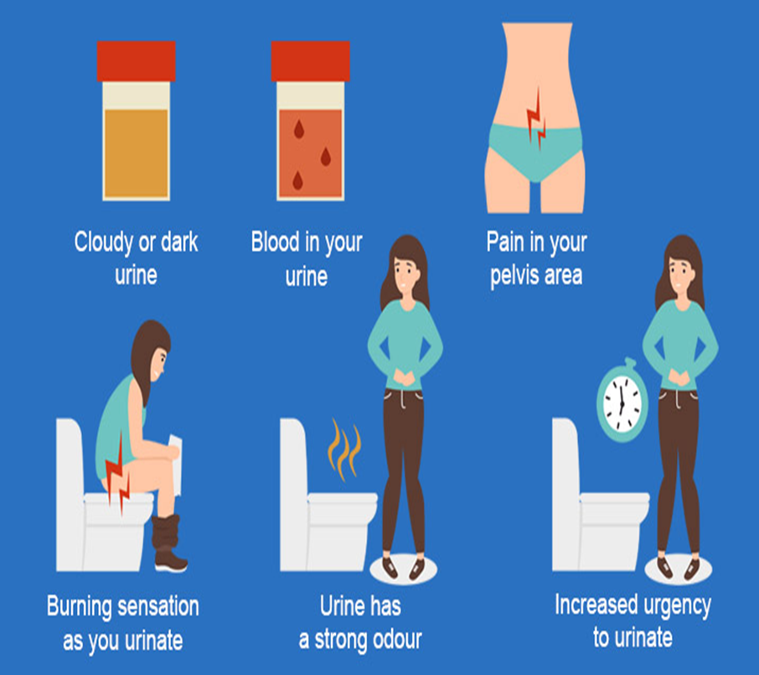
**Clinical Features
Typical symptoms of cystitis and urethritis include:
abrupt onset of frequency of micturition and urgency
burning pain in the urethra during micturition (dysuria)
suprapubic pain during and after voiding
intense desire to pass more urine after micturition, due to spasm of the inflamed bladder wall (strangury)
urine that may appear cloudy and have an unpleasant odour
non-visible or visible haematuria.

Slide 6
**Clinical Features (follow)
Systemic symptoms are usually slight or may be absent, but when lower UT is infected, infection may spread causing “Acute pyelonephritis”, with these systemic symptoms:
Fever and Rigors
Vomiting
Hypotension
Guarding or tenderness
There may be indications for hospitalisation
If the patient has a suprapubic pain, pain on ejaculation and prostatic tenderness on rectal examination, these are more suggestive to “Prostatitis”.

Slide 7
**Clinical Features (follow)
Differential diagnoses to lower UT symptoms include:
Urethritis due to STDs, esp Chlamydia
Urethritis ass with reactive arthritis
Differential diagnoses to Acute pyelonephritis include:
Pyelonephrosis; Infection of kidneys and collecting system
Acute appendicitis
Diverticulitis
Cholecystitis
Salpingitis; inflammation of Fallopian tube
Ruptured ovarian cysts or ectopic pregnancy

Slide 8
**Acute Pyelonephritis
Is when kidneys get infected in a minority of UTIs
It presents as a Triad of:
Loin pain
Fever
Tenderness around kidneys
Renal pelvis is inflamed and small abscesses are evident in renal parenchyma.
Renal infection is almost caused by bacterial ascending from bladder, bacterial profile is similar to that in lower UTIs.
Bacteremia may rarely cause renal or perinephric abscesses that's usually secondary to Staphylococci infection.
Acute bacterial pyelonephritis.
A widespread inflammatory infiltrate that includes many neutrophils is seen.
Granulocyte casts (G) are forming within some dilated tubules (T).
Other tubules are scarcely visible because of the extent of the inflammation and damage

Slide 9
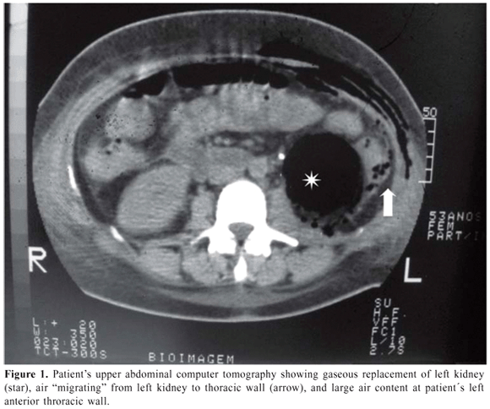
**Acute Pyelonephritis (follow)
Rarely, Acute pyelonephritis is ass with papillary necrosis.
Fragments of renal tissue are passed per urethra and may be identified histologically. They may cause ureteric obstruction -either unilateral or bilateral- that may lead to AKI.
Predisposing factors include;
DM
Chronic urinary obstruction
Analgesic nephropathy; renal injury from analgesic medications
Sickle cell disease
“Emphysematous Pyelonephritis”: Is a necrotising form of pyelonephritis with gas formation, is seen with DM (See CT besides)

Slide 10
**Acute Pyelonephritis (follow)
“Xanthogranulomatous Pyelonephritis”: Is a chronic infection of kidney that can resemble renal cell cancer
Usually ass with obstruction
Characterized by accumulation of foamy macrophages and generally requires nephrectomy.
Infection of cysts with PKD calls for prolonged antibiotic treatment
Investigations and treatment:
Are similar to those in UTIs
IV rehydration may be needed in severe cases
If complicated infection is suspected OR response to treatment is not prompt, there should be:
Urine re-culture
Renal tract ultrasound should be performed in order to exclude UT obstruction and perinephric collection
If obstruction is presented, drainage should be performed by Percutaneous nephrostomy or ureteric stent
A characteristic feature of acute pyelonephritis on microscopic urinalysis is the presence of WBC's casts

Slide 11
**Acute Pyelonephritis (follow)
Xanthogranulomatous Pyelonephritis
The cut surface of this swollen kidney reveals many small yellowish microabscesses involving cortex and medulla
Ascending urinary tract infection leading to acute pyelonephritis is more common than the hematogenous route

Slide 12
**Acute Pyelonephritis (follow)
A characteristic feature of acute pyelonephritis on microscopic urinalysis is the presence of white blood cell casts
Findings on dipstick urinalysis
include a positive leukocyte esterase and a positive nitrite test

Slide 13
**Asymptomatic Bacteriuria
When more than 10⁵ organism/mL in the urine are found in apparently healthy individuals.
It affects:
1% of children less than 1 year
1% of school girls
0.03% of schoolboys and men
3% of non-pregnant adult women
5% of pregnant women
Is increasingly common in those above 65 years of age
Treatment is not indicated generally and there's no evidence that it may cause renal scarring
Up to 30% will develop a symptomatic infection within a year
Treatment is required in infants, pregnant women and those with UT abnormalities

Slide 14
**Catheter-related Bacteriuria
In patients with urinary catheter, bacteriuria increases risk of Gram (-ive) bacteremia Five-folds.
Bacteriuria is common and almost universal during long-term catheterisation.
Treatment is usually avoided in asymptomatic patients as it may promote antibiotic resistance.
Careful sterile insertion techniques are important and the catheter should be removed as soon as it's not required.

Slide 16
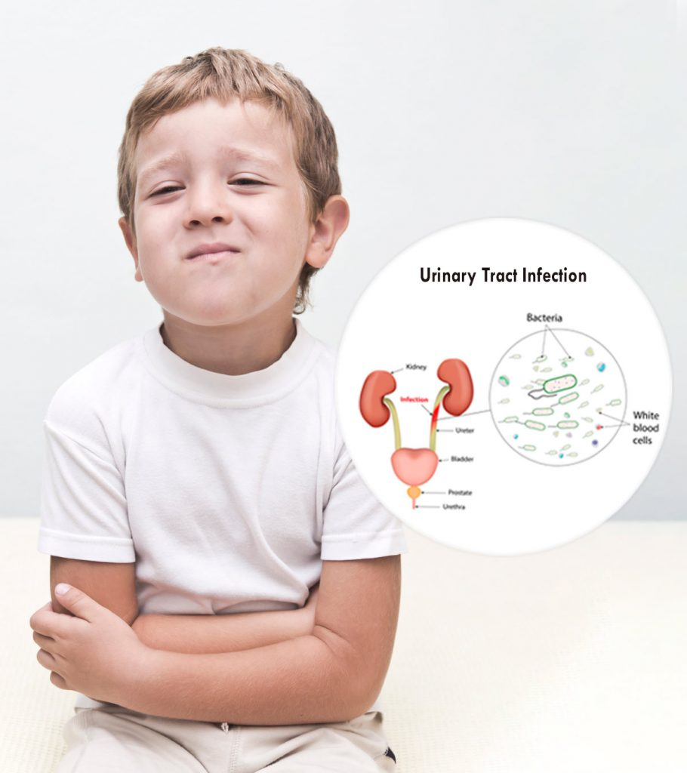
**Urinary infection in children

Slide 17
**Women with uncomplicated cystitis( most common
Are sexually active. Sexual intercourse can result in bacteria being pushed into the urethra.
Use certain types of birth control. Women who use diaphragms are at increased risk of a UTI. Diaphragms that contain spermicidal agents further increase your risk.
Are pregnant. Hormonal changes during pregnancy may increase the risk of a bladder infection.
Have experienced menopause. Altered hormone levels in postmenopausal women are often associated with UTIs.
Prolonged use of bladder catheters. These tubes may be needed in people with chronic illnesses or in older adults.

Slide 18
**Women with uncomplicated cystitis( most common)

Slide 19
**Women with recurrent cystitis
Recurrent cystitis is usually defined as three episodes of urinary tract infection (UTI) in the previous 12 months, or two episodes in the previous six months.
How can I stop recurring cystitis?
Cranberry products (juice or capsules) seem to significantly reduce the recurrence of symptomatic cystitis.
continuous antibiotic prophylaxis.
oestrogen (topical) in postmenopausal women; passing urine after intercourse

Slide 20
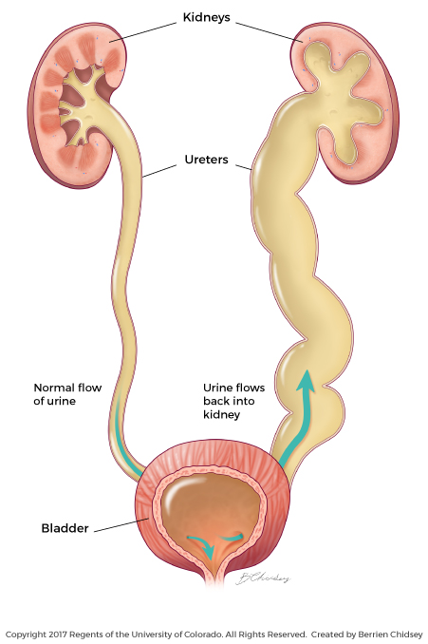
**Complicated urinary tract infection
An obstructive uropathy of any aetiology, e.g. bladder outlet obstruction (including neurogenic urinary bladder), stones and tumour
Vesicoureteric reflux or other functional abnormalities
Renal insufficiency and transplantation, diabetes mellitus and immunodeficiency
PROSTATITIS

Slide 21
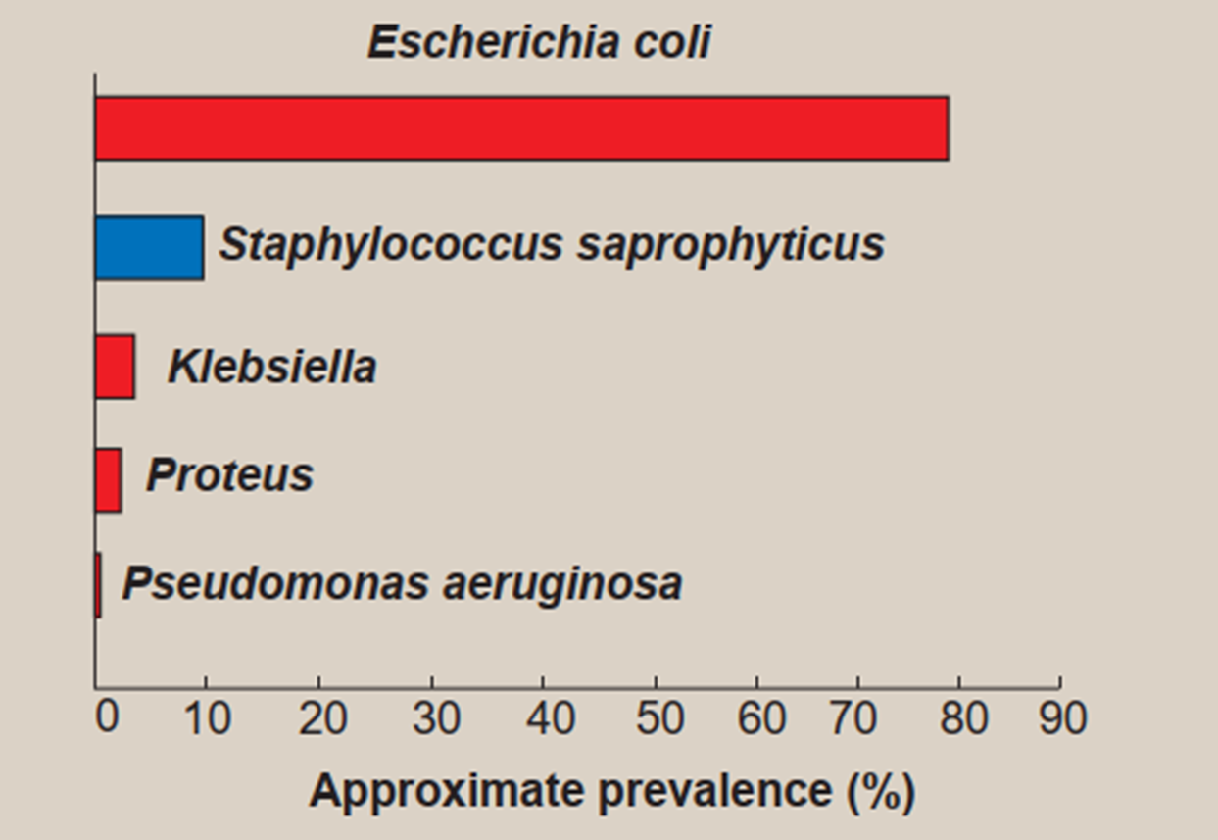

Slide 22
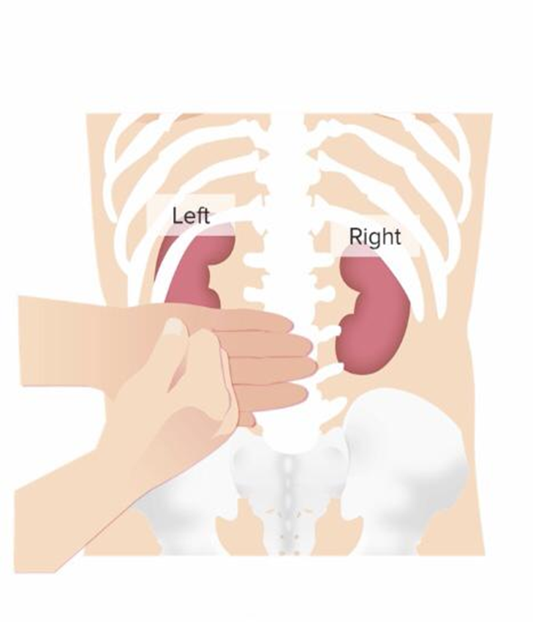
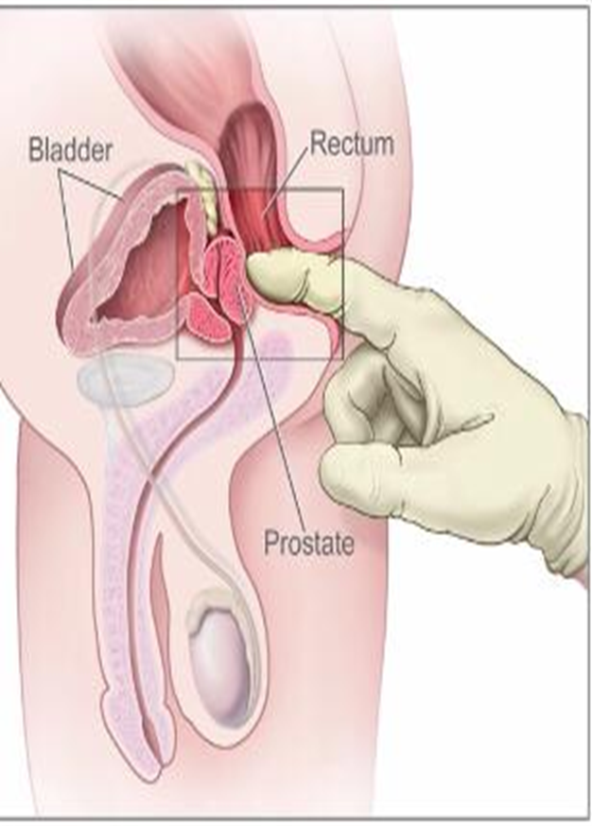
**DIGNOSIS OF UTI (physical exam)
Costovertebral angle tenderness ,abdominal and suprapubic tenderness.
Digital rectal exam to evaluate for edematous prostate in prostatitis

Slide 23
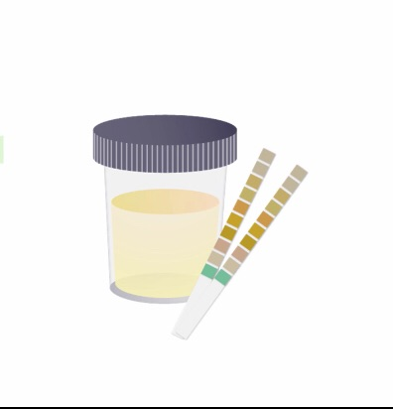
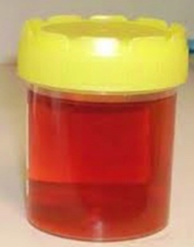
**Urine analysis (microscopic)
WBC(pyuria) indicates inflamation/infection
WBC cast indicates inflamation in kidney
RBC ( hematuria ) indicates inflamation in bladder
Nitrites refer to presence gram negative bacteria ( ESCHERICHIA COLI )
Lecocyte esterase refer to WBS in urine

Slide 24
**URINE CULTURE
Urine culture is mandatory in the followings:
Patients with recurrent UTIs or after failure of initial treatment
During pregnancy
Patients susceptible to serious infections such as immunocompromised patients
Patients with DM
Indwelling catheter
Old people

Slide 25
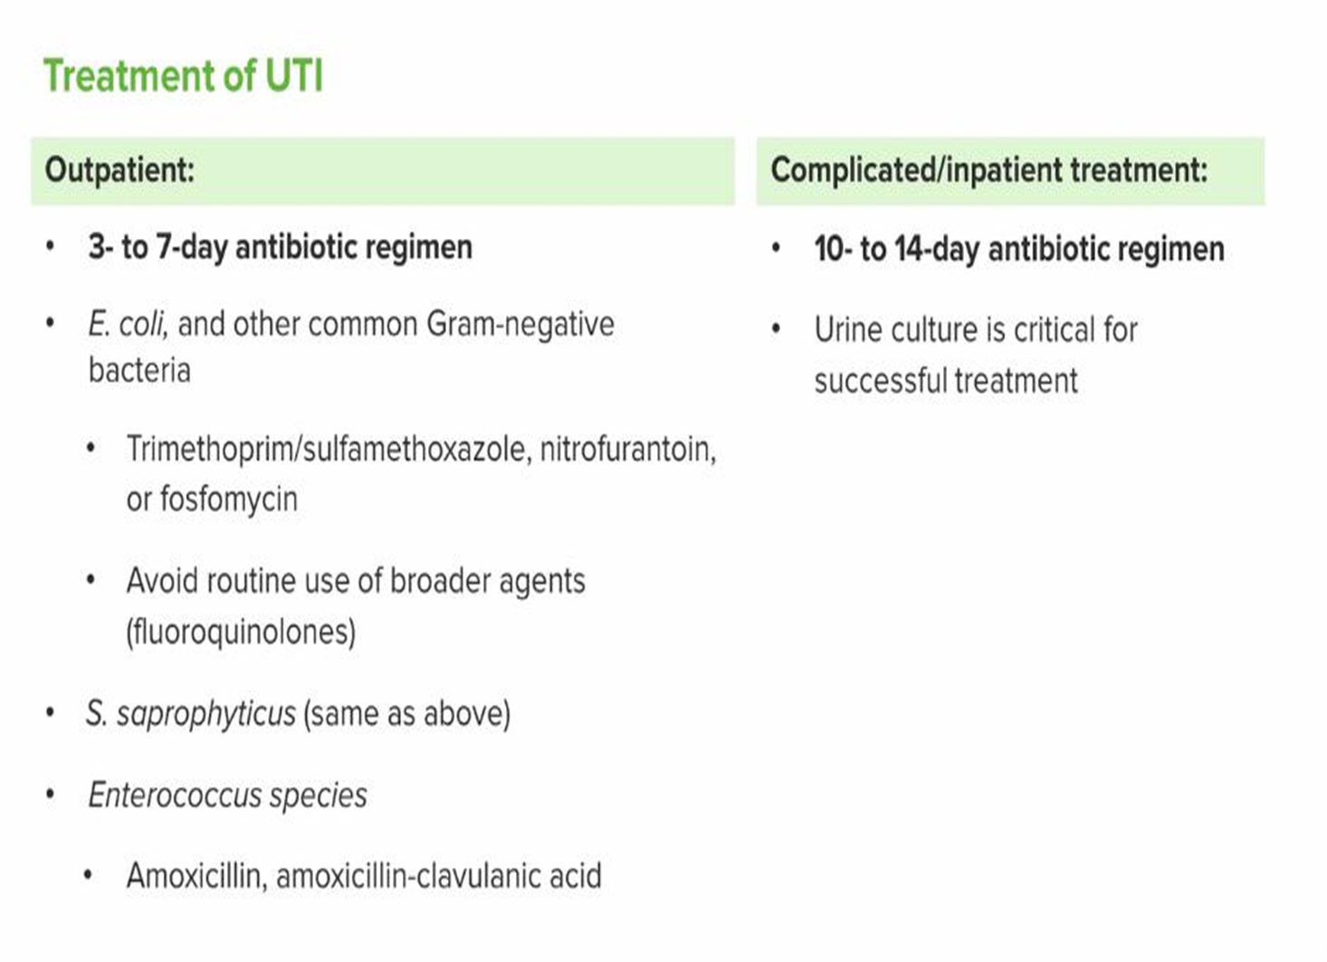
Penicillin and Cephalosporins Are safe to use in pregnancy
A fluid intake of 2L/day is recommended !!!!!!!!

