Slide 1
SHORT STATURE
SUPERVISED BY:
DOCTOR RANDA ALQAISI
PRESENTED BY:
WALAA MAHARMAH
YOUSEF HIJAZEEN
MOUTAZ DAHAMSHEH
SAJA ABUISSA

Slide 2
GROWTH
an increase in physical size of the whole body or any of its parts.
It is simply a quantitative change in the child's body.
A normal growth pattern is good evidence of overall health , it is pulsatile in nature and it is the final common pathway of many factors including : birth size , general well being , endocrine and environmental factors .
Factors affecting growth? (Follow the Infantile childhood (ICP) puberty growth model:
Infantile phase : depends on nutrition , genetic potential and intrauterine growth.
Childhood phase ‘4-10’ years : Depends on growth hormone , thyroxine and general well-being .
Pubertal phase : depends mainly in Sex steroid androgens and growth hormone .

Slide 3
Definitions
Growth velocity , the change in weight or height over time.
Height velocity : we need a period of al least 6 months to calculate it .
Chronological age: Actual age of the child
Height age: it’s the age at which the height of the child is at 50th centile.
Bone age: is an indicator of skeletal maturation

Slide 4
Short stature
Is a height that is 2 standard deviations (SD) or more below the mean height for individuals of the same sex and chronologic age in a given population or less than 3rd percentile.
The most common causes of short stature beyond the first year or two of life are familial (genetic) short stature and constitutional short stature (also known as constitutional delay of growth and puberty), which are normal nonpathological variants of growth.
Short Stature Vs F.T.T .
Failure to thrive is associated with greater impairment in weight gain than linear growth (resulting in a reduced weight for height ratio). Although failure to thrive may be associated with short stature or slow growth velocity, it primarily represents an inability to gain weight appropriately .
Can be classified :
Normal variants of Growth ( non pathology) Vs pathological
Proportionate Vs Disproportionate

Slide 5
Pediatric growth parameters :
1- Linear growth :
< 2 years: supine length with measuring board
≥ 2 years: standing height with stadiometer
Infants grow 25 cm/year in the first year of life.
Length increases ∼ 30% by 5 months and∼ 50% by one year.
''Nelson-Wheech formula''is used to calculate the Expected height = (6X+77) cm, X = age in years. (for children aged 2-12 y)

Slide 6
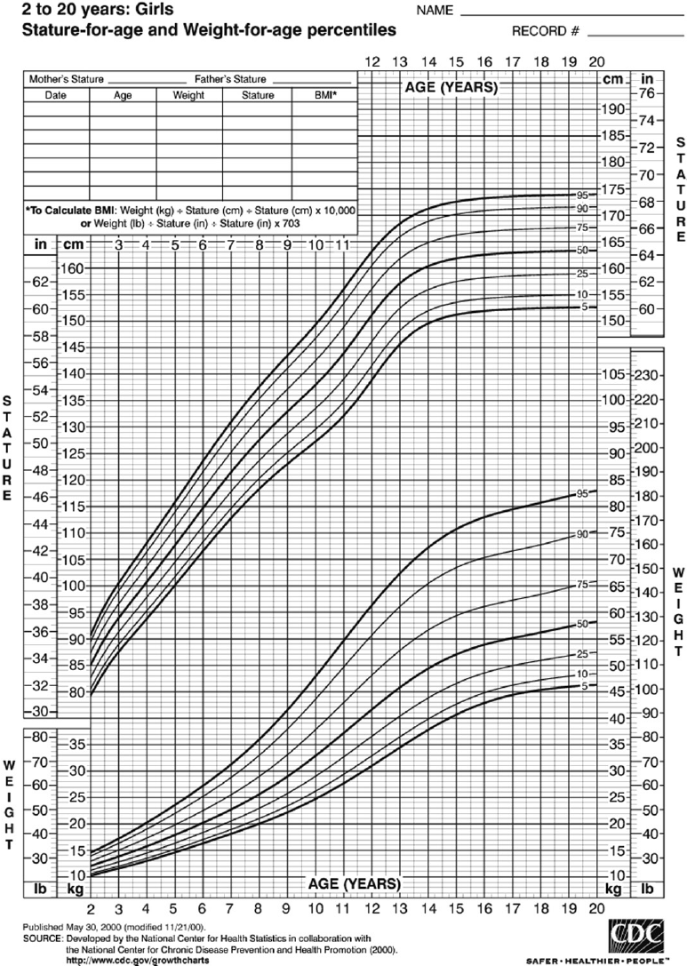
*Normal birth length 50cm
*Expected growth
1st year +25cm = 75cm
2nd year +12cm = 87cm
3rd year +6cm=93cm
*Doubling at 4 years = 100cm
*Children grow (5cm per year) between age four years and puberty.
*Tripling at 13 years =150 cm .

Slide 7
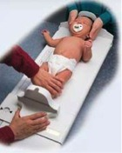
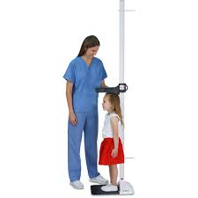
Accurate height measurement
Below 2 yrs supine length with infantometer ( measuring table ).
For older children Harpenden Stadiometer
child should be looking straight up, with the trunk and pelvis aligned with the measuring device.
*Without footwear
*back of Heels & back touching the wall .
*straight neck and Looking straight ahead.

Slide 8
2- Weight-for-age measurement :
Normal birth weight: 2.4-4.2 kg , doubles by 4 months, triples by 1 year, and quadruples by 2 years of age.
< 2 SDs below the mean: failure to thrive.
3- Head circumference-for-age :
Infants and children ≤ 3 years.
Measure the fronto-occipital-circumference (FOC) at the widest possible spot.
< 2 SDs below the mean: microcephaly.
> 2 SDs above the mean: macrocephaly.

Slide 9
Assessment of body proportion
*Upper segment (US) total height/length – LS.
*Lower segment (LS) pubic symphysis to ground.
*US to LS ratio is 1.7 at birth decreases by 0.1 every year to reach 1.3 at 3 years and 1 at (7_10) years of age.
Proportionate short stature : Normal upper to lower body segment ratio .
Limbs proportionate to trunk.
Seen in most cases of familial short stature.
Disproportionate short stature : (Abnormal upper to lower body segment ratio)
Limbs disproportionately short compared to trunk.
Seen mostly in cases of skeletal dysplasia.

Slide 10
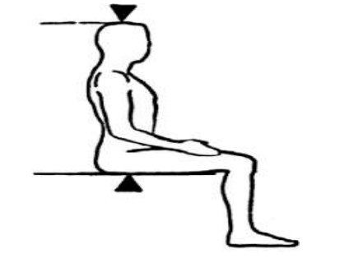
How to measure upper and lower segments?
You should measure the upper segment( US ) then by using the total height you will obtain LS. Upper segment is the sitting height.
Upper segment: Lower segment ratio
Decreased
Short trunk (scoliosis)
Increase
Achondroplasia
Skeletal dyspalsias
untreated hypothyroidism
Short neck (Turner syndrome)
Arachnodactyly (Marfan’s syndrome )

Slide 11
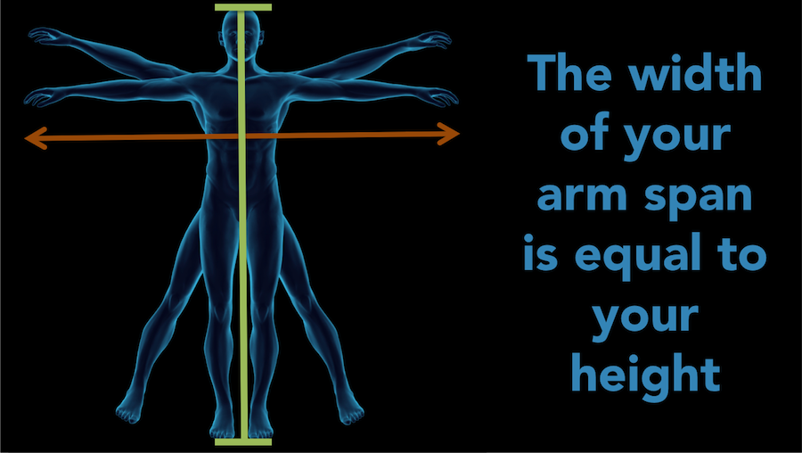

Slide 12
5- Mid- parental height
Comparison with child’s own genetic potential.
Then plot the result on Growth Chart at Age 20 to form Family chart ±8.5cm.
Mid parental height for boys=
(mother’s height + father’s height +13) / 2.
Mid parental height for girls=
(mother’s height + father’s height -13)/2.

Slide 13
3 years old girl ht=85cm wt=10kg father ht=165cm mother ht=155cm is she short? MPH?

Slide 15
Pediatric growth patterns
Normal pediatric growth
Proportionate growth parameters.
Growth parameters that follow closely to a percentile curve .
Expected height within 2 standard deviations (i.e., 8.5cm ) of the mid-parental height.
Abnormal pediatric growth
Values that deviate ≥ 2 standard deviations from the mean, i.e. < 3% or > 97% percentiles.
Crossing ≥ 2 major percentile lines on the growth curve.
(Children < 2–3 years may cross major percentiles, but after this time should track consistently).
Deviating > 8.5 cm from the mid-parental height.
Disproportionate parameters.

Slide 16
5y girl ht=105 cm wt=17 kg is she short?

Slide 18
6- Growth Velocity
The change in growth over time and its the most critical factor in evaluating the growth.
Calculate growth velocity as the change in standing height over at least 6 months (in children) or in length over at least 4 months (in infants).
Observation of child's height pattern in the form of “CROSSING PERCENTILE LINES” on a linear growth curve is the simplest method of observing abnormal growth velocity.

Slide 19
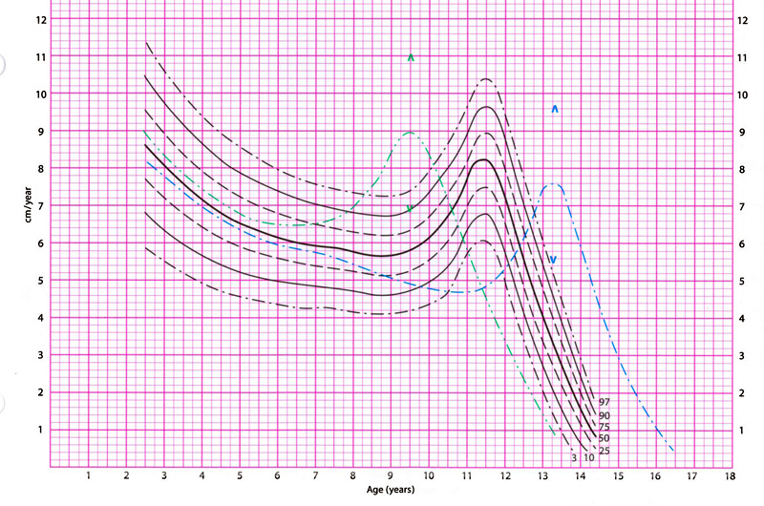

Slide 20
Normal Growth Velocity by Age
AGE | GROWTH VELOCITY PER YEAR
Birth to 12 months | 23 to 27 cm
12 months to 1 year | 10 to 14 cm
2 to 3 years | 8 cm
3 to 5 years | 7 cm
5 years to puberty | 5 to 6 cm
Puberty | Girls: 8 to 12 cm
 | Boys: 10 to 14 cm

Slide 21
Watch GV
Normal growth velocity
Low birth weight
Growth delay
Idiopathic SS
Low growth velocity
Chronic systemic disease
Endocrine disorder
Genetic, chromosomal Psychosocial
Not Within Range
Calculate the height
Within Range
Observe – GV Normal

Slide 22
Normal variants of Growth
Short children with normal height velocity without a pathological causes , including:
1. Familial short stature
2. Constitutional delay of growth and puberty
3. Idiopathic short stature
4. small for gestational age infants with catchup growth

Slide 23
Familial short stature
Individuals with familial short stature usually have low-normal height velocity throughout life.
Their bone age is consistent with their chronologic age, which helps distinguish them from children with constitutional delay of growth.
Constitutional delay
Severe Constitutional Delay may be difficult to differentiate from growth hormone deficiency, and stimulation testing with growth hormone secretagogues + priming dose of sex steroid androgens.
Results in childhood short stature but relatively normal adult height.
For these children and adolescents, height data should be interpreted according to bone age rather than chronologic age to accurately reflect height potential. Because the bone age is delayed, growth typically continues longer than normal.
In addition to a low preadolescent height velocity , they tend to have delayed pubertal maturation , but is followed by catch-up growth when they do enter puberty.

Slide 25
Genetic causes:(syndromes with dysmorphic features)

Slide 26
Turner syndrome
Turner syndrome is an important consideration in girls with short stature and especially growth failure, because shortness may be the presenting feature of the syndrome.
Virtually all girls with Turner syndrome have short stature, with an average adult height about 20 cm shorter than predicted by the mid-parental height.
In addition, affected patients usually have absent or very delayed pubertal development and may have a square "shield" chest, webbed neck, cubitus valgus, genu valgum , shortened fourth metacarpals, and Madelung deformity of the forearm .
Prompt diagnosis of Turner Syndrome is important because of associated cardiovascular, renal, and endocrine abnormalities, which may require treatment, including growth hormone therapy.

Slide 27
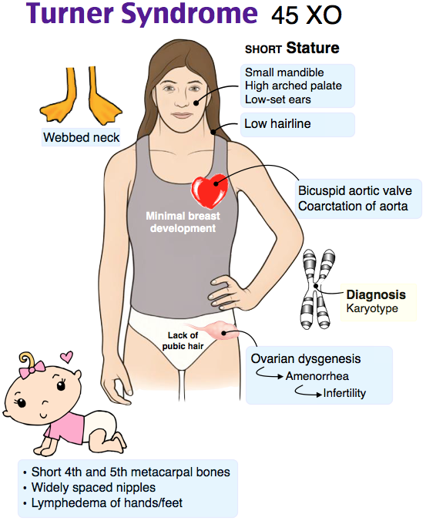

Slide 28
NOONAN SYNDROME
is a relatively common autosomal dominant disorder that is associated with short stature and congenital heart disease, most often pulmonic stenosis.
▪ It is clinically and genetically heterogeneous and can present at any age. The most consistent clinical features are widely spaced eyes (hypertelorism) and low-set ears, short stature, and pulmonic stenosis.
▪ Short stature associated with Noonan syndrome can be treated effectively with growth hormone

Slide 30
Prader-Willi syndrome
Prader-Willi syndrome (PWS) is the most common syndromic form of obesity. caused by a loss of function of specific genes on chromosome 15. Obesity and hyperphagia typically develop during early childhood and can be severe. Other common clinical characteristics are hypotonia and feeding problems during infancy, developmental delay, and hypogonadism.
Short stature is common but may not develop until late childhood when the child fails to undergo a pubertal growth spurt.
Treatment with growth hormone improves linear growth and body composition.

Slide 32
SHOX GENE VARIANTS
SHOX (short stature homeobox)-containing gene on the X chromosome cause a syndrome in which the primary manifestation is short stature, which tends to be more severe in girls
▪ In addition to short stature, individuals with this variant tend to have shorter forearms and lower legs (with reductions in arm span and leg length compared with trunk), Madelung deformity of the forearm (focal dysplasia of the distal radial physis), cubitus valgus (increased carrying angle of the arm) .
▪ These skeletal abnormalities are similar to those seen in many patients with Turner syndrome

Slide 34
SILVER RUSSELL SYNDROME
The syndrome is associated with epigenetic alterations involving either hypomethylation of an imprinting control region that regulates expression of the insulin-like growth factor 2 (IGF-2) gene or others on chromosome 11p15.5. IGF-2 is known to have important effects on growth, especially during fetal development

Slide 36
Laurence Moon Bardet Biedl Syndrome
is a disorder with an identified pentad of symptoms: which are obesity, hypogonadism, intellectual impairment, polydactyly and retinitis pigmentosa

Slide 38
Achondroplasia
Autosomal dominant inheritance, Mutation in FGFR3.
Champagne glass pelvis.
Hand abnormality.
Obesity.
Neurologic problems.
Delayed motor milestones.
Recognized at birth.
Bowing of legs.
Proximal limb shortening.
Large head.
Short stature.
Intervertebral distance decreases.

Slide 42
Systemic disorders with secondary effects on growth

Slide 43
Under-nutrition
The hallmark of under-nutrition is low weight-for-height
Notes:
Insufficient nutrition tends to lead to short stature with a delayed pattern of growth.
Under-nutrition can be isolated ( caused by inadequate food supply or self-imposed restriction, such as fear of obesity), or it may be a component of an underlying systemic disease that interferes with food intake or absorption, or increases energy needs.

Slide 44
Glucocorticoid therapy
Since glucocorticoids are used for treatment of a variety of diseases, they are a common cause of growth failure in children.
The growth effects of glucocorticoids are related to the type, dose, and duration of the exposure. If glucocorticoids are discontinued, children usually experience some catchup growth.
Growth impairment is more pronounced with agents with a longer duration of action (dexamethasone > prednisone > hydrocortisone) and progressive growth impairment is seen with increasing doses
Notes:
They suppress growth through several different mechanisms, including interference with endogenous growth hormone secretion and action, bone formation, nitrogen retention, and collagen formation
Cushing syndrome is caused by excessive glucocorticoids and is characterized by the combination of weight gain and growth retardation, resulting in excessive weight-for-height
The best tests to establish the diagnosis are a 24-hour urine collection for free cortisol (and creatinine), or a dexamethasone suppression test. Measurements of serum cortisol are not reliable screening tests, unless performed late at night

Slide 45
Gastrointestinal disease
Children with growth failure resulting from gastrointestinal disease tend to have a greater deficit in weight than height (ie, they are underweight-for-height) in contrast to those with endocrine disorders, who are often overweight-for-height .
Short stature can be the only symptom of celiac disease , so short children should be tested for celiac even if they have no GI symptoms.
IBD also associated with short stature.The growth failure is closely related to the inflammatory disease process, as well as decreased food intake, malabsorption, and/or high-dose glucocorticoids if used for treatment

Slide 46
Rheumatologic disease
Childhood rheumatologic diseases, especially systemic juvenile idiopathic arthritis (JIA), are frequently associated with growth retardation .
This may be a consequence of the proinflammatory cytokines associated with disease activity and is also caused by the high-dose glucocorticoids that are often used for treatment
Common presenting symptoms in JIA are fever, arthralgias, rash, and lymphadenopathy, in addition to growth failure.

Slide 47
Chronic kidney disease
Growth failure is seen in at least one-third of children with chronic kidney disease.
Affected patients are candidates for growth hormone therapy until renal transplantation, and some of these patients may also benefit from growth hormone therapy after transplantation.
Notes:
The primary causes of growth failure in children with chronic kidney disease are disturbances of growth hormone metabolism and its main mediator, insulin-like growth factor-I (IGF-I).
Other factors may include metabolic acidosis, uremia, poor nutrition secondary to dietary restrictions, anorexia of chronic illness, anemia, calcium and phosphorus imbalance, or use of high-dose glucocorticoids if used for treatment.
Metabolic acidosis alone can also impair growth, as occurs in children with renal tubular acidosis. Alkali therapy may lead to maintenance of normal stature

Slide 48
Cancer
Children with cancer may grow poorly before diagnosis because of poor food intake, nausea, vomiting, and increased caloric utilization.
After diagnosis, anorexia, nausea, and vomiting induced by chemotherapy and radiotherapy also can contribute to impaired growth. These effects often subside within one to two years of initiating treatment, and some children then have catch-up growth
Notes:
Late growth failure is common in children who received cranial radiotherapy because it can damage the hypothalamus and cause insufficiency of one or more hormones from the pituitary, including growth hormone, gonadotropins, and thyroid stimulating hormone (TSH) .
In younger children, especially girls, cranial radiotherapy can cause precocious puberty and adult short stature. Primary hypothyroidism also can occur if the thyroid gland was in the radiation field.
Spinal irradiation may result in slow growth of the spine with relative preservation of normal limb growth

Slide 49
Pulmonary disease
Cystic fibrosis is both a pulmonary and gastrointestinal disease. Growth failure in children with this disorder may be caused by multiple mechanisms, including poor food intake, maldigestion or malabsorption, chronic infection, and increased energy requirements (work of breathing)
Asthma has been associated with a deceleration of height velocity, which is most pronounced with severe disease. Growth failure in children with asthma is usually due to treatment with glucocorticoids, including inhaled glucocorticoids

Slide 50
Cardiac disease
Growth failure is common in children with severe heart disease of any cause. The major pathogenetic factors are thought to be anorexia and increased basal energy requirements . Occasionally, growth failure is the presenting feature of the heart disease.

Slide 51
Metabolic diseases
children with diabetes and very poor glycemic control develop Mauriac syndrome, characterized by attenuated linear growth, and delayed puberty, hepatomegaly, and Cushingoid features.
Any disorder associated with vitamin D deficiency or decreased vitamin D action can cause hypophosphatemia and rickets
rickets is characterized by abnormal epiphyseal development, bowing of the extremities, and diminished growth.
Vitamin D deficiency in the absence of rickets does not seem to affect linear growth.

Slide 52
Endocrine causes of growth failure

Slide 53
Primary endocrine disorders with effects on growth are uncommon but are important to identify because they can be treated . In general, these disorders are characterized by excessive weight for height. They should be considered in any child with markedly reduced height velocity, and especially in those with other pituitary disorders, brain tumors, optic nerve hypoplasia , midline brain and facial defects, neonatal hypoglycemia, history of cranial irradiation, or a familial pattern of growth hormone deficiency. Any patient with an abnormality of one pituitary hormone (central hypothyroidism, Cushing disease, or growth hormone deficiency) should be evaluated for other pituitary hormone deficiencies.

Slide 54
Cushing syndrome
Cushing syndrome is caused by excessive glucocorticoids and is characterized by the combination of weight gain and growth retardation, resulting in excessive weight-for-height
Endogenous Cushing syndrome (caused by excessive endogenous production of cortisol) is rare in children. The most common cause is a corticotropin (ACTH)-secreting pituitary adenoma (Cushing disease) .
key clinical features are central obesity, suprascapular fat pad ("buffalo hump"), abdominal striae, hirsutism, acne, and neuropsychological symptoms
. The best tests to establish the diagnosis are a 24-hour urine collection for free cortisol (and creatinine), or a dexamethasone suppression test. Measurements of serum cortisol are not reliable screening tests, unless performed late at night.
Notes:
Exogenous sources of glucocorticoids (eg, due to glucocorticoid therapy for asthma or inflammatory bowel disease) are a much more common cause of Cushing syndrome

Slide 55
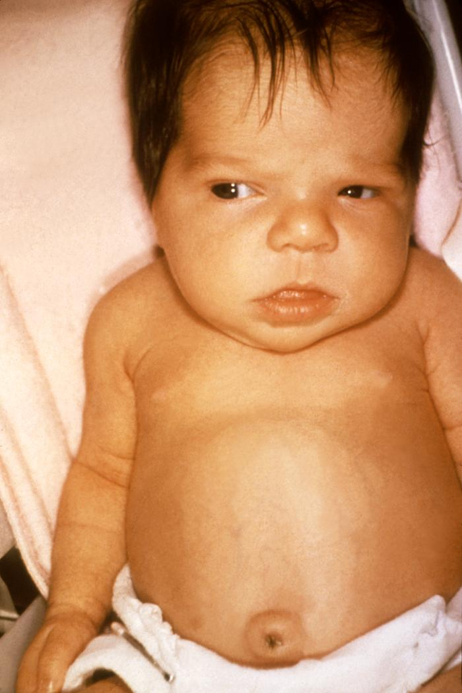
Hypothyroidism
Growth failure is a well-recognized consequence of hypothyroidism during childhood and may be the presenting feature. The bone age is delayed; as a result, many children with hypothyroidism have a reasonably normal growth potential once the disorder is identified and treated. Children whose hypothyroidism is promptly diagnosed and treated often have good catch-up growth and normal adult height outcomes, unless they have other causes for short stature. The evaluation should include measurements of both TSH and free thyroxine to allow detection of both primary and central hypothyroidism.

Slide 56
Sexual precocity
Several conditions are associated with increased secretion of gonadal steroids (estradiol in girls and testosterone in boys), which have two consequences. One is sexual precocity. The other is accelerated epiphyseal maturation, which causes rapid childhood growth but more rapid advancement of bone age. Without intervention, these initially tall children will be short adults because early epiphyseal closure stops linear growth prematurely

Slide 57
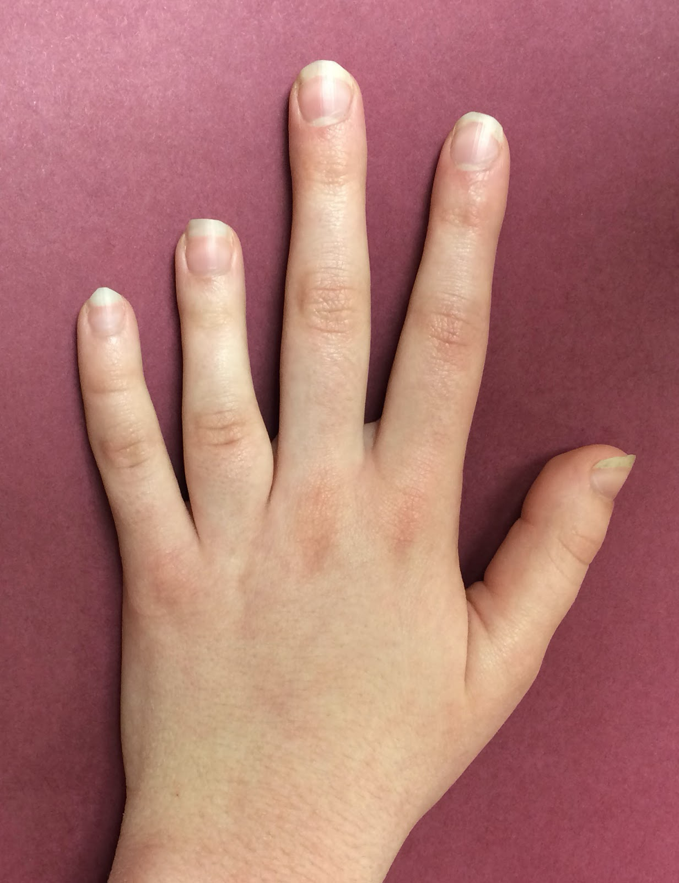
Pseudohypoparathyroidism
Type 1 pseudohypoparathyroidism (hypoCa & hyperphosphatemia) is characterized by physical findings that may include brachydactyly (short 4th and 5th metacarpals), short stature, stocky build, early-onset obesity, ectopic ossifications, and, sometimes, neurodevelopmental deficits as well as resistance to parathyroid hormone(high)

Slide 58
Physiology of Growth Hormone
Growth hormone (GH), the most abundant anterior pituitary hormone, is produced by the pituitary somatotroph cells. GH production begins early in fetal life and continues throughout childhood and adult life, although at a progressively lower rate in the latter.
GH secretion is directly controlled by hypothalamic and peripheral factors acting on the somatotrophs. Hypothalamic growth hormone-releasing hormone (GHRH) and somatostatin (SRIH) stimulate and inhibit GH secretion, respectively. These hormones act by binding to specific cell-surface receptors on the somatotroph cells. GHRH stimulates GH transcription and secretion, and also somatotroph proliferation

Slide 59
Daily GH secretory rates decline from a peak during puberty then start to decline; this decline parallels the age related decline in muscle mass. GH secretion is also lower in obese subjects.
GH secretion is pulsatile. There are approximately 10 pulses of GH secretion per day, lasting approximately 90 minutes and separated by approximately 128 minutes. Thus, approximately 50 percent of samples collected during the day in normal subjects have undetectable serum GH concentrations.
The predominant action of GH is to stimulate hepatic synthesis and secretion of insulin-like growth factor 1 (IGF-1), a potent growth and differentiation factor. As a differentiating and growth factor, IGF-1 is a critical protein induced by GH and is likely responsible for most of the growth-promoting activities of GH.

Slide 64
Growth hormone deficiency
Growth hormone deficiency usually results from deficiency of growth hormone-releasing hormone (GHRH). It can also be caused by sellar and parasellar tumors (craniopharyngioma ) that destroy the pituitary gland itself, in which case there may be deficiencies of multiple hormones produced by the anterior pituitary .
Children with growth hormone deficiency can have striking catch-up growth during growth hormone replacement therapy .
Children with a sellar or parasellar tumor that causes growth hormone deficiency occasionally experience rapid catch-up growth after surgical resection of the tumor without growth hormone treatment; this phenomenon is known as "growth without growth hormone" and is not fully understood .

Slide 65
If growth hormone deficiency is congenital and complete, the diagnosis is relatively easy to confirm.
Affected children present with severe postnatal growth failure, delayed bone age, and very low serum concentrations of growth hormone, IGF-I, and IGF-binding protein-3 .
Additional findings are hypoglycemia, prolonged jaundice, and micropenis, especially if gonadotropins are deficient as well

Slide 66
MRI images showing the normal pituitary gland (solid white arrow) and a pituitary tumor (dashed white arrow). The optic chiasm (where the optic nerves meet) is shown by the green arrows and is pushed up by the pituitary tumor.

Slide 67
craniopharyngioma

Slide 68
Growth hormone receptor mutations (Laron syndrome)
congenital disorder characterized by marked short stature associated with normal or high serum growth hormone (GH) and low serum insulin-like growth factor-1 (IGF-I) levels which fail to rise after exogenous GH administration
Other clinical features of Laron syndrome include small head circumference, characteristic facies with saddle nose and prominent forehead, delayed skeletal maturation, small genitalia and testes, short limb length compared with trunk length, and abnormal body composition, with osteopenia and obesity
Patients with Laron syndrome also have metabolic abnormalities including hyperlipidemia and episodes of hypoglycemia, especially during infancy
Patients have near immunity to cancer and diabetes
Notes:
Ttx biosynthetic IGF-1 before puberty

Slide 70
How to approach

Slide 71
Approach to a child with short stature
1- History
2-Physical examination : (Anthropometric measurements and Plotting on growth chart)
3- Investigations
4- Manegment

Slide 72
History
1- Birth history 2- Nutritional history 3- Family history 4- Drugs (steroids) 5- Medical Hx (Chronic diseases) 6- Perinatal Hx 7- Systemic review→ to exclude chronic infections and chronic illnesses

Slide 73
Perinatal
Infections, placental insufficiency, poor nutrition, and medication side effect can impair fetal growth and development.
Nutritional
Malnutrition is the most common cause of poor growth world wide : a detailed history of quality and quantity of nutrition is needed in the evaluation of abnormal growth
Family
Father's height and age during pubertal growth spurt
birth measurements reflect intrauterine conditions.
may point to specific pathologies
(hypopituitarism,hypothyroidism)
a 24-hour food recall or three-day food diary for evaluation.
Ask about nutrition (problems with feeding, appetite, special diets or any other indication of inadequate nutrition)
mother's height and age at menarche
heights of siblings
medical conditions of family members.
The heights of parents determine the heights of their children; most children also follow their parents

Slide 74
GIT |  | Chronic diarrhea, abdominal pain and GITbleeding | IBD
 |  | Diarrhea, weight loss and abdominal distention | Coeliac disease
Respiratory |  | including severe asthma, recurrent infections | cystic fibrosis or immunodeficiency
Renal |  | Polyuria and edema/ Recurrent UTI | CKD
CNS |  | Headache, vomiting, visual problem | Pituitary/ hypothalamic Space occupying lesion .
infections |  | Recurrent infections and poor wound healing | Immunodeficiency

Slide 75
Physical Examination
Assessment of a child with short stature
1) Accurate height measurement:
▪ Height plotted on appropriate growth chart
▪ Normal Measuring
2) Height velocity : Calculate growth velocity as the change in standing height over at least6 months (in children) or in length over at least 4 months (in infants)
3) Body Proportions
▪ Lower segment (LS) ▪ Upper segment (US)
▪ Proportionate ▪ Disproportionate
4) Mid parental height (MPH)
▪ Then plot the result on Growth Chart at Age 20 to form Family chart ±10
5) Exam the whole body

Slide 76
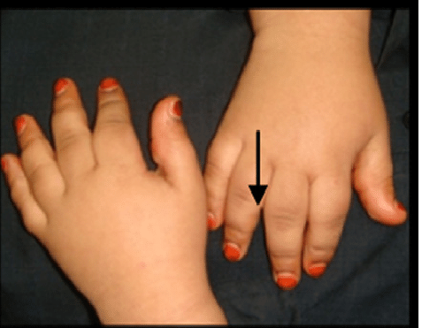
hands and feet examination
Short 4th and 5th metacarpal : Turner.
Trident hand : achondroplasia.
Asymmetry : Russell silver syndrome

Slide 77
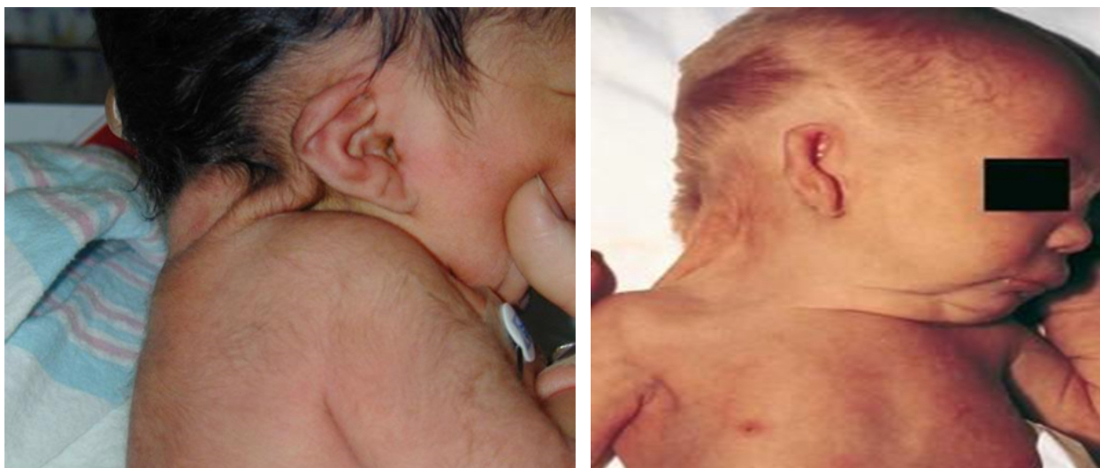
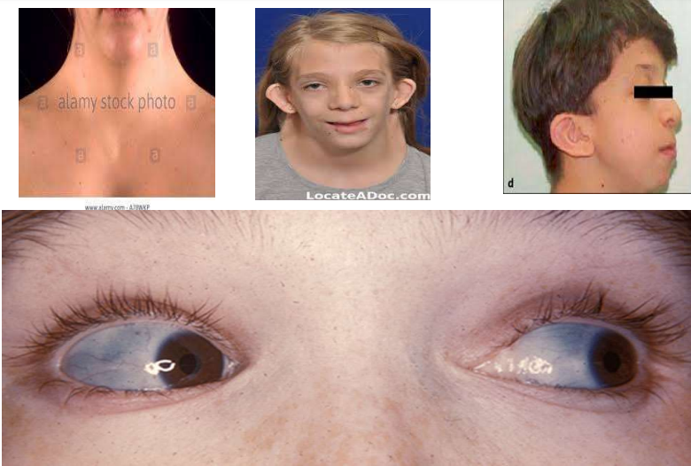
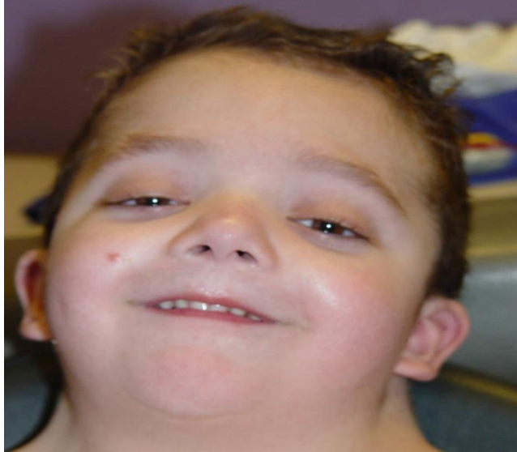
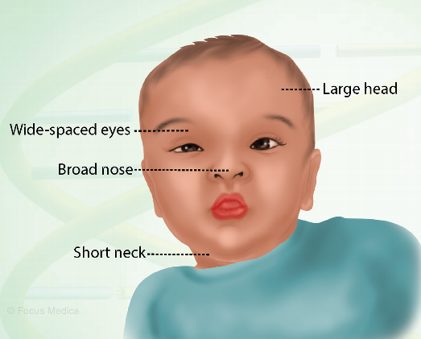
Head and neck examination
Turner : short webbed neck , Low posterior hair line .
osteogenesis imperfecta : Blue sclera
Nonaan syndrome: short webbed neck , low set ears .

Slide 78
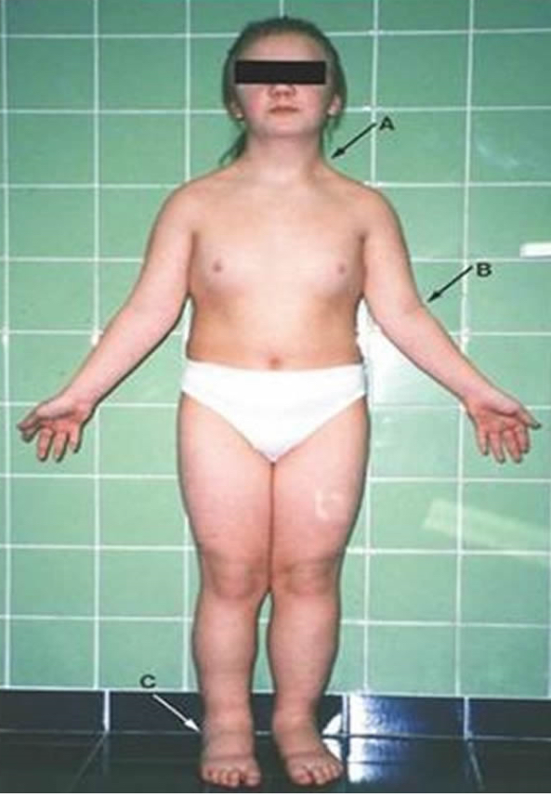
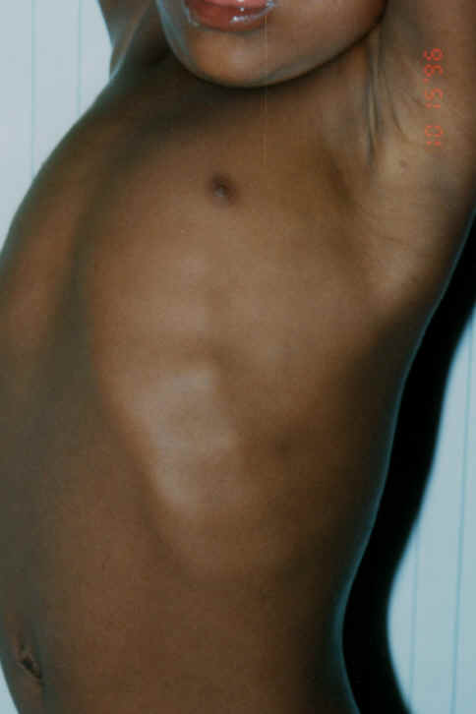
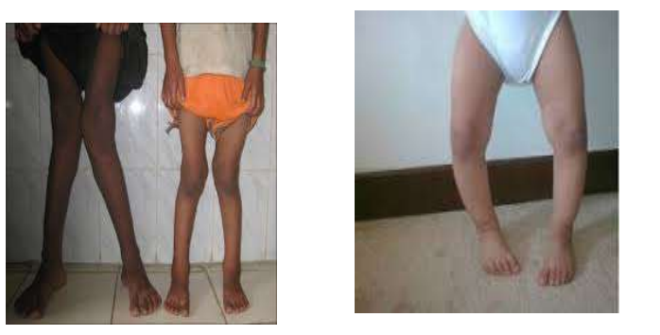
chest and abdomen
Rosary beads….. Rickets.
Wide spaced nipple….. Turner
Distended abdomen…. Coeliac.
Hepatosplenomegaly… thalassemia.
Stria……. Cushing syndrome.
lower limbs
Bow legs and other signs of rickets

Slide 79
investigation
Level 1 (essential-investigations) :
1. CBC with ESR &CRP
2. BONE AGE : The most widely used system is the Greulish-pyle Atlas method (GP method) in which a left-hand is compared by means of a sequence of radiographs grouped in the atlas according to age & gender
3. Urinalysis (Microscopy, pH, Osmolality) and Renal function tests (in case of CKD and associated renal osteodystrophy)
4. T4/ TSH . For hypothyroidism
5. Celiac screening (anti- endomysial or anti- tissue transglutaminase antibodies)Duodenal biopsy, if malabsorption was suspected)
6. LFT (chronic diseases)

Slide 80
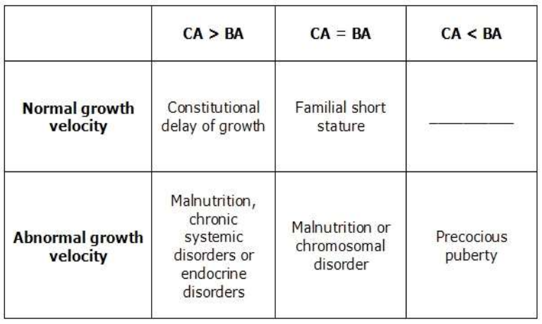
bone age
Perform anteroposterior radiography of left hand and wrist to assess bone age.
BA = bone age.
CA = chronological age

Slide 81
Level 2 :
Genetic study e.g. SHOX gene mutation→ esp. if the mother is short
2. Karyotype to rule out Turner syndrome in girls Observe height velocity for 6-12months→If height < 3SD→ level 3 investigations1.
Level 3 : GH stimulation test with Clonidine or insulin ; serum insulin like GF-1 levels

Slide 82
IGF1 and IGFBP3 measurement
IGFBP-3 and IGF-1 serum levels represent a stable and integrated measurement of GH production and tissue effects.
▪ Primary test!
▪ The combination of IGF-1 and IGFBP-3 measurements appears superior in the diagnosis of growth hormone (GH) related disorders
▪ Interpretation of results:
✓ If IGF-1 and IGBP-3 level are normal then it shows that GH level is also normal (no need for GH testing)
✓ If IGF-1 and IGBP-3 level are low then it may be due to GH def or GH resistance → Go for GH basal level and after stimulation
✓ If GH also low then GH def
✓ if GH normal or high then GH resistance (Primary IGF-1 def., Loran syndrome).

Slide 83
Provocative tests (GH stimulation tests)
▪ Random sampling of serum GH is insufficient to diagnose GHdeficiency; GH stimulation tests are required
▪ A limited number of provocative agents should be used afteran overnight fast(10-12h) without exercise in a well standardised protocol.
▪ Insulin tolerance test (ITT), Glucagon test, L-dopa test,Arginine test, Clonidine test, exercise stimulation test, sugar stimulation test
▪ Interpretation:
✓ In healthy volunteers the peak of GH levels are 10 ng/ml(20 mU/m1).
✓ If peak GH level of 10 ng/ml (20 mU/m1) is detected, itexcludes classical GHD
✓ In a classical GHD case a GH peak is not detected or GH peak is less than 3 ng/ml (6 mU/m1) in all thesetests.
✓ In partial GHD cases GH peak of 8-10 ng/ml (16-20 mU/m1) may be seen.

Slide 84
Management.
1. counselling of parents
2. treat the underlying cause
3. precautions of GH therapy (children with neoplasms)

Slide 85
growth hormone therapy
Indications :
1. GHD
2. Turner syndrome
3. Noonan syndrome
4. Prader-Willi syndrome
5. chronic renal failure (pre-transplantation)→Higher doses
7. children born small for gestational age who havenot reached 5th centile by 2yrs
.the long-term treatment of idiopathic short stature withheight 2.25 SDs or less below the mean.

Slide 86
Automated pen type

Slide 87
Side effect of RHGH replacment
Side effects of RHGH replacement therapy in children and adolescents include :
rash and pain at injection site
1. Pseudotumor Cerebri: Higher risk in GHD ‚hypothyroidism and obesity.
2. Slipped-Capital Femoral Epiphysis: Higher risk in GHD, hypothyroidism and obesity
3. Worsening of Scoliosis
4. Insulin Resistance
5. Increased Nevi
6. Pubertal Gynecomastia
7. Pancreatitis

Slide 88
THANK YOU

