Slide 1
Immunology Lab Techniques 2
Dr.Eman Albataineh,
Associate Prof. Immunology
College of Medicine, Mutah university
Immunology,

Slide 2
Complement fixation test

Slide 4
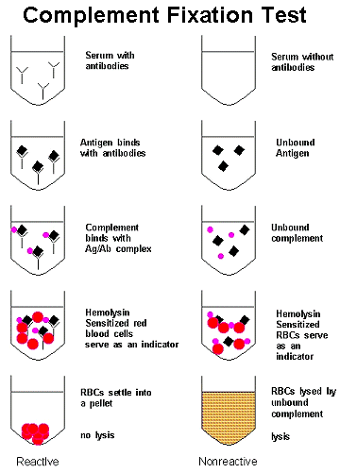

Slide 5
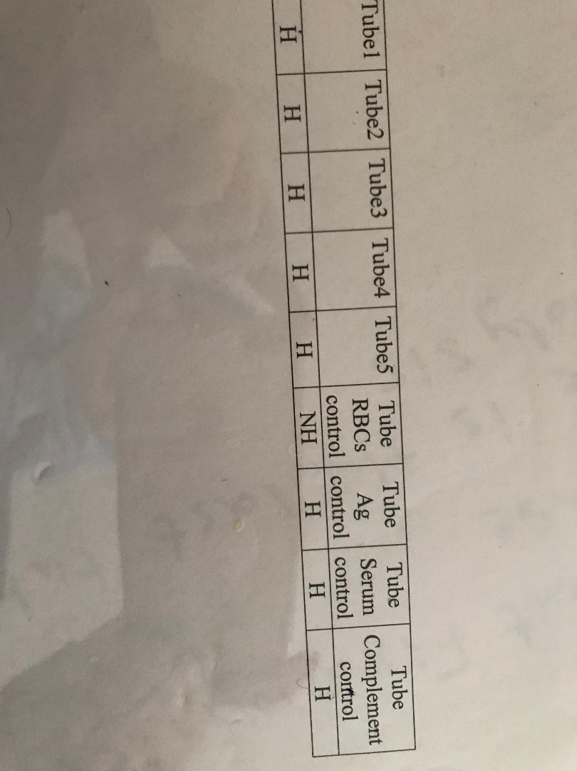

Slide 6
Titer

Slide 7
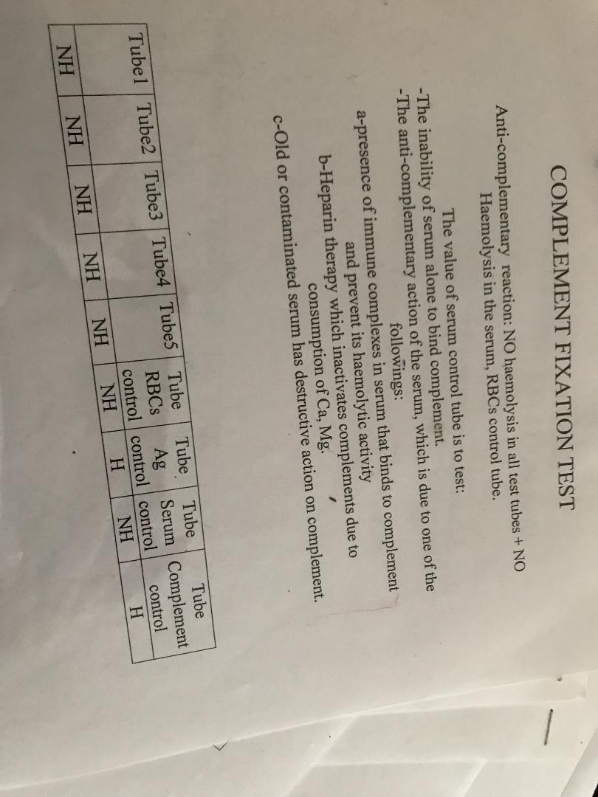

Slide 8
radio- immune assay (RIA) and ELISA
When the antigen or antibody is labeled with a radioisotope, it may be quantified by instruments that detect radioactive decay events; the assay is called a radioimmunoassay (RIA).
When the antigen or antibody is covalently coupled to an enzyme, it may be quantified by determining with a spectrophotometer the rate at which the enzyme converts a clear substrate to a colored product; the assay is called an enzyme-linked immunosorbent assay (ELISA).

Slide 9
Measures amount quantities of antigens or antibody (protein) using radiolabelled sign:
- Hormones
- Drugs
- Tumour markers
- Abs
-Viral and bacterial antigens

Slide 10
ELISA
Enzyme linked immunosorbent assay(1971)
the antibody is enzyme linked,
Done in 96 well microtitre plates
To detect the presence of a protein and its quantity
Ag or Ab coated on wells

Slide 11
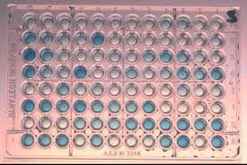
ELISA plate

Slide 12
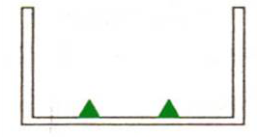
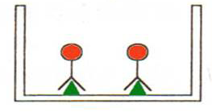
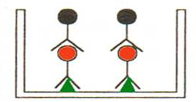
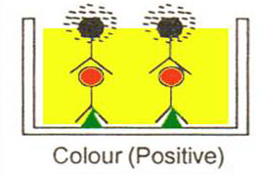
Indirect ELISA
For Ab detection,
Ag coated wells used
Add patient serum then wash
(If Ab present, it binds to Ag)
Add goat anti-human
Ig antibody enzyme linked or radiolabeled

Slide 13
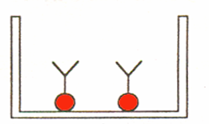
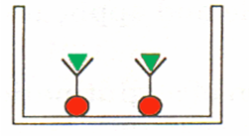
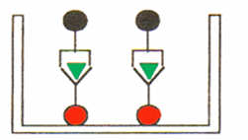
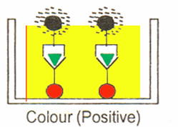
Sandwich ELISA
For Ag detection, wells coated with Sp. Ab.
add patient specimen then wash, Ag in specimen binds to
coated Ab.
Add antibody enzyme linked or radiolabeled
Colour produced

Slide 14
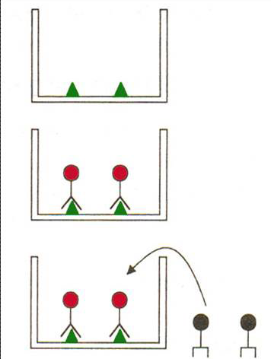
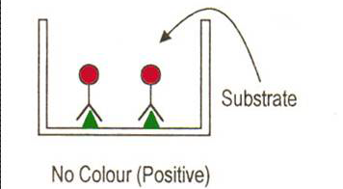
Competitive ELISA
Ag coated wells
Two specific Abs,
(enzyme linked or radiolabeled antibody.& pateint serum) added simultaneously then wash
More specific tested Abs attach to Ag
Positive test- no colour

Slide 15
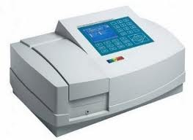
Spectrophotometer for reading the color

Slide 16
Identification and purification of protein from a mixture
The specific proteins are separated and inserted on gel by gel electrophoresis
Proteins may be detected after electrophoresis by a Western blot analysis
Notes:
The antibody attach to insulable bead is typically added to a protein mixture (lysate of specific cells),.
Unwanted proteins that do not bind to the antibody are then removed by washing the beads

Slide 17
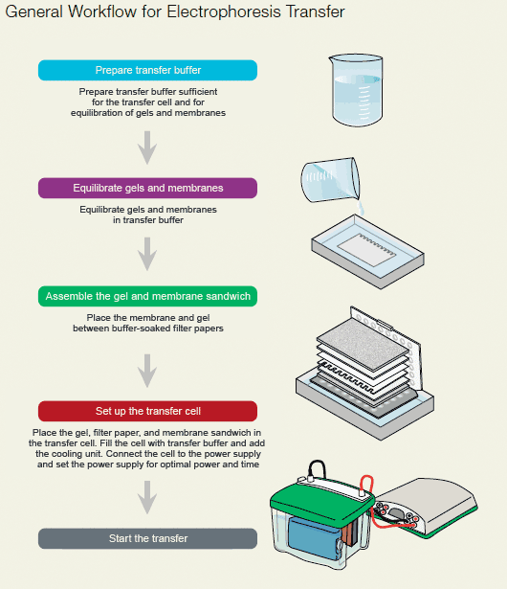

Slide 18
Western blot
Western blotting is used to identify and determine the relative quantity and molecular weight of a protein within a mixture of proteins or other molecules and it comes after electrophoresis step, When the proteins transferred from gel to membrane## and The position of the protein antigen on the membrane is depending on molecular weight, then it can be detected by an antibody that is in turn revealed by a second antibody that may be conjugated to an enzyme such as horseradish peroxidase, that generate signals and leave images on photographic film.

Slide 19
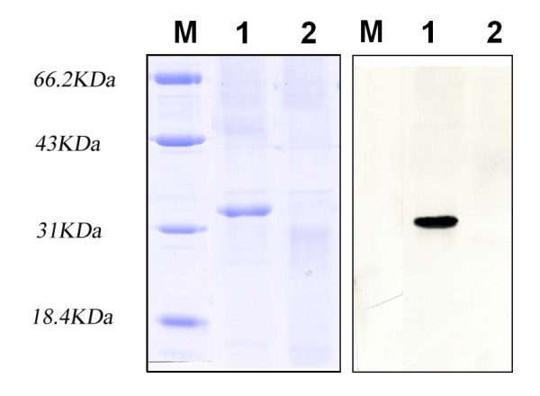

Slide 20
Southern blot, a technique for DNA detection (transfer from gel to a membrane) developed earlier by Edwin Southern. Detection of RNA is termed northern blot

Slide 21
Tests for Cell/ tissue Associated Antigens.Immuno-cyto/histo-chemistry
Detection of cell surface or intracellular expression of different molecules.
Immunofluorescence Immunofluorescence is a technique whereby an antibody labeled with a fluorescent molecule (fluorescein or rhodamine) Determine the anatomic distribution of antigen in tissues using the fluorescence emitted by the bound antibody. Uses in tumor antigen detection, SLE and Rheumatoid arthritis.
Direct Immunofluorescence attaching horseradish peroxidase to a specific mouse antibody directed against the antigen of interest,
Indirect Immunofluorescence In indirect immunofluorescence, horseradish peroxidase can be attached to a second anti-antibody (e.g., rabbit anti-mouse Ig antibody) that is used to bind to the first unlabeled antibody. Indirect fluorescence is more sensitive than direct immunofluorescence since there is amplification of the signal.

Slide 22
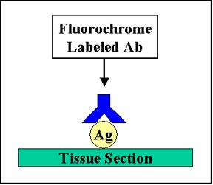
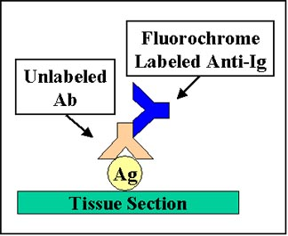
Direct and Indirect IF

Slide 23
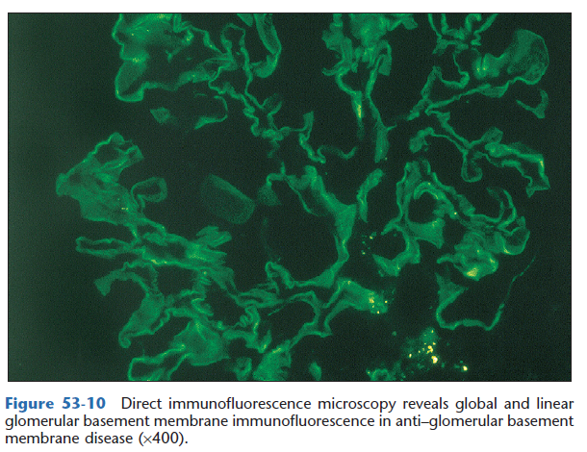

Slide 24
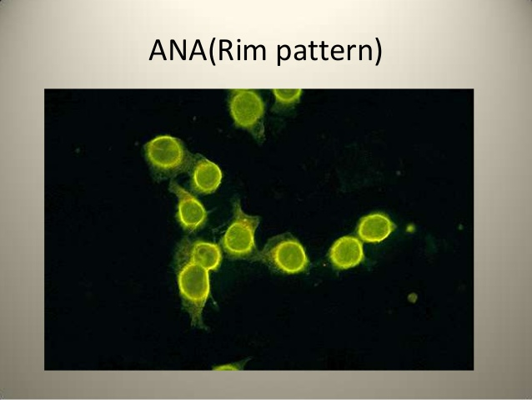

Slide 25
ANA follow

Slide 26
2. confocal microscopy, identify the detailed structure of the cell
3. A conventional light microscope; antibodies may be coupled to enzymes as the immunoperoxidase technique.

Slide 27
4. Antibody can be coupled to an electron-dense probe such as colloidal gold, and the location of antibody can be determined subcellularly by means of an electron microscope,

Slide 28
Flow Cytometry
The maturation stage, cytokine secretion (inside cells and bound) or cell cycle, apoptotic cell and numerating B and T cells.
The flow cytometer is a specialized instrument that can detect fluorescence on individual cells in a suspension and thereby determine the number of cells expressing the molecule.
cytoplasmic and extracellular cytokines can be stained and seen.
flow cytometers also identify and separate the cells depending on the cell size and internal complexity by forward ( size)and side light-scattering ( complexity) properties of cells, This information is often used to distinguish different cell types. For example, neutrophils and monocytes.
can be used to study proliferation of T and B cells in vivo.

Slide 29
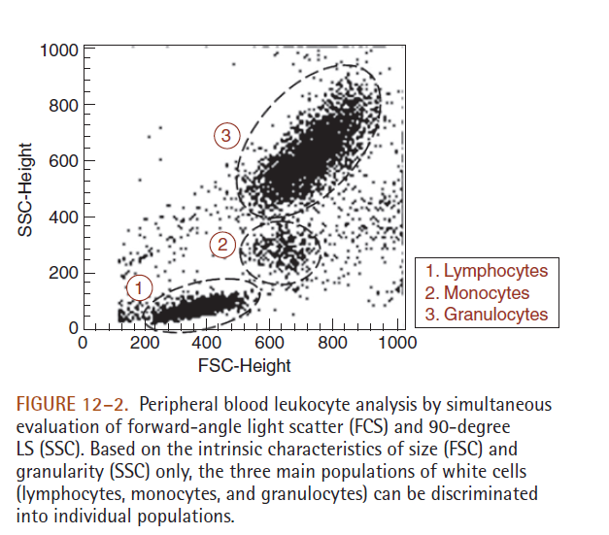

Slide 30
Ag-Ab binding affinity
A method, more commonly used today, to measure the kinetics of antigen-antibody interactions depends on surface plasmon resonance. In this method, a specialized biosensing instrument (such as the Biacore) uses an optical approach to measure the affinity of an antibody that is passed over an antigen that is immobilized over a metal film. A light source is focused on this film through a prism at a specific angle (resonance), and the reflected light provides a surface plasmon resonance readout. Adsorption of an antibody to the antigen alters the surface plasmon resonance readout, and this alteration can provide information on affinity.

Slide 31
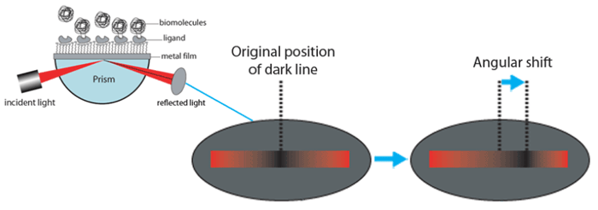

Slide 32
follow
Another method, Antibody affinities for antigen can be measured directly for small antigens (e.g., haptens) by a method called equilibrium dialysis. In this method, a solution of antibody is confined within a “semipermeable” membrane of porous cellulose and immersed in a solution containing the antigen. (Semipermeable in this context means that small molecules, such as antigen, can pass freely through the membrane pores but that macromolecules, such as antibody, cannot.) If no antibody is present the antigen in the bathing solution enters until the concentration of antigen within the two membrane-side compartments becomes exactly the same as that outside. However, when antibody is present , the net amount of antigen inside the antibody compartment increases by the quantity that is depending on affinity

Slide 33
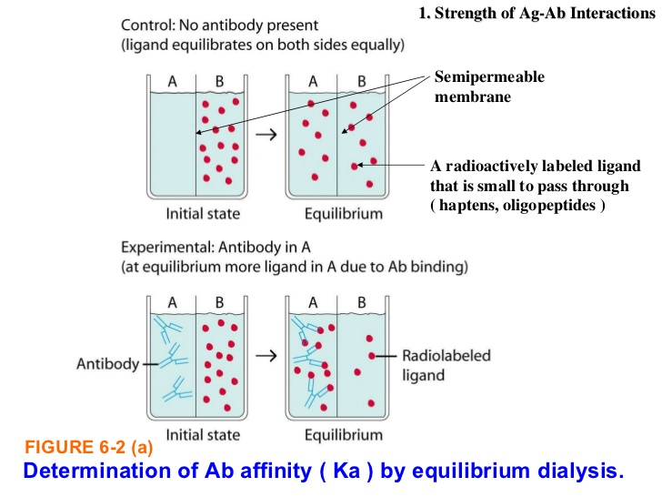

Slide 34
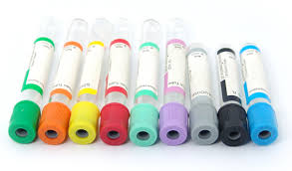

Slide 35
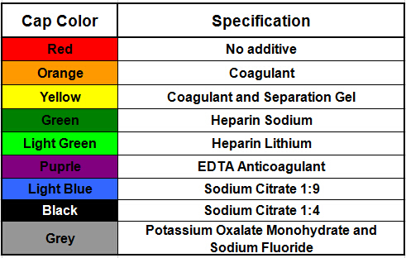

Slide 36
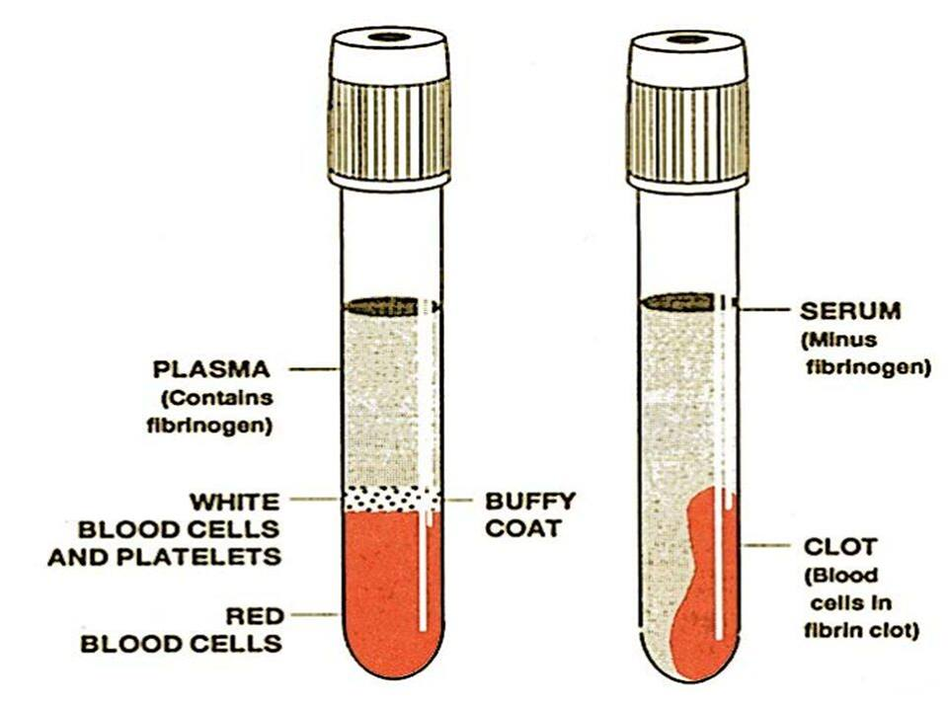
Plasma VS serum EDTA tube (purple cover for CBC) plain tube (red cover)

Slide 37
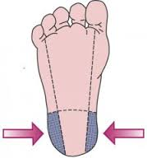
Heel puncture sites

Slide 38
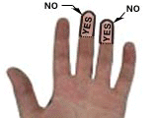
Finger puncture site

Slide 39
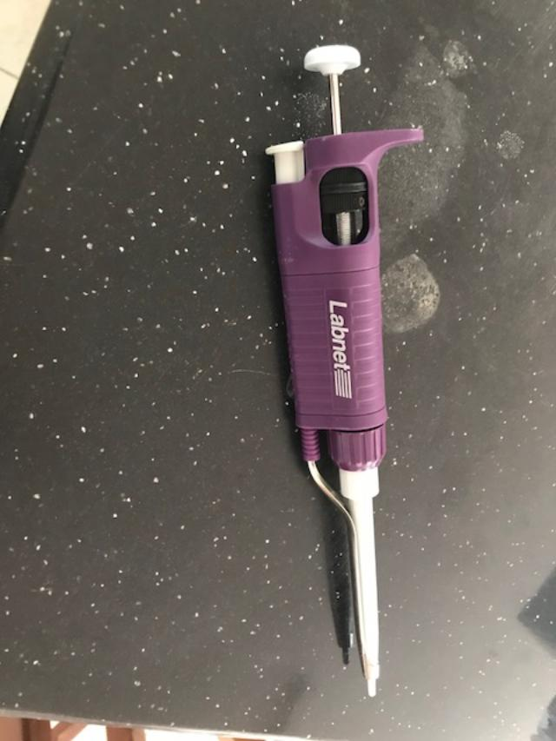
pipette

Slide 40
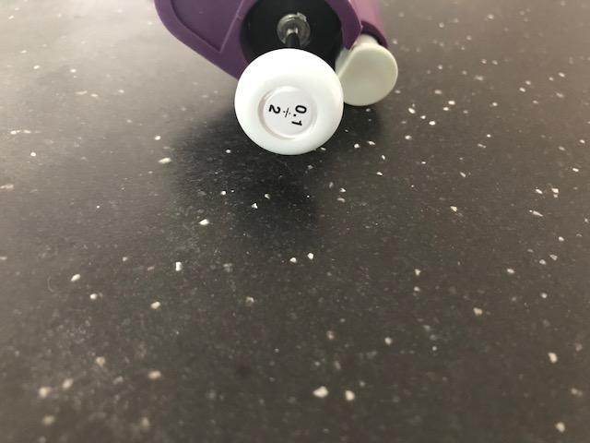

Slide 41
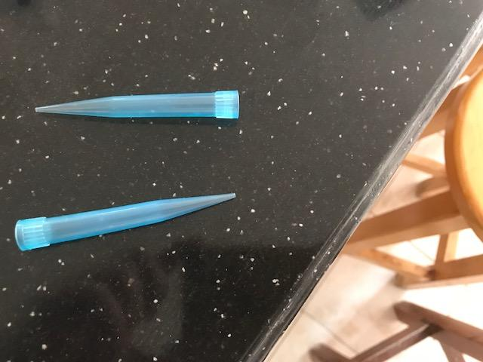
tips

Slide 42
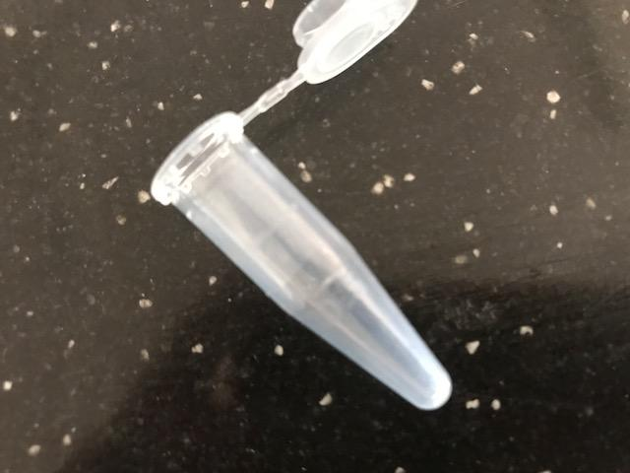
eppendorf

Slide 44
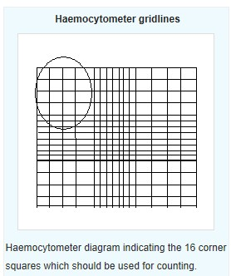
Number of cells/cmm= counted cells in 16 corner sequare*10*dilution factor

Slide 45
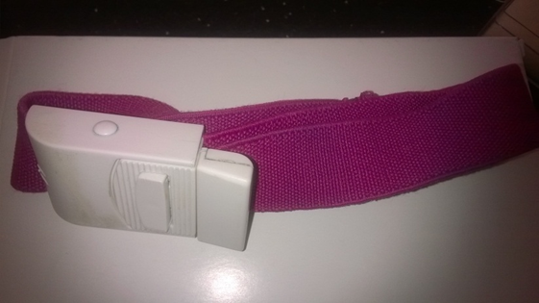
tourniquet

