Slide 1
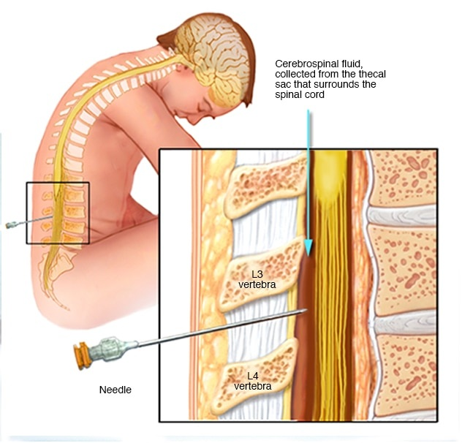
Cerebrospinal fluid
By
Dr/ Heba M. Kareem
Assistant Professor of Medical Biochemistry
Mutah University

Slide 2
CSF
CSF is a colorless, clear liquid that fills the ventricles (cavities) of the brain and the spinal cord.
Acts as lubricant and a mechanical barrier against shock
About 100 – 150 ml in adults
10 – 60 ml in infants - children
It is mainly 99% water
It has low amounts of protein and lipids compared to blood

Slide 3
CSF
Formations
Basically CSF is a secretion product of ultra filtration of blood
Its composition is the result of material exchange between blood and adjacent brain tissue
Circulates through the foramen of Monro from the two lateral ventricles to the third ventricle.
Some of the CSF travels down the central canal of the spinal cord.

Slide 4
CSF
Circulation

Slide 5
CSF
Functions
The central nervous system (CNS) : Brain and spinal cord are floating by the cerebrospinal fluid medium.
This provides CNS with support and protection against rapid movements and trauma by acting as cushion
CSF provides nutrition for both neuron and glial cells
CSF functions as lymphatic system by providing medium for removing waste products of metabolism of CNS cells

Slide 6
CSF
Functions
CSF plays role in maintaining the micoenvironment like ionic concentration
Might serve as transport system of biological active substances like co-factors, hormones, neurotransmitters and several metabolites
As CSF and extracellular space of brain are in continuity, analysis of CSF provides information about the normal and pathological state of CNS function

Slide 7
CSF examination
Indications for CSF analysis
CNS
infections
Demyelinating diseases
CNS
malignancy
Hemorrhage in CNS
Autoimmune disorders
The following examinations performed for CNS samples:
Physical examination
Chemical examination
Microscopic examination
Microbiological test

Slide 8
CSF
Sample collection
Lumbar puncture or spinal tap is the most common procedure of collecting CSF(Between L3, 4).
Patient positioned on side with knees and chin tucking towards abdomen
Occasionally can be done in sitting position bending forward
Sterile conditions has to practiced throughout the procedure
10-20 ml can be collected as required

Slide 9
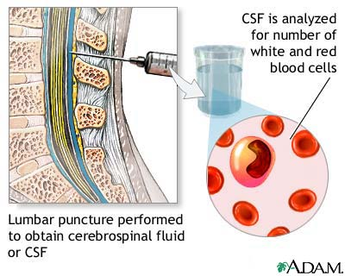
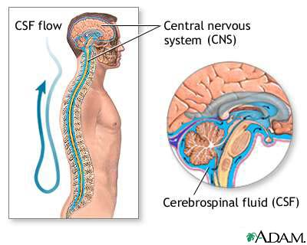

Slide 10
CSF
Sample collection
Sample must be collected under sterile conditions
Proper labeling should be done before collecting
Immediate examination is required
Usually collected in 3 tubes
Chemical analysis
Microbiology
Cell count

Slide 11
CSF analysis
Physical examination | Color :
Appearance | Normal CSF is colorless clear liquid. Looks almost similar to water (crystal clear) Cloudy or turbid, milky appearance indicate abnormal conditions like presence of RBC, microorganisms etc……
Specific gravity | 1.006 – 1.008

Slide 12
CSF analysis

Slide 13
CSF analysis
Physical examination | Color :
Appearance | Xanthochromic CSF Xanthochromia is a term used to indicate pink/orange/yellow CSF which may be caused by the following conditions Oxyhemoglobin from lysed RBC present before spinal tap or traumatic spinal tap Bilirubin from lysed RBC or direct bilirubin with normal blood-brain barrier or in immature infants High protein levels because of traumatic tap Contamination from disinfectants used Carotinoids in CSF due to hypercarotenemia Melanin in CSF because of meningeal melanosarcoma

Slide 14
CSF analysis
Physical examination | Color :
Appearance | Bloody appearance Highly bloody CSF indicate hemorrhage It can also be due to puncture of blood vessel during spinal tap It can be differentiated by…. Uneven distribution of blood : traumatic tap shows more blood in first sample traumatic tap often shows clear supernatant after brief centrifugation Traumatic tap shows clot formation Care should be taken while reporting A recent hemorrhage would have the same properties as blood vessel damage

Slide 15
CSF analysis
Chemical examination
pH | Normal CSF is alkaline in nature as plasma
Spontaneous clotting | Occurs when there is an excess of fibrinogen in the specimen. This usually associated with high protein concentration Classically this is associated with tuberculous menengitis or tumors in CNS

Slide 16
CSF analysis
Chemical examination | CSF is formed by filtration of plasma Same chemicals can be found in CSF as plasma How ever because of selective filtration process and the chemical composition is adjusted by the blood brain barrier, normal values of CSF chemicals are not the same as plasma values Abnormal values can be attributed to alterations in the permeability of blood-brain barrier or increased metabolism by neuronal cells in response to pathological condition
Lactate | Measurement of lactate may be useful as part of investigation of inborn errors of metabolisms like Disorders of gluconeogenesis Disorders of pyruvate dehydrogenase complex Disorders of Krebs cycle and ETC Also in children with neurological diseases

Slide 17
CSF analysis
Chemical examination
Proteins | Most frequently done test is protein determination. Normal CSF has very low amount. Normal CSF protein is less than 1% of plasma Usually 15 – 45 mg / dl Elevated protein can be found in Froin’s syndrome – complete spinal block) Cerebral tumors Meningitis In all diseases there is decreased clearance of normal protein, and degeneration of neural tissue. Increased local synthesis of Immunoglobulins Increased capillary permeability due to blood brain barrier damage

Slide 18
CSF analysis
Chemical examination
IgG – albumin index | The IgG-albumin index can be used to distinguish diseases affecting permeability (meningitis, cerebral infarctions, tumors of the brain) from diseases resulting in increased immunoglobulin (usually IgG) synthesis (multiple sclerosis) and some inflammatory diseases (idiopathic polyneuropathies). A normal range for this index has been proposed to be 0.34-0.58. In diseases associated with increased IgG production, the ratio is elevated, whereas in diseases affecting CSF permeability, the ratio is deceased because of increased CSF albumin concentration. Some disorders can affect both CSF IgG concentration and blood permeability.

Slide 19
CSF analysis
Chemical examination
Glucose | Glucose enters CSF by active transport across blood brain barrier. CSF glucose is little lower than that of Plasma and is usually 60-70% of plasma Relative comparison has to be done with blood glucose
 | Low CSF glucose can be of considerable diagnostics value in determining the causative agents in meningitis An increased WBCs with large percentage of neutrophils indicate bacterial meningitis WBCs count and later percentage of T cells indicate tubercular meningitis
 | Low glucose values can be associated with diseases of glucose transport, utilization of glucose by brain cells, bacteria and leukocytes

Slide 20
CSF analysis
Chemical examination summary

Slide 21
CSF analysis

