Slide 1
DISSEMINATED INTRAVASCULAR COAGULPATHY
Mona Aloutani
Hadeel Abu-Khshait
Roqea Al-khamaiseh

Slide 2
Contents
1 Defention 2 Etiology 3 Clinical picture 4 Clinical type 5 History and Physical Examination 6 Complication 7 Investigation 8 Treatment

Slide 3
Coagulation pathway
Damage surface

Slide 4
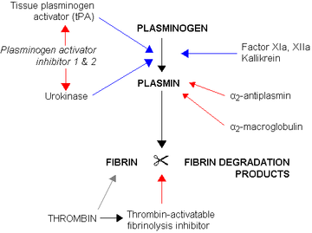

Slide 5
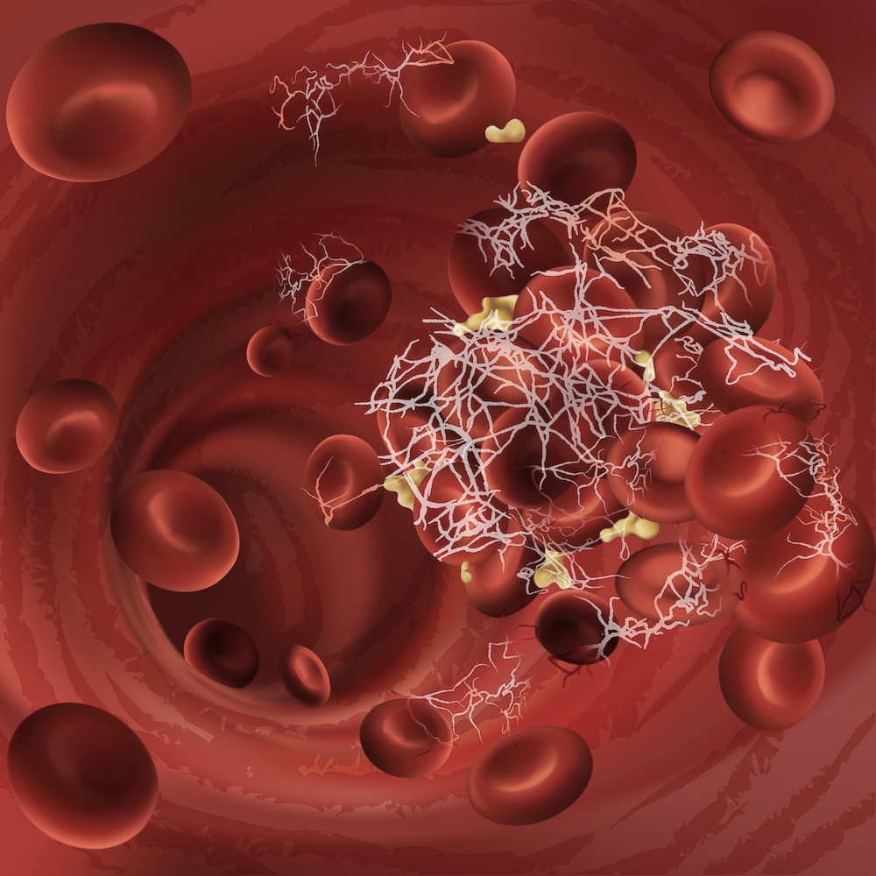
DEFENTION
DIC : it is an acquired coagulopathy in which there is widespread fibrin formation , resulting in consumption of platelets and coagulation factors and activation of fibrinolysis .

Slide 6
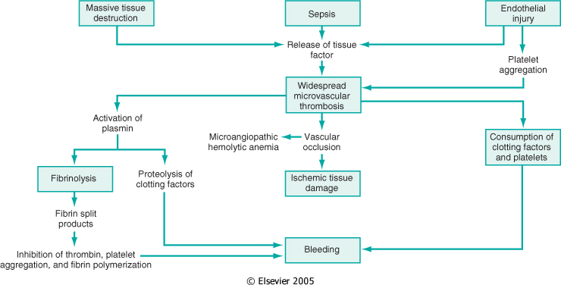

Slide 7
ETIOLOGY
Endothelial damage activation of intrinsic pathway
●Infection : Gram - ve bacteria ( eg . meningococcus ) , Gram + ve bacteria ( e.g. pneumococcus ) , anaerobes , TB viruses , ...
● Vascular : Malignant hypertension , MI .
2- Trauma release of tissue factor activation of extrinsic pathway
A. Obstetric complications : amniotic fluid embolism , retroplacental hemorrhage , IUFD and pre – eclampsia .
B. Crush injury , Thermal injury .
C. Leukemia : especially acute promyelocytic leukemia .

Slide 8
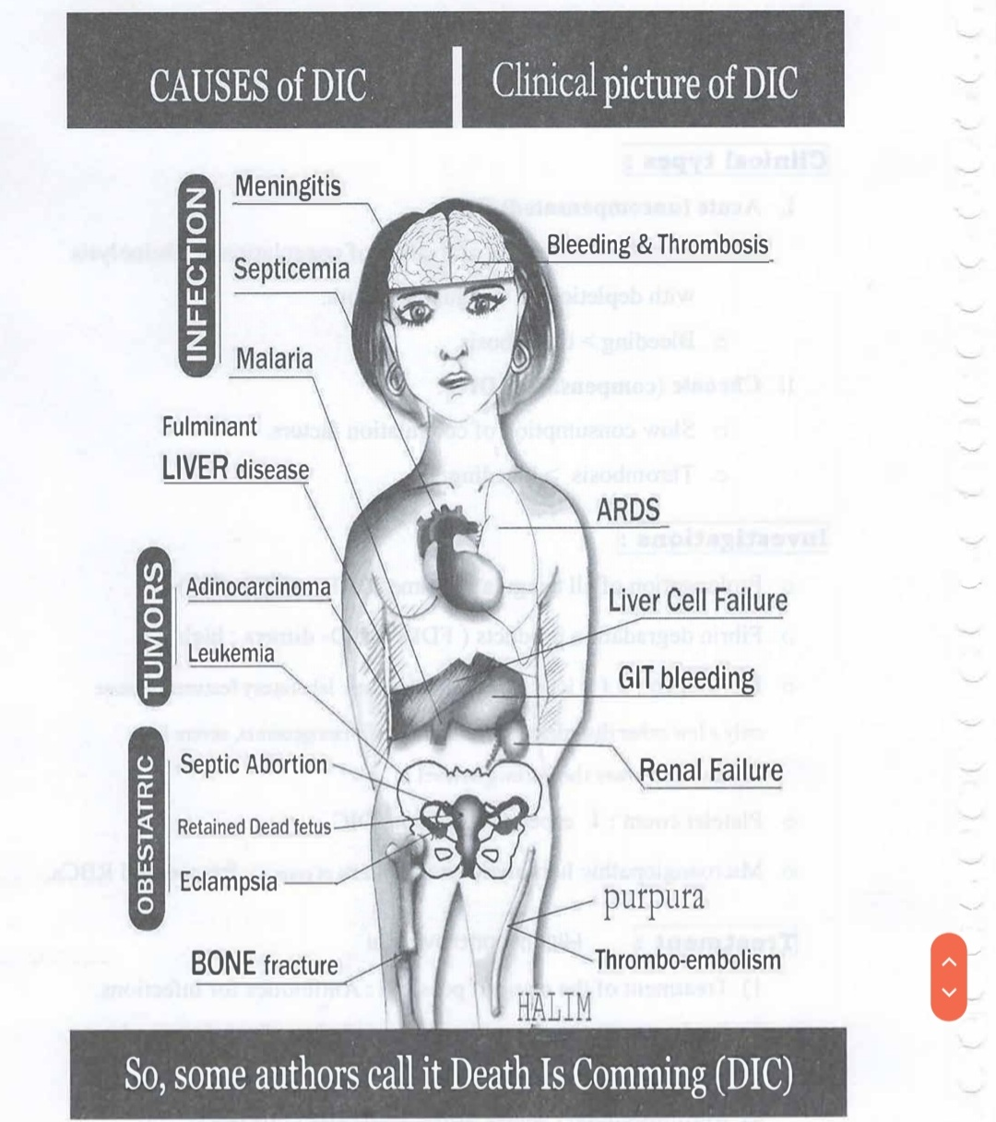

Slide 9
CLINICAL PICTURE
DIC leads to both bleeding and thrombosis I. Clinical picture of the cause . II. Bleeding ( due to consumption of coagulation factors ) *Ecchymosis , petechiae , oozing from venepuncture sites . * post - operative bleeding .III Thrombosis Organ failure : * Renal dysfunction * Cerebral dysfunction * skin necrosis * ARDS ( acute respiratory distress syndrome ) .

Slide 10
CLINICAL TYPES
I. Acute ( uncompensated ) DIC : * Rapid and extensive activation of coagulation & fibrinolysis with depletion of coagulant factors . * Bleeding more than thrombosis . II . Chronic ( compensated ) DIC : * Slow consumption of coagulation factors . * Thrombosis is more than bleeding .

Slide 11
HISTORY
A recent history of severe infections or trauma , hepatic failure , obstetric complications, and malignancy and history of deep vein or arterial thrombosis may also be suggestive of DIC. *The symptoms of (DIC) are often those of the underlying condition.
Bleeding tendency (more common on acute case) :
Superficial bleeding (ecchymoses/ petechiae/purpura)
bleeding from multiple sites including gingiva/GI tract (Hematemesis /Hematochezia) /urinary tract .
Oozing from areas of trauma or procedures / incision .
Thrombosis (more often in chronic cases): end organ infarction may develop especially in CNS and kidney .
Symptoms of hematuria, oliguria, and anuria may be seen if there is renal failure from DIC .
dyspnea and hemoptysis if pulmonary hemorrhage or pulmonary embolism is occurring.
A patient could also experience chest pain if arterial occlusion of a coronary artery develops .
Menorrhagia (heavy menstrual bleeding) .

Slide 12
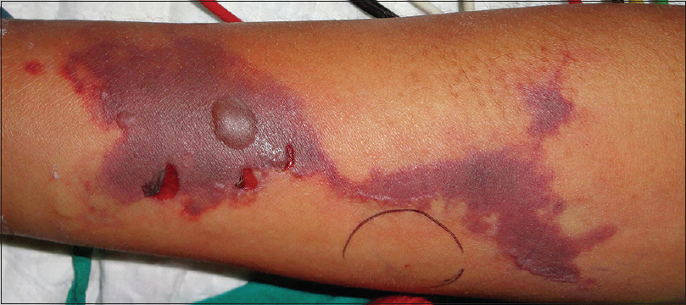
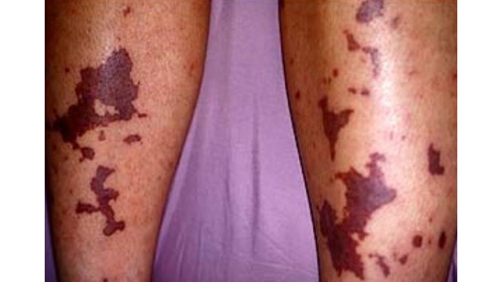
FINDINGS IN PHYSICAL EXAMINATION
Obvious bleeding, or frank hemorrhage in various areas of the body may be noted by inspection.
. Petechiae/ purpura/ecchymosis
. Jaundice (liver dysfunction or hemolysis)
. Localized infarction and gangrene
. Hypotension
. Tachycardia
. Nonspecific altered consciousness
. neurologic deficits
. Dyspnea, cyanosis

Slide 13
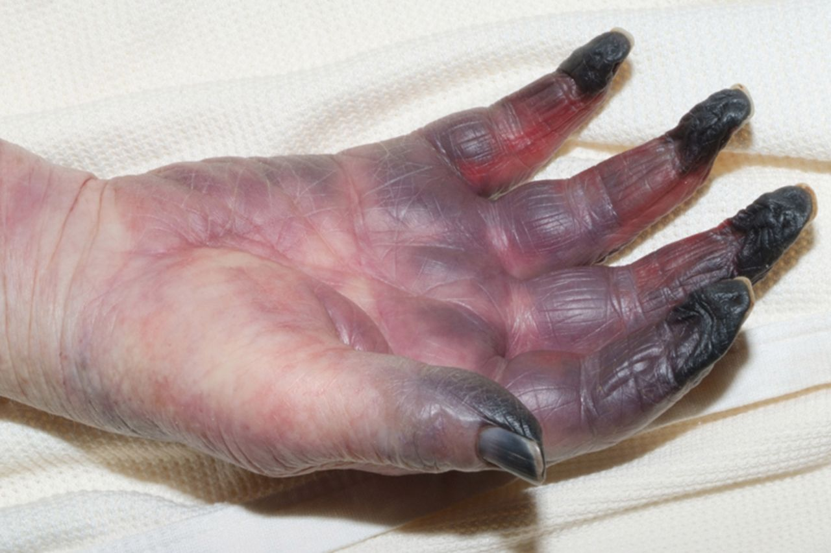
Complications: ( summary )
Acute kidney injury
Microangiopathic hemolytic anemia
Respiratory dysfunction
Hepatic dysfunction
Change in mental status due to if either thrombi or hemorrhage to areas of the brain arise.
Gangrene and loss of digits
Shock
Death

Slide 14
INVESTIGATION
1- Prolongation of all coagulation times ( PT , APTT , TT ) 2- Fibrin degradation products ( FDPs ) & D – dimers : high 3- Fibrinogen depletion : ( It is an important diagnostic laboratory feature , because only a few other disorders ( congenital hypofibrinogenesim , severe liver disease ) will lower the fibrinogen level ) 4- Platelet count is decreased : especially in acute DIC . 5- Microangiopathic hemolytic anemia : due to RBCs fragmentation
schistocyte seen in blood film

Slide 15
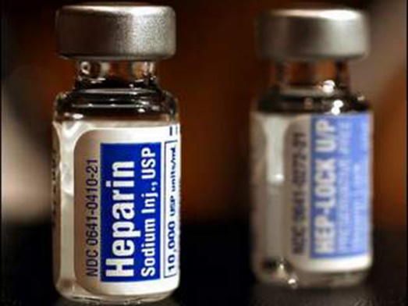
TREATMENT
It depend on the cause of DIC 1 ) Treatment of the cause if possible : Antibiotics for infections . 2 ) Replacement therapy : Platelet transfusion , fresh frozen plasma 3 ) Heparin / LMWH : Its use is controversial , it may accelerate bleeding . 4 ) Antifibrinolytic ( aminocaproic acid & tranexamic acid ) : Its use is controversial , it may accelerate microvascular clotting .
Platelet and plasma transfusions should only be considered in patients with active bleeding or a high risk of bleeding or those patients requiring an invasive procedure

Slide 16
THANKE YOU

