Slide 1
GIT Micro Lab 3
2020-2021
Dr. Mohammad Odaibat
Department of Microbiology and Pathology
Faculty of Medicine, Mu’tah University

Slide 2
Schistosoma
**المطلوب من اللابات فقط الصورة و شو بتمثل بدون تفاصيل زيادة عن كل كائن (كلام الدكتور)

Slide 3
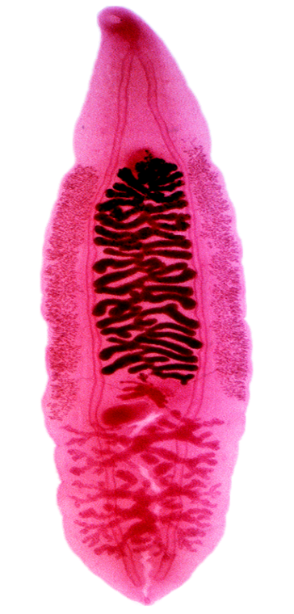
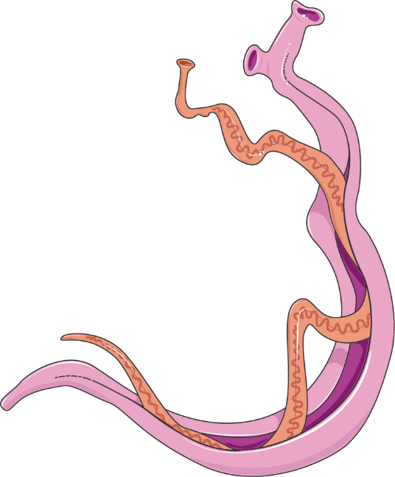
Schistosoma
It has been classified in flukes/trematodes family but its real shape is cylindrical
Cylindrical worm (Not flat – leaf like).
Only trematode in which sex is separated while other trematodes are hermaphrodite (Monoecious)
Hermaphrodite means that male and female sex organs are present in the same organism
Male and female matured in the portal vein in the liver then male carry its female to complete there life cycle in L.I (S. mansoni),
S. Japonicum complete its life cycle in L.I + S.I
Trematoda (flukes)
Schistosoma

Slide 4
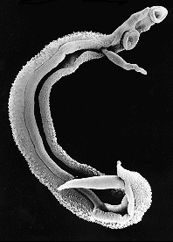
Schistosoma mansoni male
Size : 8 x 1 mm.
Oral & Ventral suckers.
Testes: 6 - 9, small and lie in cluster.
Gynecophoric canal in which female held during copulation
Male of S. mansoni migrate against venous blood direction to carry its female to the deep mesenteric vein of L.I so These suckers help the male to withstand against blood direction

Slide 5
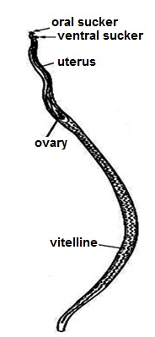
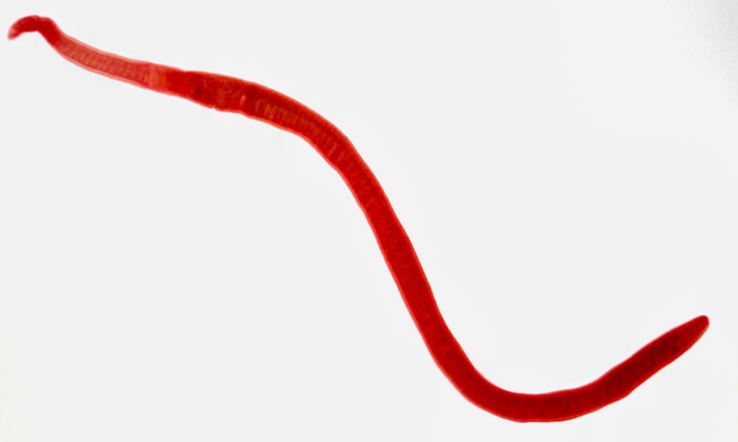
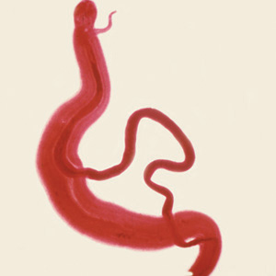
Schistosoma mansoni female
Size: 14x 0.15 mm (longer and thinner to suite the Gynecophoric canal)
Ovary: Anterior 1/3 of the body
Uterus: Short with 1-4 ova.
**بالامتحان رح يكون السؤال هاي الصورة عبارة عن؟ ما رح يسأل عن التفاصيل زي مكان المبيض و شو شكله

Slide 6
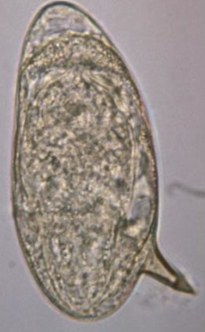
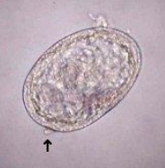
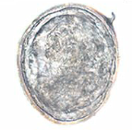
Egg of S. mansoni
Shape: Oval with lateral spine
Shell: Thin, non operculated
Colour: Translucent
Content: Mature (fully developed miracidium).
This spin beside the Proteolytic enzymes help in penetration of L.I
Egg of S. japonicum:
eggs are more round with a small spine on the side.

Slide 7
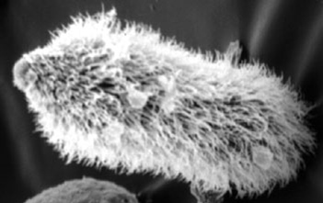
Miracidium
Miracidium found inside the egg, infect snails, inside snails miracidium become cercaria
Ciliated larva

Slide 8
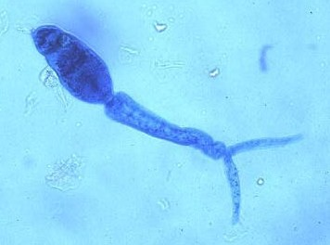
Cercaria responsible for first stage of penetration
Cercaria of S. mansoni (I.S)
Body : Oral and ventral suckers (very important in attachment) , primitive gut and 5 pairs of penetration glands.
Tail : Forked (Furcocercuscercaria).
1st: attachment by the suckers
2nd: penetration by the forked tail and proteolytic enzymes

Slide 9
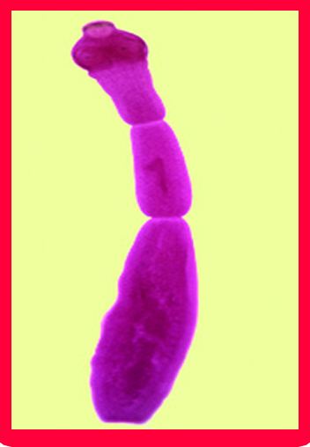
E. Granulosus is the causative agent of hydatid cyst
**tape worm, D.H is the dog
Echinococcus granulosus adult
Adult:-
Scolex:
Globular in shape.
4 muscular suckers.
Rostellum with 2 rows of taenoid hooks (asT. solium).
Strobila : 3 segments : immature, mature & gravid.
Suckers help To fix the worm in the wall of the dog's intestine

Slide 10
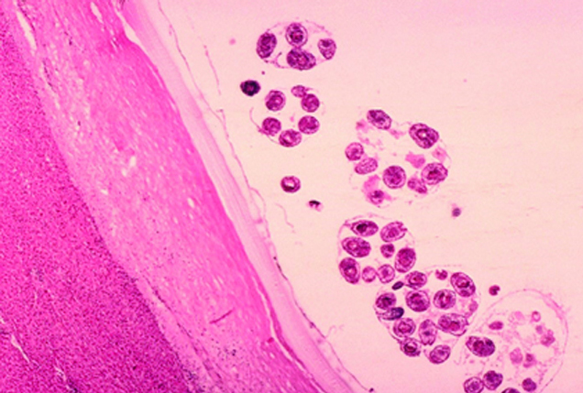
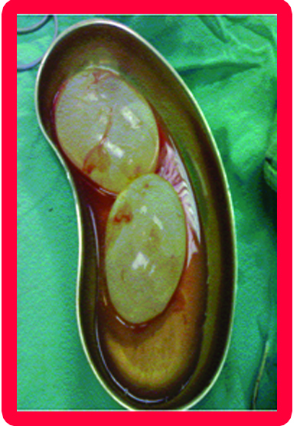
Hydatid cyst
(D.S in man and herbivorous)
Each mother cyst contain daughter cyst and each daughter cyst contain scolices, dogs eat these scolices and inside there intestine they converted to adult worm and these adult fix themselves in the wall of dog’s intestine, the last segment of the adult worm give eggs which exit with dog’s stool, humans infected with these eggs and hydatid cyst formed inside there bodies
Simple unilocular hydatid cyst
G
L

Slide 11
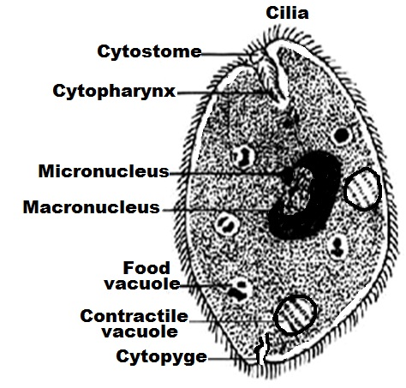
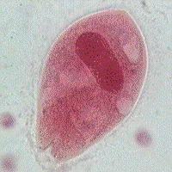
Balantidium coli
I.S of Balantidium coli and Giardia lamblia is the cyst
1-Trophozoite stage (D.S)
Oval with pointed anterior end and rounded posterior end.
Contains numerous food vacuoles, 2 contractile vacuoles, macronucleous &micronucleus
Cytostome & Cytopharynx
Macronucleus
Food
vacuole
**التفاصيل مش كثير مهمة لكن مهم نعرف انه :
Balantidium coli use cilia in its movement, cilia + proteolytic enzymes help in penetration the wall of L.I causing formation of flask-like lesions
Contractile vacuole
cilia

Slide 12
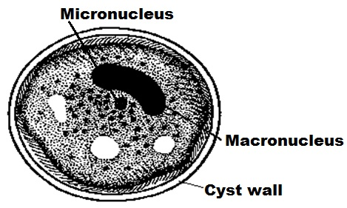
Balantidium coli cyst
Cyst (D.S&I.S)
When the liquid/ semiliquid stool become solid, the Trophozoite converted to cyst to resist the external environment
Rounded with thick double cyst wall.
Contains a single parasite, food vacuoles, macronucleus and micronucleus
**بدون تفاصيل, بس الصورة و شو بتمثل ☺

Slide 13
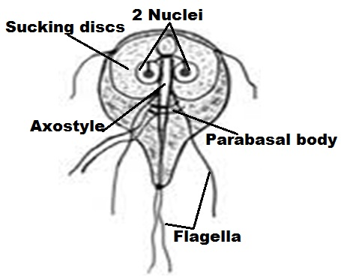
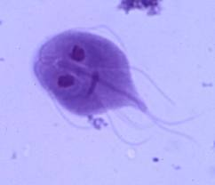
Giardia lamblia
1-Trophozoite stage
Shape: pear in shape with convex dorsal surface & flat ventral surface
2 sucking discs for attachment.
2 oval nuclei with central karyosomes anteriorly.
Four pairs of flagella.
Axostyle: 2 central roes in the middle
Parabasal body: 2 rods across the axostyle.

Slide 14
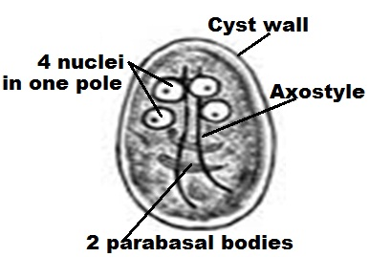
Giardia lamblia cyst
double cyst wall. Trophozoite converted to cyst Under unfavorable conditions
2- Cyst (I.S)
Size: 12x 7 mm
Shape: oval with thick cyst wall
Contents:
-4 nuclei at one pole
-Fine granular cytoplasm with remnants of flagella, axostyle & parabasal bodies
Remnants of flagella present due to the formation of cyst

Slide 15
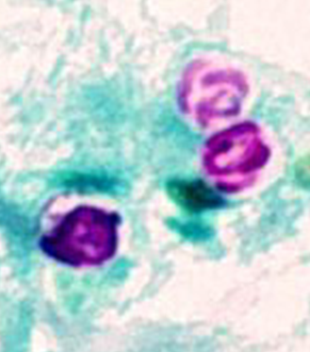
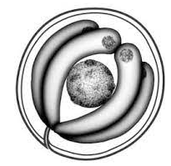
Cryptosporidium parvum
oocyst
5 um.
Spherical in shape.
Contents : 4 naked sporozoites (fully mature).

Slide 16
Hookworms

Slide 17
Hookworms
Hookworms
Human hookworms
Dogs & cats hookworms
Old world hookworms
New world hookworms
Ancylostoma
caninum
Ancylostoma
braziliense
Ancylostoma duodenale
Necator americanus
Cutaneous larva migrans

Slide 18
Hookworms
Pathogenicity & Clinical Features
Ancylostomiasis or hookworm disease, characterised by iron deficiency anaemia
Majority of infections are asymptomatic
Symptoms develop in heavy infections and divided into three groups: those produced by
Intestinal phase
Migrating larvae
Skin invasion

Slide 19
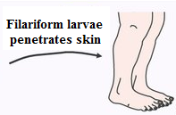
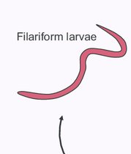
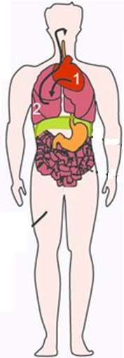
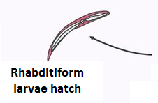
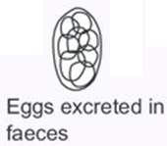
Hookworms- Life Cycle
1
2
3
دورة حياتها لازم نكون عارفينها, مش عارف اذا قصده لل لاب و المحاضرة او بس للمحاضرة ☺

Slide 20
Hookworms- Pathogenesis and symptomatology
Intestinal phase
Injury of the mucous membrane by cutting teeth and plates at the site of attachment  ulceration and bleeding that may be infected  nausea, vomiting, pain, flatulence, constipation or diarrhea with (black or red stool. due to the bleeding)
Anaemia  hypochromic microcytic iron deficiency & aneamia (due to blood loss).
Causes:
1-Each parasite sucks about 0.5 cc of blood daily.
2-Bleeding at the site of attachment due to the effect of anticoagulant secreted by the cephalic glands).
Hypoproteinaemia,nutritional oedema and signs of avitaminosis are due to impairment of food absorption and blood loss.
Retardation of physical, mental and sexual development in heavily infected children.
hypochromic microcytic iron deficiency & aneamia: continuous bleeding+ continuous red blood cell production→ iron storage decreases due to that decrease the bone morrow produce small and less pigmented (less amount of Hgb) RBCs

Slide 21
Hookworms- Laboratory diagnosis
Laboratory diagnosis
Stool examination for egg detection by different methods:
Direct smear.
Concentration methods
Faecal cultures.
Stoll's counting technique for determination of the intensity of infection.
Examination of stool for larvae by Baermann's technique
Blood examination for anaemia

Slide 22
Laboratory Diagnosis
Hookworms- Laboratory diagnosis
Stool examination – microscopy: non bile stained egg, segmented
Occult blood in stool – positive
Blood examination – anaemia, eosinophilia
The shell of the egg is fine and dark
Occult blood in stool: presence of a hidden blood in the stool in case of light infections, so we cant detect the blood in the stool by our eyes. In this situation a certain reagent used to detect the blood (occult blood test: mixing 1-2 g of stool with certain reagent, if we notice a change in the color of the reagent the result is positive and there is blood in this stool)

Slide 23
Hookworms- Treatment
Treatment
Supportive treatment:
-High protein diet.
-Vitamins & iron.
Mebendazole
(Drug of choice)
In severe anaemia, blood transfusion may be needed

Slide 24
THANK YOU

