Slide 1
Fungal infections of Lungs
(RSM 2021-2022)
Dr. Mohammad Odaibat
Department of Microbiology and Pathology
Faculty of Medicine, Mutah University

Slide 2
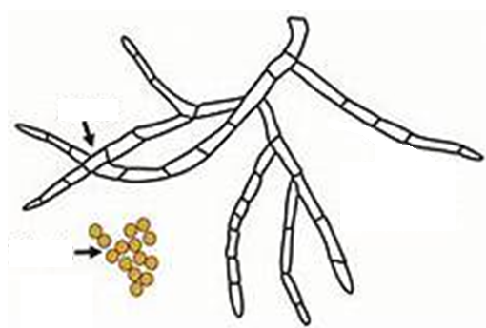
Fungi, Yeasts, Molds
A mold is a fungus that grows in the form of multicellular filaments called hyphae.
Yeasts are fungi that can adopt a single-celled growth habit.

Slide 3
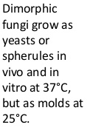
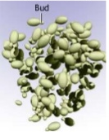
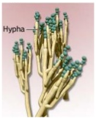
Structure of Fungi

Slide 4
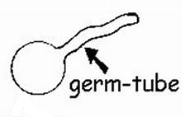
Structure of Fungi
Pseudohypha
C. albicans
Parent cell
Budding yeast
When Candida is grown in human or sheep serum at 37°C for 3 hours, they forms a germ tubes (filamentous outgrowth), which can be detected with a wet films as filamentous outgrowth extending from yeast cells
Notes:
When cells of Candida are incubated in serum at 37 ° C for 2-4 hours Candida albicans produce short, slender, tube like structures called germ tubes. Formation of germ tubes is associated with increased synthesis of protein and ribonucleic acid.

Slide 5
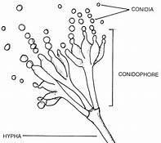
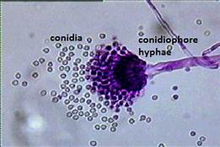
Structure of Fungi
Hyphae (Hypha, singular): is a long, branching filamentous structure of a fungus with fruiting body on the top that give conidia .
Hyphae may be septate, having internal septa, or nonseptate.
Notes:
When cells of Candida are incubated in serum at 37 ° C for 2-4 hours Candida albicans produce short, slender, tube like structures called germ tubes. Formation of germ tubes is associated with increased synthesis of protein and ribonucleic acid.

Slide 6
Pulmonary Mycosis
Due to primary pathogenic fungi
Due to opportunistic fungi
1- Histoplasma capsulatum
2- Coccidioides immitis
1- Aspergillus fumigatus
2- Pneumocystic jirovicii
Systemic Pulmonary Mycosis

Slide 7
Characters of systemic pulmonary mycoses:
Infection acquired by Inhalation of fungal spores (conidia).
Most fungal lung infections are asymptomatic and self – limiting. However, in some persons mainly immunocompromised , infection disseminates to other organs.
Infected persons rarely transmit the disease to others.

Slide 8
Predisposing factors and causes of fungal infection:
1- Taking strong antibiotics for a long period of time.
2- Suppression of the immune system by diseases (ex. AIDS, diabetes), or drugs as steroids and chemotherapy.
3- Very young and very old people are groups at risk.

Slide 9
Pulmonary mycosis due to Primary pathogenic fungi
1- Histoplasmosis
A disease usually affecting the lungs caused by Histoplasma capsulatum fungus.
Causing acute pneumonia or chronic cavitary lesions in the lungs as T.B.
This fungus is dimorphic lives and grows best in soil mixed with bird or bat excreta as filamentous form & yeast form in tissues .
Endemic in the United States.
Unlike its name; Histoplasma capsulatum is not encapsulated. The designation H. capsulatum is actually a misnomer. Virulence factor: Ability to survive within the macrophage probably by modulating the pH within the phagolysosome is the key virulence factor of Histoplasma capsulatum.

Slide 10
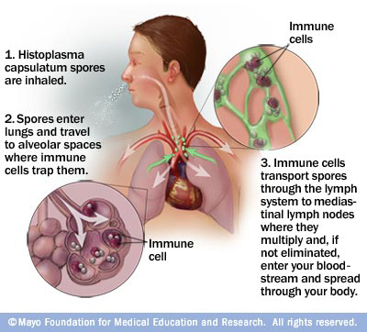
Mode of infection & life cycle

Slide 11
Clinical pictures
Most of infected people are asymptomatic (95%).
5% may have acute pneumonia with flue-like symptoms (ex. fever, chills, headache, cough, chest pain, fatigue, body aches, mouth sores) & red skin bumps called erythema nodosum, most often on the lower limbs.
Sometimes the infection progress to become chronic.
In immunocompromised patients, the infection disseminates to different organs via reticuloendothelial cells to the liver, spleen & L. nodes their enlargement and to CNS headache & neck stiffness due to high fever.

Slide 12
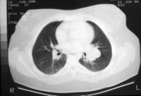
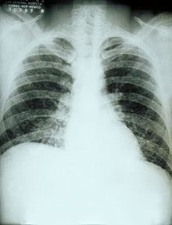
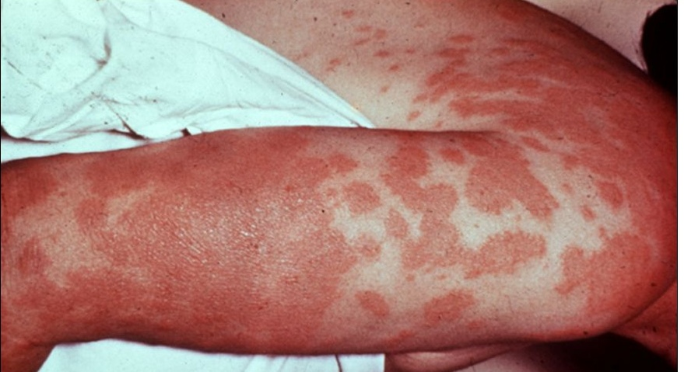
Mediastinal L. nodes enlargement
Acute pneumonia
Erythema nodosum

Slide 13
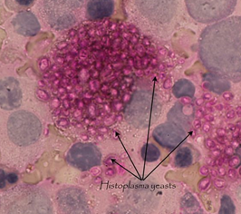
Laboratory diagnosis
Direct
Indirect
Microscopic Examination: of sputum, biopsy specimens, bone marrow aspirates, urine or blood films after staining with Periodic Acid Schiff (PAS) or Calcofluor white or Giemsa stains
Chest X ray & CT scan.
Culture of specimens on Sabouraud’s agar at 25 (up to 3 weeks)
Skin test: using fungal antigen (histoplasmin).
Serological tests: to detect Abs, or fungal antigen.
PCR.
Periodic Acid Schiff staining

Slide 14
Treatment
Oral
Parentral
By itraconazol
By amphotrecin B
(IV)
In acute cases, the drug is used for 6-12 ws.
In severe infection, chronic & disseminated histoplasmosis, the drug is used for 3 months to one year .
It used in disseminated infection.
Bind to ergosterol or inhibits its synthesis in the cell membran.
Nephrotoxic.

Slide 15
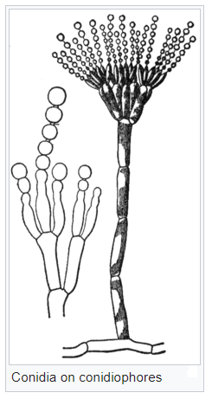
Pulmonary mycosis due to opportunistic fungi
1- Aspergillosis
A fungus infection caused by Aspergillus spp.
Wide spread as saprophytic moulds.
Filamentous fungus with septate hyphae and Aspergillus head (conidia or spores).
Airborne found in soil, water, contaminate starchy food, on decaying organic vegetation, on pillow or bedding, and air conditions.

Slide 16
Causes: 3 important medical species
1- A. fumigatus causing pulmonary aspergillosis.
2- A. flavus causes sinus and cutaneous infections..
3- A. niger causing invasive infections and otitis.
Pulmonary aspergillosis
It is a disease affecting the lung caused by A. fumigatus fungus.
Portal of entry: nasal passage & respiratory tract (inhalation of spores).
The disease my occurs in 3 forms:
1- Allergic pulmonary aspergillosis.
2- Aspergilloma or fungal ball.
3- Invasive aspergillosis.

Slide 17
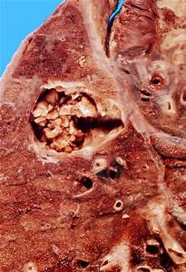
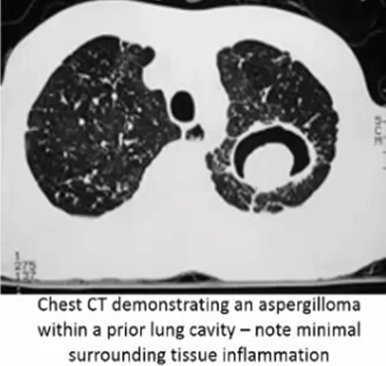
1- Allergic pulmonary aspergillosis
Occurs due to hypersensitivity reaction to A. fumigatus infection of the major air ways.
C/P: recurrent attack of wheeze, cough & expectoration.
2- Aspergilloma or fungal ball
Fungal colonization of A. fumigatus in a pre-existing lung cavity (TB) or dilated bronchus without tissue invasion.
C/P: usually asymptomatic may be haemoptysis occurs.

Slide 18
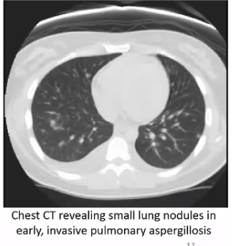
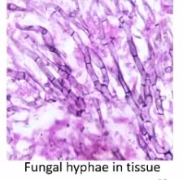
3- Invasive aspergillosis
Affect mainly imunocompromised patients.
Causing acute pneumonia & haemoptysis with or without dissemination.
Laboratory diagnosis
Culture:
On sabouraud’s agar.
Aspergillus spp. can be identify by the pigmentation of their growth in the culture as follows:
A. fumigatus: gives white filaments with green spores.
A. flavus : gives white filaments with yellowish green spores.
A. niger : gives white filaments with black spores.

Slide 19
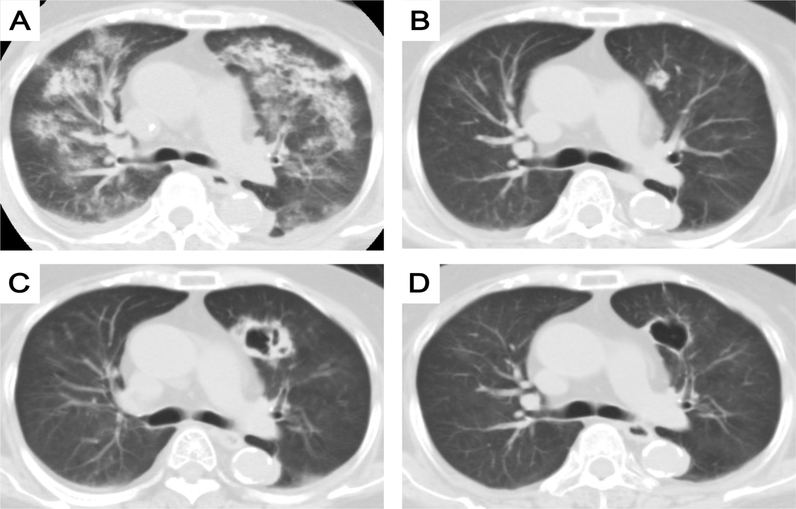
Invasive aspergillosis
Treatment
1- Antifungal drugs in invasive pulmonary aspergillosis and dissiminated disease:
Amphotricine B (IV) & oral itraconazole.
2- Surgical removal of fungal ball in lung.

