Slide 1
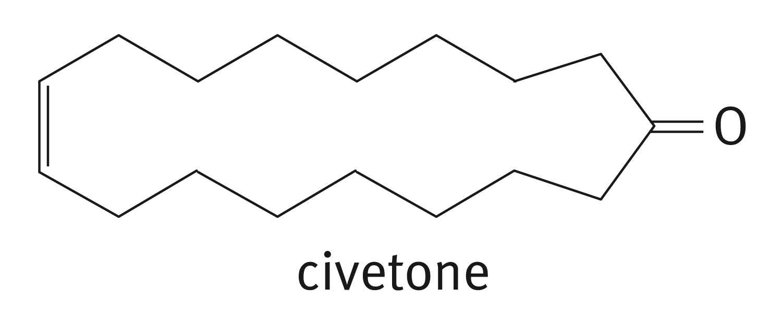
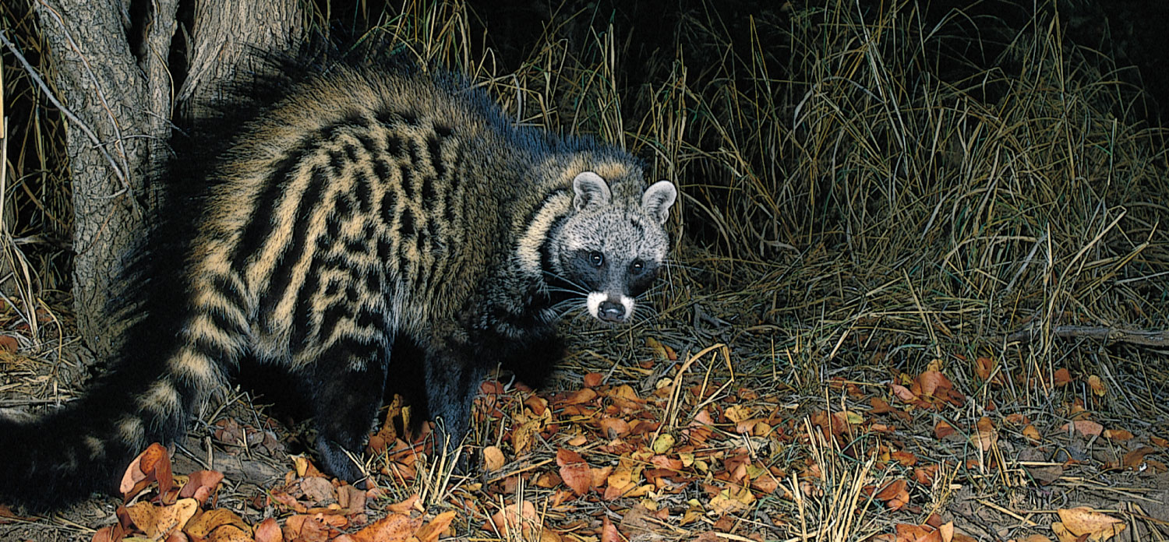
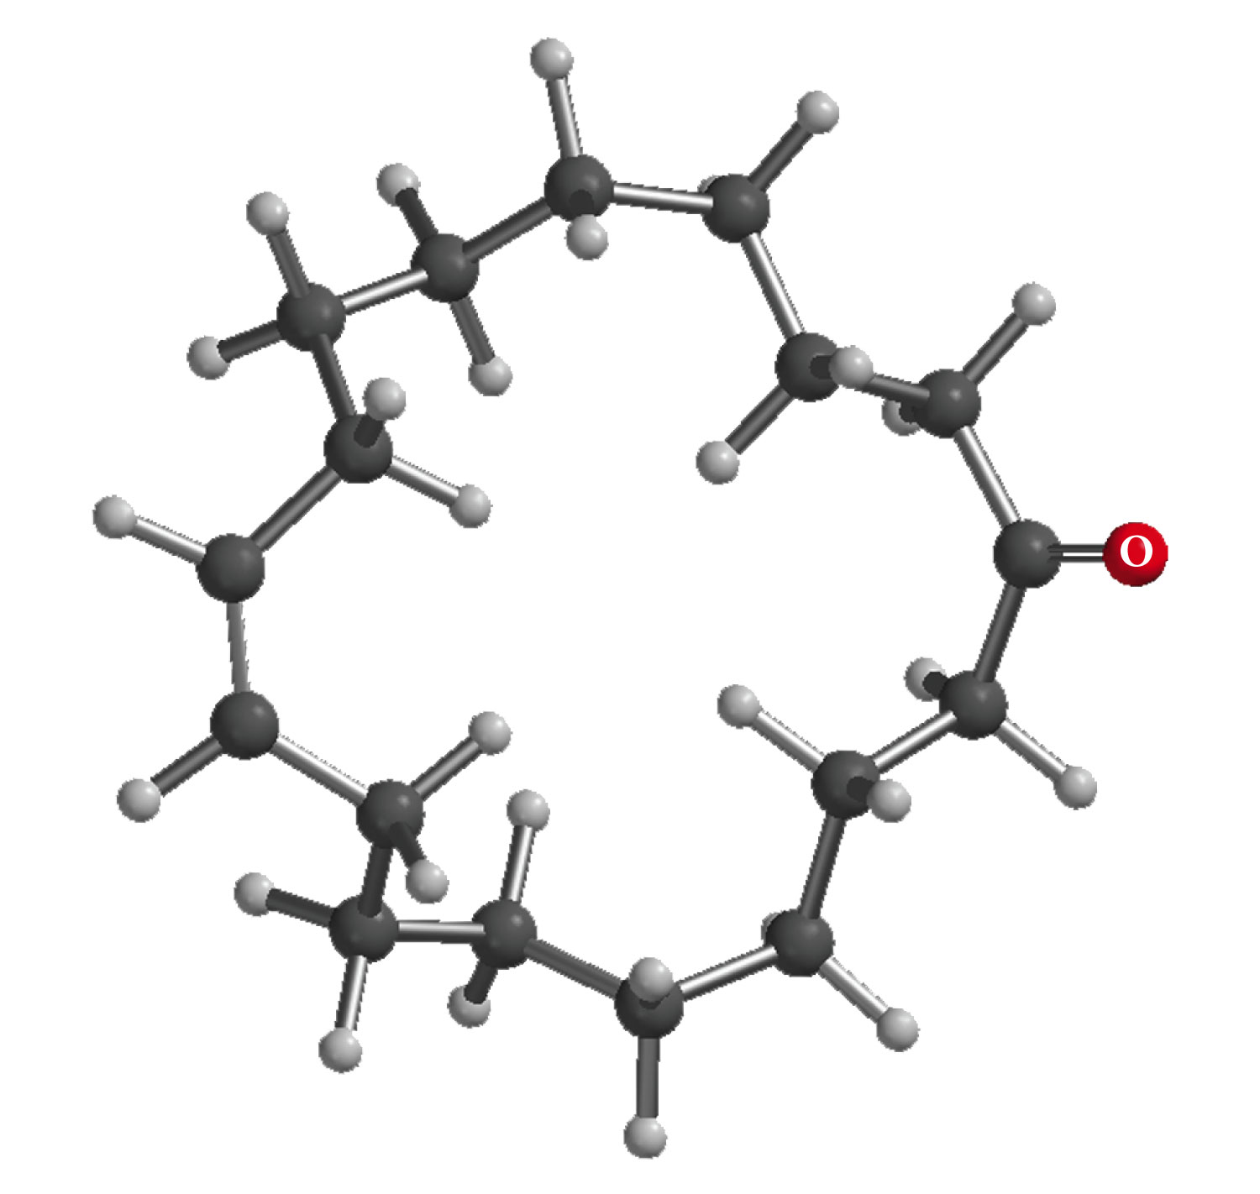
Chapter 9: Aldehydes and Ketones
The Civet Cat is the original source of civetone, a sweet and pungent ketone used as a fixative in perfumery

Slide 2
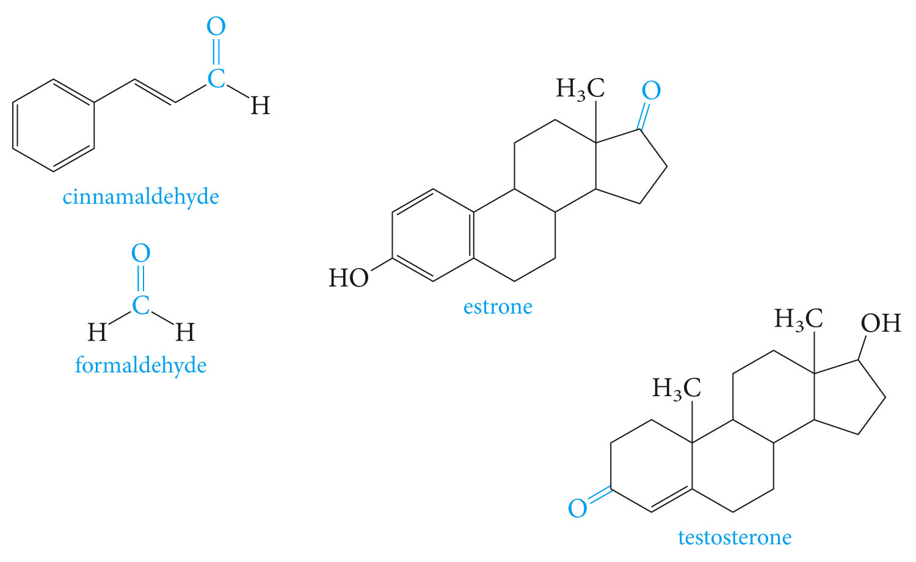
Aldehydes and ketones are found in many fragrant odors of many fruits, fine perfumes, hormones etc. some examples are listed below.

Slide 3
# Aldehydes and ketones are characterized by the presence of the carbonyl group, which is perhaps the most important functional group in organic chemistry.
# Aldehydes have at least one hydrogen atom attached to the carbonyl carbon atom. The remaining group may be another hydrogen atom or any aliphatic or aromatic group. The –CH=O group characteristic of aldehydes is often called a formyl group.
# In ketones, the carbonyl carbon atom is connected to two other carbon atoms
The carbonyl group is in many compounds including carboxylic acids and their derivatives.

Slide 4
Functional Group: The Carbonyl Group
# The carbonyl carbon is sp² –hybridized, the carbon-oxygen double bond consists of a sigma bond and a pi bond.
# The three atoms attached to the carbonyl carbon lie on the same plane with bond angle of 120⁰.
# The C=O bond distance is 1.24 Å, shorter than a C-O single bond in ethers and alcohols (1.43 Å)
The C=O bond is polarized

Slide 5
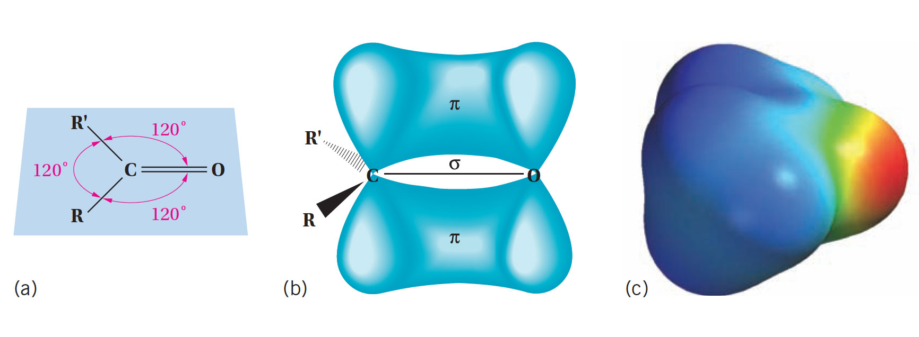

Slide 6
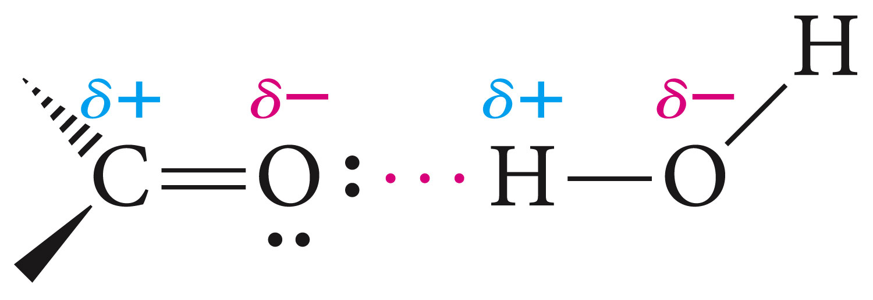
# Aldehydes and ketones that have a C=O bond , but no O-H bond, cannot form hydrogen bonds with one another, as alcohols.
# Aldehyde and ketones therefore have relatively higher boiling points than hydrocarbons, but less than alcohols.
# Low molecular weight aldehydes and ketones are water soluble as they can for hydrogen bonds with the water molecules but not with themselves.

Slide 7
Clicker Question
Arrange Benzaldehyde (MW=106), Benzyl alcohol (MW=108) and
p-Xylene (MW=106) in order of increasing boiling point?
A. Benzaldehyde<Benzyl alcohol<p-Xylene
B. Benzyl alcohol<Benzaldehyde<p-Xylene
C. p-Xylene<Benzaldehyde<Benzyl alcohol
D. p-Xylene<Benzyl alcohol<Benzaldehyde

Slide 8
Nomenclature;
In the IUPAC system, the characteristic ending for aldehydes is –al from the first syllable of aldehyde)

Slide 9
In the presence of a double bond or an alcohol group, the aldehyde group takes priority

Slide 10
For cyclic aldehydes the suffix –carbaldehyde is used. Most of the aromatic aldehydes have common names.

Slide 11
The ending of ketones is –one (from the the last syllable of ketone). The chain is numbered so that the carbonyl carbon has the lowest possible number.

Slide 13
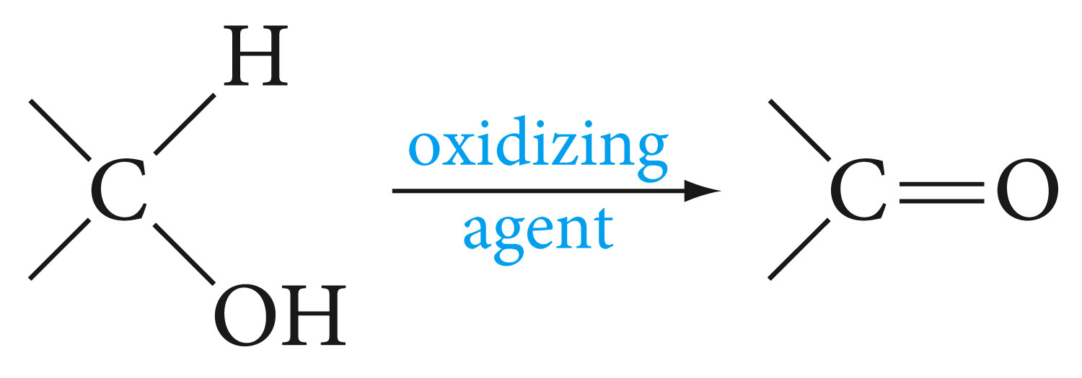
Synthesis of Aldehydes and Ketones
1- Aldehydes and ketones are mostly prepared by the oxidation of primary and secondary alcohols respectively. Chromium reagents such as pyridinium chlorochromate (PCC), are commonly used in the laboratory.
example

Slide 14
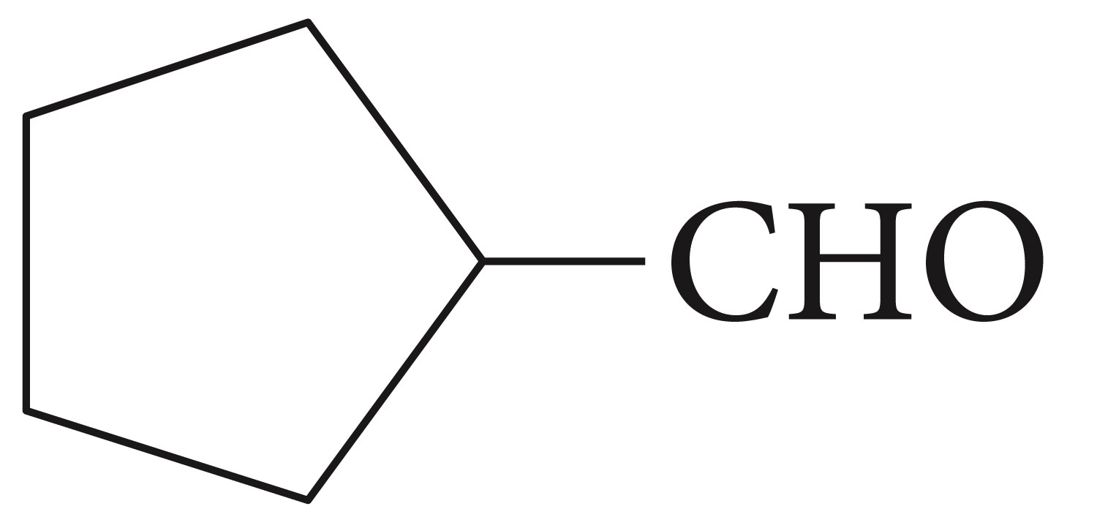
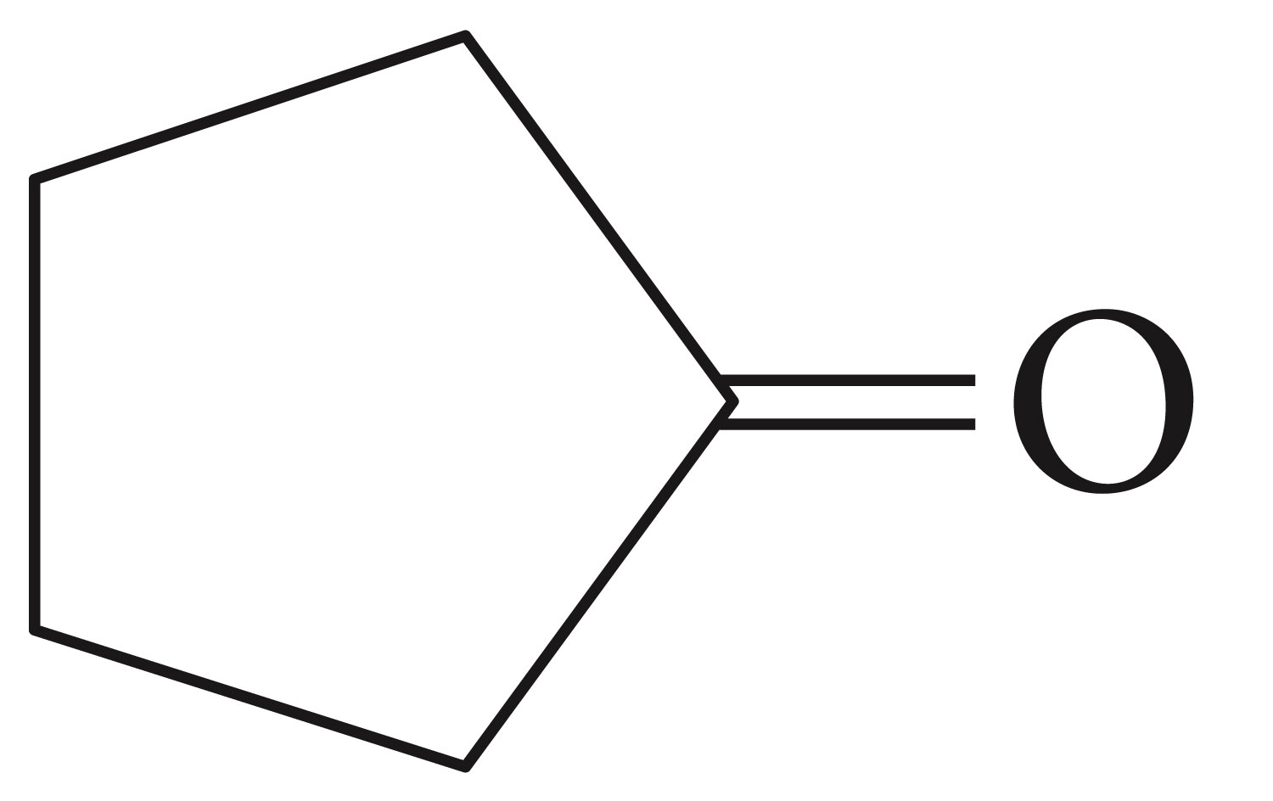
Using an appropriate alcohol, write an equation to show how the following compounds can be made by oxidation.

Slide 15
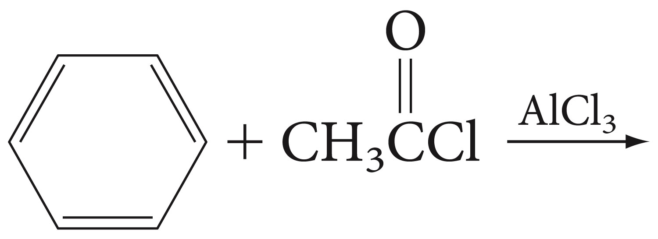
2- Aromatic ketones can be prepared by Friedel-Crafts acylation of an aromatic ring

Slide 16
3- Methyl ketones can be prepared by the hydration of terminal alkynes, catalyzed by acid and mercury ion.

Slide 17
Reactions of Aldehydes and Ketones:
1-Nucleophilic Addition to Carbonyl Groups
Nucleophiles attack the carbon atom of a carbon-oxygen double bond because that carbon has a partial positive charge. The pi-electrons of the C=O bond move to the oxygen atom

Slide 18
Acids can catalyze the addition of weak nucleophiles to carbonyl compounds by protonating the carbonyl oxygen atom. This makes the carbonyl carbon more electrophilic and reactive by converting it to a carbocation thereby enhancing is susceptibility to attack by nucleophiles.
Classification of Nucleophiles;
Those that add reversibly are also good leaving groups and are conjugate bases of relatively strong acids
Those that add irreversibly are poor leaving groups, and are conjugate bases of weak acids.

Slide 19
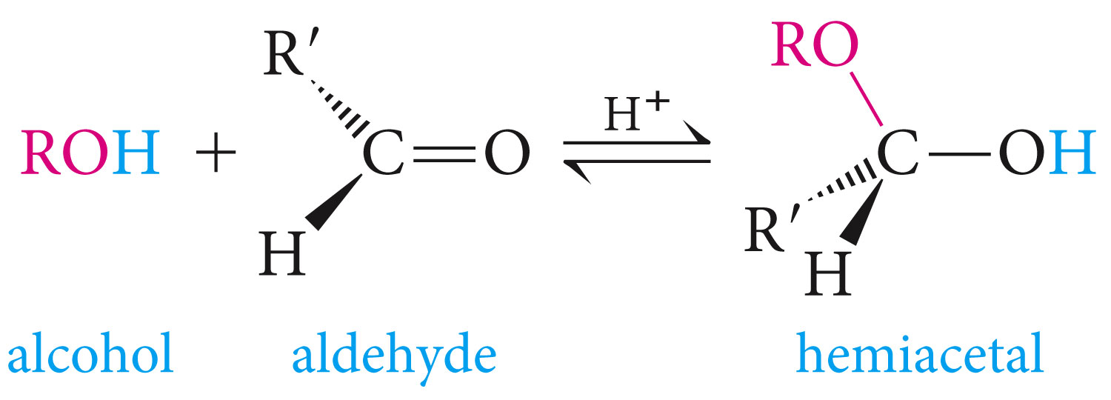
A- Addition of Alcohols: Formation of Hemiacetals and Acetals
Alcohols are oxygen nucleophiles, they add to the C=O bond, the OR group becoming attached to the carbon and the proton becoming attached to the oxygen.
The product is a hemiacetal which contains both alcohol and ether groups on the same carbon.
The addition process is reversible

Slide 20
In the presence of excess alcohol, hemiacetals react to form acetals.
acetals have two ether functional groups at the same carbon atom.

Slide 21
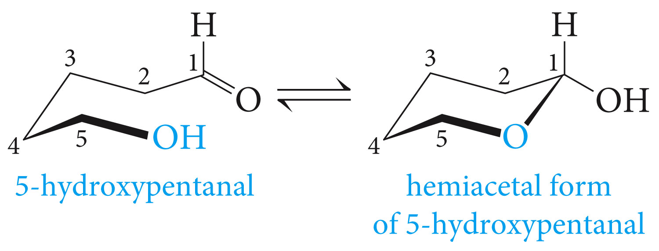
Aldehydes that have an appropriately located hydroxyl group in he same molecule may exists with cyclic hemiacetal, formed from intramolecular nucleophilic addition.

Slide 22
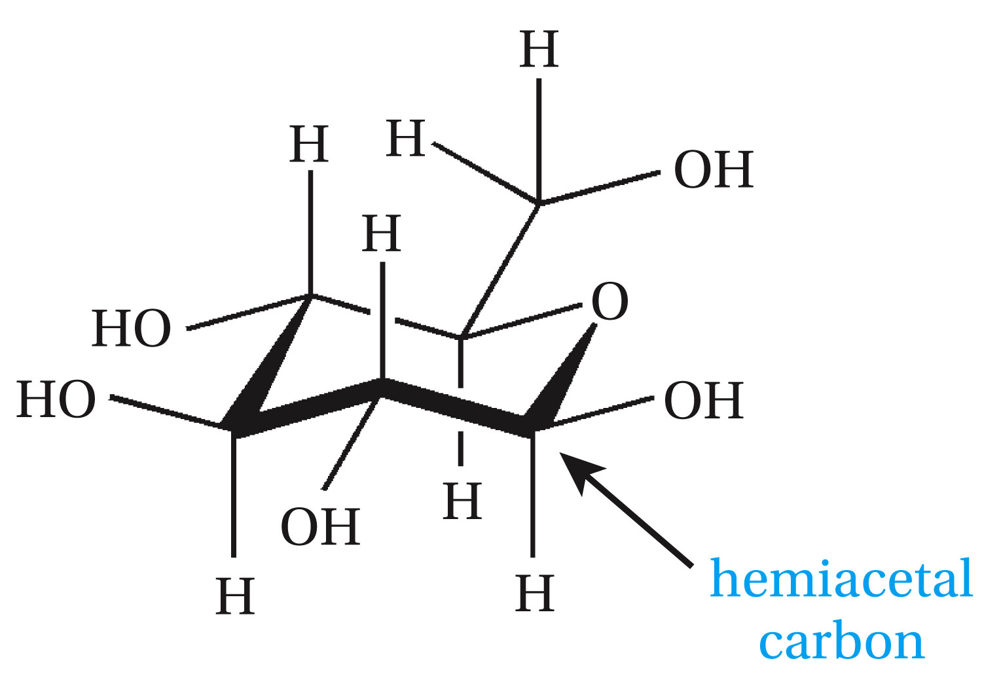
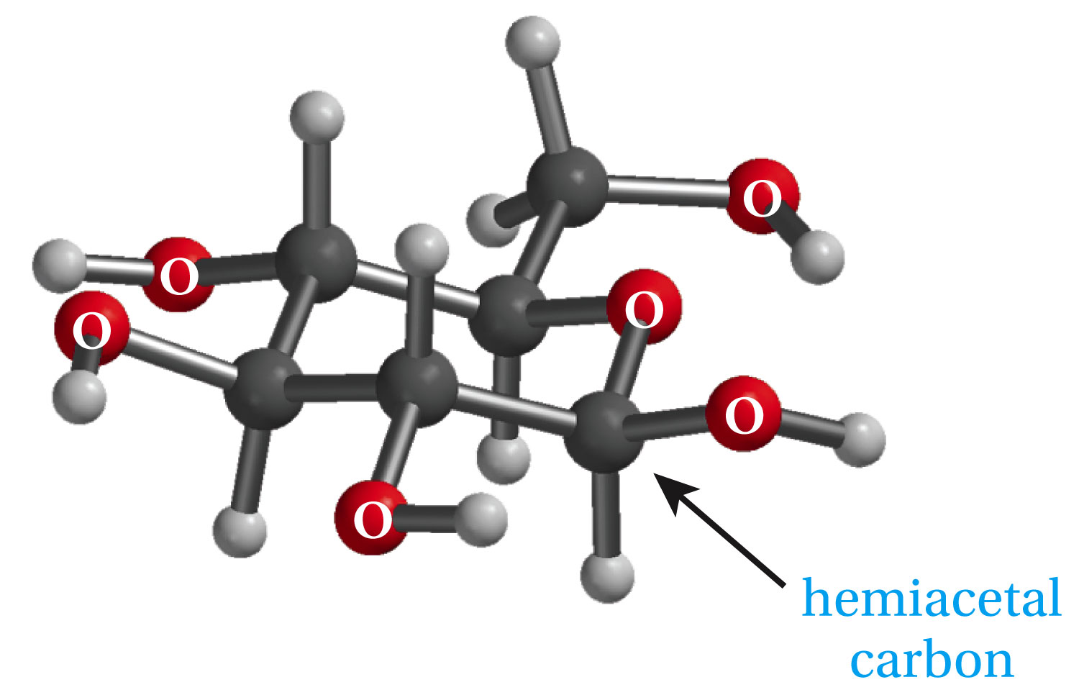

Slide 23
Ketones also form acetals. If glycol is used as in the example below, the product is a cyclic acetal.

Slide 24
Reaction summary
Question
Write the equation for the reaction of benzaldehyde with excess methanol and an acid catalyst.

Slide 25
The reverse of acetal formation if acetal hydrolysis. This is achieved by excess water in the presence of an acid catalyst.

Slide 26
B- Addition of Water: Hydration of Aldehydes and Ketones

Slide 27
C- Addition of Grignard Reagents and Acetylides

Slide 30
Example;
What is the product expected from the reaction of ethylmagnesium bromide and 3-pentanone followed by hydrolysis?

Slide 31
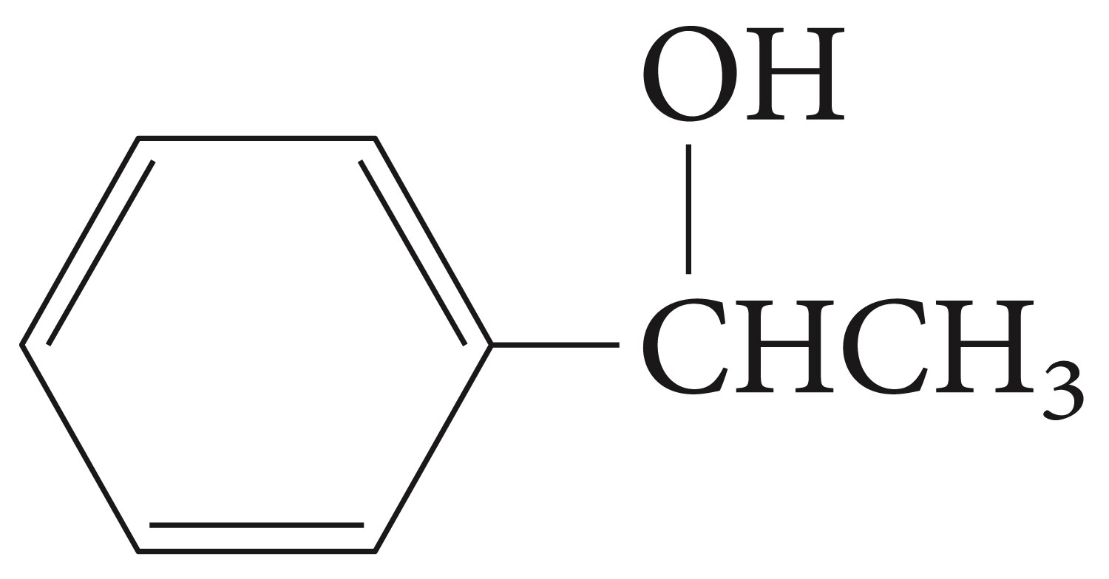
Show how the following alcohol can be made from a Grignard reagent and a carbonyl compound:

Slide 32
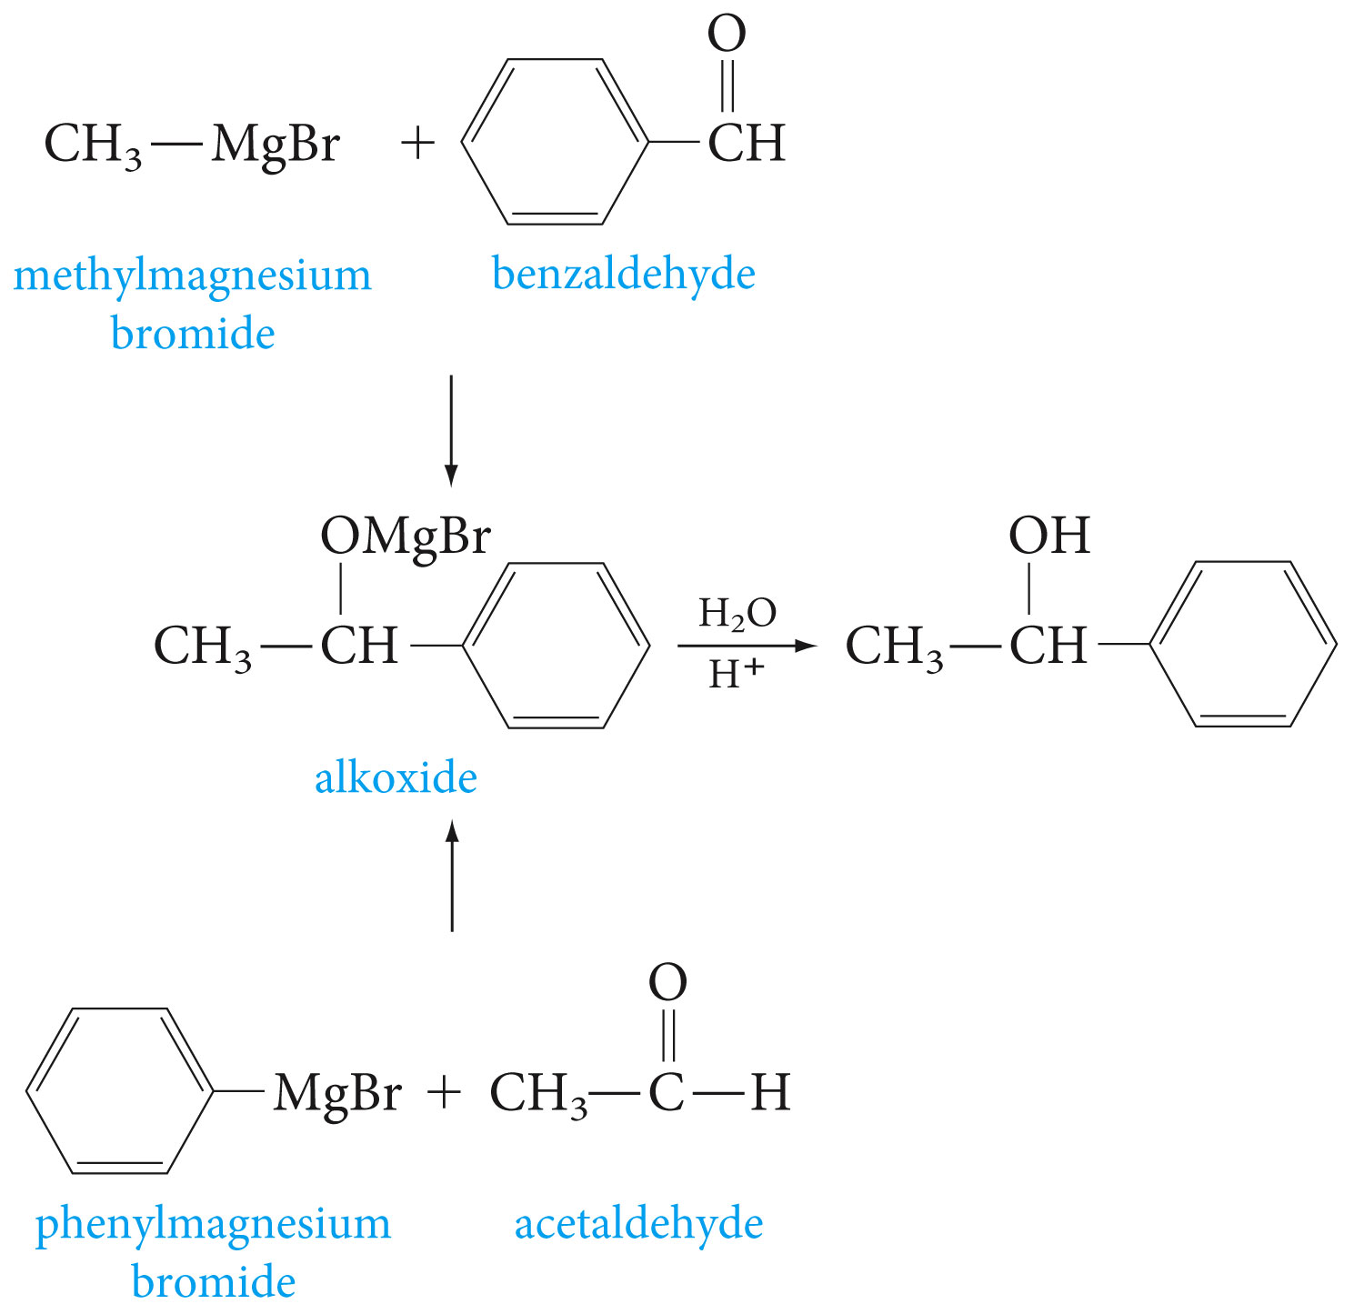

Slide 33
Other organometallic reagents, such as organolithium compounds and acetylides, react with carbonyl compounds in a similar fashion to Grignard reagents.
Example

Slide 34
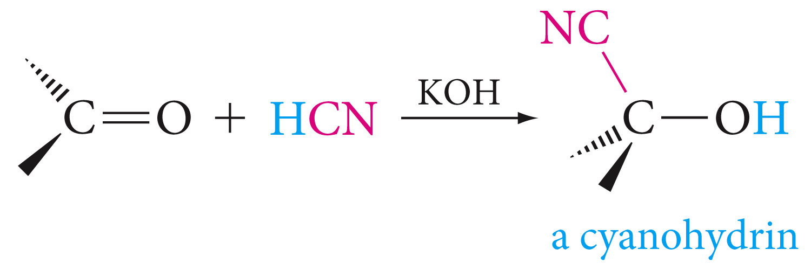
D- Addition of Hydrogen Cyanide; Cyanohydrins

Slide 36
E- Addition of Nitrogen Nucleopiles

Slide 37
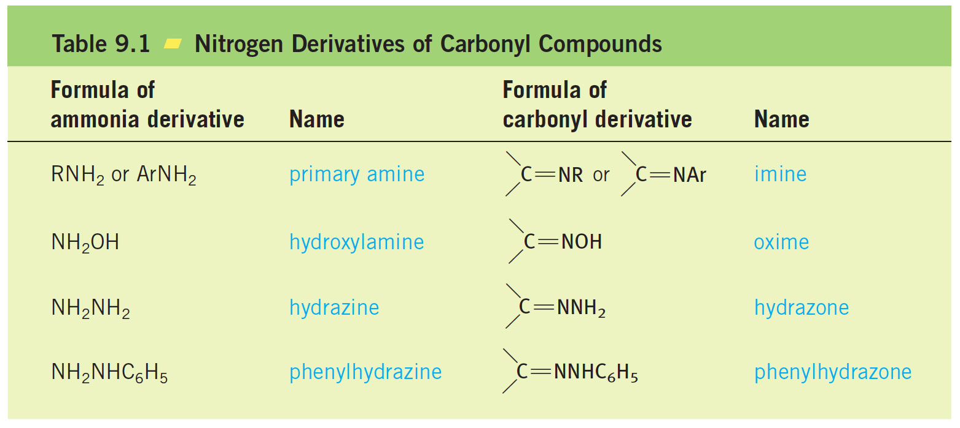

Slide 39
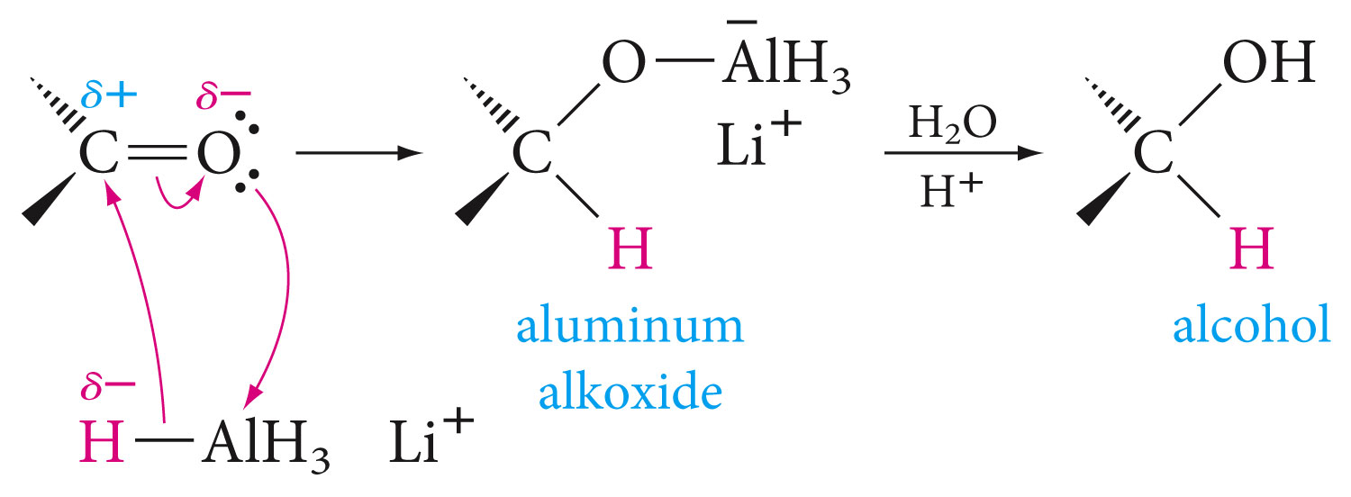
F- Reduction of Carbonyl Compounds
Aldehydes and ketones are easily reduced to primary and secondary alcohols respectively. Reduction can be accomplished in many ways, most commonly by metal hydrides.
Lithium aluminum hydride (LiAlH₄) and sodium borohydride (NaBH₄) are among the commonly used.

Slide 41
Because a carbon-carbon double bond is not readily attacked by nucleophiles, metal hydrides can be used to reduce a carbon-oxygen double bond to the corresponding alcohol without reducing the alkene.

Slide 42
H- Oxidation of Carbonyl Compounds
Aldehydes are more easily oxidized than ketones. Oxidation of an aldehyde gives a carboxylic acid with the same number of carbon atoms.
Oxidation may be achieved by many oxidizing agents, such as KMnO₄, CrO₃, Ag₂O, and peracids.

Slide 43
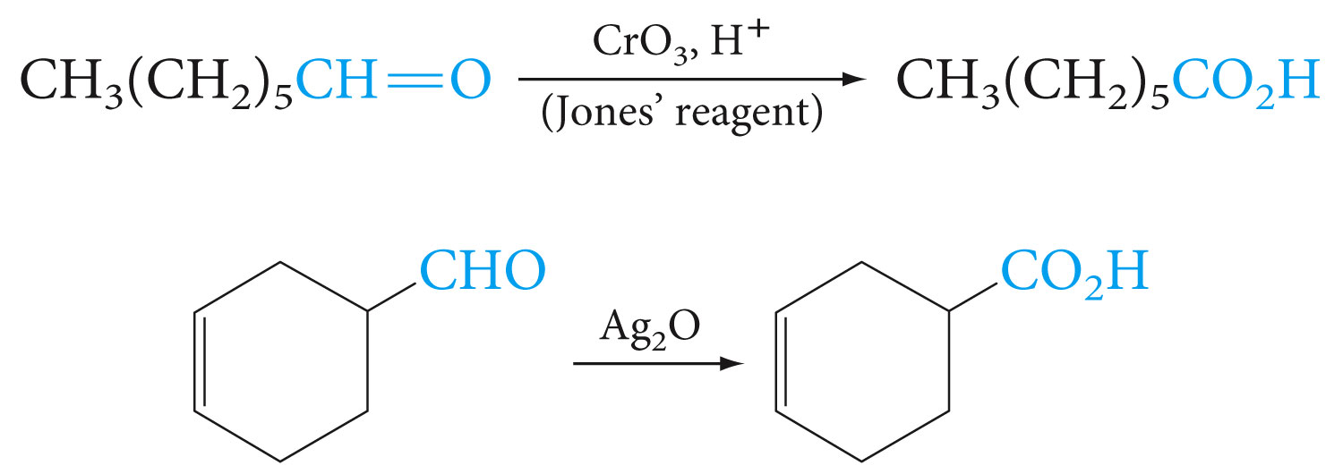

Slide 44
Silver ion as an oxidizing agent is expensive but has the virtue that it selectively oxidizes aldehydes to carboxylic acids in the presence of alkenes.
A laboratory test that distinguishes aldehydes from ketones takes advantage of their different ease of oxidation. In the Tollen’s silver mirror test, the silver-ammonia complex ion is reduced by aldehydes (but not ketones) to metallic silver according to the equation bellow.

Slide 45
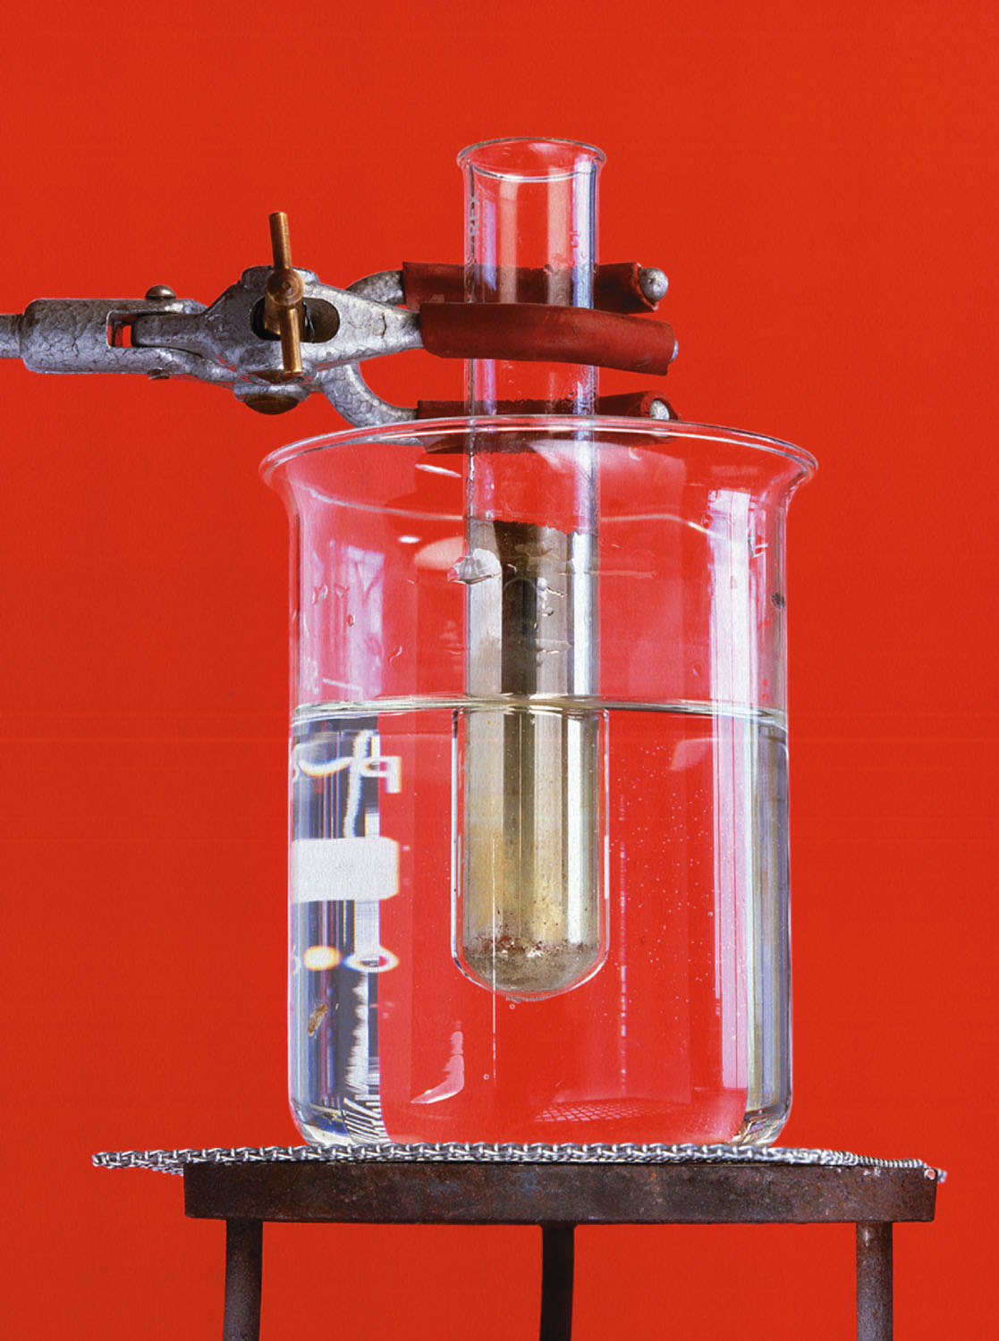
If the glass vessel in which the test is performed is thoroughly clean, the silver deposits as a mirror on the glass surface.

