Slide 1
Body fluids
and its compartments
BY
Dr. Nour A. Mohammed
MUTAH SCHOOL OF MEDICINE

Slide 2
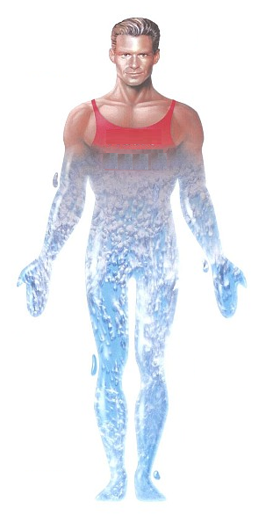
-Water is the most abundant constituent in our bodies.
- It forms 60% of total body weight of normal adult male weighing 70 Kg.
Water
60 %
Body weight
70 Kg

Slide 3
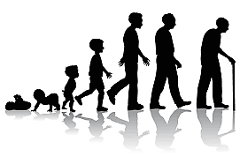
Age
Sex
Notes:
Water body content differs according age & sex

Slide 4
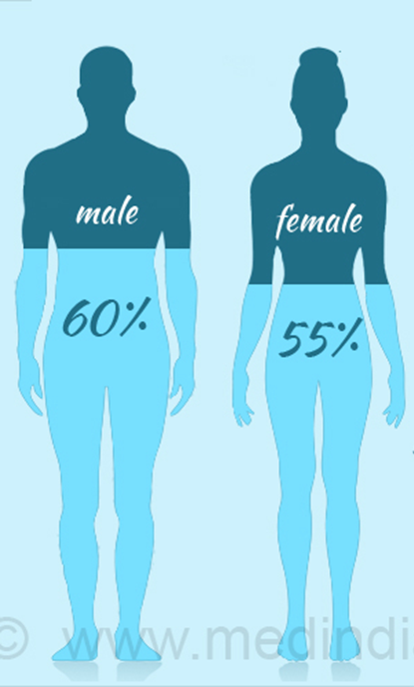
Sex
Fat cells contain less water and thus females (being fattier than males) contain slightly less water.
Notes:
Male= 60%, Female = 55%

Slide 5
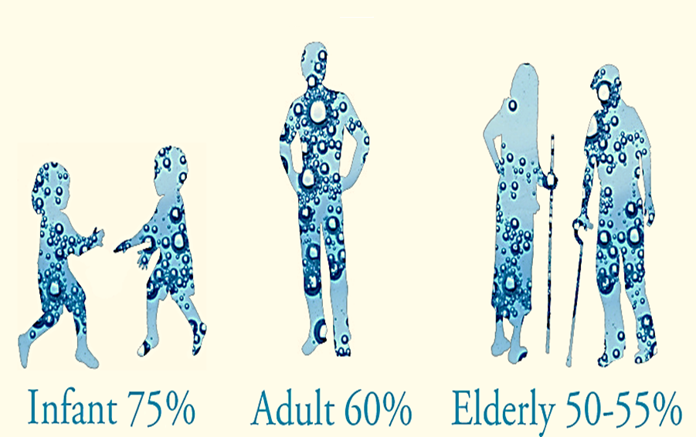
Age
Although the newly born have more percentage of their body as water
than adults, yet most of their body water is intracellular and the
percentage of their ECF is less than adults thus they are more liable to
dehydration in cases of vomiting and diarrhea than adults.

Slide 6
Composition
& distribution
of body fluids

Slide 7
1- Composition of body fluids
Water
Solids
Inorganic
= ions
Na+, K+, Ca++..
Body fluid
Organic:
-Glucose.
-Amino acids.
-Enzymes.
-Hormones.

Slide 8
2- Distribution of body fluids
Total Body fluid
Intracellular Fluid (40%)
Extracellular Fluid (20%)
Intravascular Fluid
(Plasma)
Interstitial Fluid
Transcellular Fluid
Lymph
Joint Fluid
Pericardial Fluid
Pleural Fluid
CSF

Slide 9
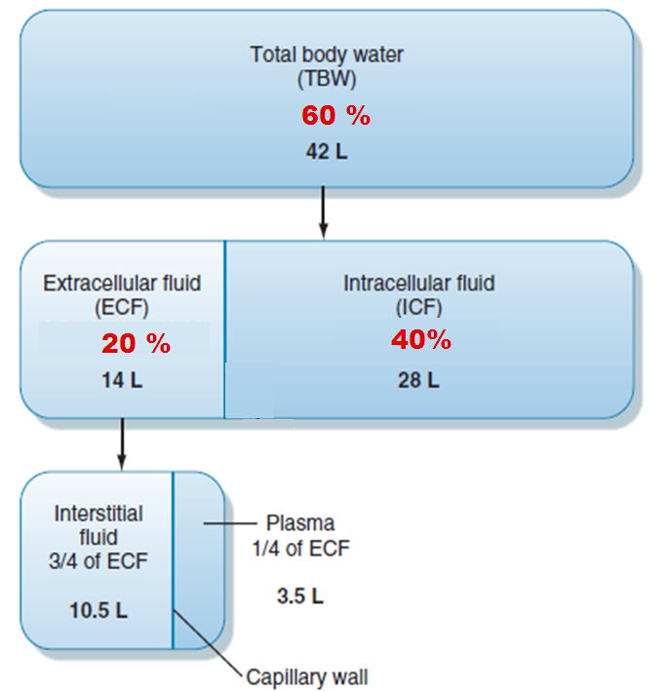
Notes:
total body water volume is 42L:
there are 14L of extracellular ﬂuid and 28L of intracellular ﬂuid.
Extracellular ﬂuid comprises
the blood plasma (3.5L),
interstitial ﬂuid (including bone and connective tissues, 10.5L)
one liter represented as other fluids e.g. lymph, C.S.F, pericardial, pleural, and joints fluid.

Slide 10
1
2
3
Notes:
Intracellular = (1)
Extracellular = Plasma (2) + Interstitial fluid (3)

Slide 11
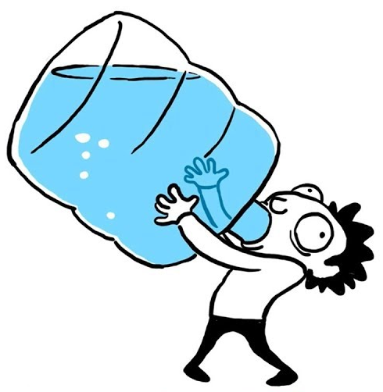
What is the importance of body fluid ?

Slide 12
Water is the origin of life, and there is no form of life can be maintained without water. Moreover, all the chemical & biological reactions in the body must be performed in an aqueous media.
Some other vital functions of water are:
1. It favors ionization of dissolved salts.
2. It regulates body temperature via both heat loss and heat gain balance.
3. It gives the blood its fluidity to reach all cells and to maintain BP.

Slide 13
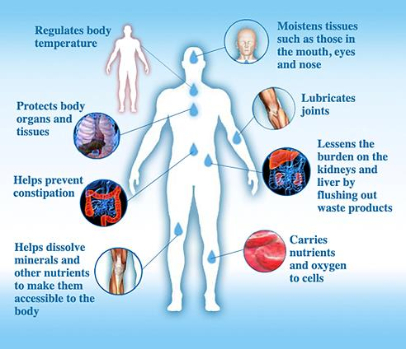

Slide 14
Body water balance
It is the balance between water intake and water loss.
In comfortable zone of body temperature (22oC ) it was estimated that water intake by normal adult 70kg male= 2500 ml/day which distributed as follow: 1500 ml is taken as pure water and beverages (tea for example), 800 ml from food as fruits and vegetables and 200ml from metabolic processes.
The water loss normally = 2500ml/day which distributed as follow:
1500 ml excreted as urine, 900ml evaporated from the skin and lungs and 100 ml excreted in feces.
The amount of water lost by sweating is highly variable, depending on physical activity and environmental temperature.
The volume of sweat normally is about 100 ml/day.
Obligatory water loss = 1 L/day. So, minimal intake of 1 L/day is essential for life as there is No reserve of water in the body.

Slide 15
Regulation of Water Intake (Thirst Sensation)
The stimuli of thirst sensations are:
1. Increased plasma osmolarity either due to pure water loss or excessive intake of salts.
2. Loss of large amount of ECF fluid (following vomiting or diarrhea).
3. Hemorrhage and shock.
4. Dryness of mouth (from inhibition of salivary secretion).
5. Increased angiotensin II secretion.
Thirst center located in the hypothalamus.

Slide 17
A serious problem that faces us that there is no reserve of water in our bodies despite the large amount present.
A reduction of 5% of water content makes the person very thirsty, a loss of 10% makes him very ill while a reduction of 20% will kill him.
without water intake there is obligatory water loss = 1 liter/day (in urine, insensible perspiration and in expired air) thus death occurs even in cool climate if water is not totally taken after 4-6 days.
A minimal intake of liter/day is essential for life.
Antidiuretic hormone “ADH” controls water loss by the kidney.

Slide 18
How can we measure body fluid volume??

Slide 19
DILUTION PRINCIPLE
Based on using a marker whose concentration can be measured.
Inject x gm of marker into compartment
measure concentration at equilibrium (y gm/L)
Since concentration = mass / volume
Volume = mass / concentration
V = x/y L

Slide 20
Total body water volume
It is measured by the application of the Indicator dilution principle or dye dilution principle.
CA x VA = CB x VB
Notes:
Heavy water= deuterium used to caculate toody water volume

Slide 21
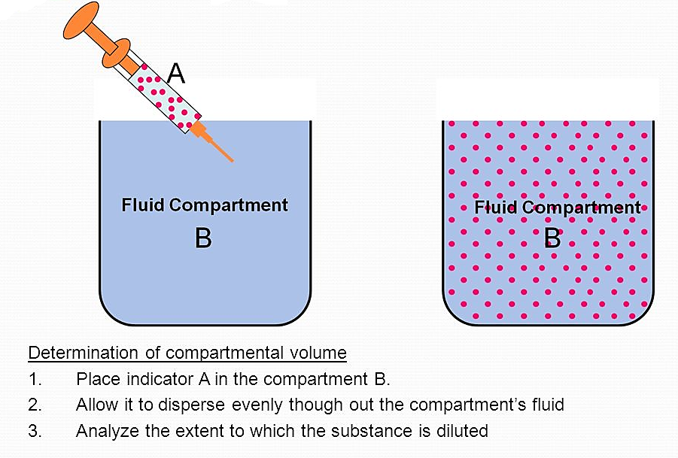

Slide 25
Activity time!

Slide 26
In 1mL of solution a certain mass of dye is dispersed resulted in concentration equal (10mg/mL) then dye in chamber B and final concentration in the chamber is 0.01mg/mL .
What is the volume in chamber B?

