Slide 1
Prostatic cancer

Slide 2
Prostatic cancer - Epidemiology
Most prevalent cancer in males >65 y.o.
3rd leading cause of male cancer deaths
75% diagnosed between ages of 60 and 85 ( mean age at diagnosis is 72 )
Latent cancer present in 25% of screened patients and 50% of post-mortem patients

Slide 3
Risk factors
Age → much more common in over 70s
African Americans
Family Hx → 1st degree relative = 2X risk
→ 1st and 2nd degree relatives = 9X risk
High dietary fat
Familial Ca prostate gene – Chr 1

Slide 4
Histopathology
An adenocarcinoma and usually originates in the PZ (70%). Therefore prostatectomy for BPH does not protect from subsequent carcinoma.
10-20% may arise from the TZ → good prognosis
5-10% may arise from the CZ.
Mets to prostate are very rare.
Prostatic Intraepithelial Neoplasia (consists of architecturally benign prostatic acini and ducts lined by cytologically atypical cells)
→ chance of cancer is 30-40%

Slide 5
Clinical features
Early prostate cancer usually asymptomatic
If symptomatic:
Storage and voiding :uncommon w\o spread
Obstructive symptoms: hesitancy, decreased force and caliber of the stream, sensation of incomplete bladder emptying ,straining to urinate, postvoid dribbling.
Irritative symptoms: frequency, urgency , nocturia
Back pain, incontinence
Bone pain ( mets )
Leg pain and edema (nodal mets → lymphatic and venous obstruction)

Slide 6
Notes:
Voiding symptom

Slide 7
Diagnosis
Digital rectal exam. (DRE)
Or as an incidental finding on TURP
Investigations
Elevated PSA
Transrectal ultrasound (TRUS)
Biopsy
Bone scan and CT scan to assess mets
Notes:
Transurethral resection of the prostate TURP

Slide 8
DRE
Stony hard irregular nodules or diffuse dense induration involving one or both lobes (normally is firm)
The prostate is asymmetrically enlarged.
Heterogeneous in texture; some areas are hard others are soft.
The median sulcus may be absent.
Rectal mucosa may be tethered to the gland.
50% of abnormal DREs are associated with prostate cancer, the remainder being benign hyperplasia, prostatic calculi, chronic prostatitis, or post-radiotherapy change

Slide 9
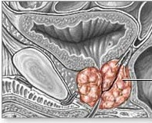

Slide 10
Prostate Specific Antigen (PSA)
Enzyme released by prostate during ejaculation
PSA is prostate-specific, but not prostate cancer-specific.
Leaks into circulation < 4 ng/ml
Other causes of elevated serum PSA are :
- BPH
- UTI
Prostatitis
Prostatic massage
- Acute urinary retention
- Biopsy, TURP, surgery
- Ejaculation
- DRE

Slide 11
PSA
Total PSA = free PSA 15% + complexed PSA (85%)
Free to total PSA ratio :
In prostate cancer the complexed PSA increases and the free decreases
<10% free PSA (of total) → suggestive for cancer
>20% free PSA → suggests benign cause

Slide 12
PSA density = Serum PSA/prostate volume
>0.15 ng/ml/g associated with increase risk of cancer
PSA velocity
Change of >0.75 ng/ml/year associated with increased risk of cancer
PSA elevations may help in staging, and following up.

Slide 13
Age adjusted PSA reference ranges
PSA normal range(ng/ml) | age
0-2.5 | 40-49
0-3.5 | 50-59
0-4.5 | 60-69
0-6.5 | 70-79

Slide 14
Transrectal ultrasound (TRUS)
TRUS is useful in:
prostatic biopsies under TRUS guidance
Staging information (detect extracapsular extension)
Measurement of prostate volume.

Slide 15
TRUS-guided needle biopsy
The decision to proceed to prostate biopsy should be based primarily on PSA and DRE results , but should take into account multiple factors ( free and total PSA , pnt age, PSA velocity , PSA density, family Hx, ethnicity and comorbidities)

Slide 16
Complications of prostatic biopsy
Vaso-vagal ,fainting immediately after the procedure.
Septicaemia.
Rectal bleeding.
Mild haemospermia or haematuria, for up to three weeks.

Slide 17
Methods of tumor spread
Local invasion
Lymphatic ( obturator > iliac > presacral/para-aortic)
Hematogenous
Prostatic CA is the commonest site of origin for skeletal mets → osteoblastic (sclerosis)

Slide 18
Staging
The TNM system, evaluates the size of the tumor, the extent of involved lymph nodes, and any metastasis.
Gleason’s system

Slide 19
“T”- Primary tumor
TX: cannot evaluate the primary tumor
T0: no evidence of tumor
T1: clinically undetectable tumor, normal DRE and TRUS
T1a: tumor was incidentally found in less than 5% of prostate tissue resected (for other reasons)
T1b: tumor was incidentally found in greater than 5% of prostate tissue resected
T1c: tumor was found in a needle biopsy performed due to an elevated serum PSA
T2: palpable, confined to prostate
T2a: the tumor is in half or less than half of one lobe of the prostate gland's T2b: the tumor is in more than half of one lobe, but not both
T2c: the tumor is in both lobes
T3: the tumor extends through the prostatic capsule (if it is only part- way through, it is still T2)
T3a: the tumor has spread through the capsule on one or both sides
T3b: the tumor has invaded one or both seminal vesicles
T4: the tumor has invaded adjacent structures

Slide 20
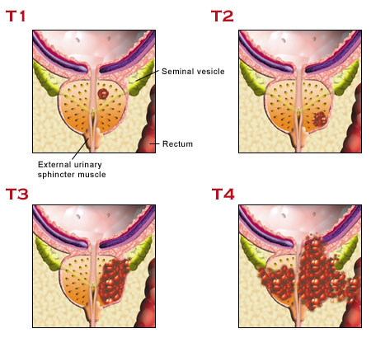

Slide 21
“N”
N0: no regional lymph node metastasis
N1: spread to regional lymph nodes
“M”
M0: there is no distant metastasis
M1: there is distant metastasis
M1a: non-regional L.N
M1b: the cancer has spread to bone
M1c: the cancer has spread to other sites (regardless of bone involvement)

Slide 22
Gleason’s system
It is a system that relies upon the low-power appearance of glandular architecture under the microscope.
Primary grade - assigned to the dominant pattern of the tumor (has to be greater than 50% of the total pattern seen).
Secondary grade - assigned to the next-most frequent pattern (has to be less than 50%, but at least 5%, of the pattern of the total cancer observed).
Gleason sum → is the addition of the primary and secondary glandular patterns present on microscopic examination
Higher Gleason score are more aggressive and have a worse prognosis.
e.g: a Gleason 3+3 = 6 adenocarcinoma carries a worse prognosis than a 3+2 = 5 cancer of equivalent stage.

Slide 23
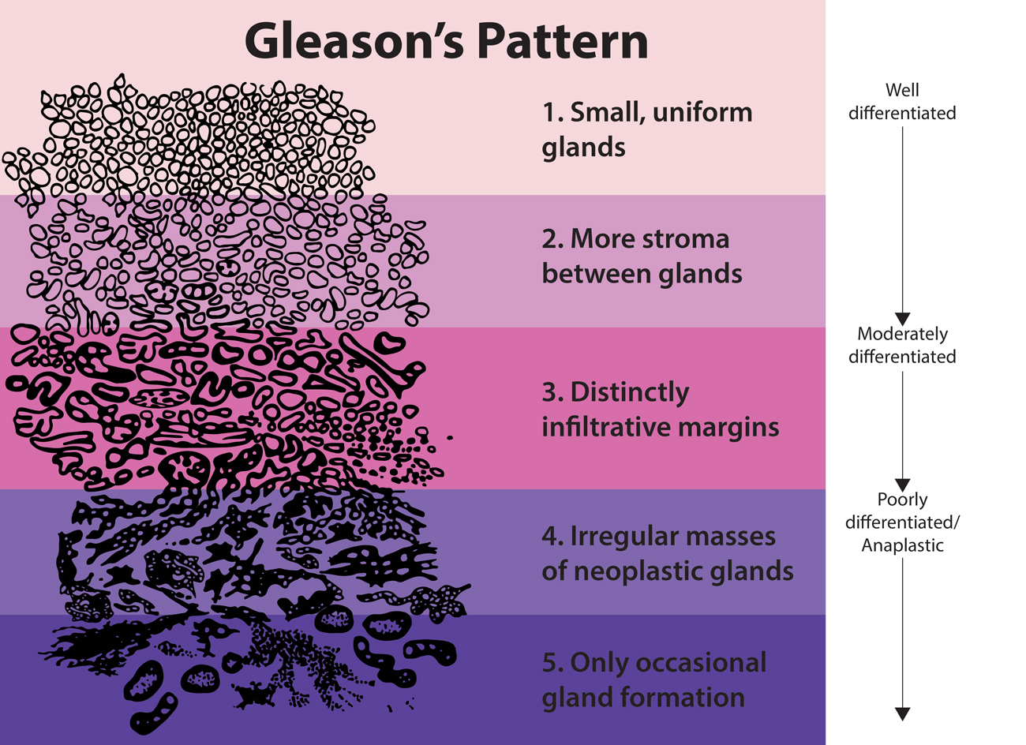
Gleason system
tumour grade (Gleason score out of 10)
2-4 represent well differentiated
5-7 represent moderately differentiated
8-10 represent poorly differentiated

Slide 24
Prostate cancer mortality risk
 | Low risk | Moderate risk | High risk
PSA | <10 | 10-20 | >20
Gleason score | <7 | 7 | 8-10
stage | T1-2a | T2b-T2c | T3/4
Prognostic factors :
Tumor stage, grade , PSA value and PSA doubling time

Slide 25
Prognosis
• T1-T2: comparable to normal life expectancy
• T3-T4: 40-70% 10-yr survival
• N+ and/or M+: 4 % 5 yr survival

Slide 26
Treatment
Mahmoud Alshorman
Musa Ammouri

Slide 27
Treatment
T1\T2 (localised,LOW-RISK)
if young consider radical prostatectomy (<70 y.o.) brachytherapy or radiation.
Older patients treated with watchful waiting or hormone treatment (if PSA>20) → Rarely treat localised cancer in the over 80s
T3\T4
Staging lymphadenectomy and radiation or hormonal
N>0 OR M>0
Hormonal / palliative radiotherapy for mets
Chemotherapy in advanced disease

Slide 28
Of circulating androgen, 95%, mainly testosterone, is produced by the
Leydig cells of the testes under the infl uence of luteinizing hormone (LH).
The anterior pituitary synthesizes LH, stimulated by LH-releasing hormone
(LHRH) produced by the hypothalamus. The remaining 5% of circulating
androgen is synthesized by adrenal cortex from cholesterol

Slide 29
All prostate epithelial cells are dependent on androgens to grow or undergo programmed cell death

Slide 30
Androgen deprivation results in a reduction in PSA and clinical improvement in the majority of patients.
However, most will still die within 5 years because of the development of androgen-independent growth

Slide 31
Hormonal Therapy (androgen deprivation) :
Mechanisms of androgen deprivation
• Surgical castration: bilateral orchiectomy
• Medical castration: LHRH agonists, LHRH antagonists, estrogens
• Antiandrogens (steroidal or nonsteroidal): androgen receptor blockade at target cell
inhibitors of steroidogenesis
• Maximal androgen blockade (MAB): medical or surgical castration plus anti-androgen

Slide 32
Side effects of bilateral orchiectomy and LHRH agonists/antagonists
• Loss libido
• Hot flushes
• Weight gain and obesity
• Gynecomastia
• Anemia
• mood changes
• Metabolic syndrome (increased blood glucose and lipid profile)
• Osteoporosis and pathological fracture occur in patients on long-term treatment

Slide 33
Prognostic factors
Predictors of poor hormone therapy response include the following:
More than 5 metastatic lesions
• Elevated alkaline phosphatase
• Anemia at presentation
• Poor performance status
• Low serum testosterone
• Failure of bone pain to improve within 3 months of treatment
• Failure of PSA to normalize within 6 months of treatment

Slide 34
General principles of management of localized prostate cancer
When considering treatment options for the man with localized prostate
cancer, the following factors should be considered in the discussion:
• Patient’s life expectancy and overall health status
• Tumor characteristics, including Gleason score, tumor stage, PSA
levels, PSA velocity and PSA doubling times
• Risk stratification
• Outcome tools such as nomograms1 and Partin tables
that give specific likelihood of final pathological stage or specific
outcomes based on tumor characteristics and individual treatments
(e.g., brachytherapy, radical prostatectomy, etc.)

Slide 35
Management of localized prostate cancer: watchful waiting and active surveillance
Watchful waiting is based on the premise that some patients will not
benefit from definitive treatment of the primary prostate cancer
active surveillance is based on the concept that some, but
not all, patients may derive benefi t from treatment of their primary prostate
cancer.

Slide 36
Surveillance protocol (if life expectancy <10 years follow up may be less frequent) is as follows:
• Patients must have clinically localized disease and be candidates for
defi nitive treatment and choose observation.
• DRE and PSA as often as every 6 months but at least every 12 months
• Repeat prostate needle biopsy within 6 months of diagnosis if initial
biopsy was <10 cores
• Needle biopsy may be performed within 18 months if >10 cores
obtained initially, then done periodically

Slide 37
Advantages of active surveillance include avoidance of possible side effects and costs of definitive therapy that may be unnecessary, and maintaining quality of life.
Disadvantages include possibly missing an opportunity for cure, the risk of progression and/or metastases, increased anxiety, increased physician visits and tests, and causing subsequent treatment to be more aggressive.

Slide 38
Management of localized prostate cancer: radical prostatectomy
Radical (total) prostatectomy (RP) is excision of the entire prostate,including the prostatic urethra, with the seminal vesicles. It may be performed by open retropubic, perineal, laparoscopic, or robotically assisted laparoscopic approaches.

Slide 39
Postoperative course after radical prostatectomy : Patients are generally hospitalized for 24–48 hours and maintain Foley catheter drainage for 10–14 days.
RP is indicated for the treatment of men in good health with localized prostate cancer whose life expectancy exceeds 10 years, with curative intent.

Slide 40
Complications of radical prostatectomy
General complications
These include those of any major surgery: bleeding requiring reoperation and/or transfusion; infection; thromboembolism; and cardiopulmonary complications or disturbance. These are minimized by attention to hemostasis, prophylactic antimicrobials, pneumatic calf compression, low-dose heparin postoperatively, and early mobilization.

Slide 41
Specific complications—early
Intraoperative obturator nerve, ureteral, or rectal injury (all rare) should be managed immediately if recognized, with end-to-end nerve anastomosis; ureteral reimplantation; or primary three-layer rectal closure with or without a temporary loop colostomy

Slide 42
Postoperative catheter displacement
Postoperative urine or lymphatic leak
Lymphocele (encapsulated collection of lymphatic fluid)

Slide 43
Specific complications—late
Erectile dysfunction (ED)
Incontinence (stress-type)
Bladder neck stenosis (bladder neck contracture), Predisposing factors include heavy bleeding, postoperative urinary leak, and previous TURP….Patients complain of new voiding difficulties, and treatment is by endoscopic bladder neck incision with a laser, cold knife, or electrocautery. Occasionally, chronic dilation may be necessary

Slide 44
Management of localized prostate cancer: radical external beam radiotherapy (EBRT)
Indications
These are clinically localized prostate cancer and life expectancy >5 years.
Contraindications
• Severe lower urinary tract symptoms
• Infl ammatory bowel disease
• Previous pelvic irradiation

Slide 45
• Transient moderate/severe filling-type LUTS (common, rarely permanent) • Hematuria, significant: 4% • Moderate to severe gastrointestinal symptoms, bloody diarrhea, pain: 3–32% (common, rarely permanent) . Erectile dysfunction (ED)
Side effect

Slide 46
Management of localized prostate cancer: brachytherapy (BT)
This is ultrasound-guided transperineal implantation of radioactive seeds,
usually I125,
Indications for BT as monotherapy
BT is best for low-risk disease: localized T1–2a, Gleason <6, PSA <10 ng/
mL prostate cancer, with a life expectancy >5 years.
Indications for BT with EBRT
In the non-protocol setting, patients with intermediate-risk prostate cancer
are sometimes treated in combination: T2b–T2c, Gleason 7, PSA
10–20 ng/mL.

Slide 47
Contraindications to BT
These include previous TURP (risk of incontinence); large-volume prostate (>60 mL), which causes difficulty with seed placement; and moderate to severe lower urinary tract symptoms (risk of retention).
High-risk prostate cancer does not do well with BT monotherapy and should not be performed

Slide 48
Complications
• Perineal hematoma (occasional)
• Lower urinary tract symptoms (common), due to prostatic edema
post-implant
• Urinary retention (5–20%)
• Incontinence (5%), if TURP is required to treat urinary retention
• ED affects up to 50% of patients; gradual onset

Slide 49
Management of localized and radiorecurrent prostate cancer: cryotherapy and HIFU
These two minimally invasive treatments for localized prostate cancer
they are viable alternatives to radical surgery or radiotherapy and that they are options for salvage treatment of organ-confined recurrent disease following radical radiotherapy

Slide 50
Cryotherapy
A transperineal ultrasound-guided cryoprobe delivers argon or liquid nitrogen at a temperature of –20*C to –40*C. When applied in two cycles of freeze–thaw, cellular necrosis occurs. The diameter of the ice ball is monitored using ultrasound; precautions must be taken to protect the urethra, external sphincter, and rectal wall, such as using warming devices.

Slide 51
Complications
These include ED (40–80%); incontinence (4–27%); LUTS due to urethral
sloughing; pelvic pain; transient penile numbness; and rectourethral fistula
(rare).

Slide 52
High-intensity focused ultrasound (HIFU)
HIFU has the potential of selective destruction of tissues at depth without damaging intervening structures. Tissue is heated to the point of coagulative necrosis by high-energy ultrasound transmitted to the prostate using a transrectal device. The tissue temperature is raised locally at this point (over 85°C).

Slide 53
Complications
These include ED, urinary retention, stress incontinence, and recto-urethral fistula (rare).

Slide 54
Management of locally advanced nonmetastatic prostate cancer (T3–4 N0M0)
EBRT
Hormone therapy
Watchful waiting or active surveillance
Palliative treatment of locally advanced disease

