Slide 1
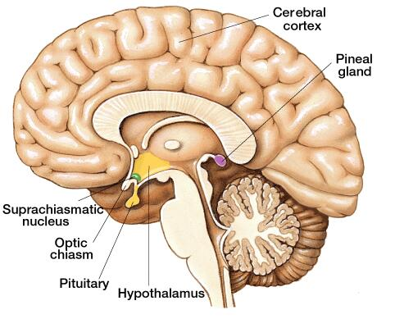
Pineal body (Epiphysis cerebri)
Cerebrum
cerebellum
It is embedded in between the cerebellum and cerebrum. inside the brain
The shape is flattened stalk like structure hence it is called epiphysis.
The name is derived from its pinecone like structure.
known as ‘third eye’ as this gland receives its stimuli through vision

Slide 2
Its a part of brain tissue so it has structure similar to brain structure
Pineal gland
Stroma: pia mater → septa ( BVs & unmyelinated nerve fibers
Parenchyma: Two types of branching cells are present:
Contains
** B.V to receive the secreted hormones
glial cells (astrocytes 5%), small dark nuclei
pinealocytes (95%), are large and lightly stained have larger, lighter and round nuclei secrete melatonin, the secretory cells
Pineal gland don’t have C.T capsule, instead of this capsule it has pia matter as a cover
**Pia matter: inner most layer of meninges, highly vascularized C.T

Slide 3
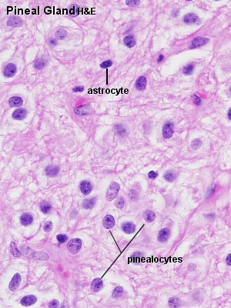
 | Pinealocytes | Astrocytes (neuroglia)
Nuclei | large irregular, active | elongated and denser, inactive, small
Cytoplasm | pale basophilic (contain rER, ribosomes, so it’s a protein secreting cells)
Function | Melatonin secretion | Supportive & nutritive
Function : Pineal gland controls the sex drive, hunger, thirst and the biological clock which determines the body’s normal aging process.
It is a neurosecretory cell the gland secretes melatonin.
It controls sleepiness and wakefulness.
melatonin - is involved in daily cycles or circadian rhythms. Levels are high at night as we grow sleepy & low at day light as we awake. The pineal body is directly light sensitive;
Notes:
3

Slide 4
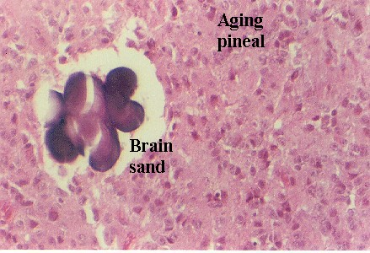
Pineal body with aging
↑ fibrosis
↑ formation of calcified bodies
= (brain sand)
Brain Sand, calcareous secretions (areas of calcification) that are easily seen with the microscope. These are not a degenerative change; not pathological. Normal process occur with aging

Slide 5
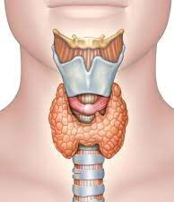
Thyroid gland
Thyroid gland found in the front of the neck
Pyramidal lobe arise from isthmus
R. lobe
L. lobe
Isthmus

Slide 6
Thyroid gland
Structure
Stroma
Thyroid gland is covered by
double capsule
Outer: false capsule, deep cervical fascia = pretracheal fascia
Inner: true CT capsule
incomplete septa divide the capsule into incomplete, false lobes and lobules
reticular fibers = elastic fibers with lose C.T
Lose C.T
شو اهمية الكبسولة اللي الها طبقتين؟
اذا اجى مريض و بعاني من تضخم او انتفاخ بعنقه قريب من الغدة الدرقية كيف رح اميز اذا هذا الانتفاخ سببه الغدة او تركيب ثاني موجود بالعنق؟
بطلب من المريض انه يبلع ريقه, اذا تحرك الانتفاخ اثناء البلع ف معناها الخلل بالغدة. و هاي هي اهمية وجود الكبسولة بطبقتين خاصة الطبقة الخارجية
الانتفاخ= swelling
يبلع ريقه = swallowing

Slide 7
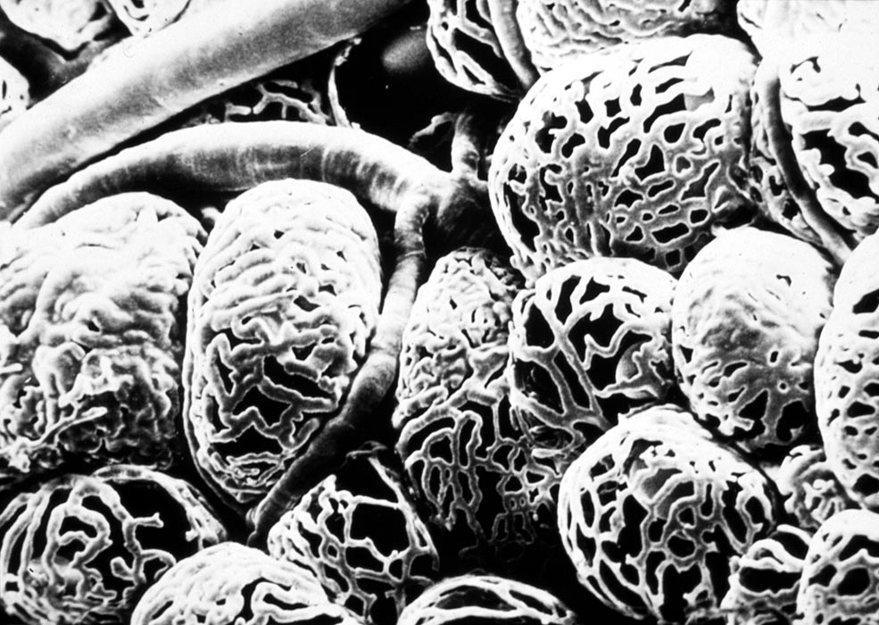
B.Vs found at the basement membrane of follicles and they form a network around these follicles
Parenchyma
lobules surrounded by interlobular connective tissue
each lobule is composed of a number of 1. Follicles + Blood vessels
Follicles the structural and functional building block of the thyroid gland spherical in shape
separated by scant interfollicular connective tissue.
Arrangement of cells
Thyroid capillary beds SEM

Slide 8
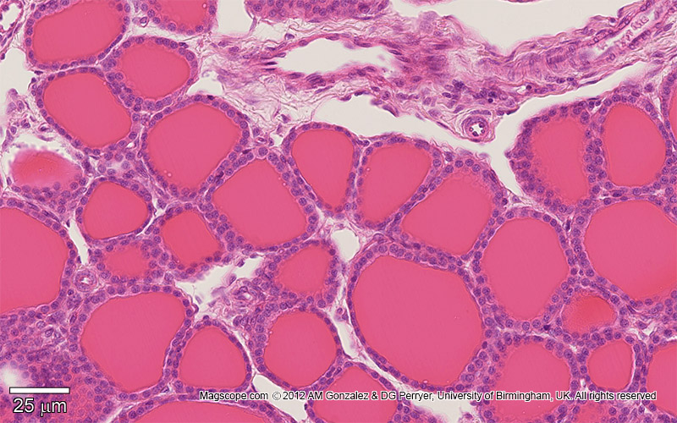
Thyroid follicles
Follicular cells: a simple cuboidal epithelium
Parafollicular cells (or "C cells") parafollicular cells are scattered among follicular cells and in spaces between the spherical follicles, they secrete calcitonin. –large, pale stain and few in number
No direct contact with the follicular lumen. They are always situated within the basement membrane, which surrounds the entire follicle
Interfollicular cells
Represent the follicular + parafollicular cells when we have a Superficial cut of the follicles
يعني هون اخذت من الخلايا بدون ما اصل للتجويف
The most common type of cells, cuboidal in normal state
Interfollicular cells
Acidophilic colloid
One follicle
Colloid: hormones stored in the lumen of follicles

Slide 9
 | Follicular cells | Parafollicular cells
Size | smaller | larger
Number | numerous | Few
Extension | Reach the lumen | Do not
Stain | Basophilic due to presence of rER + ribosomes, protein secreting cells | Pale (clear cells)
Secretion | Stored extracellularly in the lumen Secrete T3 &T4 | Stored intracellularly in small basal secretory granules Secrete calcitonin
Lysosomes & phagosomes | abundant | Few in No
Notes:
9

Slide 10
Parafollicular cells
Colloid
Immunocytochemical localization of calcitonin in C cells
Parafollicular cells

Slide 11
Parafollicular cells
EM
Parafollicular
cells
Clusters of
Parafollicular
cells
B.V
Superficial section
Interfollicular cells
Its granules present at the base to transmit the secretion directly to B.V
**بهاي الشريحة مبين عدد الخلايا البينية كثير كبير بس هي فعلياً مش هيك, بيّنت هيك لأنه هاي الخلايا بتكون على الحواف و بارزة شوي و احنا اصلاً اخذنا هاي الشريحة من سطح الفوليكليز اللي موجود عليه اغلب الخلايا البينية

Slide 12
Interfollicular cells
Group of nuclei represent interfollicular cells
Colloid

Slide 13
Correlates EM structure of follicular cells to its function.
rER.
Golgi apparatus
exocytotic vesicles
Microvillous border
endocytotic vesicles.
lysosomes.
Synthesis of thyroglobulin.
add carbohydrate and form the vesicles.
dischargeThyroglobulin into the lumen
Follicular cells trap the iodide and liberate it as iodine in the follicular lumen
Surface area
iodination takes place extracellularly.
reabsorb thyroglobulin.
hydrolyse thyroglobulin to thyroxine
thyroxine which is released into the fenestrated blood capillaries
**organelles of protein synthesis→ rER, mitochondria, ribosomes, Golgi apparatus. All these organelles present in the follicular cells
Notes:
13

Slide 14
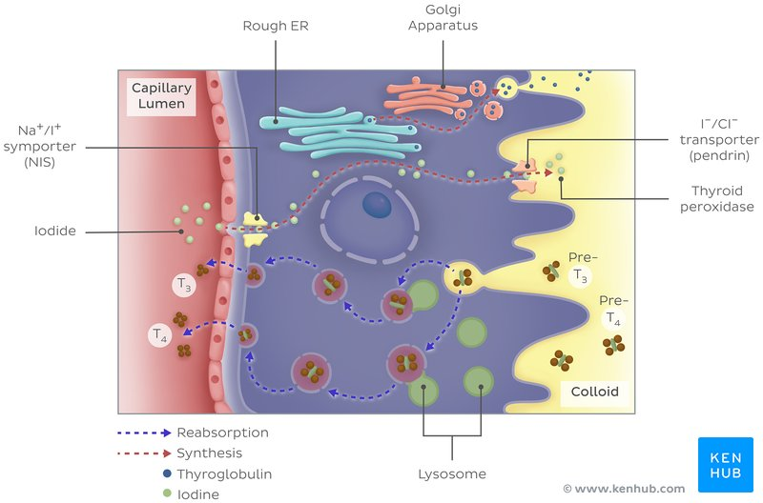
Follicular cells
synthesis of T3 & T4
1-organelles of protein synthesis produce thyroglobulin hormone (precursor)
2-Tg transmitted by exocytosis to lumen of follicles to stored as colloid
3-iodine enter from the blood →cell→ lumen, to iodinate the precursor
4-iodinated Tg stored in the lumen until we need it
5-when we need it, the iodinated Tg re-enter the cells by endocytosis
6-inside cells there is numerous lysosomes which will take the precursor and break it down, then it released to blood as T3, T4
1
2
3
4
5
6
Related to step2, thyroid gland is the only gland which stored its secretion outside the cells

Slide 15
Functional states of thyroid follicles
(variable - depending on the functional state) not secreting T3/T4 (inactive), the epithelial cells range from low columnar to cuboidal cells. When active, the epithelial cells become tall columnar cells.
Normal
hypoactive
: produce hormones without secrete them, so the colloid will pressure cells until they become flattened
hyperactive
Produce hormones and secrete them directly

Slide 16
Enlargement of thyroid gland occur when it hyper-hypo function
Pathology of thyroid glands
Iodine deficiency goiter
Hypertrophy of thyroid gland
↓ iodine in diet →↓ T3 &T4 →↑ TSH
Hypothyroidism
In children → cretinism (dwarf & mental retardation)
In adults → myxedema
Hyperthyroidism (thyrotoxicosis) T4, T4
Grave’s disease or exophthalmic goiter
autoimmune disorder
TSH elevated by feedback stimulation
exophthalmic goiter: accumulation of retro-orbital fat which will cause protrusion of eye

Slide 17
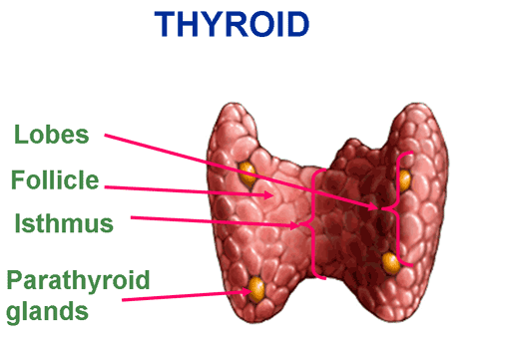
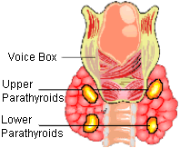
Parathyroid gland

Slide 18
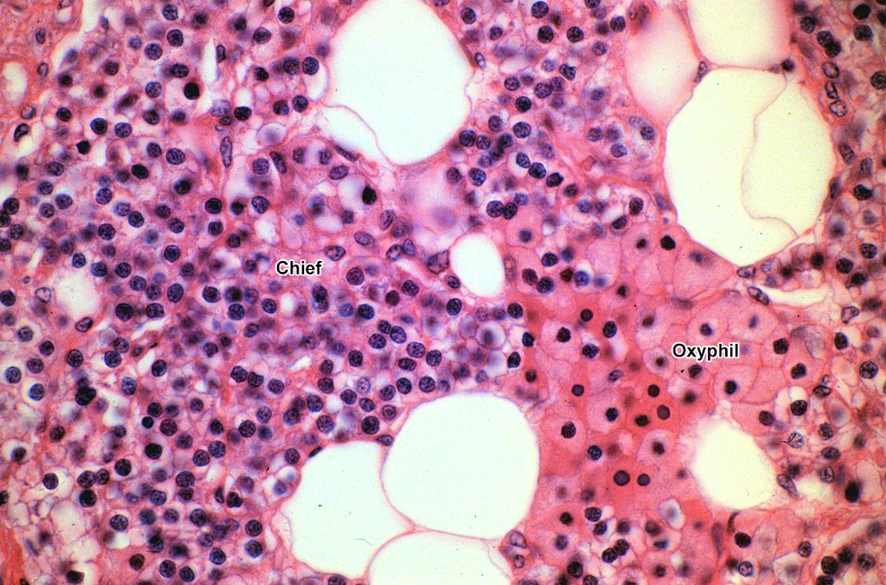
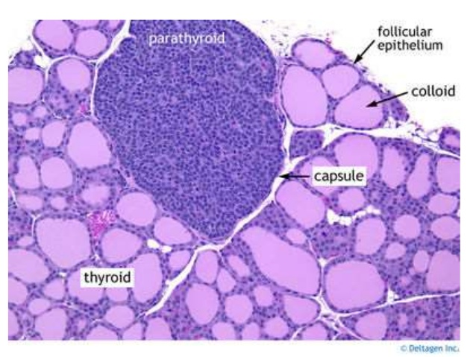
Structure of parathyroid gland
This capsule will separate it from thyroid gland
Stroma
Each parathyroid gland is surrounded by a thin connective tissue capsule, delicate connective tissue septa , a considerable number of fat cells infiltrate the gland
Parenchymal cells
Two types of cells arranged in anastomosing cords surrounded by abundant capillaries
Chief cells
Oxyphil cells
Fat cells

Slide 19
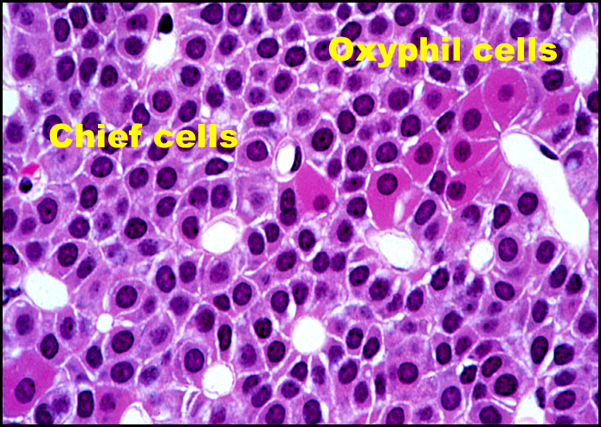

Slide 20
 | Chief cells (principal) | Oxyphil cells
size | Small polygonal | Large polygonal
number | numerous | few
Stain | Faint acidophilic | Deep acidophilic
nucleus | Active, Large vesicular | Inactive, Small dense
rER | More (produce hormone protein in nature) | sparse
Function | Parathyroid hormone (↑ Blood Ca level) | unknown
Notes:
20

Slide 21
Parathyroid gland in old people
Increase number of fat cells
Increase number of oxyphil cells )this increase make them to say it’s a degenerated shief cells)

Slide 22
Regulation of blood calcium level mainly by parathyroid gland
↓ Blood Ca level ↑ PTH → ↑ Blood Ca level
through:
bone: ↑ osteoclasts
kidney: ↑ Ca reabsorption
intestine: ↑ Ca absorption
↑↑ Blood Ca level ↑ Calcitonin ↓↓ Ca level by ↓activity of osteoclast
Hyperparathyroidism
Increase parathyroid hormone →
bone fracture
Calcification of several organ
Hypoparathyroidism
Decrease parathyroid hormone →:
bones become denser
↑ excitability of nervous system → tetany
Notes:
22

Slide 23
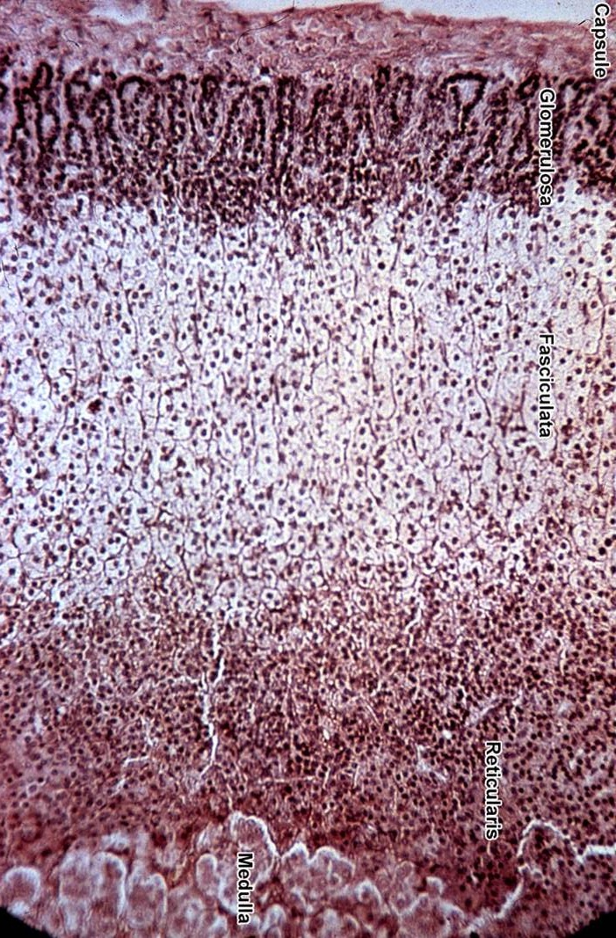
ADRENAL GLANDS or suprarenal gland
In the abdomen

Slide 24
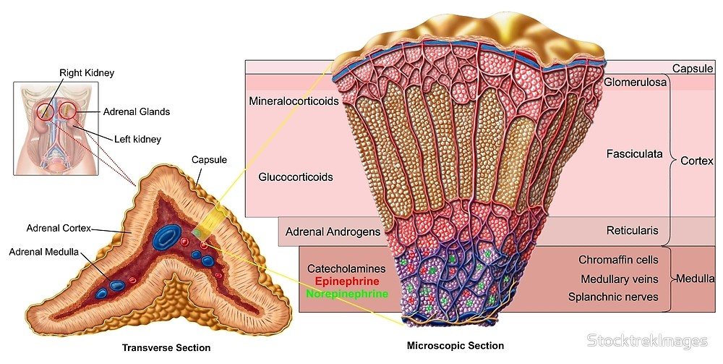
Triangular in shape

Slide 25
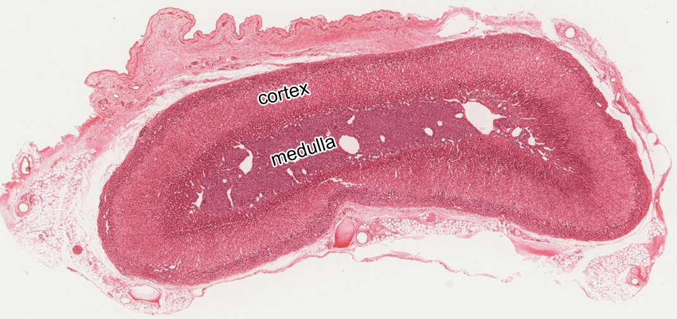
Stroma : The gland is surrounded by a thick connective tissue capsule.
Vessels and nerves reach the medulla by way of connective tissue (trabeculae which extend from the capsule towards the medulla.= septa)
Parenchyma : consist of
outer cortex (the main part)
inner medulla 10%
 | Cortex (beneath the capsule) | Medulla
Color in fresh state | Yellow | Reddish-brown due to presence of large B.Vs
Position | Peripheral | Central
Origin | Coelomic mesoderm (mesodermal) | Neural crest (ectodermal)

Slide 26
Zones of the cortex
All cells in the cortex are lipid secreting cells
zona glomerulosa (15%) /small rounded cells groups (clusters) or curved columns. The smallest cells, their nuclei are dark and round, and the cytoplasm is light basophilic// not influenced by ACTH// mineralocorticoid
2- zona fasciculata (65%) consists of radially arranged cell cords separated by fenestrated sinusoid capillaries. The nucleus is light and typically located centrally. The cytoplasm is also light and often has a characteristic foamy or spongy appearance (lipid droplets) spongiocytes// glucocorticoids
3- zona reticularis (7%). Make irregular network (reticulum)
Outer cells: like zona fasciculata but with fewer lipid droplets
Inner cells: two types:
Dark cells: pyknotic nuclei, excess lipofucsin pigment suggesting cellular degeneration.
Light cells: pale with pale staining nuclei
Zona fasciulata contain very large cells and full of vaculation so it appear like sponge

Slide 27
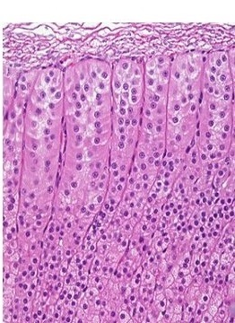
Zones of the cortex
Capsule
G
F
F
R
Lipid content: F→ G→ R
الترتيب من الاكثر للاقل

Slide 28
Cortex | Z. Glomerulosa | Z. Fasciculata Spongiocytes | Z. Reticularis
% of volume | 15% | 65% | 7%
Shape of cells Arrangement | Columnar or pyramidal cells Closely packed rounded or arched clusters | Polyhedral Cords 1 or 2 cell thick | Polyhedral Anastmosing Irregular cords
Cytoplasm (Acidophilic) | Slightly vacuolated | Numerous vacuoles (spongiocytes) | less
Lipid droplets | few | numerous | less
Function | mineralocorticoids | glucocorticoids | Sex hormones
Notes:
28

Slide 29
Cells in adrenal cortex are steroid secreting cells
Extensive smooth ER
Mitochondria with
tubular cristae
Golgi apparatus
Lipid droplets
Spongiocytes in zona fasiculata (highly vacuolated cells due to lipid droplets)
Contain precursor not active hormone

Slide 30
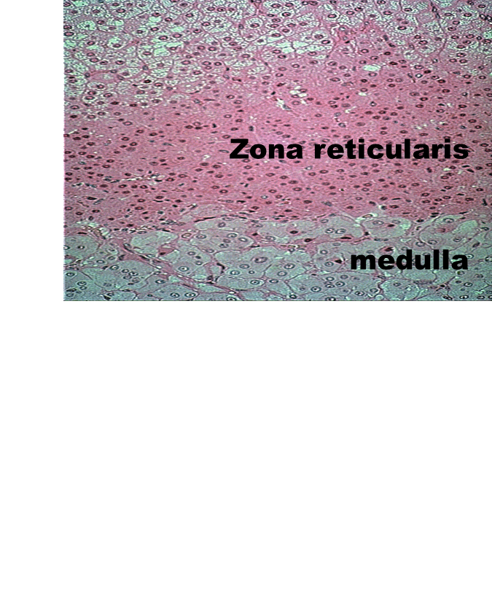
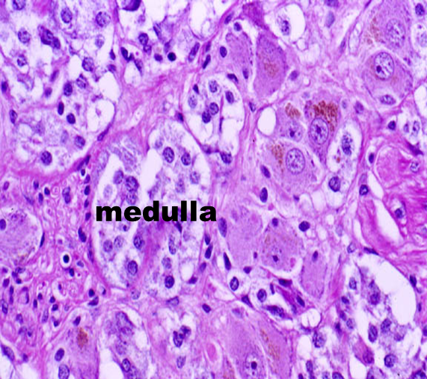
Adrenal medulla
هيك كيف رح اميز انا وين صرت؟ بعتمد على تغير شكل الخلايا
-not sharply delimited from the cortex.
-Cells are arranged in strands or small clusters with capillaries and venules, weakly basophilic. (protein secreting cells)
-chromaffin cells, granules of these cells can be stained with potassium bichromate.
-Catecholamines adrenaline and noradrenaline
-Chromaffin cells are, like ganglion cells of the PNS, derived from neural crest cells.
It includes 3 types of cells:
1- Chromaffin cells (the secreting cells)
2- Sympathetic ganglion cells (Supports that it is of nervous origin)
3- Lymphocyte like cells
In chromaffin test these cells (سبب التسمية) give +ive result

Slide 31
Chromaffin cells epinephrine cells & nor epinephrine cells
Any cell gives +ive chromaffin test its named chromaffine like cell
Large B.V
و هاي علامة اني وصلت النخاع
LM: large ovoid cells
large spherical nuclei
pale basophilic cytoplasm
arranged in rounded groups
or short cords intimately
related to BVs
Chromaffin reaction
After using chromaffin reaction how to differentiate between A, NA secreting cells? By EM

Slide 32
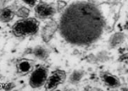
Granules of epinephrine & norepinephrine
Granules in: | Epinephrine-secreting cells | Norepinephrine-secreting cells
Size | Small | larger
Contents | Fill the granule | Do not
 | E M protein synthesizing cells: rER mitochondria prominent Golgi membrane-limited electron-dense granules of either epinephrine or norepinephrine
Notes:
32

Slide 33
Function of adrenal medulla
epinephrine and norepinephrine → vasoconstriction, hypertension, ↑ heart rate & metabolic rate
Clinical hints of medulla
Pheochromocytoma
(tumor of chromaffin cells)
This tumor will cause increase in A + NA
→ paroxysmal elevation of BP

Slide 34
Blood supply of adrenal gland
Artery with 2 branches
The adrenal glands are supplied by several arteries ,these arteries can be divided into:
Cortical arteries, arteries that irrigate the capsule; branching into capillaries that irrigate the gland cells of the cortex and that eventually reach the medullary capillaries;
medullary arteries, which pass through the cortex and form an extensive capillary network in the medulla.
The cells of the medulla are, thus, bathed with both arterial blood from the medullary arteries and venous blood originating from the capillaries of the cortex.
Capillaries of the medulla, together with capillaries that supply the cortex, form the medullary veins, which join to constitute the adrenal or suprarenal vein
Cortical artery communicate with medullary artery in medullary capillaries

Slide 35
Control of the Adrenal Cortex
The secretion of glucocorticoids is controlled initially through the release of corticotropin-releasing hormone in the median eminence, followed by secretion of (ACTH, corticotropin) by the pars distalis of the hypophysis
Free glucocorticoids may then inhibit ACTH secretion. The degree of pituitary inhibition is proportionate to the concentration of circulating glucocorticoids; inhibition is exerted at both the pituitary and hypothalamic levels
Aldosterone secretion is controlled primarily by renin-angiotensin and secondarily by ACTH.
MEDICAL APPLICATION
Because of the feedback mechanism of adrenal cortex control, patients who are treated with corticoids for long periods should never stop taking these hormones suddenly:
secretion of ACTH in these patients is inhibited, and thus the cortex will not be induced to produce corticoids, causing a severe misbalance in the levels of sodium and potassium. so stoppage of steroids gradually is the choice for treatment

Slide 36
Control of adrenal Medulla
The adrenal medullary cells are innervated by cholinergic endings of preganglionic sympathetic neurons.
Epinephrine and norepinephrine are secreted in large quantities in response to intense emotional reactions, such as fright, that are part of an alarm reaction
(the fight-or-flight response).
Secretion of these substances is mediated by the preganglionic fibers that innervate medullary cells.
Glucocorticoids produced in the cortex, which reach the medulla through capillaries that bathe cells of the cortex, constitute another mechanism of control.

