Slide 1
Bacterial Genetics General Microbiology 2020-2021
Dr. Mohammad Odibate
Department of Microbiology and Pathology
Faculty of Medicine, Mutah University

Slide 2
Definitions
Genetics: the study of genes, heredity, and variation in living organisms
Genomics: The study and analysis of the nucleotide sequence of DNA is called genomics
Genome: The complete set of genetic information for a cell.
Heredity: is a biological process where a parent passes certain genes onto their children or offspring
Mutation: is an actual change in the DNA
Mutant: Is a new genetic character arising or resulting from an occurrence of mutation
Notes:
variant of a normal organism

Slide 3
Definitions
An organism phenotype vs. An organism genotype
genotype
…..ccggattaggcccaaggcctaaaa…
The nucleotides sequnce
Gene
Pili
The gene product
phenotype
No pili

Slide 4
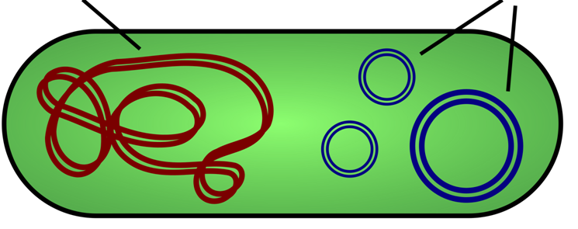
Bcatrial DNA

Slide 5
plasmid
A plasmid is a small DNA molecule within a cell that is physically separated from a chromosomal DNA and can replicate independently.
They are most commonly found in bacteria as small circular, double-stranded DNA molecules
Plasmids almost always carry at least one gene.
Many of the genes carried by a plasmid are beneficial for the cells
Some of these genes encode traits for
antibiotic resistance
resistance to heavy metal
virulence factors that enable a bacterium to colonize a host and overcome its defences
specific metabolic functions that allow the bacterium to utilize a particular nutrient including the ability to degrade toxic organic compounds.
Provide bacteria with the ability to fix nitrogen.

Slide 6
Factors affecting bacterial genes
Normal gene
GCCGAATTTCACGGCCATTGCCATTAG
Mutations
Acquiring of new genetic materials (Sexual reproduction)
Transformation.
Transduction.
Conjugation.
Abnormal gene
GCCGAATTT GCT GGCCATTGCCATTAGCGGATATC
AAGGC

Slide 7
Factors affecting bacterial genes
GCCGAATTT GCT GGCCATTGCCATTAG
Mutations
Natural mutations
Beneficial mutations
Harmful (lethal) mutations
Silent mutations
Induced mutations

Slide 8
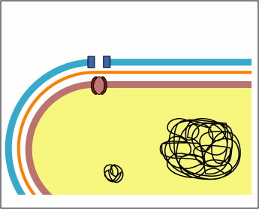
Factors affecting bacterial genes
Example on Beneficial mutations
Mutations enable the bacterium to survive exposure to various antibiotics. Such mutations may affect enzymatic activities , regulatory, or transport systems.
Mutations enable bacteria to survive temporary exposure to high temperatures or starvation

Slide 9
Acquiring of new genetic materials: Bcateria developd diffrenr ways to exchange genetic material
Acquiring of new genetic materials
Transformation - Bacteria take up DNA from their environment and incorporate it into their genome (i.e., the Griffith experiment).
Transduction - Movement of DNA between bacteria by viruses.
Conjugation - The direct transfer of DNA by bacteria usually via plasmids.

Slide 10
Acquiring of new genetic materials
Transformation
The uptake by the bacterium of naked DNA
Types:
Natural: The uptake by the bacterium of naked DNA from the environment. Some bacteria have membrane proteins specialized for this function.
Artificial: uptake of DNA by a process called recombination or cloning.

Slide 11
Transformation
Crossing
over
Insertion
Notes:
Floating DNA

Slide 12
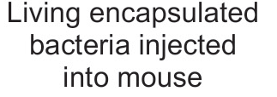
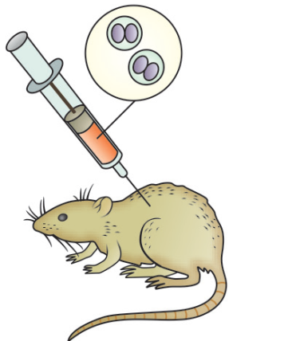
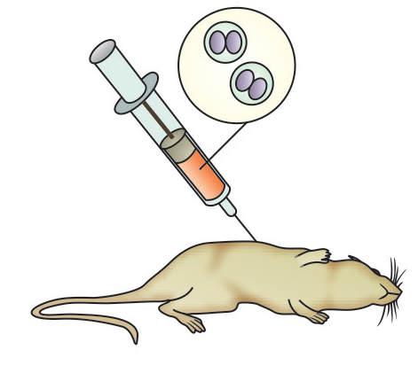
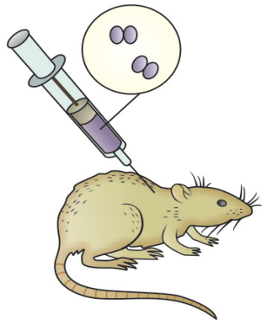
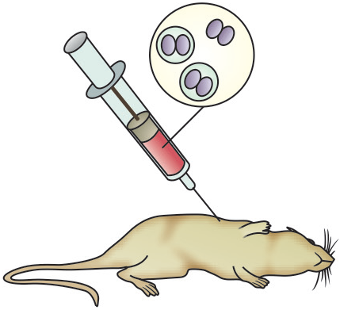
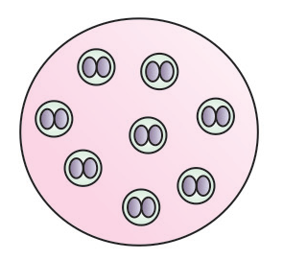
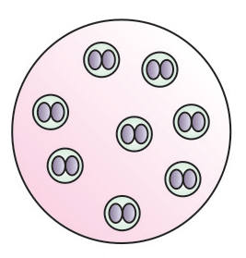
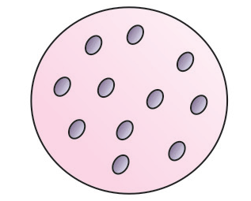
Natural Transformation
Griffith’s Experiments with Pneumococcus

Slide 13
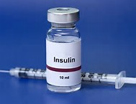
Artificial Transformation
Artificial transformation: Cloning (Example, Insulin production)
Insulin extraction

Slide 14
Acquiring of new genetic materials
Conjugation:
Is the commonest process of sexual reproduction in bacteria.
In conjugation two parental cells physically contact between two genetically different cells of the same or closely related species and transfer their genetic material through a small tube like projection called conjugation tube.
The genetic material from one cell (donor or male) is transferred to other (recipient or female).
Notes:
Conjugation is the commonest process of sexual reproduction in bacteria. In
conjugation two parental cells physically contact between two genetically different cells
of the same or closely related species and transfer their genetic material through a small
tube like projection called conjugation tube. The genetic material from one cell (donor
or male) is transferred to other (recipient or female).
Lederberg .and Tautum (1946) used two mutant of the E.coli strain K12. Both mutant
require certain growth factors while culturing on minimal media. These bacterial strain
are known as Auxotrophs. Strains A of E. coli require methionine and biotin for there
growth. There genotype is Met- Bio- while strain B require Thrionine, Leucine and
Thiamine for their growth. There genotype is Thr-, Leu-, Thi-.

Slide 15
Acquiring of new genetic materials
Conjugation
Fertility factor (F-factor):
plasmid trasnfered by conjugation are celled F-factor.
Bacteria are classified in two groups on the basis of presence and absence of F factor. They are as follows :
F+ strain bearing the F-factor, also known as donor cell. It always bears sex pili or F pili on its surface.
F- strain lacking the fertility factor, also known as recipient cell. It lacks sex pili or F pili on its surface.
Notes:
Fertility factor or F factor in conjugation was first of all discovered by William
Hayes (1950) in E. coli. He reported that in E.coli a plasmid is present in the form of
fertility ~actor. E.coli is classified in two strains on the basis of presence and absence
of F factor. They are as follows :
(i) F+ strain bearing the fertility factor, also known as donor cell. It always bears
sex pili or F pili on its surface.
(ii) F- strain lacking the fertility factor, also known as recipient cell. It lacks sex
pili or F pili on its surface.

Slide 16
Conjugation
F plasmid
F⁺ bacteria
Mating Bridge
F⁻ bacteria

Slide 17
Conjugation
F plasmid
F⁺ bacteria
Mating Bridge
Original
F⁺ bacteria
F⁻ bacteria
New
F⁺ bacteria

Slide 18
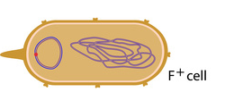
Conjugation
A conjugation tube forms between the donor cell and the recipient cell
A single strand from the plasmid DNA is transferred through the tube from the donor to the recipient.
A double stranded DNA is formed from the single strand in both the donor and the recipient cells.
Notes:
F factor (Fertility factor)
The F factor is a transfer factor that contains the
genetic information necessary for the synthesis of
the sex pilus and for self-transfer

Slide 20
Acquiring of new genetic materials
Medically important factors transferred by conjugation
Resistance (R) plasmids, which contain genes that provide resistance against antibiotics or poisons.
colicinogenic (or Col ) plasmids: determines the production of proteins called colicins (bacteriocins), which have antibiotic activity and can kill other bacteria

Slide 21
Acquiring of new genetic materials
High frequency recombination or HFR transfer:
The plasmid formed in the newly F+ cell get combined with the bacterial chromosome.
The F+ factor combines with the bacterial chromosome is known as episome.
This process is known as high frequency recombination.
Notes:
Jacob & Wollman (1951) reported, when F+ plasmid of donor reaches to the Fplasmid
of recipient cell in the newly formed F+ cell (previously P- recipient cell) this
plasmid occur in two stages (i) either it lie independently in the cytoplasm of F+ cell
(ii) or it get combined with the bacterial chromosome. This later stage where the F+ factor combines with the bacterial chromosome is known as episome. The term episome
was used by Lederberg et al. (1952). This type of bacterial cell convert into high,
reproductive ability donor or male cell. This process is known as high frequency
recombination or Hfr male. The reproductive ability of Hfr strain is 1000 times more
than of F+ strain. The integration of plasmid DNA with this genophore (F bacterial
DNA) can occur in 20 parts.
Conjugation in HFr male: During conjugation a conjugation tube is formed
between the Hfr male and F" recipient cell. After that the donor DNA opens near the
F+ factor and become single stranded. Now this single stranded DNA moves slowly
from the donor cell to the recipient cell. This transfer process is continued until, both
the Hfr and F- cells are separated naturally. After this separation some part of DNA
of Hfr strain remain inside the F- recipient cell and get combined with the DNA of
recipient cell as a result new genes are integrated into the recipient F- cell. The
combination of both the DNA results into the formation of a genetic hybrid which is
partially diploid. This type of reproduction is found in Salmonella, Pseudomonas, Vibrio
and E. coli.
Sexduction : Jacob Adelberg (1959) reported this process in bacteria. In general
in Hfr strains the F+ factor is integrated with the bacterial chromosome but some times
this F+ factor separate from the bacterial chromosomes and becomes fully autonomous
and replicate independently.
Sometimes during separation this F+ factor contains some genes of the bacterial'
chromosome and now it is called as F+ prime. When this F+ prime cells comes in contact
with the F- recipient cell it transfer some of the genes are taken from the DNA of the
previous bacterial cell. This process is known as sexduction and as a result the recipient
cell become partly diploid and the structure is called as merozygote.

Slide 22
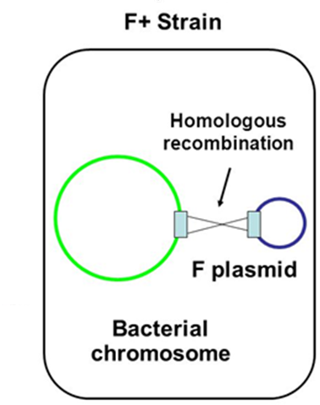
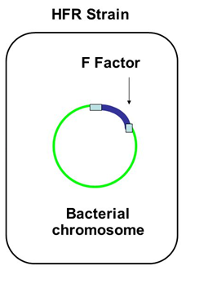
high frequency recombination or HFR transfer:
Notes:
Jacob & Wollman (1951) reported, when F+ plasmid of donor reaches to the Fplasmid
of recipient cell in the newly formed F+ cell (previously P- recipient cell) this
plasmid occur in two stages (i) either it lie independently in the cytoplasm of F+ cell
(ii) or it get combined with the bacterial chromosome. This later stage where the F+ factor combines with the bacterial chromosome is known as episome. The term episome
was used by Lederberg et al. (1952). This type of bacterial cell convert into high,
reproductive ability donor or male cell. This process is known as high frequency
recombination or Hfr male. The reproductive ability of Hfr strain is 1000 times more
than of F+ strain. The integration of plasmid DNA with this genophore (F bacterial
DNA) can occur in 20 parts.
Conjugation in HFr male: During conjugation a conjugation tube is formed
between the Hfr male and F" recipient cell. After that the donor DNA opens near the
F+ factor and become single stranded. Now this single stranded DNA moves slowly
from the donor cell to the recipient cell. This transfer process is continued until, both
the Hfr and F- cells are separated naturally. After this separation some part of DNA
of Hfr strain remain inside the F- recipient cell and get combined with the DNA of
recipient cell as a result new genes are integrated into the recipient F- cell. The
combination of both the DNA results into the formation of a genetic hybrid which is
partially diploid. This type of reproduction is found in Salmonella, Pseudomonas, Vibrio
and E. coli.
Sexduction : Jacob Adelberg (1959) reported this process in bacteria. In general
in Hfr strains the F+ factor is integrated with the bacterial chromosome but some times
this F+ factor separate from the bacterial chromosomes and becomes fully autonomous
and replicate independently.
Sometimes during separation this F+ factor contains some genes of the bacterial'
chromosome and now it is called as F+ prime. When this F+ prime cells comes in contact
with the F- recipient cell it transfer some of the genes are taken from the DNA of the
previous bacterial cell. This process is known as sexduction and as a result the recipient
cell become partly diploid and the structure is called as merozygote.

Slide 23
Acquiring of new genetic materials
Transduction:
Transport of bacterial DNA of donor cell to the recipient cell with the help of bacteriophage
Transduction is generally of two types:
Generalized transduction
Specialized transduction.
Notes:
Jacob & Wollman (1951) reported, when F+ plasmid of donor reaches to the Fplasmid
of recipient cell in the newly formed F+ cell (previously P- recipient cell) this
plasmid occur in two stages (i) either it lie independently in the cytoplasm of F+ cell
(ii) or it get combined with the bacterial chromosome. This later stage where the F+ factor combines with the bacterial chromosome is known as episome. The term episome
was used by Lederberg et al. (1952). This type of bacterial cell convert into high,
reproductive ability donor or male cell. This process is known as high frequency
recombination or Hfr male. The reproductive ability of Hfr strain is 1000 times more
than of F+ strain. The integration of plasmid DNA with this genophore (F bacterial
DNA) can occur in 20 parts.
Conjugation in HFr male: During conjugation a conjugation tube is formed
between the Hfr male and F" recipient cell. After that the donor DNA opens near the
F+ factor and become single stranded. Now this single stranded DNA moves slowly
from the donor cell to the recipient cell. This transfer process is continued until, both
the Hfr and F- cells are separated naturally. After this separation some part of DNA
of Hfr strain remain inside the F- recipient cell and get combined with the DNA of
recipient cell as a result new genes are integrated into the recipient F- cell. The
combination of both the DNA results into the formation of a genetic hybrid which is
partially diploid. This type of reproduction is found in Salmonella, Pseudomonas, Vibrio
and E. coli.
Sexduction : Jacob Adelberg (1959) reported this process in bacteria. In general
in Hfr strains the F+ factor is integrated with the bacterial chromosome but some times
this F+ factor separate from the bacterial chromosomes and becomes fully autonomous
and replicate independently.
Sometimes during separation this F+ factor contains some genes of the bacterial'
chromosome and now it is called as F+ prime. When this F+ prime cells comes in contact
with the F- recipient cell it transfer some of the genes are taken from the DNA of the
previous bacterial cell. This process is known as sexduction and as a result the recipient
cell become partly diploid and the structure is called as merozygote.

Slide 24
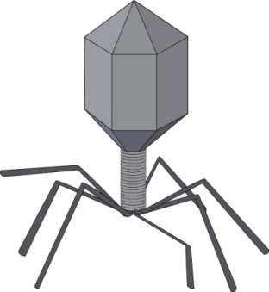
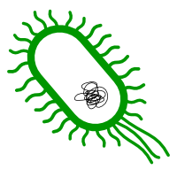
Transduction
The transfer of DNA among bacteria by bacteriophage
Notes:
Is a virus that infects and replicates within the bacteria.

Slide 25
Acquiring of new genetic materials
Generalized transduction: It is completed in following steps:
It starts with the infection of bacteria with the bacteriophage.
The bacteriophage utilizes the bacterial enzymes and synthesize new phage components
The DNA of the bacteria breaks down into small fragments.
At the same time when these progeny phage particles are form, the DNA fragments of the bacteria incorporate into these DNA particles of the phage.
The genetic material or DNA fragments of the previous bacterial cell is transferred to the new bacterial cell infected by these progeny phage particles.
Notes:
Jacob & Wollman (1951) reported, when F+ plasmid of donor reaches to the Fplasmid
of recipient cell in the newly formed F+ cell (previously P- recipient cell) this
plasmid occur in two stages (i) either it lie independently in the cytoplasm of F+ cell
(ii) or it get combined with the bacterial chromosome. This later stage where the F+ factor combines with the bacterial chromosome is known as episome. The term episome
was used by Lederberg et al. (1952). This type of bacterial cell convert into high,
reproductive ability donor or male cell. This process is known as high frequency
recombination or Hfr male. The reproductive ability of Hfr strain is 1000 times more
than of F+ strain. The integration of plasmid DNA with this genophore (F bacterial
DNA) can occur in 20 parts.
Conjugation in HFr male: During conjugation a conjugation tube is formed
between the Hfr male and F" recipient cell. After that the donor DNA opens near the
F+ factor and become single stranded. Now this single stranded DNA moves slowly
from the donor cell to the recipient cell. This transfer process is continued until, both
the Hfr and F- cells are separated naturally. After this separation some part of DNA
of Hfr strain remain inside the F- recipient cell and get combined with the DNA of
recipient cell as a result new genes are integrated into the recipient F- cell. The
combination of both the DNA results into the formation of a genetic hybrid which is
partially diploid. This type of reproduction is found in Salmonella, Pseudomonas, Vibrio
and E. coli.
Sexduction : Jacob Adelberg (1959) reported this process in bacteria. In general
in Hfr strains the F+ factor is integrated with the bacterial chromosome but some times
this F+ factor separate from the bacterial chromosomes and becomes fully autonomous
and replicate independently.
Sometimes during separation this F+ factor contains some genes of the bacterial'
chromosome and now it is called as F+ prime. When this F+ prime cells comes in contact
with the F- recipient cell it transfer some of the genes are taken from the DNA of the
previous bacterial cell. This process is known as sexduction and as a result the recipient
cell become partly diploid and the structure is called as merozygote.

Slide 27
Transduction
Medical Importance
Bacterium | Phage | Gene Product | Phenotype
Vibrio cholerae | CTX phage | cholerae toxin | cholera
Streptococcus pyogenes | T12 | erythrogenic toxins | scarlet fever
Corynebacterium diphtheriae | corynephage beta | diphtheria toxin | diphtheria
Escherichia coli | lambda phage | shigalike toxin | hemorrhagic diarrhea
Clostridium botulinum | clostridial phages | botulinum toxin | botulism (food poisoning)

Slide 28
Acquiring of new genetic materials
Specialized transduction:
Certain bacteria are able to survive (no lysis) for a long time even after infection by bacteriophages
Herein there is a joining of bacterial DNA with the phage DNA and they replicate together.
This bacterium is known as lysogenic bacteria and the phage is called as prophage.
These bacterial cells can survive for many generations which is due to the synthesis of a special repressor protein.
Repressor protein inhibits the synthesis of phage particle inside the bacterial cell.
Notes:
Jacob & Wollman (1951) reported, when F+ plasmid of donor reaches to the Fplasmid
of recipient cell in the newly formed F+ cell (previously P- recipient cell) this
plasmid occur in two stages (i) either it lie independently in the cytoplasm of F+ cell
(ii) or it get combined with the bacterial chromosome. This later stage where the F+ factor combines with the bacterial chromosome is known as episome. The term episome
was used by Lederberg et al. (1952). This type of bacterial cell convert into high,
reproductive ability donor or male cell. This process is known as high frequency
recombination or Hfr male. The reproductive ability of Hfr strain is 1000 times more
than of F+ strain. The integration of plasmid DNA with this genophore (F bacterial
DNA) can occur in 20 parts.
Conjugation in HFr male: During conjugation a conjugation tube is formed
between the Hfr male and F" recipient cell. After that the donor DNA opens near the
F+ factor and become single stranded. Now this single stranded DNA moves slowly
from the donor cell to the recipient cell. This transfer process is continued until, both
the Hfr and F- cells are separated naturally. After this separation some part of DNA
of Hfr strain remain inside the F- recipient cell and get combined with the DNA of
recipient cell as a result new genes are integrated into the recipient F- cell. The
combination of both the DNA results into the formation of a genetic hybrid which is
partially diploid. This type of reproduction is found in Salmonella, Pseudomonas, Vibrio
and E. coli.
Sexduction : Jacob Adelberg (1959) reported this process in bacteria. In general
in Hfr strains the F+ factor is integrated with the bacterial chromosome but some times
this F+ factor separate from the bacterial chromosomes and becomes fully autonomous
and replicate independently.
Sometimes during separation this F+ factor contains some genes of the bacterial'
chromosome and now it is called as F+ prime. When this F+ prime cells comes in contact
with the F- recipient cell it transfer some of the genes are taken from the DNA of the
previous bacterial cell. This process is known as sexduction and as a result the recipient
cell become partly diploid and the structure is called as merozygote.

Slide 29
Acquiring of new genetic materials
Specialized transduction:
As the synthesis of this protein is stopped the bacterial cell start the synthesis of phage components.
The DNA of both phage DNA and bacterial DNA breakdown before the synthesis of the phage particles starts.
At the same time some bacterial genes are carried out by phage DNA and replicate with the phage DNA.
In this type of transduction only those special genes are transmitted which are attached very closely to the phage DNA.
Notes:
Jacob & Wollman (1951) reported, when F+ plasmid of donor reaches to the Fplasmid
of recipient cell in the newly formed F+ cell (previously P- recipient cell) this
plasmid occur in two stages (i) either it lie independently in the cytoplasm of F+ cell
(ii) or it get combined with the bacterial chromosome. This later stage where the F+ factor combines with the bacterial chromosome is known as episome. The term episome
was used by Lederberg et al. (1952). This type of bacterial cell convert into high,
reproductive ability donor or male cell. This process is known as high frequency
recombination or Hfr male. The reproductive ability of Hfr strain is 1000 times more
than of F+ strain. The integration of plasmid DNA with this genophore (F bacterial
DNA) can occur in 20 parts.
Conjugation in HFr male: During conjugation a conjugation tube is formed
between the Hfr male and F" recipient cell. After that the donor DNA opens near the
F+ factor and become single stranded. Now this single stranded DNA moves slowly
from the donor cell to the recipient cell. This transfer process is continued until, both
the Hfr and F- cells are separated naturally. After this separation some part of DNA
of Hfr strain remain inside the F- recipient cell and get combined with the DNA of
recipient cell as a result new genes are integrated into the recipient F- cell. The
combination of both the DNA results into the formation of a genetic hybrid which is
partially diploid. This type of reproduction is found in Salmonella, Pseudomonas, Vibrio
and E. coli.
Sexduction : Jacob Adelberg (1959) reported this process in bacteria. In general
in Hfr strains the F+ factor is integrated with the bacterial chromosome but some times
this F+ factor separate from the bacterial chromosomes and becomes fully autonomous
and replicate independently.
Sometimes during separation this F+ factor contains some genes of the bacterial'
chromosome and now it is called as F+ prime. When this F+ prime cells comes in contact
with the F- recipient cell it transfer some of the genes are taken from the DNA of the
previous bacterial cell. This process is known as sexduction and as a result the recipient
cell become partly diploid and the structure is called as merozygote.

Slide 30
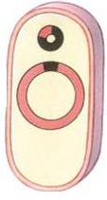
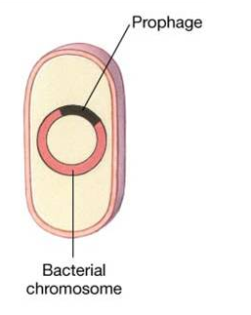
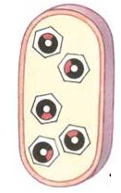
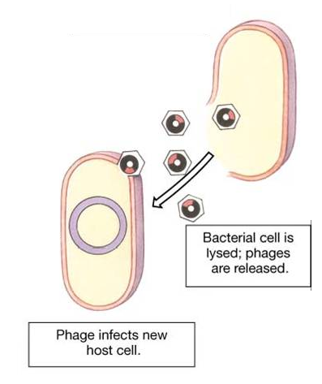
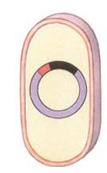
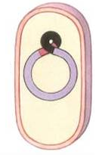
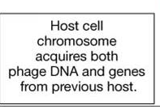

Slide 31
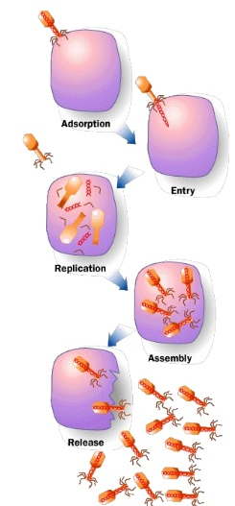
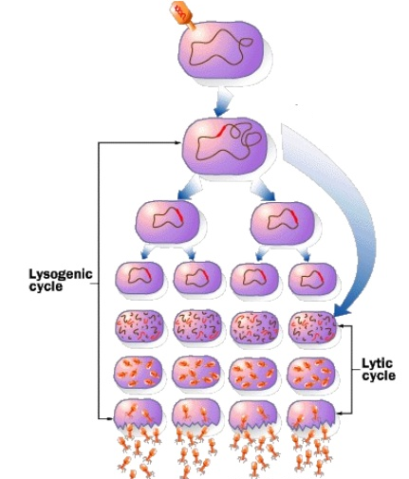
Types of Phage Cycles
Notes:
Virulent or lytic cycle: large numbers of progeny phages are built up inside the host bacterium, which ruptures to release them.
Temperate or nonlytic cycle: the host bacterium is unharmed. The phage DNA becomes integrated with the bacterial chromosome as the prophage and is replicated stably as part of the host cell chromosome and is transferred to the daughter cells. This process is called lysogeny and bacteria harbouring prophages are called lysogenic bacteria. In lysogenic bacteria, the prophage behaves as an additional segment of the bacterial chromosome, coding for new characteristic. This process by which the prophage DNA confers genetic information to a bacterium is called lysogenic or phage conversion. In transduction, the phage acts only as a vehicle carrying bacterial genes from one cell to another; but in lysogenic conversion, the phage DNA itself is the new genetic element.

