Slide 1
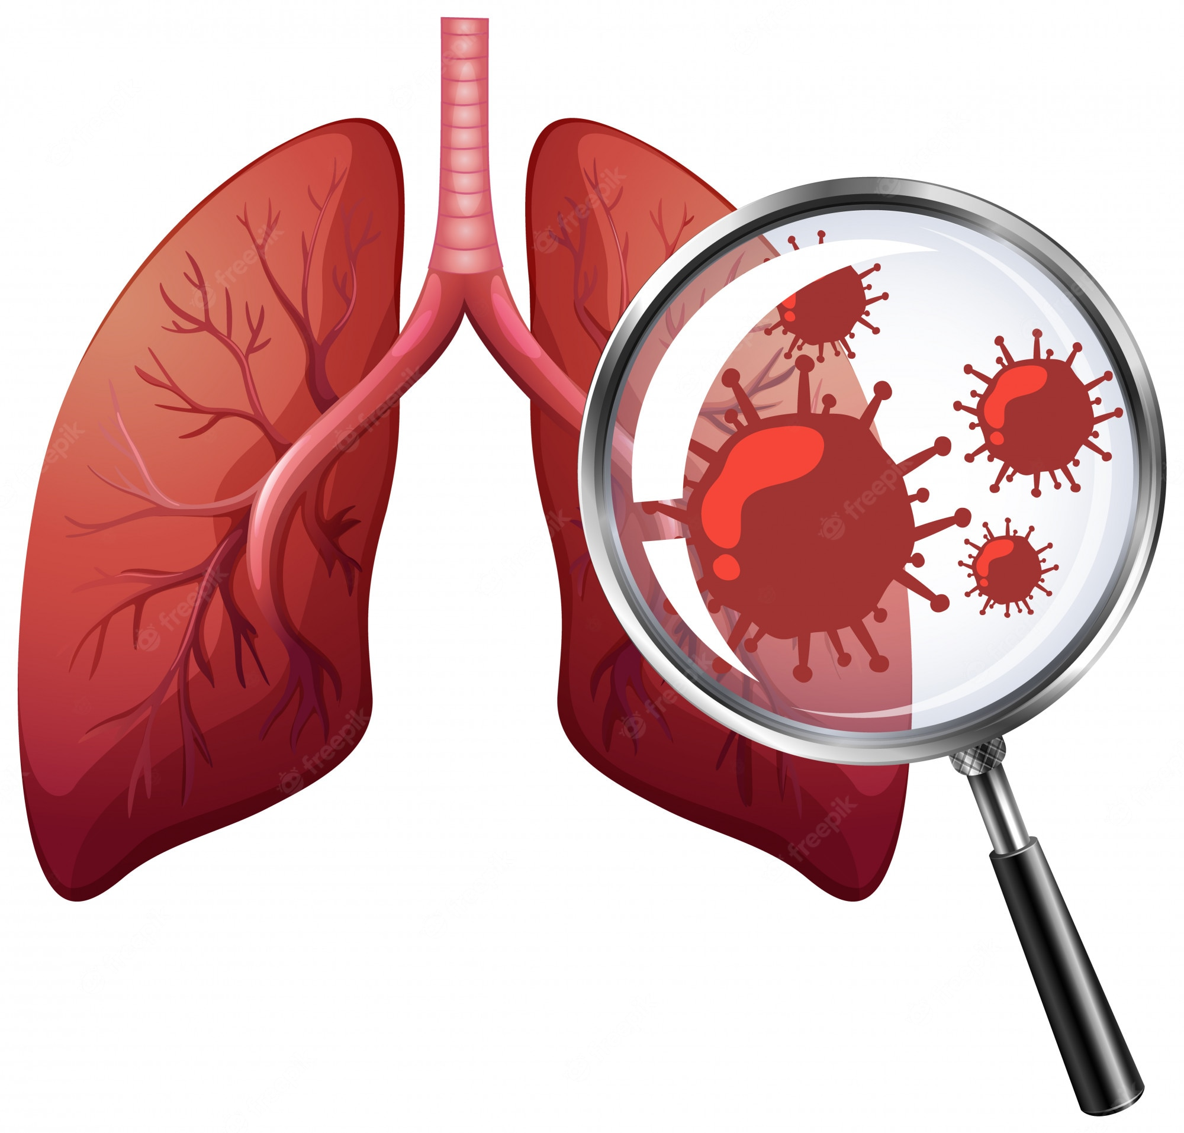
Dr. Eman kreishan
RSM – 1
Atelectasis and Pulmonary vascular Diseases
Dr. Eman Kreishan, M.D.
11-10-2022

Slide 2
Notes
Office hours: Sunday and Tuesday, 12-2 pm.
My office at second floor.

Slide 3
Introduction.. Anatomy

Slide 4
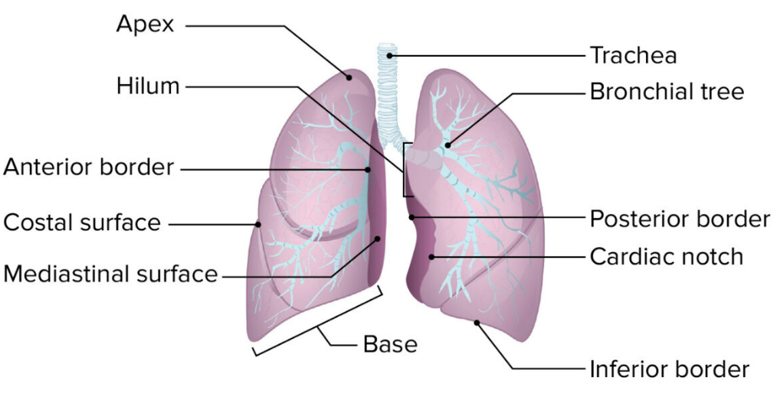

Slide 5
All the respiratory passages from the trachea to the respiratory bronchioles are called the tracheobronchial tree

Slide 6
HISTOLOGY

Slide 8
Respiratory module pathology lectures
Atelectasis and Pulmonary Diseases of Vascular Origin.
Obstructive Lung (Airway) Diseases-2.
Chronic Interstitial (Restrictive, Infiltrative) Lung Diseases.
Pulmonary Infections-2.
Lung Tumors -2.

Slide 9
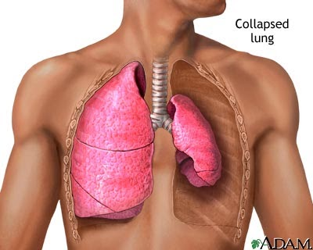
Atelectasis
Collapse and loss of lung volume caused by inadequate expansion of air spaces. It results in shunting of inadequately oxygenated blood from pulmonary arteries into veins, thus giving rise to a ventilation perfusion imbalance and hypoxia.

Slide 10
Atelectasis is classified into three forms:
1. Resorption atelectasis:
occurs when an obstruction prevents air from reaching distal airways.
Any air present gradually becomes absorbed, and alveolar collapse follows.
The most common causes are:
intrabronchial mucous or mucopurulent plugs.
foreign body aspiration.
bronchial asthma and bronchiectasis.
chronic bronchitis and intrabronchial tumor.

Slide 11
2. Compression atelectasis:
associated with accumulation of fluid, blood, or air within the pleural cavity.
Usually associated with congestive heart failure.
3. Contraction atelectasis:
occurs when local or diffuse fibrosis affecting the lung

Slide 12
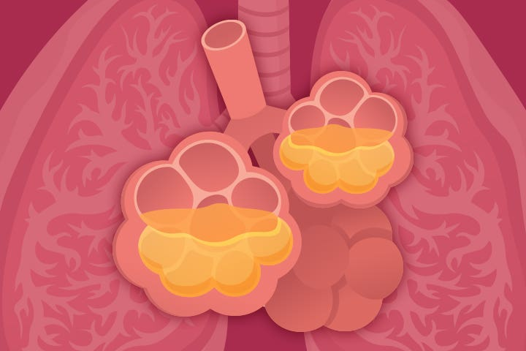
Acute respiratory distress syndrome
Respiratory failure occurring within 1 week of a known clinical insult with bilateral opacities on chest imaging, not fully explained by effusions, atelectasis, cardiac failure, or fluid overload.
Causes are diverse; the shared feature is that all lead to extensive bilateral injury to alveoli.
Severe ARDS is characterized by rapid onset of life threatening respiratory insufficiency, cyanosis, and severe arterial hypoxemia that is refractory to oxygen therapy.

Slide 13
The histologic manifestation
of ARDS in the lungs
is known as diffuse alveolar damage (DAD)
IL-8

Slide 14
Pathogenesis
In ARDS, the integrity of the alveolar-capillary membrane is compromised by endothelial and epithelial injury.
There is increased synthesis of interleukin 8 (IL-8), a potent neutrophil chemotactic and activating agent.
Release of IL-8, IL-1 and tumor necrosis factor (TNF), leads to endothelial activation and sequestration and activation of neutrophils in pulmonary capillaries
Activated neutrophils release a variety of products (e.g., reactive oxygen species, proteases) that damage the alveolar epithelium and endothelium.
The assault on the endothelium and epithelium causes vascular leak and loss of surfactant that render the alveolar unit unable to expand.

Slide 15
MORPHOLOGY
Acute phase:
Gross: the lungs are dark red, firm, airless, and heavy.
Microscopic examination :
capillary congestion.
necrosis of alveolar epithelial cells.
interstitial and intraalveolar edema and hemorrhage .

Slide 16
The most characteristic finding is the presence of hyaline membranes (fibrin-rich edema fluid admixed with remnants of necrotic epithelial cells).

Slide 17
2. organizing stage:
type II pneumocytes proliferate.
fibrin-rich exudates organize into intraalveolar fibrosis.
Marked thickening of the alveolar septa
due to proliferation of interstitial cells and deposition of collagen.

Slide 18
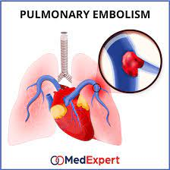
PULMONARY DISEASES OF VASCULAR ORIGIN 1. Pulmonary Embolism, Hemorrhage, and Infarction:
More than 95% of all pulmonary emboli arise from thrombi within the large deep veins of the legs.
The risk factors are :
(1) prolonged bed rest .
(2) surgery, especially orthopedic surgery on the knee or hip.
(3) severe trauma (including burns or multiple fractures).
(4) congestive heart failure.
(5) in women, the period around parturition or the use of oral contraception pills with high estrogen content

Slide 19
There are two important consequences of pulmonary arterial occlusion:
(1) an increase in pulmonary artery pressure from blockage of flow and vasospasm caused by neurogenic mechanisms and/or release of mediators (e.g., thromboxane A2, serotonin).
(2) ischemia of the downstream pulmonary parenchyma.
Thus, occlusion of:
major vessel results increase in pulmonary artery pressure, diminished cardiac output, right sided heart failure (acute cor pulmonale).
smaller vessels are occluded, the result is less catastrophic and may even be clinically silent

Slide 20
MORPHOLOGY :
The consequences of pulmonary embolism, as noted, depend on the size of the embolic mass and the general state of the circulation:
A large embolus may embed in the main pulmonary artery or at the bifurcation as a saddle embolus.
no time for morphologic
alterations in the lung
patient die

Slide 21
Smaller emboli become impacted in medium-sized and small-sized pulmonary arteries.
With adequate circulation and bronchial arterial flow:
alveolar hemorrhage may occur as a result of ischemic damage to the endothelial cells.
With compromised cardiovascular status:
as may occur with congestive heart failure, infarction results.

Slide 22
Clinical Features
1. Most (60% to 80%) are clinically silent because they are small; the bronchial circulation sustains the viability of the affected lung parenchyma, and the embolic mass is rapidly removed by fibrinolytic activity.
2. In 5% of cases, death, acute right-sided heart failure, or cardiovascular collapse.
3. Obstruction of small to medium pulmonary branches (10% to 15% of cases) causes pulmonary infarction.
4. less than 3% of cases, recurrent “showers” of emboli lead to pulmonary hypertension, chronic right-sided heart failure.

Slide 23
How I can modify the risk factors???
patients who have experienced one pulmonary embolism have a 30% chance of developing a second.
Prophylactic therapy may include:
anticoagulation.
early ambulation for postoperative patients.
application of elastic stockings.
leg exercises for bedridden patients.

Slide 24
Pulmonary Hypertension
Defined as pressures of 25 mm Hg or more at rest, may be caused by a decrease in the cross-sectional area of the pulmonary vascular bed or, less commonly, by increased pulmonary vascular blood flow.

Slide 25
WHO has classified pulmonary hypertension into the following five groups:
*systemic sclerosis
*Obstructive sleep apnea
Mitral stenosis
*idiopathic pulmonary
arterial hypertension
reducing the functional cross-sectional area
obliterate alveolar capillaries, increasing pulmonary resistance to blood flow
Notes:
Mitral stenosis causes an increase in left atrial pressure and pulmonary venous pressure that is eventually transmitted to the arterial side of the pulmonary vasculature, leading to hypertension.

Slide 26
Morphology
All forms of pulmonary hypertension are associated with:
medial hypertrophy of the pulmonary muscular and elastic arteries.
pulmonary arterial atherosclerosis.
right ventricular hypertrophy.
plexiform lesion: tuft of capillary formations is present, producing a network, or web, that dilated thin-walled, small arteries

Slide 27
Clinical Features
The presenting features are usually:
dyspnea and fatigue.
Anginal chest pain.
Over time:
respiratory distress and cyanosis.
right ventricular hypertrophy.
Death from decompensated cor pulmonale, often with superimposed thromboembolism and pneumonia.

