Slide 1
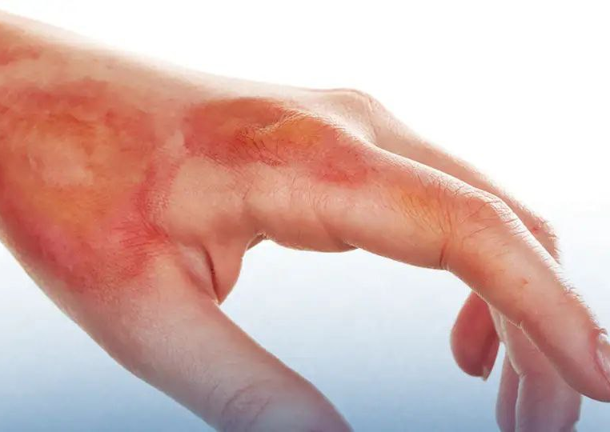
BURN
Presented By :
Ahmad Raed
Auwid Alshra`ah
Qutiaba Al-Tarawneh
Supervising doctor :
Mohammed Assem

Slide 2
A burn is an injury to the skin or other organic tissue.
Primarily caused by :
Flame—damage from superheated oxidized air
Scald—damage from contact with hot liquids
Contact—damage from contact with hot or cold solid materials
Chemicals—contact with noxious chemicals
Electricity—conduction of electrical current through tissues

Slide 3
Pathophysiology of burn injury :
Coagulation of protein due to intense heat
Release of local mediators
Change in blood flow due to vasoconstriction and thrombosis
Tissue edema

Slide 4
Loss of skin’s barrier function leads to fluid loss and massive fluid shifts.
Injured tissues release vasoactive mediators with secondary interstitial edema, hypoproteinemia, fluid shifts, and organ dysfunction.
Bacterial translocation
Immune function: Hypermetabolic state

Slide 5
Immune function: Hypermetabolic state
Initial response: Decreased cardiac output, decreased metabolic rate
24 to 48 hour after injury: Increased cardiac output (2 times
normal),increased metabolic rate (2 times normal).
Hypothalamic function altered: Increased glucagon/cortisol/Catecholamines
GI barrier function breaks down, leads to bacterial translocation
Nutritional needs dramatically increase (2 to 3 times normal)

Slide 6
Severity
→ Total body surface area (TBSA) burned and presence of inhalation injury are the most important.
→ Depth of burn can be affected by temperature, duration of contact, and thickness of skin.
→ Patient comorbidities and age are other important factors
→ Patients may have coexisting traumatic injury (motor vehicle accidents ,explosions, etc.)

Slide 7
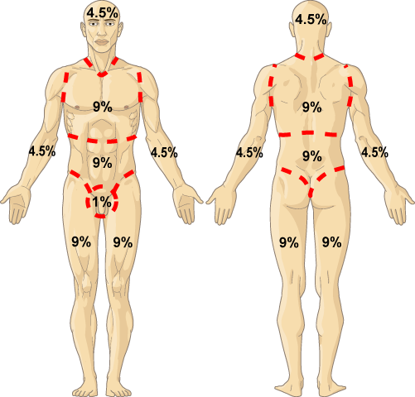
How to estimate TBSA ?
1) “Rule of nines”
The Rule of Nines is altered for
children and infants whose heads are larger and extremities smaller than adult patients.
Each upper limb = 9%
Each lower limb = 18%
Anterior and posterior trunk = 18% each Head and neck = 9% Perineum and genitalia = 1%

Slide 8
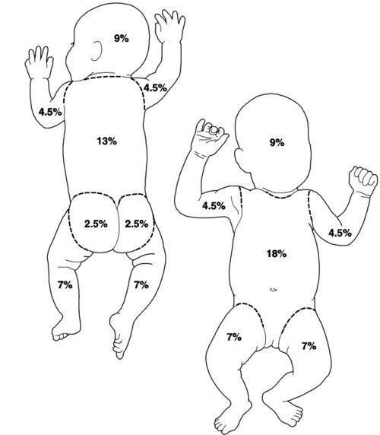

Slide 9
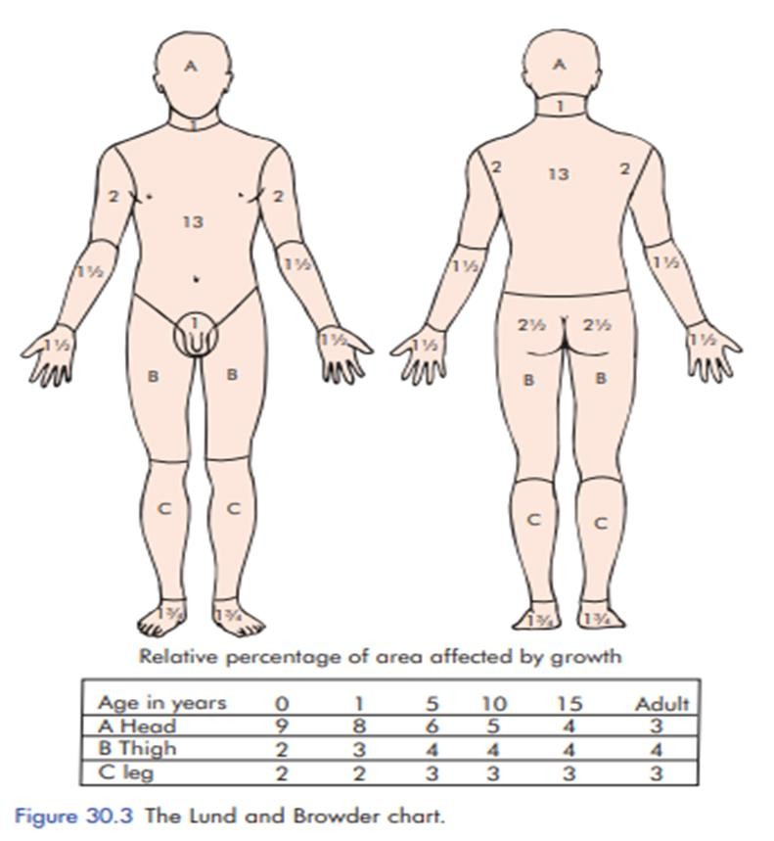
2) “Rule of the palm” Surface area of the patient’s palm is ≈1% of the TBSA used for estimating size of small burns.

Slide 10
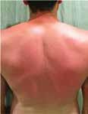
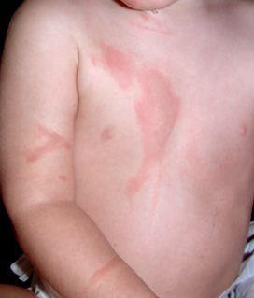
Superficial burns
Involve the epidermis
Blisters are not present
Symptoms similar to a bad sunburn and include hyperemia, blanching skin ,and tenderness to palpation.

Slide 11
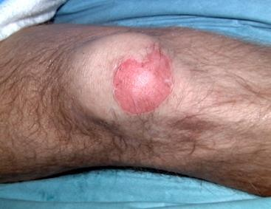
Partial-thickness burns (Superficial)
Papillary dermis involved without involvement of skin appendages
Raw surfaces are deeper red and tender to palpation
Blisters (either intact or ruptured) will be present
Blanches with pressure
If the dermal appendages are intact, then healing without skin grafting is possible

Slide 12
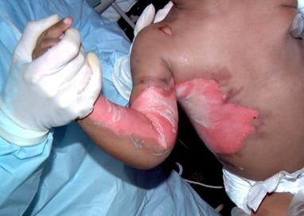
Partial-thickness burns (Deep)
Reticular dermis involved with skin
appendages
No capillary refill
White
Decreased sensation
Blisters present

Slide 13
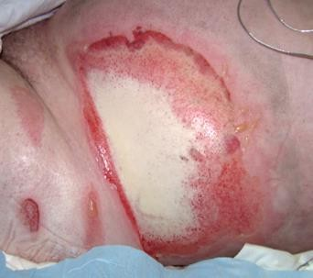
Full thickness burns
Result in destruction of the epidermal and dermal
layers Burns extend into the subcutaneous tissues, muscle, or bone.
Skin is white and non blanching or, in deeper burns, dry and leathery in appearance no sensation is present (If a burn is painful, it is not full thickness sensory nerves are preserved)
Will not heal on own and will require surgery for coverage or closure

Slide 14
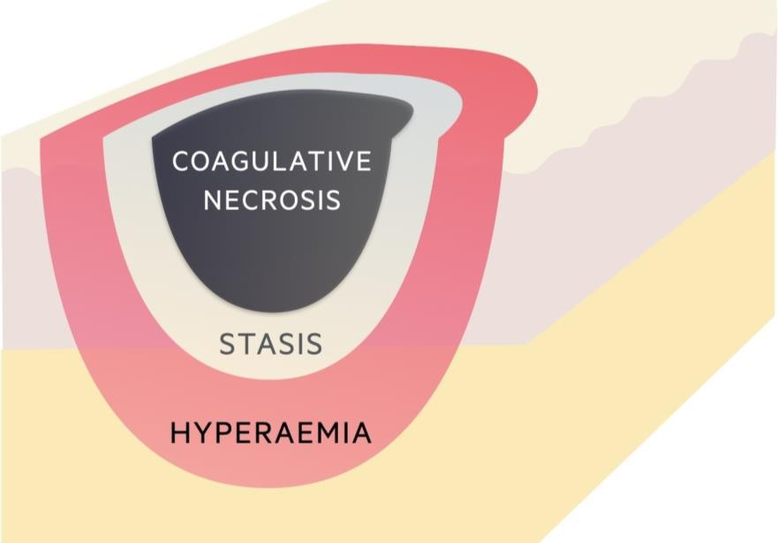
Jackson burn model
Describes the distinct areas within every burn wound
Zone of coagulation: Tissue is severely damaged and will not recover Treatment: excision and grafting
Zone of stasis: Tissue is inflamed with impaired vasculature Tissue may recover with appropriate resuscitation Surrounds zone of coagulation Treatment: Aggressive resuscitation
Zone of hyperemia: Tissue has intense vasodilation with
increased blood flow and should recover, treatment: Aggressive resuscitation

Slide 15
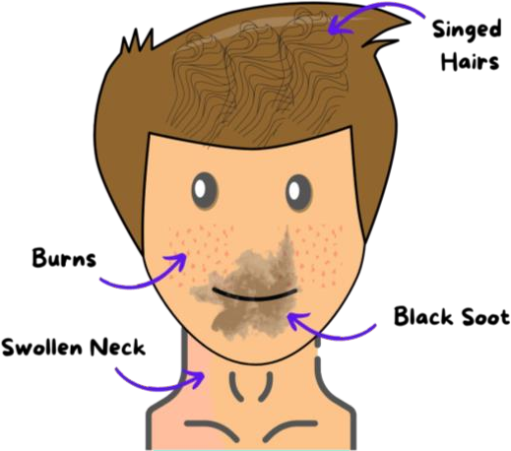
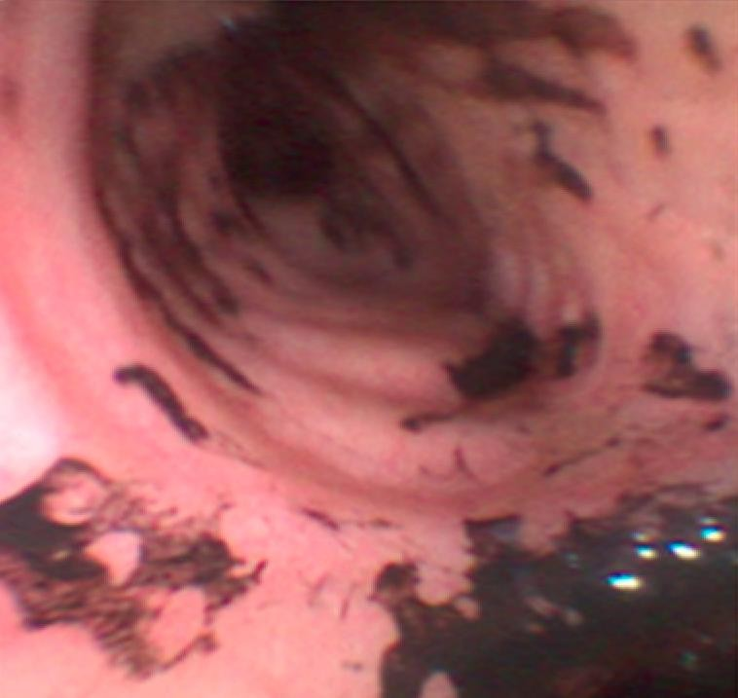
Inhalation Injury
Occurs in ∼10% of burn patients.
Present in ∼70% of patients who die of their burn injury.
History :often includes fire in an enclosed space such as a basement.
Physical examination : singed nasal hairs, facial burns, carbonaceous sputum, hoarseness, Agitation or shortness of breath may be caused by hypoxia.
Definitive diagnosis is made by direct airway examination using nasopharyngeal scope or fiberoptic bronchoscopy.
Early intubation for airway protection is mandatory.
Intubation becomes much harder when the airway swells.
Fluorescein eye examination is mandatory for patients with facial burns

Slide 16
Inhalation injury can be divided into three categories :-
Injury above the glottis: from inhalation of superheated air.
Injury below the glottis : smoke particles damaging large airway epithelium.
Carbon monoxide CO poisoning: CO will shift oxygen disassociation curve to the left and create tissue hypoxia, occurs because CO has 200 times affinity for hemoglobin compared to O2.

Slide 17
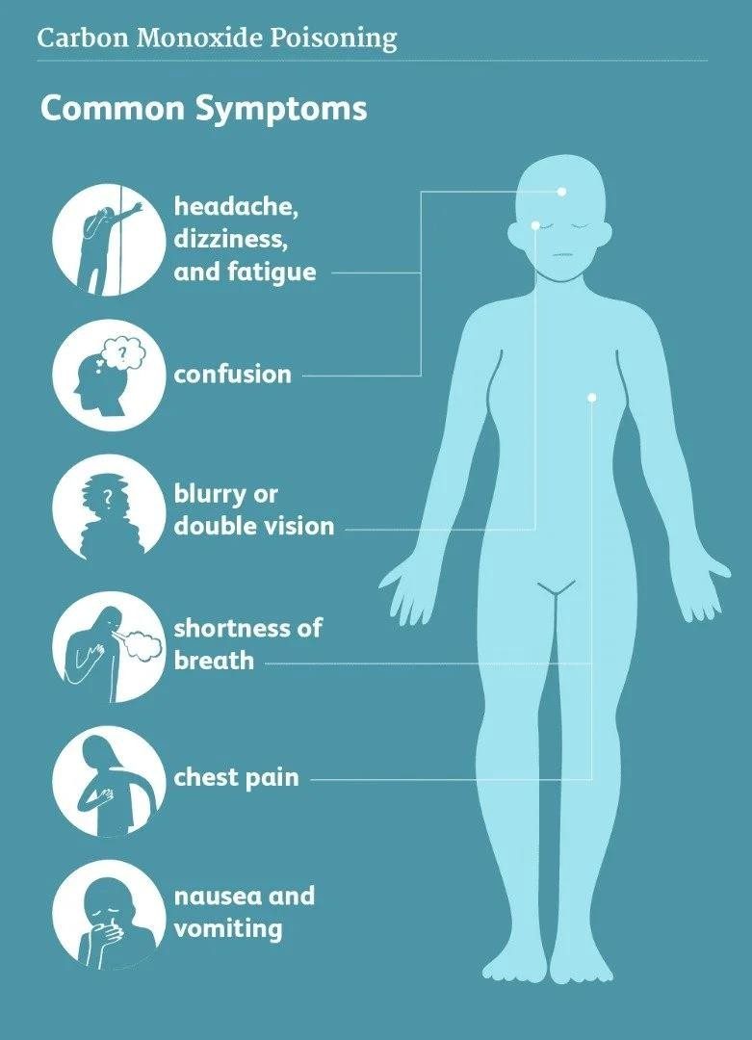
Physical examination:-
cherry red color of mucous membranes altered level of consciousness agitation
Pulse oximetry may be normal ; why ? cannot distinguish between CO and O2 Carbon dioxide removal is unaffected, so cyanosis and tachypnea are less likely
Treatment :
100% oxygen because CO half life is 4 hours on room air versus 1 hour on 100% FiO2.

Slide 18
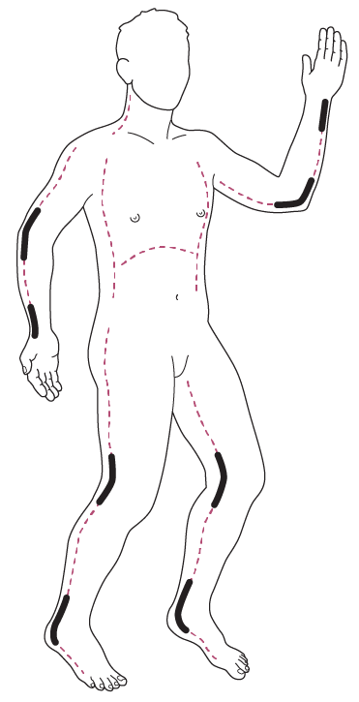
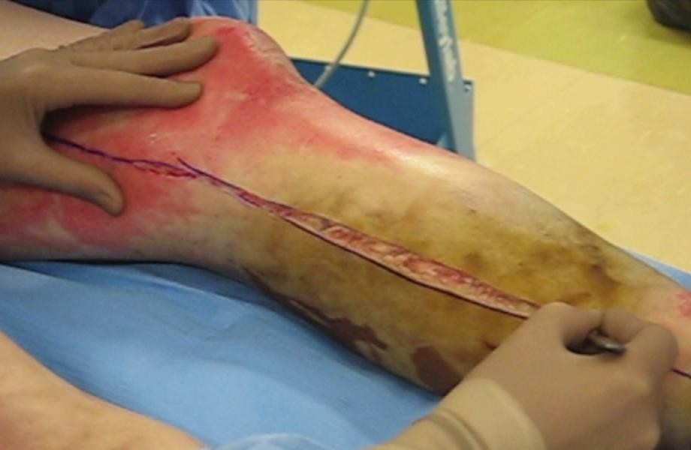
Circumferential burns
It can produce a tight, inelastic contraction with limited ability for expansion of tissues. so; as tissue edema develops during resuscitation, supraphysiologic pressures can develop with subsequent tissue ischemia and necrosis.
Escharotomy : is an incision of burned skin to relieve constriction

Slide 19
Burned extremities
Physical signs are often obscured by the burn injury or tissue edema. However, physical examination remains your best clinical diagnostic tool.
Doppler examination is unreliable in estimating tissue perfusion.
Burned chest: Circumferential burns can cause difficulty in ventilation with high peak pulmonary pressures.
Burned abdomen 1. Circumferential burns can create an abdominal compartment syndrome.
2. Bladder pressure is a good estimate of intra-abdominal pressure and can be measured via the foley catheter.
Arms and legs Can be decompressed with axially oriented medial and lateral incisions. Digital
escharotomies are not typically needed.
Chest and upper abdomen Can be decompressed with bilateral midaxillary releases. These can be connected with one or multiple horizontal incision toform an “H”

Slide 20
Special burn areas
face :
The central face has deeper skin appendages and excellent blood supply, resulting in a greater
healing capacity.
Assessed using the subunit principle: When greater than 50% of a subunit requires grafting, use unmeshed sheet grafts.
Thicker grafts are preferable on the face.
Full thickness graft is the choice.
Facial grafting should be performed less than 2 weeks from the time of injury to decrease
scarring.

Slide 21
2)eye :
Lid edema usually protects the eyes in the early stages.
Patients are at risk of corneal exposure and corneal abrasion as edema subsides.
Fluorescent staining often indicated to assess for corneal abrasions.
Electrical burn could make glaucoma so consultation is a must.
Goals: Restore the lid to the proper functional position.
Covering the inferior margin of the corneoscleral limbus in neutral gaze
Don’t forget : Ophthalmology consult Eye lubrication Tarsorrhaphy
Definitive surgical correction

Slide 22
3)ears :
If no cartilage exposure → split-thickness skin grafting and a bolster are appropriate.
Small amounts of exposed cartilage → debrided to allow primary wound closure.
Large amounts of exposed cartilage→ necessitate vascularized coverage prior to grafting ( An ipsilateral temporal-parietal fascia flap is ideal. )
4)hands & feet:
After 5 days of immobilization, ROM exercises should be restarted
Burns of the feet are managed similarly to hand burns

Slide 23
5)Genital area
Place burned foreskin into its normal position to prevent paraphimosis.
Topical antibiotic for several weeks as needed.
Any remaining open wounds should then be sheet-grafted.
Early urologist consultation is recommended.

Slide 24
The criteria for acute admission to a burns unit:
Suspected airway or inhalational injury
Any burn likely to require fluid resuscitation
Any burn likely to require surgery
Patients with burns of any significance to the hands, face, feet or perineum
Patients whose psychiatric or social background makes it inadvisable to send them home
Any suspicion of non-accidental injury
Any burn in a patient at the extremes of age
Any burn with associated potentially serious sequelae, including high-tension electrical burns and concentrated hydrofluoric acid burns

Slide 25
Burn wound care
1-Fluid resuscitation
The simplest and most widely used formula is the Parkland formula. This calculates the fluid to be replaced in the first 24 hours by the following formula:
total percentage body surface area × weight (kg) × 4 = volume (mL).
Administer half of the above volume during the first 8 hours (calculated from the time of injury, not the time of hospital admission),and the other half over the next 16 hours
Do not include superficial/first degree burns.
Lactated Ringer’s solution (LR) should be used as its composition is closest to extracellular fluid.
DO NOT resuscitate with colloids.

Slide 26
The adequacy of resuscitation is best judged by hourly urine output (0.5 mL/kg/h in adults or 1 mL/kg/h in children.
Also important to follow trend of base deficit, lactate and pH. These should continue to go down with adequate resuscitation.
Swan Ganz Catheter or bedside ultrasound (IVC filling and cardiac contractility) can
also be used to assess fluid status
Pediatric patients :
Add maintenance fluid with D5 LR
Infants and children have limited stores of glycogen which can quickly lead to
hypoglycemia.

Slide 27
2- Debridement
All blisters and nonviable tissue should be :
debrided at the bedside.
dressed with a topical antimicrobial agent.
Initial debridement of blisters should be performed at the bedside prior to initial wound dressing.
Formal debridement and grafting in the operating room is performed after adequate resuscitation and when the patient is hemodynamically stable
Early debridement can prevent burn wound infection; the first debridement (formal) is often
within 2 to 4 days of injury.
For large burns, sequential debridement and grafting is appropriate.
Ideally, all burn wounds would be grafted by 3 weeks to prevent hypertrophic scar formation that
lead to form fibrotic bands that lead to contractures , however, in very large burns, it is important
to perform early escharotomies to remove the large bioburden of dead tissue

Slide 28
Tangential excision allows sequential excision of thin layers of nonviable
tissue until bleeding, healthy tissue is reached.
Thin layer sequential excision of all nonviable tissue, until a viable tissue level is reached
At debridement, the most important distinction is between superficial and deep partial-thickness burns.
Deep partial-thickness burns require skin grafting.
Superficial partial-thickness injuries will heal on their own without grafting.
Delayed grafting can be performed if inadequate donor skin is present.

Slide 29
Dressing used materials
Silvadene ( 1% silver sulfadiazine )
Sulfamylon : 10% mafenide acetate (a carbonic anhydrase inhibitor)
Silver nitrate (0.5%)
Acticoat a silver impregnated
Bacitracin zinc

Slide 30
Grafting
Autograft: It is tissue transfer from one location to another on the same patient.
Isograft: Tissue transfer between two genetically identical individuals : monozygotic
twins.
Allograft (Homograft): Tissue transfer between two genetically different members, same species : kidney transplant.
Xenograft (Heterograft): Tissue transfer from a donor of one species to a recipient of another species , The donor and recipient are of different species

Slide 31
Partial Thickness Graft
It is removal of full epidermis plus part of dermis from the donor area, leaving some skin appendages in the remaining dermis.
Advantages
Disadvantages
It is technically easier.
Infection
Graft take up is better
Contracture
Donor area heals on its own.
Loss of hair growth
hematoma formation will prevent graft take up

Slide 32
Full Thickness Graft
A full-thickness skin graft (FTSGs) removes epidermis and the entire thickness of the dermis and leaves a donor defect (which needs to be sutured or grafted)
Advantages | Disadvantages
Color match is good | Used only for small areas
Sensation and function of sebaceous gland, hair follicles retained better. | Wider donor area has to be covered with SSG

Slide 33
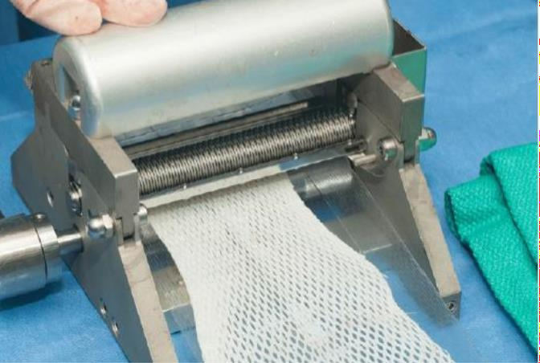
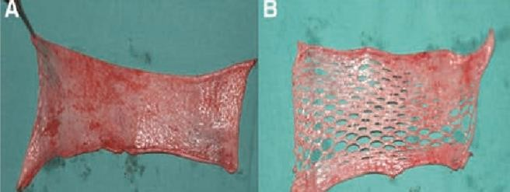
Meshing
cut with a special guarded freehand knife or an electric dermatome.
Is typically performed at a 1:1.5 ratio to increase surface area and decrease fluid collection beneath the graft.
Meshing decrease hematoma and seroma
Higher mesh ratios (e.g., 1:2, 1:3, or 1:4) can be used but prolong healing.

Slide 34
Graft failure
Inadequate wound debridement prior to graft application is the primary cause.
Quantitative cultures showing more than 105 cells will result in graft loss.(infection)
Fluid collection beneath the graft, including hematoma (most common) or seroma.
Shear force to graft from inadequate immobilization and compression.
Poor nutrition or overall physiologic status

Slide 35
Differences between grafts and flaps
Grafts | Flaps
Depends on recipient site for nutrition. | Has own blood supply.
Cosmetic may discolor or contract. | Better color take, less likely to contract.
Less adaptable to weight bearing. | More adaptable to weight bearing
Less able to survive on a bed with questionable nutrition. | Can be used on a bed with questionable nutrition.
Requires pressure dressing. | Requires no pressure dressing.

Slide 36
3.Nutritional supplementation
A hypermetabolic response is common to all large burns
The metabolic rate is proportional to the size of the burn, up to 60% TBSA, and remains constant
thereafter.
This response begins soon after injury, reaching a plateau by the end of the first week.
Most burns >30% TBSA require intensive nutritional support until wound healing is complete.
*Curreri formula for caloric requirements: 24 hour caloric requirement = (25 kcal × kg body weight) + (40 kcal × %TBSA).
Protein requirements: 2.5 to 3 g/kg/day are recommended. In children, requirements are 3 to 4
g/kg/day

Slide 37
B. Intestinal feeding should be performed early
Initial feeds can be performed using a nasogastric tube.
If feeds are administered to the stomach, feeding should be held 6 hours prior to the OR.
A post-pyloric Dobhoff tube is appropriate for long-term feeding. Post-pyloric feeds can
be continued in the perioperative period.
C. Weekly nutrition labs, prealbumin levels are drawn to monitor nutrition status.
D. Early involvement of a registered dietician is imperative.

Slide 38
Thank you

