Slide 1
Psoriasis
Dr. Awad Hasan Al-Tarawneh,MD
Consultant Dermatologist and Dermatopathologist
Associate professor, Mu`tah University

Slide 2
Definition
Epidemiology
Pathogenesis
Clinical presentations and variants
Histopathological features
Exacerbating factors
Differential diagnosis
Associated co morbidities
treatment

Slide 3
Psoriasis-Definition
Psoriasis is a chronic, inflammatory, immune‐mediated systemic disease affecting mainly the skin with characteristic cutaneous clinical and histopathological features .It can be associated with significant morbidity and impaired patient quality of life .

Slide 4
Epidemiology
It is a young person's disease with a median age at onset of 25 years in women and 28 years in men
Its incidence is 2-3% by some studies
Genetic predisposition is important (Between 60% and 90% of patients with psoriasis have a family history of the disease -by one study)

Slide 5
Pathogenesis
Precise etiology of psoriasis is not known yet but the pathogenesis is well understood
The development of psoriasis is the end result of interplay between keratinocytes and T lymphocytes with the participation of dendritic cells-the end result of this is hyper proliferation and increased turnover of the epidermal cells and formation of psoriatic plaques

Slide 6
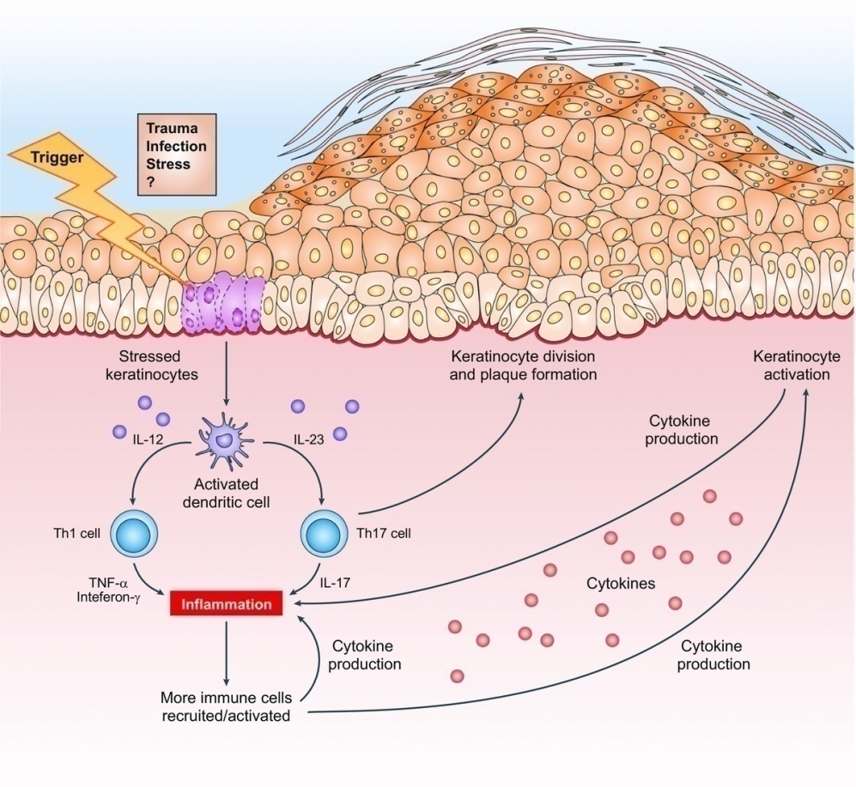
Psoriasis for the primary care practitioner
Journal of the American Association of Nurse Practitioners, Volume: 29, Issue: 3, Pages: 157-178, First published: 23 February 2017, DOI: (10.1002/2327-6924.12443)
Notes:
Pathogenesis of psoriasis. Reprinted by permission from Macmillan Publishers Ltd: [NATURE] (494(7429):552‐554), copyright .
IF THIS IMAGE HAS BEEN PROVIDED BY OR IS OWNED BY A THIRD PARTY, AS INDICATED IN THE CAPTION LINE, THEN FURTHER PERMISSION MAY BE NEEDED BEFORE ANY FURTHER USE. PLEASE CONTACT WILEY'S PERMISSIONS DEPARTMENT ON PERMISSIONS@WILEY.COM OR USE THE RIGHTSLINK SERVICE BY CLICKING ON THE 'REQUEST PERMISSIONS' LINK ACCOMPANYING THIS ARTICLE. WILEY OR AUTHOR OWNED IMAGES MAY BE USED FOR NON-COMMERCIAL PURPOSES, SUBJECT TO PROPER CITATION OF THE ARTICLE, AUTHOR, AND PUBLISHER.

Slide 7
Clinical presentations
Skin: Well demarcated erythematous plaques covered with dry silver scales on extensor surfaces ( in psoriasis vulgaris)
Positive Ozpit`s sign
Nails: pitting, oil spot, onychlysis,dyscoloration and thickening
Scalp: Thick scaly plaques covered with sivery dry scales that may extend beyond the hair margin
Mouth –Geographical tongue

Slide 8
Clinical variants of psoriasis
Plaque psoriasis (psoriasis vulgaris)
Scalp psoriasis
Nail disease
Inverse psoriasis
Pustular psoriasis
Palmoplatar psoriasis
Erythrodermic psoriasis
Guttate psoriasis

Slide 9
Plaque psoriasis( Psoriasis vulgaris)
This presentation is most common and accounts for more than 80% of all cases
It is characterized by well‐defined erythematous plaques that may have adherent dry silvery scales
Symmetrical plaques on elbows, knees, and lower trunk , with scalp involvement and it can be pruritic
The development of lesions on previously uninvolved skin following cutaneous injury is known as the Koebner phenomenon

Slide 10
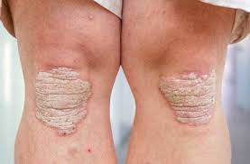
Plaque psoriasis(vulgaris)

Slide 11
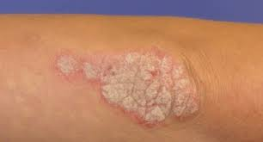
Plaque psoriasis(vulgaris)

Slide 12
Scalp psoriasis
Between 50% and 80% of patients with psoriasis develop lesions on their scalp
It can occur without skin lesions and called scalp psoriasis
The sales are dry and silvery and the lesions can be felt
lesions may extend onto facial skin or posterior neck( do not respect the hair margin)

Slide 13
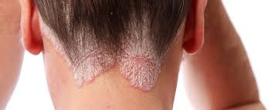
Scapl psoriasis

Slide 14
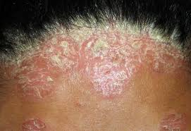
Scalp psoriasis

Slide 15
Nail disease(Nail psoriasis)
Nail involvement is common in all forms of psoriasis, affecting an estimated 80% of patients with the disease especially in pustular, erythrodermic and palmoplantar forms and with psoriatic arthritis
nail pitting, oil drop–like patterns of yellow or salmon discoloration , nail thickening ,onycolysis and dyscoloration
Nail disease can occur without any skin involvement(nail psoriasis )Which is sometimes difficult to diagnose

Slide 16
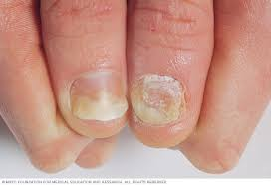
Nail psoriasis-(pitting,onycholysis,oil spots)

Slide 17
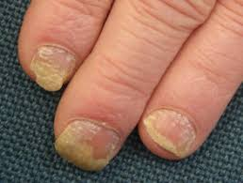
Nail psoriasis

Slide 18
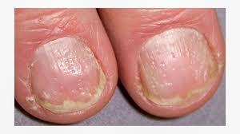
Nail psoriasis

Slide 19
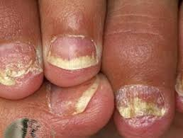
Nail psoriasis

Slide 20
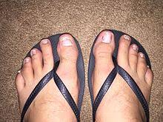
Nail psoriasis

Slide 21
Inverse(flexural) psoriasis
Inverse or flexural psoriasis involves the groin and/or other intertriginous areas, such as the armpits, under the breasts, or in abdominal skin folds
Characterized by well‐defined, shiny, erythematous plaques with minimal scaling
Should be differentiated from fungal infection and seborrheic dermatitis

Slide 22
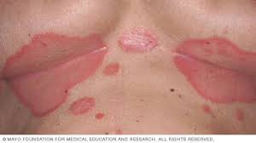
Flexural(inverse)psoriasis

Slide 23
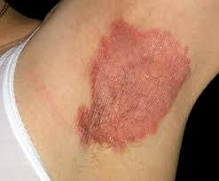
Inverse(flexural) psoriasis

Slide 24
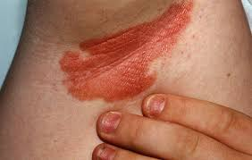
Inverse(flexural) psoriasis-with nail changes

Slide 25
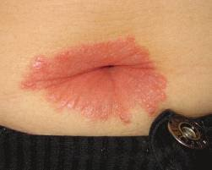
Inverse(flexural)psoriasis-umbilical area

Slide 26
Pustular psoriasis
Eruption of sterile pustules that can be generalized and extensive or localized to existing plaques
Acute generalized pustular psoriasis is known as the von Zumbusch variant, an uncommon, severe form of psoriasis that may be accompanied by edema and fever and may require hospitalization

Slide 27
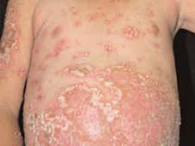
Pustular psoriasis-Generalized

Slide 28
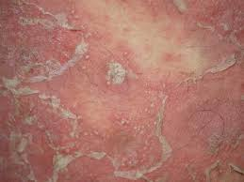
Pustular psoriasis(generalized)

Slide 29
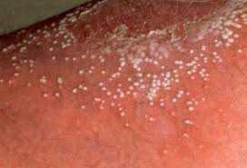
Pustular psoriasis-Generalized(Sterile pustules)

Slide 30
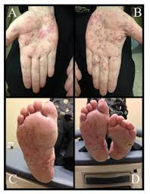
Pustular psoriasis-Localized(palmoplantar)

Slide 31
Palmoplantar psoriasis
Palmoplantar pustular psoriasis is characterized by yellow‐brown sterile pustules on the hands and feet
Nail changes are more frequent in this variant
Patients may also experience scaling and severe pruritus, making this variant difficult to differentiate from hand eczema
This form of psoriasis is more common in women
Smoking is a risk factor for this variant
Differential diagnosis includes ;eczema and fungal infection

Slide 32
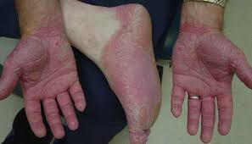
Palmoplantar psoriasis

Slide 33
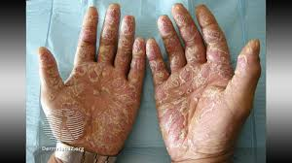
Palmoplantar psoriasis

Slide 34
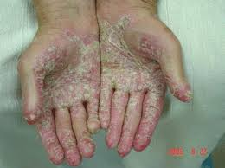
Palmoplantar psoriasis

Slide 35
Erythrodermic psoriasis
Erythrodermic psoriasis appears as generalized exfoliative dermatitis that can affect a large percentage of a patient's body surface area
Hair loss and nail dystrophy are common with this type
Patients may experience fever, chills, and/or fatigue
Erythrodermic psoriasis can be life‐threatening and require hospitalization

Slide 36
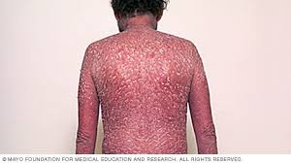
Erythrodermic psoriasis

Slide 37
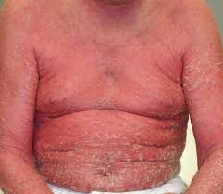
Erythrodermic psoriasis

Slide 38
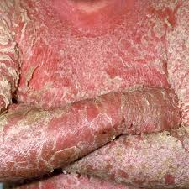
Erythrodermic psoriasis

Slide 39
Guttate psoriasis
It is characterized by small, scattered, pink, oval (drop‐shaped) papules with silvery scaling that usually appear on the trunk and extremities
It is typically occurs as new onset psoriasis in patients under 30 years of age
Guttate psoriasis is often triggered by strep throat infections
Differential diagnosis :pityriasis rosea, lichen planus,pityriasis lichenoides
Good prognosis

Slide 40
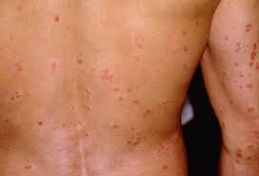
Guttate psoriasis

Slide 41
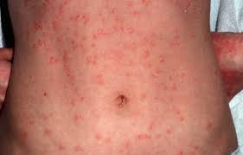
Guttate psoriasis

Slide 42
Histopathological features
Hyperkeratosis
Parakeratosis containing neutrophils (Munro`s microabscess)
Acanthosis
Hypogranulosis
Lymphocytic inflammatory infiltrate
So psoriasis has a diagnostic histopathological features

Slide 43
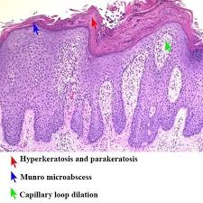
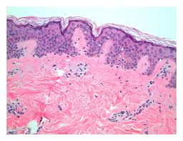
Psoriasis pathology compared with normal skin

Slide 44
Exacerbating factors
Infections, particularly strep throat
smoking, alcohol consumption , obesity
Drugs: lithium, synthetic antimalarial drugs, tetracycline antibiotics, beta blockers, and non- steroidal anti‐inflammatory drugs (NSAIDS)
Skin trauma
Emotional stress
In women, psoriasis severity often fluctuates with changes in hormone levels( High levels of disease activity are often observed during puberty, postpartum, and during menopaus psoriasis often improve during pregnancy when levels of estrogen are increased )

Slide 45
Associated co morbidities
Psoriatic arthritis
Hyperlipidemia
Obesity
Hypertension
Hyper metabolic syndrome
Increased risk for cardiovascular disease

Slide 46
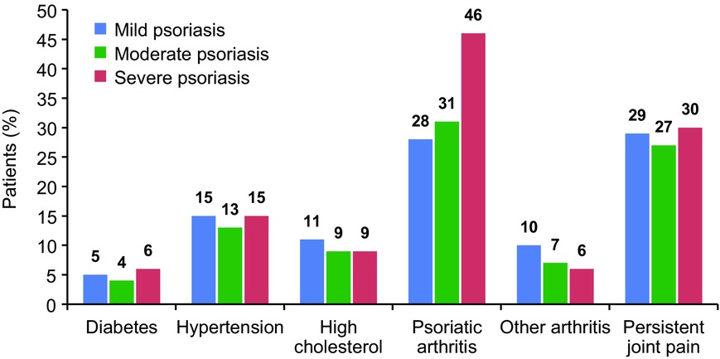
Psoriasis for the primary care practitioner
Journal of the American Association of Nurse Practitioners, Volume: 29, Issue: 3, Pages: 157-178, First published: 23 February 2017, DOI: (10.1002/2327-6924.12443)
Notes:
Prevalence of psoriasis comorbidities by disease severity (Armstrong, Schupp, & Bebo, ).
IF THIS IMAGE HAS BEEN PROVIDED BY OR IS OWNED BY A THIRD PARTY, AS INDICATED IN THE CAPTION LINE, THEN FURTHER PERMISSION MAY BE NEEDED BEFORE ANY FURTHER USE. PLEASE CONTACT WILEY'S PERMISSIONS DEPARTMENT ON PERMISSIONS@WILEY.COM OR USE THE RIGHTSLINK SERVICE BY CLICKING ON THE 'REQUEST PERMISSIONS' LINK ACCOMPANYING THIS ARTICLE. WILEY OR AUTHOR OWNED IMAGES MAY BE USED FOR NON-COMMERCIAL PURPOSES, SUBJECT TO PROPER CITATION OF THE ARTICLE, AUTHOR, AND PUBLISHER.

Slide 47
Psoriatic arthritis
One in five patients with psoriasis has psoriatic arthritis (20%).
Psoriasis appears to precede the onset of psoriatic arthritis in 60-80% of patients (by as many as 20 years, but usually by less than 10 years)
In as many as 15-20% of patients, arthritis appears before the psoriasis.They my appear simultaneously
It is a seronegative arthritis
Nail changes is seen more with psoriatic arthritis
Dactilitis is a clinical feature
X-ray is helpful in the diagnosis

Slide 48
Psoriatic arthritis-Clinical variants
Asymmetrical oligoarticular arthritis( most common)
Symmetrical polyarthritis
Distal interphalangeal arthropathy
Arthritis mutilans
Spondylitis with or without sacroiliitis

Slide 49
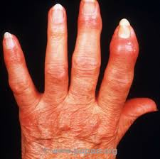
Psoriatic arthritis

Slide 50
Differentioal diagnosis for psoriasis
Eczema
Lichen planus
Fungal infection
Pityriasis rubra pilaris
Pityriasis lichenoides
Mycosis fungoides
Secondary syphilis

Slide 51
Treatment
No curable treatment till now
Our treatment control the disease to go into a remission
Topical treatment for less severe not extesive disease(less than 10% body surface area) as first line of treatment
Systemic treatment for more extensive and severe disease and for disease that is not responding to topical treatment and affecting the quality of life of the patients

Slide 52
Topical treatment agents
Crude coal tar
Emollients
Dithranol
Topical steroids
Topical calcipotriol (Vit.D dirivative)
Topica calcineurin inhibitors (Tacrolimus)
Topical retinoids (Vit. A derivatives)
Local phototherapy
Local laser treatment

Slide 53
Systemic treatment Obtions
Phototherapy (PUVA and NB-UVB)
Methotrexate ( low weekly dose)
Retinoids ( Vit.A derivatives : Acitritin)
Cylosporin
Apremilist
Biological treatment(Adalimumab, Etanercept, Secukinumab,Ustekinumab and others)

Slide 54
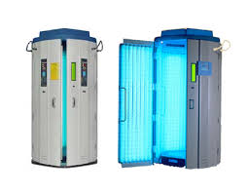
Phototherapy machine

Slide 55
Phototherapy-Local for nail disease

Slide 56
Thank You

