Slide 1
RBC disorders 2 Anemia of diminished production
Dr. Bushra AlTarawneh, MD
Anatomical pathology Mutah University School of Medicine- Department of Laboratory medicine & Pathology HLS lectures 2021

Slide 2
•Iron deficiency anemia
•Anemia of chronic disease
•Megaloblasticanemia
•Others
- anemia in liver disease
- anemia in renal disease
- aplastic anemia
- Myelophthisic anemia

Slide 3
1-Iron deficiency anemia
•Iron deficiency can result from
(1) dietary
(2) impaired absorption,
(3) increased requirement,
(4) chronic blood loss.

Slide 4
pathogenesis
•Negative iron balance due to any reason
•Compensation by storage iron
•Progressive deficiency until complete depletion
•Anemia develops accompanied by low ferritin and low transferrin saturation

Slide 5
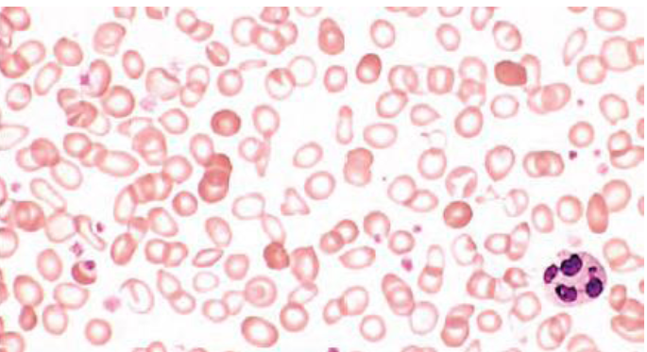
morphology

Slide 6
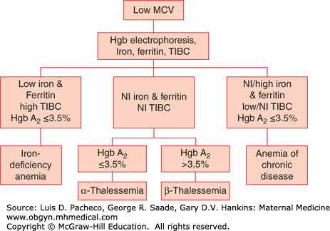

Slide 7
Lab findings
•Low hemoglobin and hematocrit
•Low MCV
•Low MCH
•Low iron levels
•Low ferritin
•High TIBC
•High RDW
•Low hepcidin
•Low transferrin saturation

Slide 8
2-Anemia of chronic disease
•Anemia of chronic disease is impaired red cell production associated with chronic diseases that produce systemic inflammation
•The most common cause of anemia among hospitalized patients.
•Examples include chronic microbial inflammation, autoimmune inflammation, and malignancy.

Slide 9
Lab findings
• Low HB and Hct
•Can be hypochromic microcytic or normochromic normocytic.
•High ferritin and low TIBC(exactly opposite to iron deficiency anemia)

Slide 10
3- Macrocytic Anemia: > 99 fl (B12 and/or Folate Deficiency) *look for Reticulocyte count, if increased think of secondary macrocytosis: 1- Recent hemorrhage 2-Treated anemia 3- Hemolytic anemia *All of the above cause Macrocytosis with Reticulocytosis

Slide 11
https://www.picswe.com

Slide 12
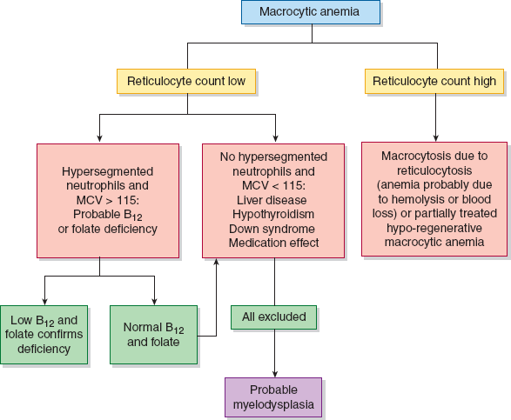
https://accessmedicine.mhmedical.com

Slide 13
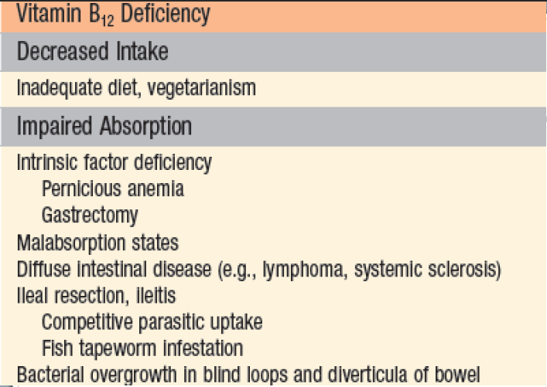
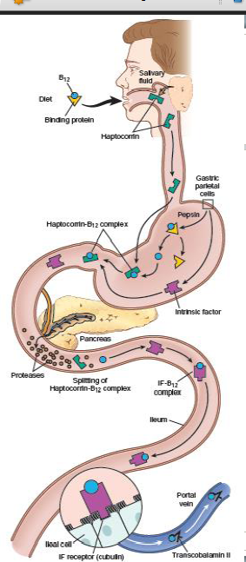
Pernicious anemia
Autoimmune attack on gastric mucosa.
three types of antibodies
1-parietal canalicular antibodies
2-blocking antibodies
3-intrinsic factor–B12 complex antibodies

Slide 14
Clinical manifestations
•Related to anemia similar to those found in folate deficiency
•Additionally, leukopenia with hypersementedneutrophils can be seen
•Neurological symptoms:
Numbness
Unsteady gate
Loss of position sense
Increase risk of malignancy in patient with pernicious anemia

Slide 15
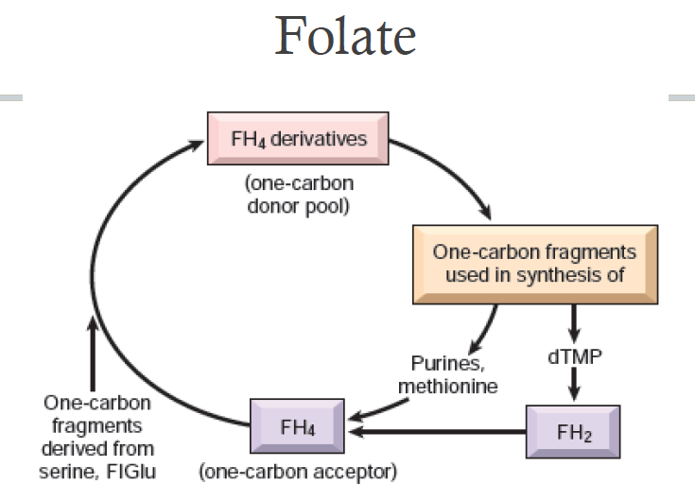

Slide 16
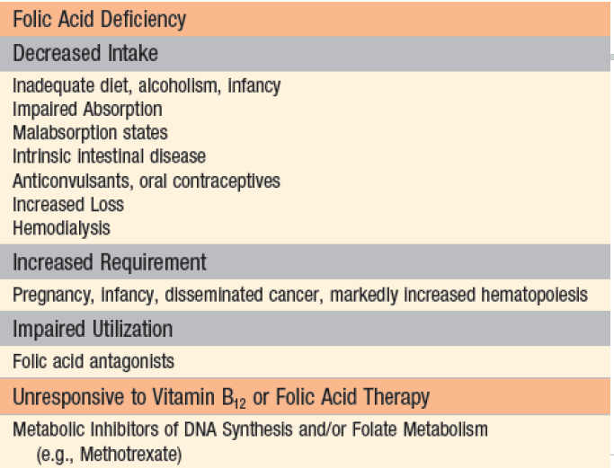

Slide 17
Clinical manifestations
•Nonspecific symptoms of anemia, weakness, fatigue…etc
•GI symptoms due to the effect on GI epithelial lining cells.
•NO neurological symptoms
•Diagnose by serum and RBC folate levels.

Slide 18
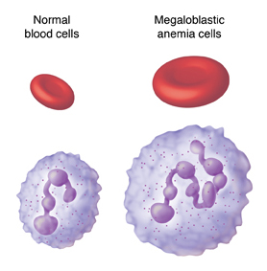
https://www.sterlingcare.com

Slide 19
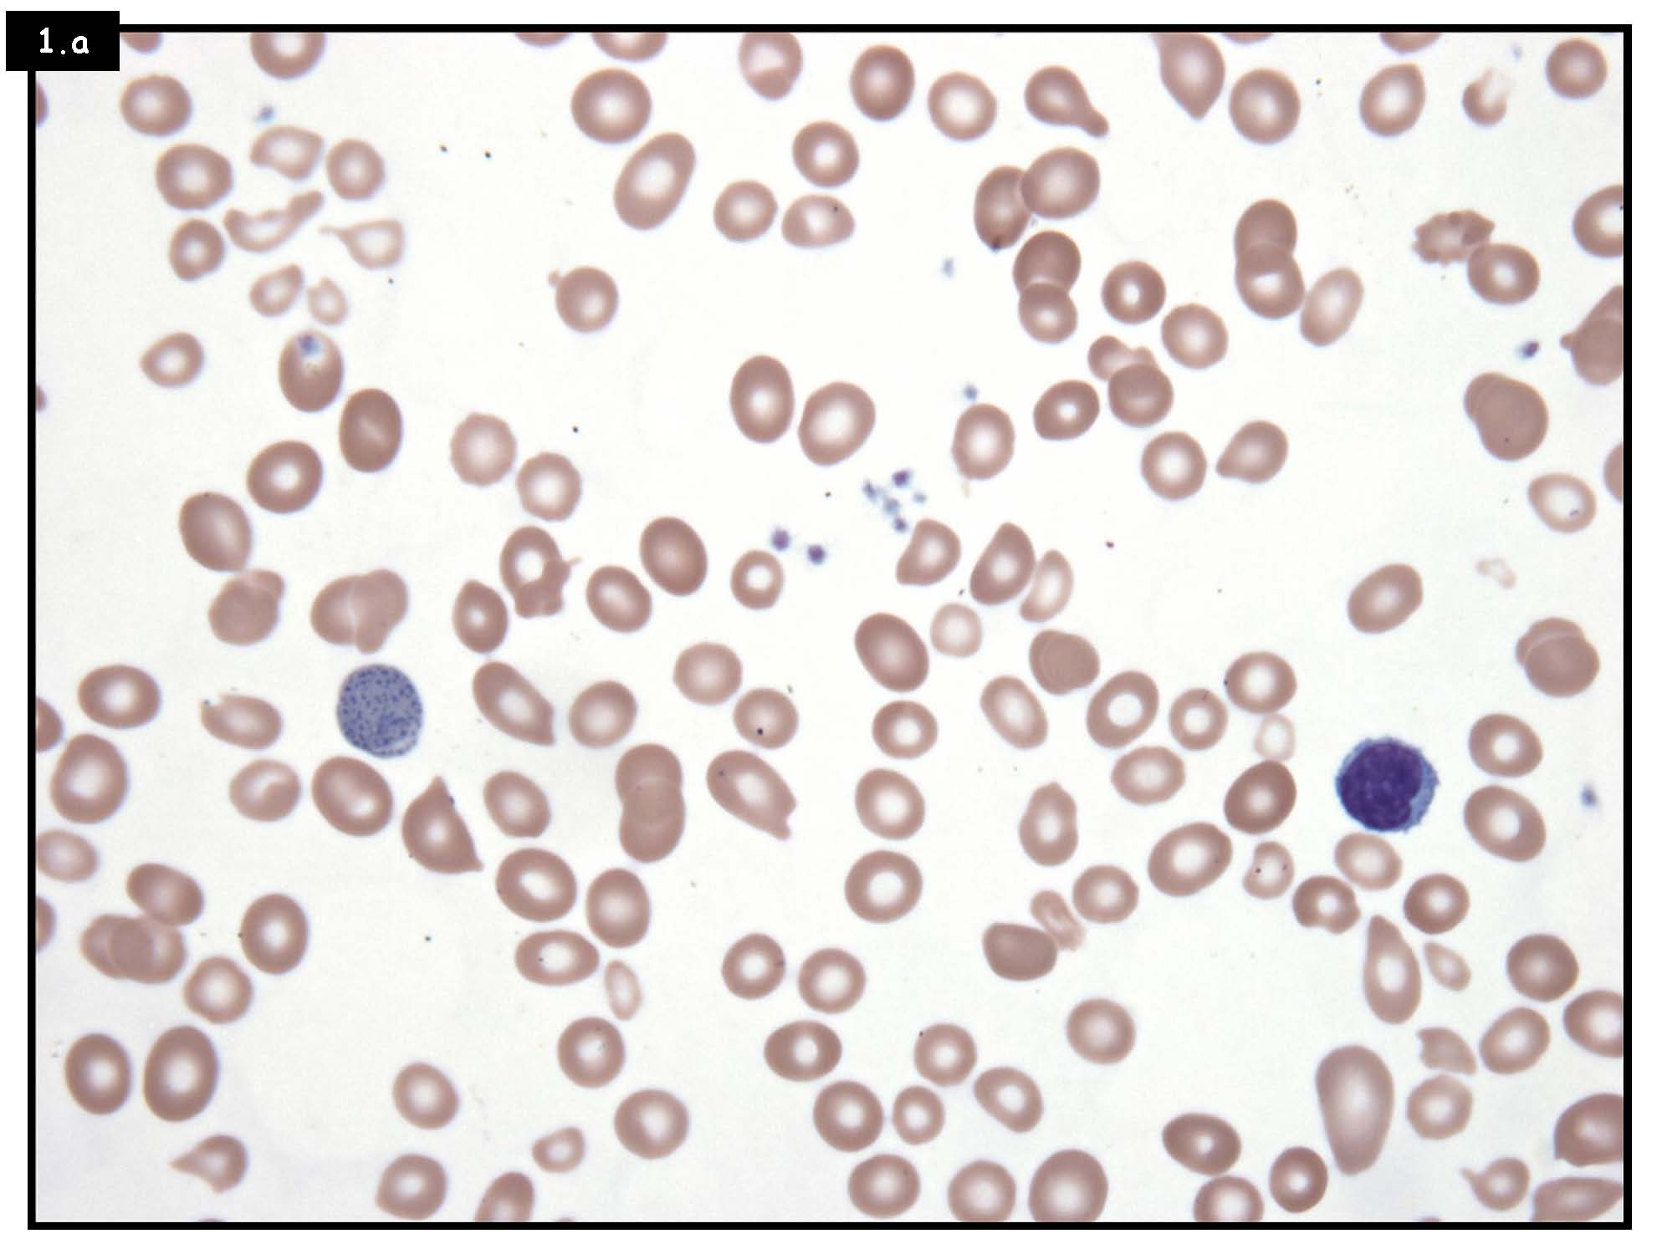
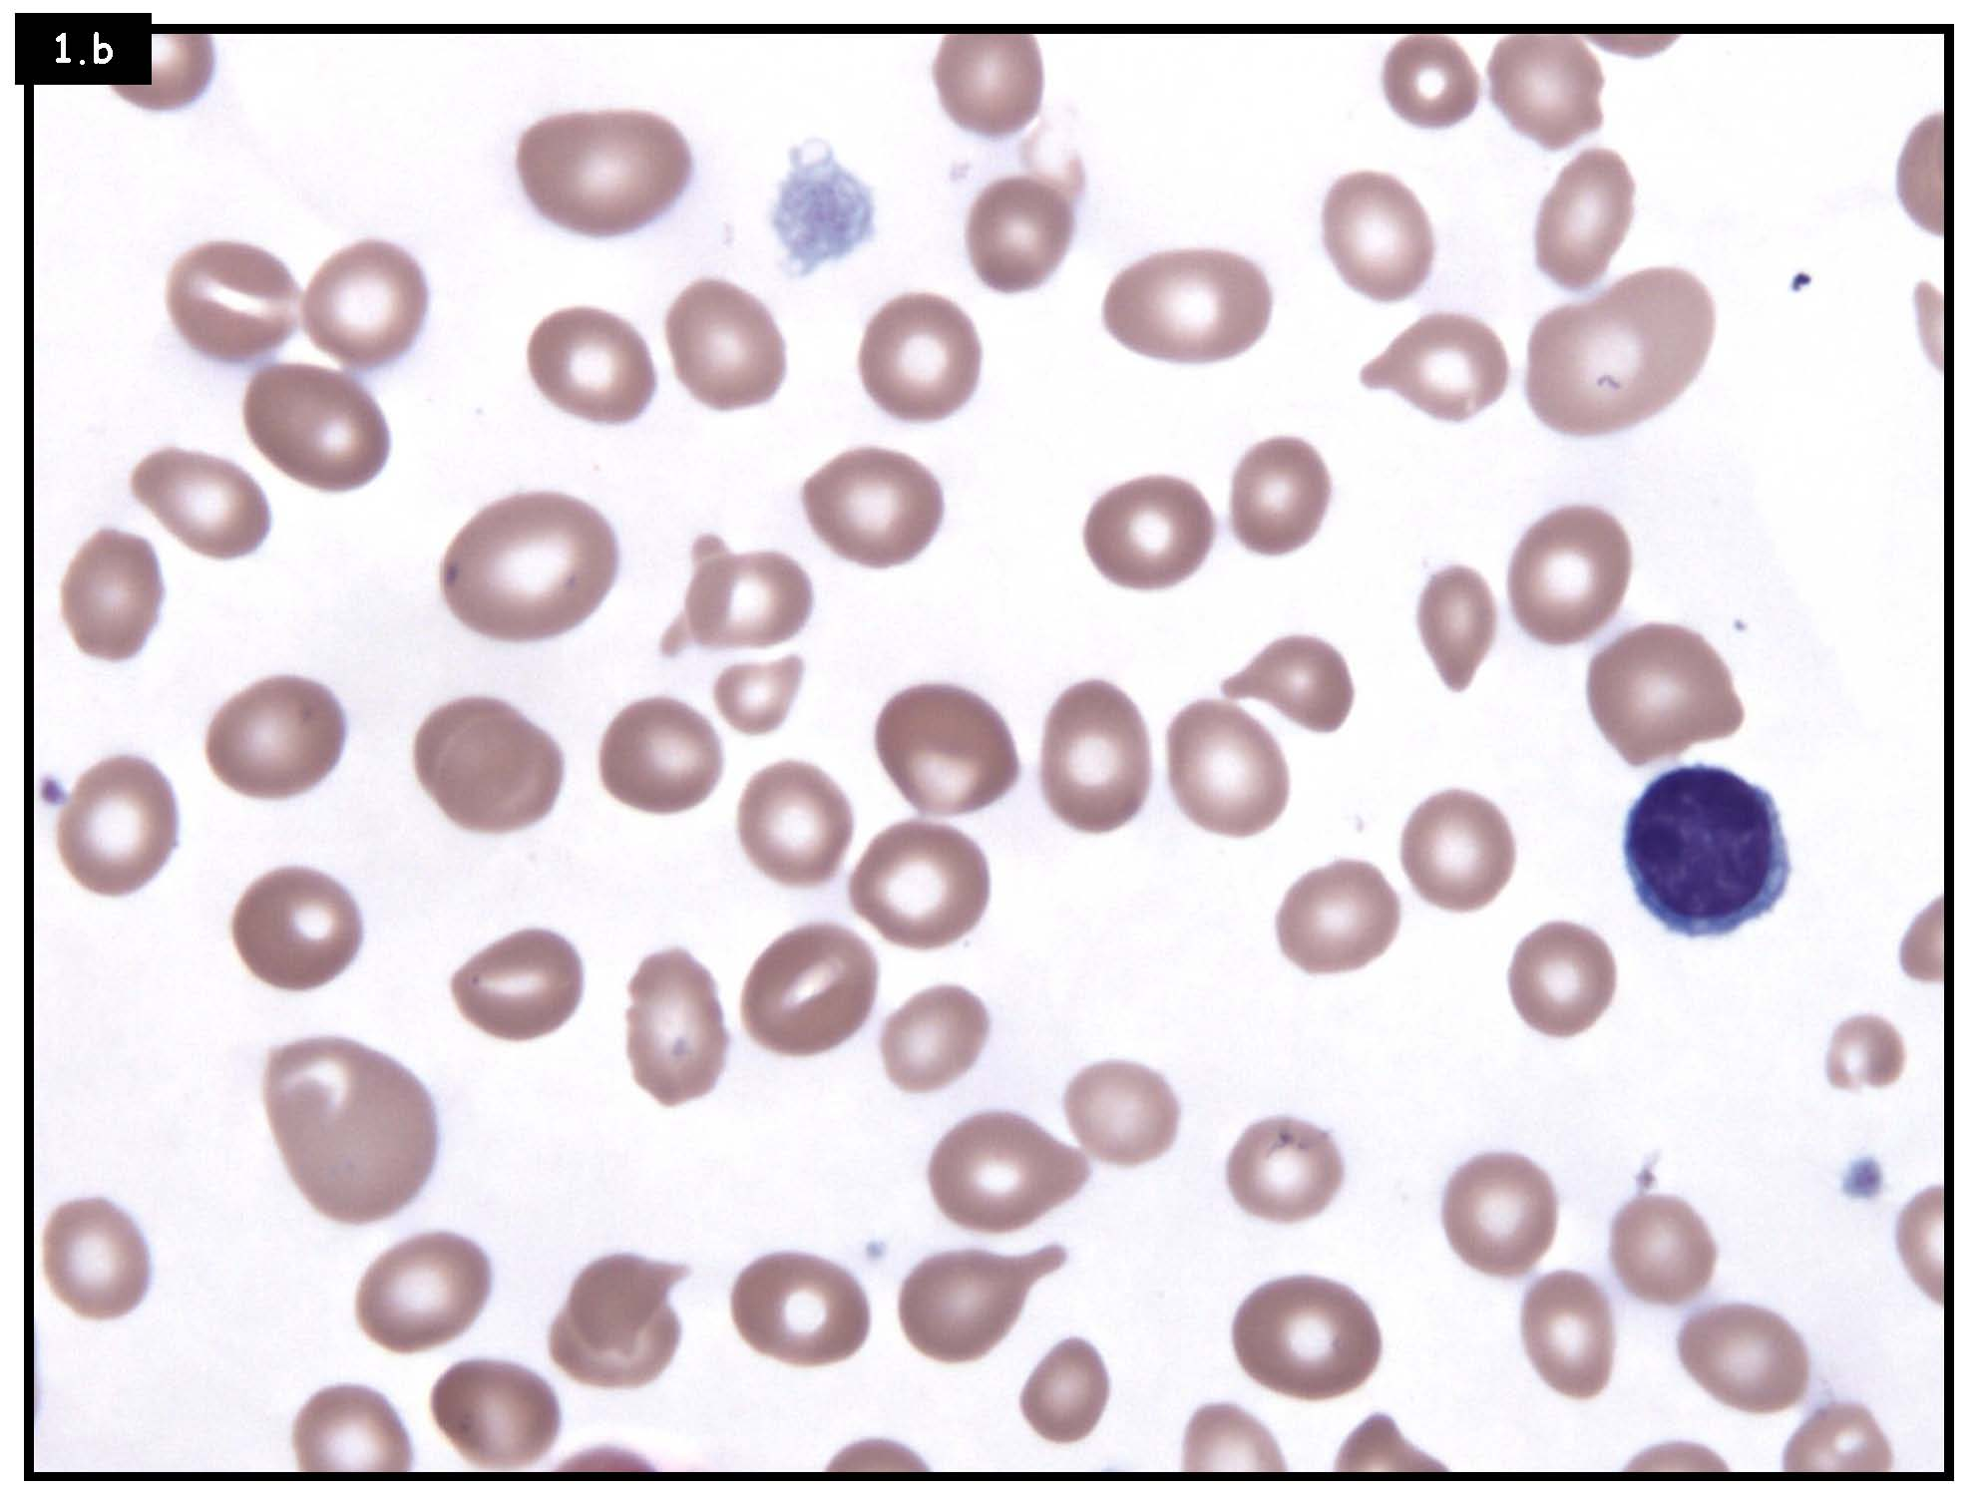
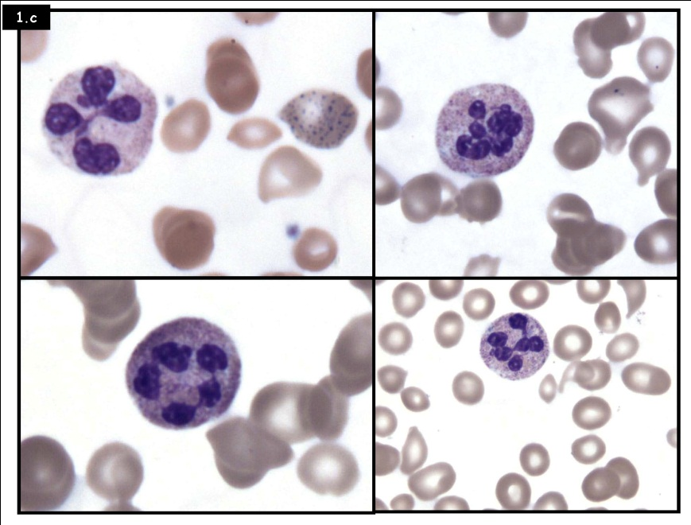
Macro-ovalocytes
Moderate anisopoikilocytosis
Neutrophilic hypersegmentation

Slide 22
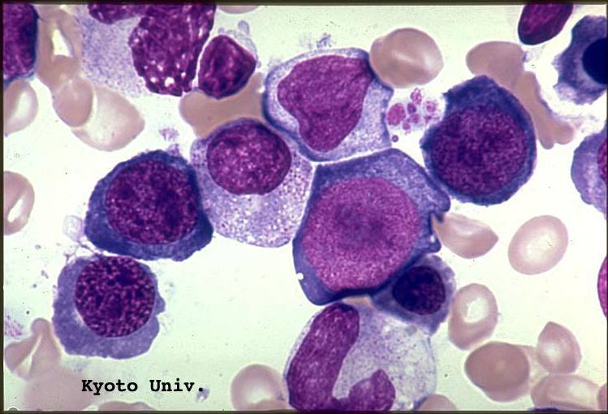
http://pathy.med.nagoya-u.ac.jp

Slide 23
4-Normocytic/Normochromic 1)Anemia OCD …Cytokine (IL-6) induced Hepcidin production Hepcidin binds ferroportin and induces it is internalization and degradation…so: Decrease RBC life span Decrease Iron Mobilization from stores Increase iron stores Lab findings: Low iron, High Ferritin, Low Transferrin, Low TIBC 2)under-production …Dec.Reticulocyte count *Pure red cell aplasia *Aplastic anemia *Myelophthisic

Slide 24
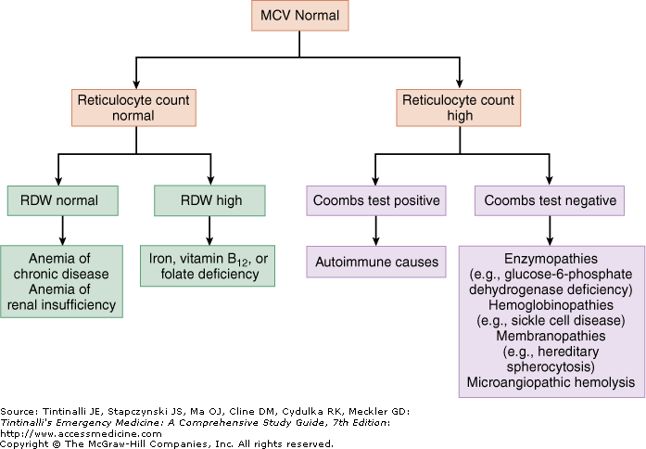

Slide 25
Aplastic Anemia
Aplastic anemia refers to a syndrome of chronic primary hematopoietic failure and attendant pancytopenia(anemia, neutropenia, and thrombocytopenia), that is secondary to suppression of multipotent myeloid stem cells.
Idiopathic
Secondary:
* Idiosyncratic
* Predictable, reversible, dose dependent :
XRT, myelotoxic drugs, drugs, chemicals, &Viral infections

Slide 26
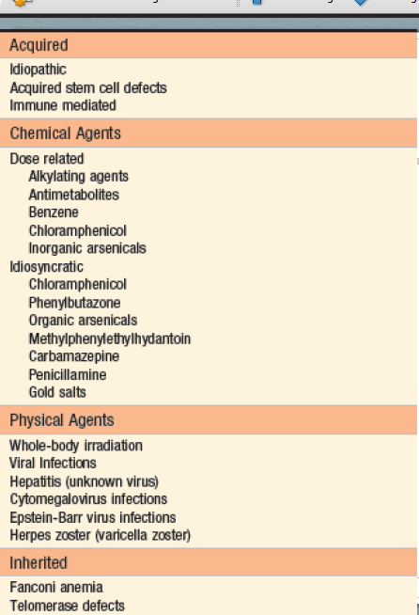
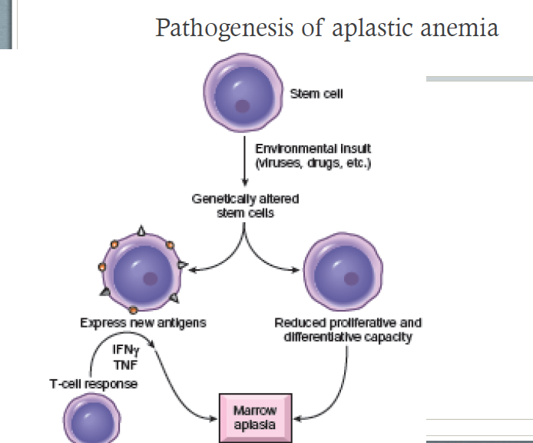

Slide 27
Clinical features
•Any age with no gender predilection
•Stigmata of pancytopenia
•Normocytic and occasionally macrocytic anemia.
•No splenomegaly
•No increased reticulocyte count
•Bone marrow exam is a must for diagnosis
•Respond well to immunosuppressive therapy, BM transplantation is the treatment of choice with 5 year survival of more than 75%.

Slide 28
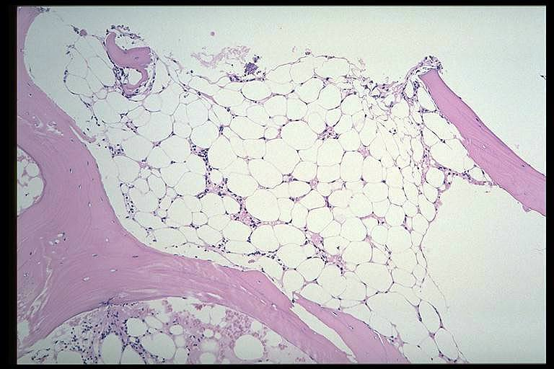
pathy.med.nagoya-u.ac

Slide 29
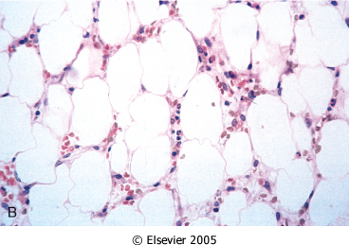

Slide 30
5- Anemia in liver disease
•Multiple etiologies:
•Iron deficiency is the most common
•Hypersplenism
•Therapy related hemolytic anemia and suppression of EPO receptor
•Alcoholic-cirrhosis-induced folate deficiency

Slide 31
6-Anemia of renal disease
• Related to decrease EPO production by the damaged kidney.
•High levels of inflammatory cytokines
•Hemolysis
•Chronic bleeding
•Folate deficiency in patients on dialysis.

Slide 32
Myelophthisic anemia
Extensive infiltration of the marrow by tumors or other lesions.
•Metastatic cancer (lung, breast, prostate)
•Tuberculosis
•Lipid storage disorders
•Osteoscelrosis
•Leukoerythroblasticreaction on peripheral blood.

