Slide 1
Excision of endometriosis
Prepared by: Ghazi Jadeed, Anas Khamaiseh
Supervised by: Dr. Alaa Owais

Slide 2
Introduction
Endometriosis has an innate capacity to involve various structures, with varying degrees of infiltration. Because of this, it offers some of the most challenging surgery in our field.
It exists in three distinct entities: peritoneal, ovarian and deep endometriosis, and remains an enigmatic disease for general gynaecologists and specialist laparoscopic surgeons alike.
With the centralisation of severe endometriosis services, the most complex cases will be treated by multidisciplinary teams. Still, other units will be expected to treat patients with less severe endometriosis. Therefore, a sound and safe technique for optimal excision of endometriosis is relevant to many gynaecologists with an interest in minimally invasive surgery.

Slide 3
Although there is consensus that minimally invasive excision surgery is the best operative management for endometriosis, the surgical techniques employed by surgeons vary widely.
The evolution of endometriosis excision can be attributed to advances in surgical technology and rapid progress in laparoscopic image quality, which enable the surgeon to see fine anatomical structures such as small nerves. It can also be attributed to the knowledge gained and shared among surgeons with a better understanding of laparoscopic retroperitoneal anatomy.

Slide 4
Most of the steps and the principles for optimal and safe excision of endometriosis are the same for all cases, regardless of severity.
Fundamentals of endometriosis excision can be utilised by all gynaecologists performing surgical treatment of endometriosis.

Slide 5
Fundamentals of endometriosis surgery

Slide 6
Structured approach
The importance of a structured approach in surgery cannot be overemphasised.
This does not mean rigidly following a series of pre-defined steps, but rather a framework a surgeon can employ and to which they can return according to the surgical scenario.
SOSURE is a mnemonic for the steps that are required in most endometriosis excision surgery.

Slide 7
Optimal exposure and use of assistance
In open surgery, retractors and packs are used to maximise access and exposure.
In endoscopic surgery, the laparoscope provides excellent views and allows the surgeon to visualise the entirety of the pelvis and the abdomen. However, pelvic organs, such as ovaries, the uterus and loops of bowel must be moved out of the way. Temporary ovarian and uterine suspension can provide excellent access, while allowing the assistant to be more than simply a ‘retractor’. The assistant is freed to perform other important tasks, such as keeping the surgical field dry and helping with tissue traction.
Ergonomics in laparoscopic surgery is another fundamental principle.

Slide 8
Retroperitoneal dissection
Identifying important anatomical structures (ureters, vessels, nerves, etc.) and separating them from the abnormal tissue to avoid injury to these structures is the mainstay of endometriosis surgery. This often requires careful tissue dissection by taking advantage of surgical planes.
Deep endometriosis poses considerable challenges because it obliterates normal anatomical planes by causing fibrosis. Stony hard nodules can fuse adjacent structures together, making it difficult for the surgeon to separate them.
The most effective approach is to start the dissection from normal tissue away from the disease and work towards the endometriotic nodule. The use of tissue traction and counter-traction facilitates opening spaces and often guides the surgeon to the best tissue plane to explore. Pushing the instrument gently into the plane and opening the jaws of the laparoscopic instrument can help develop these spaces, while minimising blood loss.

Slide 9
SOSURE
SOSURE is a mnemonic conceived by the authors that provides a framework to describe a number of operative steps that maximise access and optimise assistance during endometriosis surgery.
Among other benefits, these techniques provide greater independence to the lead surgeon. The surgical steps and resulting exposure of the pelvic organs ensures the lead surgeon is exclusively occupied with operating/dissection.
Meanwhile, the assistant, rather than simply holding intrusive structures out of the way, can aid in tissue dissection and maintaining a clear surgical field.
It is important to highlight that, as a framework, it is intended to provide a structured approach to endometriosis surgery; it is not a set of rigid rules to follow consecutively. Not all the steps are necessary for all cases and the order in which they need to be performed will vary.

Slide 10
S: Survey/sigmoid mobilisation
Once pneumoperitoneum and access via umbilical, suprapubic and two lateral ports have been established, a thorough 360-degree survey is performed.
A suitable starting point to consider is mobilisation of the sigmoid colon. This frees the bowel from the sidewall, allowing it to be manipulated more readily. It will also facilitate left ureterolysis. Gentle traction towards the midline is applied to the sigmoid colon, often by lying an open atraumatic grasper over the bowel. The fusion line that is subsequently revealed between the peritoneum of the sigmoid and the peritoneum (also known as ‘the white line of Toldt’) can be cut just medial to the peritoneum.

Slide 11
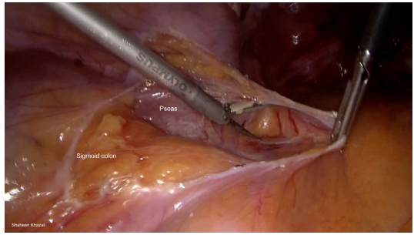
Notes:
Sigmoid mobilization. The fusion line is identified and dissected to mobilise the sigmoid colon.

Slide 12
O: Ovarian mobilisation
In advanced endometriosis, the ovaries may be adherent to the uterus, pelvic sidewall, bowel, or to each other (often with associated endometriomas).
A combination of traction and blunt/sharp dissection can be used to mobilise the ovaries. The intention here is to free the ovaries from associated adhesions so they can be mobilised for suspension. It also ensures that any disease hidden under the ovaries can be accessed and excised.

Slide 13
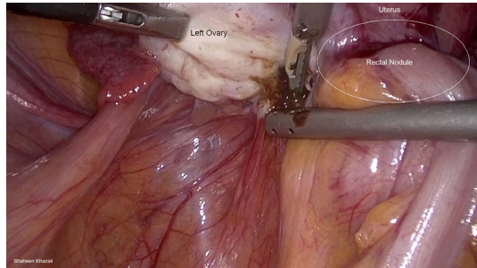
Notes:
Mobilisation of the left ovary. In this case, the adherent left ovary is separated from the pelvic sidewall, posterior aspect of the uterus and endometriotic nodule.

Slide 14
Suspension of ovaries /uterus
Ovarian Suspension
We use a non-braided suture on a straight needle (Prolene 2-0) for ovarian suspension.
The needle is introduced just lateral to the inferior epigastric vessels and 4-5 cm below the lateral operating ports.
The needle is positioned using graspers/needle holders and passed through the ovary prior to being extruded from the abdomen adjacent to the insertion,The suture can be retrieved using a rectus sheath closure device.

Slide 15
It is important to avoid vessels in the abdominal wall and also visualize the full length of the needle at all times, as both ends can be traumatic to surrounding structures.
We usually leave the ovarian suspension sutures in place for 5-7 days in an attempt to reduce the risk of adhesions between the ovaries and pelvic sidewalls.
Removal is performed in the community typically by the patients GP surgery.

Slide 17
UTERINE SUSPENSION
Uterine suspension is not used as commonly as ovarian
suspension. In our unit, however, uterine suspension is used
in most lateral and posterior compartment excision cases.
Uterine suspension can deliver strong and stable traction and
anteversion of the uterus, which is arguably superior to that
produced by a uterine manipulator.
It also removes the need For a second assistant for uterine manipulation.
We use two techniques for uterine suspension, depending
on the severity of disease and the amount of upward traction required :

Slide 18
First technique :
1-Using a straight 2-0 prolene needle, the suture is introduced perpendicular to the abdomen, close to pubic symphysis, taking
care to avoid the bladder.
While one grasper retracts the uterus, the other passes the needle
through the fundus, perpendicular to the axis of the uterus.
The needle goes through myometrium only, before being removed from the same position it entered the abdomen.

Slide 19
Sec techniuqe:
Alternatively, a strong vicryl suture on a large, curved needle can be used. Using a needle holder, a transverse figure-of-eight stitch is passed through the lower part of the uterus before being retrieved using a rectus sheath closure device just above pubic symphysis.
In ‘frozen pelvis’ cases, where there is limited initial access to the
Pouch of Douglas, the uterus can be suspended in a stepwise approach.

Slide 20
The first figure-of-eight suture can be placed at the lowest point on the uterus that is readily accessible.
As adhesiolysis is performed and the uterus is freed, another figure-of-eight suture can be placed inferior to the previous one and the optimal amount of anteversion/retraction can be obtained.
In both methods, the degree of anteversion can be adjusted throughout the procedure by changing the traction on the extracorporeal sutures.

Slide 21
Notes:
Uterine suspention . top:introduction of the uterine suspention suture -bottom :uterine suspention once the suture is brought under extracorporeal tension.

Slide 22
There are scenarios in which it might be necessary to use a uterine manipulator, such as testing tubal patency or hysterectomy.
When assessing tubal patency, the uterine manipulator can be introduced at the beginning of the procedure and removed after the dye test.
When a hysterectomy needs to be performed in a patient with
rectovaginal endometriosis, we release the uterine suspension
after the excision is completed and then insert a uterine manipulator to complete the hysterectomy.

Slide 23
U: Ureterolysis
Ureterolysis frees and lateralises the ureters to prevent potential injury during surgery.
It also enables the surgeon to keep the ureters under direct vision when dissecting close by.
We always begin our ureteric dissection in an area of normal tissue to allow dissection of the correct surgical plane.
The ureters are identified over the pelvic brim and the overlying peritoneum is grasped so that it can be retracted away from the underlying ureter.

Slide 24
A small incision can be made in the tented peritoneum using either cold scissors or an ultrasonic energy device.
Gentle traction is applied at the edges of the peritoneum and the ureter can be exposed using a combination of blunt dissection, cold scissors and ultrasonic/bipolar energies.
Care should be taken to not compromise the ureteric blood supply by avoiding the use of energy close to the ureter and by keeping the adventitia intact.
Our usual practise is to reserve the use of ureteric stents for patients who are known to have hydroureter, or where there is an intraoperative concern for either the integrity of the ureter or its blood supply.

Slide 26
Rectovaginal/Pararectal Space Entry( R) :
Access to the rectovaginal space, where necessary, can be obtained using blunt and sharp dissection with caution advised in the use of electrosurgical instruments in close proximity to the bowel to minimize the risk of thermal injury.
In cases where a nodule involves the rectum (but is not full thickness and therefore does not require either a disc or segmental resection) and is also adherent to the uterus/uterosacral ligaments, it is our preference to completely dissect the disease away from the bowel first and then excise the nodule off the back of the uterus.
We have found this facilitates a cleaner shave and more complete excision, allowing the surgeon to get beyond the nodule to healthy tissue.

Slide 27
Using a rectal probe to provide countertraction and a grasper pulling gently on the uterosacral ligament, the pararectal space can be entered by dissecting the avascular space adjacent to the rectum.
Suspension has another benefit during this step: since there is no uterine manipulator in place, the rectal probe is not impeded when introduced and positioned within the pelvis.
Gentle movements of the rectum using the probe can also help to demonstrate the margins of the bowel, thus reducing the risk of inadvertent injury.
If both pararectal spaces are opened, then both sides can be extended to meet with the rectovaginal space.
This ensures complete excision of the affected area.

Slide 28
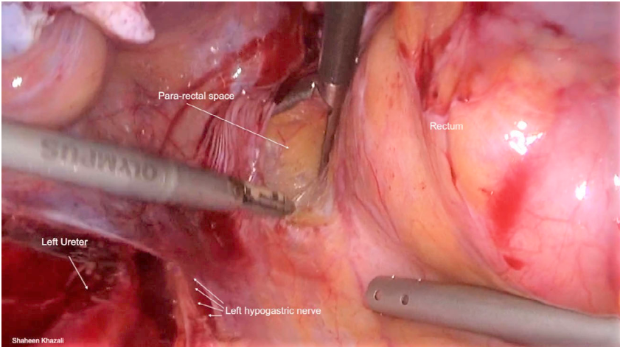
Notes:
DIssection of pararectal space .,the pararectal space is entered by using blunt or sharp dissection

Slide 29
Notes:
Rectovaginal space dissection

Slide 30
Excision of disease (E) :
At this point the important structures are safely separated from the disease, all visible endometriosis can be excised.
If both pelvic sidewalls and both uterosacral ligaments are involved, the ‘Butterfly Area’ (bilateral pelvic sidewalls, uterosacral ligaments and torus uterinus) will often need to be excised.
Care should be taken to not compromise the nerve plexuses within the pelvic sidewall during excision, especially the hypogastric nerves and the inferior hypogastric plexuses. If the hypogastric nerve is involved in disease, and is thus severed during resection, it is important to try and preserve at
least one side

Slide 31
Notes:
Butterfly area "prior to excision" ,note complete suspention of uterus and ovaries

Slide 32
Notes:
Excision of endometriosis. Above: full-thickness rectal nodule and surrounding anatomy prior to excision. Below: appearances following
excision and bowel resection. Abbreviations: Rt Ureter = right ureter; Rt Hypogastric nerve = right hypogastric nerve; Lt Ureter = left ureter.

Slide 33
Conclusion
In our experience, time spent at the beginning of the procedure to optimise access and identify and normalise pelvic anatomy provides the surgeon with a structured and safe approach to laparoscopic excision of endometriosis.
It optimises identification of all areas of abnormal tissue, allowing the surgeon to excise all areas of disease.
Ultimately, this leads to better outcome for the patient, with reduced surgical morbidity.

