Slide 1
Signs and Symptoms
Done by :Rayan Nihad
Supervised by Dr . Malik

Slide 2
Abnormalities in urine volume and composition
♣ Polyuria : abnormally large volume of urine, and is most commonly due to excessive fluid intake (more than 2.5-3 liters per 24 hrs). - External ( Diuretics , Diabetes insipidus , …) - Renal : kidney fails to reabsorb water
interstitial nephritis
urinary tract infection
renal tubular acidosis
♣ Oliguria : reduction in urine volume to <800 ml/day.
- Acute renal failure
♣ Anuria : total absent of urine production
- acute renal failure
♣ Pneumaturia : passing gas bubbles in the urine
- colovesical fistula

Slide 3
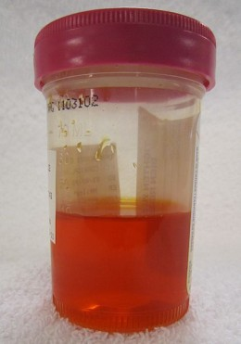
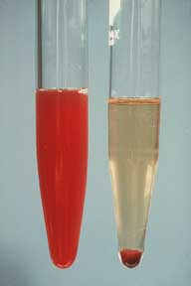
Abnormalities in urine color
Orange : - dehydration - laxatives - vitamins - chemotherapy
Red : - Blood , myoglobin , free hemoglobin - blackberries , beetroot - Drugs ( rifampicin , … )

Slide 4
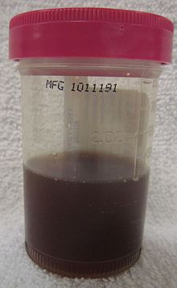
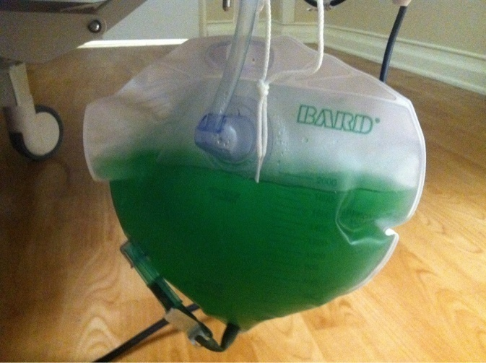
Brown-Black : - Conjugated bilirubin - Homogentisic acid ( alkaptonuria ) - Drugs ( L-Dopa , metronidazole , …)
Blue Green : - Drugs / Dyes ( propofol , fluorescein , triamterene )

Slide 5
Hematuria
* It is the presence of RBCs in the urine.
- Macroscopic (gross) hematuria is visible to the naked eye (overtly bloody, smoky or blood clots)
- Microscopic or dipstick hematuria is when blood is identified by urine microscopy or dipstick testing
- >3 RBCs/HPF on urinalysis of at least two separate samples

Slide 6
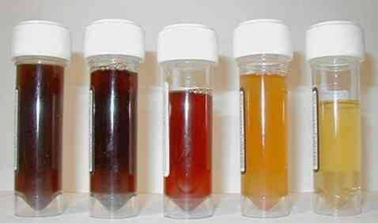
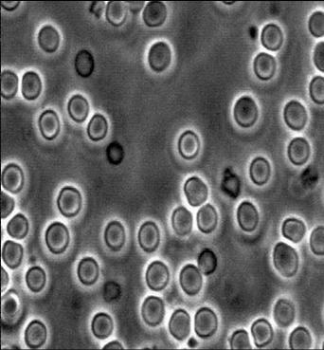
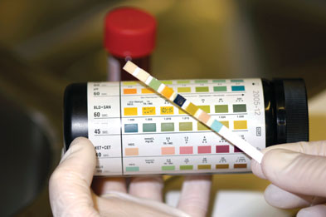
Gross Hematuria
Urine Microscopy
Dipstick urinalysis

Slide 7
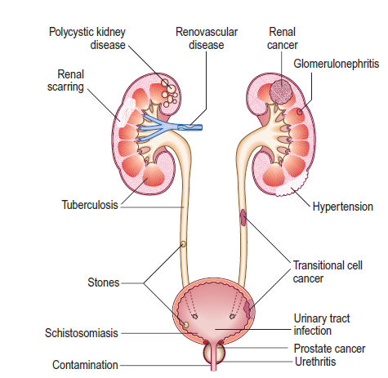

Slide 8
Causes of hematuria :
- Recent Urological Interventions : Bladder Catheterization , urethral stent , Prostate
biopsy ) - Trauma - Radiotherapy , Chemotherapy
- Coagulopathies
** Pseudo hematuria : Menses , Drugs (Rifampicin) , Dyes , Food (Beets) , porphyria

Slide 9
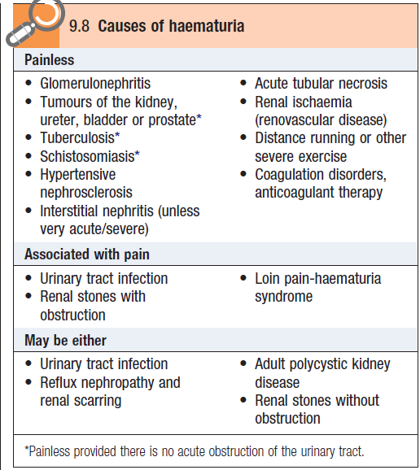
Timing of Hematuria :
Total : Above bladder neck ( bladder , ureters and kidneys)
Terminal : Prostatic urethra and neck of bladder
Initial : Anterior urethra

Slide 10
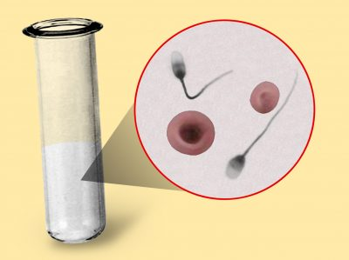
Hematospermia
It is the presence of blood in the semen.
- It can be ( bright red, coffee-colored, rusty, or darkened ) in appearance and may change as blood ages.

Slide 11
Causes
- Iatrogenic: after prostate biopsy , cystoscopy , prostate intervention . - Age < 40 : Inflammatory (prostatitis, epididymo-orchitis, urethritis, urethral condylomata ) / Idiopathic / Trauma / testicular or perineal tumors .
- Age > 40 : prostate or bladder cancer / BPH with dilated veins in the prostatic urethra / prostatic or seminal
vesicle (SV) calculi/ hypertension / carcinoma of the seminal vesicles
- Rare causes : bleeding diathesis/ utricular cysts/ Müllerian cysts/ TB/ schistosomiasis/ amyloid of prostate or seminal vesicles/ following therapeutic injection of hemorrhoids .

Slide 12
Nocturia and nocturnal polyuria
Nocturia is the frequent need to get up and urinate at night. Enuresis (bed wetting) in that the person does not wake and the bladder empties.
Nocturnal polyuria (NP) refers to a condition in which the rate of urine output is excessive only at night and total 24-hour output is within normal limits.
Awakening 2 or more times at night considered as nocturia

Slide 13
Lower Urinary Tract Symptoms
• two phases of lower urinary tract function :
1. Storage phase (bladder filling and urine storage)
 accommodation and compliance
 no involuntary contraction
2. Voiding phase (bladder emptying)
 coordinated detrusor contraction
 with relaxation of outlet sphincters
 no anatomic obstruction

Slide 14
Filling (Storage) or irritative symptoms :
- Frequency : micturating more often with no
increase in the total urine output.
- Urgency : a sudden strong need to pass urine
- Dysuria : painful urination
- Nocturia
Voiding or obstructive symptoms :
- Poor stream (unimproved by straining)
Hesitancy ”difficulty in beginning the flow of urine “
(worsened if bladder is very full)
Terminal dribbling : patient continues to leak urine after micturition has ceased
- Urinary retention : inability to completely empty the bladder

Slide 15
Urinary Incontinence
Definition • involuntary leakage of urine
Types : 1- Urgency Urinary Incontinence (UUI) : Involuntary leakage accompanied by or immediately preceded by urgency
Detrusor overactivity : CNS lesion , inflammation /infection (cystitis, stone, tumour), bladder neck obstruction (tumour, stone), BPH, idiopathic
Decreased compliance of bladder wall CNS lesion, fibrosis , sphincter/urethral problem

Slide 16
2- Stress Urinary Incontinence (SUI) : Urine leakage associated with increased abdominal pressure from laughing, sneezing, coughing, climbing stairs, or other physical stressors on the abdominal cavity and, thus, the bladder
Common in women , seen in men after prostate cancer surgery
Mechanism : - Urethral Hypermobility : weakness in pelvic floor - Intrinsic sphincter deficiency (ISD)
Notes:
 urethral hypermobility
 weakened pelvic floor and musculofascial urethral and vaginal supporting mechanisms
allows bladder neck and urethra to descend with increased intra-abdominal pressure
 urethra is pulled open by greater motion of posterior wall of outlet relative to anterior
wall
 associated with childbirth, pelvic surgery, aging, levator muscle weakness, obesity
 intrinsic sphincter deficiency (ISD): weakness of the urethra and associated smooth and
striated muscle elements
 pelvic surgery, neurologic problem, aging and hypoestrogen state
 ISD and urethral hypermobility can co-exist

Slide 17
3- Mixed incontinence :
A combination of stress and urge incontinence,
4- Overflow incontinence: increased residual or chronic urinary retention leads to urinary leakage from bladder overdistention.
5- Functional incontinence :
loss of urine related to deficits of cognition and
mobility.(eg, delirium, psychiatric disorders, urinary infection, impaired mobility)
6- Continuous incontinence : associated with fistulas ( vesicovaginal , urethrovaginal ) and ectopic ureter inserted distal to external sphincter

Slide 18
Overactive Bladder
a symptom complex that includes urinary urgency with or without urgency incontinence, urinary frequency , and nocturia
Etiology
etiology unknown
symptoms usually associated with involuntary contractions of the detrusor muscle. The overactivity of the muscle could be neurogenic, myogenic or idiopathic

Slide 19
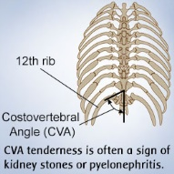
PAIN PRESENTATIONS ( renal, ureteric, vesical, urethral )
- Renal angle pain – dull ache between 12th rib and erector spinae muscle on the side of the affected kidney – pyelonephritis. (Refer renal angle tenderness)

Slide 20
- Renal colic – due to ureter obstruction – a severe pain – lumbar region; radiates to abdomen, groin, testes, thigh – due to stone or tumour
- Ureteric colic – spasmodic, severe pain during the passage of a renal calculus; radiation path of renal colic; may be associated with vomiting, sweating.
- Suprapubic pain from bladder / urethra - is referred to lower abdomen, perineum and glans penis in male

Slide 22
Urine analysis and Lab invesigation
Presented by : Omar Okkeh

Slide 23
Types of Analysis
Visual examination
Chemical examination
Microscopic Examination
Culture Cytological Examination

Slide 24
Urine analysis I. Physical properties of urine
Volume, Colour, Odour, Reaction(ph), Aspect, Deposits, Specific Gravity.
Volume
Normal urine volume is 600 - 2000 ml/day.
Normally, more urine is secreted during the day than at night.
Increased volume:
Physiological increase:
- In winter. - After excessive fluid intake.
Abnormal increase(polyuria): More than 3 L/day
- diabetes mellitus (may reach 5 L/day)
- diabetes insipidus (10-15 L/day)

Slide 25
Urine analysis I. Physical properties of urine:Volume
Decreased volume:
Physiological decrease:
in summer due to increased sweating
during fasting or restricted fluids in diet.
Abnormal decrease (Oliguria): Less than 200 ml/day
acute nephritis.
heart failure.
hemorrhage.
vomiting and diarrhea.
Anuria: No urine at all. In late stages of renal failure and heart failure.

Slide 26
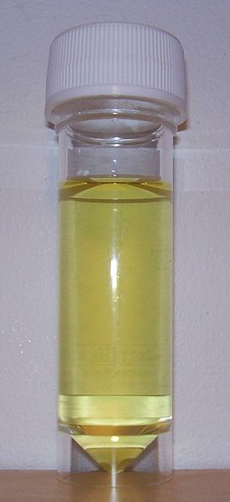
Urine analysis I. Physical properties of urine: Color
Normal color is amber yellow due to pigments called urochromes (derivative of urobilin or urobilinogen.)
Ingestion of food colored with dyes or colored drugs
result in discoloration of urine.
Abnormal urine colors:
Diabetes insipidus: colorless or pale yellow.
Fever: deep orange.
Obstructive jaundice: Greenish brown due to presence of cholebilirubin (conjugated or direct bilirubin).
Haemorrhage in urinary tract: reddish brown colour.
Alkaptonuria: Black (homogentisic acid is oxidized to give black color when exposed to air).

Slide 28
Urine analysis I. Physical properties of urine: Color
Alkaptonuria: Rare inherited genetic disorder of phenylalanine and tyrosine metabolism.It is an autosomal recessive condition. It is due to a defect in the enzyme homogentisate 1,2-dioxygenase , which participates in the degradation of tyrosine.
Odor
Fresh urine is normally aromatic (urineferous).
Abnormalities:
Fruity odor: uncontrolled DM & severe starvation
Ammoniacal odour: Urinary tract infection & Long standing exposed sample

Slide 29
Urine analysis I. Physical properties of urine: Reaction
On mixed diet, it is acidic. Urinary pH varies between 4.5 and 8, averaging between 5.5 and 6.5.
Acidic urine: - High protein diet due to excretion of excess phosphate and sulphate. - Ketoacidosis.
Alkaline urine:
- Vegetables and fruits. - Bacterial infection.
Aspect: Normal urine is clear (transparent).
On standing, it turns cloudy due to precipitation of muco- and nucleoproteins and epithelial cells (present in traces in normal urine).
It becomes turbid and opaque due to presence of albumin.
Exposed urine is a good medium for bacterial growth as its pH becomes alkaline, resulting in precipitation of phosphates.

Slide 30
Urine analysis I. Physical properties of urine: Specific gravity
Normally it is 1.005 to 1.025.
= density of the urine / density of water
Ability of the kidney to concentrate urine
It varies inversely with the volume of urine, e.g.:
In diabetes insipidus, it is low (1.004).
In fever, it is high (more than 1.030) due to small amount of urine.
In diabetes mellitus, the specific gravity is 1.40 due to the presence of glucose.
.

Slide 31
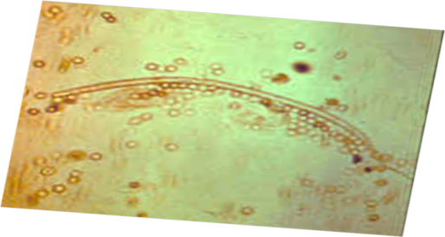
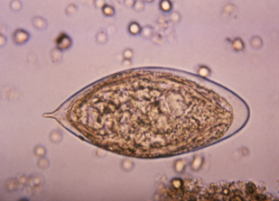
Urine analysis microscopic examination
The examination includes:
Organized elements
1-cells:RBCs, WBCs and pus cells, epithelial cells and neoplastic cells
2-pasasites and ova:B , filariasis
3-bacteria, virus
5-casts.
b) Non organized elements (crystalluria)
1-acidic urine: uric acid crystals, calcium oxalate.
2-alkaline urine: amorphous phosphate, triple phophate.

Slide 32
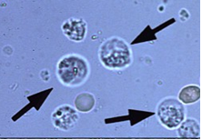
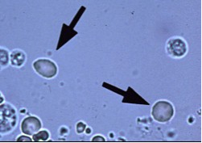
Urine analysis microscopic examination: Cells
Pus cells:
Nucleus: disintegrated.
Normal urine contain from 2-4 pus cells.
Their presence in excess would point to infection and in such cases a culture of urine is indicated.
Red Cells:
Nucleus: non-nucleated.
Normal urine contain from 0-2 red cells.
Their presence in excess is pathological and is due to the different causes of hematuria e.g. bilharziasis, urinary tumors, urinary stones or sometimes crystalluria.

Slide 33
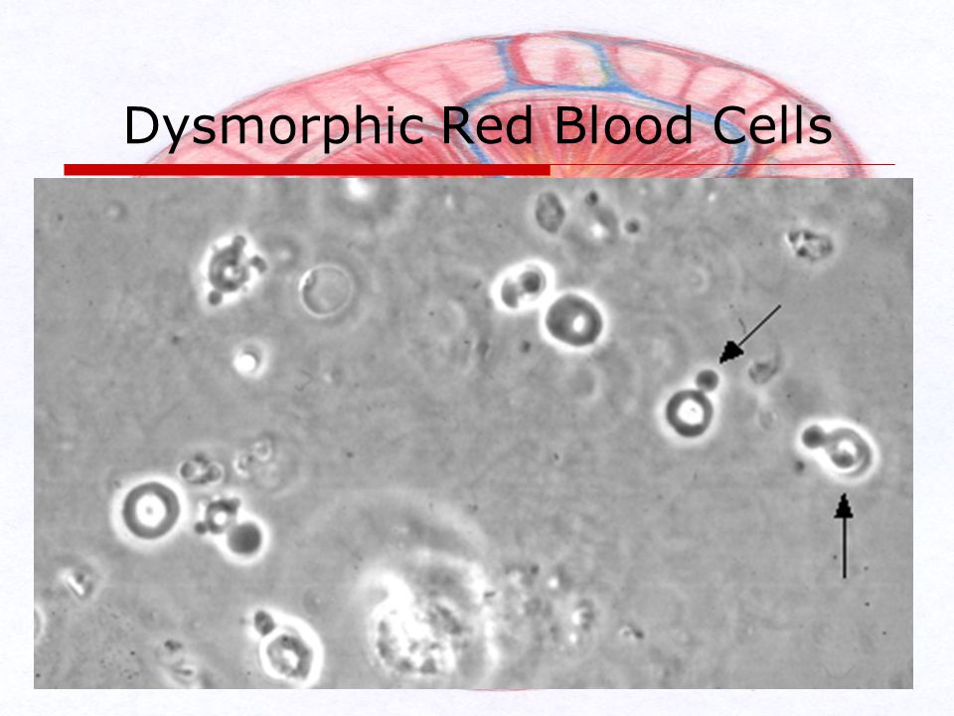
RBCs derived from the glomerulus are dysmorphic (they have been distorted by their passage through the glomerulus). RBCs derived from tubular bleeding (tubulointerstitial disease) and those from lower down the urinary tract (urological bleeding from the renal pelvis, ureters, or bladder ) have a normal shape

Slide 34
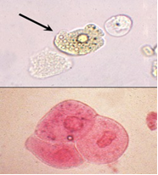
Urine analysis microscopic examination: Cells
Epithelial cells:
Shape: large irregular cells
Nucleus: large, intact and central.
Normal urine may contain few epithelial cells, but excess of these cells in urine is considered pathological and might point to the presence of an inflammatory condition.

Slide 35
Urine analysis microscopic examination: Casts
The casts are the molds of renal tubules.
Normal urine does not contain casts and so their appearance in urine is important and diagnostic for certain diseases.
There are various types of casts which may appear in urine.
The material or cells that form a cast may have:
come through a damaged glomerulus.
been part of an interstitial inflammatory infiltrate.
have been dead tubular cells.
The cast is expelled into the urine, and maintains the shape of the tubule in which it formed.
Casts reflect conditions of the kidney proper and not the lower urinary tract.

Slide 36
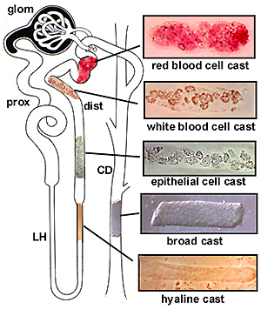
Urine analysis microscopic examination: Casts

Slide 37
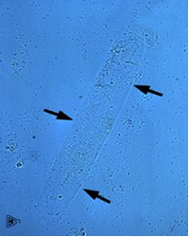
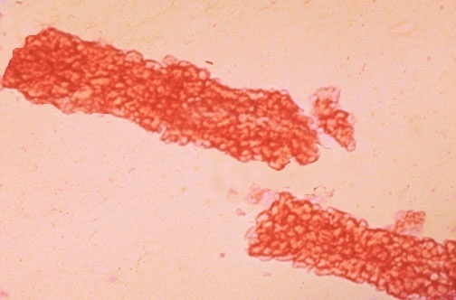
Urine analysis microscopic examination: Casts
Hyaline casts:
They are colorless, homogenous and empty.
Excess of these casts may be present in any type of nephritis and also in heart failure.
Blood casts:
Simply, they are hyaline casts full of red blood corpuscles.
They are present in acute nephritis.
Pus casts:
They are hyaline casts full of pus cells.
They are present in pyelonephritis.

Slide 38
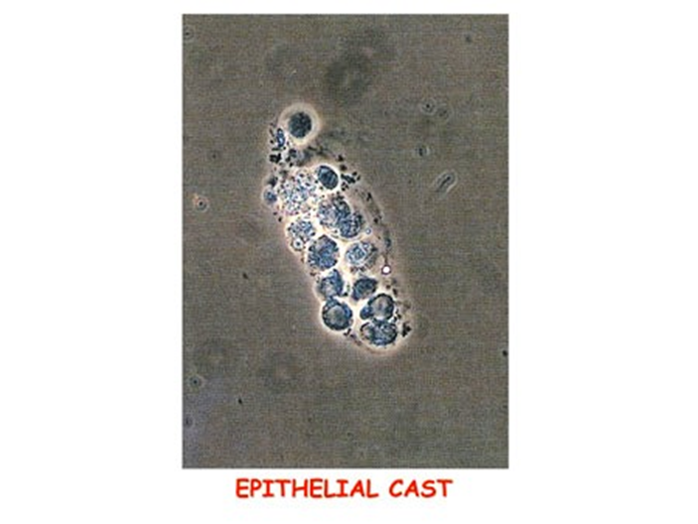
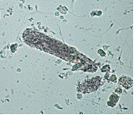
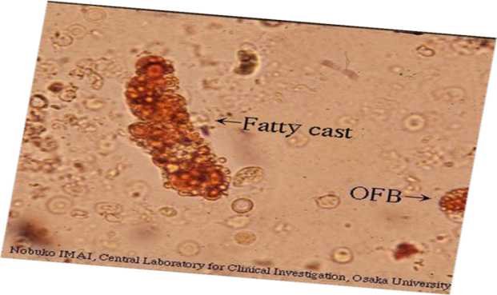
Urine analysis microscopic examination: Casts
Epithelial casts:
They are hyaline casts full of renal epithelial cells.
They are also present in acute nephritis.
Granular casts:
They are hyaline casts full of granules.
They are present in chronic nephritis.
Fatty casts:
They are hyaline casts full of oil globules.
They are present in sub-acute nephritis.

Slide 39
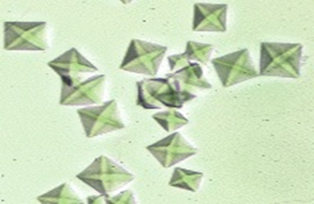
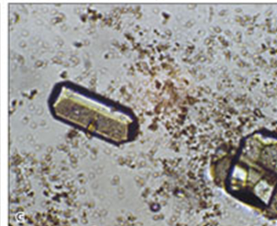
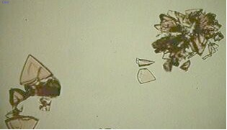
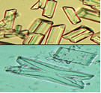
Urine analysis microscopic examination: Crystals
Crystals in acidic urine:
Calcium oxalate:
Shape: envelope shaped or in the form of dumb-bells.
Color: colorless.
Uric acid:
Shape: various forms e.g. rosettes or barrels.
Color: brownish or colorless.
Crystals in alkaline urine
Triple phosphate:
Shape: prismatic
Color: colorless

Slide 40
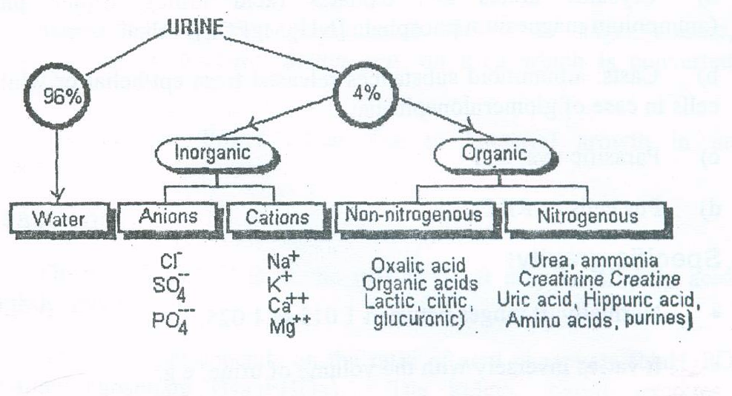
Normal constituents of urine

Slide 41
The Urine Dipstick:
Protein
A
dipstick test is based on a
tetrabromophenol blue dye
color
Chemical Principle
“Protein Error of Indicators Method”
H
Pr
H
Pr
Pr
H
Negative
H
Pr
Pr
H
Pr
H
Trace
Tetrabromphenol Blue
(buffered to pH 3.0)
H⁺
H⁺
H⁺
+ (30 mg/dL)
H⁺
H⁺
H⁺
Pr
Pr
Pr
++ (100 mg/dL)
Pr
Pr
Pr
+++ (300 mg/dL)
Read at 60 seconds
RR: Negative
++++ (2000 mg/dL)

Slide 42
Abnormal constituents of urine
1. Proteins. 2. Sugars. 3. Ketone bodies
4. Bile 5. Blood 6. Porphyrins

Slide 43
Proteinuria
Estimation of proteinuria helps in differentiating between tubulointerstitial and glomerular diseases.
Normally excretion in most healthy adults is between 20-150 mg of protein in urine over 24 hrs.
Proteinuria more than 3.5 gm/day is taken to be diagnostic of nephrotic syndrome.
Panels of protein measurement including albumin, macroglobulin, IgG and β 2- microglobulin have been employed in differential diagnosis of prerenal and postrenal disease.
It is recommended the use of the protein/creatinine ratio in 24 hour urine collection.

Slide 44
Abnormal constituents of urine
2. Sugars
Glucose (glucosuria): Normally not more than 1 g/day
Fructose (fructosuria): It is a rare anomaly in which the metabolism of fructose is disturbed.
Galactose (galactosuria):May occasionally occur in infants and mothers, also in congenital galactosemia (deficiency of galactose-1-phosphate uridyl transferase enzyme).
Lactose (lactosuria): During pregnancy and lactation, may appear in mothers and infants.
Pentose (pentosuria): May occur after ingestion of food containing large amounts of pentoses. Also appears in congenital pentosuria due to inability to metabolise L-Xylulose.

Slide 45
Abnormal constituents of urine Renal glucosuria
Glucosuria. In most cases glucosuria is a symptom of diabetes mellitus, when level of glucose in blood more than kidney threshold (180 mg/dl).
But sometimes glucose can be present in urine even its level in blood is normal. This is so called “renal glucosuria” which is due to disorders of glucose reabsorption in tubules.

Slide 46
Abnormal constituents of urine
3. Ketone bodies (ketonuria)
Normally 3-15 mg are excreted in urine per day.
Ketonuria is the presence of excessive amounts of ketone bodies in urine (acetone, aceto-acetate, 3-hydroxybutyrate).
This may occur in:
uncontrolled diabetes mellitus
prolonged starvation.
Aceto-acetate and 3-hydroxybutyrate are eliminated as salts thus depleting the alkali reserve which results in acidosis.

Slide 47
Abnormal constituents of urine
4. Bile
Bile pigments : appear in urine in hepatic, obstructive and haemolytic jaundice.
Bile salts: Bile salts appear only in obstructive jaundice.
5. Blood
Hematuria in: - blood diseases. - renal stones. - renal tumors. ( Microscopic > 3 )
Hemoglobinuria: which is less common, is due to excessive hemorrhage in the urinary tract.
6. Porphyrin
Porphyrias: the occurrence of uroporphyrins as well as increased amount of coproporphyrins in urine .

Slide 48
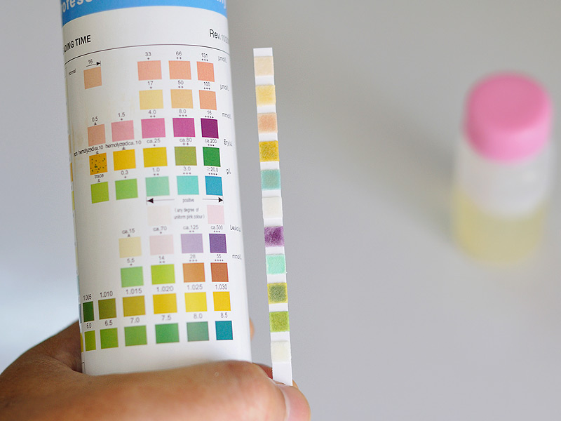

Slide 49
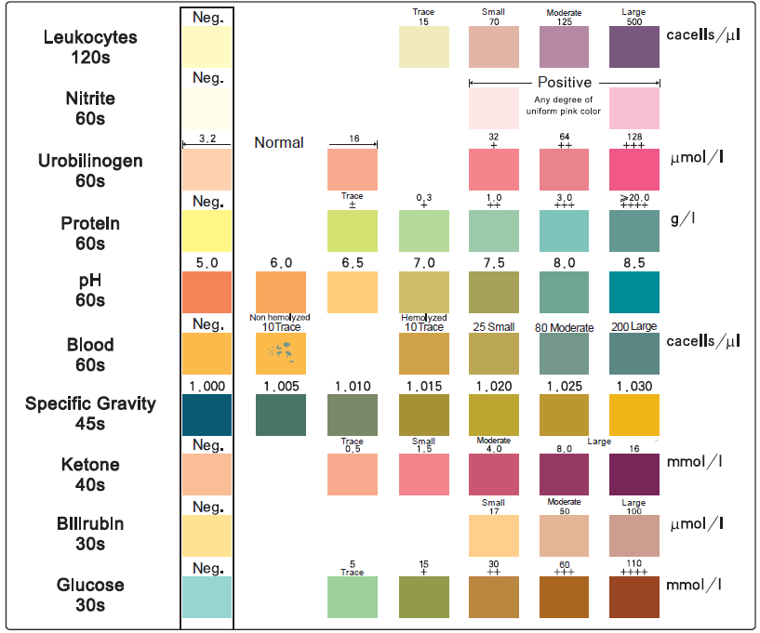

Slide 50
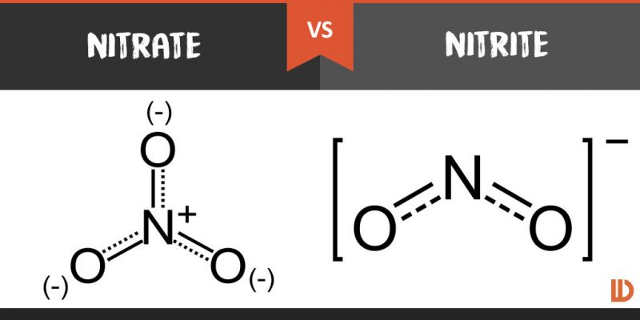
Nitrite testing
Nitrites in the urine suggest the possibility of bacteriuria. They are not normally found in the urine. Many species of gram-negative bacteria can convert nitrates to nitrites, and these are detected in urine by a reaction with the reagents on the dipstick that form a red azo dye. it is less accurate in urine containing fewer than 105 organisms/mL.

Slide 52
White blood cells
Leukocyte esterase activity detects the presence of WBC In the urine.
Leukocyte esterase is produced by neutrophils and causes a color change in a chromogen salt on the dipstick. Not all patients with bacteriuria have significant pyuria.
False negatives are due to concentrated urine, glycosuria, presence of urobilinogen, and consumption of large amounts of ascorbic acid. False positives are due to contamination

Slide 53
Urinary cytolgy
Causes of a positive cytology report :
• Urothelial malignancy ( transitional cell carcinoma [TCC], squamous cell carcinoma, adenocarcinoma )
• Previous radiotherapy [ especially if within the last 12 months ]
• Previous cytotoxic drug treatment [especially if within the last 12 months; e.g., cyclophosphamide, busulphan, cysclosporin]
• Urinary tract stones

Slide 56
Imaging Studies
Done by: Abdallah Dalal

Slide 57
Topics
1- Ultrasound
2- Plain abdominal radiography (KUB)
3- Intravenous pyelography (IVP)/(IVU)
4- Voiding cystourethrography [ VCUG ]
5- Urethrography
6- Retrograde pyelography
7- CT
8- MRI

Slide 58
ultrasound
Non-invasive method.
Painless and safe.
Provides good images of the kidneys and bladder but poor images for the ureter.
Uses of ultrasound:
1-Renal :
Assessment of hematuria
Determination of nature of renal mass [ cystic . Solid ]
Hydronephrosis .
Allows ultrasound-guided nephrostomy insertion [ hydronephrosis , infected or obstructed kidneys , renal impairment ].
2-Bladder
Measurement of post-void residual urine volume.
Allows ultrasound-guided placement of a suprapubic catheter

Slide 59
3-Prostate:
transrectal ultrasound (TRUS)
Measurement of prostate size
To assist prostate biopsy
Investigation of azoospermia (can establish the presence of ejaculatory duct obstruction).
4-Urethra
Can image the urethra and establish the depth and extent of spongiofibrosis in urethral stricture disease.
5-Testes
Assessment of the patient complaining of a lump in the testicle (or scrotum).
When combined with power Doppler can establish the presence or absence of testicular blood flow in suspected torsion.
Assessment of testicular trauma.
Investigation of infertility —varicoceles and testicular atrophy may be identified.

Slide 60
Normal renal ultrasound

Slide 61
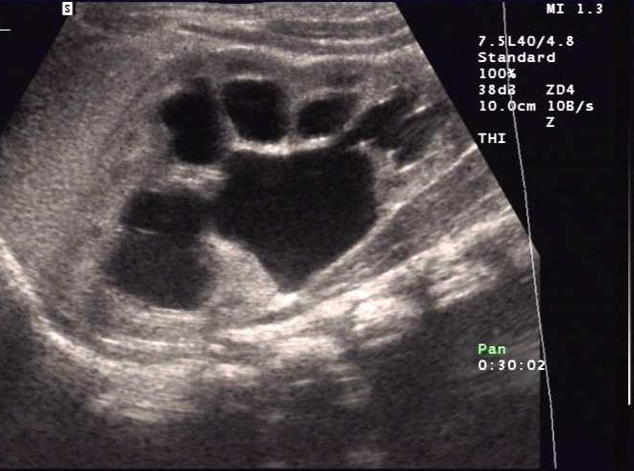
Kidney stones
Hydronephrosis

Slide 62
Plain abdominal radiography (KUB)
Requires special preparation.
Used as initial test for detection of urinary stones.
Not useful in uric acid stones and small stones.
Affected by bowel gases.
Note: there are other opacities that may be confused with stone. (calcified lymph nodes or phleboliths)

Slide 63
Normal KUB

Slide 64
Intravenous pyelography (IVP)/(IVU)
Is a radiological procedure used to visualized abnormalities of the urinary system, including the kidneys, ureters, and bladder by using intravenous contrast.
After a preliminary control film of the abdomen, 50ml of contrast medium is injected intravenously.
Films after 5, 10, and 15 minutes are taken and reveal contrast in the pelvi-calyceal systems, ureters, and in the bladder.
Post-micturition film is taken to assess bladder residual volume.

Slide 65
Uses of IVP
Haematuria.
Renal colic.
Suspected stone in the ureters.
Renal trauma.
Side effects of administration of intravenous contrast media :
These occur in 1% of patients given nonionic and 5% given ionic contrast media.
anaphylactic reaction —hypotension with flushing of the skin (marked peripheral vasodilatation).
edema (face, neck, body, and limbs), bronchospasm, and urticaria.
Rarely, cardiac arrest can occur.

Slide 66
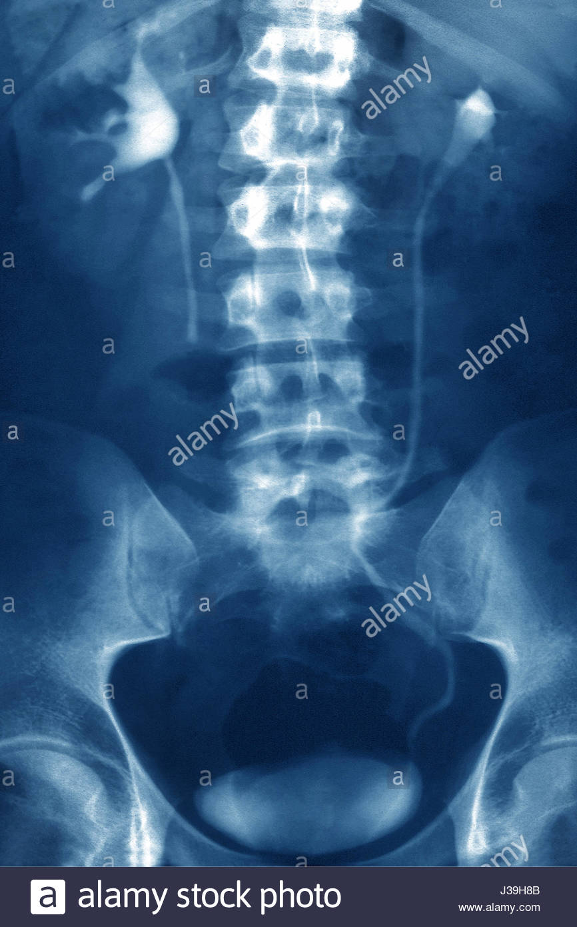

Slide 67
Voiding cystourethrography ( VCUG )
Is the study of the urinary bladder and urethra with contrast medium.
The bladder is filled with contrast via a urethral catheter. Films of the bladder are obtained.
After removal of the catheter, patient is asked to void and films are taken during micturition to assess the bladder neck and urethra, as well as reflux.

Slide 68
Reflux have five degrees:
1. to lower ureter.
2. to ureter and kidney without hydronephrosis.
3. mild hydronephrosis.
4. moderate hydronephrosis.
5. severe hydronephrosis.

Slide 69
Stage 2 reflux

Slide 70
Urethrography
The adult male urethra can be studied by ascending urethrogram.
Contrast is injected through foley catheter inserted into the meatus.
Films are taken to the urethra in oblique position during contrast injection.
The most common indication for urethrogam is urethral strictures.

Slide 71
Multiple urethral strictures

Slide 72
Retrograde pyelography
This study consists of retrograde instillation of contrast into the ureters by a ureteric catheter inserted into the ureter via a cystocope.
detection of ureteric and renal pelvic TCCs or radiolucent stones in patients with persistent hematuria in whom other tests have shown no abnormality.
diagnose the presence and site of ureteric injury (obstruction, ureteric leak) in cases of ureteric injury (e.g., after hysterectomy or caesarean section).

Slide 73
CT Scan
CT is excellent modality for assessment of:
Renal masses.
Obstruction.
Retroperitoneal disease.
Staging of renal and bladder neoplasms.
Tumor invasion into the renal vein or IVC
Evaluation after trauma or surgery.

Slide 74
Bilateral renal cell carcinoma

Slide 75
MRI
When should MRI be used to evaluate the kidneys?
When a renal mass or abscess is suspected but intravenous contrast cannot be administered, because of either contrast allergy or abnormal renal function, in this case MRI can be performed.
Gadolinium, the contrast agent for MRI, can be safely administered in such circumstances.

Slide 76
Left renal cell carcinoma

Slide 77
Thank you

