Slide 1
Hydatid Lung Pulmonary (Echinococcosis)
Hadeel mazen
Nosaiba maaitah
Ahmad yahya

Slide 2
Definition
It is a parasitic infection of both humans and other mammals such as sheep, cattle and pigs with hydatid cyst, the larval stage of different Echinococcus species.

Slide 3
Four specieses of the E. Genus are exist:
1- Cystic echinococcosis:most Common and caused by the larval stage of E. Granulosus. Dog tapeworm,most common site is liver .
2- Alveolar echinococcosis: less common but more dangerous caused by the larval stage of E. Multilocularis. Small fox tapeworm most common site is lung.

Slide 4
3-Polycystic echinococcosis: Rare and caused by the larval stage of E. Vogeli.
4- E.oligarthrus cause unicystic echinococcosis ,rarly .

Slide 5
 | Definitive Host | Intermediate Host
E. granulosus | Dogs | Sheeps, cattles, pigs
E. multilocularis | foxes | Small rodent
E. Vogeli | dogs | Rodent
E. oligarthus | Wild felids animals | Rodent

Slide 6
Definitive host
Diagnostic stage
Infective stage
dead host
Intermediate host

Slide 7
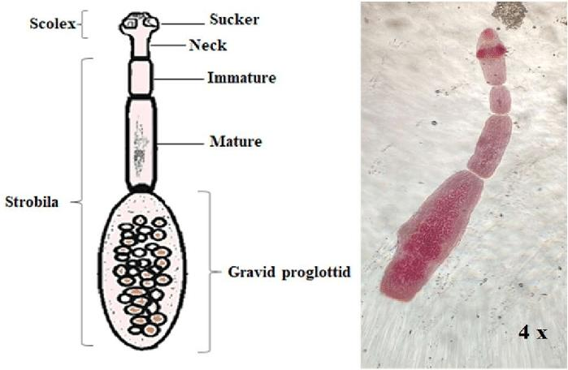
Morphological Characters
Adult worm
Adult worm length 3-6 mm
Comprises of
Scolex: four suckers with rostellum with two rows of hooks
Neck: short and thick
proglottids or strobilla : 3 or 4 segments.
1st segment (Immature)
2nd segment (Mature)
3rd and 4th (Gravid)

Slide 8
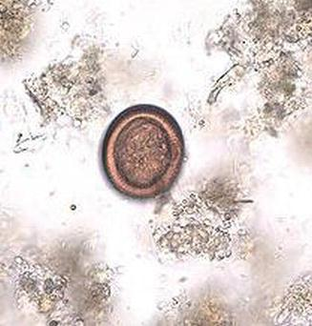
Egg
Hexacanth embryo oncosphere
Passed through the faeces of definitive host and it’s ingestion leads to infection in the intermediate
Spherical in shape, brown color ,have 2 layers outer and inner

Slide 9
LIFE CYCLE
1).Adult echinococcus granlousus in small bowel of definitive host
In 32 – 80 days
6) Protoscolices evagination and attach to the intestine
2) Gravid proglottids release egges which pass in Faeces
Ingested by intermediate host
Cyst eaten by the definitive host and protoscolices enter the intestine of DH
3)Egg hatches in small bowel of intermediate host to oncosphere
4) Cyst
Contain protoscolices

Slide 10
Echinococcus granulosus
Habitat: Small intestine of the D.H
D.H: Dogs, foxes and other canines.
I.H: Sheep, cattle, pigs and man(accidental untermediate host )
incubation Period : variable – months to years (depends on number of cysts and growth rate)

Slide 11
mood of transmission
Human infection does not occur by the handling or ingestion of meat or viscera from infected sheep !
humans are accidental intermediate hosts that become infected either by :
direct contact with a dog contaminated with egg-bearing feces.
by ingesting water, food, or soil contaminated with such feces.
Direct transmission of echinococcosis from human to human does not occur

Slide 12
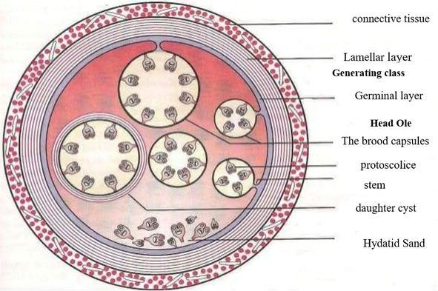
3-Hydatid cyst

Slide 13
1- a thick wall that is consisted of three layer
a- adventitia (pericyst): host origin granulation tissue represents the host immune response
b-laminated membrane (ectocyst): parasite origin. elastic fiberous white covering, easily separable from the adventitia.

Slide 14
c- germinal epithelium (endocyst): is a single layer of cells lining the inner aspects of the cyst and is the only living component
**responsible for formation of :
the other layers
the hydatid fluid
brood capsules.

Slide 15
3-brood capsule: when laminated membranes may eventually disintegrate and the germinal layer encyst to form brood capsules. some grow into daughter cysts containing multiple scoleces, which if lifted untreated may cause recurrence by forming secondary cysts when they rupture

Slide 16
4-hydatid fluid:
clear, yellowish fluid with slightly acidic media.
composed of many chemical substances such as sodium sulfate , sodium gluconate, succinate other nutritional components for the scolex .
it is highly toxic and antigenic thus when the cyst rupture and the fluid leak out it may induce anaphylactic reaction.

Slide 17
Hydatid sand : formed when the brood capsules and daughter cyst break off and their contends of scolex deposit down at the primary cyst.

Slide 18
Organ involvement
Following ingestion of E. granulosus eggs, the cyst can be found in virtually any organ (primary echinococcosis).
Secondary echinococcosis results from the spread of the metacestodes from the primary sites.
The liver is the most common site of cyst formation, followed by the lung in 10–30% of cases and other sites (usually the spleen, kidney, orbit, heart, brain and bone) iny10% of cases .
Pulmonary hydatid disease affects the right lung in 60% of cases, 30% exhibit multiple pulmonary cysts, 20% bilateral cysts and 60% are located in the lower lobes

Slide 20
Clinical features
Hydatid disease is seen in subjects of any age and sex, although it is more common in those aged 20–40 yrs .
Most intact lung cysts are discovered incidentally on chest radiographs.
Small cysts may remain asymptomatic indefinitely, but cysts may enlarge to 20 cm in diameter and cause symptoms by compressing adjacent structures.

Slide 21
Lung involvement
The most common symptoms of pulmonary cystic echinococcosis (CE) described in the literature include cough (53 to 62 percent), chest pain (49 to 91 percent), dyspnea (10 to 70 percent), and hemoptysis (12 to 21 percent). Less frequent symptoms include malaise, nausea and vomiting, and thoracic deformations . The majority of children and adolescents with lung lesions are asymptomatic despite having lesions of impressive size, assumedly because of a weaker immune response and the relatively higher elasticity of the lung parenchyma relative to older patients.

Slide 22
Mediastinal cysts may erode into adjacent structures causing bone pain or airflow limitation.
Symptomatic hydatid disease of the lung, however, more often follows rupture of the cyst. The cyst may rupture spontaneously or as a result of trauma or secondary infection.
Rupture may be associated with the sudden onset of cough and fever. If the contents of the cyst are expelled into the airway, expectoration of a clear salty or peppery tasting fluid containing fragments of hydatid membrane and scolices may occur

Slide 23
Release of antigenic material and secondary immunological reactions that develop following cyst rupture. Fever and acute hypersensitivity reactions ranging from urticaria and wheezing to life-threatening anaphylaxis.
Other potential clinical effects of hydatid infection include immune complex-mediated disease, glomerulonephritis leading to nephrotic syndrome, and secondary amyloidosis .
Hydatid disease is a rare cause of recurrent acute pulmonary embolism. This complication may develop after invasion of the cardiovascular system or direct invasion of the inferior vena cava .

Slide 24
Diagnosis

Slide 25
Take a history
Do an examination
Investigations
Laboratory Studies
Imaging

Slide 26
Laboratory tests
There are no routine blood workups that may be used specifically for CE.
Serologic diagnostic methods are used to support the radiological diagnosis and for follow-up assessment.
A negative serological test does not role out echinococcosis.

Slide 27
Laboratory investigations:
- mild eosinophilia
- Leukocytosis
- increased erythrocyte sedimentation rate (ESR)
Serology :
The indirect hemagglutination test (IHA)and the enzyme-linked immunosorbent assay (ELISA) have a sensitivity of 80% overall ( 40% in pulmonary echinococcosis) and are the initial screening tests of choice.

Slide 28
Casoni test
intradermal skin test had a sensitivity of 70%. It is now largely abandoned because of its low sensitivity, low accuracy, and potential for severe local allergic reaction.

Slide 29
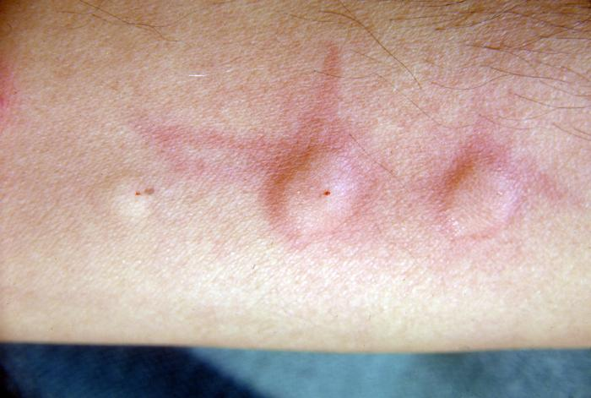
intradermal injection of sterilised fluid from hydatid cysts, a wheal response occurring at the injection site within 20 minutes is considered positive

Slide 30
Imaging Techniques
Chest imaging is the principal investigational modality for pulmonary hydatid cyst, backed up by CT confirmation when available.
Radiological presentation depends on whether the cysts are complicated or not.

Slide 31
Classical signs of pulmonary hydatid cyst on chest X-ray
Uncomplicated hydatid cyst
1) One or more homogenous round or oval masses with smooth borders surrounded by normal lung tissue

Slide 32
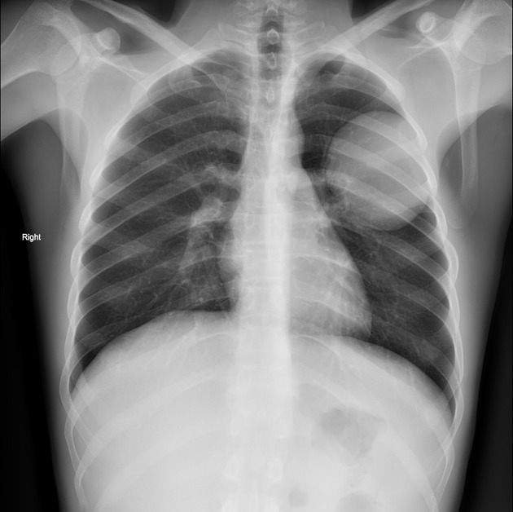
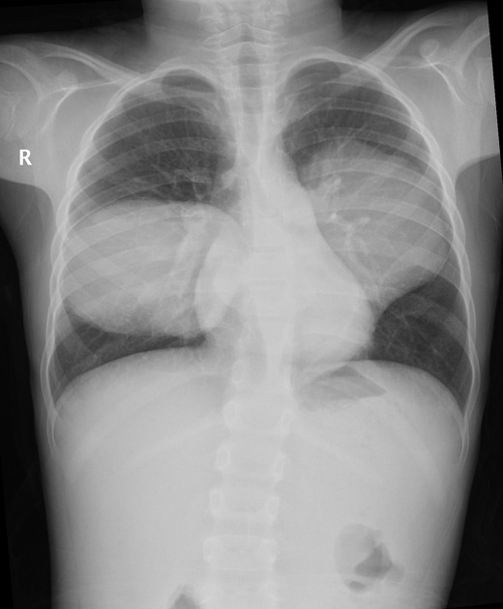
2) Polycyclic and bilobed appearance:
Cysts can assume polycyclic configuration due to pressure from adjacent structures,Notching can also occur in cysts, giving them a bilobed appearance
3) Slot sign (impending rupture):The loss of a spherical shape on an X-ray with the appearance of small depression

Slide 33
Complicated hydatid cyst
Crescent sign
Cumbo or double arch sign
Water lily
Rising sun sign
Dry cyst sign

Slide 34
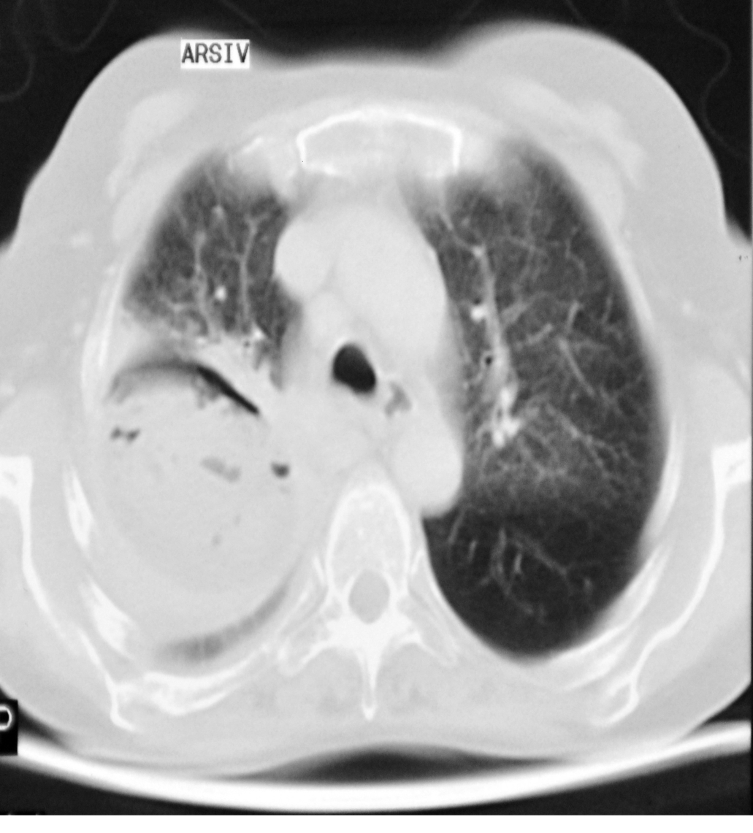
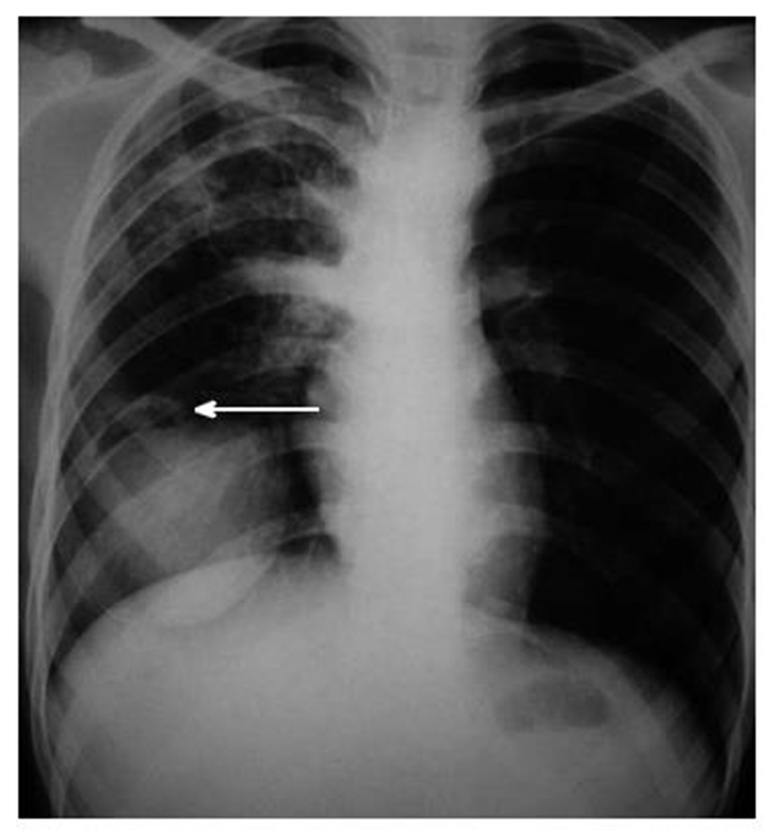
Erosion of the bronchioles results in air being introduced between the pericyst and the laminated membrane and gives
a fine radiololucent crescent (the ‘meniscus or crescent sign’)

Slide 35
With the introduction of more air, the endocyst shrinks and ruptures with the introduction of air into the endocyst. At this stage, an air fluid level is seen in the endocyst with a radiolucent rim between the pericyst and the endocyst, known as the “cumbo sign” or the “double arch sign”

Slide 36
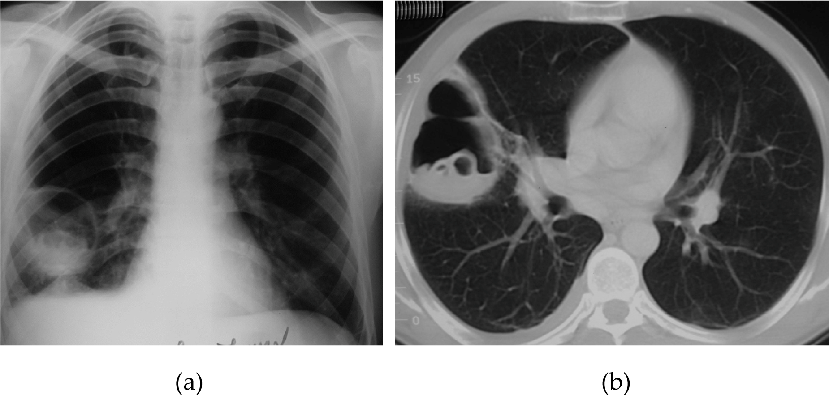

Slide 37
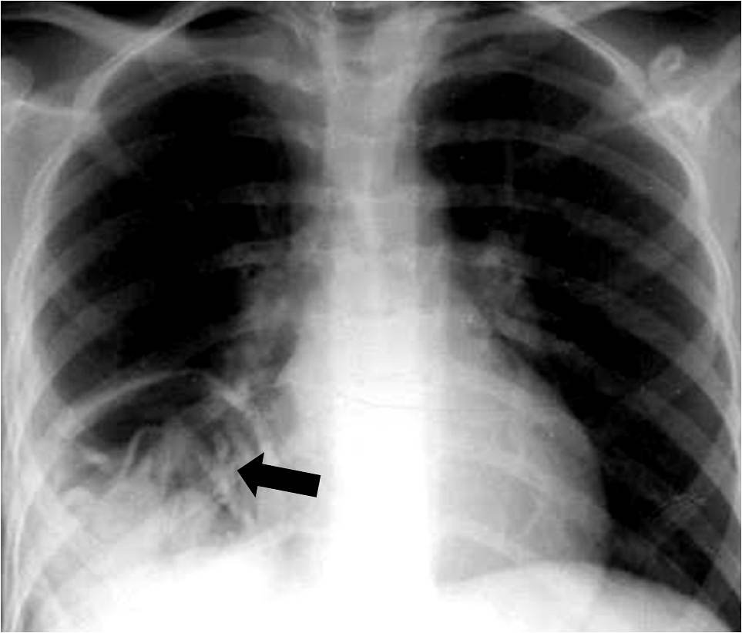
The water-lily sign, also known as the camalote sign, is seen in hydatid infections when there is detachment of the endocyst membrane which results in floating membranes within the pericyst that mimic the appearance of a water lily.

Slide 38
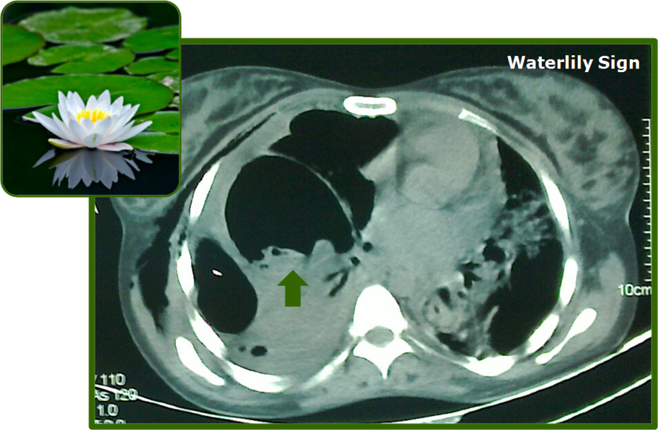

Slide 39
With the rupture of the endocyst, daughter cysts may appear as round radio-opacities at the bottom of cysts, giving them
a “rising sun” appearance

Slide 40
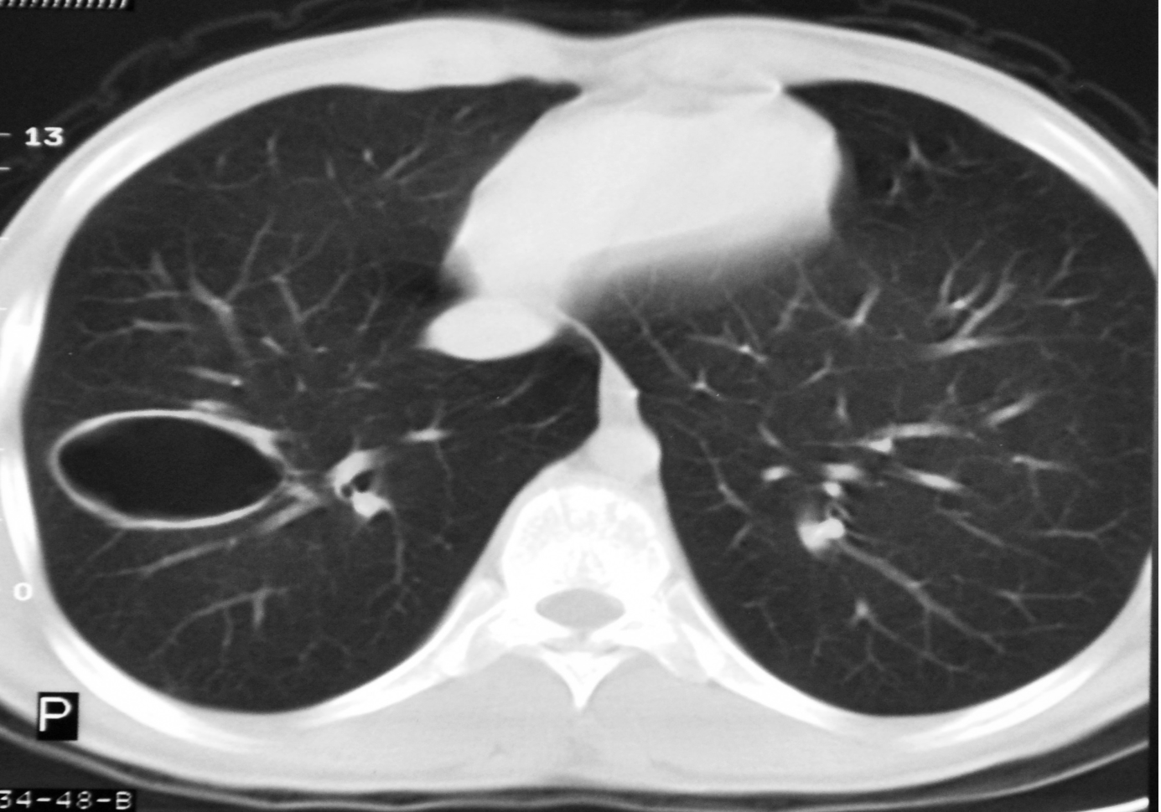
With coughing out of membranes, the pericyst can become empty appearing as air-filled cysts (the “dry cyst sign”),

Slide 41
The double arch sign and the sign of the camalote are pathognomonic of a ruptured hydatid cyst.
Unlike extrapulmonary cysts, pulmonary hydatid cysts calcification, and daughter cyst formation are rare

Slide 42
Percutaneous aspiration
percutaneous aspiration can confirm the diagnosis by demonstrating the presence of protoscolices, hooklets or hydatid membranes.
Active cysts exhibit clear watery fluid containing scolices and show elevated pressure, whereas inactive cysts exhibit cloudy fluid without detectable scolices and do not show elevated
pressure .
but this method of diagnosis is generally reserved for situations when other diagnostic methods are inconclusive because of the potential for anaphylaxis,cyst rupture and secondary spread of the infection
.

Slide 43
Management
1-pharmacotherapy
2- Surgical therapy

Slide 44
pharmacotherapy
Benzimidazol group of drug:
Albendazol 10-15 mg/kg two times a day
Mebendazol 40-50 mg/kg three times a day
* minimum 3-6 months

Slide 45
Indication of pharmacotherapy:
Smaller cysts
recurrent cysts or multiple cyst
poor surgical risk
refusal for surgery
multiorgan disease
When there is intraoperative spillage of hydatid fluid

Slide 46
Contraindication of pharmacotherapy
Large cysts that are at risk of rupture
Inactive or calcified cysts
Bone marrow depression
Pregnancy, specifically the first trimester of pregnancy.

Slide 47
Surgical therapy
*It's considered the treatment of choice since the parasite can be completely removed and the patient cured
*The aim of surgery is to remove the cyst completely while preserving the lung tissue as much as possible

Slide 48
The surgical method may be different in the intact (simple) and ruptured(complicated ) cysts
The operation has two steps :
A) removal of the cyst (germinal layer)
B)management of the residual pulmonary cavity

Slide 49
Notes :
During surgery its important to prevent cystic content spillage in order to prevent intraoperative dissemination and eventual recurrence
Preoperative albendazol is essential
started 4 days prior the surgery and continue for 1-3 month
post.op
The proponent view is that preoperative use of benzimidazoles softens the cysts and reduces the intracystic pressure. It simplifies cysts removal and reduces the risk of recurrences.

Slide 50
NOTES
Standard posterolateral thoracotomy is the preferred surgical approach. In patients with bilateral cysts, median sternotomy or two-stage thoracotomy can be used
Surgery for pulmonary hydatid cysts is a safe procedure with a good outcome, low morbidity, and negligible mortality

Slide 51
finding the cyst : Once the chest is opened , the lung is palpated gently to avoid rupture of the cyst . Deflate the lung on the affected side to make it easier to find it
Covering the adjacent lung with saline soaked towels : because there is always risk of spillage of daughter vesicles during the operation , only the area of the cyst-containing lung must be in the operating field
Removal of the cyst * enucleation of the cyst without aspiration * removal of the cyst following aspiration then remove the cyst membrane (in ruptured cyst)

Slide 52
Removal of cyst following aspiration: aspiration is performed with a syringe adapted to 3 valved aspiration catheter + 10% povidone iodine injected to the cyst with the same catheter to kill living vesicles after finishing remove the laminating membrane
(2) Enucleation without aspiration : removing the intact cyst from cystic cavity by a careful dissection between the pericyst and laminated membrane . The pericyst incised superficially until the laminated membrane of cyst is seen
If the hydatid cyst occupies more than 50% of a lobe ---- lobectomy

Slide 53
Management of residual cavity When the cyst is removed :
-The pulmonary cavity is cleaned completely with sterile gauze
Observation for presence of air leakage
Closure of major bronchial opening
The lung cavity that remains after removal of the cyst may be left as it is or obliterated by sutures in regard to the size and location of the cyst
The bronchial openings in the cavity must be closed by sutures in all cases
- Remove the towels by grasping instrument

Slide 56
Percutaneous aspiration of pulmonary hydatid cyst has been reported in literature.
However, percutaneous aspiration is not a routine practice in pulmonary hydatid cyst due to the risk of rupture, dissemination, and anaphylaxis reaction. It is more commonly done in hepatic hydatid cysts.

Slide 57
Postsurgical follow-up
Postoperative all patients should receive ABZ (10 mg/kg per day) for 6 months to prevent recurrence of the disease. The recurrence rate of pulmonary hydatid cyst without postoperative antihelminthic therapy is as high as 11%.

Slide 58
Liver function tests and chest radiography should be done monthly for the first 3 months. The follow-up then continued every 3 months by chest radiography until the end of postoperative year 1.

Slide 60
Thank You

