Slide 1
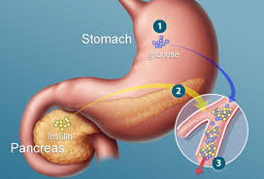
Glycolysis
Dr. Nesrin Mwafi
Biochemistry & Molecular Biology Department
Faculty of Medicine, Mutah University

Slide 2
Glucose as Energy Substrate
To function properly, our cells are in need for energy which can be generated from the metabolism of various biomolecules such as carbohydrates, proteins and lipids
Actually CHO particularly glucose is a major energy substrate in certain tissues like brain
What are the metabolic pathways of glucose inside our cells?

Slide 3
Glycolysis
Glycolysis is the metabolic pathway which converts glucose (6C) into 2 pyruvate molecules (3C)
It occurs in the cell cytosol
Glycolysis takes place in nearly all organisms both aerobic and anaerobic (i.e. microorganisms live in O₂ free environments )
Glycolysis is a sequence of ten oxygen-independent and enzyme-catalyzed steps
The intermediates either provide entry points to the cycle or themselves directly useful (biosynthetic intermediates)

Slide 4
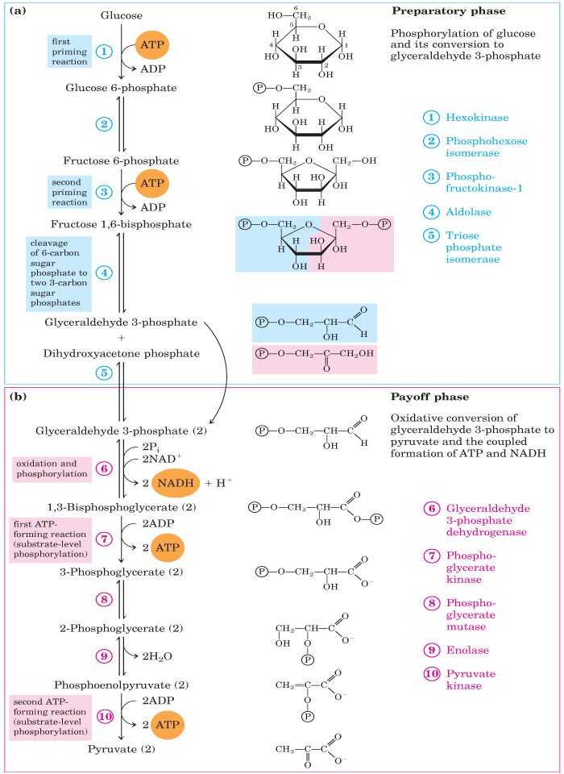
Glycolysis
The entire pathway is divided into two distinct phases:
Energy Investment Phase (Preparatory Phase)
Energy Generation Phase (Pay Off Phase)
Phosphoglucose

Slide 5
A. Preparatory Phase
phosphorylation
Phosphoglucose
isomerization
phosphorylation
cleavage
isomerization

Slide 6
A. Preparatory Phase
Step 1: Hexokinases catalyze the ATP- dependent phosphorylation of glucose to produce glucose-6-phosphate (G6P)
Hexokinase is a transferase enzyme which phosphorylates hexoses by transferring an inorganic phosphate from ATP usually to hydroxyl O at C6
Irreversible reaction (another enzyme catalyzes the dephosphorylation only found in specific tissues). Therefore, it is a target site for cycle regulation

Slide 7
Hexokinases
This first priming reaction is important to maintain the influx of glucose through glucose transporters (GLUTs) and at the same time to trap the transported glucose molecules inside the cell
Hexokinase is nonspecific and can phosphorylate a variety of hexoses (e.g. glucose, fructose…..etc.)
Hexokinase is inhibited by G6P only at high concentration (it is controlled by the level of its product)

Slide 8
A. Preparatory Phase
phosphorylation
Phosphoglucose
isomerization

Slide 9
A. Preparatory Phase
Step 2: Phosphoglucose isomerase (PGI) interconverts G6P and F6P (reversible reaction). Indeed, Mannose and Fructose can enter the glycolytic pathway at this point
O
H
1
CH₂OH
1
Hexose C₆H₁₂O₆
2
O
H
2
OH
H
OH
3
H
OH
3
OH
H
4
OH
H
4
H
OH
H
5
OH
5
6
6
CH₂OH
CH₂OH
D-glucose
D-fructose

Slide 10
A. Preparatory Phase
phosphorylation
Phosphoglucose
isomerization
phosphorylation

Slide 11
A. Preparatory Phase
Step 3: This is a rate limiting or key regulatory step. The activity of phosphofructokinase-1 (PFK-1) enzyme can be controlled. PFK-1 catalyzes the phosphorylation of hydroxyl oxygen at C1 to produce fructose-1,6-bisphosphate
Step 4: Aldolase enzyme catalyzes the cleavage to two triose phosphates: DHAP (dihydroxyacetone phosphate) and GADP (glyceraldehyde-3-phosphate)
The addition of the second phosphate group on C1 from the previous step destabilizes the hexose ring and facilitates the cleavage reaction

Slide 12
A. Preparatory Phase
phosphorylation
Phosphoglucose
isomerization
phosphorylation
cleavage

Slide 13
Aldolase Mechanism of Action

Slide 14
Aldolase Mechanism of Action
1
2
3
4
5
6

Slide 15
A. Preparatory Phase
phosphorylation
Phosphoglucose
isomerization
phosphorylation
cleavage
isomerization

Slide 16
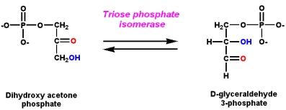
A. Preparatory Phase
Step 5: Isomerization of DHAP by triose phosphate isomerase (TPI) to GADP to proceed further in glycolysis as GADP is the substrate for the next reaction. This reaction is reversible

Slide 17
B. Pay Off Phase
Phosphoglucose
Oxidative
phosphorylation
Substrate-level
Phosphorylation
isomerization
Dehydration
Substrate-level
Phosphorylation

Slide 18
B. Pay Off Phase
Step 6: GADP dehydrogenase enzyme catalyzes the oxidative phosphorylation of GADP (electron donor) into super-high-energy compound (1,3-BPG) and the transfer of electrons into the coenzyme NAD⁺(electron acceptor) forming NADH
Dehydrogenases are named as electrons donor substrate -dehydrogenase
+ H₂O
+ H⁺
Electrons
acceptor
Electrons
donor
Electrons donor
Electrons acceptor

Slide 19
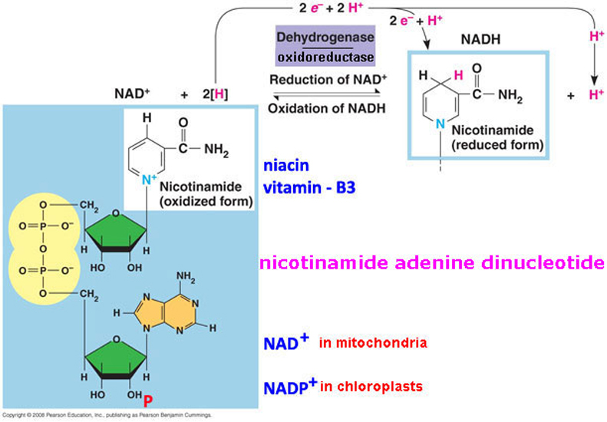
Nicotinamide Adenine Dinucleotide
NAD (Nicotinamide adenine dinucleotide) is a coenzyme which exists in two forms: NADH (the reduced form) and NAD⁺ (the oxidized form)

Slide 20
B. Pay Off Phase
Phosphoglucose
Oxidative
phosphorylation
Substrate-level
Phosphorylation

Slide 21
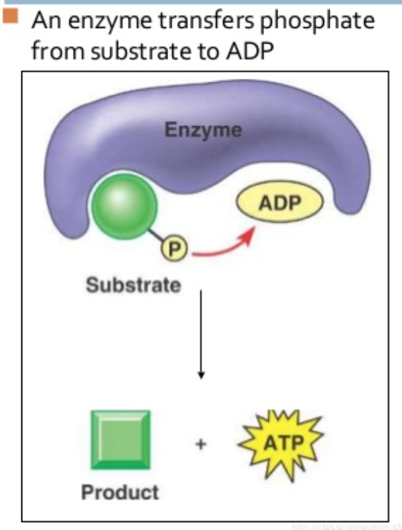
B. Pay Off Phase
Step 7: The first ATP molecule is generated by the substrate-level phosphorylation process catalyzed by phosphoglycerate kinase (PGK)
Methods of ATP synthesis:
Substrate-level phosphorylation: it is a direct method of ATP synthesis by an enzyme which catalyzes the transfer of phosphate group from substrate to ADP
Oxidative phosphorylation: indirect method of ATP synthesis in which the oxidation of NADH/FADH2 and the subsequently transferred electrons indirectly drive ATP synthesis from ADP

Slide 22
B. Pay Off Phase
Phosphoglucose
Oxidative
phosphorylation
Substrate-level
Phosphorylation
isomerization

Slide 23
B. Pay Off Phase
Step 8: Phosphoglycerate mutase (PGM) is an isomerase which catalyzes the isomerization of 3-phosphoglycerate to 2-phosphoglycerate
It is actually an internal shifting of P group from C3 to C2 within the same molecule
The main purpose of this step is the activation of the phosphate group to prepare for the generation of the second ATP in the next reactions
Step 9: The synthesis of the second super-high-energy compound phosphoenolpyruvate (PEP) in a simple dehydration reaction catalyzed by enolase enzyme
Enolase acts by catalyzing the cleavage of bond between C3 and oxygen of OH group thus enhancing the formation of double bond between C3 & C2 and subsequently H atom elimination

Slide 24
B. Pay Off Phase
Phosphoglucose
Oxidative
phosphorylation
Substrate-level
Phosphorylation
isomerization
Dehydration
Substrate-level
Phosphorylation

Slide 25
B. Pay Off Phase
The aim of this step is to increase the energy stored in the phosphate bond
Step 10: The second ATP molecule is generated by the substrate-level phosphorylation process catalyzed by pyruvate kinase (PK). Pyruvate is the final product of glycolysis
The activity of pyruvate kinase can be controlled (irreversible reaction) so this reaction is regulatory step
The net result of glycolysis is the formation of:
2 pyruvate
2 ATP
2 NADH

Slide 26
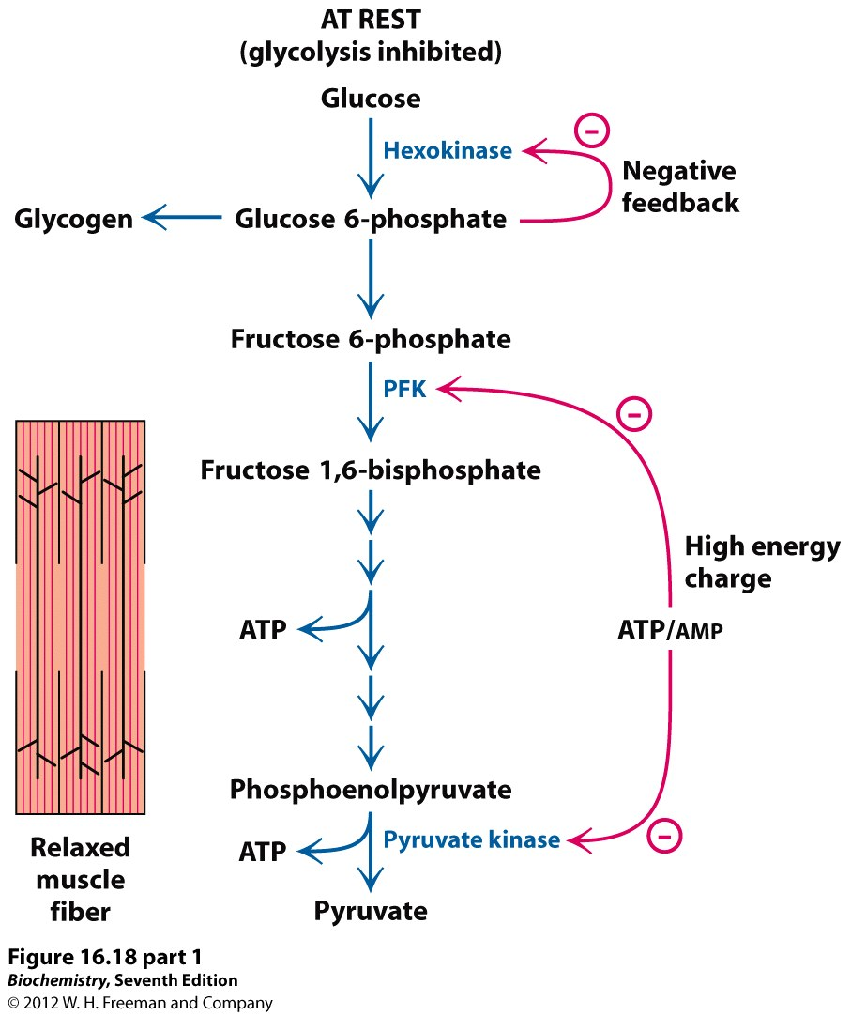
Glycolysis Regulation
1
glycogenolysis
G-6-phosphatase
Glycogen
Glucose 1-p
phosphoglucomutase
Pentose phosphate pathway
glycogenesis
PFK-2
Fructose 2,6-bisphosphate
PFK-1
+
3
and citrate
10
Fatty acids
oxidation
Acetyl CoA
Citric acid cycle

Slide 27
Glycolysis Regulation
Glycolysis can be controlled at 3 points:
Step 1 Hexokinase enzyme is inhibited by excess G6P
Step 3 which is catalyzed by phosphofructokinase-1 enzyme. It is an allosteric enzyme. Two significant inhibitors are citrate and ATP whereas AMP/ADP and recently fructose 2,6-biphosphate (in liver) are activators. Actually this is the most important control point and it is considered as the main rate-limiting step in glycolysis
Step 10 which is catalyzed by pyruvate kinase enzyme. It is controlled by the level of ATP and Acetyl CoA (both are allosteric inhibitors). Accumulated Acetyl CoA in the cytosol is an indicator that the energy is now available from fat breakdown so no need to proceed in glycolysis

Slide 28
Metabolic Fates of Pyruvate
Fates of Pyruvate
1
2
2
5
6
4
Oxaloacetate
3
Biosynthesis of amino acids
Malate
and
electron transport chain

Slide 29
Metabolic Fates of Pyruvate
2. Lactic Acid Fermentation: bacteria, RBCs and O₂-starved muscle cells

Slide 30
Metabolic Fates of Pyruvate
Fates of Pyruvate
1
2
2
5
6
4
Oxaloacetate
3
Biosynthesis of amino acids
Malate
and
electron transport chain

Slide 31
Metabolic Fates of Pyruvate
In aerobic conditions, pyruvate is converted to acetyl CoA which enters the citric acid cycle for further oxidation to CO₂ followed by oxidative phosphorylation
In anaerobic conditions like in lactic acid bacteria and some animal cells (e.g. RBCs and O₂-starved muscle cells), pyruvate is reduced to lactic acid with the concomitant oxidation of NADH to NAD⁺ (lactic acid fermentation)
In anaerobic conditions like in some M.O’s (e.g. yeast), pyruvate is converted to ethanol
Amino acid biosynthesis: pyruvate is a precursor of some amino acids like alanine
5. & 6. Pyruvate can be used for synthesis of oxaloacetate
or malate (both are TCA cycle intermediates)

Slide 32
Glycolysis as Anabolic Pathway
Glycolysis acts as catabolic as well as anabolic pathway. Therefore, glycolysis is very important central metabolic pathway
Glycolysis intermediates with biosynthetic roles:
Nucleotides biosynthesis: G6P is an initial substrate in pentose phosphate pathway (metabolic pathway which generates pentoses)
Glycogenesis via G6P
Lipids biosynthesis: DHAP is converted to glycerol
Amino acids biosynthesis: pyruvate as precursor of alanine

Slide 33
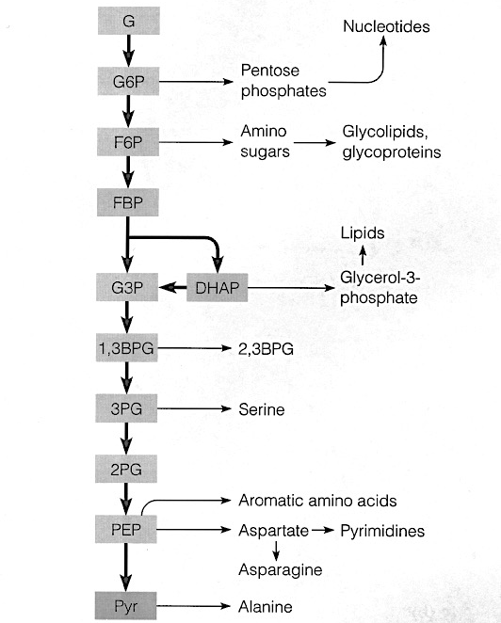
Glycolysis as Anabolic Pathway
2
1
Glycogenesis
3
4

