Slide 1
Benign lesions of the lower genital tract
BY : Sara Bilal

Slide 2
Vulva
A wide variety of lesions occurs on the vulva. Some of the disorders causing these lesions are limited to the vulva, while others also involve skin or mucocutaneous membranes elsewhere on the body.

Slide 3
Urethral Caruncle and Urethral Prolapse
DEFINITION — The terms urethral caruncle, urethral prolapse, and urethral polyp represent three distinct lesions, although the terms are sometimes used interchangeably.
● Urethral caruncle – Urethral caruncle refers to eversion of only a portion of the distal urethra that often occurs at the posterior edge . The caruncle is a small, fleshy mass that is soft, smooth or friable, and bright red to dark pink. These are generally single and sessile , but they can also be pedunculated and grow to 1 to 2 cm. Caruncles typically occur in postmenopausal women and hypoestrogenism is the proposed mechanism.
● Urethral prolapse – Urethral prolapse refers to urethral mucosa that is circumferentially everted around the meatus . The condition typically occurs in premenarcheal girls and in postmenopausal women as well. The tissue can also be friable, ulcerated, and edematous.
● Urethral polyp – Urethral polyps are more common in boys, but cases have been reported in prepubertal girls While urethral polyps can arise from any part of the urethra in girls, in boys the lesions mainly arise from the prostatic urethra . In girls, urethral polyps are benign fibroepithelial polyps that are thought to be congenital and often present as interlabial masses.

Slide 4
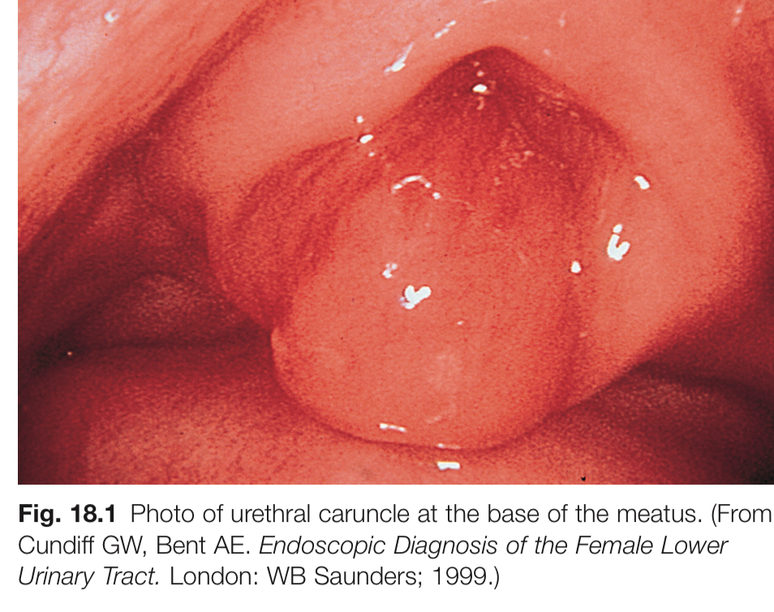
A urethral caruncle is a benign fleshy outgrowth of the posterior urethral meatus. It is the most common lesion of the female urethra and occurs primarily in postmenopausal women. The lesion is typically asymptomatic, although some women present with vaginal bleeding.
This topic will discuss the clinical presentation, diagnosis, and management of urethral caruncles in adults
Urethral caruncle

Slide 5
PATHOGENESIS AND HISTOLOGY — The pathogenesis of urethral caruncles is not well understood. A distal segment of the urethral mucosa, most commonly the posterior lip of the urethral meatus, prolapses to form the caruncle . Estrogen deficiency after menopause results in atrophy of the uroepithelium, which appears to be a predisposing factor, possibly by causing retraction of the postmenopausal vagina. Chronic inflammation of the exposed, prolapsed urethral mucosa may lead to enlargement, bleeding, and necrosis. Secondary infection can also occur.
Histologically, urethral caruncles contain a core of blood vessels and loose connective tissue covered by hyperplastic urothelial and squamous epithelium Chronic irritation of the prolapsed segment of mucosa results in a dense inflammatory infiltrate. The stromal component may be associated with variable degrees of edema, vascularity, red blood cell extravasation, and fibrosis; dilated blood vessels may contain organizing thrombus. Urethral caruncles are subclassified as granulomatous, papillomatous, or angiomatous

Slide 6
CLINICAL MANIFESTATIONS
●
Incidental finding — Many women with urethral caruncles are asymptomatic, and the caruncle is identified as an incidental finding during genital examination. Most patients are postmenopausal women, with occasional occurrences in premenopausal women and prepubertal girls . In one study, an asymptomatic urethral caruncle was noted in 50 of 850 women (6 percent) who presented with urinary incontinence; all of the caruncles were <1 cm in diameter
●
Symptomatic women — Symptomatic women may present when they discover a lump at the urethral meatus or because of symptoms such as light bleeding, dysuria, pain, or obstruction to urine flow . Bleeding may be associated with urination or it may be noted on toilet paper, feminine hygiene pads, or underclothes. In a review of 394 women presenting with caruncles and malignant urethral lesions, bleeding was the most common complaint . Urinary obstruction was more common in women with a malignant urethral neoplasm than in those with a caruncle.

Slide 7
EVALUATION
●Lesion examination – The caruncle generally appears as a soft pink or red, sessile or pedunculated, polyploid nodule protruding from a segment of the urethral meatus . The exophytic mass is covered by epithelium and is usually <1 to 2 cm in greatest dimension. It may be friable, ulcerated, or hemorrhagic. Thrombosed lesions are deep blue, purple, or black.
●Urethral evaluation – The urethra should be palpated to assess for induration (suggestive of malignancy) or the presence of additional lesions not visible externally. Cystourethroscopy is indicated for further evaluation of the urethra if palpation reveals abnormalities.
●Urinalysis – Urinalysis should be obtained to look for hematuria and a urine culture is indicated in patients with hematuria or dysuria. Although a caruncle may cause microscopic or gross hematuria, women with hematuria are also evaluated for possible malignancy of the kidneys and urinary tract.
●Biopsy – Biopsy of the urethral mass is not required for diagnosis, but excisional biopsy is indicated if the mass is irregular, firm, or has other characteristics suspicious for malignancy (eg, induration, local extension, inguinal adenopathy, increasing size, failure to respond to topical estrogen cream).
●Additional evaluation – As bleeding is a common symptom of urethral caruncles, it is important to consider the possibility of concurrent, potentially malignant causes of postmenopausal bleeding. The extent of evaluation depends on patient-specific factors (eg, associated symptoms, amount of bleeding, findings on pelvic exam, risk factors) and response to treatment of the caruncle.

Slide 8
MANAGEMENT — Because of their low prevalence, there are no large studies or randomized trials evaluating treatment strategies for management of urethral caruncles.
Asymptomatic lesions — Asymptomatic women with caruncles that appear typical and benign do not require treatment
Symptomatic lesions — Women with benign and typical-appearing caruncles who have symptoms (eg, bleeding, irritation, and dysuria) warrant treatment.
Initial approach — For first-line treatment of symptomatic patients, we suggest use of a topical estrogen cream for two to three months. The patient should apply a fingertip amount (ie, about 0.3 mg) of estrogen cream to the caruncle once daily for two weeks and then twice per week for two to three months. Low-dose vaginal estrogen has few risks, and women using it do not require progestin treatment for endometrial protection
Large or persistent lesions — In rare cases, if the caruncle is large and symptomatic or if symptoms do not resolve with topical estrogen therapy, we offer biopsy and surgical excision under local or regional anesthesia. Alternate treatment modalities include cryosurgery, laser therapy, or fulguration
Recurrrent lesions — Symptomatic recurrence can be treated by excision or repeat use of topical estrogen. Maintenance therapy with twice weekly estrogen cream may prevent further recurrence.

Slide 9
Urethral prolapse — In prepubertal girls, the distal end of the urethra can prolapse either partially (anterior or posterior) or in a complete circumferential ("donut-like") fashion. The tissue may be friable and become infected, but rarely becomes necrotic. Children with urethral prolapse present with bleeding, dysuria, and/or difficulty with urination. It is important to make sure of the diagnosis because a sarcoma botryoides , originating in the distal urethra or a prolapsed ureterocele can both be easily confused for urethral prolapse. A pediatric urology consultation may be needed for confirmation of the diagnosis.
Prepubertal girls with symptomatic urethral prolapse can be treated with topical estrogen therapy. similar to postmenopausal women with this problem. Sitz baths twice daily may also be helpful. Topical estrogen cream is applied twice daily after the sitz bath for two weeks, then the urethra is reassessed and treatment is continued if the prolapse has not resolved and is still present. The prolapse will usually resolve within a few weeks of topical estrogen treatment but can sometimes take longer. Rarely, the distal urethra can be necrotic, and if so, it may require surgery. If there is persistence of the prolapse, assessment for a urethral polyp may be indicated.

Slide 10
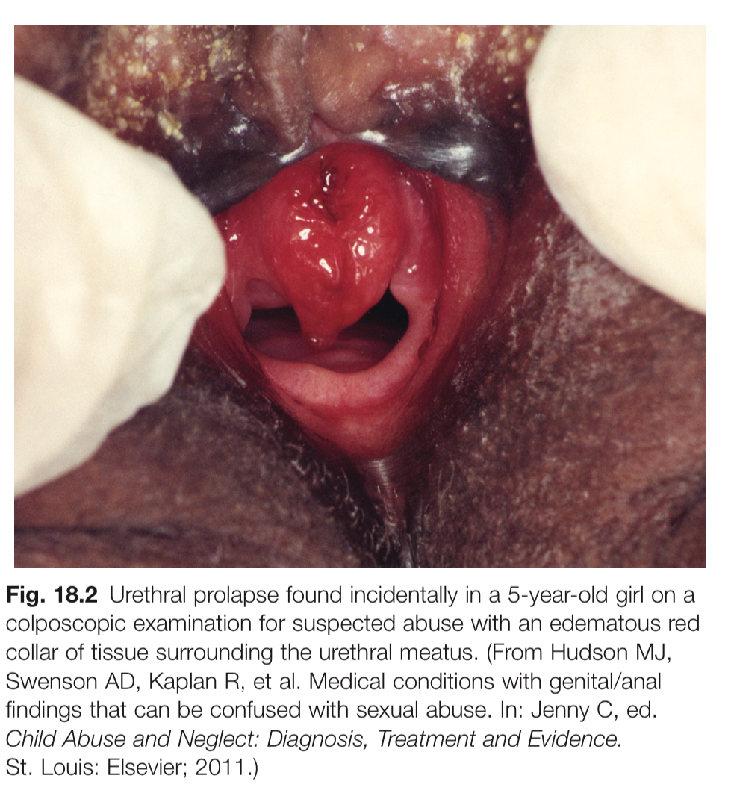

Slide 11
Cysts
INTRODUCTION — The Bartholin glands (also called the greater vestibular glands) are located in the vulva, and blockage of the Bartholin ducts is a common etiology of a vulvar mass. The most common Bartholin masses are cysts or abscesses. The mainstay of management of a Bartholin abscess is incision and drainage (I&D), and a Word catheter is often placed as well .The Word catheter is a balloon that is placed in the Bartholin gland after I&D to allow continued drainage and reepithelialization of a tract for future drainage.

Slide 12
BARTHOLIN GLAND ANATOMY — The Bartholin glands (also called the greater vestibular glands . are the female homologue of the bulbourethral glands in the male. The Bartholin gland's main function is to secrete mucus to provide vaginal and vulvar lubrication .
Each Bartholin gland is approximately 0.5 cm in size and drains tiny drops of mucous into a duct 2.5 cm long. The glands are deep to the posterior aspects of the labia majora. The ducts open onto the vulvar vestibule at the four and eight o'clock positions on each side of the vaginal orifice, just below the hymenal ring .

Slide 13
TYPES OF BARTHOLIN GLAND MASSES
Epidemiology and risk factors — The most common types of Bartholin gland masses are cysts or abscesses. Benign tumors of the Bartholin gland are extremely rare and Bartholin gland carcinoma is a rare type of vulvar carcinoma.
For women ≥40 years old, most experts advise a biopsy of a Bartholin gland mass. Bartholin gland carcinoma is rare, but the risk is increased in this age group.

Slide 14
Bartholin cyst — If the orifice of the Bartholin duct becomes obstructed, mucous produced by the gland accumulates, leading to cystic dilation proximal to the obstruction. Obstruction is often caused by local or diffuse vulvar edema. Bartholin cysts are usually sterile and the gland is not affected.
Bartholin abscess — An obstructed Bartholin duct can become infected and form an abscess .
The single most common pathogen was E. coli (55 isolates) followed by polymicrobial infections (10 patients), Staphylococcus aureus (8 isolates), Group B Streptococcus (6 isolates), and Enterococcusspecies (spp) (6 isolates). There were no STIs isolated [10].

Slide 15
CLINICAL PRESENTATION — A Bartholin cyst is typically painless, and may be asymptomatic. Most Bartholin cysts are detected during a routine pelvic examination or by the woman herself. Larger cysts may cause discomfort, typically during sexual intercourse, sitting, or ambulating. Patients may also find the presence of a cyst to be disfiguring, even in the absence of symptoms.
Bartholin abscesses typically present with such severe pain and swelling and patients are unable to walk, sit, or have sexual intercourse.
EVALUATION — Evaluation of a suspected Bartholin mass includes taking a medical history and performing a pelvic examination. Exudate from the mass is sent for culture to exclude methicillin-resistant Staphylococcus aureus. There is no role for imaging studies in the evaluation of a Bartholin mass. There is also no role for blood tests, if systemic infection is not suspected.

Slide 16
History — A history of the presenting symptoms should be elicited, including:
● Days since the onset of the mass.
● Presence of pain – If the mass is painful, the severity and associated characteristics of the pain should be elicited, including whether the pain is constant or intermittent, whether it is worsening, if there is dyspareunia, and if there is pain with activity such as sitting or walking. Cysts may be non-painful or associated with mild pain, but a Bartholin abscess is typically severely painful.
● Drainage of fluid from the mass and whether the drainage was purulent – If there was drainage, the patient should be asked what the color of the drainage was. Cysts are likely to have clear or white fluid. Abscesses have a purulent discharge that is typically yellow or green. The patient should be asked whether the pain decreased after the drainage.
● Fever - One-fifth of patients with abscess are febrile
● Previous history of vulvar mass, particularly a Bartholin mass.
● Comorbidities, including diabetes or immunosuppression – These may impact the severity of infection and also wound healing.
● Previous history of vulvar conditions or surgery – This may impact the vulvar examination or surgical planning.

Slide 17
Physical examination — Vital signs are obtained. Fever is absent in the majority of patients with Bartholin abscess. There is typically no impact on hemodynamic status. Systemic infection may be occur in rare cases.
A vulvar examination is performed, including visual inspection followed by palpation of the Bartholin gland.
A normal Bartholin gland is not palpable, except possibly in very thin women.
A Bartholin cyst averages 1 to 3 cm in size and is usually unilateral.

Slide 18
DIAGNOSIS
Cyst — The diagnosis of a Bartholin cyst is clinical and is based upon physical examination findings of a soft, painless mass in the posterior aspect of the vaginal introitus, at the site of the Bartholin duct and gland .
Abscess — The diagnosis of a Bartholin abscess is clinical and is based upon the presence of a painful vulvar mass and physical examination findings of a large, tender, soft, or fluctuant mass at the site of the Bartholin duct and gland . Occasionally erythema, edema, and pointing (opening with abscess at a point in the skin, often with purulent discharge) are present.
●
For women with a first or second occurrence of an uncomplicated Bartholin abscess, we recommend I&D with Word catheter placement rather than I&D alone or I&D with marsupialization
●
Bartholin gland excision is a definitive treatment, but must be performed in an . operating room and can be associated with significant hemorrhage and post-procedure morbidity. '
Recurrent abscess — A recurrent abscess presents with the same signs and symptoms as an initial occurrence. An abscess may occur immediately after treatment or remote from treatment. For women who have failed initial treatment and have a recurrence of abscess after one or two Word catheter placements, we suggest marsupialization.
If there is a recurrence after marsupialization or if there is suspected Bartholin's gland carcinoma, excision may be performed

Slide 19
Pregnant women — The incidence of Bartholin gland abscess in pregnant women is 0.13 percent . The bacterial characteristics are similar to nonpregnant women. In our practice, we treat pregnant women in the same manner as other nonpregnant women. One exception is that we usually do not perform cyst excision during pregnancy or the immediate postpartum period given the increased risk of excessive bleeding.

Slide 20
SKENE'S GLANDS And Skenitis
• Function :
unknown, they are thought to provide
lubrication to the urethra.
• Anatomy :
Its also known as periurethral glands, or paraurethral glands, they are structures
located on the upper wall of the vagina, around the lower end of the urethra and
are normally neither seen nor felt, except in the presence of disease or infection.
Close inspection will reveal the pinpoint openings of these periurethral glands.
• The Skene's glands are subject to inflammation and infection of varying degrees
of intensity, known by the term Skenitis.

Slide 21
• Presentation :-
• -A urinary infection that fails to be cured, or recurs after appropriate antibiotic therapy
• -Pain at the urethral opening or at the urethral-vaginal septum
• Pronounced local tenderness with contact, e.g., with touch, tight pants, Pain
during intercourse
• physical findings
* Tenderness at the urethral opening or at the urethral-vaginal septum
• A discharge of pus from the ducts of the Skene's glands which can be expressed by compressing the urethra
• A red and inflamed para-urethral mass
> they are almost infected by Neisseria gonorrhoeae, chlamydia.

Slide 22
• Cultures, particularly for gonorrhea, chlamydia should thus be obtained.
• Treatment
Most important step in management is
folley's catheter drainage:
• Long course of a potent antibiotic.
• antibiotic for 4-6 week period of time is often required to achieve resolution.
• A surgical procedure will be required (drainage) if the
Skenitis does not respond to antibiotics.

Slide 23
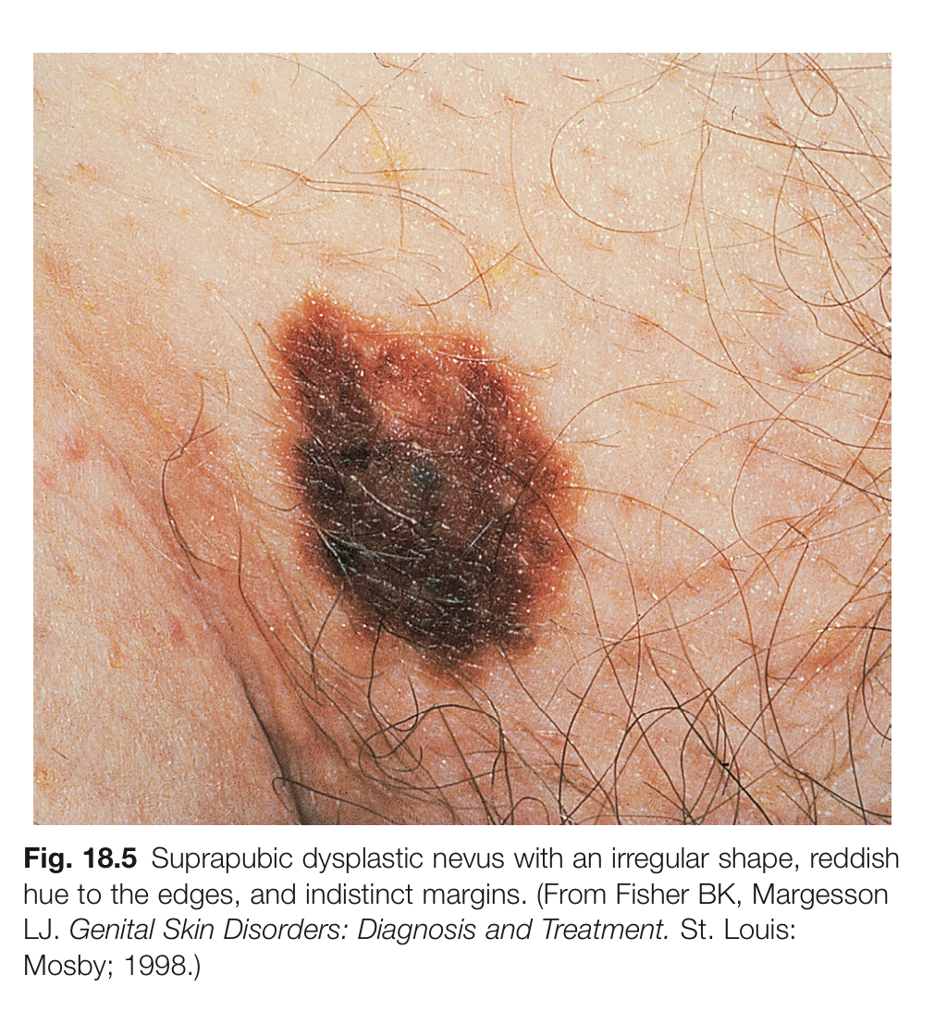
vulvar nevi
A vulvar nevus is a mole or benign skin growth found in the vulvar region. These are generally harmless and similar to moles found on other parts of the body. However, like any mole, it’s important to monitor them for any changes in size, color, shape, or texture, as changes could indicate a potential risk for melanoma or other skin conditions.
If you notice any changes or if the nevi become symptomatic (like itching or bleeding), it’s a good idea to consult with a healthcare provider for further evaluation. They may recommend a biopsy to ensure that the growth is benign.
Treatment of Benign Nevi
• Most vulvar nevi do not require treatment unless they cause discomfort, cosmetic concerns, or show signs of suspicious changes.
• If removal is necessary, procedures like excision or laser therapy can be considered.

Slide 64
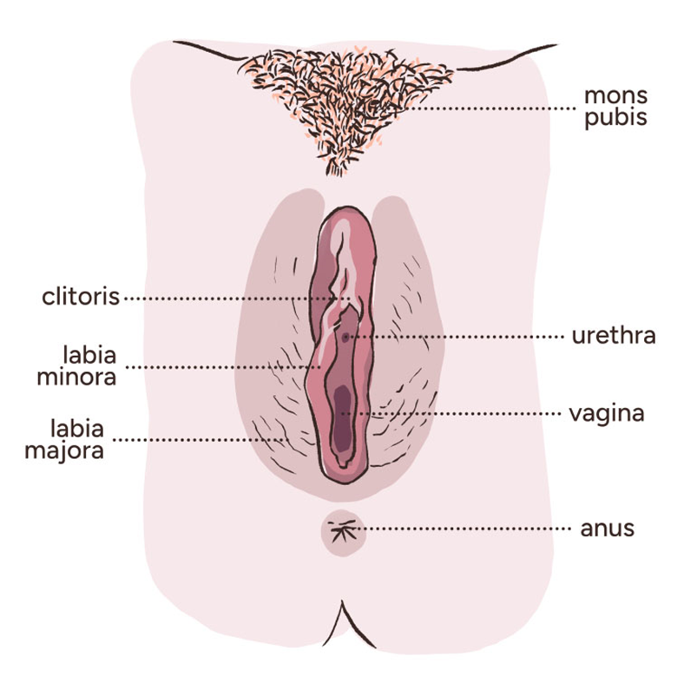
History
BY : Ansam Kamal

Slide 65
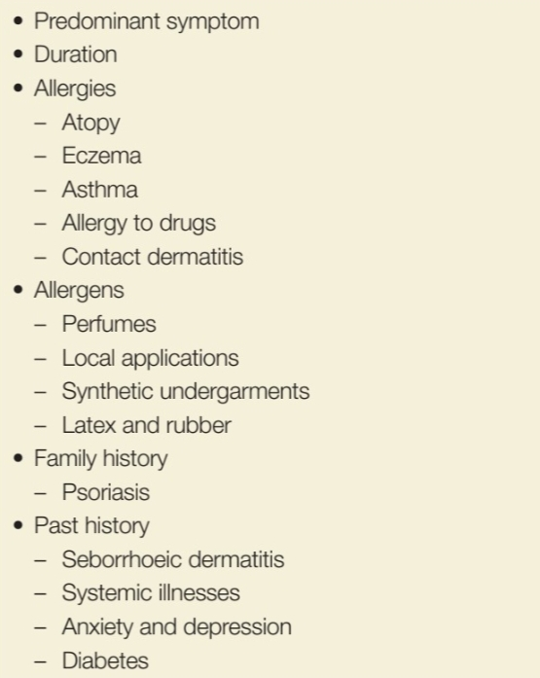
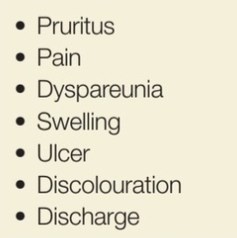

Slide 67
Pruritus
the single most common gynecologic problem;
it is a symptom of intense itching with an associated desire to scratch and rub the affected area.
Not uncommonly, secondary vulvar pain develops in association or subsequent to pruritus.
In some women pruritus becomes an almost unrelenting symptom, with the development of repetitive “itch-scratch” cycles.

Slide 68
” The itchscratch cycle “ : a complex of itching leading to scratching, producing excoriation and then healing. The healing skin itches, leading to further scratching.

Slide 69
Pruritus is a nonspecific symptom.
The differential diagnosis includes
wide range of vulvar diseases, including skin infections, sexually transmitted diseases, specific dermatosis, vulvar dystrophies, lichen sclerosus,
premalignant and malignant disease
contact dermatitis
neurodermatitis
atrophy
diabetes
drug allergies
vitamin deficiencies
pediculosis, scabies
psychological causes
systemic diseases such as leukemia and uremia

Slide 70
The management of pruritus involves
establishing a diagnosis,
treating the offending cause,
improving local hygiene.
For successful treatment the itch-scratch cycle must be interrupted before the condition becomes chronic,resulting in lichenification of the skin (lichen simplex chronicus).
Lichenification clinically is recognized by palpably thickened skin, exaggerated skin markings, and lichen-type scale. The resulting dry, scaly skin often cracks, forms fissures, and becomes secondarily infected, thus complicating the treatment

Slide 71
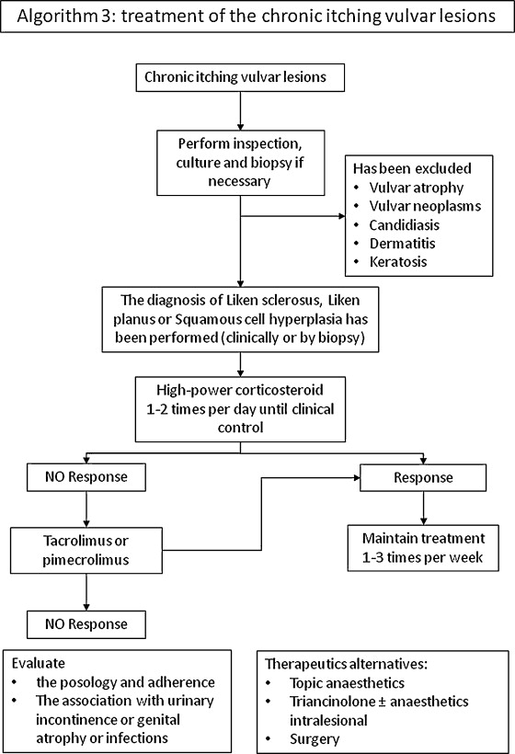

Slide 73
Vulvar pain
Vulvar pain (vulvodynia) is one of the most common gynecologic problems, reported by up to 16% of women in the general population
Vulvodynia is a pain disorder that occurs without visible findings, infection, inflammation, neoplasia, or a neurologic disorder.
The diagnosis is made after excluding other treatable causes.
The disease has a wide spectrum of symptomology and response to treatment; therefore causation is most likely multifactorial.

Slide 74
Vulvar vestibulitis is somewhat of a misnomer because it is not inflammation.
Vulvar pain syndrome is further subdivided into two categories:
both groups of women have an increased incidence of atopy.

Slide 75
Vestibulodynia :
is found in younger women, most commonly white, with onset shortly after puberty through the mid-20s.
involves the symptom of allodynia,
which is hyperesthesia, a pain that is related to nonpainful stimuli.
Thepain is not present without stimulation.
The diagnostic maneuver to establish the presence of allodynia is to lightly touch the vulvar vestibule with a cotton-tipped applicator. The vulvar areas most likely to be affected are from the 4 to 8 o’clock positions along the vulvar-vaginal borders.
Erythema is not always present, but when present, it is confined to the vulvar vestibule (Fig. 18.18).
Additionally, patients with vestibulodynia experience intolerance to pressure in the vulvar region.
This pain is neurogenic in origin.
The intolerance to pressure may be caused by tampon use, sexual activity, or tight clothing
the pain is described as raw and burning.
It is not a spontaneous pain; it is invoked.
However, it is severe in nature.
Some authors have suggested that symptoms be present for at least 6 months before establishing the diagnosis. The symptoms may appear around the time of first intercourse, or within the next 5 to 15 years.

Slide 76
Studies of women with vulvar vestibulodynia have found
no increased incidence of sexual abuse compared with controls. However, many women are found to have erotophobia.
Some even noted an increased nerve density and normal estrogen receptors compared with controls. In contrast, other investigators have noted an increase in alpha-estrogen receptors.
Theories regarding the cause cite potential immunologic and infectious factors, though no theory has been proved to date.
Oral contraceptive use in younger women and hormone replacement in older women have no association with vestibulodynia.

Slide 77
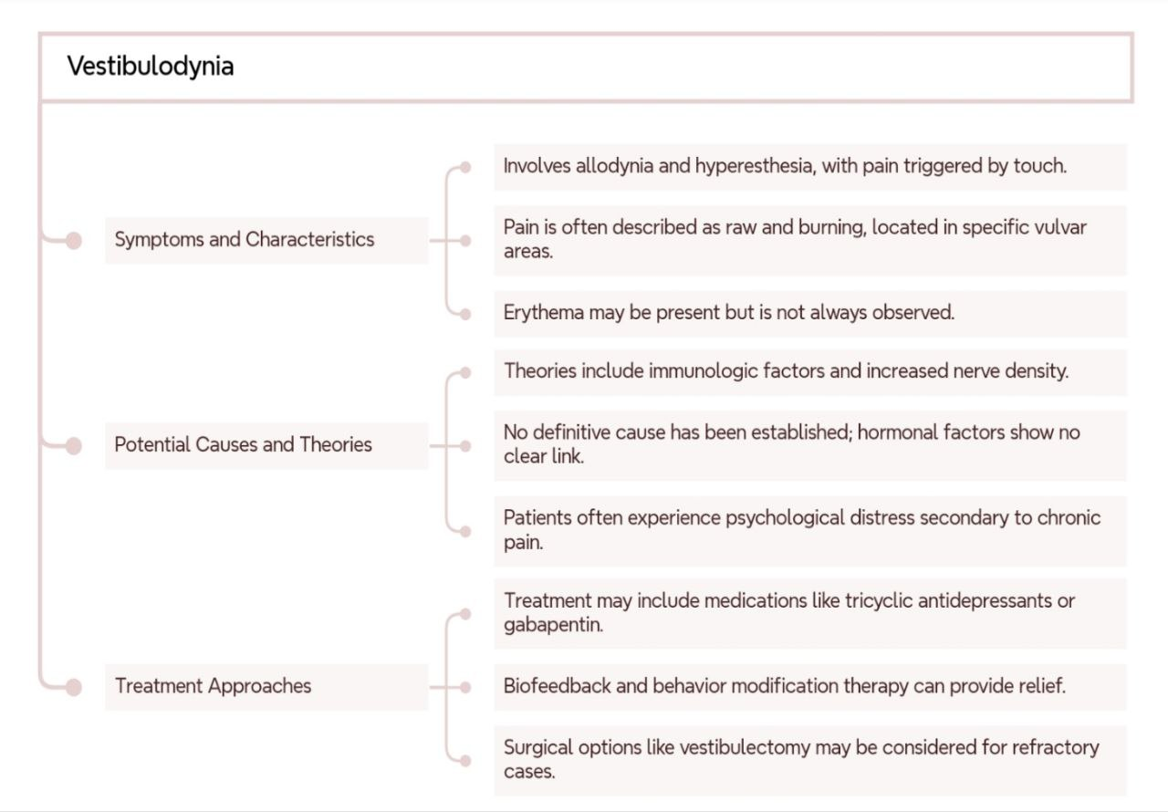

Slide 78
Vulvar dysesthesia, or vulvodynia :
Dysesthetic vulvodynia is most common in peri- and postmenopausal women who have rarely if ever had previous vulvar pain.
is a nonlocalized pain that is constant (not provoked by touch), mimicking a neuralgia.
Allodynia is rarely noted, and erythema is also much less common than in vulvar vestibulodynia.
Dyspareunia is currently present but has usually not been present before the development of dysesthesia.
Similar to women with vulvar vestibulodynia, there is not an increased history of sexual abuse compared with controls.
Women with dysesthesia also have an increased incidence of chronic interstitial cystitis.
In some, a history of inflammation from topical agents may be elicited.
These agents have usually either been self-prescribed or prescribed by a professional to treatinitially what seems to be infection.
Patients are often depressed and anxious, but this is thought to be a secondary reaction to the chronic pain.

Slide 79
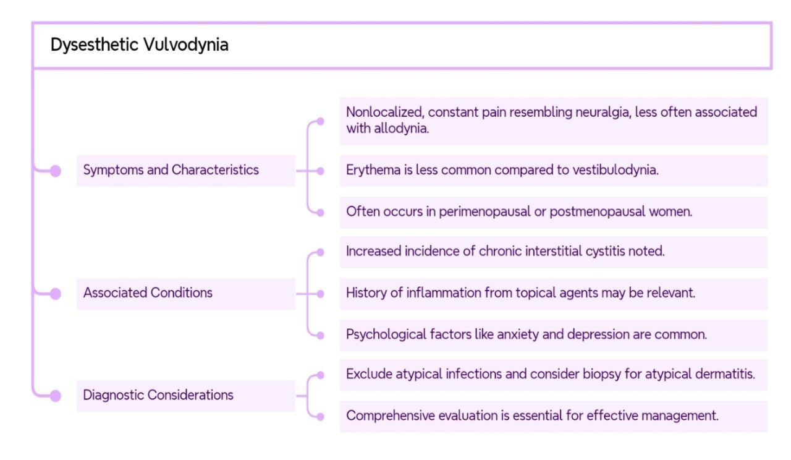

Slide 80
The differential diagnosis of vulvar pain includes
neurologic diseases,
herpes simplex infection,
chronic infections,
abuse,
pain syndromes,
neoplasia,
contact dermatitis, and
psychogenic causes.
Chronic pain is considered to be part of the vulvodynia spectrum
once the diagnoses of infection, invasive disease, and inflammation have been excluded. Severe chronic pain can be socially debilitating, and these patients have a wide spectrum of associated affective symptomology as well.
Women with vulvodynia have greater psychological distress than women who have other vulvar problems. Importantly, these psychological concerns must be addressed as part of the therapeutic management

Slide 81
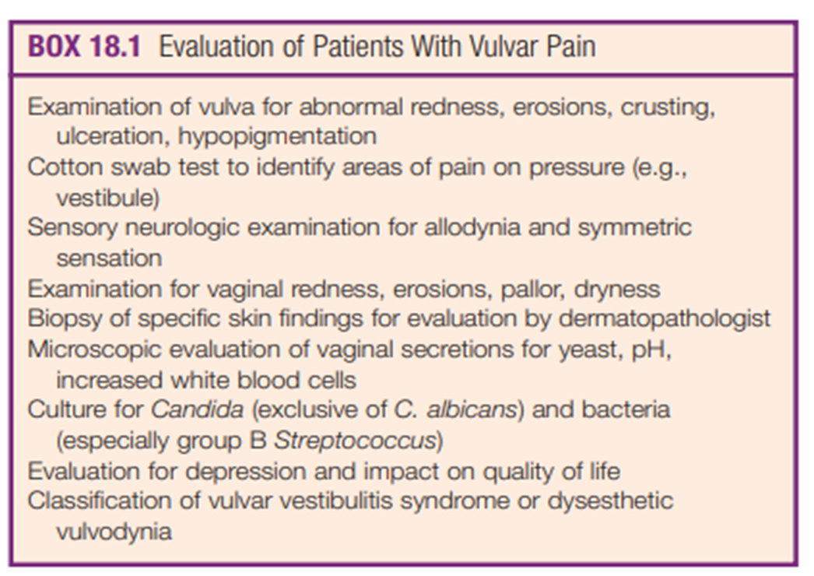
outline for evaluating these patients
A complete history identifying the onset of pain, other associated symptoms, duration of pain, medical and sexual history, treatments tried, allergies, and triggers for pain should be taken.
A physical examination with a cotton swab to identify specific areas of pain should be documented.
Before the diagnosis,
exclude infection by
atypical Candida (which may not be obvious on inspection and should be diagnosed by culture)
and by group B Streptococcus.
Some would recommend that before extensive treatment a punch biopsy should be obtained to rule out dermatitis presenting atypically, including lichen sclerosis

Slide 82
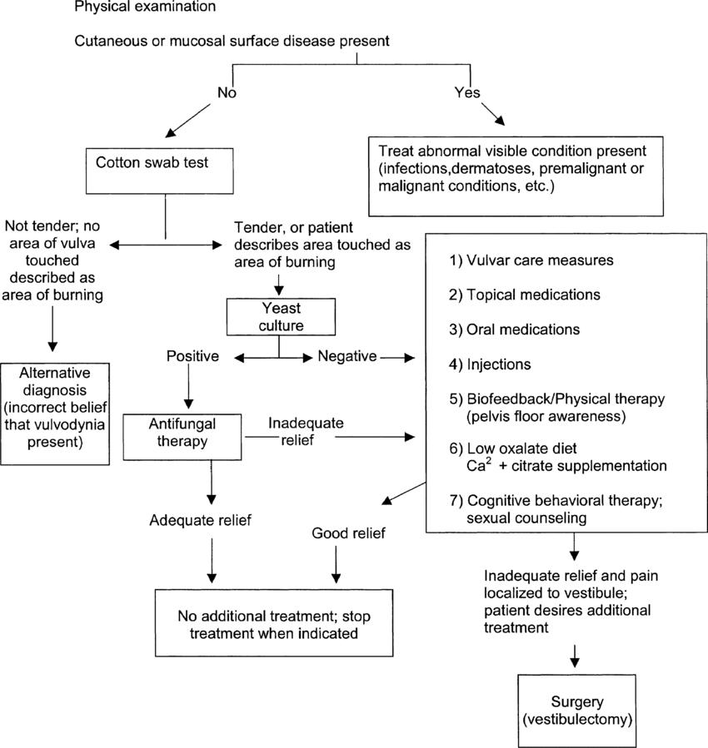

Slide 83
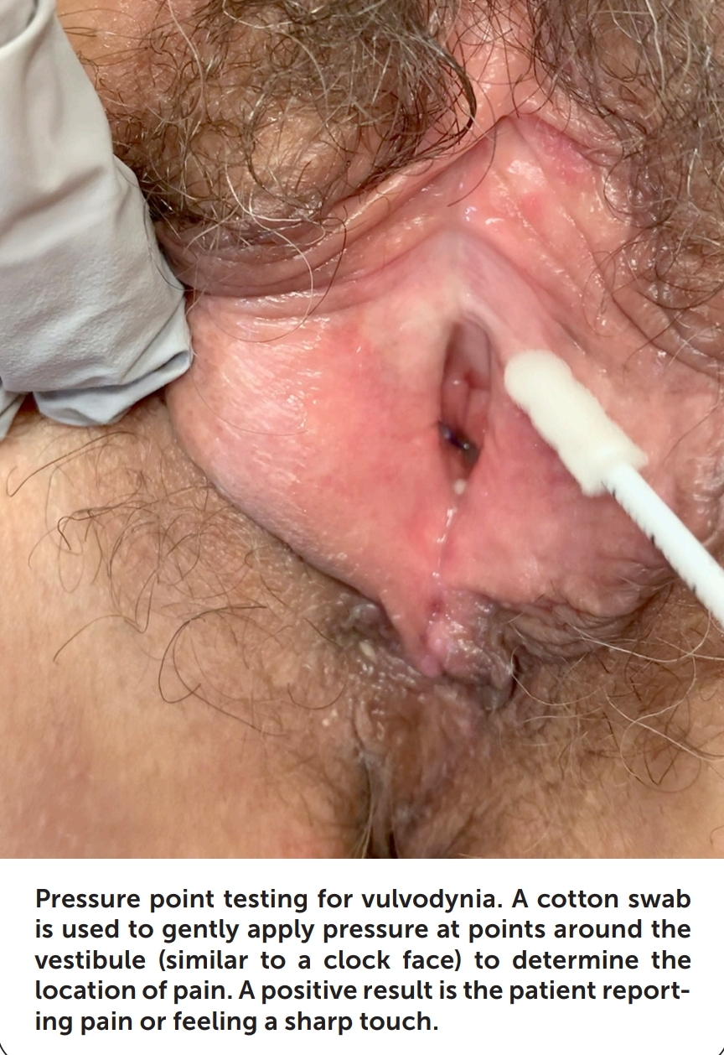

Slide 85
Large population-based studies have noted that symptoms wax and wane, with many women having spontaneous remission (up to 10% of the time).
The therapeutic approach for these two conditions emphasizes a sensitivity to the debilitating social aspects of the problem.
Similar to other chronic pain syndromes, tricyclic antidepressants or gabapentin have been found to be successful in several series.
Doses of gabapentin range from 300 to 3600 mg,
usually given with increasing doses every week.
Most authors start at 300 mg daily, increase to 300 mg twice daily, then three times a day, then 600 mg three times per day to 900 three times per day And so on;
the average effective dose is approximately 1800 mg daily.
Approximately 66% to 75% of women have a response to treatment with gabapentin.When the medication is discontinued, it should be tapered.

Slide 86
Biofeedback and behavior modification therapy have also produced relief.
Topical 5% lidocaine ointment has been described as a local treatment option with limited success.
Reports have indicated that multilevel nerve block given simultaneously for refractory cases has produced some response.
Botulinum neurotoxin is also effective in some women, particularly those with concurrent vaginismus and levator ani spasm.
Series of treatments and combinations of treatments are often used.

Slide 87
In the past, women with refractory vulvar vestibulitis have been treated with surgical removal of the vulvar vestibule and reapproximation of tissue. The surgery is difficult, with a significant complication rate, but results are generally good.
In one series of 126 women with vulvar vestibulitis,

Slide 88
For women with vestibulodynia unresponsive to other therapies, surgery is usually recommended.
Vestibulectomy and modified vestibulectomy (partial or limited from 3 to 9 o’clock)

Slide 89
Edema
Edema of the vulva may be a symptom of either local or generalized disease.
Two of the most common causes of edema of the vulva are secondary reactions to inflammation or to lymphatic blockage.
Vulvar edema is often recognized before edema in other areas of the female body is noted.
The loose connective tissue of the vulva and its dependent position predispose to early development of pitting edema.

Slide 90
Systemic causes of vulvar edema include
circulatory and renal failure,
ascites, and
cirrhosis.
Vulvar edema also may occur after intraperitoneal fluid is instilled to prevent adhesions or for dialysis.
Local causes of vulvar edema include
allergy,
neurodermatitis,
inflammation,
trauma, and
lymphatic obstruction caused by carcinoma or infection.
Infectious diseases that are associated with vulvar edema include necrotizing fasciitis, tuberculosis, syphilis, filariasis, and lymphogranuloma venereum

Slide 92
Physical Examination

Slide 95
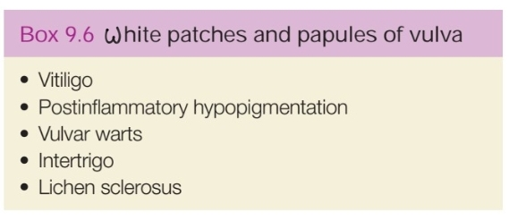

Slide 98
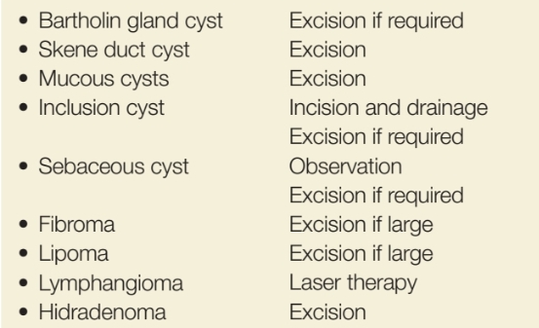

Slide 99
Benign lesions of the vagina
By Ragad kuran

Slide 100
Ddx of anterior vaginal wall masses
Pelvic organ prolapse
Congenital or inclusion vaginal cysts. Urethral diverticulum. Large uterine polyp. Pedunculated fibroid.
ectopic ureter that empties into the urethra Skene glands cysts.

Slide 101
Urethral Diverticulum
What is it?
A urethral diverticulum is a permanent, epithelialized, saclike projection that arises from the posterior urethra.
Most are thought to be acquired and occur in women between ages 30 and 60 years
It often presents as a mass on the anterior vaginal wall.
They are small, from 3 mm to 3 cm in diameter. The majority of urethral diverticula open into the midportion of the urethra.
Malignancy has been reported in 6% to 9% of cases, mostly adenocarcinoma

Slide 102
How dose it happen
It is assumed that the majority of urethral diverticula result from repetitive or chronic infections of the periurethral glands. The suburethral infection may cause obstruction of the ducts and glands, with subsequent production of cystic enlargement and retention cysts.
These cysts may rupture into the urethral lumen and produce a suburethral diverticulum
Histologically the diverticulum is lined by epithelium; however, there is a lack of muscle in the saclike pocket.

Slide 103
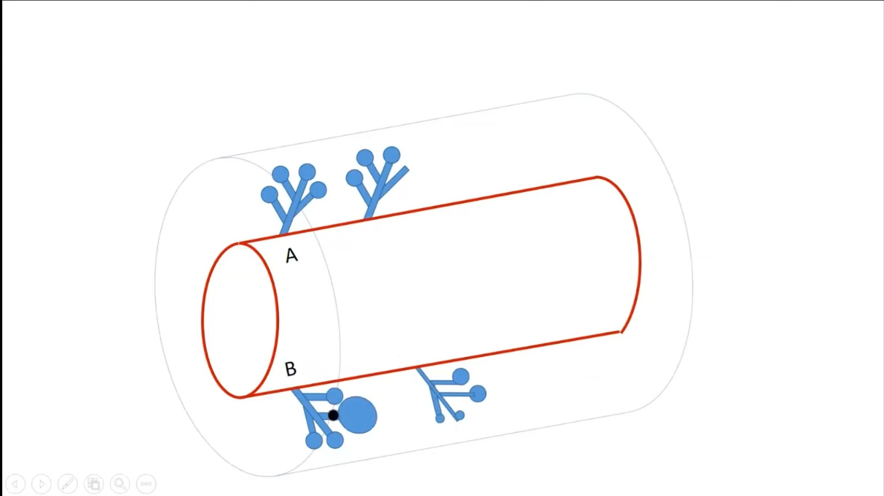
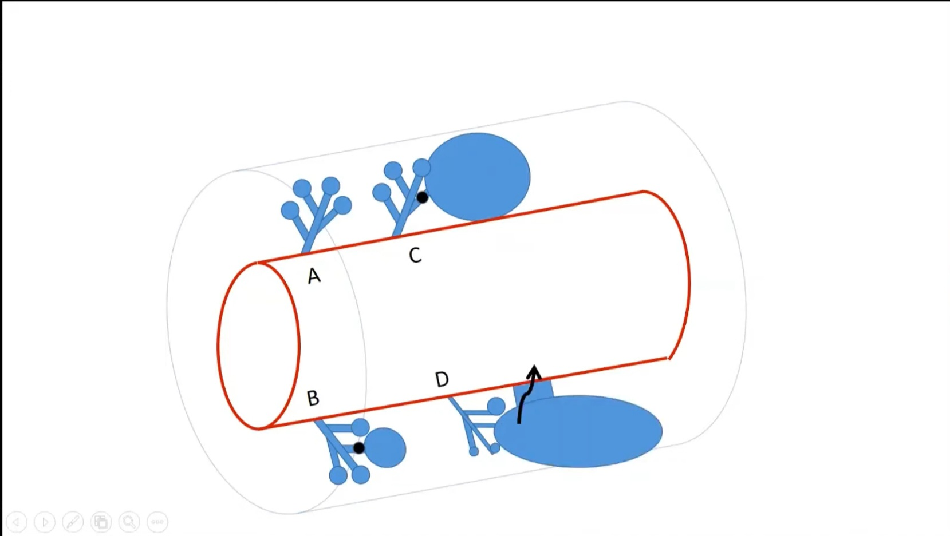
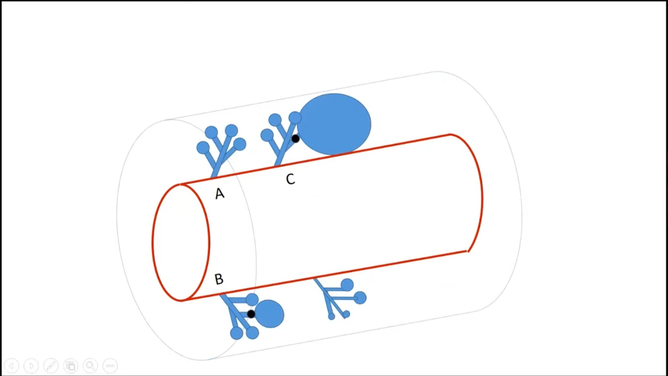

Slide 104
When to suspect
Chronic urinary symptoms that have not resolved with multiple courses of oral antibiotic therapy.
Symptoms associated with urethral diverticula are:
Urinary urgency
frequency 90%
Dysuria
Hematuria
Three Ds associated with a diverticulum: dysuria, dyspareunia, and dribbling of the urine. <10%
Expressions of purulent material from the urethra after compressing the suburethral area during a pelvic examination.

Slide 105
How to diagnose
Voiding cystourethrography
Cystourethroscopy
MRI sensitivity is 100%
Positive-pressure urethrography is done with a special double-balloon urethral catheter (Davis catheter)

Slide 106
Treatment
Diverticula of the distal one-third may be treated by simple marsupialization
The recurrence rate varies between 10% and 20%, and many failures are due to incomplete surgical resection.
The most serious consequences of surgical repair of urethral diverticula are urinary incontinence and urethrovaginal fistula
Postoperative incontinence usually follows operative repairs of large diverticula that are near the bladder neck.

Slide 107
Inclusion Cysts
Inclusion cysts are the most common cystic structures of the vagina.
The cysts are usually discovered in the posterior or lateral walls of the lower third of the vagina.
they vary from 1 mm to 3 cm in diameter.
Are more common in parous women. They usually result from birth trauma or gynecologic surgery. Often they are discovered in the site of a previous episiotomy or at the apex of the vagina after hysterectomy.
Histologically, inclusion cysts are lined by stratified squamous epithelium.
The majority of inclusion cysts are asymptomatic. If the cyst produces dyspareunia or pain, the treatment is excisional biopsy

Slide 108
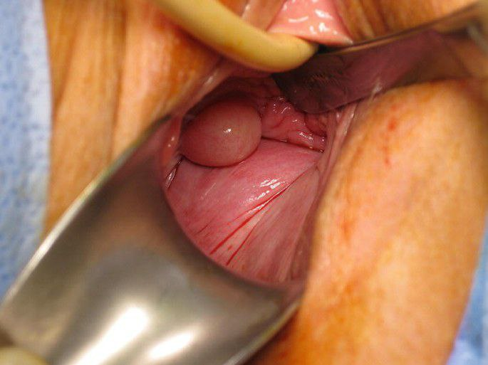
Dysontogenetic Cysts
Dysontogenetic cysts of the vagina are thin-walled, soft cysts of embryonic origin:
Gartner duct cyst arise from the mesonephros ,have cuboidal, nonciliated epithelium. müllerian cyst arise from the paramesonephricum have columnar, endocervical-like epithelium
Vestibular cyst arise from the urogenital sinus
Most of these benign cysts are asymptomatic, sausage-shaped tumors that are discovered only incidentally during pelvic examination

Slide 109
Symptoms were reported, including dyspareunia, vaginal pain, urinary symptoms, and a palpable mass. Sometimes large cysts interfere with the use of tampons.
Operative excision is indicated for chronic symptoms.
Infected cyst if operated on during the acute phase, marsupialization of the cyst is preferred

Slide 111
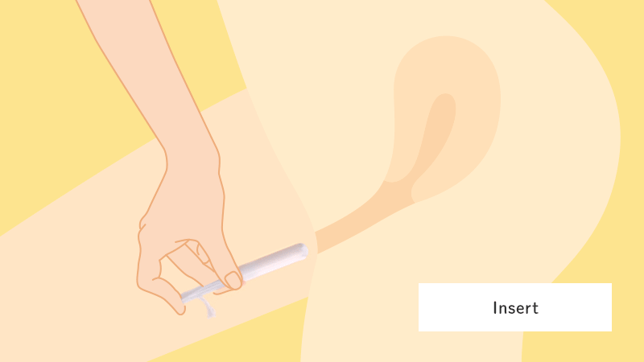
Tampon Problems
Vaginal ulcers
“forgotten” tampon toxic shock syndrome.

Slide 112
Ulcers
In 15% of women wearing tampons only during the time of normal menstruation for a few days has been associated with microscopic epithelial changes. The majority of women develop epithelial dehydration and epithelial layering, and some will develop microscopic ulcers.
no clinical symptoms were associated with these microscopic changes. Theoretically these microulcerations are a potential portal of entry for HIV.

Slide 113
Large macroscopic ulcers of the vaginal fornix have been described in women using vaginal tampons for prolonged times for persistent vaginal discharge or spotting
The pathophysiology of the ulcer is believed to be secondary to drying and pressure necrosis induced by the tampon.
Vaginal ulcers can be secondary to several types of foreign objects, including diaphragms, pessaries, and medicated silicon rings.
Management is conservative because the ulcers heal spontaneously when the foreign object is removed. Any persistent ulcer should be biopsied to establish the cause.

Slide 114
Forgotten tampon
A woman with a “lost” or “forgotten” tampon presents with a classic foul vaginal discharge and occasionally spotting. The tampon is usually found high in the vagina. The odor from a forgotten tampon is overwhelming. The tampon is removed using a “double glove technique” where two gloves are donned on the removal hand and, on grasping the tampon, the outer glove is pulled over the tampon and tied as the tampon is removed. The woman should be treated with an antibiotic vaginal cream or gel (such as metronidazole or clindamycin) for the next 5 to 7 days.

Slide 115
TSS

Slide 116
Local Trauma
The most common cause of trauma to the lower genital tract of adult women is coitus.
Other causes of vaginal trauma are straddle injuries, penetration injuries by foreign objects, sexual assault, vaginismus, and water-skiing accidents.
The most common injury is a transverse tear of the posterior fornix due to the poor support of the upper vagina, which is supported only by a thin layer of connective tissue.

Slide 117
The most prominent symptom of a coital vaginal laceration is profuse or prolonged vaginal bleeding. Many women experienced sharp pain during intercourse, and 25% noted persistent abdominal pain.
Extremely rare complication of vaginal laceration is vaginal evisceration.
Sensitive but thorough history regarding abuse is always appropriate.
Management of coital lacerations involves prompt suturing under adequate anesthesia. Secondary injury to the urinary and gastrointestinal tracts should be ruled out.

