Slide 1
Aberrant liquor
Polyhydramnios & Oligohydramnios
Presented by :
Dina Haddad Muna Al- Shawabkeh
Vildana Sabra Yazeed Qsous
Nader Horani Natalie Baitamouni

Slide 2
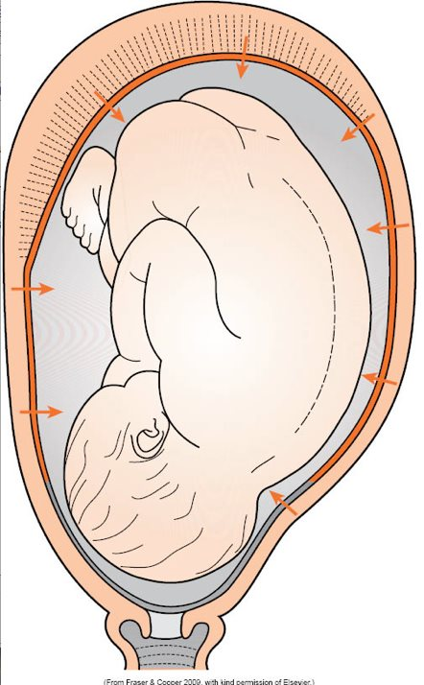
Table of contents
01
AMNIOTIC FLUID
02
POLYHYDRAMNIOS
03
OLIGOHYDRAMNIOS

Slide 3
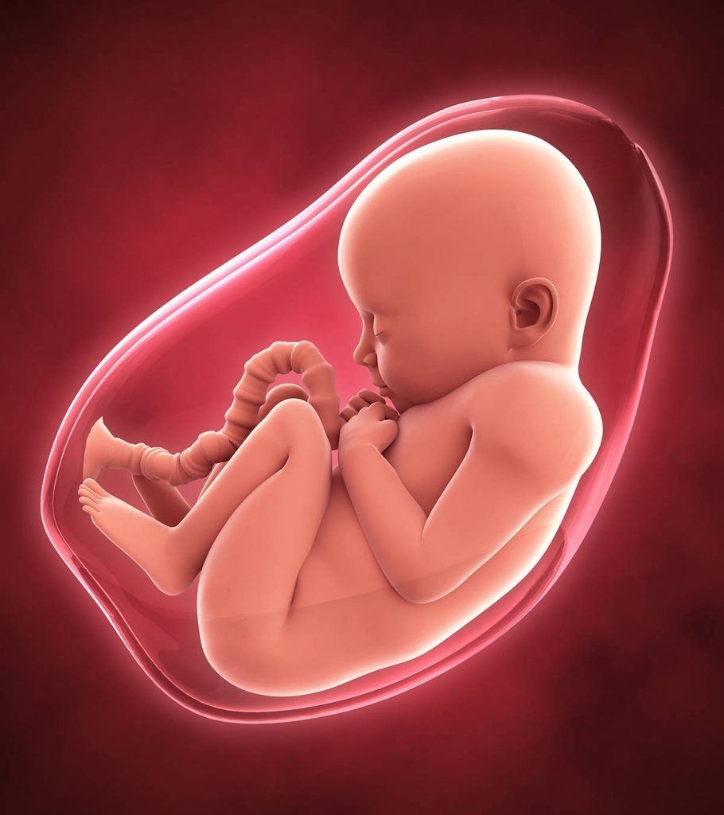
Amniotic fluid
Is the clear or slightly yellowish liquid surrounding the fetus in the amniotic sac. Normally has a pH of 7.0-7.5.
It is formed from the mother’s plasma or the fluid part of blood cells as it diffuses past the fetal membranes and succumbs to the forces of osmosis and hydrostatic pressure . It is mainly water with electrolytes, but by about the 12-14 week the liquid also contains proteins, carbohydrates, lipids and phospholipids and urea, all of which aid in the growth of the fetus.

Slide 4
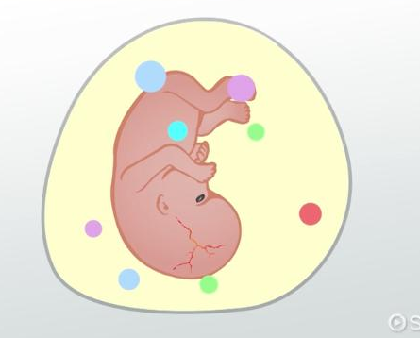
Protection from external forces
It protects the umbilical cord by providing a cushion between the fetus and umbilical cord , thus reducing the risk of compression between the fetus and the uterine wall .
Amniotic fluid also helps protect the fetus from infectious agents due to its inherent antibacterial properties .
Maintain temperature .
Functions :

Slide 5
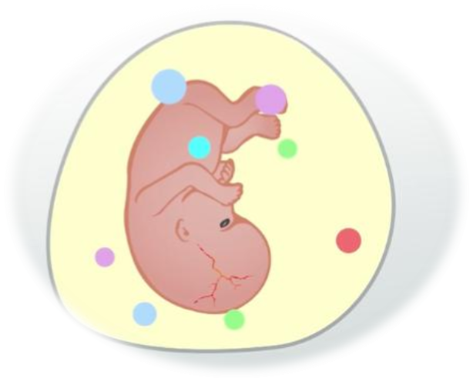
It serves as a reservoir of fluid and nutrients for the fetus containing :proteins , electrolytes ,immunoglobulins , and vitamins from the mother .
It provides the necessary fluid , space and growth factors to allow normal development and growth of fetal organs such as the musculoskeletal system , gi system and pulmonary system .
Clinicians can use amniotic fluid as a tool to monitor the progression of pregnancy and predict fetal outcomes .
Functions :
Low resistance environment > freedom of movement > musculoskeletal development .

Slide 6
The development of amniotic fluid organizes into : early gestation and late gestation .
Early gestation is the embryonic period which is from the start of fertilization to 8 weeks .
Late gestation , which encompasses the fetal period 8 weeks to birth .
The composition of amniotic fluid changes from early gestation to late gestation .
Development :
So , what is the source of this fluid in both periods ?
During the embryonic period , amniotic fluid derives from both fetal and maternal factors such as water from maternal serum , coelomic fluid , and fluid from the amniotic cavity .
During late gestation , amniotic fluid is largely produced by fetal urine and lung secretions .

Slide 7
Once the coelomic fluid begins to disappear, the amniotic cavity takes over.
In the early stages of gestation, the water in amniotic fluid is derived mostly from maternal serum; however, at 10 weeks, the fetus begins to produce urine which is secreted into the amniotic sac.
Development :

Slide 8
During late gestation (the second and third trimesters), as the amniotic fluid expands, fetal urine becomes the largest source of the amniotic fluid. Is there a variation in the color between those two phases?
Why?!!!
Compared to the composition of yellow coelomic fluid early in pregnancy, amniotic fluid is less viscous and always clear due to its lower protein concentration.

Slide 9
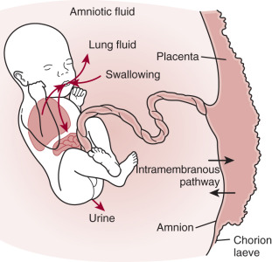
Homeostasis of the amniotic fluid:
Early in pregnancy, fluid freely diffuses through fetal skin and the chorionic villi until week 8.
Eventually, fetal skin begins to become stratified epithelium and becomes fully keratinized by 25 weeks. Once the skin of the fetus is fully keratinized later in pregnancy, it can no longer absorb or transfer fluids as easily back and forth.
(Keratinization prevent the free passage of fluid under hydrostatic and osmotic forces).

Slide 10
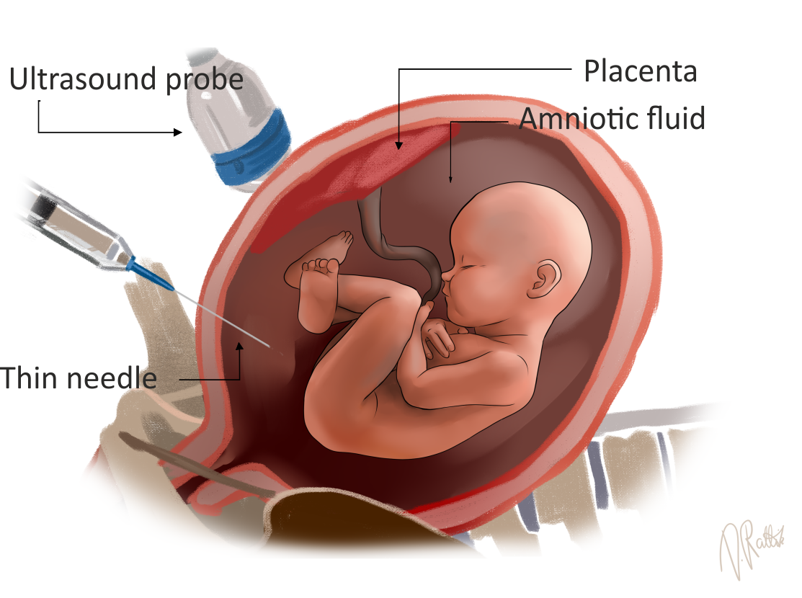
Amniotic fluid constituents by 12-14 weeks :
Water and electrolyte
Urea
Creatinine
Uric acid
Desquamated fetal cells
Proteins , lipids and phospholipids
(Which gives the slightly yellow color).

Slide 11
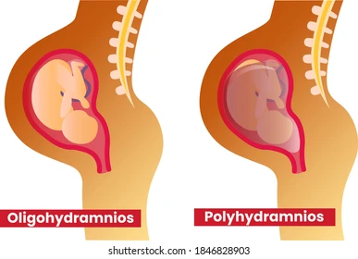
Clinical Significance :
Clinicians can use the amniotic fluid index (AFI) or single deepest pocket (SDP) ?!!
AFI and SDP are estimations of amniotic fluid volume based on ultrasound measurements.

Slide 12
Amniotic Fluid Volume (AFV):
The volume of amniotic fluid increases with the growth of fetus until reaching the peak then gradually goes down
10-20 week, it increases from 25-400 ml approximately.
Its volume continues to increase until the 34-36 week of pregnancy (peak is 800-1000 ml).
The fluid volume then gradually goes down to roughly 400 ml at 42 weeks.

Slide 13
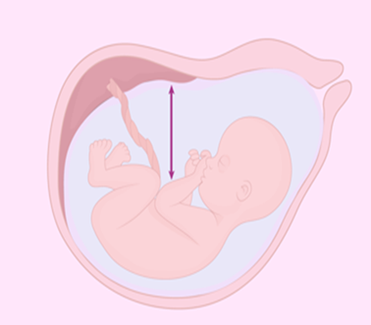
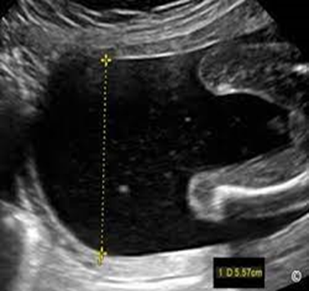
Amniotic Fluid Assessment:
1- maximum vertical pocket (single deepest pocket) SDP
Can be used all through the pregnancy. (before and after 24 weeks).
Normal measurement 2 to 8 cm.
> 8 cm is polyhydramnios.
< 2 cm is oligohydramnios.
2- Amniotic fluid index
Used in singleton pregnancies 24 weeks or more.
Normal measurement 5-25 cm.
<5 cm is oligohydramnios, and > 25 cm is considered polyhydramnios.

Slide 14
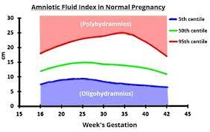
Polyhydramnios can be caused by gastrointestinal tract obstruction, genetic disorders, musculoskeletal disorders, or congenital diaphragmatic hernias. EXAMPLE!?
One of the most common causes of oligohydramnios is the preterm premature rupture of membranes (PPROM).
Oligohydramnios can cause complications such as renal agenesis, genitourinary tract obstruction, and IUGR.
!!!

Slide 15
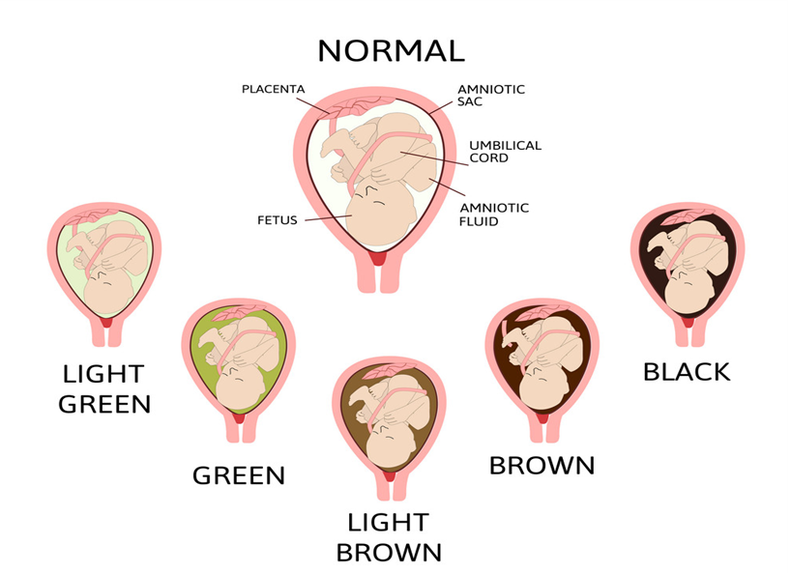
AFV ASSESSMENT :
This is usually done during labour:
Normal AF is watery, slightly yellowish in colour.
Golden yellow:- In Rh incompatibility patients (iso-immunization)
Greenish yellow:- In post-maturity patients or meconium passage. !!?
Dark maroon:- Due to altered blood in accidental hemorrhage.
Dark brown:- In presence of retained dead fetus (Missed miscarriage).
Blood stained:- In abruption, vasa previa.
Postmaturity refers to any baby born after 42 weeks of gestation.
!!!

Slide 16
Polyhydramnios

Slide 17
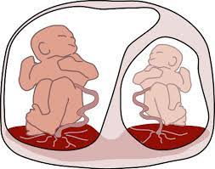
Polyhydramnios :
Any increases in the AFV surrounding the fetus is termed hydramnios . Once a pre-defined sonographic value has been exceeded this is classified as polyhydramnios. .
Affects approximately 1-2 percent of pregnancies .
In late 2nd and 3rd trimester , an MPD >25 cm is diagnostic.

Slide 18
An amount of amniotic fluid more than 2000ml .
Incidence about 1:200
Aetiology : increased production or decreased consumption of amniotic fluid will result in polyhydramnios .

Slide 19
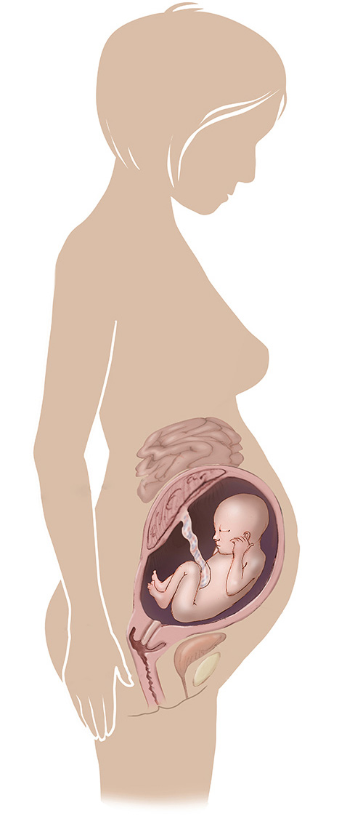
Etiology
Fetal causes :
Congenital anomalies
Uniovular twins
Increased placental mass
Maternal causes :
Diabetes mellitus
Severe generalised edema

Slide 20
Fetal causes :
congenital anomalies :
Anencephaly
Transudation of the cerebrospinal fluid from the exposed meninges .
Absence of swallowing of the liquor
Foetal polyuria resulting from lack of antidiuretic hormone or irritation of the exposed centers .
Atresia of the esophagus or of the duodenum enables of the fetus to swallow the liquor

Slide 21
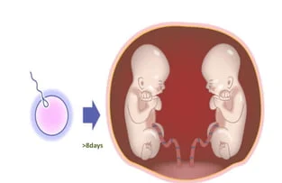
Fetal causes :
Uniovular twins
Due to interconnecting vascularity in the placenta , one fetus obtains more circulation so that its heart and kidneys hypertrophy leading to increased urine production . So one amniotic sac only is affected .

Slide 22
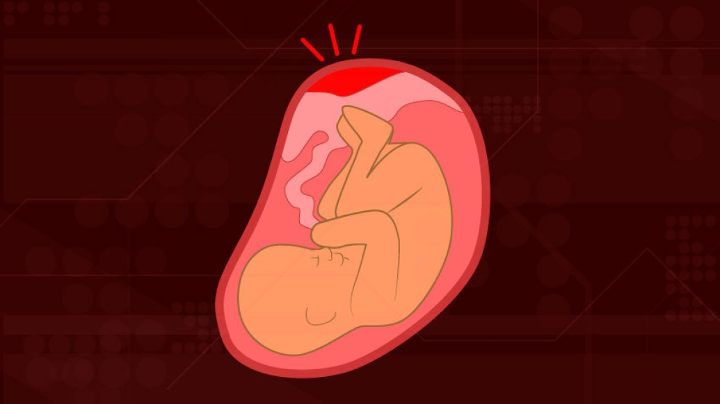
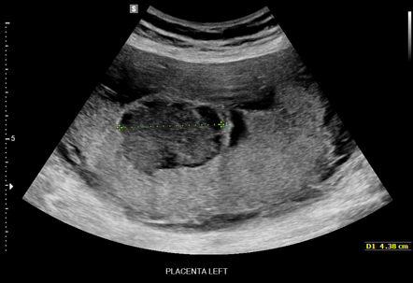
Fetal causes:
Increased placental mass
Edema of the placenta due to :
Hydrops fetalis resulting from RH incompatibility , severe anemia , hemoglobinopathesies particularly alpha thalassemia major and cytomegalovirus infection .
True knot of the cord causes obstruction of venous return with placental congestion .
Fetal liver cirrhosis as in syphilis
b. Chorio-angioma and large placenta

Slide 23
Maternal causes :
Diabetes mellitus due to :
Increased osmotic pressure of the liquor amnii due to its high sugar content
Fetal polyuria resulting from hyperglycemia

Slide 24
Etiology
Maternal factor | Materno-Fetal Etiology | Fetal etiology
Maternal DM Fetal hyperglycemia 🡪 fetal polyuria | 1. Multiple gestation Twin gestation with twin-to twin transfusion syndrome (increased amniotic fluid in the recipient twin and decreased amniotic fluid in the donor) or multiple gestations affect 10% of MCDA due to vascular anastomosis and blood flow imbalance | swallowing defect Central nervous system abnormalities and neuromuscular diseases that cause swallowing dysfunction Ex : anencephaly | Extrinsic intestinal compression (diaphragmatic hernia or masses within the thorax and mediastinum)
 |  | Congintal anamolies 1.Esophageal atresia (associated with 2.tracheoesophageal fistula Tracheal agenesis 3.Duodenal atresia 4.intestinal atresias | Infectious Congenital syphilis Viral hepatitis Parvovirus b19 CMV
 | 2. Chorioangioma | Fetal akinesia syndrome with absence of swallowing | Chromosomal Disorders; • Trisomy 18 • Trisomy 21 also 13
 | 3. Blood incompatibilities (Rh iso-immunization)

Slide 25
Polyhydramnios criteria & classification

Slide 26
Criteria for mild, moderate, and severe polyhydramnios:
 | Mild | Moderate | severe
Single deepest pocket | 8 – 11.9 cm | 12 – 15 cm | >= 15cm
Amniotic fluid index | 24 – 29.9 cm | 30 – 34.9 cm | >= 35 cm

Slide 27
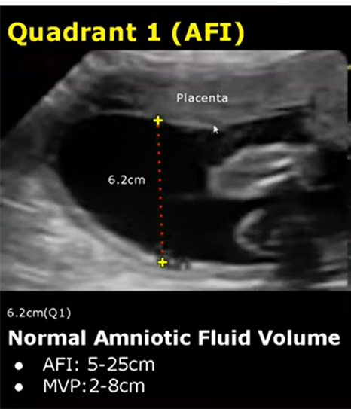
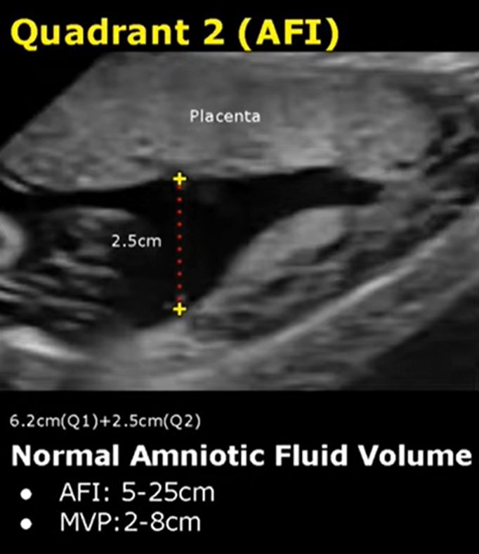
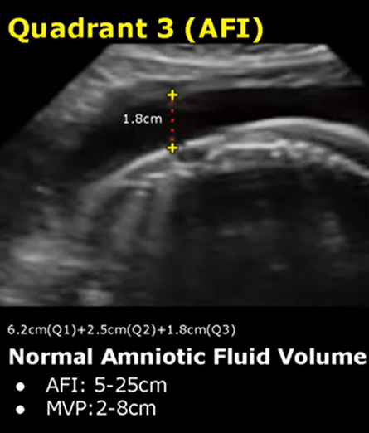
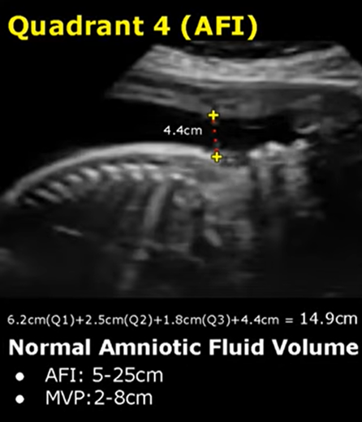
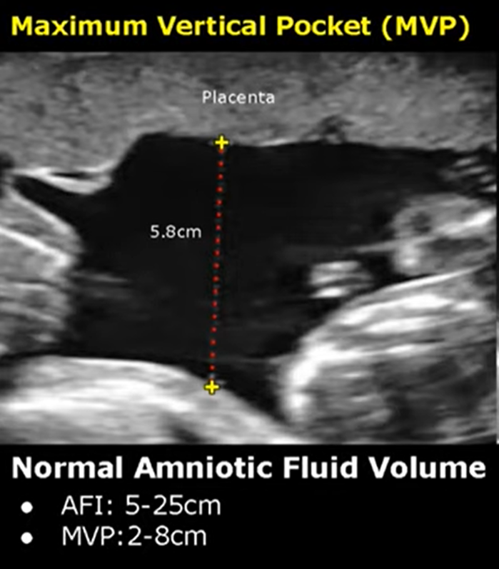

Slide 28
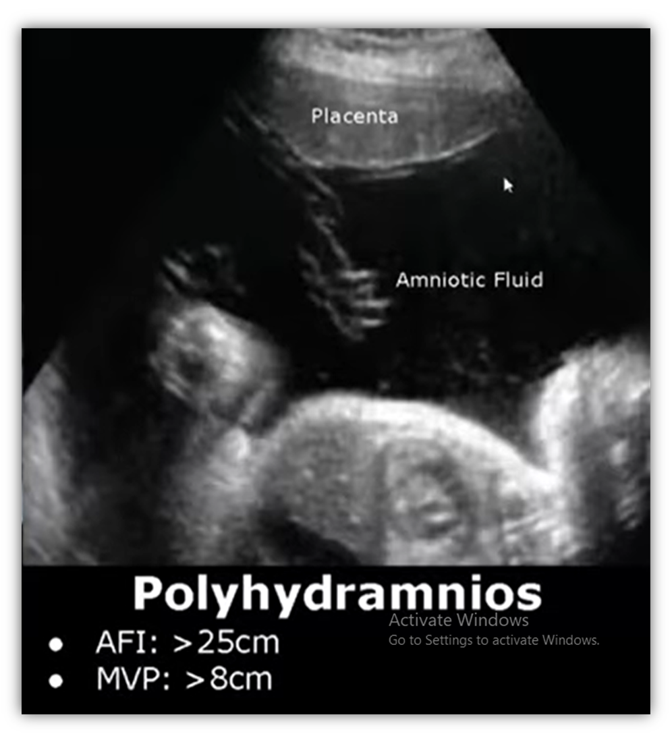
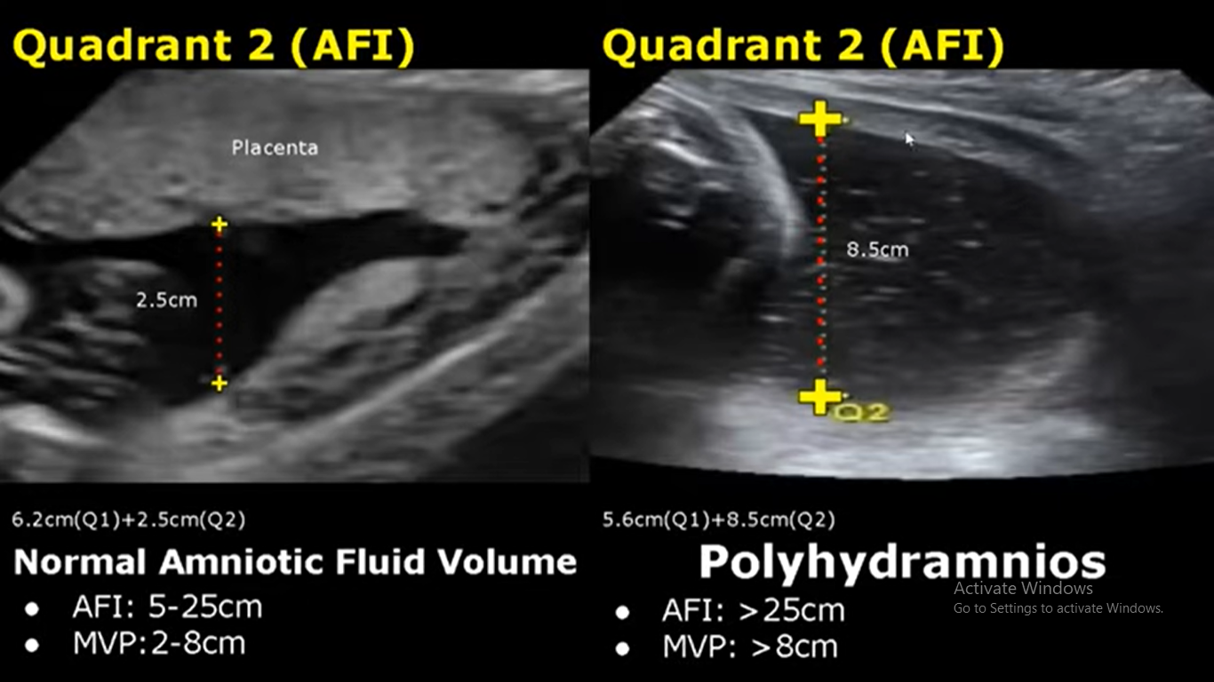
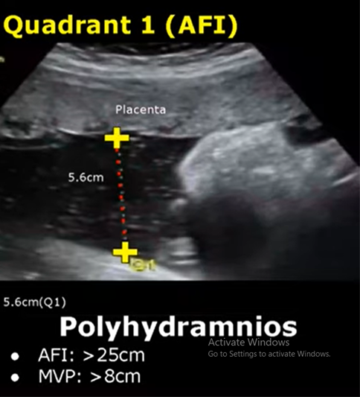
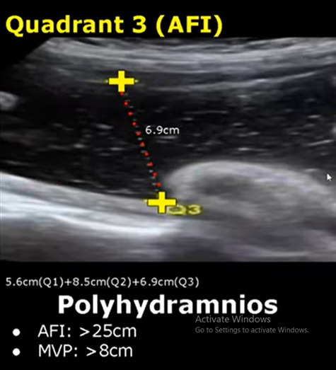
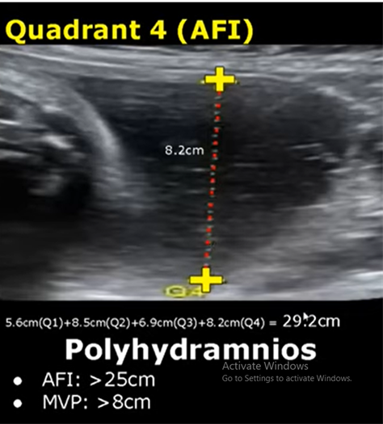
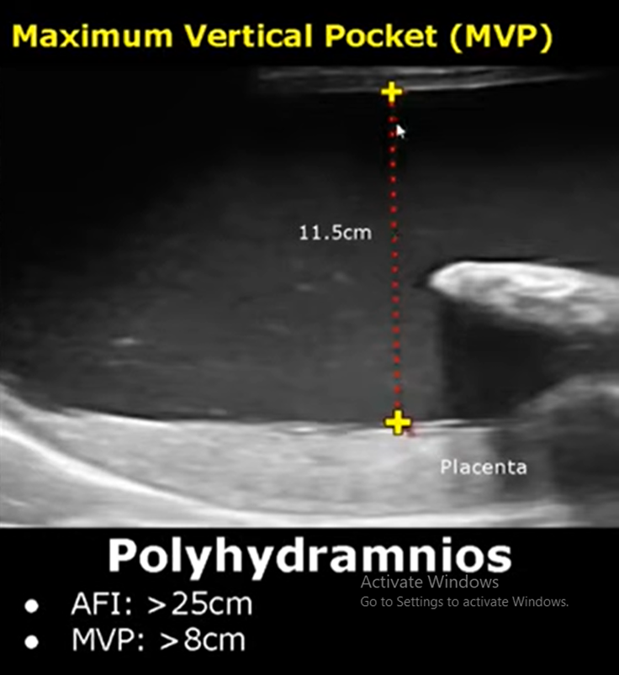

Slide 29
Clinical types :
Depending on the rapidity of onset hydramnios
can be :

Slide 30
Acute Polyhydramnios: Onset is acute usually occurs before 20 weeks of pregnancy and presents usually with symptoms and labour starts before 28 weeks of pregnancy.
It may present as
Acute abdomen - abdominal pain, nausea, vomiting
Breathlessness which increases on lying down position
Palpitation
Oedema of legs, varicosities in legs, vulva and hemorroids
Signs:
Patient looks ill, without features of shock
Oedema of legs with signs of PIH
Abdomen unduly enlarged with shiny skin
Fluid thrill may be present
Internal examination shows taking up of cervix or even dilatation with bulging membranes

Slide 31
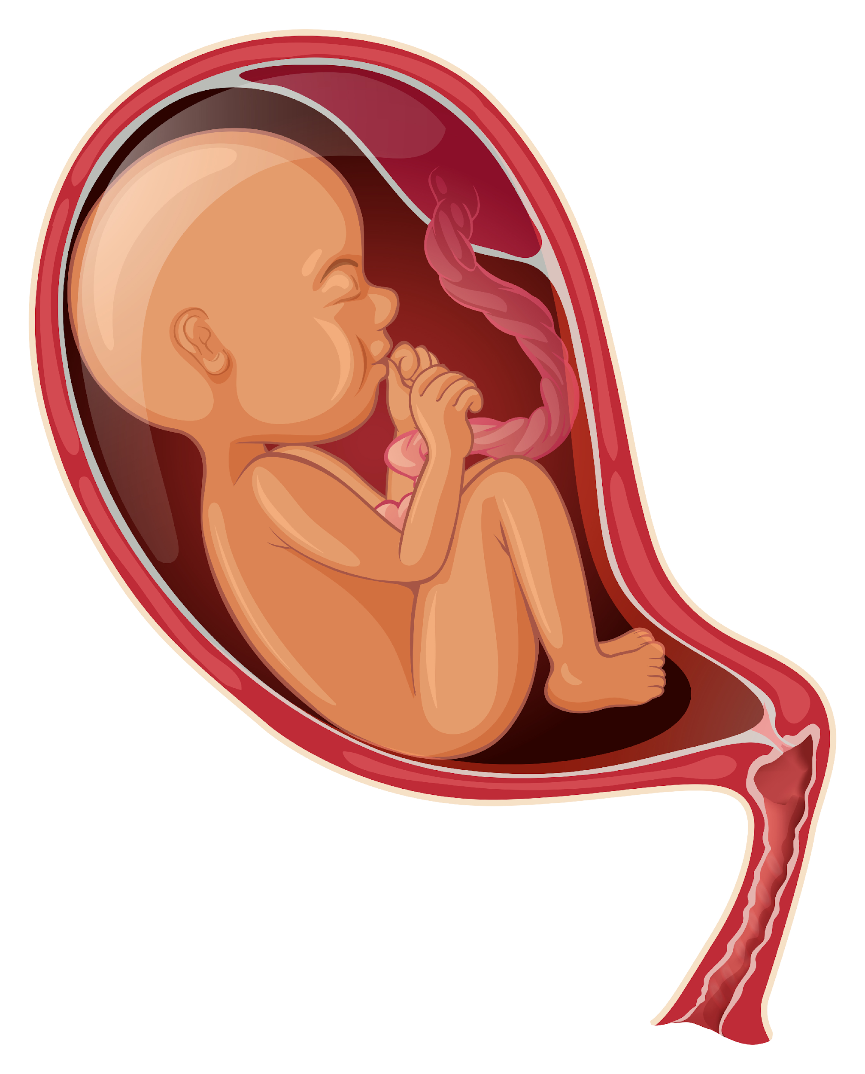
Chronic Polyhydramnios:
More common than acute 10% more common
Since accumulation of liquor is gradual and so patient may be symptomatic or asymptomatic.
Symptoms are mainly due to mechanical causes
Dyspnea is more in supine position
Palpitation
Oedema
Oliguria may result from ureteral obstruction by enlarged uterus
Pre-eclampsia 25 %( oedema, hypertension and proteinuria)

Slide 32
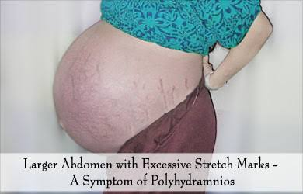
Signs GPE
Patient may be dyspneic at rest
Pedal Oedema
Evidence of PIH
Abdominal examination
Inspection
Abdomen is markedly enlarged globular with fullness in flanks
Skin over the abdomen is tense shiny with large striae
Palpation
Height of uterus is more than the corresponding periods of Amenorrhoea
Abdominal girth is more
Fetal parts cannot be well defined external ballottment is more easily elicited
Malpresentations are more common and presenting part is usually high up
Fluid thrill is present
Auscultation
Fetal heart sounds are not heard distinctly

Slide 33
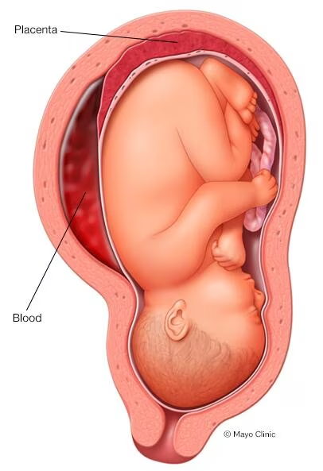
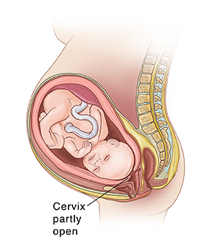
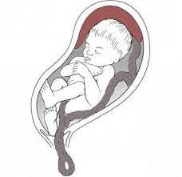
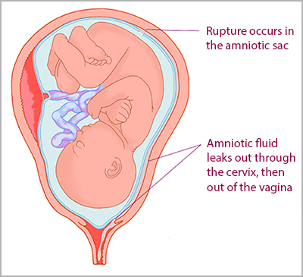
Internal examination :
Cervix is pulled up
May be sometimes dilated and admits tip of finger through which bag of membranes which is tense is felt.
At times patient may present with complications like :
General abdominal discomfort and slight dyspnea (in mild cases) Marked respiratory distress and severe abdominal symptoms (moderate to severe)
premature rupture of membranes so preterm labor and Premature birth.
Placental abruption
Umbilical cord prolapse.
Macrosomia
Maternal respiratory compromise.
Fetal malposition and mal-presentation
Cesarean delivery and NICU
Still-birth and Perinatal Mortality

Slide 34
Polyhydramnios diagnosis & investigations

Slide 35
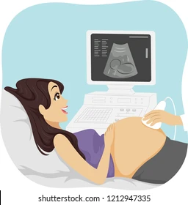
Diagnosis & Investigations
Sonographic Visualization By US
Confirm diagnosis
Deepest vertical pocket (DVP) more than 8 cm
Amniotic Fluid Index (AFI) more than 25 cm
fetal number and Chorionicity
severity of polyhydramnios
fetal growth.
If there is any obvious fetal anomaly as anencephaly , spina bifida , gastrointestinal tract anomaly
Macrosomia

Slide 36
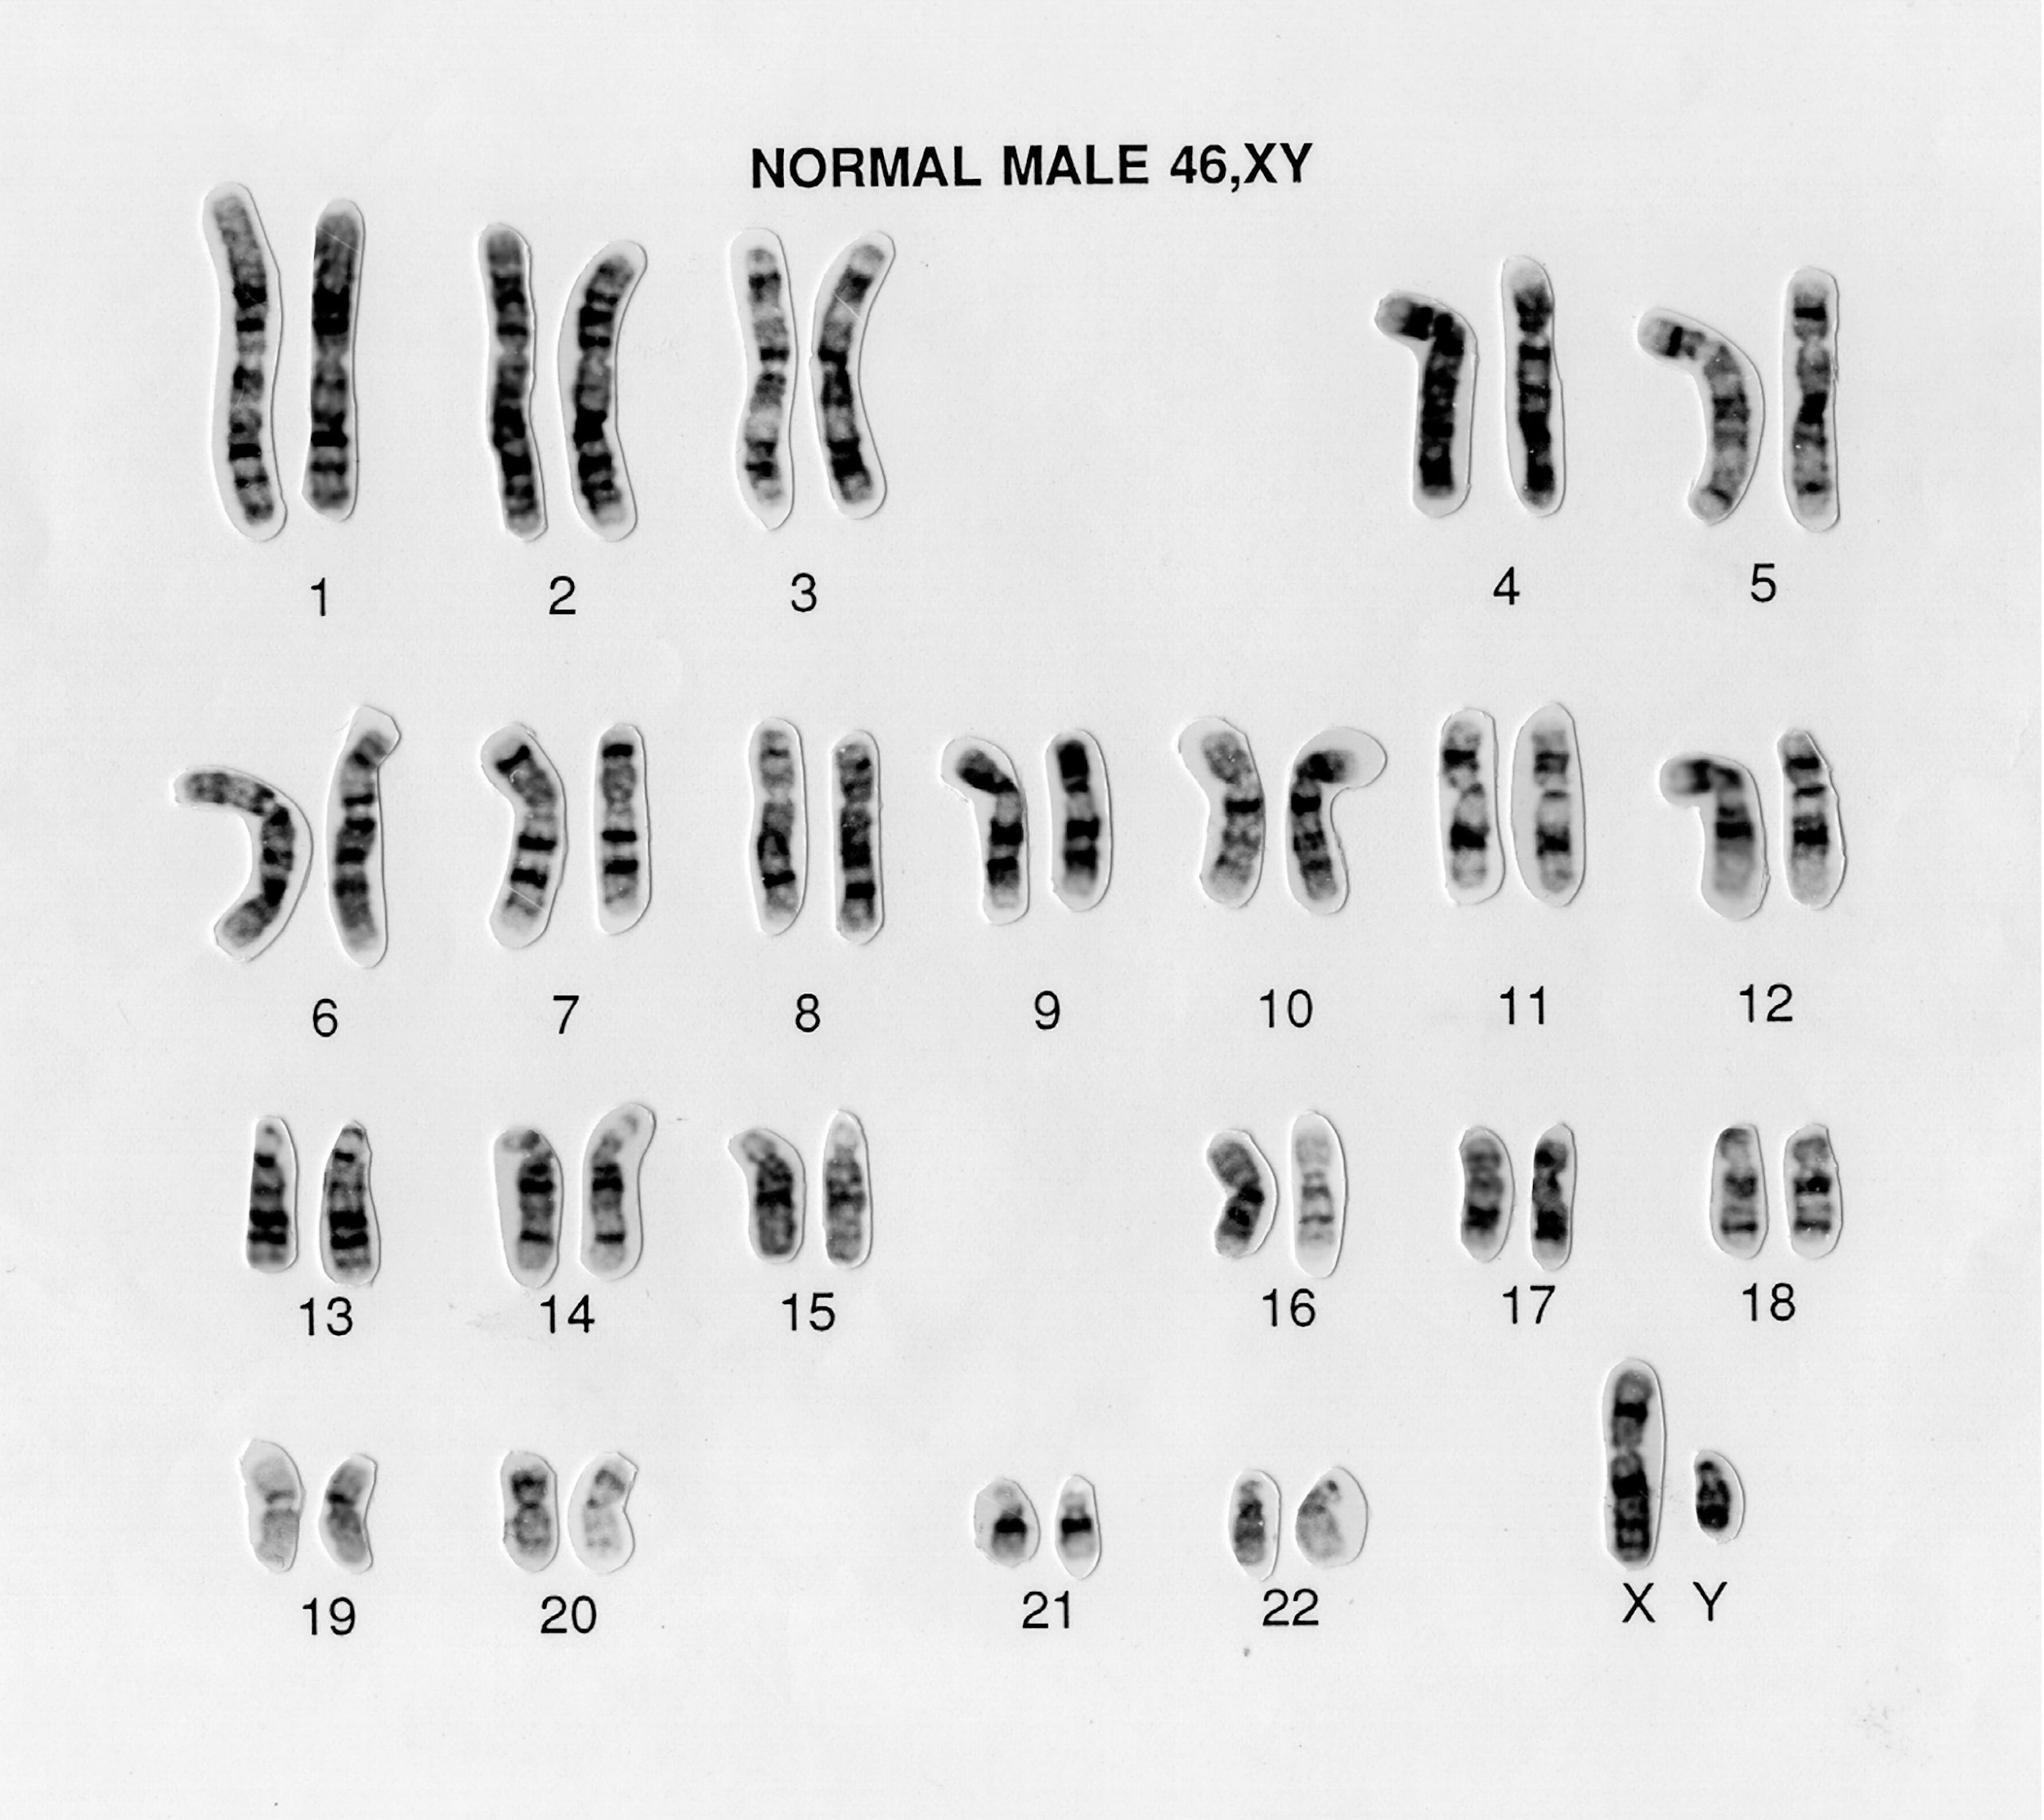
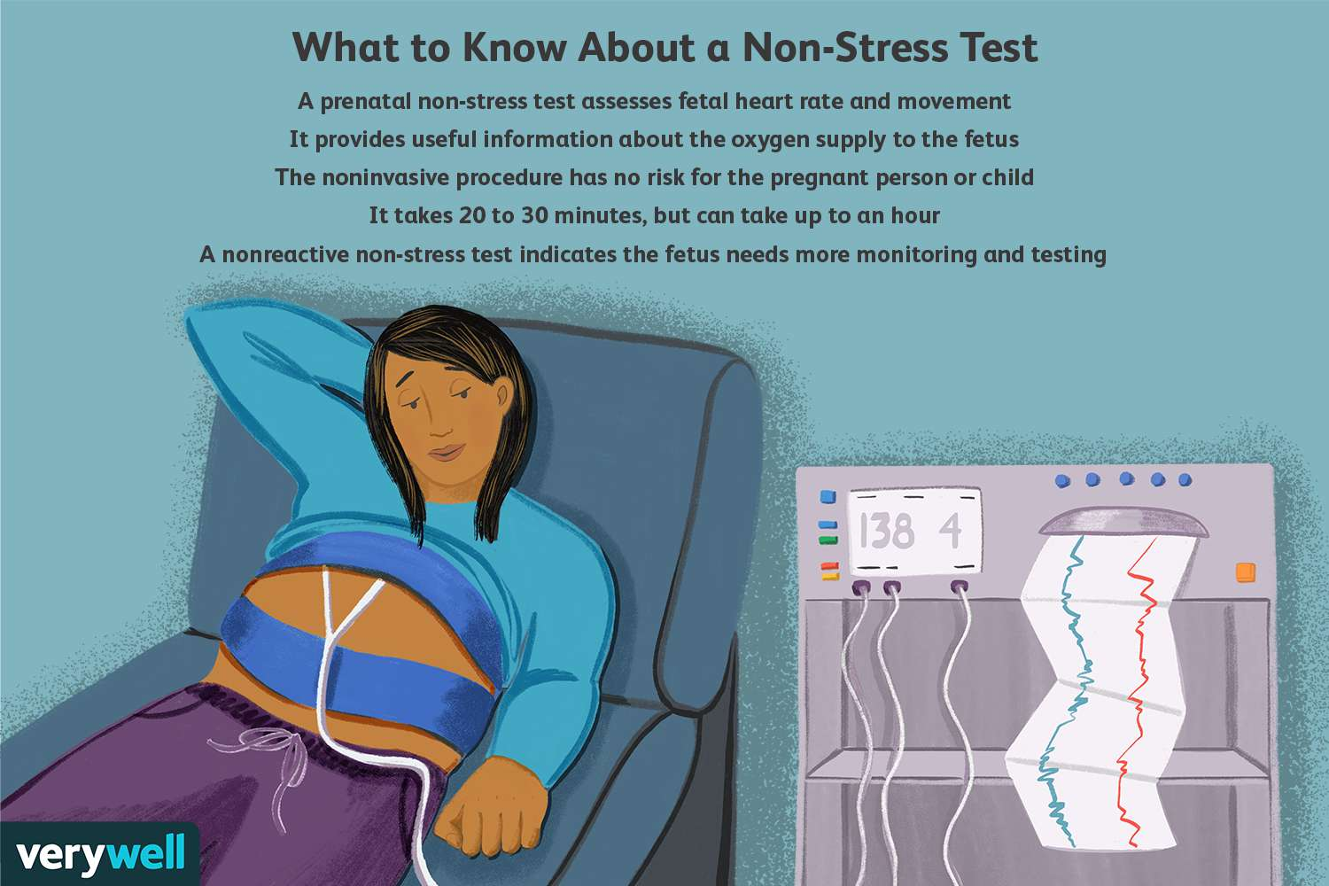
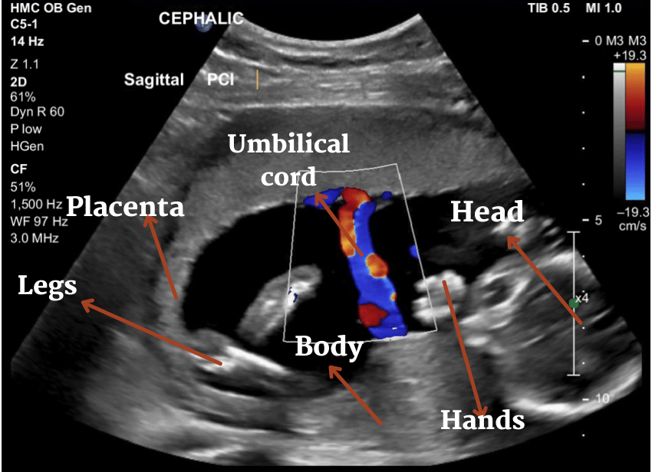
Other tests :
1-Diabetes screening
2- Serological testing to exclude underlying alloimmunization
3- Serological testing if underlying infectious cause is suspected
4- karyotype : Assessment of structural and chromosomal anomalies if diagnosed less than 30 week’s gestation ( fetal medicine referral)
5- Nonstress test
6- Biophysical profile.
7- Doppler ultrasound

Slide 38
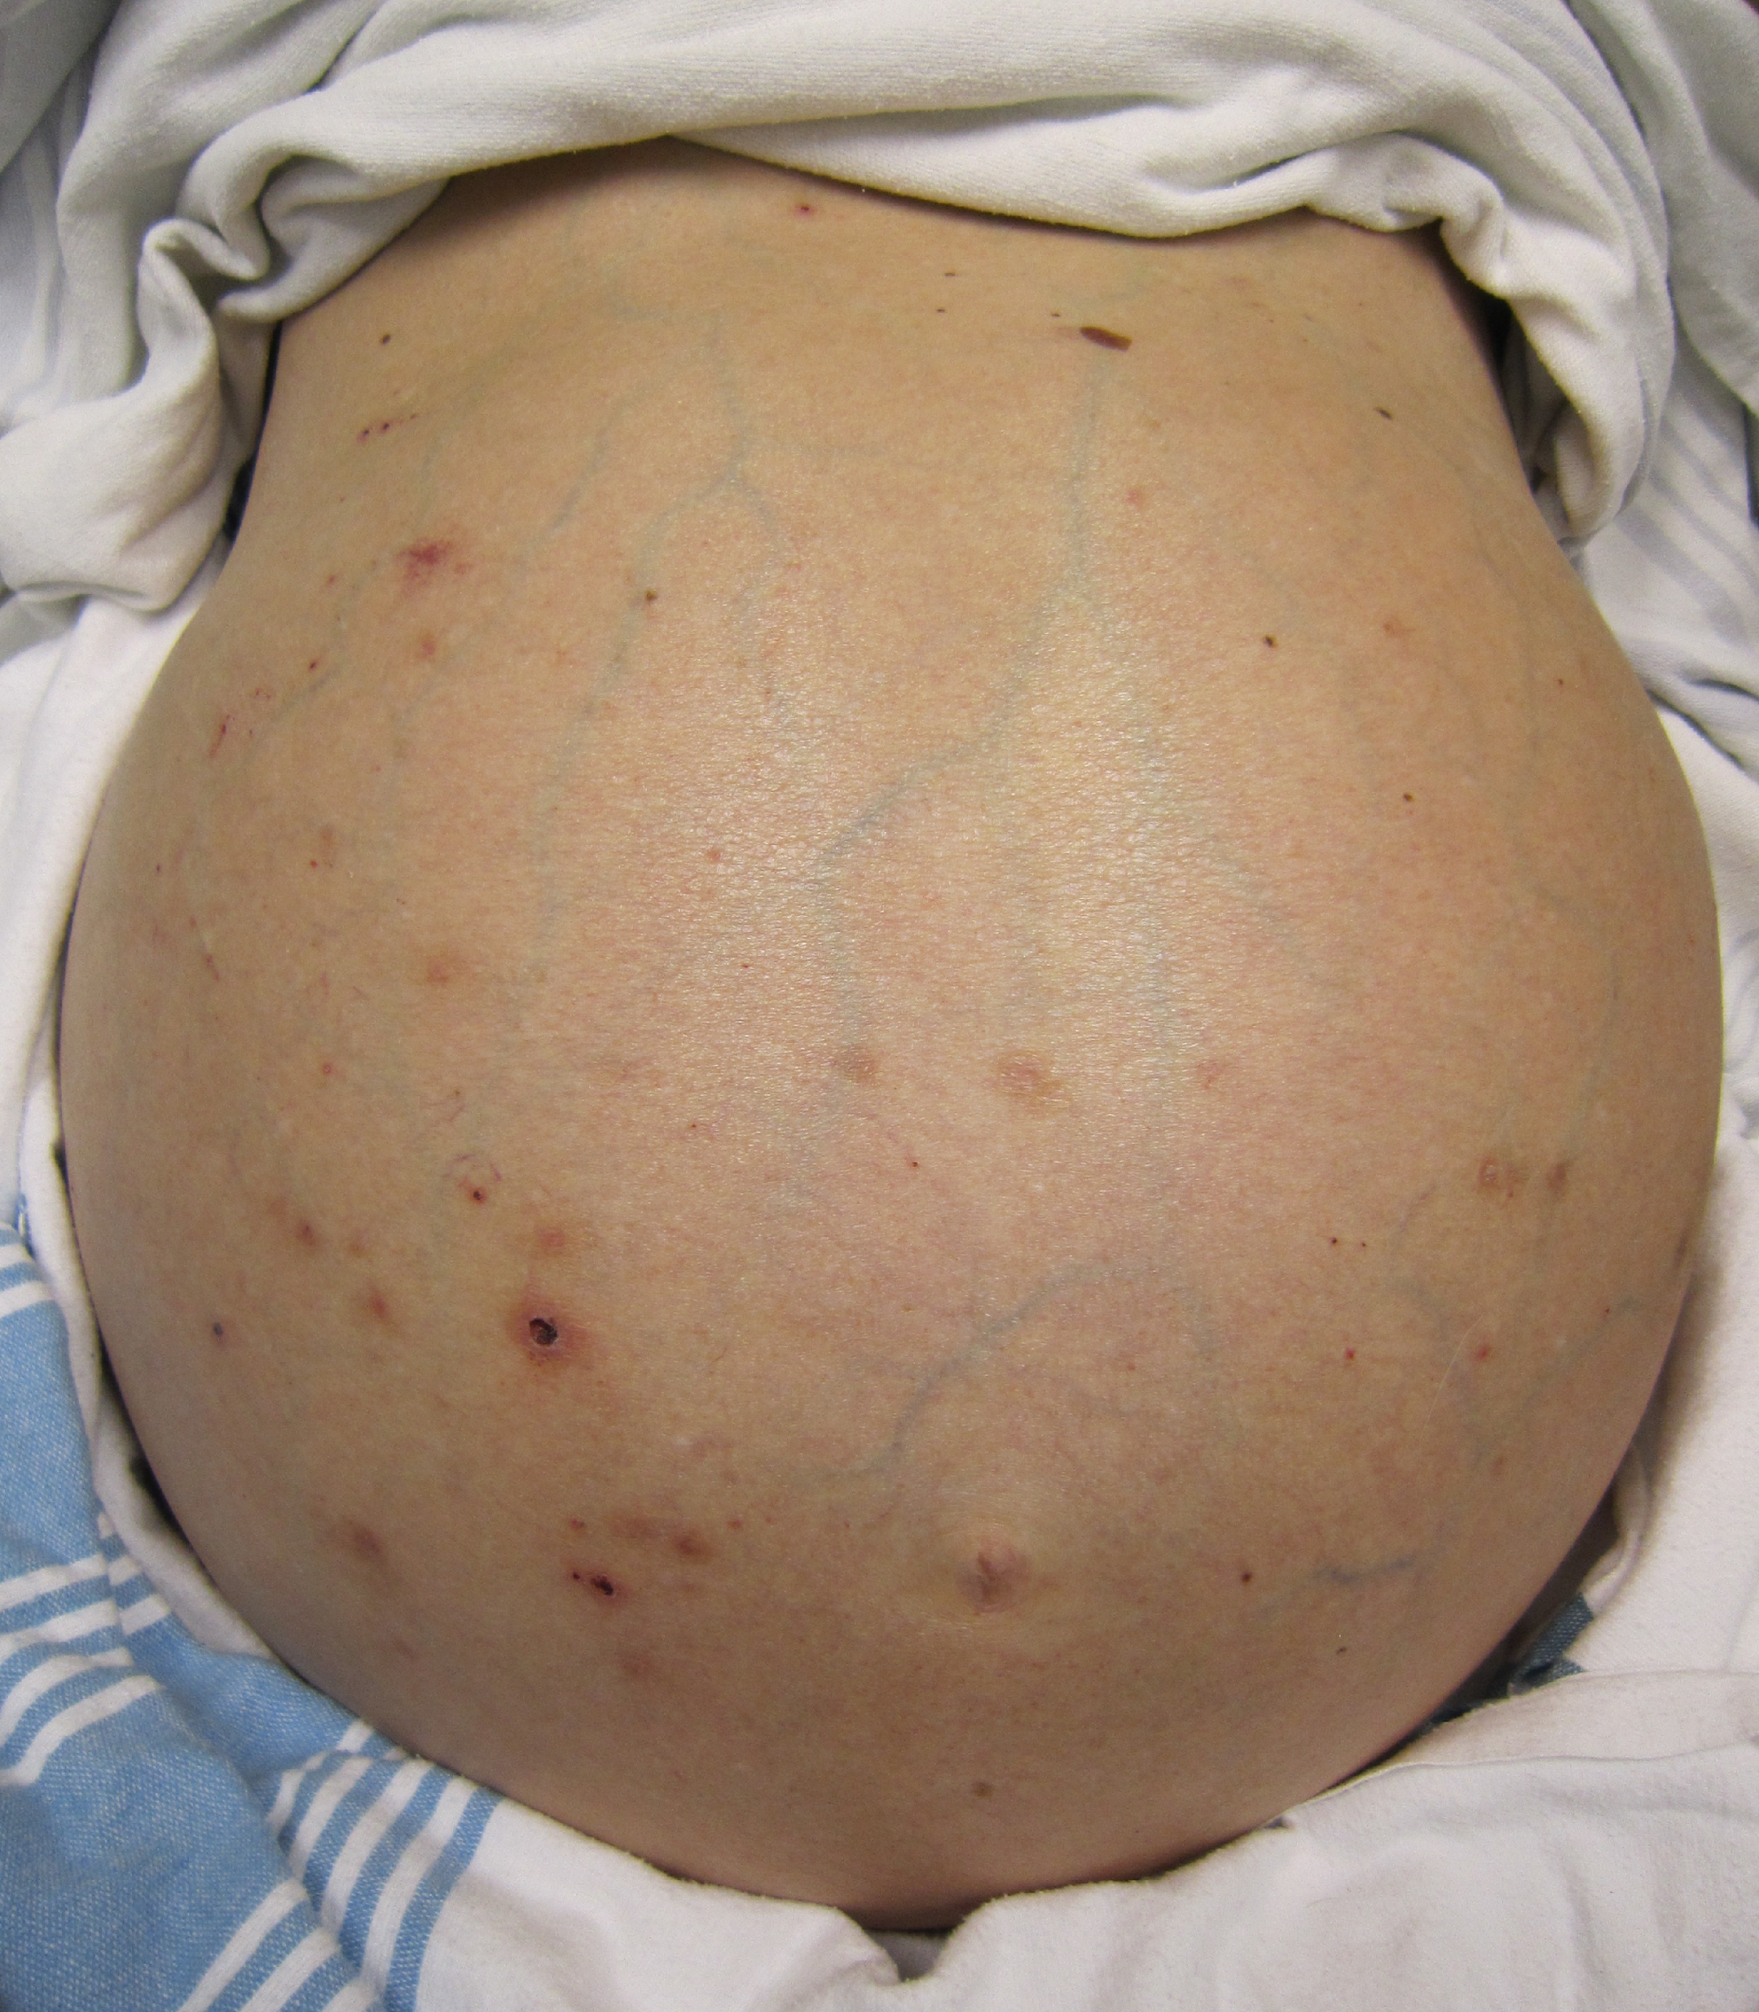
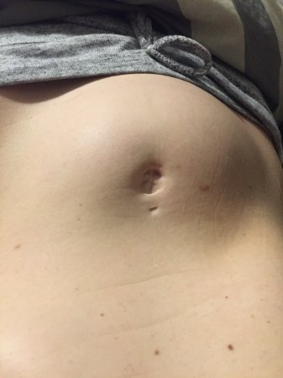
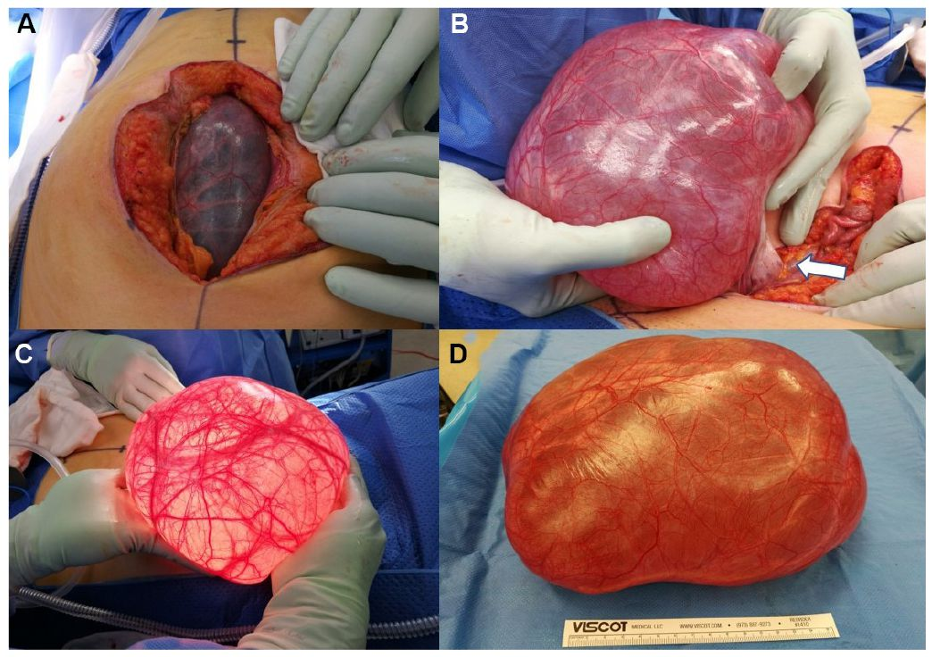

Slide 39
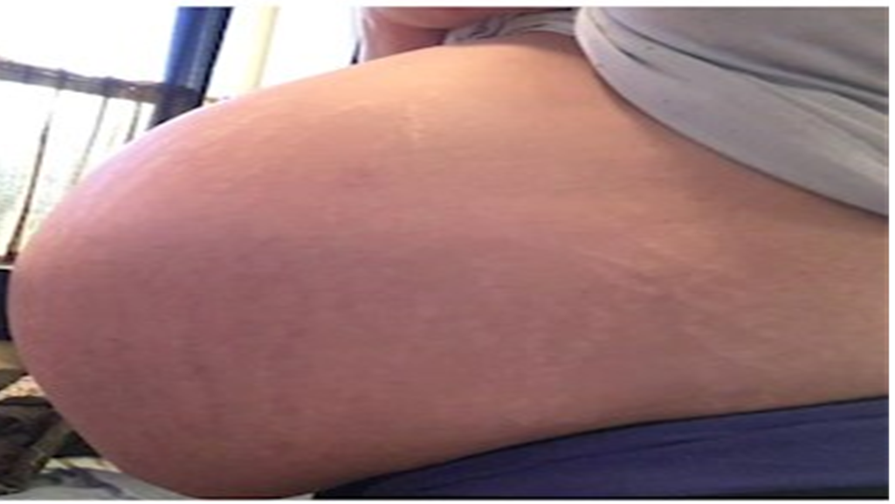
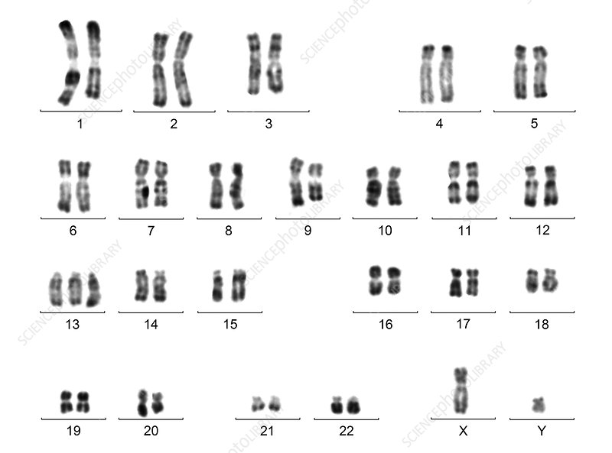
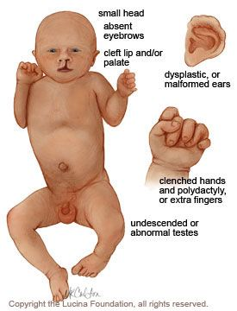
Clinical scenario
A 37 year multigravida presented at 25 weeks gestation with difficulty in breathing for last two weeks, more so in the recumbent position. She was referred with polyhydramnios (Amniotic fluid index 27cms) and moderate anaemia (Hemoglobin 8.3gm%). She was a G3P1L1A1, married since 7 years. First baby delivered by Caesarean section at term in view of cephalopelvic disproportion, 6 years back, alive and healthy. She was not a known case of cardiac or renal disease, nor had any history of substance abuse. Her blood group was A Rh-positive. An anomalyscan done at 20 weeks of gestation at the referring hospital did not reveal any major congenital anomalies or abnormalities of the placenta or cord. The values of a 75 gram 2 hour oral glucose tolerance test performed at 24 weeks of gestation were within normal limits. Since she was in considerable respiratory distress, hence therapeutic and diagnostic amniocentesis was done. The fluid was sent for FISH and karyotyping where an anomaly was found ? TORCH screening was negative .

Slide 40
Antepartum fetal monitoring
Mild to Moderate Polyhydramnios:
(NST) and (BPP) upon diagnosis
every 1 to 2 weeks until 37 weeks
weekly from 37 weeks to delivery
Severe Polyhydramnios:
NST and BPP every week until delivery

Slide 41
Complications:
General abdominal discomfort and slight dyspnoe (in mild cases)
Marked respiratory distress and severe abdominal symptoms (moderate to severe)
Preterm rupture of membranes and preterm labour
Placental abruption and cord prolapse
Maternal haemorrhage secondary to uterine atony
Fetal malposition & malpresentaion
Cesarean delivery & NICU Perinatal mortality

Slide 42
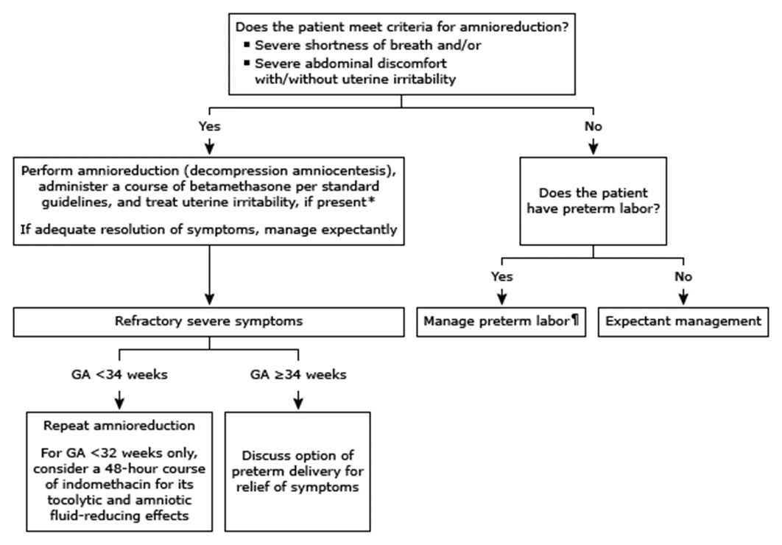
Management

Slide 43
Management
Expectant
Amnioreduction
Indomethacin
if asymptomatic: bed rest with serial US

Slide 44
Amnioreduction
only if polyhydramnios is both severe and symptomatic (associated with significant maternal discomfort or preterm labor) for intentional reduction of amniotic fluid volume.
The procedure is terminated when: the AFI is normalized (generally 15 to 20 cm) when intraamniotic pressure is less than 20 mmHg.
Risk factor:
PPROM
Infection
placental abruption
membranous detachment
re-accumulation may develop rapidly and serial re-treatments may be indicated up to every 2–3 days
Notes:
PPROM Preterm premature rupture of the membranes

Slide 45
Indomethacin
At less than 32 weeks to reduce maternal symptoms and prolong gestation.
Mode of action: PG synthetase inhibitor and it also reduces fetal urine production and subsequent AFV more widely recognized for its role as a tocolytic in the prevention of preterm labor.
The dose: according to total AF (ranging from 50 mg/day to 200 mg/day)
Since there is a potential delay in treatment onset (4–20 days), therapy is often commenced after an initial amino-reduction, but subsequently avoids the need for serial invasive procedures.
Treatment should be used with caution and once AFV has returned to the upper range of normal, treatment is to be stopped immediately
The main fetal risks of treatment include:
premature closure of the ductus arteriosus
intraventricular haemorrhage
renal failure

Slide 46
Management of Labor
Check Fetal Position
During labor, the fetal position is checked frequently to confirm vertex presentation as the excess amniotic fluid allows greater fetal mobility. Conversion to a breech, compound, or transverse presentation may occur.
Spontaneous rupture of membranes can cause sudden severe uterine decompression with risk of cord prolapse or abruption.
So What to do?
Gradual abdominal or trans cervical amnioreduction with a needle may prevent these complications during labor Fetal Heart Rate monitored continuously due to increased risk of abnormalities.
What about IOL? No absolute contraindication to use of oxytocin or prostaglandins
These agents should be used with Caution: marked increase in the incidence of postpartum hemorrhage related to atony in patients with polyhydramnios
Laser ablation of placental vessels may be effective in cases of twin-to-twin transfusion syndrome, performed at highly specialized centers.

Slide 48
Oligohydramnios

Slide 49
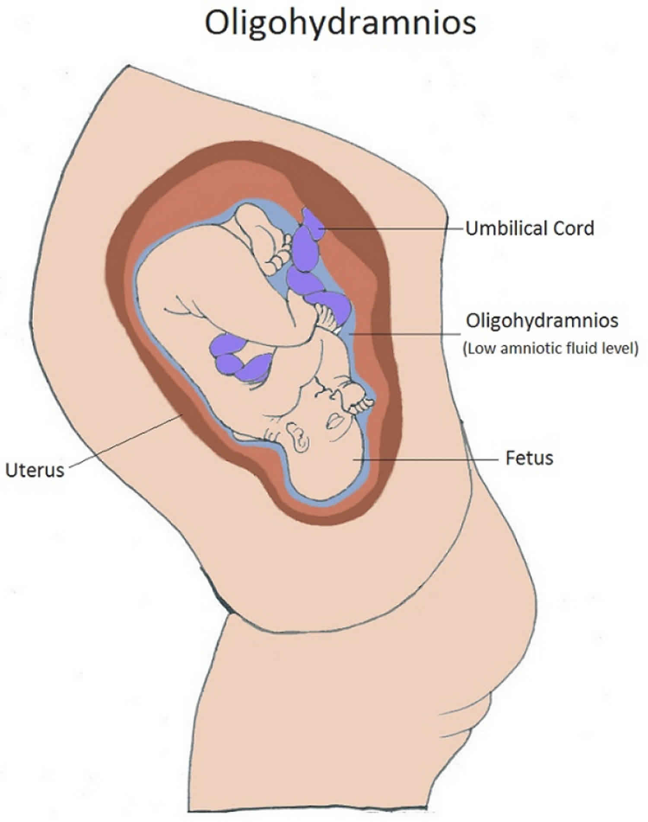
Oligohydramnios
“Too little amniotic fluid”
As amniotic fluid index (AFI) less than the 5th centile for gestation or single deepest pocket less than 2 cm.
NOTE :-
The AFI is an ultrasound estimation of amniotic fluid derived by adding together the deepest vertical pool in four quadrants of the abdomen.
The AFI (in cm) is therefore associated with some degree of error. In general, however, it is possible to differentiate
subjectively on ultrasound between ‘too much’, ‘too little’ and ‘normal looking

Slide 50
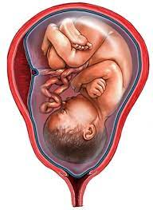
INCIDENCE
0.5 – 5%

Slide 51
AETIOLOGY
PREGNANCY
COMPLICATION
PPROM (common cause )
SROM
POSTTERM PREGNANCY (>42W)
FETAL
IUGR
TTTS
RENAL AGENESIS
URETHRAL OBESTRACTION
DRUGS
Indomethacin
ACE INHIBITORS
IDIOPATHIC
MATERNAL
HTN (PET)
CHRONIC KIDNEY DISEASE
MATERNAL DEHYDRATION

Slide 53
PPROM
(Preterm Prelabor Rupture Of Membranes):
Breaking of the amniotic sac before the onset of labor, and is called “premature” if rupture is before 37w of pregnancy. It could be spontaneous or iatrogenic and is associated with an inflammatory reaction and/or an infection.
risk factors include: prior PPROM or PTL of any cause, bleeding in any trimester, genital tract infection, collagen disease, tobacco exposure.
complications: infection (chorioamnionitis), placental abruption, retained placenta, prolonged maternal hospitalisation, early onset neonatal sepsis, higher neonatal morbidity and mortality.
Management: 1) screening for infection (GBS)
2)antenatal corticosteroids
3)tocolysis
4)antibiotics (penicillin + macrolide/azithromycin)
5)fetal monitoring NST, AFV, fetal growth
6)maternal monitoring
7)timing of delivery (depending on NICU capability)
8)SURGICAL TREATMENT: amniograft, amniotic patch (1/2unit of platelets + 1unit of cryoprecipitate)

Slide 54
Multiple pregnancies ( Twin-to-Twin Transfusion Syndrome)
blood is continuously shunted from on twin to the other through vascular anastomoses on the shared placenta, posing a risk to both fetuses:
Recipient twin: 1)polycythemia
2)hypervolemia
3)polyhydromnios in diamniotic pregnancies
Donor twin: 1)anemia
2)growth retardation
3)hypovolemia, dehydration (stuck twin or cocooned appearance)
4)oligohydromnios in diamniotic pregnancies

Slide 55
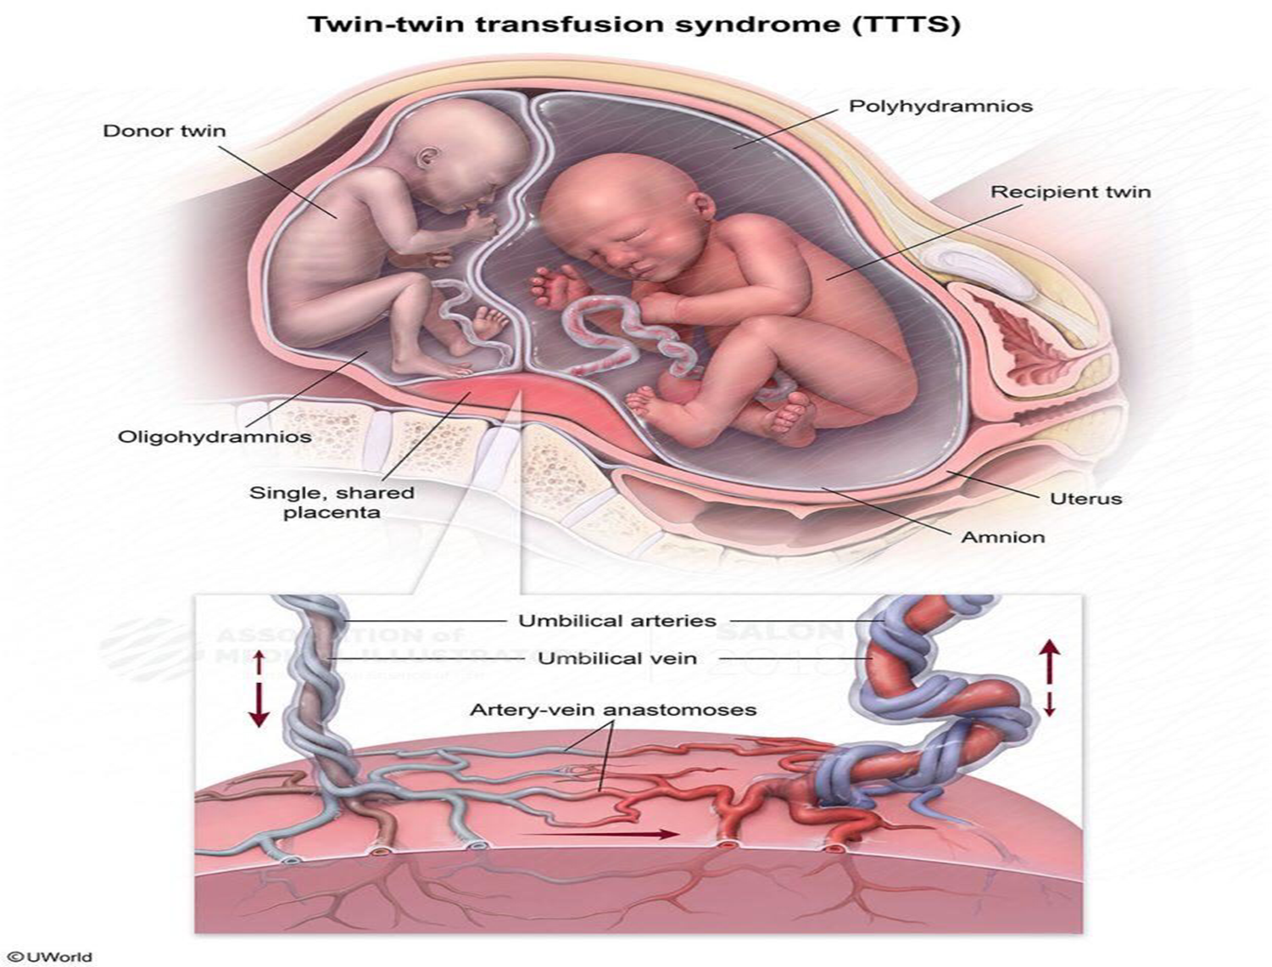

Slide 56
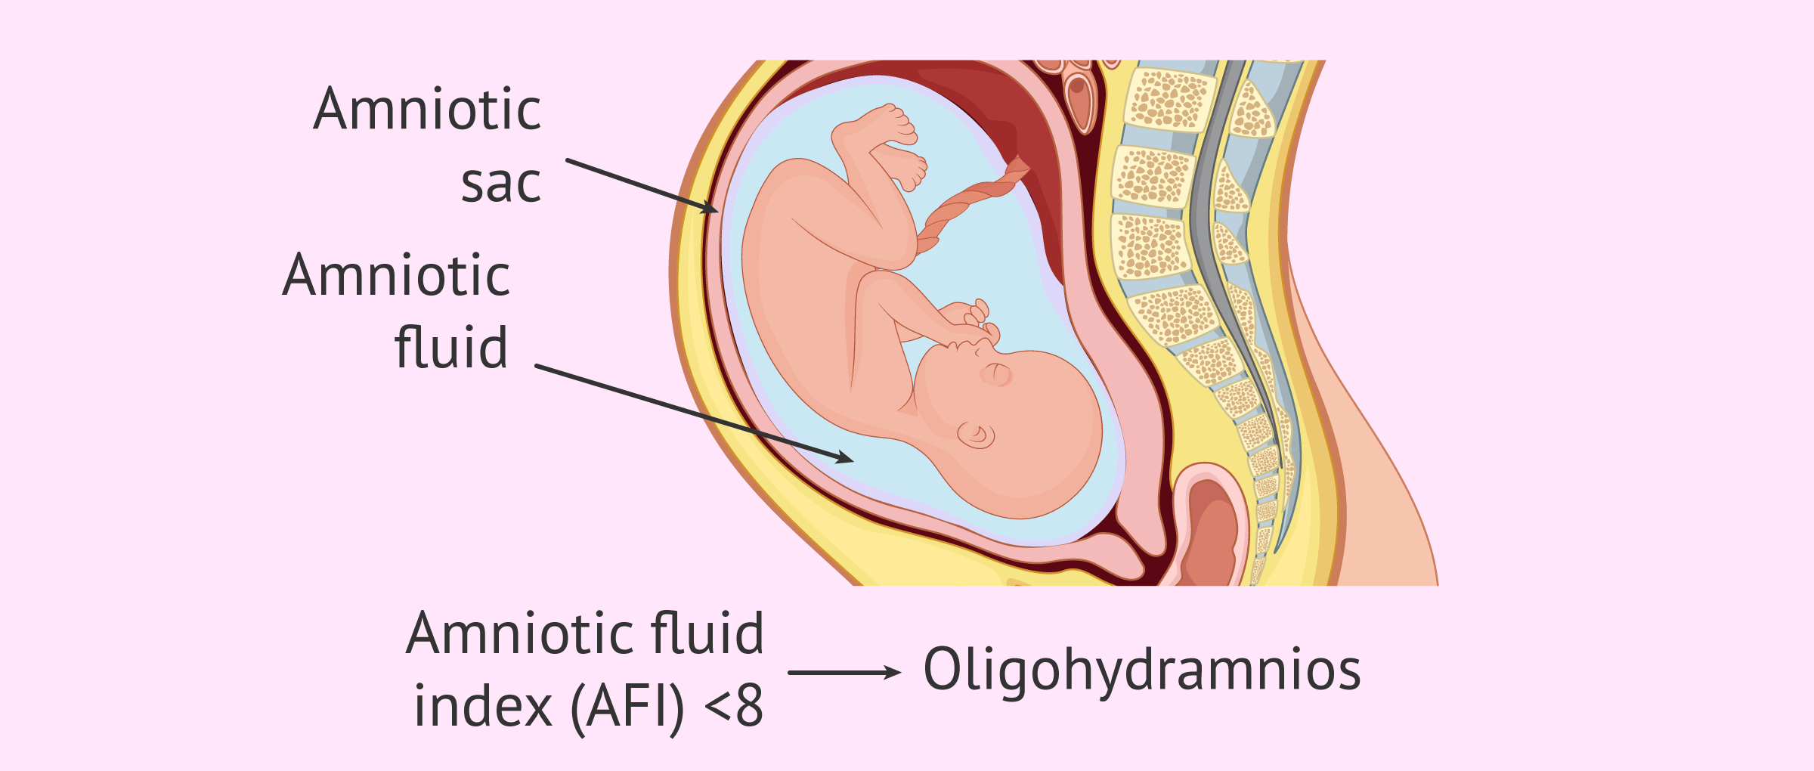
SIGNS AND SYMPTOMS
*NO SPECIFIC SYMPTOMS
*leaking
*Less fetal movements
*Uterus – small for date
*Malpresentations
*IUGR

Slide 59
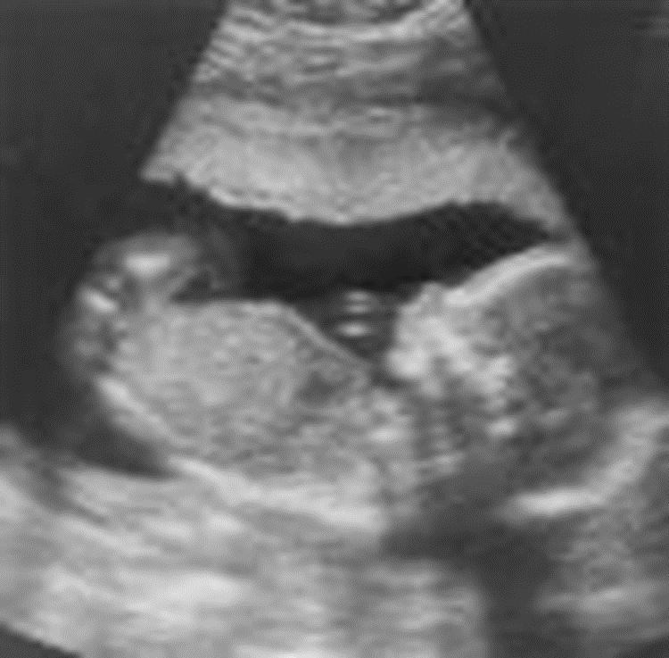
USG
METHODS
MVP <2 cms
(<1 severe)
AFI <5 cms
(5-8 borderline)

Slide 61
COMPLICATIONS
FETAL
Abortion
Prematurity
IUFD
Deformities –clubfoot
Malpresentations
Fetal stress (MSAF – MAS)
MATERNAL
*Increased morbidity
*Prolonged labour: uterine inertia
*Increased operative intervention

Slide 62
MANAGEMENT
DEPENDS UPON
AETIOLOGY
GESTATIONAL AGE
SEVERITY
FETAL STATUS & WELL BEING

Slide 63
DETERMINE AETIOLOGY
R/O PROM
USG FOR ANOMALIES
R/O IUGR ,IUFD when suspected
Amniocentesis if chromosomal anomalies suspected

Slide 64
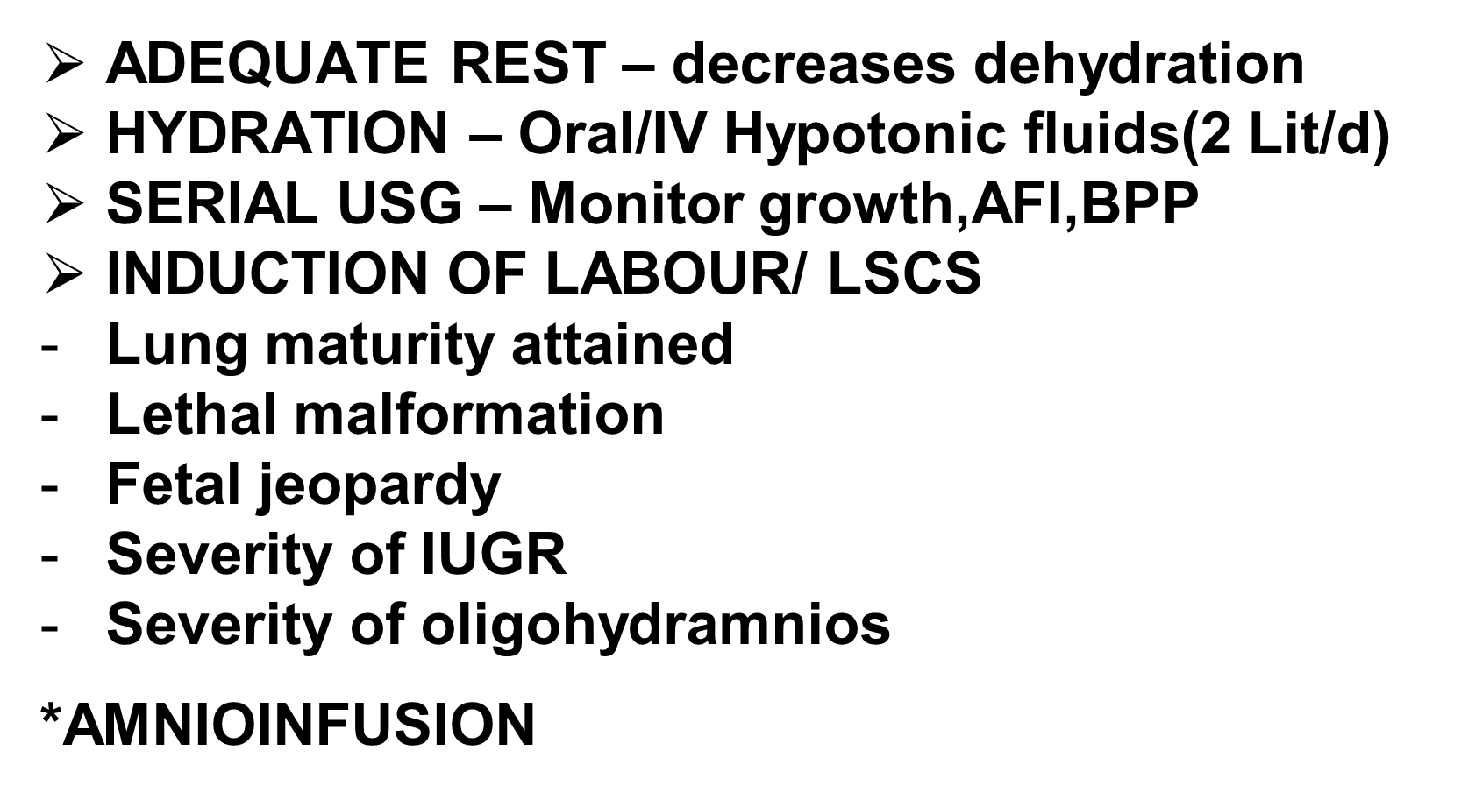
TREATMENT

Slide 65
TREATMENT ACCORDING TO CAUSE :
Drug induced – STOP IT
PPROM – INDUCTION
PPROM – Antibiotics, steroid – Induction
FETAL SURGERY
VESICO AMNIOTIC SHUNT
Laser photocoagulation for TTTS

Slide 68
Key Points *Oligohydramnios is a decrease in the volume of amniotic fluid, with the diagnosis usually being made using ultrasound. *Causes of oligohydramnios include ruptured membranes, placental insufficiency, fetal anomalies, maternal ingestion of medications, chromosomal abnormalities, and idiopathic. *Significant oligohydramnios occurring prior to 22 weeks of gestation is associated with a poor prognosis because of a high likelihood of pulmonary hypoplasia and associated malformations. *Once oligohydramnios is diagnosed, a careful maternal history should be obtained and a physical examination should be performed to evaluate for preterm premature rupture of membranes. *Whenever a diagnosis of oligohydramnios is made > U/S to evaluate for fetal anomalies such as features of urinary tract obstruction or renal malformation. *Management of oligohydramnios depends on the gestational age and on the fetal and maternal status.

Slide 69
Thank you !

