Slide 1
Approach to chronic pelvic pain
Presented by :
Layla abutair
Lina alhasan
Mohammed Hashim Salameh

Slide 2
TABLE OF CONTENTS
01
03
02
04
Definition
Evaluation
Causes
Treatment

Slide 3
Chronic Pelvic Pain
CPP refers to pelvic pain of more than 6 months’ duration that has a significant effect on daily function and quality of life.
CPP includes reproductive and non reproductive organ–related pain. Although CPP is an enigmatic disorder, it is one of the most common presenting complaints in a gynecologic practice. As a public health problem, it results in great cost to society in terms of hospital services, loss of productivity, and human misery.

Slide 4
Causes

Slide 5
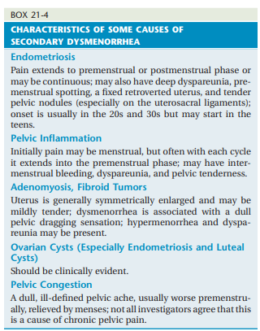

Slide 6
Endometriosis
Endometriosis may be missed visually at the time of diagnostic laparoscopy in as many as 20-30% of women who have histologically proven disease, so it is justifiable to initiate hormonal treatment based on a presumptive diagnosis of the disease once other etiologies have been ruled out. Current hormonal therapies are often very effective and may preclude the need to undergo a costly surgical procedure that is not without risk. The size and location of the endometriosis implants do not appear to correlate with the presence of pain, and the reasons for the pain are not fully understood, although prostaglandins, cytokines, and innervation of lesions have been hypothesized.

Slide 7
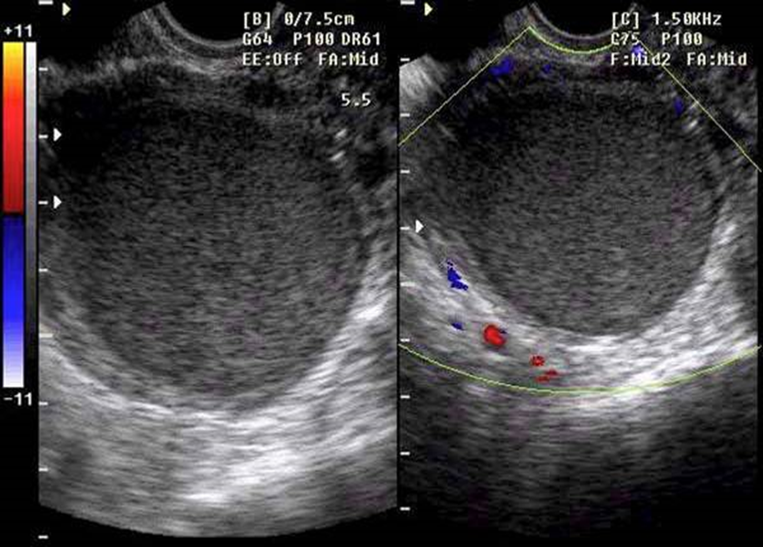
Ultrasound:
Sensitivity for focal endometrial implants is poor , very good for diagnosing Endometrioses “chocolate cyst” >> (appearance of turbid fluid)

Slide 8
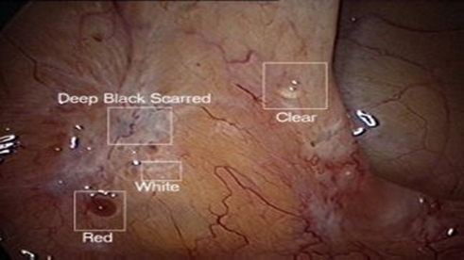
Laparoscopy:
•Puckered black lesions
•White scarring
•Red polyps
•Clear blebs

Slide 9
Chronic Pelvic Inflammatory Disease
Chronic PID may cause pain because of anatomic distortions (hydro salpinges and adhesions between the tubes, ovaries, and intestinal structures) that result from the acute infection. It is also thought that prior PID may lead to “upregulation” of sensory processing from the previously inflamed tissue. Persistent active infection is called acute PID, even if fever and peritoneal signs are absent. Recurrent active infections that require antibiotic therapy must be ruled out.

Slide 10
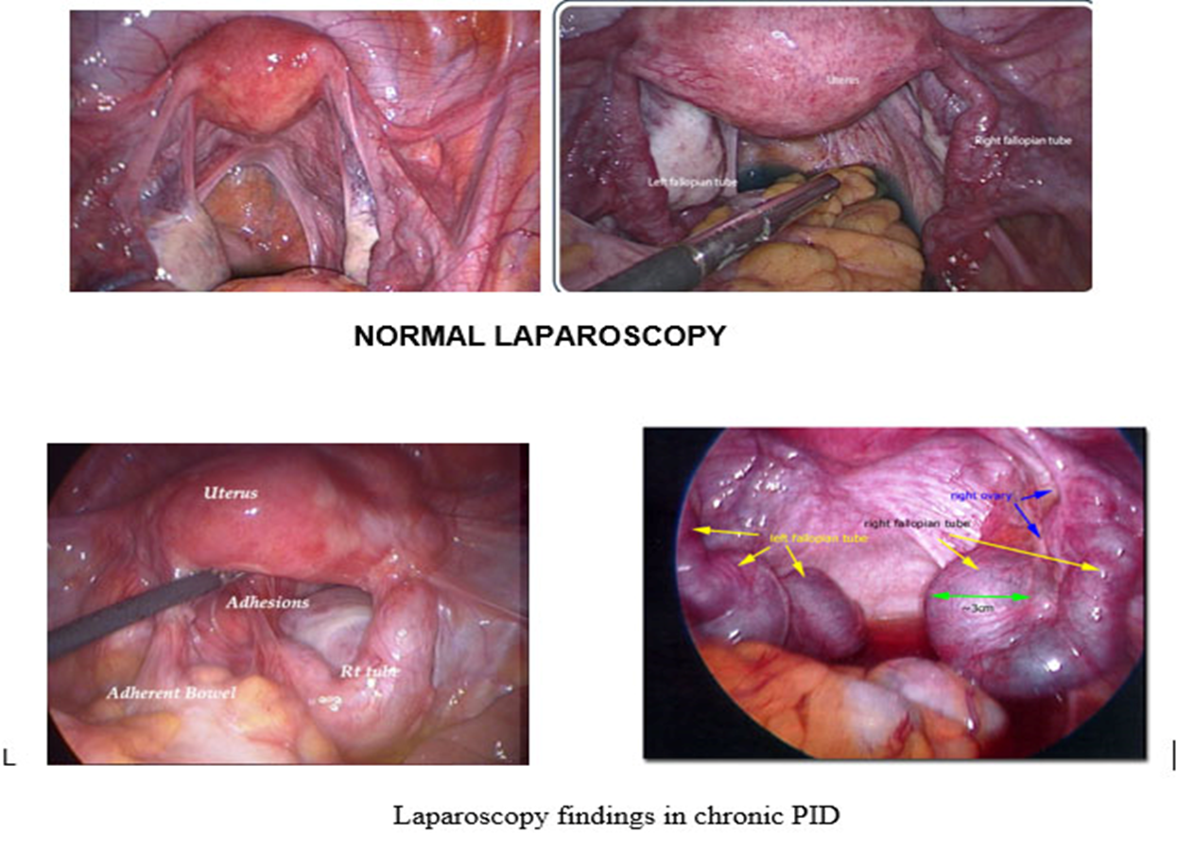

Slide 11
Ovarian Pain
Ovarian cysts are usually asymptomatic, but episodic pain may occur secondary to rapid distention of the ovarian capsule or rupture or leakage of irritating fluid into the peritoneal cavity. An ovary or an ovarian remnant may occasionally become retroperitoneal secondary to inflammation or previous surgery, and cyst formation in these circumstances may be painful. Some women, for unknown reasons, may develop multiple recurrent functional hemorrhagic ovarian cysts that seem to cause pelvic pain and dyspareunia on an intermittent basis. Hormonal suppression of ovulation is usually an effective treatment for painful functional cysts.

Slide 12
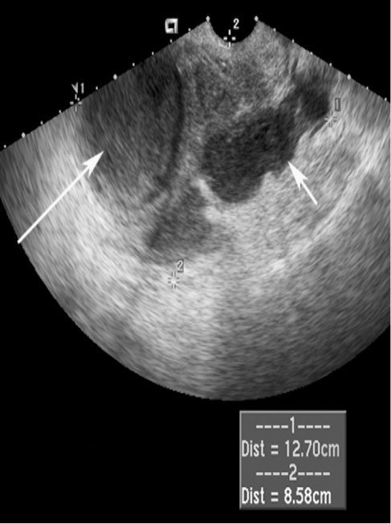
Tubo-ovarian abscess Ovarian abscess : Thick wall , heterogeneous , unilocular , Fluid in peritoneal cavity

Slide 13
Uterine Pain
Adenomyosis can cause dysmenorrhea, dyspareunia, and menorrhagia, but rarely does it cause chronic daily intermenstrual pain. Uterine myomas usually do not cause pelvic pain unless they are degenerating, undergoing torsion or compressing pelvic nerves. A completely sub mucous leiomyoma can attempt to deliver via the cervix, which may cause considerable campy uterine pain This is generally associated with heavy vaginal bleeding. During pregnancy, uterine myomas can cause pain from rapid growth or infarction .Pelvic pain is not likely to be caused by variations in uterine position, but deep dyspareunia may occasionally be associated with uterine retroversion, especially when the uterus is fixed in place by adhesions or endometriosis. tender uterus that is in a fixed retroverted position usually signifies other intraperitoneal pathology, such as endometriosis or PID, and diagnosis rests on laparoscopic findings

Slide 14
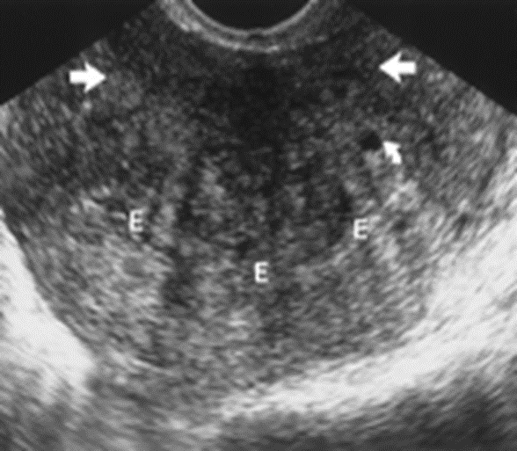
TVUS :
ill defined hypoechoic areas
indistinct endometrial-myometrial border
increases myometrial thickness
decreased uterine echogenicity
preoperative differential diagnosis of adenomyoma versus leiomyoma .

Slide 15
Pelvic Congestion Syndrome
The concept of a pelvic congestion syndrome still has many proponents. This entity has been described in multiparous women who have pelvic vein varicosities and congested pelvic organs. The pelvic pain is worse pre menstrually and is increased by fatigue, standing, and sexual intercourse. Many women with this condition are noted to have a mobile ,retroverted, soft, boggy ,and slightly enlarged uterus. There may be associated menorrhagia and urinary frequency. Dilated veins may be seen on pelvic MRI with contrast. Factors other than venous congestion may be involved in the genesis of pain, because most women with pelvic varicosities have no pain. Surgery for this condition, consisting of hysterectomy and oophorectomy, may be beneficial for women who have completed their families, as is ovarian hormonal suppression (decreased blood flow to the pelvic organs) and cognitive behavioral therapy.

Slide 16
Evaluation

Slide 17
HISTORY A pain history should be obtained during the first visit. Characteristics of the pain should be determined, including its location, radiation, severity, alleviating and aggravating factors, as well as the effects of menstruation, level of stress, work, exercise, and intercourse. Symptoms related to the gastrointestinal, genitourinary, musculoskeletal, and neurologic systems should be ascertained.

Slide 18
PAIN HISTORY MNEMONIC (OLD CAARTS)
Onset: When and how did the pain start? Does it change over time?
Location: Localize specifically—can the woman put a finger on it?
Duration: How long does it last?
Characteristics: e.g., cramping, aching, stabbing, itching
Alleviating/aggravating factors: What makes it better (e.g., change of position, medication, stress reduction) or worse (e.g., menstrual cycle, stress, specific activity)?
,

Slide 19
Associated symptoms:
Gynecologic (e.g., dyspareunia, dysmenorrhea, abnor-mal bleeding, discharge)
Gastrointestinal (e.g., constipation, diarrhea, bloating, gas, rectal bleeding)
Genitourinary (e.g., urinary frequency, dysuria, urgency, incontinence)
Neurological (specific nerve distribution of the pain)
Radiation: Does the pain move to other areas of the body?
Temporal: Time of day and relationship to daily activities
Severity: On a scale of 0 to 10 (from no pain to the most severe imaginable)

Slide 20
PHYSICAL EXAMINATION
The abdomen should be examined initially, and the patient should be asked to point to the exact location of the pain and its radiation. An attempt should be made to duplicate the pain by palpating each abdominal quadrant

Slide 21
The patient should be asked to tense the abdominal muscles by performing a straight-leg raising maneuver. Points that are more tender or that reproduce the patient’s pain suggest nerve entrapment, impingement, or a muscular trigger point pain. These points should be injected with 2 to 3 mL of 0.25% bupivacaine. Chronic abdominal wall pain is confirmed if the pain level is reduced by at least 50% and out lasts the duration of the local anesthetic.
A thorough pelvic examination should be performed, with an attempt made to reproduce and localize the patient’s pain. The examination should be performed gently so as to prevent involuntary guarding, which may obstruct the findings. The examination may be suggestive of specific pelvic pathology. For example, patients with endometriosis may have a fixed retroverted uterus with tender uterosacral nodularity.
An adnexal mass may suggest ovarian pathology. Bilateral, tender, irregularly enlarged adnexal structures
may suggest prior salpingitis with subsequent formation of adhesions and bilateral hydro salpinges. A prolapsed uterus may account for pelvic pressure, pain, or low backache

Slide 22
Investigations
CBC ESR urinalysis pelvic us If bowel or urinary symptoms are present, an abdominal and pelvic (CT) scan, endoscopy, cystoscopy, or CT urogram may be useful. Similarly, if there is clinical evidence of musculoskeletal disease, a lumbosacral x-ray film, CT scan, magnetic resonance imaging (MRI) scan, or orthopedic consultation may be in order. Diagnostic laparoscopy is the ultimate method of diagnosis for patients with CPP of undetermined etiology

Slide 23
Cervical culture for CHLAMYDIA OR GONORRHEA Blood culture may be positive for gram-negative bacteria and anaerobic organisms. Culdocentesis may yield pus. WBC and ESR are markedly elevated . Sonography or CT will show bilateral complex pelvic masses.

Slide 24
Management

Slide 25
THE MULTIDISCIPLINARY TEAM
In approximately one-third of CPP patients, no etiology is found ,If a specific diagnosis is made, treat according to the condition. otherwise do as follows
.The most productive strategy for the management of patients with CPP is a multidisciplinary approach.
The personnel should include a gynecologist, a psychologist who also has expertise in chronic pain, sexual and marital counseling, a physical therapist with pelvic floor muscle expertise, and for more complex cases requiring diagnostic or therapeutic nerve blocks, an anesthesiologist.
It is the role of the psychologist to provide cognitive behavioral pain management and stress reduction, assertiveness training, and adaptive coping strategies, as well as marital and sexual counseling.

Slide 26
THE MULTIDISCIPLINARY TEAM
Psychiatric referral for psychopharmacologic therapy may be needed. This aspect of therapy is crucial, because many of these patients have become severely depressed and often withdrawn interpersonally, sexually, and occupationally.
Depression may be secondary to pain, but without treatment of the depression, the pain may persist. Relaxation, cognitive and behavioral therapies are employed to replace the pain behavior and its secondary gain with effective behavioral responses.
Multidisciplinary management has been shown to be more effective than traditional gynecologic management.

Slide 27
MEDICAL AND SURGICAL MANAGEMENT MEDICAL
In the initial stages of therapy, a trial of ovulation and or menstrual suppression with combined hormonal contraception (pills, patches, rings; cyclic or continuous), high-dose or intrauterine progestins or a gonadotropin-releasing hormone analogue (GnRHa-) may be helpful. They are especially helpful in patients who have midcycle, premenstrual, or menstrual exacerbation of pain, or in those who have ovarian pathology, such as periovarian adhesions or recurrent functional cyst formation.
Treating the pain: acetaminophen, acetylsalicylic acid, and nonsteroidal anti-inflammatory drugs, are considered first-line therapy for pain relief in treatment of CPP .
Pharmacologic approaches to increase inhibitory neuromodulators such as norepinephrine, serotonin (5-HT), and GABA or sodium channel blockers are frequently used in the form of tricyclic antidepressants (Amitriptyline) , selective serotonin reuptake inhibitors (fluoxetine), anticonvulsants (gabapentin)
Women with IBS should be offered a trial with antispasmodics and encouraged to amend their diet to attempt to control symptoms. smooth-muscle relaxants such as mebeverine hydrochloride are beneficial in the treatment of IBS where abdominal pain is a prominent feature
Notes:
There is a growing trend to treat CPP with GnRH agonists without doing a laparoscopy first.
The theory is that any pelvic condition that varies with menstrual cycles will respond to suppression of the hypothalamic-pituitary-gonadal axis. Conditions that have been shown to respond include endometriosis, IC, IBS, pelvic congestion syn- drome, ovarian retention syndrome, and ovarian rem- nant syndrome.

Slide 28
MEDICAL AND SURGICAL MANAGEMENT SURGICAL
When to operate for suspected pelvic pathology ?
conditions that may be responsive to surgery ,Examples of such causes may include
severe deep infiltrating endometriosis
a reversible process iatrogenically caused by a prior procedure (such as pain following IUD placement, vaginal mesh procedures for urogenital prolapse, or loop electrosurgical excisional therapy)
focal pain that is reproduced with palpation of a leiomyoma, chronic adnexal pathology
stable longstanding uterine pain disorder, including refractory dysmenorrhea.

Slide 29
MEDICAL AND SURGICAL MANAGEMENT SURGICAL
Surgical procedures that have not proved to be effective for CPP without pathology include unilateral adnexectomy for unilateral pain or total abdominal hysterectomy, presacral neurectomy, or uterine suspension for generalized pelvic pain.
Lysis of adhesions is only effective in situations where the site of adhesions, as visualized by the laparoscope, specifically coincides with the localization of pain. However, pelvic adhesions often recur following surgical lysis.
Without proof of organic pathology or a reasonable functional explanation for the pelvic pain, a thorough psycho-somatic evaluation should be carried out before any surgical procedure is considered.
Hysterectomy is typically reserved for intractable pain and is more effective when a bilateral oophorectomy is done. Also, hysterectomy is indicated in some cases of pelvic congestion syndrome.
Notes:
Pelvic congestion syndrome : It's thought to be caused by problems with the veins in the pelvic area
hysterectomy and oophorectomy, may be beneficial for women who have completed their families, as is ovarian hormonal suppression (decreased blood flow to the pelvic organs) and cognitive behavioral therapy. A few uncontrolled studies have suggested that embolization of involved veins by an interventional radiologist may be helpful.

Slide 30
INJECTION THERAPIES
Trigger point injections: These injections are used mostly for localized trigger points (myofascial pain or neuroma).
Peripheral nerve blocks: Specific peripheral nerve block with local anesthetic and steroids may be helpful in selected cases. (nerve impingement/entrapment)
Less studied targeted treatments —There is some evidence supporting the use of vaginal anxiolytics and botulinum toxins for pelvic floor pain syndromes
some studies demonestrated the effectivness of Acupuncture

Slide 31
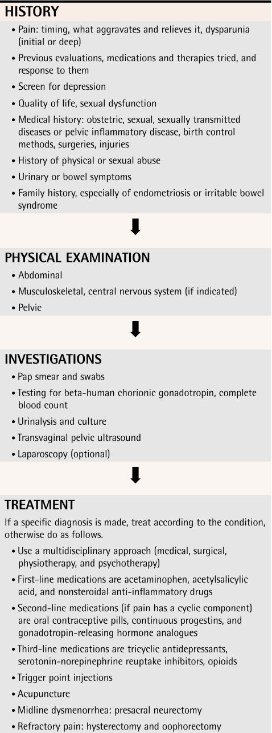

Slide 32
Clinical case

Slide 33
History
A 29-year-old woman presents with lower abdominal pain for 4 years occurring with
her periods. She takes paracetamol and ibuprofen and goes to bed with a hot water bottle
for up to 2 days every month. For the last 18 months pain has also occurred in between
periods.
The pain is dull and constant across the lower abdomen. Her periods are regular and there
is no menorrhagia, intermenstrual or postcoital bleeding. There is no other significant
medical history.
She has been married for 2 years and has deep dyspareunia which makes her interrupt
intercourse. She does not use any contraception, as they are keen to start a family. She has
never been pregnant in the past.

Slide 34
Examination
There is generalized lower-abdominal tenderness, particularly in the suprapubic area but
no masses are palpable. Speculum examination is unremarkable. On bimanual palpation
the uterus is axial and fixed with cervical excitation. The pouch of Douglas is very tender
and contains a mass. The adnexae are both tender but no adnexal masses are palpable.

Slide 35
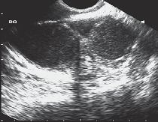
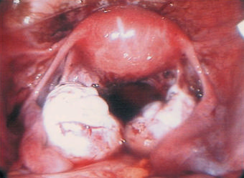
Investigations
Transvaginal ultrasound scan.
Findings at laparoscopy

Slide 36
The Qustions
1
2
What is the diagnosis?
How would you further manage this woman?

Slide 37
The history of dysmenorrhoea and dyspareunia are classic for endometriosis, and the
ultrasound examination and laparoscopy images show bilateral endometriomas (‘chocolate cysts’)
The mainstay of management for endometriosis is surgical
Medical suppression of endometriosis is possible with the contraceptive pill or gonadotrophin-releasing hormone analogues,

Slide 38
REFERENCES
THANK YOU FOR LISTENING 😁
hacker & moore's essentials of obstetrics and gynecology 6th edition
100 cases in obstetrics and gynaecology
Presented by :
Layla abutair
Lina alhasan
Mohammed Hashim Salameh

Slide 39
CREDITS
This is where you give credit to the ones who are part of this project.
Presentation template by Slidesgo
Icons by Flaticon
Infographics by Freepik
Images created by Freepik
Author introduction slide photo created by Freepik
Text & Image slide photo created by Freepik

