Slide 1
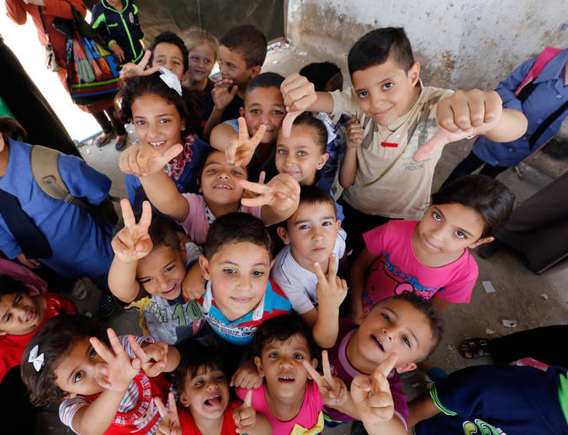
School Health
Dr. Israa Al-Rawashdeh MD, MPH ,PhD
Faculty of Medicine/Mutah University
2020

Slide 2
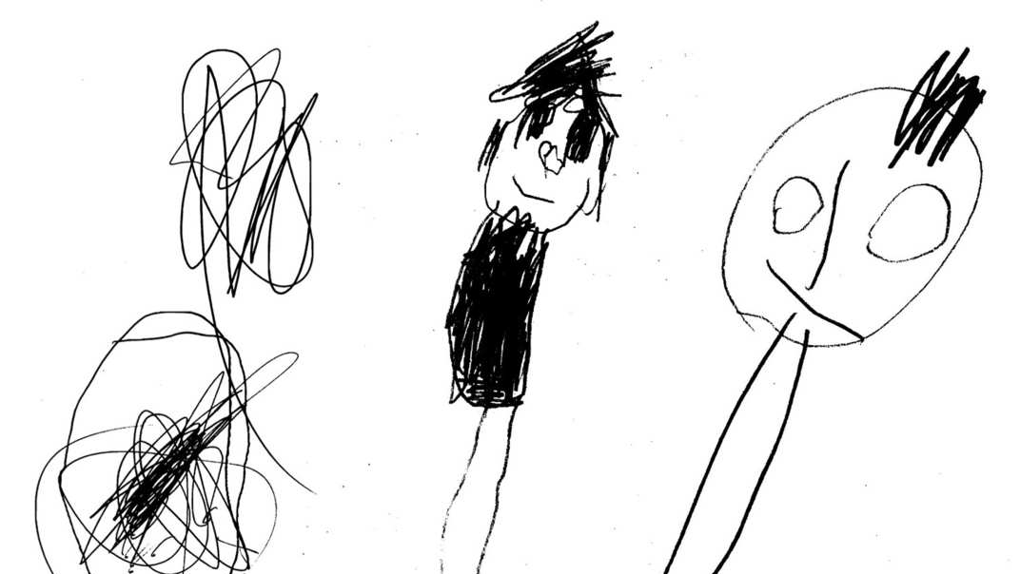
Preschool

Slide 3
Note for previous lecture:
Change to : from 3 to less than 6

Slide 4
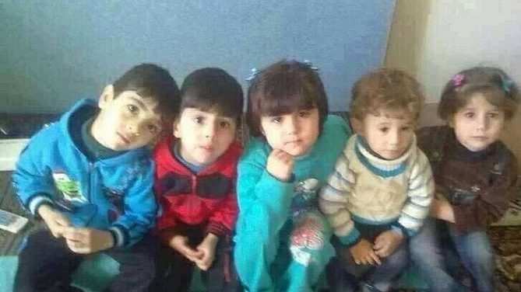
Preschool children are those aged from three to less than six years.
Characteristics of preschool period:
High morbidity and mortality.
Malnutrition
Injuries
Increased Growth and development

Slide 5
1) High morbidity and mortality
Morbidity: Infectious and parasitic diseases
o Communicable diseases: ARI, chicken pox, whooping cough, rubella
o Diarrheal diseases, enteric and hepatitis A.
o Skin diseases such as impetigo, scabies and fungal diseases.
o Parasitic infestations such as oxyuris vermicularis (pinworms) and ascaris.
High mortality (Remember indicators of children mortality and causes).

Slide 6
2) High prevalence of malnutrition
Malnutrition is prevalent among preschool children due to:
o Hyperactivity and lack of interest in food.
o Faulty feeding habits.
o High prevalence of infectious and parasitic diseases
o Protein energy malnutrition (mild, moderate and severe)
o Micronutrient deficiencies: iron deficiency anemia, vitamin A deficiency and iodine deficiency. Rickets

Slide 7
3) High incidence of injuries
Preschool children are more prone to injuries.
They are curious, energetic and eager to explore the environment.
Most injuries occur where children spend the most active portion of their day (home, nursery or playgrounds), Injuries such as:
➢ Falling downstairs causing head injuries or fractures.
➢ Household liquids Ingestion (kerosene, potash, insecticides).
➢ Ingestion of drugs.
➢ Burns or scalds. ➢ Electric shock.
Almost all injuries are preventable. Efforts to reduce preschool injury rate should focus on the promotion of safety of conditions and practices at:
1. homes, 2.kinder gardens 3. play grounds

Slide 8
4) Growth and development
Growth:
Children grow steadily during the preschool period.
Children become less chubby and more slender (adult body proportions) (U/L→1.0)
Muscle size increases
Bones becomes sturdier.
By age of six, boys are taller and heavier than girls (on average).

Slide 9
Development
Motor skills are usually more developed : children are very active at this period . gross (jump, climb stairs, swing, kicks), and fine (draw, prints name, use a small scissor).
Language use expands (use sentences )
Emotional development (control temper, show affection, distinguish feelings)
Children become aware of their bodies, their genital parts and differences between sexes.
Can control urine and bowel.
Egocentric thinking (less awareness of other perspectives), magical, illogical.

Slide 10
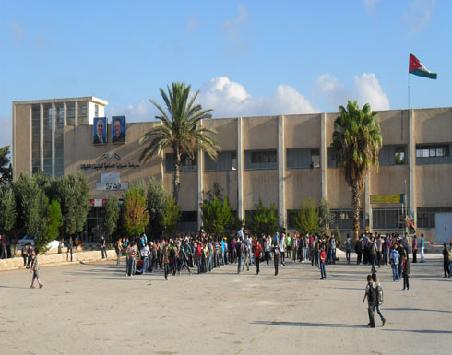
School
An educational institution where groups of pupils pursue defined studies at defined levels, receive instructions from one or more teachers, frequently interact with other officers and employees such as principal, various supervisors/ instructors, and maintenance staff etc., usually housed in a single building.

Slide 11
School health
Refers to a state of complete physical, mental, social and spiritual well being and not merely the absence of disease or Infirmity among pupils, teachers and other school personnel.
School-aged Health Services
Refers to providing need based comprehensive services to pupils to promote and protect their health, control diseases and maintain their health.

Slide 12
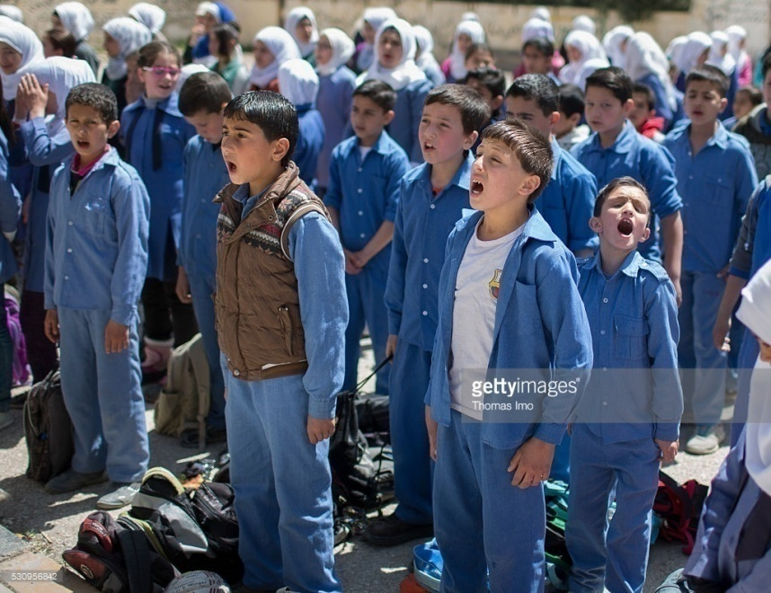
Why is school health an important component of community health?
School children constitute a substantial segment of population. In Jordan, ~20% of population are school-aged (2016).
School children→ vulnerable section of population (stresses of physical, mental, emotional and social growth and development during this period)
School children belong to different socio-economic and cultural backgrounds which affect their health and nutrition status→ require help in promoting, protecting and maintaining their health and nutritional status.

Slide 13
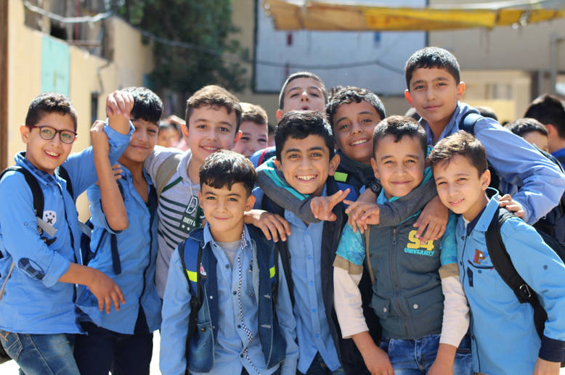
Why is school health an important component of community health?
4. School health services are the first and the most accessible point of contact with health services for many children.
5. Schools health services are cost-effective strategies→ ensure that every child is as healthy as possible to obtain the full benefit from his or her education.
6. The school provides a unique opportunity for health education→establishing healthy habits of the future adult population (school age children spend one third of their time in schools).

Slide 15
Components of School Health programme
Safe school environment
Prevention and control of health hazards
Medical inspection and assessment

Slide 16
medical inspection and assessment
Routine, periodic medical examination is designed to detect defects that require medical attention.
The medical examination also provides the opportunity of discussing with parents and teachers the health problems and needs of the children. It includes screening for defects of hearing and sight.
Assessment of the growth and development of the child using growth charts and developmental tables.

Slide 17
Prevention and control of health hazards
Main health problems among school children:
Infectious diseases
Parasitic diseases
Malnutrition
Accidents
Psychological and social problems
Disabilities

Slide 18
1. Infectious diseases:
Communicable diseases at schools constitute a major health problem because:
They are highly prevalent among pupils
They may lead to serious complications
They may delay growth and intellectual development of the pupils
They are preventable

Slide 19
1. Infectious diseases:
School pupils are more liable to communicable diseases due to:
Having low immunity level
Pupils are gathered in schools from different localities and with different health problems
They might adopt unhealthy practices (e.g. uncovered sneezing or coughing, sharing head caps or eating utensils) or might have poor hygiene or dirty hands)
Overcrowding at school and in classrooms contributes to transmission of respiratory diseases.

Slide 20
1. Infectious diseases:
Forms of spread:
Sporadic: infrequent scattered cases.
Outbreak: Epidemic in a closed community.
Types of infections:
Respiratory tract infection (Common cold, mumps, varicella,. Etc)
Food borne infections ( typhoid, food poisoning, hepatitis A)
Contact infections (skin, eye. Etc)

Slide 21
Prevention of infectious diseases at school
General measures:
Sanitation of school environment.
Health education of students, families and teachers about mode of transmission, complications and immunisation.
Examples of simple personal health practices that can be promoted through health education include:
Thorough hand-washing after going to the toilet and before eating,
covering coughs and sneezes,
avoid sharing cups or combs.
Health promotion via adequate nutrition, physical exercise and open air recreation.

Slide 22
Prevention of infectious diseases at school
Special measures:
For students:
1) Active immunization at school entry against:
Diphtheria, tetanus (DT) booster dose.
TB (BCG)
Polio vaccine
Meningococcus vaccine
2) Chemoprophylaxis
Rifampicin for contact in meningococcal meningitis
Long acting penicillin for Rheumatic Fever
INH for TB
Erythromycin for pertussis
II. For school personnel:
Preemployment and periodic medical examination
Health education for healthy habits
Supervision during work

Slide 23
Measures for control of communicable diseases at schools
Daily and continual observation of the pupils in the morning before entering the classrooms: for detection of any deviation from normal ((الطابور الصباحي
Examination of the absentees records: It is important to know the cause of absence among pupils particularly during epidemics.
Sick Pupils : should be excluded from the school
Readmission to school after sickness:
medical examination or certain investigations should precede readmission.
Physician’s written report that the child is in a non-communicable state should be provided.

Slide 24
Measures for control of communicable diseases at schools
E. Care for contacts:
Observation for longest incubation period
Chemoprophylaxis might be required in some diseases
Mass treatment for household contacts (ex: scabies)
Health education
Care for convalescence (التعافي:
Most pupils who have been ill return to school during the period of convalescence.
Their resistance to other infections is low so, full participation in physical education activities should be avoided.
Also, children should be observed carefully for signs of possible complication.
Searching for the source of infection

Slide 25
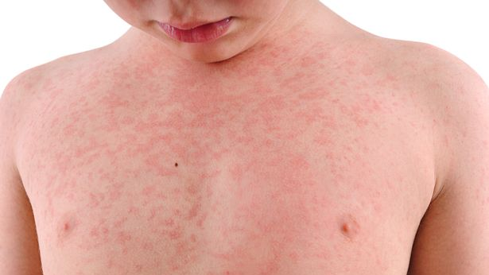
Outbreak of communicable diseases
If children or staff develop similar symptoms one after another and the incidence is higher than usual, occurrence of outbreak is suspected.

Slide 26
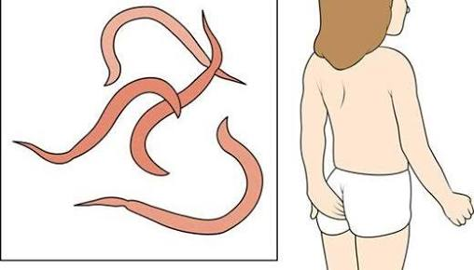
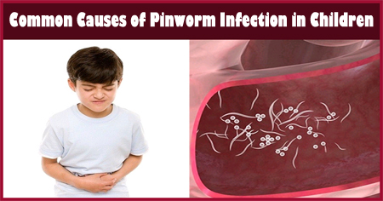
2. Parasitic diseases
Enterobius vermicularis (The most prevalent, easy spread by hand to mouth infection)
Ascaris
Giardia lambia: an important etiological agent of recurrent diarrheal disease.
E.histolytica, Taenia saginata, Ancylostoma, and Schistosoma in endemic areas.
Prevention and control:
General measures
Case finding (urine and stool examination)
Treatment and re-evaluation of cases.

Slide 27
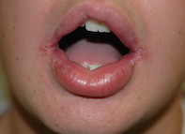
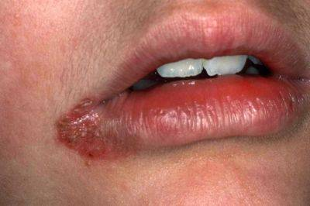
3. Malnutrition problems
Protein deficiency disorder :impairment of growth (wasting and stunted growth)
IDA
Riboflavin def. (B2 Def.): causing angular stomatitis and cheilosis.
Vit. A def.: skin and ocular manifestations and decreased resistance to infections.
Dental caries
Overweight and obesity

Slide 28
Assessment of nutritional diseases:
Dietary history and intake data
Anthropometric data: height and height for wight
History and clinical examination
Biochemical data
Assessment of ecological habits: prevalence of infectious diseases, food habits, SEC factors.

Slide 29
Improving nutrition at schools:
School feeding programme
Nutritional education of children and their families
Prevention and control of parasitic diseases
Periodic examination for detection and management of deficiency.

Slide 30
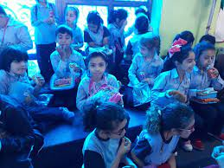
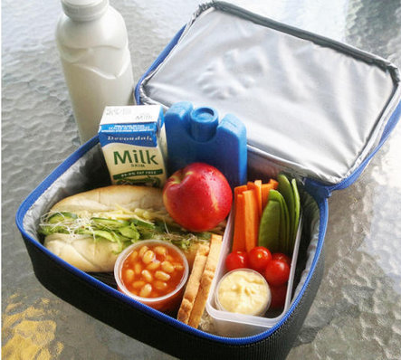
Mid-day school meal:
A good nourishing meal should be provided to school children ,
It should provide at least one-third of daily caloric requirements and about half of daily protein requirement of the child.
Use of specific nutrients (e.g. fortified biscuits with iron) is indicated to prevent nutrient disorders.

Slide 31
4. School accidents and emergencies
Emergencies commonly found in schools are:
Accidents with effects range from minor inconvenience and pain to extended disability and death.
Medical emergencies: appendicitis, gastroenteritis, colic, epileptic fits and fainting, fracture, coma, epistaxis.
Injuries are the leading cause of death among the school-age children.
Causes and factors related to causation:
Poor environmental conditions at school
Overcrowding
Unsuitable site of school
Risky or violent behaviours among pupils
Prevention:
Applying safety measures at school and its surrounding
Supervision of children while at school

Slide 32
Emergency care and first aid services:
Emergency care for diseased or injured pupils and staff members are a responsibility of school health services.
Its purposes are:
to prevent further damage,
to arrange transportation, to home or hospital, if needed,
to notify the family as soon as possible.
Every school should have an emergency care plan, supplies, facilities and available trained medical (physician, nurse) or first aid personnel (teacher, social worker, and pupils).

