Slide 1
1- ECG part -I By Prof. Sherif W. Mansour Physiology dpt., Mutah school of Medicine .

Slide 2
ELECTROCARDIOGRAM (ECG)
The potential changes (fluctuations) that represent the algebraic sum of the action potential of myocardial fibers which occurs regularly with each cardiac cycle are conducted along the body fluids to the body surface and can be recorded extra-cellularly because the body fluid is a good conductor to potential fluctuations.
Recording of ECG :
ECG is recorded by electrocardiography machine (sensitive galvanometer), which record these potential changes (during the cardiac cycle) on a moving strip of paper (electrocardiogram film).

Slide 3
Normal ECG waves
1) P-wave :
- It is the primary wave of ECG (hence it is called "P").
- Cause : due to depolarization of the atria.
- Duration : 0.08 - 0.1 second (sec).
- Amplitude : 0.2 mv (positive wave)
(starts 0.02 second before atrial contraction).

Slide 4
2) QRS complex :
- Cause: it is due to depolarization of the whole ventricles.
- Duration : 0.04 - 0.08 sec.
- Amplitude : 1 mv , (starts 0.02 second before ventricular contraction).
- Q-wave : - Cause : depolarization of inter-ventricular septum (from left to right).
- Duration : 0.02 sec
- Amplitude : small (negative wave)
- R -wave
- Cause : depolarization of both ventricles.
- Duration" : 0.04 second
- Amplitude : 1 mv (positive wave)
- S-wave :
- Cause : depolarization of the remaining parts (postero-basal of the ventricle and pulmonary conus).
- Duration : 0.02 sec.
- Amplitude : small (negative wave)

Slide 5
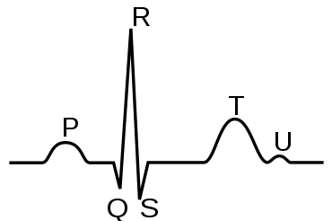
3) T-wave :
- Cause : due to repolarization of the ventricles.
- Duration : 0.25 sec.
- Amplitude : 0.4 mv (positive wave)
4) U-wave :
- This wave is usually absent.
- Cause : it may be due to slow repolarization of papillary muscles (that is attached to A.V. valve) or it may be due to supernormal phase of excitability (i.e. if excitability of cardiac muscle is more than normal).

Slide 6
5) P-R interval:
- It is measured from the beginning of P to the beginning of R., - Its duration : 0.12 - 0.2 sec.
- It represents :
-atrial depolarization. , -conduction from atrium to ventricle (AVN & AVB).
- Prolonged in: -Increased parasympathetic (vagal) tone with bradycardia.
-AVN block (delayed conduction) - Atrial enlargement
- Shorten in:
- Increased sympathetic tone with tachycardia. - AV nodal rhythm
-Wolff-parkinson-white syndrome (accessory bundle conduct impulses from left atrium directly to the left ventricle), so, no AV nodal delay.
6) Q.T. interval:
- From the beginning of Q to the end of T wave., - Normal duration = 0.44-0.48
- It represents the electrical activity of the ventricle (depolarization and repolarization)
- It is called electrical ventricular systole.
N.B.: Increase Ca⁺⁺ → decrease electrical ventricular systole → decrease Q-T interval

Slide 7
7) S-T segment:
- It is measured from the end of S to the beginning of T.
- Duration : 0.1 sec .
- It should be isoelectric (i.e. at the end of S all the ventricles are depolarized and repolarization starts with T wave, so during S-T segment the ventricles are completely depolarized without potential differences between any points on surface of the heart) So, S-T segment should be in isoelectric line).
- If it is displaced upward or downward (i.e. elevated or depressed) from isoelectric line this means myocardial ischaemia.
N.B. :
Atrial repolarization is not recorded because:
a. It is of very low voltage.
b. Masked by QRS complex (because it occurs at the same time with ventricular depolarization).
Electrical activity of pace-maker cells and specialized conducting cells (SAN, AVN, AVB) are not recorded because of their relatively small size.

Slide 8
-Relationship of (ECG) and action potential of a single ventricular fibre:
1.QRS complex coincides with ventricular depolarization (occurs at the beginning of the action potential).
2. ST segment coincides with the Plateau.
3. T wave coincides with rapid repolarization (occurs at the end of the action potential).
-The direction of the wave forms depend on :
1. The site of the recording electrodes on the body surface.
2. The direction of electrical activity (whether it is directed toward or away from the exploring electrode).
a) If a wave of depolarization is moving toward the exploring electrode a + ve wave is recorded (upward deflection).
b) If a wave of depolarization is moving away from the exploring electrode a -ve wave is recorded (downward deflection).
-The direction of depolarization in the septum is from left to right and in ventricular wall from endocardium to epicardium. The direction of depolarization in both ventricles is algebric summation of both opposite directions (with direction of left ventricle which is the most thicker).

Slide 9
-Why the repolarization wave (T) is in the same direction (+ve) as the depolarization wave (R)?
-During depolarization the direction of dipole is from endocardium to epicardium → +ve wave (R).
-The last point of depolarization is the first point of repolarization (as epicardium has more blood supply with rapid repolarization but endocardium suffers from ischemia).
- So the direction of dipole during repolarization is the same as in depolarization → +ve wave (T).
N.B.: in skeletal muscle the first part depolarized is the first repolarized → opposite direction of waves. Also in atria, SAN is the 1st depolarized & repolarized. So repolarization wave in atria is –ve and called Ta wave).
There is no potential (at all) recorded in the ECG when the ventricles are either polarized (during T-P segment) or completely depolarized (during S-T segment).

Slide 10
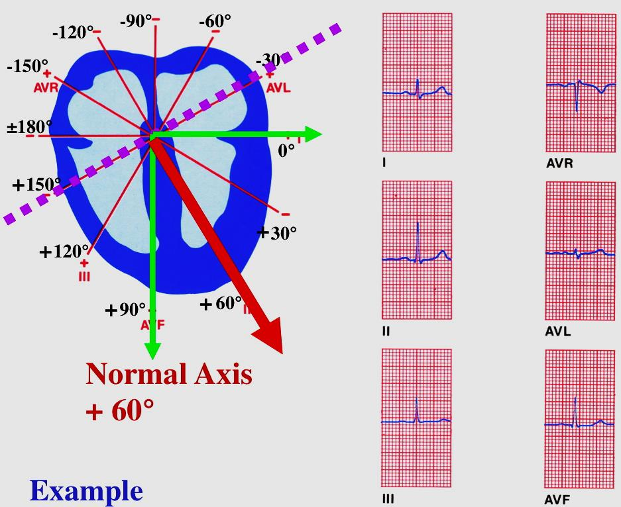
Applications on the standard limb leads :
1. Vector cardiography :
- Vector is an arrow which represents the sum of the electrical activity of the heart at any moment (it has magnitude and direction).
- Vector cardiogram is a line connecting the tops of all cardiac vectors during the cardiac cycle. The line forms a series of 3 loops for P, QRS complex and T waves.
2. Electric axis of the heart (mean QRS vector) :

Slide 11
- It is the resultant vector of the heart.
- An equilateral triangle (einthoven's triangle) is represented.
- Perpendiculars are dropped from the mid point of the sides of the triangle to meet in the centre (point A).
- The average QRS complex deflections are measured in the standard limb leads and represented on the Einthoven's triangle
- Perpendiculars are dropped from the distances measured on each limb (representing the mean QRS complex) to meet at point B.
- An arrow drown between A & B represents the vector (normal
direction is – 30° to + 110° with an average 60° downward and to the left slightly anterior

Slide 12
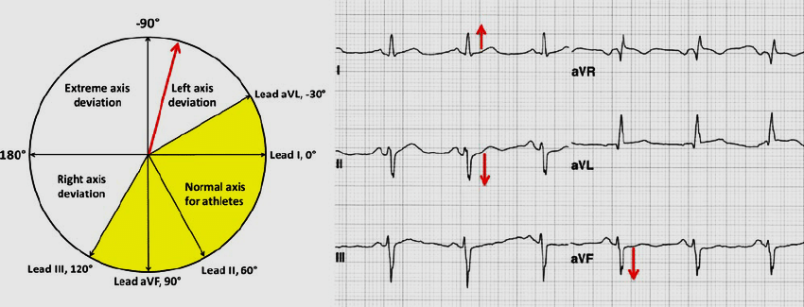
Cardiac Axis deviation
Is due to a change in position of the heart either to the left or to the right.

Slide 13
Thank You

