Slide 1
PURINE & PYRIMIDINE METABOLISM & DISORDERS

Slide 2
FUNCTIONS OF NUCLEOTIDES
Polymerize to make DNA and RNA Energy currency of the cell e.g. ATP, GTP
Act as carriers of active intermediates in various metabolic pathways e.g. UDP-glucose in glycogen synthesis, SAM
Component of coenzymes e.g. FAD, NADH, NADPH Act as 2nd messengers e.g. cAMP and cGMP
Allosteric regulation of various metabolic pathways e.g. ATP inhibits PFK-1

Slide 3
There are two pathways leading to nucleotides
De novo synthesis: The synthesis of nucleotides begins with their metabolic precursors: amino acids, ribose-5-phosphate, CO₂, and one-carbon units.
Salvage pathways: The synthesis of nucleotide by recycle the free bases or nucleosides released from nucleic acid breakdown.

Slide 4
De novo synthesis of purines:
Occur in the cytosol of the cell
Starts by conversion of ribose 5- phosphate to PRPP
By the enzyme PRPP synthase then formation of 5- phosphoribosylamine by PRPP glutamyl amidotransferase , then condensation reactions of glycine , aspartate, glutamine, Co2 and folate to form IMP

Slide 5
Once formed, IMP is rapidly converted to AMP
and GMP (it does not accumulate in cells).

Slide 6
Regulation
1- Availability of PRPP
2- PRPP synthetase is feedback regulated by AMP, ADP, GMP and GDP.
3- Activity of PRPP glutamyl amidotranferse is feedback
Regulated by GMP and AMP.
Inhibitors of purine synthsis
-they are toxic
-Examples:
1- Azaseine : glutamine analogue
2-Trimethoprim, methotrxate: folic acid analogues

Slide 7
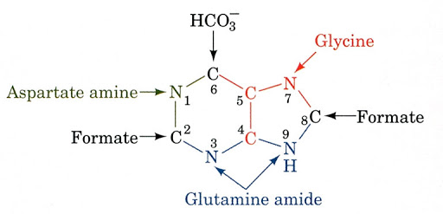
IMP Synthesis - Significance
IMP = serves as a precursor for synthesis of all other purine nucleotides such as adenine and guanosine monophosphate (AMP & GMP)and ATP.

Slide 8
INOSINE 5’- MONOPHOSPHATE (IMP(
Adenylosuccinate synthetase
IMP
dehydrogenase
GTP + Asp
NAD+
GDP + Pi
NADH
Adenylosuccinate
Xanthine monophosphate (XMP(
ATP + Gln
GMP
synthetase
AMP + Glu
Adenylosuccinase
Fumarate
Adenosine monophosphate (AMP(
Guanosine monophosphate (GMP(

Slide 9
Salvage Pathways for Purine Synthesis
Purine bases created by degradation of RNA and DNA and intermediate of purines synthesis can be directly converted to the corresponding nucleotides.
The significant of salvage pathway
Save fuel
Some tissues and organs such as brain and bone marrow are only capable of synthesizing nucleotides by Salvage pathways
Broken down endogenous nucleotides = salvage pathways.
Purine salvage pathways us one of two enzymes.
Adenine phosphoribosyltransferase (APRT(.
Converts free adenine to AMP
Hypoxanthine-guanine phosphoribosultransferase (HGPRT).
Converts hypoxanthine to IMP Converts guanine to GMP

Slide 10
Purine Salvage Pathway
adenine phosphoribosyl transferase
Adenine
AMP
PRPP
PPi
O
O
N
N
N
N
²⁻O₃POH₂C _{O} ^{N}
N
N
N
hypoxanthine-guanine phosphoribosyl transferase (HGPRT)
Hypoxanthine
HO OH
IMP
O
PRPP
O
N
N
PPi
N
N
N
N NH₂
²⁻O₃POH₂C _{O} ^{N} N NH₂
Guanine
HO OH
GMP
Absence of activity of HGPRT leads to Lesch-Nyhan syndrome.

Slide 11
DEGRADATION OF PURINE NUCLEOTIDES
IMP is the precursor for both AMP and GMP
AMP deaminase
AMP
IMP
GMP
P_{i} 5’ Nucleotidase
P_{i}
5’ Nucleotidase
P_{i}
Adenosine
deaminase
Adenosine
Inosine
Guanosine
Ribose
5’ Phosphorylase
Ribose
Hypoxanthine
Xanthine oxidase
Guanine
Uric Acid (excreted)
Guanase
NH₃
Xanthine
oxidase
Xanthine

Slide 12
DISEASES ASSOCIATED WITH DEFECTS IN PURINE METABOLISM
HYPERURICEMIA GOUT
LESCH-NYHAN SYNDROME KIDNEY STONES
SEVERE COMBINED IMMUNODEFECIENCY (SCID(

Slide 13
HYPERURICEMIA
Characterized by plasma urate (uric acid) level greater than 7.0 mg/dL
Normal plasma levels
Females | = | 2.4-6 mg/dL
Males | = | 3.4-7 mg/dL

Slide 14
HYPERURICEMIA
Primary Hyperuricemia: an innate defect in purine metabolism and/or uric acid excretion
Secondary Hyperuricemia: increased availability of purines due to medications/ medical conditions or through diet.

Slide 15
GOUT
Gout is caused by precipitation of sodium urate crystals in the joints resulting in inflammation and pain.

Slide 16
Progression of Hyperuricemia to Gout
Stage 1: Asymptomatic hyperuricemia. At a serum urate
concentration greater than 6.8 mg/dL, urate crystals may start to deposit in the joints. No evidence that treatment is required.
Stages 2 : Acute gout. If sufficient urate deposits develop around
joints, and if the local environment or some trauma triggers the
release of crystals into the joint space, an inflammatory response occurs. These flares can be self-resolving but are likely to recur.
Stage 3 : Intercritical periods. These are the intervals between
attacks. During these periods, crystals may still be present at a low level in the synovial tissue and fluid, resulting in future attacks.
Stage 4 : Advanced gout. If crystal deposits continue to
accumulate, patients may develop chronically stiff, swollen joints
and tophi. This advanced stage of gout is relatively uncommon
generally avoidable with therapy.

Slide 17
GOUT - Causes
Underexcretion of uric acid
Diet rich in purines/alcohol; deficient in dairy products Increased purine degradation
Increased PRPP Synthetase activity
overproduction of PRPP = increased purine synthesis = increased purine degradation = increased uric acid production Decreased/partial HGPRT activity
Deficiency of HGPRT = increased HX and G
Deficiency of HGPRT = accumulation of PRPP = increased purine synthesis = increased uric acid levels
Deficiency of HGPRT = decreased IMP and GMP = decreased inhibitors for purine synthesis

Slide 18
GOUT - Treatment
Colchicine –reduces inflammation
Allopurinol – inhibits uric acid synthesis
Low purine diet - Foods that are high in purine include:
Red meat and organ meats (eg. liver)
Yeasts and yeast extracts (eg. beer and alcoholic beverages)
Asparagus, spinach, beans, peas, lentils, oatmeal, cauliflower and mushrooms
Avoid caffeine and alcohol Keep hydrated

Slide 19
Allopurinol – a suicide inhibitor used to treat Gout
O C
O C
H C
N
CH
HN
C
HN
C
N
HC
C
HC
C
N H
N
Allopurinol
N H
N
Hypoxanthine
Xanthine oxidase
Xanthine oxidase

Slide 21
Gout:
accumula-tion of uric acid salts in joints

Slide 22
Gout: accumulation of uric acid salts in joints

Slide 23
Gout: tophuses – accumulation of uric acid salts in cartilages, under skin.

Slide 24
KIDNEY STONES
When uric acid is present in high concentrations in the blood, it may precipitate as a salt in the kidneys. The salt can form stones, which can in turn cause pain, infection, and kidney damage.

Slide 25
Gout: kidney stones.

Slide 26
Lesch-Nyhan Syndrom: is a inherited disorder caused by a deficiency of the enzyme hypoxanthine-guanine phosphoribosyltransferase. LNS is present at birth in baby boys.
Hypoxanthine and guanine are not used in the salvage pathway of purine
nucleotides synthesis.
Hypoxanthine and guanine are not utilizied repeatedly but converted into uric acid.
Symptoms:
- severe gout
-severe mental and physical problems
- self-mutilating behaviors

Slide 27
SEVERE COMBINED IMMUNODEFICIENCY (SCID(
Adenosine deaminase deficiency
Accumulation of dATP = inhibition of ribonucleotide reductase =B and T cells unable to divide

Slide 28
Pyrimidine Ribonucleotide Synthesis
Uridine Monophosphate (UMP) is synthesized first
CTP is synthesized from UMP
Pyrimidine ring synthesis completed first; then attached to ribose-5-phosphate
N1, C4, C5, C6 : Aspartate C2 : HCO3⁻
N3 : Glutamine amide Nitrogen

Slide 29
Pyrimidine Synthesis
O
2 ATP + HCO ⁻ + Glutamine + H O
3 2
C
2 ADP +
Glutamate +
P_{i}
HN
CH
Carbamoyl Phosphate Synthetase II
O
C
C
C
O
N
HN
CH
PRPP PP_{i}
2-
COO
NH
O₃P O CH₂
O
2
C
C
Orotate Phosphoribosyl Transferase
COO
H
H
β
O C
O
N H
H
H
_{PO} -2
OH
OH
O
3
Orotate
Orotidine-5'-monophosphate (OMP)
Carbamoyl Phosphate
Aspartate
Reduced Quinone
OMP
Decarboxylase
Aspartate Transcarbamoylase (ATCase)
Dihydroorotate Dehydrogenase
Quinone
CO₂
P_{i}
O
O
O
C
HN
CH
HO C
C
C
CH
CH₂
HN
CH₂
O
N
NH₂
H₂O
C
CH
2-_{O3P}
O CH₂
O
C
CH
Dihydroorotase
O
N H
H
H β
O
N H
COO
H
H
COO
OH
OH
Dihydroorotate
Carbamoyl Aspartate
Uridine Monophosphate (UMP)

Slide 30
UMP ➔ UTP and CTP
Nucleoside monophosphate kinase catalyzes transfer of Pi to UMP to form UDP; nucleoside diphosphate kinase catalyzes transfer of Pi from ATP to UDP to form UTP
CTP formed from UTP via CTP Synthetase driven by ATP hydrolysis
Glutamine provides amide nitrogen for C4 in animals

Slide 31
UTP and CTP biosynthesis
kinase kinase
UMP UDP
ATP ADP ATP
UTP
ADP

Slide 32
Degradation of Pyrimidines
CMP and UMP degraded to bases similarly to purines by
Dephosphorylation Deamination
Glycosidic bond cleavage
Uracil reduced in liver, forming β-alanine
Converted to malonyl-CoA → fatty acid synthesis for energy metabolism

Slide 33
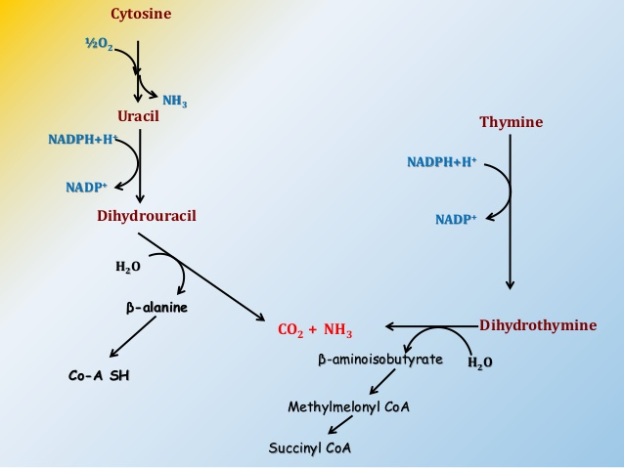

Slide 34
OROTACIDURIA
inherited disorder of pyrimidine synthesis caused by a deficiency of the enzyme of orotate-phosphoribosyltransferase and decarboxylase.
Symptoms:
–excess of orotic acid and its excretion with urine (1.0-1.5 g)
-mental and physical retardation
-megaloblastic anemia

Slide 35
O
HN
C
⁻O₃PO
CH
O -O
PPi
NH
2
O
-O
O-
OOC ^{C}
C
P P
O O O
C H
O
OH OH
Orotate
5-phosphoribosyl-1-pyrophosphate (PRPP)
– Treatment: patients are fed uridine U → UMP → UDP → UTP
UTP inhibits carbamoyl phosphate synthase II, preventing the biosynthesis and accumulation of orotic acid

