Slide 1
Arrythmias
Dr .. Ahmad Abu-Halawa
by : Tasneem Ma’aitah Weaam Ma’aitah

Slide 2
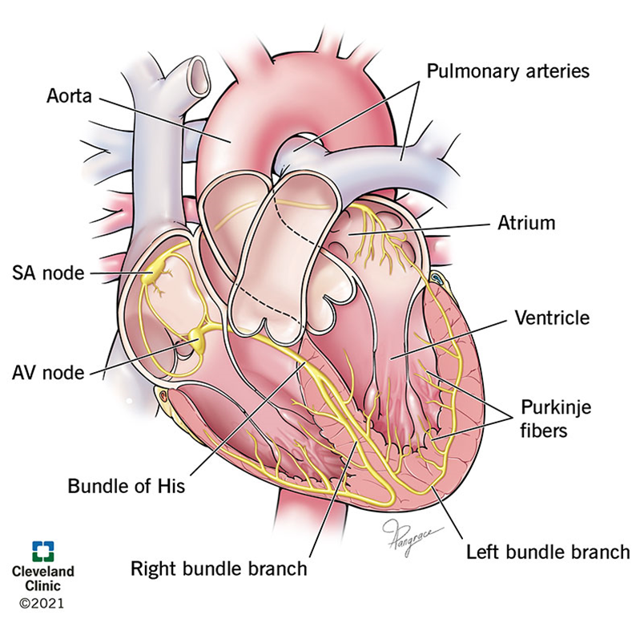
Definition :
A disturbance of the electrical rhythm of the heart
Pathogenesis
Occur as the result of pathology affecting the conductive system of the heart .
SA node act as a pacemaker and its intrinsic rate regulated by ANS
Parasympathetic ( vagal ) decrease the HR & Sympathetic increase it via cardiac sympathetic nerves and circulating catecholamines

Slide 3
Clinical features
Many arrhythmias are asymptomatic
Tachycardia :
Rapid palpitation , Dizziness, chest discomfort or breathlessness may also occur.
Syncope (Extreme tachycardias)
Bradycardia :
Fatigue, lightheadedness and syncope. ( symptoms of low CO )
Extreme bradycardias or tachycardias can precipitate sudden death or cardiac arrest.

Slide 4
Investigations
First line investigation is a 12-lead ECG
If arrythmias are intermittent and the resting ECG normal we use ambulatory
ECG or a patient activated ECG

Slide 5
Types :
Sinus arrythmia
Sinus bradycardia
Sinus tachycardia
Sinoatrial disease
AV block
Bundle branch block
Atrial ectopic beats
Atrial tachycardia
Atrial flutter
Atrial fibrillation
SVT
Ventricular premature beats
Ventricular tachycardia
Torsade's de pointes

Slide 6
Sinus arrythmia
Alteration in HR during respiration , with an increase during respiration and decreased during expiration
Normal phenomenon and can be quit pronounced in children .
Absence of heart rate variation with breathing or with changes in posture may be a feature of
diabetic neuropathy autonomic neuropathy or increased sympathetic drive.
Sinus arrhythmia does not require treatment

Slide 7
Sinus bradycardia
Definition: a cardiac rhythm with appropriate cardiac muscular depolarization initiating from the
sinus node with heart rate less than 60 beat per minute (bpm).
Occur in healthy people at rest and common finding in athletes.
If sinus bradycardia is asymptomatic, then no treatment is required.
Symptomatic sinus bradycardia may occur acutely during an MI and can be treated with intravenous atropine (0.6–1.2 mg). Patients with recurrent or persistent symptomatic sinus bradycardia should be considered for permanent pacemaker implantation.

Slide 8
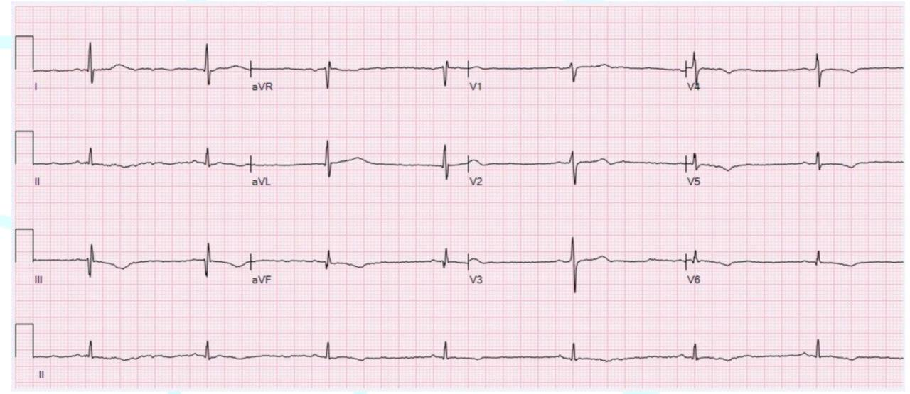

Slide 9
Etiology

Slide 10
Sinus Tachycardia
Definition: a cardiac rhythm with appropriate cardiac muscular depolarization initiating from the sinus node with heart rate more than 120 beat per minute (bpm).
Usually due to an increase in sympathetic activity associated with exercise or emotion.
Healthy young adults can produce rapid sinus rate, up to 200/min, during intense exercise.
Sinus tachycardia usually does not require treatment but sometimes may reflect an underlying disease

Slide 11
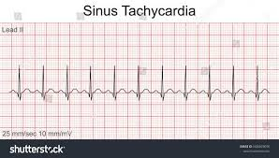

Slide 12
Etiology

Slide 13
Sinoatrial disease
Sick sinus syndrome (previously )
► Definition: an abnormality in sinoatrial (SA) node action potential generation or conduction.
Occur at any age but most common in older people.
It is caused by degenerative changes in SA node and is characterized by a variety of arrhythmias.
The typical presentation is with palpitation, dizzy spells or syncope, due to intermittent tachycardia, bradycardia, or pauses in sinus rhythm with no atrial or ventricular activity

Slide 14
Feature of end organ hypoperfusion also occur
Fatigue , dizziness , decreased physical activity , syncope , presyncope , dyspnea on exertion , angina , palpitation , oliguria , CHF

Slide 15
► Treatment:
● Asymptomatic patients: observation
● Symptomatic patients
▪ Manage reversible causes of SND.
▪ Severe and/or frequent symptoms of bradycardia due to irreversible causes
- First-line (after patient stabilization): permanent pacemaker placement

Slide 16
Atrioventricular block
► Definition: an interrupted or delayed conduction between the atria and the ventricles.
► Pathophysiology:
● AV blocks result from the interruption of the electrical impulse anywhere within the
atrioventricular conduction system, including the: AV node - Bundle of His - Left and right bundle branches
● Blocks at the level of the AV node:
impulse passes through AV node → normal propagation through conduction system → narrow QRS complex
● Infranodal block
Can be at the level of OR below the bundle of His
Ventricular depolarization is impeded → wide QRS complex
● More distal AV blocks:
typically result from more extensive damage to the conducting system → ↑ risk of progression to complete heart block.

Slide 17
First degree av block
Av conduction is delayed and so PR interval is so prolonged > 0.2 sec ( 3-5 small boxes )
A QRS complex follows each P wave
Rate of SA node = HR
Its benign and asymptomatic , often discovered incidentally on ECG
Rarely require treatment
Risk of progression to complete heart block : low

Slide 18
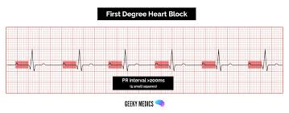

Slide 19
Second degree AV block
Here drop beat occur become some impulses from atrial fail to conduct the ventricle
Two subtypes :
Mobitz type 1 (Wenckebach phenomenon ) :Characterized by progressive prolongation of PR interval until a P wave fails to conduct
Site of block is usually within the AV node
Mostly regular rhythm separated by short pauses, which may lead to bradycardia (regularly
irregular rhythm)
Rate of SA node > heart rate
Benign condition that does not require treatment
Risk of progression to complete heart block: typically low, as the block is most often at the level of the AV node

Slide 21
● Mobitz type II
P wave fails to conduct suddenly, without a preceding PR interval prolongation; therefore, the QRS drops suddenly.
Site of block is within the His–Purkinje system
The conduction of atrial impulses to the ventricles typically follows a regular pattern, e.g.:
3:2 block: regular AV block with 3 atrial depolarizations but only 2 atrial impulses that reach the
ventricles (heart rate = 2⁄3 SA node rate).
▪ 4:3 block: regular AV block with 4 atrial depolarizations but only 3 atrial impulses that reach the
ventricles (heart rate = 3⁄4 SA node rate).
“2:1 block follows a regular pattern, it cannot be classified as Mobitz type I or II and is classified.
separately (see “2:1 AV block”)”.
Risk of progression to complete heart block: high (> 50%), as it is typically due to infranodal block.
Pacemaker implantation is necessary.

Slide 22
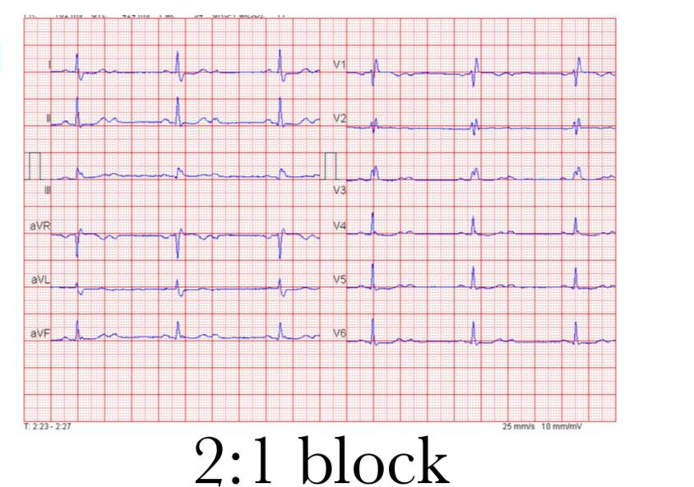
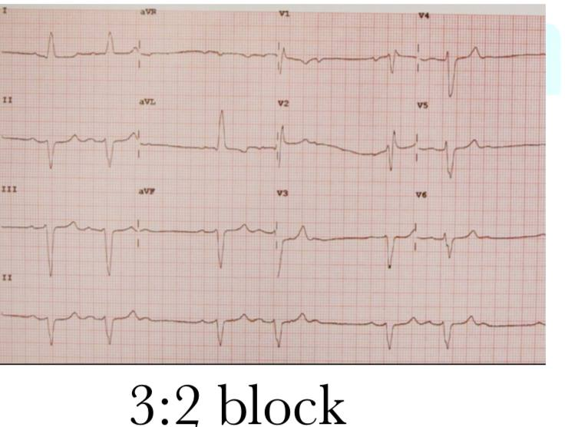

Slide 23
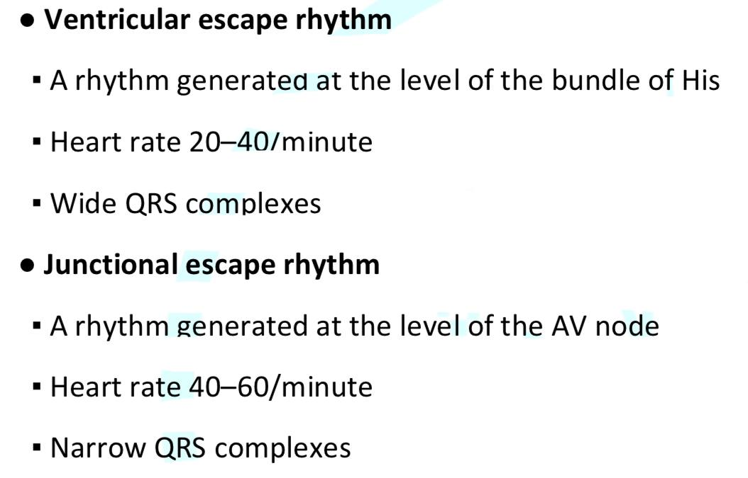
Third degree av block
Conduction fails completely and the atria and ventricles beat independently .
Known as AV dissociation
Ventricular activity is maintained by an escape rhythm arising in the AV node or bundle of His ( narrow QRS complex ) or Purkinje tissues ( board QRS complex )
Distal escape rhythm tend to be slower and less reliable
Complete AV block produces a slow ( 25-50 / min) ,regular pulse that doesn’t vary with exercise , except in case of congenital complete Av block .

Slide 24
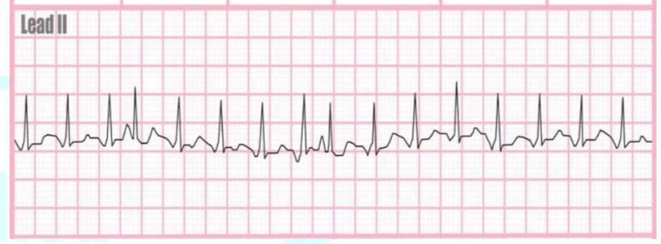
Atrial tachycardia
Manifestation of increased atrial automaticity , sinoatrial disease or digoxin toxicity
It produced narrow complex tachycardia with abnormal P wave morphology
Sometimes associated with AV block if the atrial rate is rapid
It may respond to beta blocker which reduce automaticity or class 1 or 3 anti-arrythmic
The ventricular response maybe controlled by AV node blocking agent

Slide 25
Atrial flutter
Definition: a supraventricular tachyarrhythmia that is usually caused by One irritable automaticity
focus in the atria fires at about 250 to 350 bpm (typically very close to 300 bpm), giving rise to regular atrial contractions.
►Epidemiology:
• Incidence: 88 per 100,000 person-years(increases with age)
• Sex: M > F (incidence in men is 2.5 times greater than in women)
ECG findings
• Ventricular Rate: typically 75–150/minute.
• Atrial rate (250-350) ≥ ventricular rate.
• Regular, narrow QRS complexes.
• Sawtooth appearance of P waves:

Slide 26
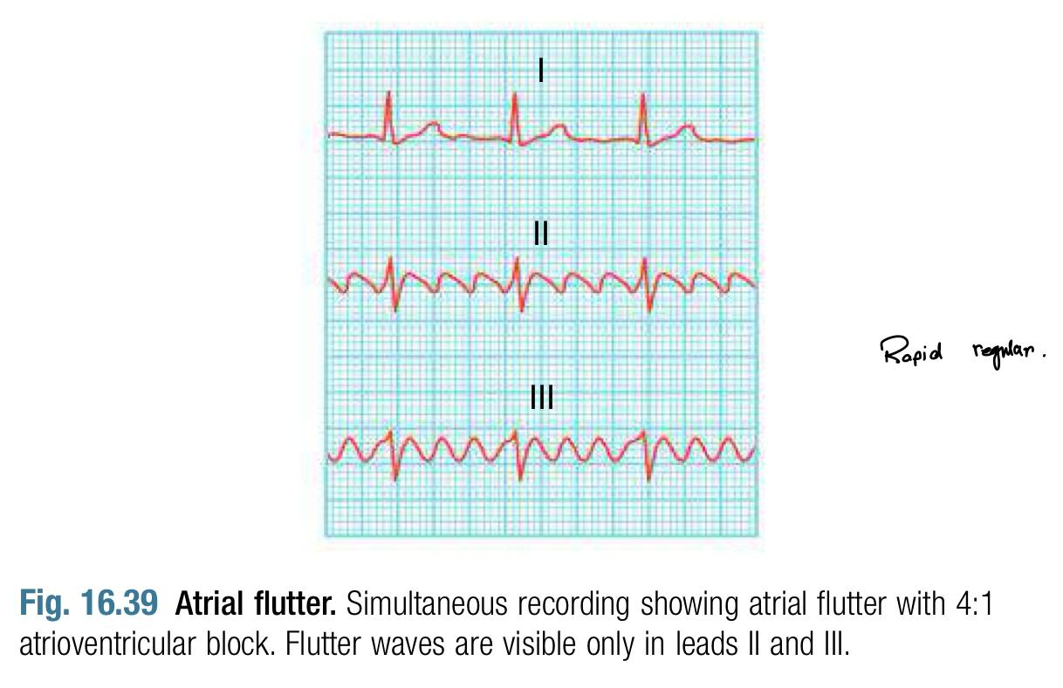
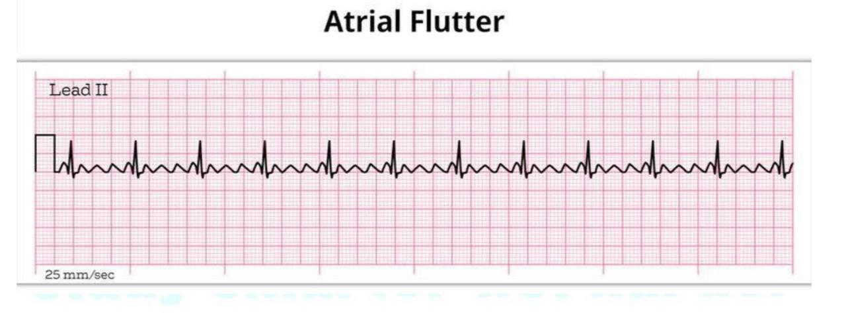

Slide 27
Etiology:
• Heart disease: Heart failure (most common association), rheumatic heart disease, CAD
• COPD, other hypoxic pulmonary disease
• Atrial septal defect (ASD)
• Very similar risk factors to AFib
► Treatment:
Same general treatment strategies as AFib
• Rate control: more difficult to achieve in atrial flutter than in Afib.
• Rhythm control:
▪ Better results and lower recurrence compared to Afib
▪ Catheter ablation is highly successful may be the most effective rhythm control strategy.
• Anticoagulation recommendations are the same as for long-term anticoagulation in Afib.

Slide 28
Atrial Fibrillation (Afib)
common type of supraventricular tachyarrhythmia characterized
by uncoordinated atrial activation that results in an irregular ventricular response.
Epidemiology
Atrial fibrillation is the most common cardiac arrhythmia.
Ectopic foci of electrical activity are most commonly present around the pulmonary veins.
Most common sustained arrhythmia
Incidence: increases with age

Slide 29
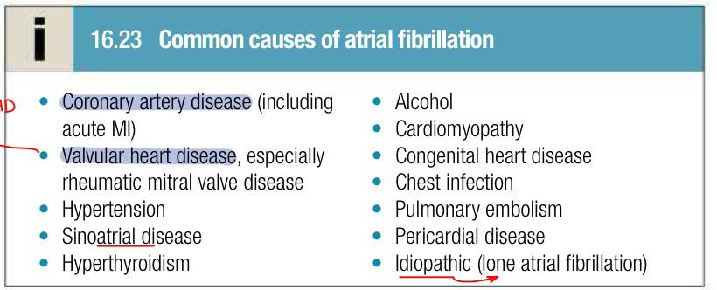

Slide 30
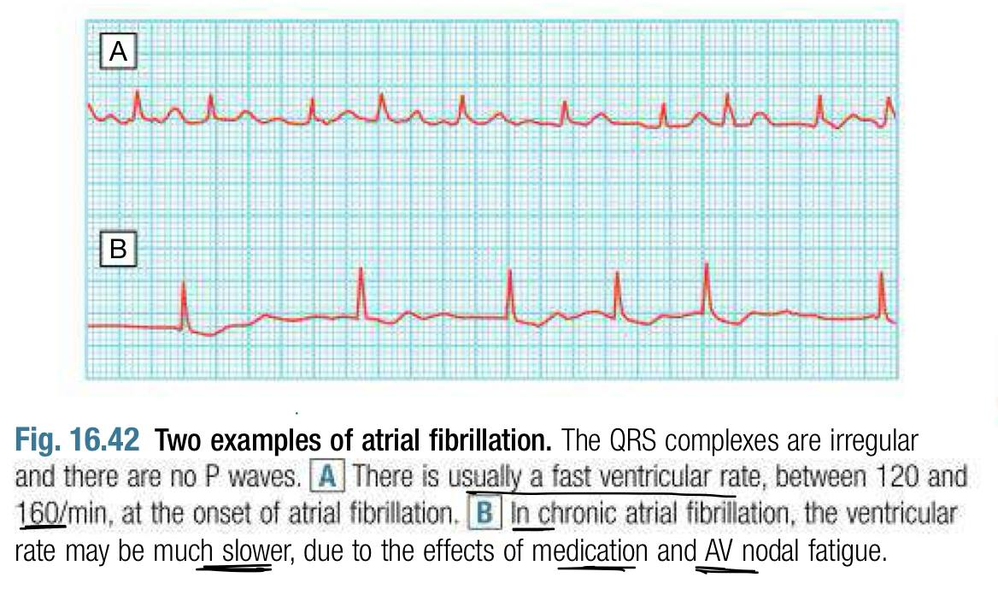

Slide 31
supraventricular tachycardias

Slide 32
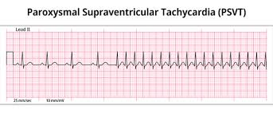
Supraventricular tachycardia
describes a group of regular tachycardias that have a similar appearance on ECG. These are usually narrow-complex tachycardias and are characterized by a re-entry circuit or automatic focus involving the atria .
The three principal types
atrioventricular nodal re-entrant tachycardia (AVNRT)-the most common reentrant tachycardia
atrioventricular re-entrant tachycardia (AVRT)
atrial tachycardia.
Notes:
management of SVT:
Attacks may be terminated by carotid sinus pressure or Valsalva manœuvre, but if not, IV adenosine or verapamil will usually restore sinus rhythm and terminate the tachycardia.
If there is severe haemodynamic compromise, the tachycardia should be terminated by DC cardioversion
For recurrent attacks, catheter ablation is the most effective therapy, and is preferable to long-term medication with β-blockers or verapamil.
Catheter ablation of the accessory pathway is first-line treatment in symptomatic patients, and is nearly always curative

Slide 33
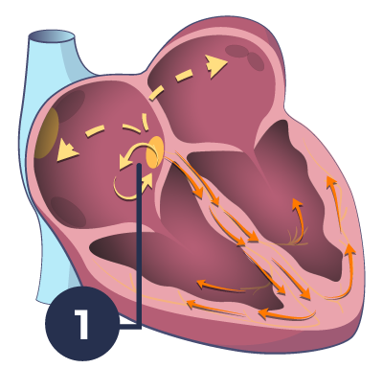
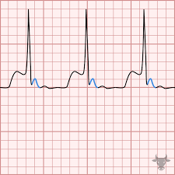
Atrioventricular nodal re-entrant tachycardia
AVNRT is attributed to re-entry in the right atrium and AV node, and tends to occur in structurally normal hearts.
It produces episodes of regular tachycardia, with a rate of 120 to 240/min lasting from a few seconds to many hours.
The patient experiences a rapid, forceful, regular heartbeat and may feel faint or breathless. Polyuria may occur.
Notes:
The ECG usually shows a regular tachycardia with normal QRS complexes, but occasionally there is rate dependent bundle branch block.

Slide 34
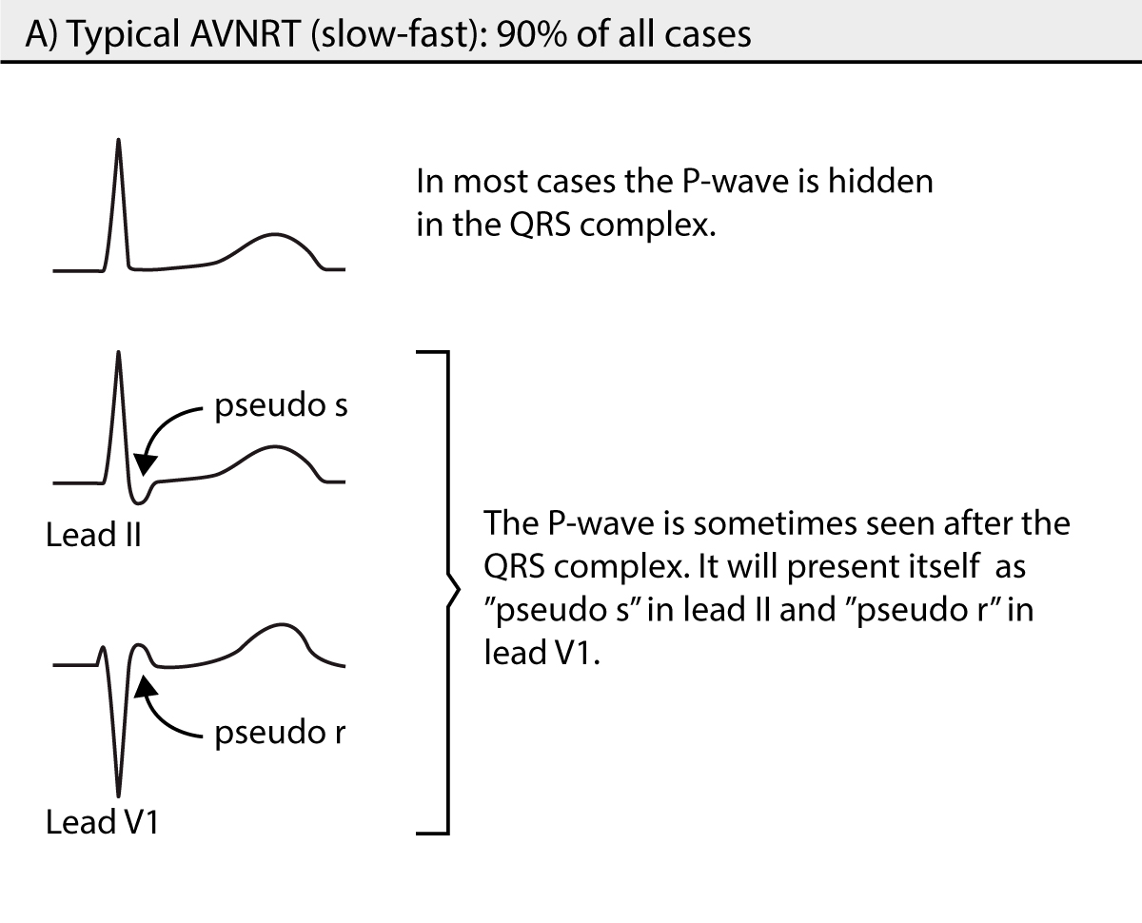
no P wave is seen (buried in QRS) or is seen or at the end of the QRS (very short R-P interval),

Slide 35
atrioventricular re-entrant tachycardia
In this condition there is an abnormal band of conducting tissue that connects the atria and ventricles. This so-called accessory pathway comprises rapidly conducting fibers that resemble Purkinje tissue.
in that they conduct very rapidly and are rich in sodium channels.
In about 50% of cases, this pathway conducts only in the retrograde direction (from ventricles to atria) and thus does not alter the appearance of the ECG in sinus rhythm. This is known as a concealed accessory pathway.
In the rest, the pathway also conducts in an antegrade direction (from atria to ventricles), so AV conduction in sinus rhythm is mediated via both the AV node and the accessory pathway, distorting the QRS complex.

Slide 37
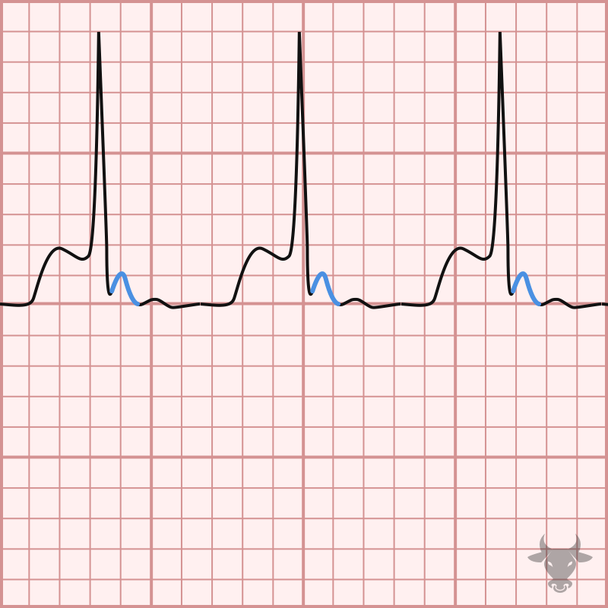
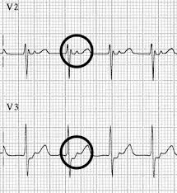
In contrast to AVNRT, each part of the circuit is activated sequentially in ,so atrial activation occurs after ventricular activation and the P wave is usually clearly seen between the QRS and T wave

Slide 38
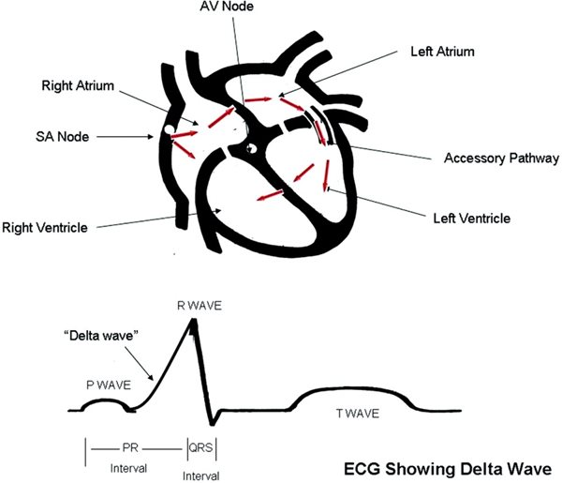
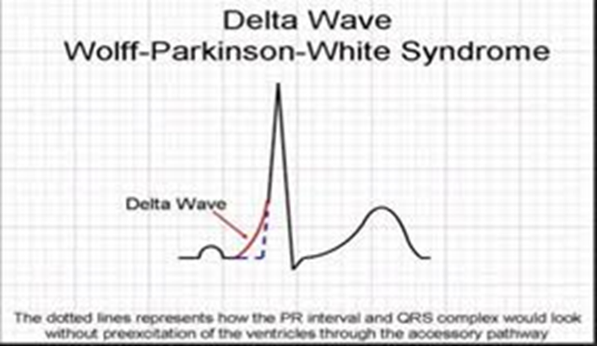
Wolff–Parkinson–White syndrome is the best-known type of AVRT in which there is an accessory pathway (bundle of Kent) between atria and ventricles.
Premature ventricular activation via the pathway shortens the PR interval and produces a ‘slurred’ initial deflection of the QRS complex, called a delta wave This is known as a manifest accessory pathway.
Notes:
WPWWolff-Parkinson-White ([WPW]; preexcitation syn- drome): PR interval is < 0.12 seconds due to a delta wave and symptoms of tachycardia. Total QRS is 0.12 seconds because of the fusion between the impulse that uses the normal conduction system and that which uses the abnormal (accessory) pathway, which bypasses the AV node. This bypass tract (accessory pathway, AP) conducts faster than the AV node; therefore, a portion of the electrical current reaches the ventricle sooner (the delta wave on the ECG) and preexcites the ventricle- hence the alternative name, "preexcitation syndrome." Occasionally, the accessory pathway is concealed, and the delta wave is not visible. An unusual cause of WPW can involve Ebstein anomaly of the tricuspid valve (more under Valvular Heart Disease on page 5-41).Spectrum of arrhythmias related to WPW includes orthodromic AVRT (narrow QRS complex regular tachycardia, which uses the AV node antegrade and AP retrograde), antidromic AVRT (wide QRS complex reg- ular tachycardia, which uses the AP antegrade and AV node retrograde), and atrial fibrillation (irregularly irreg- ular wide QRS complex tachycardia using antegrade AP conduction).Treatment of accessory pathways: Many patients have completely asymptomatic AP and no dysrhythmias. Patients with AP and symptoms of tachycardia (called WPW syndrome) can be treated with vagal maneuvers, adenosine, or calcium channel blockers-same as any SVT! (In these cases, the impulses are moving down the normal conduction system and returning via the accessory pathway to complete the circuit.) But never treat acute A-fib in WPW with digoxin, verapamil, or beta-blockers. Although verapamil and digoxin increase the refractory period in the AV node, they can preferen- tially enhance conduction down the accessory pathway and precipitate ventricular fibrillation (V-fib).Instead, treat acute A-fib in WPW with IV procainamide, ibutilide, or amiodarone. Shock if there are any signs of hemodynamic deterioration in any WPW tachyarrhythmia; especially watch those with ventricular rate > 285 bpm because they are at greatest risk of V-fib.WPW syndrome carries a low but definitive risk of sudden death, therefore, radiofrequency ablation is the preferred long-term treatment option!

Slide 39
Ventricular Arrhythmias

Slide 40
Premature Ventricular Contractions
=Ventricular premature beats.
the most common ventricular arrhythmias.
occur frequently in healthy people at rest, disappearing on exercise and frequently found in healthy people and their prevalence increases with age
They also occur in subclinical coronary artery disease, cardiomyopathy or following an MI.
If a patient has had an MI and has an ejection fraction of <40%, frequent PVCs (>10/hour) indicate a high risk of sudden cardiac death ( due to ventricular arrhythmias) especially if they are sequential.
Most patients are asymptomatic, but some feel irregular or missed beats.
On examination the pulse is irregular, with weak or missed beats because VPBs have a low stroke volume-because left ventricular contraction occurs before filling is complete
Notes:
-Ectopic beats in patients with otherwise normal hearts are more prominent at rest and disappear with exercise.
Management :
Asymptomatic, simple PVCs do not need to be treated if LV function is normal. Without treatment, most patients have spontaneous resolution or decrease anyway.
Complex PVCs (pairs, triplets) also do not need to be treated if the patient is asymptomatic and has no heart disease
Treatment (β-blockers 1st line) is only necessary in highly symptomatic cases
in some situations, catheter ablation can be used

Slide 41
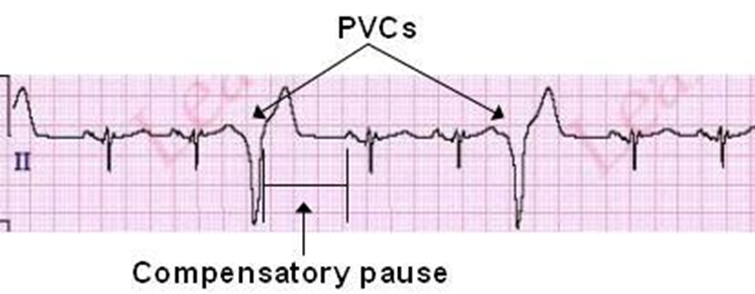
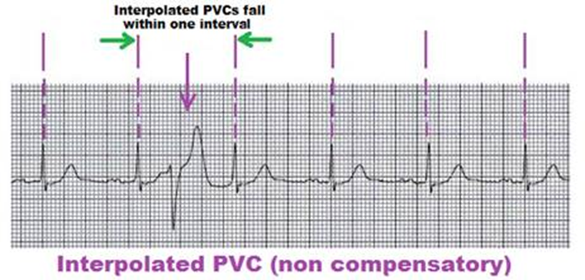
A compensatory pause usually follows a PVC before the next beat, but occasionally PVCs may occur between normally conducted beats without a pause, known as interpolated PVCs.
The QRS complex appears wide and unusual [broad and bizarre] because ventricular depolarization deviates from normal conduction pathways.
A QRS duration of at least 0.12 seconds in most leads is required to diagnose a PVC.
Retrograde P waves may occasionally be seen, but often there is no P wave
Notes:
However, QRS width may vary in different leads, so examine the entire 12-lead EKG for an accurate diagnosis.
-because the ventricles are activated sequentially rather than simultaneously. The complexes may be unifocal (identical beats arising from a single ectopic focus) or multifocal (varying morphology with multiple foci.

Slide 42
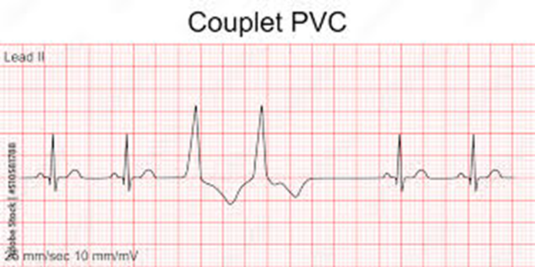
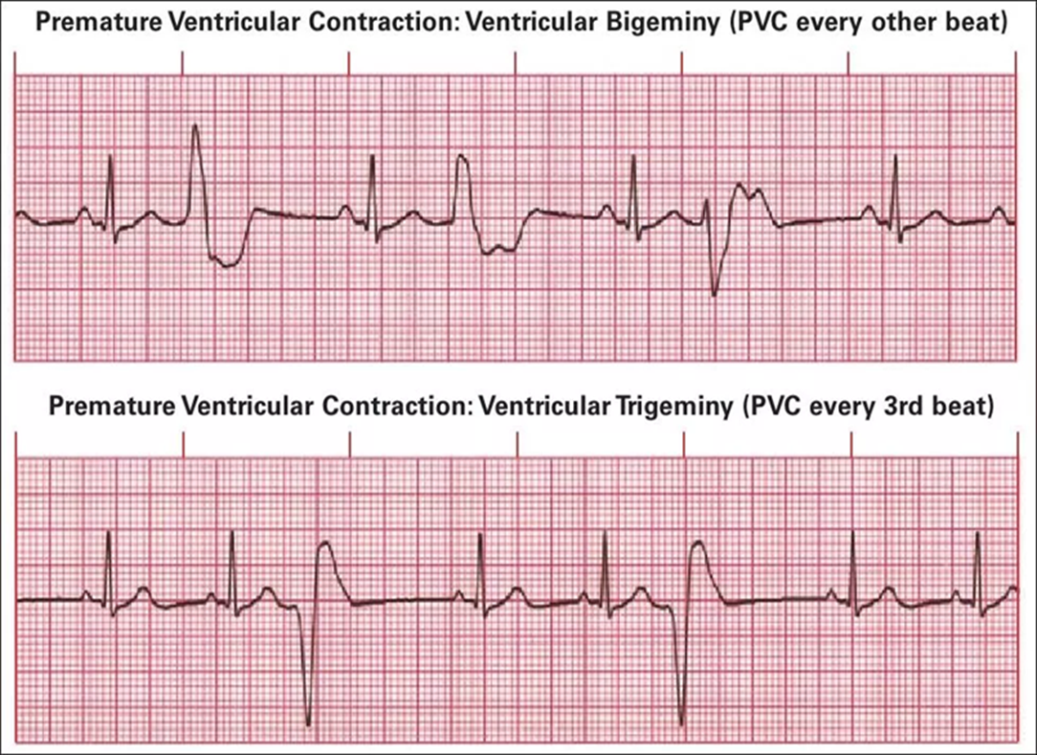
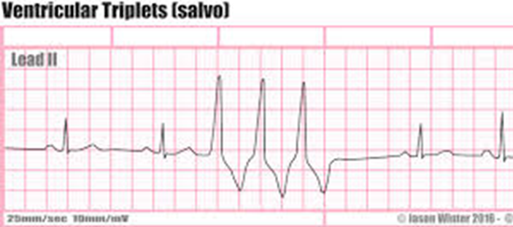
PVCs usually occur randomly but may alternate with normal sinus beats in a regular pattern. One normal beat followed by one PVC is called bigeminy, two normal beats for every PVC is trigeminy, and so on.
‘Couplet’ and ‘triplet’ are the terms used to describe two or three successive ectopic beats.

Slide 43
Ventricular Tachycardia
Ventricular tachycardia (VT) is defined as 3 or more sequential QRS complexes of ventricular origin at a rate of 100 bpm or faster.
occurs most commonly in the settings of acute MI, chronic coronary artery disease and cardiomyopathy.
It is associated with extensive ventricular disease, impaired left ventricular function and ventricular aneurysm. In these settings, VT may cause hemodynamic compromise or degenerate into ventricular fibrillation .
VT is most often caused by re-entry within scarred ventricular tissue {prior MI is the most common cause}, and less often by abnormal automaticity or triggered activity in ischemic tissue, may in patients with otherwise healthy hearts (‘normal heart VT’),
Patients may experience palpitation, dyspnea, lightheadedness and syncope.
Notes:
Causes :
a. CAD with prior MI is the most common cause
b. Active ischemia, hypotension
c. Cardiomyopathies, especially those with infiltration into myocardium such as sarcoidosis
d. Ventricular scar tissue
e. Congenital defects
f. Long QT syndrome (results in torsades de pointes)
g. Drug toxicity (antiarrhythmic or qt –prolongation drugs )
Heart failure
Hypocalemia ,hypomagnesemia
-Idiopathic VT occurs in otherwise structurally normal hearts and has much better prognosis -The most common idiopathic VT is right ventricular outflow tract (RVOT) VT

Slide 44
Based on duration and association with symptoms, VT can be defined as nonsustained (asymptomatic with duration of <30 seconds) or sustained (symptomatic or duration of 30 seconds).
VT can be monomorphic and polymorphic. Monomorphic VT is generally regular in rate and appearance. It needs to be differentiated from SVT with aberrant conduction, bundle-branch block or pre-excitation (WPW syndrome) and QRS changes due to severe hyperkalemia.
A 12-lead ECG or electrophysiology study may help establish the diagnosis. When there is doubt, it is safer to manage the problem as VT
The majority of patients with monomorphic VT have structural heart disease (particularly ischemic heart disease).
Notes:
5. Sustained versus nonsustained VT
a. Sustained VT (persists in the absence of intervention)
Lasts longer than 30 seconds and is often symptomatic
Can be associated with marked hemodynamic compromise (i.e.,hypotension) and/or development of myocardial ischemia
A life-threatening arrhythmia
Can progress to VFib if untreated
b. Nonsustained VT
Brief, self-limited runs of VT
Usually asymptomatic
When CAD and LV dysfunction are present, it is an independent risk factor for sudden death. Therefore, patients with nonsustained VT
should be thoroughly evaluated for underlying CAD and LV dysfunction

Slide 45
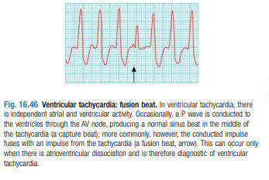
Features more in keeping with ventricular tachycardia :
History of myocardial infarction
Atrioventricular dissociation (pathognomonic) -that is, sinus P waves continue with their cycle, unaffected by the tachycardia.
Capture/fusion beats (pathognomonic) .
Extreme left axis deviation
Very broad QRS complexes (> 140msecs)
No response to carotid sinus massage
or intravenous adenosine

Slide 46
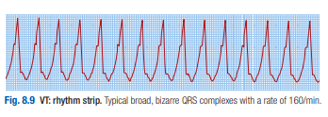
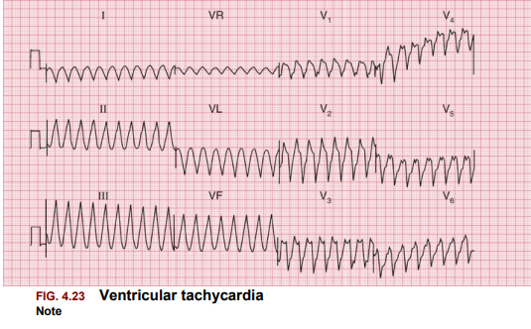
The ECG shows tachycardia with broad, abnormal QRS complexes and a rate greater than120/min
VT is by far the most common cause of a broad-complex tachycardia.
Notes:
Patients recovering from MI sometimes have periods of idioventricular rhythm (‘slow’ VT) at a rate only slightly above the preceding sinus rate and below 120/min. These episodes often reflect reperfusion of the infarct territory and may be a good sign. They are usually self-limiting and asymptomatic, and do not require treatment
Treatment :
1.Identify and treat reversible causes.
2. Sustained VT: a. Hemodynamically stable patients with mild symptoms and systolic BP>90—pharmacologic therapy IV amiodarone b. Hemodynamically unstable patients or patients with severe symptoms and systolic BP< 90 - Immediate synchronous DC cardioversion Follow with IV amiodarone to maintain sinus rhythm c. Ideally, all patients with sustained VT should undergo placement of an ICD (implantable cardiac defibrillator ), unless EF is normal (then consider amiodarone)
3. Nonsustained VT
a. If no underlying heart disease and asymptomatic, do not treat. These patients are not at increased risk of sudden death.
b. If the patient has underlying heart disease, a recent MI, evidence of left ventricular dysfunction, or is symptomatic, order an electrophysiologic study: If it shows inducible, sustained VT, ICD implantable cardiac defibrillator placement is appropriate.
c. Pharmacologic therapy is second-line treatment. However, amiodarone has the best results of all of the antiarrhythmic agents.

Slide 47
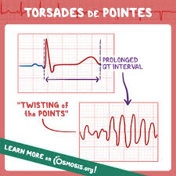
Torsades de pointes
meaning "twisting of the points” ,that seem to twist around the baseline as the QRS axis changes.
Torsades de pointes is a rapid polymorphic VT. It is typically nonsustained but may degenerate into V-Fib.
It is associated with many factors that prolong the QT interval
Risk factors for long QT include: electrolyte disturbances (↓Ca2+, ↓Mg2+, ↓K+), drugs (e.g. Antiemetics, antipsychotics , SSRIs, TCAs, macrolide and fluoroquinolone antibiotics), and congenital long QT syndrome.

Slide 48
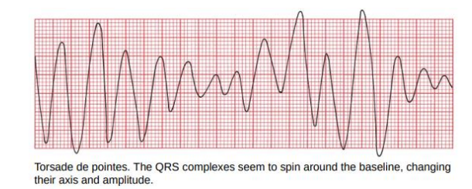
The ECG shows rapid broad complexes
prolonged QT interval (>0.44 seconds in men, >0.46 seconds in women when corrected to a HR of 60/min)
Torsade de pointes, resembling standard ventricular tachycardia, is distinguished by QRS complexes spiraling around the baseline, altering their axis and amplitude.
Notes:
Management :
IV magnesium provides cardiac stabilization.
Electrical cardioversion for unstable patients. May require drugs to increase heart rate such as isoproterenol to shorten QT interval while underlying cause is addressed.
-Otherwise, treatment is directed at the underlying cause.
Patients with congenital long QT syndrome often require an implantable cardiac defibrillator

Slide 49
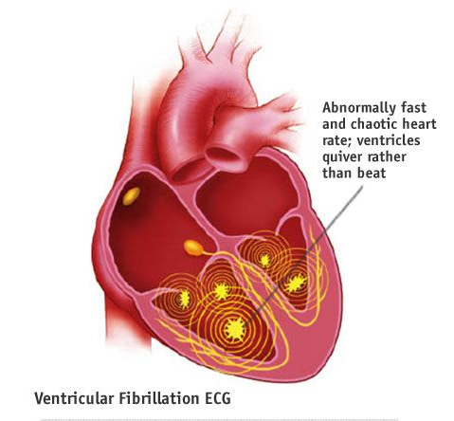
Ventricular fibrillation
Ventricular fibrillation is a critical event, typically observed in failing hearts and is the most common arrhythmia leading to sudden death in adults.
Multiple foci in the ventricles fire rapidly, leading to a chaotic quivering of the ventricles and no cardiac output.
In most cases, ventricular fibrillation is preceded by ventricular tachycardia (except in the setting of acute ischemia/infarction)

Slide 50
Common precipitants of ventricular fibrillation include :
MI (most common), Heart failure,
Overdoses of stimulants, especially when used in combination.
Antiarrhythmic drugs, especially those that cause torsades de pointes (prolonged QT intervals)
AFib with a very rapid ventricular rate in patients with Wolff–Parkinson–White (WPW) syndrome
Recurrence :
a. If VFib is not associated with acute MI, recurrence rate is high (up to 30% within the first year). These patients require chronic therapy: Either prophylactic antiarrhythmic therapy (amiodarone) or implantation of an ICD.
b. If VFib develops within 48 hours of an acute MI, long-term prognosis is favorable and the recurrence rate is low (2% at 1 year). Chronic therapy is not required in these patients.
Notes:
Also Hypoxemia or hypercapnia, Hypotension or shock, Electrolyte imbalances,

Slide 51
Clinical Features :
1. Cannot measure BP; absent heart sounds and pulse
2. Patient is unconscious
3. If untreated, leads to eventual sudden cardiac death
Diagnosis :
1. ECG: No atrial P waves can be identified
2. No QRS complexes can be identified
3. In sum, no waves can be identified; there is a very irregular rhythm
-The EKG tracing shows spasmodic jerking (coarse ventricular fibrillation) or gentle undulating (fine ventricular fibrillation) movements with no true QRS complexes

Slide 52
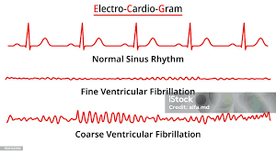
Notes:
Treatment
1.This is a medical emergency!
a. early defibrillation, CPR, epinephrine, followed eventually by a trial of amiodarone or lidocaine.
2. If cardioversion is successful :
a. Maintain continuous IV infusion of the effective antiarrhythmic agent. IV amiodarone has been shown to be effective.
b. Implantable defibrillators have become the mainstay of chronic therapy in patients at continued risk for Vf.Long-term amiodaron therapy is an alternative.

Slide 53
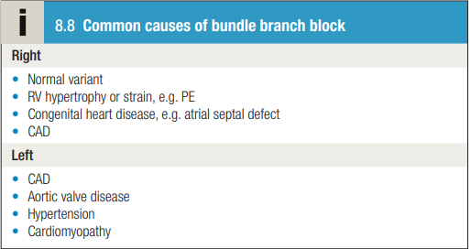
Bundle branch block
Interruption of the right or left branch of the conducting system delays activation of the corresponding ventricle, broadens the QRS complex (≥0.12 seconds) and produces characteristic alterations in QRS morphology
RBBB can be a normal variant, but LBBB usually signifies important underlying heart disease
Notes:
In left bundle branch block (LBBB) and RBBB, depolarisation proceeds through a slow myocardial route in the affected ventricle rather than through the rapidly conducting Purkinje tissues that constitute the bundle branches. This causes delayed conduction into the LV or RV, broadens the QRS complex (≥ 0.12 sec) and produces characteristic alterations in QRS morphology

Slide 54
RBBB
❖Criteria for Right Bundle Branch Block
QRS complex widened to greater than 0.12 seconds
rSR′ (rabbit ears) or a tall R wave in V1 and V2 with ST-segment depression and T-wave inversion
Slurred S waves ‘qRs’ in V5, V6, I, and aVL
o Note: Right bundle branch block doesn’t cause right axis deviation
Notes:
[you will not always see a beautiful pair of rabbit ears with RBBB]
-An ‘RSR’ pattern, with a QRS complex of normal width (less than 120 ms), is sometimes called ‘partial right bundle branch block’. It is seldom of significance, and can be considered a normal variant

Slide 56
Notes:
• Sinus rhythm, rate 60 bpm
• Normal PR interval
• Normal cardiac axis
• Wide QRS complexes (160 ms)
• RSR 1 pattern in lead V1 and deep, wide S waves in lead V6
• Normal ST segments and T waves

Slide 57
LBBB
Criteria for Left Bundle Branch Block
1. QRS complex widened to greater than 0.12 seconds
2. Broad clumsy or notched R wave with prolonged upstroke in leads V5, V6, I, and aVL, with ST-segment depression and T-wave inversion
-LBBB is associated with T wave inversion in the lateral leads (I, VL and V5–V6 ) though not necessarily in all of these.
3. Deep and broad S waves in V1 and V2
4. Left axis deviation may be present

Slide 59
Notes:
Sinus rhythm, rate 100 bpm
• Normal PR interval
• Normal cardiac axis
• Wide QRS complexes (160 ms)
• M pattern in the QRS complexes, best seen in leads I, VL,
V5 and V6
• Inverted T waves in leads I, II, VL

Slide 61
Hemiblocks
Damage to the left bundle can also occur after it divides into anterior and posterior fascicles.
In this case, the QRS complex is not broad but the direction of ventricular depolarisation is changed, causing left axis deviation in left anterior hemiblock and right axis deviation in left posterior hemiblock
O Left Anterior Hemiblock (More common & can be seen in normal hearts)
Left axis deviation {QRS +ve in lead 1 and –ve in lead aVf}
O Left Posterior Hemiblock (Less common & only seen in diseased hearts)
Right axis deviation {QRS –ve in lead 1 and +ve in lead aVf}

Slide 62
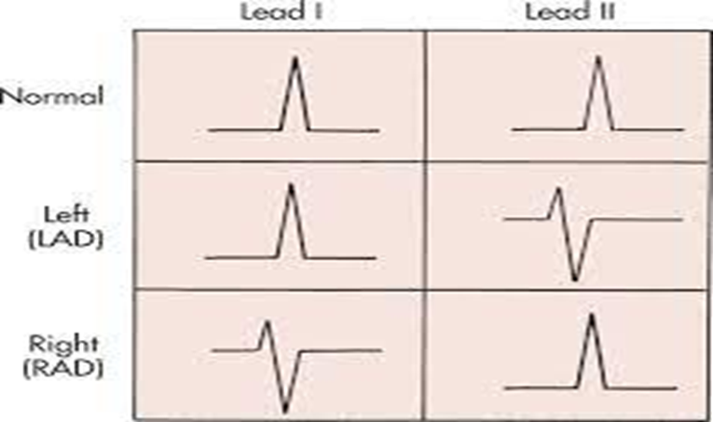

Slide 63
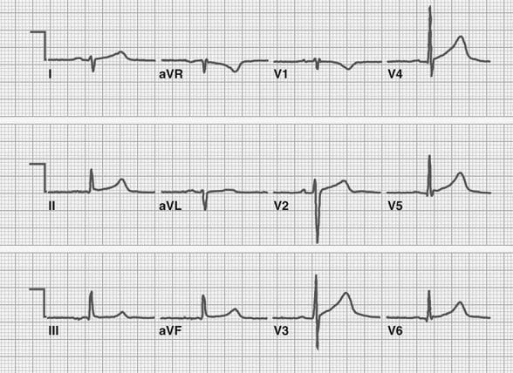
LAHB: Left axis deviation with qR in I and aVL, and rS in II, III, aVF.
LPHB: Right axis deviation with rS in I and aVL, and qR in II, III, aVF.

Slide 64
bifascicular block
The combination of RBBB and left anterior or posterior hemiblock is known as bifascicular block.
LBBB usually signifies important underlying heart disease and also causes ventricular incoordination, which may aggravate symptoms in patients with heart failure.
This can be treated in selected patients by cardiac resynchronization therapy.
The ECG findings include a combination of features of both hemiblock and right bundle branch block
Trifascular block :RBBB + hemiblock + 1st degree AVB.

Slide 65
right bundle branch block combined with left anterior hemiblock. Note the widened QRS complex and rabbit ears in leads V1 and V2, characteristic of right bundle branch block, and the left axis deviation in the limb leads (the QRS complex is predominantly positive in lead I and negative in leads aVF and II) that suggests left anterior hemiblock

Slide 66
Not every conduction block meets all the criteria for a bundle branch block or bifascicular block. These are extremely common and generally fall into two types:
1-A nonspecific intraventricular conduction delay occurs when there is QRS widening greater than 0.10 seconds without the other criteria for either bundle branch block or bifascicular block ,a conduction disorder due to cardiomyopathies, genetic disorders and ischemic heart disease.
2-An incomplete bundle branch block occurs when the EKG tracing shows a left or right bundle branch appearance (e.g., rabbit ears in V1 in right bundle branch block), but the QRS duration is between 0.10 and 0.12 seconds.
These conduction blocks are caused by the same disease processes that cause the other conduction blocks.

