Slide 1
Delusional Disorders Presented by: Ghadeer AlManaseer and Lujain Dghaimat

Slide 2
Delusions?
Delusions are fixed, false beliefs that persist despite evidence to the contrary and that do not make sense within the context of an individual’s cultural background. Delusions are classified as bizarre (impossible to be true) or nonbizarre (at least possible).
Bizarre example: “Aliens are spying on me through a Wi-Fi connection in my brain.”
Non-bizarre example: “The neighbors are spying on me by reading my e-mail.”
Expressed in speech by patient him/herself.
Delusions are characteristic for Psychosis.

Slide 3
Psychosis?
Psychosis is a general term used to describe a distorted perception of reality.
Three main manifestations:
1: Delusions
2: Hallucinations
3: Disorganized thoughts
Occurs in medical and psychiatric disorders:
Delirium / Schizophrenia / Mania / Depression / Dementia

Slide 4
Delusional Disorders..
Delusional disorder occurs more often in middle-aged or older patients (after age 40).
Delusional disorder is different than delusions; delusion is a symptom while delusional disorder is a disorder itself.

Slide 5
Population prevalence of DD: approximately 0.2%
Incidence: 0.7-3.0 /100,000
a lower frequency than that of other psychoses (e.g., schizophrenia and bipolar disorder.
Pathogenesis: abnormalities in the medial frontal, anterior cingulate cortex and insula in DD.
DMS-5 reports no gender differences in the frequency of delusional disorder, several studies have found Erotomania to be more frequent in women.
Reference in on last page…

Slide 7
1) Persecutory Delusions
- Irrational belief that one is being persecuted. His/her resulting actions are generally consistent with these concerns.
- Example: “The Central Intelligence Agency (CIA) is monitoring me and tapped my cell phone.”

Slide 8
2) Grandiose delusions
- Delusions of having a great talent. They believe they have a special powers beyond those of a normal person.
Features of the patient’s thinking may suggest the grandiosity associated with mania, but in the delusional disorder, the mood disturbance and behaviors characteristic of mania are not present.
Example:
“I am a millionaire!”

Slide 9
3) Erotomaniac delusions
- A type pf Delusion that another person is in love with the individual. Usually this person is famous, not of the patient’s social circle and not attainable.
- Example:
“Angelina Jolie is in love with me!”

Slide 10
4) Ideas of reference
Belief that cues in the external environment are uniquely related to the individual.
Example:
“The television news caster is talking about me!”

Slide 11
5) Delusions of control
Thought broadcasting:
(belief that one’s thoughts can be heard by others)
Thought Insertion:
(belief that outside thoughts are being placed in one’s head).

Slide 12
6) Somatic Delusions
- Belief that one has a certain illness or health condition.
- Example:
“There are worms in my chest!”

Slide 13
7) Delusions of guilt
- Belief that one is guilty or responsible for something.
- Example:
“I am responsible for all the world’s wars.”

Slide 14
8) Jealous type
- Patient beliefs that the one he loves ( spouse or lover) is unfaithful and cheating on him, trying with every chance to prove this belief.
*The delusion of jealousy can lead to aggressive, threatening, and possibly violent behavior, including homicide and suicide.

Slide 15
9) Mixed Type
More than one of the above.
10) Unspecified Type
Not a specific type as described above; it cannot be clearly determined.

Slide 16
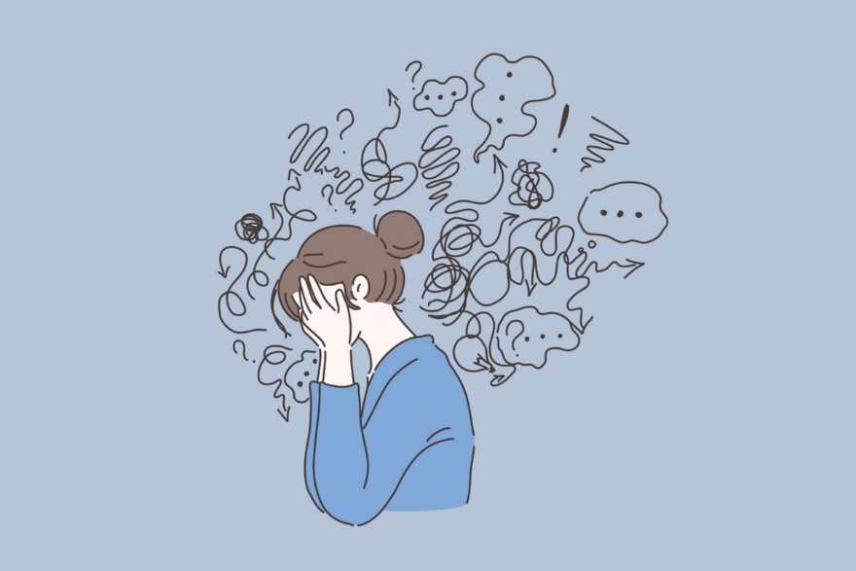
Clinical features
A. The presence of a non-bizarre delusion is the cardinal feature of this disorder .
B.Other symptoms that might appear include:
1-An irritable, angry, or low mood
2-Hallucinations
3-Mood, Feelings, and Affect.
4-Insight.

Slide 17
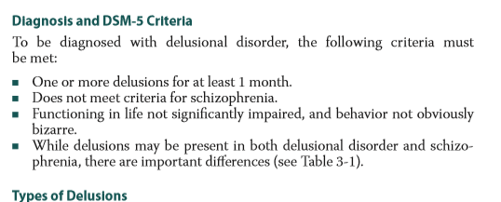
DIAGNOSIS

Slide 18
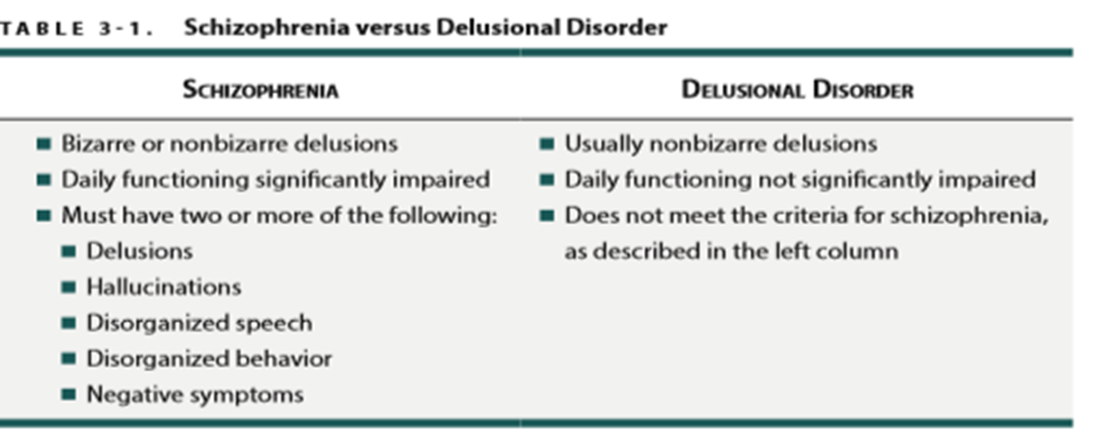

Slide 19
Prognosis
The prognosis of delusional disorder is better with treatment and medication compliance.
Almost 50% of patients have a good response to medications.
more than 20% of patients report a decrease in symptoms .
less than 20% of patients report minimal to no change in symptoms.
A good prognosis is also related to:
higher social and occupational functioning.
early-onset before age 30 years.
female.
sudden onset of symptoms.
short duration.
Delusional disorder is typically a chronic (ongoing) condition, but when properly treated, many people with this disorder can find relief from their symptoms.

Slide 20
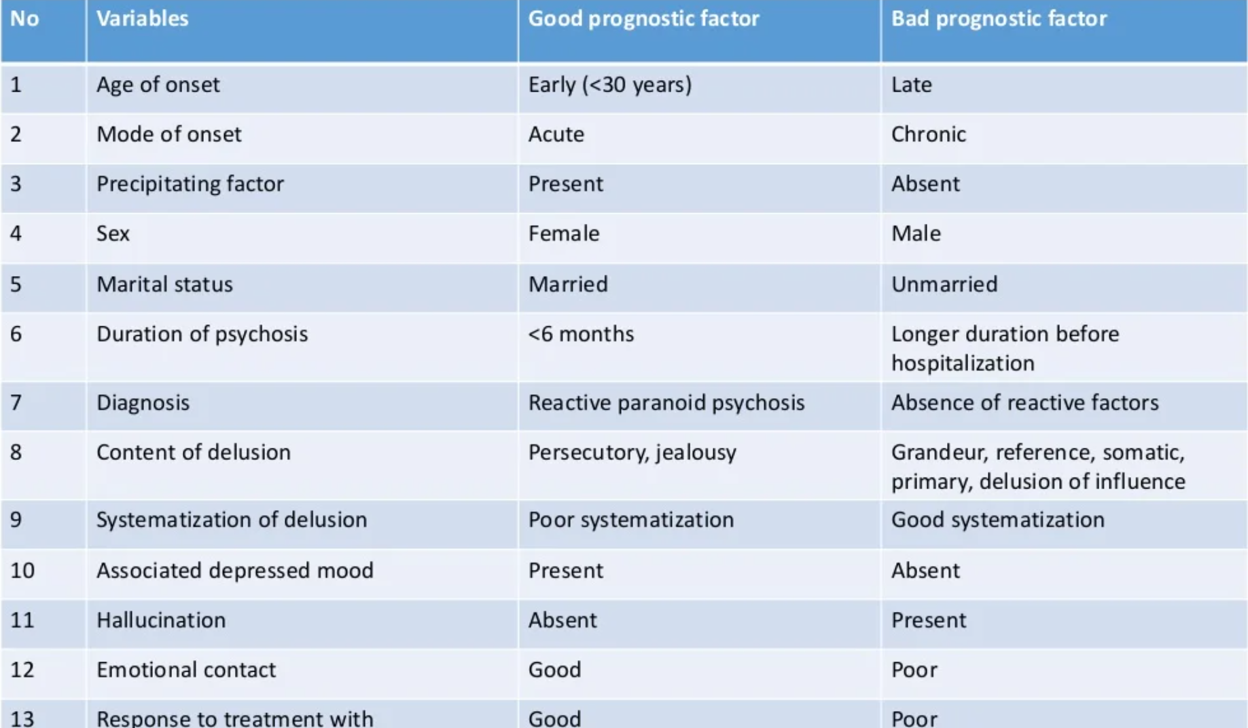

Slide 21
Management &Treatment
1-PSYCHOTHERAPY:
A good doctor-patient relationship is a key to treatment success.
2-HOSPITALIZATION
3-ELECTROCONVULSIVE THERAPY
4-COGNITIVE THERAPY:
helps the person learn to recognize and change thought patterns and behaviors that lead to troublesome feelings.
5-PHARMACOLOGICAL TREATMENT

Slide 22
References
First Aid for the Psychiatry clerkship
https://jpbs.hapres.com/UpLoad/PdfFile/jpbs_1023.pdf
National library of medicine
https://www.ncbi.nlm.nih.gov/books/NBK539855/

Slide 23
Thank You

