Slide 1
Introduction :-
Restriction Endonuclease (Restriction Enzyme) is a bacterial enzyme that cuts dsDNA into fragments after recognizing specific nucleotide sequence known as recognition or restriction site. and have evolved to provide a defense mechanism against invading viruses.
Restriction Enzymes are believed to be evolved by bacteria to resist viral attack.
Restriction Enzymes are also known as molecular scissor.

Slide 2
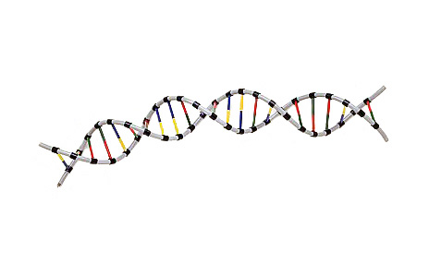
Restriction Enzymes scan the DNA sequence
Find a very specific set of nucleotides
Make a specific cut
Restriction enzymes recognize and make a cut within specific palindromic sequences, known as restriction sites, in the DNA. This is usually a 4- or 6 base pair sequence.

Slide 3
Picking a palindrome Words that read the same forwards as backwards
Hannah
Level
Madam
hannaH
leveL
madaM

Slide 4
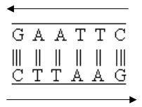
Palindromes in DNA sequences
Genetic palindromes are similar to verbal palindromes.
A palindromic sequence in DNA is one in which the 5’ to 3’ base pair sequence is identical on both strands.
5’
3’
3’
5’

Slide 6
NOMENCLATURE OF RESTRICTION ENZYME
Each enzyme is named after the bacterium from which it was isolated using a naming system based on bacterial genus, species and strain.
For e.g EcoRI
Derivation of the EcoRI name
Abbreviation | Meaning | Description
E | Escherichia | genus
co | coli | species
R | RY13 | strain
I | First identified | order of identification in the bacterium

Slide 7
How Restriction Endonucleases work ?
Restriction enzymes recognize a specific sequence of nucleotides, and produce a double-stranded cut in the DNA. these cuts are of two types:
Blunt end
Sticky end

Slide 8
Hae III
HaeIII is a restriction enzyme that searches the DNA molecule until it finds this sequence of four nitrogen bases.
5’ TGACGGGTTCGAGGCCAG 3’
3’ ACTGCCCAAGGTCCGGTC 5’

Slide 9
Once the recognition site was found HaeIII could go to work cutting (cleaving) the DNA
5’ TGACGGGTTCGAGGCCAG 3’
3’ ACTGCCCAAGGTCCGGTC 5’

Slide 10
These cuts produce what scientists call “blunt ends”
5’ TGACGGGTTCGAGG CCAG 3’
3’ ACTGCCCAAGGTCC GGTC 5’

Slide 11
“blunt ends” and “sticky ends”
Remember how HaeIII produced a “blunt end”?
EcoRI, for instance, makes a staggered cut and produces a “sticky end”
5’ GAATTC 3’
3’ CTTAAG 5’
5’ GAATTC 3’
3’ CTTAAG 5’
5’ G AATTC 3’
3’ CTTAA G 5’

Slide 12
blunt end
sticky end

Slide 13
Some more examples of restriction sites of restriction enzymes with their cut sites:
HindIII: 5’ AAGCTT 3’
3’ TTCGAA 5’
BamHI: 5’ GGATCC 3’
3’ CCTAGG 5’
AluI: 5’ AGCT 3’
3’ TCGA 5’

Slide 14
Categorization of Restriction Enzymes on the bases of
Their composition.
Enzyme co-factor requirement.
the nature of their target sequence.
position of their DNA cleavage site relative to the target sequence.

Slide 15
Restriction Endonuclease Types
Type I- multi-subunit, both endonuclease and methylase activities, cleave at random up to 1000 bp from recognition sequence
Type II- mostly single subunit, cleave DNA within recognition sequence
Type III- multi-subunit, endonuclease and methylase about 25 bp from recognition sequence

Slide 17
Separating Restriction Fragments, I

Slide 18
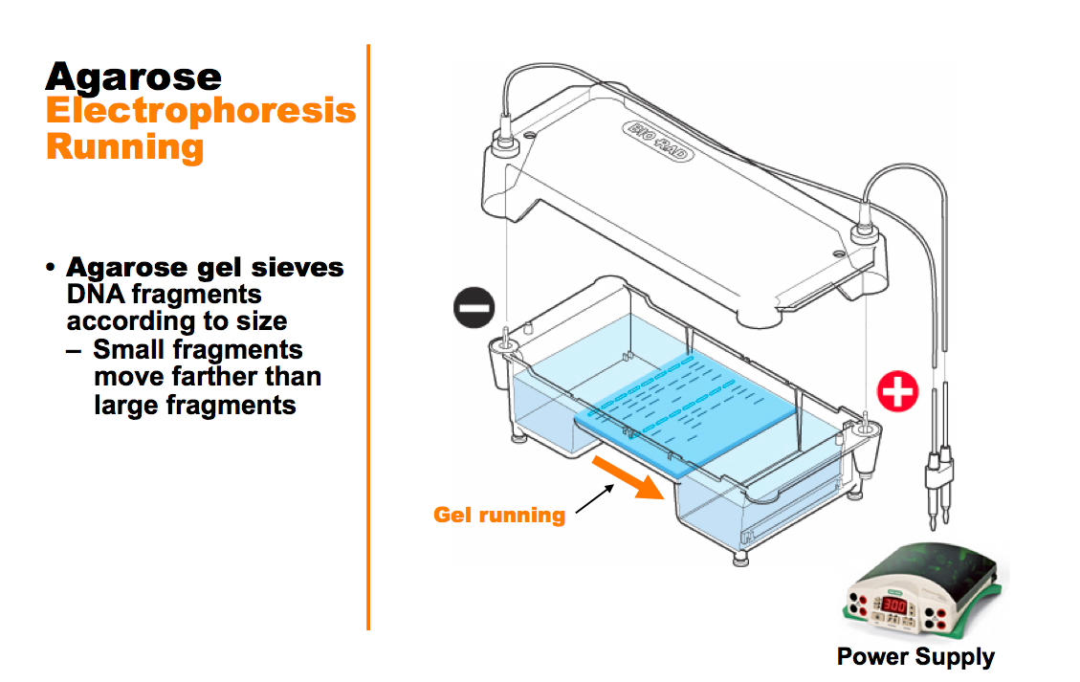
Separating Restriction Fragments, II

Slide 19
Blunt ends
Some restriction enzymes cut DNA at opposite base
They leave blunt ended DNA fragments
These blunt ended fragments can be joined to any other DNA fragment with blunt ends.
Enzymes useful for certain types of DNA cloning experiments
.

Slide 20
Sticky ends
Most restriction enzymes make staggered cuts
Staggered cuts produce single stranded “sticky-ends”

Slide 21
“Sticky Ends” Are Useful
DNA fragments with complementary sticky ends can be combined to create new molecules which allows the creation and manipulation of DNA sequences from different sources.

Slide 22
ISOSCHIZOMERS & NEOSCHIZOMERS
Restriction enzymes that have the same recognition sequence as well as the same cleavage site are Isoschizomers
Restriction enzymes that have the same recognition sequence but cleave the DNA at a different site within that sequence are Neoshizomers
Eg: SmaI and XmaI C C C G G G
C C C G G G
G G G C C C
G G G C C C
Xma I
Sma I

Slide 23
APPLICATION OF RESTRICTION ENZYMES
They are used in gene cloning and protein expression experiments.
Restriction enzymes are used in biotechnology to cut DNA into smaller strands in order to study fragment length differences among individuals (Restriction Fragment Length Polymorphism – RFLP).
Each of these methods depends on the use of agarose gel electrophoresis for separation of the DNA fragments.

Slide 24
What is RFLP
RFLP is a difference in homologous DNA sequences that can be detected by the presence of fragments of different lengths after digestion of the DNA samples.

Slide 25
Method of DNA analysis by RFLP
The method of analysis of DNA by RFLP involves the following steps:
1- In the first step fragmentation of a sample of DNA is done by a restriction enzyme, which can recognize and cut DNA wherever a specific short sequence occurs, in a process known as a restriction digest.

Slide 26
The resulting DNA fragments are then separated by length through a process known as agarose gel electrophoresis.
Then transferred to a membrane via the Southern blot procedure.
Hybridization of the membrane to a labeled DNA probe will done and then determines the length of the fragments which are complementary to the probe.

Slide 27
5- Then we will observe the fragments of different length.
An RFLP occurs when the length of a detected fragment varies between individuals. Each fragment length is considered an allele, and can be used in genetic analysis.

