Slide 1
Shock
Mutah University
Medicine Collage
Presentation: supervised by:
Dr.Ashraf Aldmour
Sadeel abuhalimeh
Waleed zakariya
Abdulrahman Aljafary
Vildana sabra
Sora Dmour
Tuqa Abunawas
Anas saed

Slide 2
Objectives:
Definition
Pathophysiology
Diagnosis
Stages
Types

Slide 3
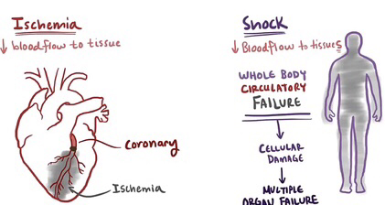
1. Definition of Shock
- Shock is defined as life-threatening condition of circulatory failure that leads to inadequate perfusion (hypo perfusion)and inadequate oxygen delivery to the tissues.
- Cellular and tissue hypoxia tissue death and organ dysfunction.
- The effect of shock is initially reversable but if left untreated or the treatment is delayed it rapidly becomes irreversible .

Slide 4
Shock results from a change in one or a combination of the following:
Cardiac output
Intravascular Blood Volume
Systemic Vascular Resistance
myocardial function
- The clinical manifestations of shock are the results of stimulation of the sympathetic and neuroendocrine system responses inadequate oxygen delivery and organs dysfunction .

Slide 5
2. Pathophysiology
The fundamental defect in shock is reduced perfusion of tissues.
Once perfusion declines and oxygen delivery to cells is inadequate for aerobic metabolism, cells shift to anaerobic metabolism with increased production of carbon dioxide and elevated blood lactic acid levels.
Tissue acidosis → interfere with cell membrane function → intracellular K is lost with Na & H20 accumulate into the cells → cellular edema.
Rupture of lysosomes → liberation of destructive proteolytic enzymes → cellular destruction → multiple organ failure

Slide 6
Inadequate perfusion
oxygen delivery
Cellular hypoxia
Lactic acid build up and ph
(due to switch of aerobic metabolism to anaerobic metabolism)
Metabolic acidosis
(type A lactic acidosis)
Cell membrane permeability and pumps dysfunction
Cell death

Slide 7
3. Key diagnostic factors (history and Phy.E)
Positive Risk factors (history of sepsis, recent MI, history of haemorrhage, trauma, surgery, exposure to known allergen, change in medications, significant co-morbidities)
Fever (suggests septic shock)
Chest pain (suggests MI)
Dyspnea (Respiratory rate may be increased because of hypoxia (e.g., in pneumonia) but will often remain elevated despite correction of PaO2 due to the need of compensatory hyperventilation of the generated metabolic acidosis.)
Hypoxemia
Hypothermia (it is the most obvious clinical sign of end-stage irreversible shock of any cause.)
1. Hypotension (defined as decrease of ≥40 mmHg from baseline. Occurs in most patients but a normal BP doesn’t rule out shock)
Tachycardia (may be an earlier sign of shock than hypotension as compensatory mechanisms can maintain cardiac output)
skin changes (cold sweaty skin, clammy peripheries, mottled, ashen appearance, skin cyanosis (besides lips and tongue cyanosis))
Oliguria (consider inserting a urinary catheter, oliguria is defined as <0.5 ml/kg/hr.)
Mental state changes (use GCS/Agitation, confusion, and distress occur early. Unresponsiveness indicates severe and advanced shock.)

Slide 8
Diagnostic Investigations
Lactate (From arterial blood gas) (result: >2mmol/L)
Arterial blood gas or venous blood gas (result: Metabolic acidosis; pH < 7.35, bicarbonate <22)
Glucose (result: > 7mmol/L or > 126mg/dL in non diabetic patients)
Blood test:
CBC (result: Hb < 100g/L suggests haemorrhages, WBC >12 x 10³/ macro-litre if sepsis is present.)
Urea and electrolytes (evidence of renal impairment if kidney perfusion is compromised for example hypokalemia and hypernatremia with diarrhea and vomiting (hypovolaemic shock)
Coagulation studies (result: PT, PTT, fibrinogen; prolonged with DIC in septic shock)
C-reactive protein (result: high values suggest sepsis)
ECG (evidence of MI, arrhythmias, electrolyte abnormalities)
CXR: look for pulmonary oedema, pneumonia, pneumothorax, widened mediastinum (e.g., due to aortic dissection).
NB:
Resuscitation should not delay while investigating the etiology of undifferentiated shock.Use an ABCDE approach to manage shock empirically.

Slide 9
Use an ABCDE approach to manage shock empirically
ABCDE | Assessment | Treatment
A – Airways | Voice changes Breath sounds (stridor, snores, or increased breathing effort) | Airway opening manoeuvre Airway suction Consider inserting an oropharyngeal or nasopharyngeal airway in deeply unconscious patients <8 GCS
B – Breathing | Respiratory rate Chest wall expansion Chest percussion Lung auscultation Pulse oximetry | Seat comfortably Inhaled medications Bag-mask ventilation Decompress tension pneumothorax (needle thrococentesis)
C – Circulation | Skin color, sweating Capillary refill time (normally <2 s) Palpate pulse rate (60–100/ min) Heart auscultation Blood pressure (systolic 100–140 mmHg) ECG monitoring | Stop bleeding Elevate legs intravenous access with crystalloid fluid administration
D – Delivery of oxygen/ Disability | Assess arterial oxygen saturation Mixed venous oxygenation Cardiac index For disability; Assess consciousness level/mental status/ movement/ reflexes | Decrease oxygen demands (Provide analgesia and anxiolytics to relax muscles and avoid shivering) Maintain arterial oxygen saturation (Give supplemental oxygen/ Maintain Hemoglobin > 10 g/dL) Serial lactate levels or central venous oxygen saturations to assess tissue oxygen extraction
E – Exposure and End points of resuscitation | Exposure and temp assessment Assess goal values | Make sure your approach is gaol-directed : Urine output > 0.5 mL/kg/hr CVP 8-12 mmHg MAP 65 to 90 mmHg Central venous oxygen concentration > 70%

Slide 10
4. stages
Pre-shock or compensated shock - As the name suggests, this stage is characterized by compensatory mechanisms to counter the decrease in tissue perfusion, including tachycardia, peripheral vasoconstriction, and changes in systemic blood pressure.
2. Shock - During this stage, most of the classic signs and symptoms of shock appear due to early organ dysfunction, resulting from the progression of the pre-shock stage as the compensatory mechanisms become insufficient.
3. End-organ dysfunction - This is the final stage, leading to
irreversible organ dysfunction, multi-organ failure, and death

Slide 11
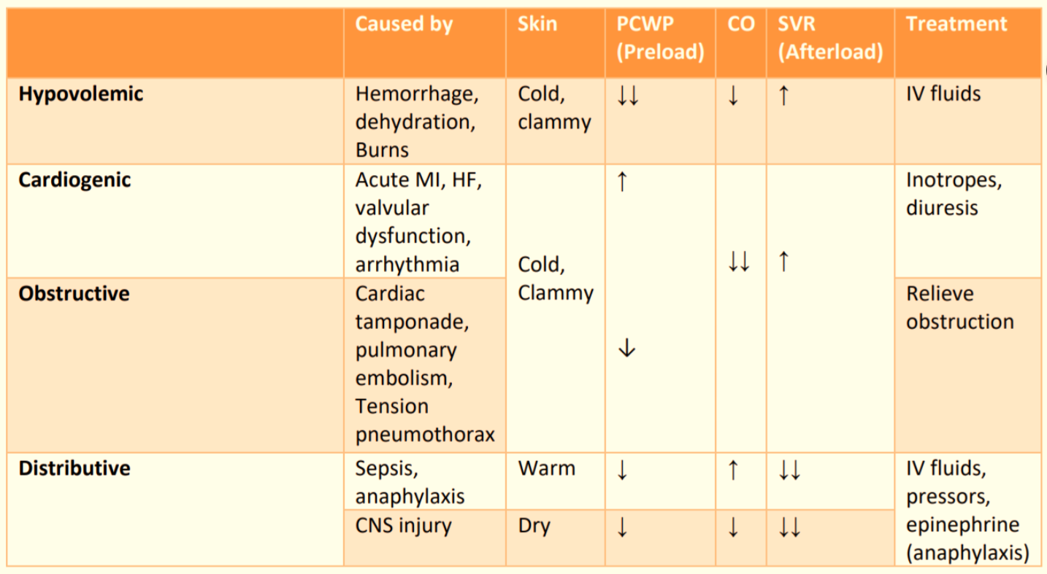
5. Types
constrictive pericarditis

Slide 12
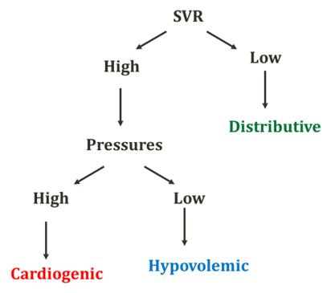
Distributive shock
The hallmark is low SVR (systemic venous resistant)
Diffuse vasodilation and/or endothelial dysfunction
Notes:
- Cardiac output classically is high (but in the real life is variable)
- Cardiac pressure variable

Slide 13
1.Septic shock
Defined as :
hypotension induced by sepsis that persists despite adequate fluid resuscitation. This results in hypoperfusion and can ultimately lead to multiple organ system failure and death
Common causes :
include pneumonia, urinary tract infection, meningitis, abscess formation, cholangitis, cellulitis, and peritonitis.

Slide 14
Pathophysiology:
There is a severe decrease in SVR secondary to peripheral vasodilation. Extremities are often warm due to vasodilation.
Cardiac output is normal or increased (due to maintenance of MAP).
EF is decreased secondary to a reduction in contractility

Slide 15
Clinical signs:
Hyperthermia
Tachycardia
Wide pulse pressure
Low blood pressure
Mental status changes

Slide 16
Diagnosis:
1. Septic shock is essentially a clinical diagnosis.
2. A source of infection can aid in diagnosis, but there may be no confirmed source in some cases.

Slide 17
Treatment :
1.Fluid administration to increase mean BP (Goal: MAP > 60)
2. Obtain cultures prior to starting antibiotics. Start IV antibiotics (broad spectrum) at maximum dosages. If cultures are positive, antibiotics can be narrowed based on sensitivity testing.
3. Surgical drainage if necessary.
4. Vasopressors (norepinephrine, vasopressin, phenylephrine) may be used if hypotension persists despite aggressive IV fluid resuscitation.

Slide 18
2. Anaphylactic shock
Definition : is a severe systemic hypersensitivity reaction , characterized by rapidly developing life-threatening airway &/or circulation problems , usually associated with skin & mucosal changes
Types of anaphylactic shock
1- IgE. Mediated
2- Non IgE. Mediated
3- Idiopathic : increased mast cell sensitivity & degranulation // unrecognized allergens

Slide 19
IgE. Mediated shock
Allergen entry : ingestion , inhalation , parenteral or skin contact
formation of immunoglobulin IgE. Antibodies specific to the antigen presented on first exposure how ? :
“ allergen first exposure , when enter the body processed by macrophages which will express the allergen on their surface by the MHC-2 complex → Th cells bind to the antigen presenting cell by their receptors “ TCR & CD4 “ → Th cell produce chemical mediators that release different types of interleukins “ IL-2 , IL-4 , IL-5 “ which stimulates B cell → B cell then converted to plasma cells which produce antibodies against the allergen

Slide 20
IgE. Mediated shock
- IgE antibodies attach to high affinity Fc receptors on basophils & mast cells
- On subsequent exposure , binding of antigen to the IgE. Antibodies leads to bridging & triggers the degranulation of mast cells “ histamine release “
Non IgE. Mediated shock
Activation of complement system
The complement peptides “ anaphylatoxin “ such as C3a & C5a directly act on mast cells & basophils leading to mediator release

Slide 21
Possible causative agent of Anaphylactic shock:
1) IgE mediated: Food, Airborne allergens, Latex, Venom, insect sting, Medication, Semen
2) Immunologic non IgE mediated: Immune aggregate, Intravenous immunoglobulin, Medication (NSAIDs), Radiocontrast media
3) Non immunologic: Opiates, Physical factors (e.g., exercise, cold, heat)
4) Idiopathic

Slide 22
• Clinical presentation of Anaphylactic shock:
Sudden onset and rapid progression of symptoms.
Firstly: Pruritus, flushing, urticaria (hives)
Next: swelling, angioedema, trouble swallowing, trouble breathing/shortness of breath, wheezing, hoarse voice, stridor.
Finally: Altered mental status, respiratory distress, bradycardia followed by respiratory failure and cardiac arrest.
Both poorly controlled asthma and previous anaphylaxis are risk factors for fatal anaphylaxis.

Slide 23
Treatment of anaphylactic shock
A) In Cardiorespiratory arrest
1. Start CPR and advanced life support
2. Call for help
3. Don’t give intramuscular adrenaline

Slide 24
Treatment of anaphylactic shock
B) Not in Cardiorespiratory arrest
1. ABCDE principles
2. Position the patient (lie flat with their legs raised ) and remove the trigger
3. IM adrenaline, repeat if not responding after 5min
4. High-concentration oxygen
5. IV crystalloid fluid to counteract fluid shifts associated with vasodilation
6. Vital signs monitor.
7. Consider the following:
- Nebulized adrenaline (if marked stridor)
- Nebulized short acting B2 agonist (if bronchoconstriction and wheezing)
- IV atropine (if bradycardic)
- IV glucagon (if patient is on B blocker and not responding to adrenaline)
Treatment is complex because:
• Hypotension, tachycardia, and adrenaline may cause myocardial ischemia by reducing perfusion during diastole.
• The alpha-1 agonist action of adrenaline can lead to severe hypertension/hypertensive crisis.

Slide 25
Biphasic reaction: Potential second reaction that can occur between 4 and 12 hours after the initial reaction.
To prevent biphasic reaction:
1. Antihistamine
2. Corticosteroids
3. If symptoms recur manage the patient as you would for an initial anaphylactic reaction
4. Review by a senior clinician.

Slide 26
3. Neurogenic Shock
General characteristic
It results of failure of the sympathetic system to maintain the vascular tone
Its causes could be injury of the spinal cord injury( from T6 and above ) , sever head injury , spinal anesthesia or pharmacologic sympathetic block
It does characterize as peripheral vasodilation and decrease in SVR

Slide 27
Clinical features
Warm , well perfused skin
Bradycardia and hypotension
Decrease in CO , CVP and Pulmonary capillary wedge pressure
Hypothermia in the core
Treatment
protect the spinal cord
Supportive of IV fluids
Vasoconstrictores
Ionotropic dopamine atropine or even pacing

Slide 28
Obstructive shock
General characteristic
Machanical obstruction of the blood flow , could be PE , cardiac tamponade or tension pneumothorax . Cardiac output limited by obstruction, SVR makes a compensatory increase to maintain systemic blood pressure. elevated JVP due to limited filling of right ventricle or obstruction
Treatment
first diagnose the underlying cause Supportive IV fluid
# PE : thrombolytics , heparin or thrombectomy
# cardiac tamponade : pericardiocentesis pericardial window
# tension pneumothorax : needle decompression or chest tube

Slide 29
Hypovolemic Shock
Definition: Reduced circulating blood volume with secondary decreased cardiac output
Causes:
a) Hemorrhagic (blood loss) b) Non-Hemorrhagic (fluid loss)
✓ GI bleeding ✓Vomiting
✓ Trauma ✓ Diarrhea
✓Massive hemoptysis ✓Bowel obstruction
✓post-partum bleeding. ✓Burns
✓Ectopic pregnancy. ✓Dehydration

Slide 30
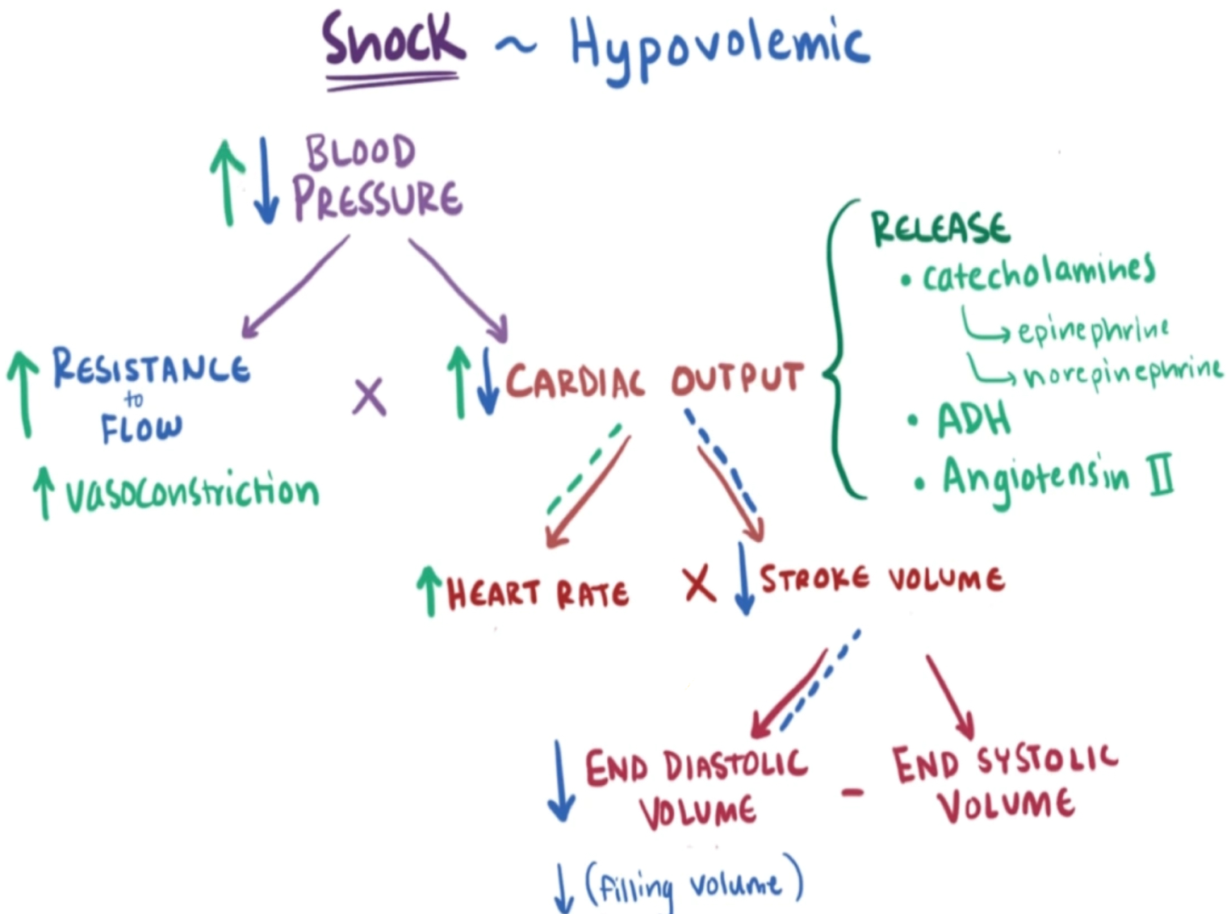
Signs & Symptoms:
↓cardiac output
↓PAOP (pulmonary artery occlusion/ wedge pressure)
↑SVR (systemic vascular resistant)
Hypotension
Tachycardia, tachypnea
Cool, clammy skin
Pallor
oliguria

Slide 31
Evaluation of Hypovolemic Shock
✓ CBC
✓ ABG
✓ Electrolytes
✓ Coagulation studies
✓ Type and cross-match
✓ As indicated:
CXR, Pelvic x-ray , CT (abdominal) , GI endoscopy , Vascular radiology

Slide 32
Management of hypovolemic shock:
✓ Control any bleeding
✓ ABCs
✓ Establish 2 large bore IVs or a central line
✓ Crystalloids: Normal Saline or Lactate Ringers: Up to 3 liters
✓ PRBCs: O negative or cross matched
✓ correct : Acidosis , coagulopathy , hypothermia

Slide 33
Cardiogenic shock
Definition: is a life-threatening condition in which your heart suddenly can't pump enough blood to meet your body’s needs
Caused by :
Arrhythmias: both bradycardia & tachycardia
Valvular lesions
Acute MI
Congestive heart failure
Congenital diseases like VSD
cardiomyopathies

Slide 34
Cardiogenic shock characterized by :
Decrease cardiac output
Increase PAOP “ pulmonary artery occlusion / wedge pressure “
Increase SVR “ as compensation to maintain drop in B.P “
Decrease left ventricular stroke work “ LVSW “

Slide 35
Pathophysiology of cardiogenic shock :
Often after ischemia there will be loss of left ventricle function “ considered clinical shock when there is loss of 40% of left ventricle “
decrease Cardiac output → hypoxia , lactic acidosis
Decrease stroke volume & as a compensation tachycardia develops

Slide 36
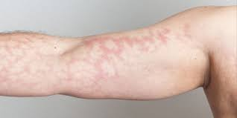
Signs of cardiogenic shock :
Cool , mottled skin
Tachypnea
Hypotension
Altered mental status
Murmur

Slide 37
Treatment :
Goals : airway stability & improving myocardial pump function
Cardiac monitor , pulse oximetry
Supplemental oxygen , IV fluid
Catheterization if ongoing ischemia
Preload augmentation : consider fluids
Contractility : dopamine , dobutamine
Afterload reduction : nitroglycerin , dobutamine
If inotropes & vasopressors fail , do an intra-aortic balloon pump

