Slide 1
PERIPHERAL NERVOUS SYSTEM
EXTERNAL & MIDDLE Ear
Dr. Aiman Qais Afar
Surgical Anatomist
College of Medicine / University of Mutah

Slide 2
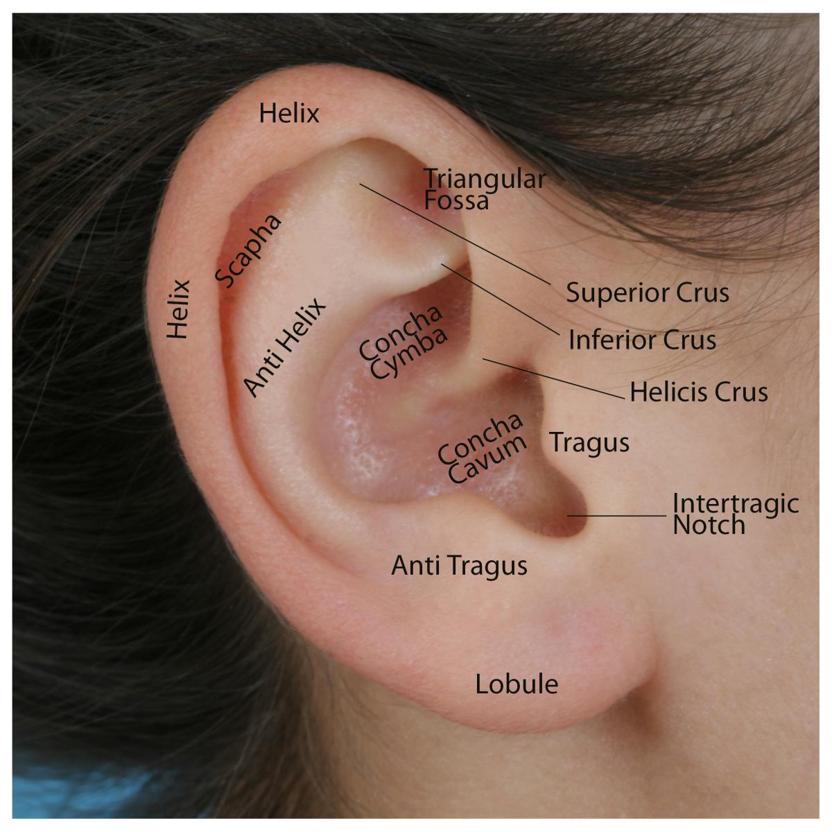
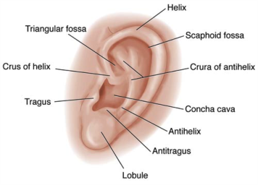
The Ear
The ear consists of the external ear; the middle ear, or tympanic cavity; and the internal ear, or labyrinth, which contains the organs of hearing and balance.
External Ear
It has an auricle and an external auditory meatus.
The auricle has a characteristic shape and collects air vibrations.
It consists of a thin plate of elastic cartilage covered by skin.
It possesses both extrinsic and intrinsic muscles, which are supplied by the facial nerve.

Slide 3
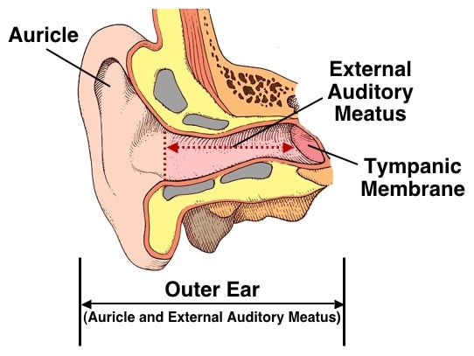
External Ear
The external auditory meatus is a curved tube that leads from the auricle to the tympanic membrane
The framework of the outer third of the meatus is elastic cartilage, and the inner two thirds is bone, formed by the tympanic plate.
The meatus is lined by skin, and its outer third is provided with hairs and sebaceous and ceruminous glands.

Slide 4
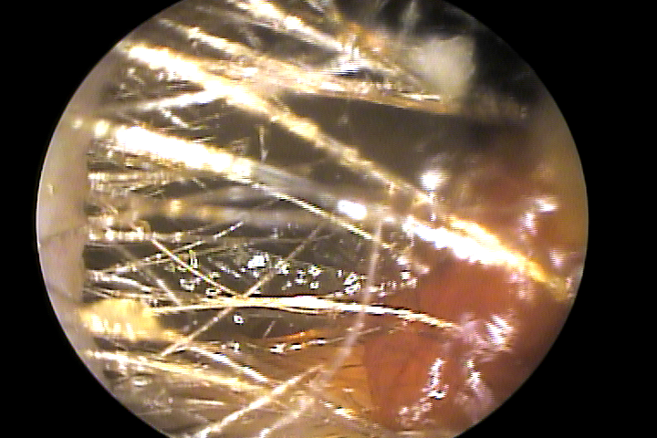
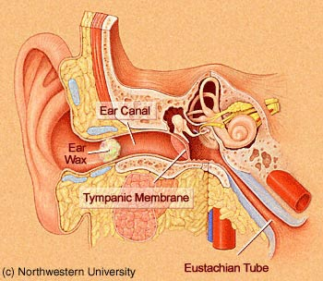
External Ear
The latter are modified sweat glands that secrete a yellowish brown wax.
The hairs and the wax provide a sticky barrier that prevents the entrance of foreign bodies.
The sensory nerve supply of the lining skin is derived from the auriculotemporal nerve and the auricular branch of the vagus nerve.
The lymph drainage is to the superficial parotid, mastoid, and superficial cervical lymph nodes.

Slide 5
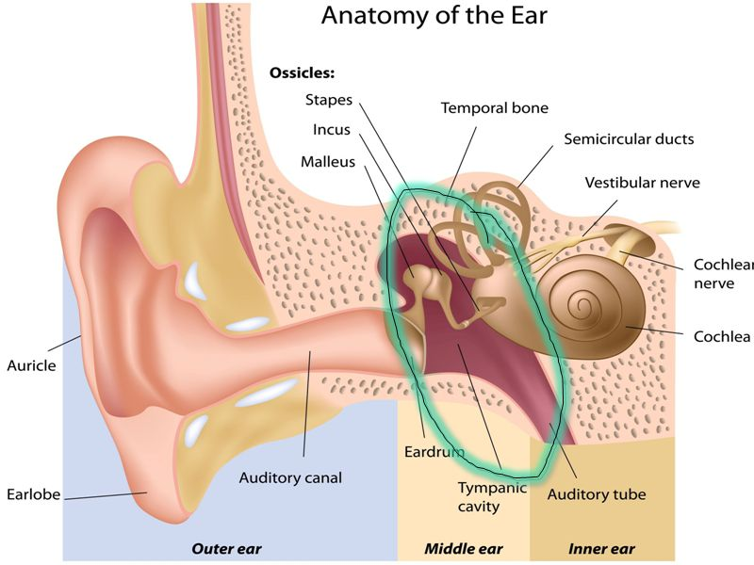
Middle Ear (Tympanic Cavity)
Is an air-containing cavity in the petrous part of the temporal bone and is lined with mucous membrane.
It contains the auditory ossicles, whose function is to transmit the vibrations of the tympanic membrane (eardrum) to the perilymph of the internal ear.
It is a narrow, oblique, slitlike cavity whose long axis lies approximately parallel to the plane of the tympanic membrane.
It communicates in front through the auditory tube with the nasopharynx and behind with the mastoid antrum.

Slide 6
Middle Ear (Tympanic Cavity)
It has a roof, floor, anterior wall, posterior wall, lateral wall, and medial wall.
The roof formed by the tegmen tympani, which is part of the petrous temporal bone
It separates the tympanic cavity from the meninges and the temporal lobe of the brain in the middle cranial fossa.
The floor is formed by a thin plate of bone, which may be partly replaced by fibrous tissue.
It separates the tympanic cavity from the superior bulb of the internal jugular vein

Slide 7
Middle Ear (Tympanic Cavity)
The anterior wall is formed below by a thin plate of bone that separates the tympanic cavity from the internal carotid artery
At the upper part of the anterior wall are the openings into two canals.
The lower and larger of these leads into the auditory tube,
and the upper and smaller is the entrance into the canal for the tensor tympani muscle

Slide 8
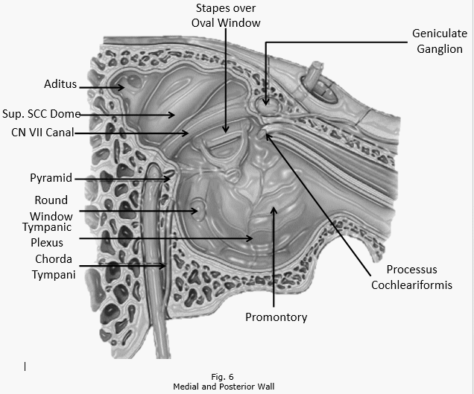
Middle Ear (Tympanic Cavity)
The posterior wall has in its upper part a large, irregular opening, the aditus to the mastoid antrum
Below this is a small, hollow, conical projection, the pyramid, from whose apex emerges the tendon of the stapedius muscle
The lateral wall is largely formed by the tympanic membrane
Lateral wall of the right middle ear viewed from the medial side. Note the position of the ossicles and the mastoid antrum.

Slide 9
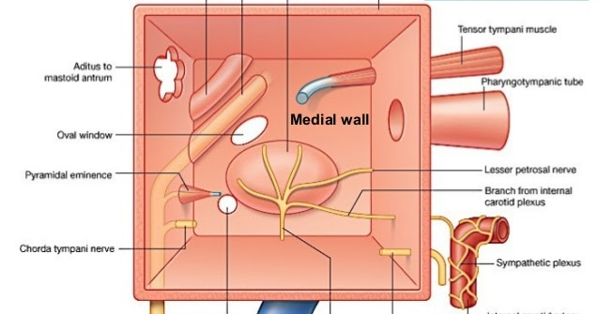
Middle Ear (Tympanic Cavity)
The medial wall is formed by the lateral wall of the inner ear. Which shows a rounded projection, called the promontory, which results from the underlying first turn of the cochlea
Above and behind the promontory lies the fenestra vestibuli, which is oval shaped and closed by the base of the stapes.
On the medial side of the window is the perilymph of the scala vestibuli of the internal ear.

Slide 10
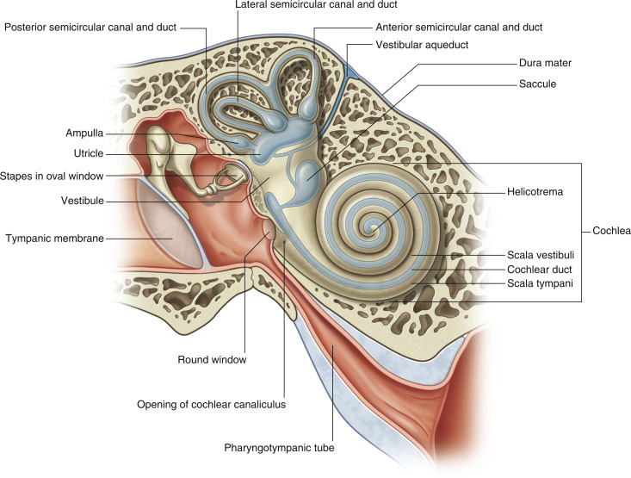
Middle Ear (Tympanic Cavity)
Below the posterior end of the promontory lies the fenestra cochleae, which is round and closed by the secondary tympanic membrane.
On the medial side of this window is the perilymph of the blind end of the scala tympani

Slide 11
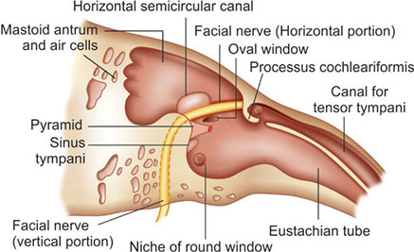
Middle Ear (Tympanic Cavity)
The bony shelf derived from the anterior wall extends backward on the medial wall above the promontory and above the fenestra vestibuli.
It supports the tensor tympani muscle.
Its posterior end is curved upward and forms a pulley, the processus cochleariformis, around which the tendon of the tensor tympani bends laterally to reach its insertion on the handle of the
malleus

Slide 12
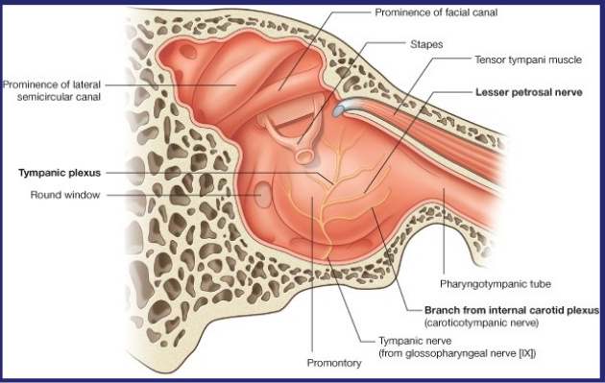
Middle Ear (Tympanic Cavity)
A rounded ridge runs horizontally backward above the promontory and the fenestra vestibuli and is known as the prominence of the facial nerve canal.
On reaching the posterior wall, it curves downward behind the pyramid

Slide 13
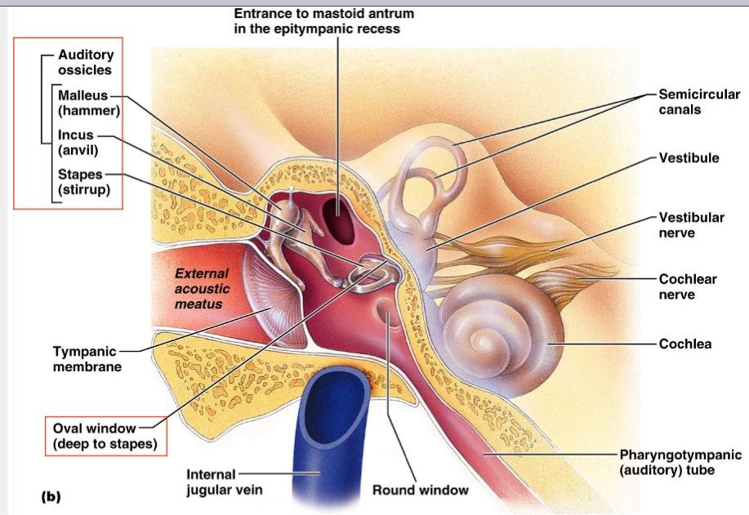
Middle Ear (Tympanic Cavity)
The tympanic membrane is a thin, fibrous membrane that is pearly gray.
The membrane is obliquely placed, facing downward, forward, and laterally.
It is concave laterally, and at the depth of the concavity is a small depression, the umbo, produced by the tip of the handle of the malleus.
When the membrane is illuminated through an otoscope, the concavity produces a “cone of light,” which radiates anteriorly and inferiorly from the umbo.

Slide 14
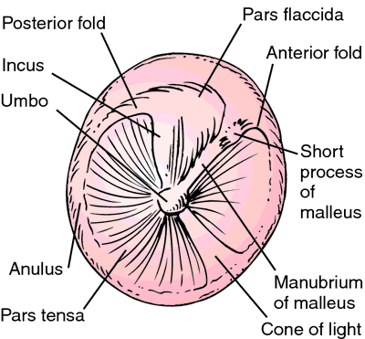
Middle Ear (Tympanic Cavity)
The tympanic membrane is circular and measures about 1 cm in diameter. The circumference is thickened and is slotted into a groove in the bone.
The groove, or tympanic sulcus, is deficient superiorly, which forms a notch.
From the sides of the notch, two bands, termed the anterior and posterior malleolar folds, pass to the lateral process of the malleus.
The small triangular area on the tympanic membrane that is bounded by the folds is slack and is called the pars flaccida

Slide 15
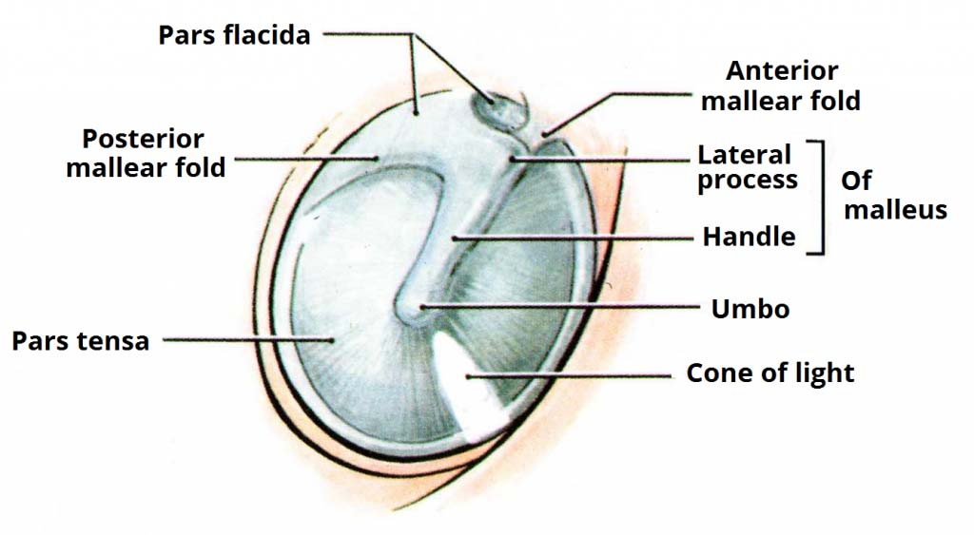
Middle Ear (Tympanic Cavity)
The remainder of the membrane is tense and is called the pars tensa.
The handle of the malleus is bound down to the inner surface of the tympanic membrane by the mucous membrane.
The tympanic membrane is extremely sensitive to pain and is innervated on its outer surface by the auriculotemporal nerve and the auricular branch of the vagus.

Slide 16
Auditory Ossicles
The auditory ossicles (malleus, incus, and stapes) form a mobile chain of small bones across the tympanic cavity from the tympanic membrane to the oval window (L. fenestra vestibuli), an oval opening on the labyrinthine wall of the tympanic cavity leading to the vestibule of the bony labyrinth
The ossicles are covered with the mucous membrane lining the tympanic cavity, but unlike other bones of the body, they are not directly covered with a layer of periosteum.

Slide 17
Auditory Ossicles
The malleus (L. hammer) is attached to the tympanic membrane
Its rounded head lies superiorly in the epitympanic recess.
The neck lies against the flaccid part of the tympanic membrane, and the handle is embedded in the tense part of the tympanic membrane with its tip at the umbo.
The head of the malleus articulates with the incus; the tendon of the tensor tympani inserts into the handle of the malleus.

Slide 18
Auditory Ossicles
The incus (L. anvil) links (articulates with) the malleus and the stapes
The body of the incus lies in the epitympanic recess where it articulates with the head of the malleus.
The long limb lies parallel to the handle of the malleus, and its inferior end articulates with the stapes by way of the lenticular process.
The short limb is connected by a ligament to the posterior wall of the tympanic cavity

Slide 19
Auditory Ossicles
The stapes (L. stirrup) is the smallest ossicle
The base (footplate) of the stapes is attached to the margins of the oval window on the labyrinthine wall.
The base is considerably smaller than the tympanic membrane; as a result, the vibratory force of the stapes is increased approximately 10 times over that of the tympanic membrane.
Consequently, the auditory ossicles increase the force but decrease the amplitude of the vibrations transmitted from the tympanic membrane.

Slide 20
PHARYNGOTYMPANIC TUBE
The auditory tube connects the anterior wall of the tympanic cavity to the nasal pharynx
Its posterior third is bony, and its anterior two thirds is cartilaginous.
As the tube descends, it passes over the upper border of the superior constrictor muscle
It serves to equalize air pressures in the tympanic cavity and the nasal pharynx.

Slide 21
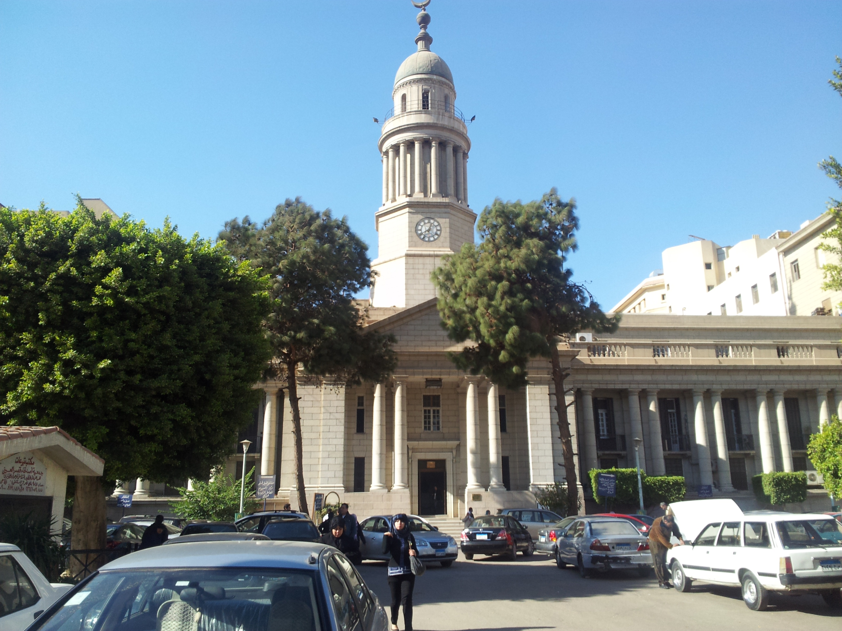
Dr. Aiman Qais Afar
Wednesday 9 March 2021

