Slide 1
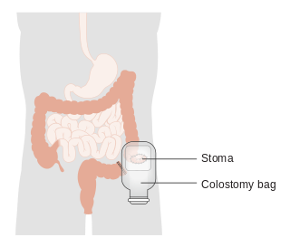
Colostomy
Jude alshawabkeh
Lana alhusban

Slide 2
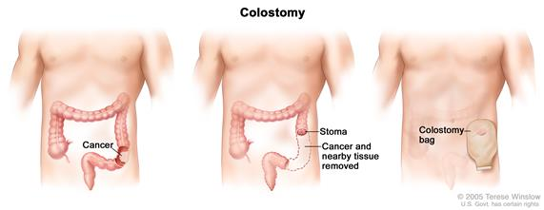
A colostomy :
is an artificial opening made in the colon to divert faeces and flatus outside the abdomen where they can be collected in an external appliance

Slide 3
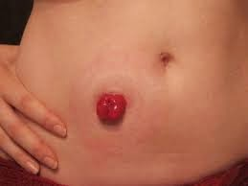
Normal stoma :
Above the skin level
Red and moist
Normal surrounding skin
It has no nerve endings,
so it is not painful
to touch.

Slide 4
Choosing a stoma site
The optimum site of stoma will depend on the type of stoma, previous incisions, scars, the patient’s build, and clothing habits
The optimum stoma site must be accessible, visible, and comfortable to the patient.

Slide 5
A stoma site should have the following criteria:
It should be at least 5 cm away from the planned incision line to reduce the risk of prolapse, hernia, and stoma retraction .
The stoma site should be away from creases, scars, the umbilicus, and bony prominences .

Slide 6
Examination of patient presenting with intestinal stoma
1 – Inspection :
site : RIF , LIF
Number of opening
Color : Red , black
Output : volume + consistency
Surrounding skin : clean and dry
Spout : present or not
Any evidence of complication : hernia, prolapse ,,,

Slide 7
2 – palpation :
Feel around the stoma site for any tenderness
Ask patient to cough and feel for a cough impulse for any parastomal hernia
3 – Auscultation :
Auscultate for bowel sound

Slide 8
Digital examination of stoma
It includes the insertion of a gloved lubricated index finger into the stoma lumen.
At times, this may be all that is needed to relieve an obstruction due to adhesions or fibrosis.
The removed gloved finger is then inspected for feces, blood or mucus.

Slide 9
Types of colostomy :
1- according to anatomical location
2- according to function
3- according to appearance
4- according to duration

Slide 10
1 - According to anatomical location :
1- end sigmoid colostomy : left iliac fossa
2- end descending colostomy : left iliac fossa
3 – transverse colostomy : above and right to umbilicus
4 – caecostomy : right iliac fossa

Slide 11
2 – according to duration :
Temporary colostomy: May be required to give a portion of the bowel a chance to rest and heal. When healing has occurred, the colostomy can be reversed and normal bowel function restored.
Permanent colostomy: May be required when a disease affects the end part of the colon or rectum .
patients with distal rectal cancers who require anabdominoperineal resection.
Severe “inflammatory bowel disease” with involvement of thesphincter mechanisms
Weak sphincter muscles and/or fecal incontinence that’s notresponding to other treatments.

Slide 12
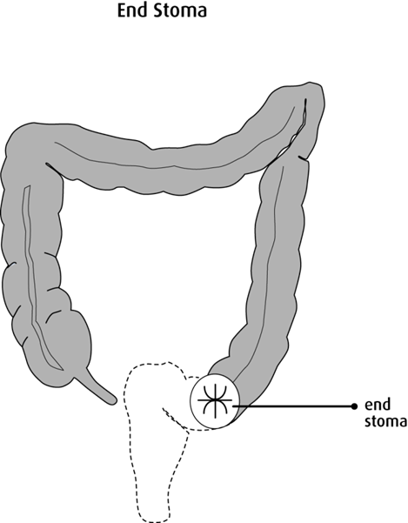
3- according to morphology:
1 – end colostomy :
The proximal end of transected colon brought to the skin for stool drainage.
Single opening (permanent usually)
The site usually in the left iliac fossa.
Smaller and easier to manage.
Lower incidence of parastomal hernia formation andprolapse.

Slide 13
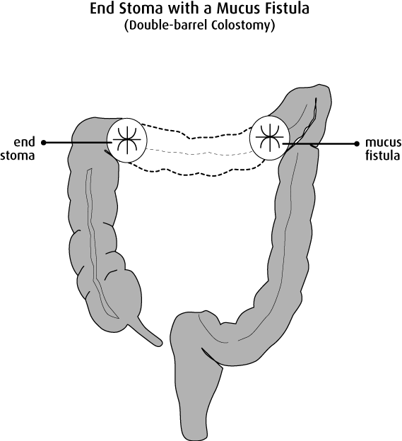
2) Double barrel colostomy :
Has two ends are brought out into the abdomen as 2 separate stoma :
1 - (proximal end) : functional stoma
2 -(distal end) : non- functioning
( mucus fistula )
Used in temporary diversion – cases where resection is required dueto perforation or necrosis

Slide 14
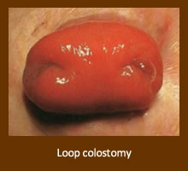
3) Loop Colostomy :
Loop of large bowel is brought up to the abdominal wall skin and aplastic rod is placed underneath the loop, then opened and sutured to the skin.
Mostly Done on the transverse colon (Temporary) Done in emergencies
Advantages: Easy reversal
Disadvantages:
Larger abdominal wall defect, and stoma opening
More prone to develop parastomal hernias, prolapse and peristomal sepsis.
It is now less commonly employed, as it is difficult to manage and potentially disrupts the marginal arterial supply to the anastomosis.
A loop ileostomy is now more commonly used.

Slide 16
Indications for colostomy.

Slide 17
A colostomy is created as a mean to treat various disorders of the large intestine.

Slide 18
Colostomy goals
1. to relive a distal obstruction of the sigmoid colon due to any cause
2. to defunction the distal colon
3. to prevent fecal peritonitis
4. to facilitate the operative repair of high fistula in ano
5. to prevent spoiling of the urinary bladder in vesico-colic fistula or vagina in vagino-colic fistula.

Slide 19
Some of the most common conditions that might necessitate a stoma are:
- Imperforate anus
- Hirschsprungs disease
- Inflammatory bowel disease
- Colitis
-Neonatal necrotising enterocolitis
- Spina bifida

Slide 20
A.Obstructions
1. congenital:
rectovesical/rectovaginal fistula.
-cloacal exstrophy.
-colonic atresia
2.colon tumors
-colorectal/anorectal tumors.
3.gangrenous sigmoid volvulus

Slide 21
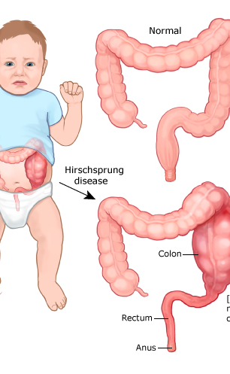
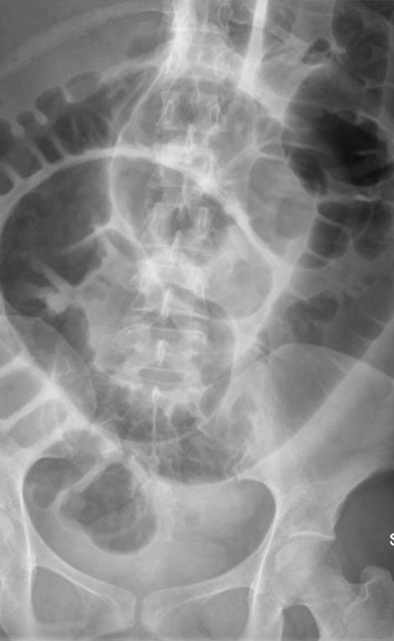
Hirschsprungs
disease
Volvuls
Imperforate anus
Colon tumor

Slide 22
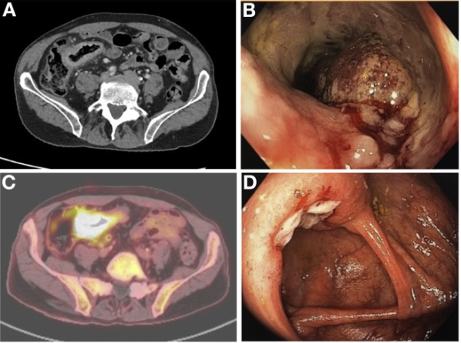
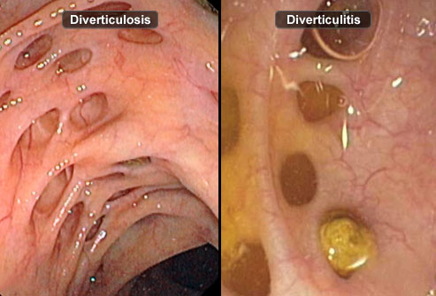
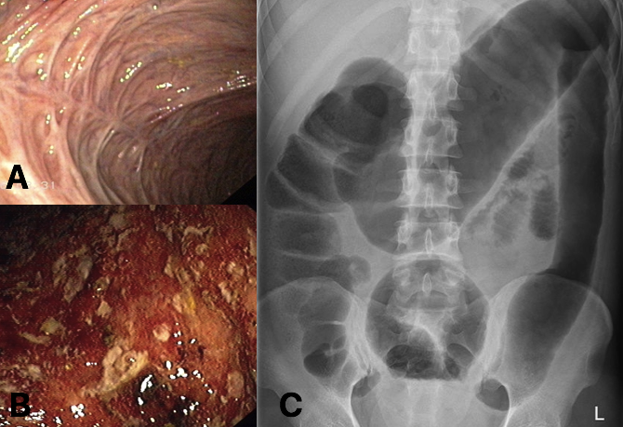
B.Inflammation
1.Crohn’s
2. ulcerative colitis
3. diverticulitis.
Crohn’s
Uclerative colitis
diverticulitis

Slide 23
C.operative
1.distal anastomosis
2.distal repair
3. Hartmann's operation

Slide 24
Hartmann's operation
A proctosigmoidectomy, Hartmann's operation or Hartmann's procedure is the surgical resection of the rectosigmoid colon with closure of the anorectal stump and formation of an end colostomy.
The indications for this procedure include:
a. Localized or generalized peritonitis
b. Viable but injured proximal bowel.
c. Complicated diverticulitis.

Slide 25
D.others
1. penetrating trauma to the colon
2.perineal trauma
3.perineal infection
4.radiation injury
5.incontinence

Slide 26
MANAGEMENT OF A PATIENT WITH COLOSTOMY
PRE-OPERATIVE NURSING CARE
Psychological preparation: Assure the patient that 'Ostomy' can be cared for without it interfering with daily activities and social life
Nutrition: A low residue diet is given for at least 1-2 days prior to the surgery.
Care of the Bowel: "Sterilization" of the bowel prior to surgery to reduce bacterial flora can be achieved through administration of poorly absorbed antibiotics such as neomycin 1grm 4 hourly for 1-3 days;
Laxatives and enema may be done

Slide 27
POST-OPERATIVE NURSING CARE
Skin Care: Access skin for sign of irritation or breakdown; apply skin barrier paste.
Control of Odor: control odor by a clean odor free, well-fitting appliance; regular change of bag, cleaning
Applying an ostomy appliance: The stoma must be measured so that the right size appliance can be chosen. The pouch attaches over the stoma and is fastened unto the faceplate.
Medications: Some medications or nutritional supplements may change the color, odor, or consistency of stool just like before surgery. Patient education and post-medication observation are therefore necessary.

Slide 28
What types of products are used for colostomies?
Pouch:
There are a variety of sizes and styles of colostomy pouches.
Pouches are lightweight and odor-proof.

Slide 29
types of colostomy pouches:
Open-ended pouch: This type of pouch allows you to open the bottom of the pouch to drain the output. The open end is usually closed with a clamp.

Slide 30
Close-ended pouch: This type of pouch is removed and thrown away when the pouch is filled.
One-piece: A one-piece pouch contains the pouch and adhesive skin barrier together as one unit.

Slide 31
Two-piece: The two-piece pouch has two parts: an adhesive flange and pouch. The adhesive flange stays in place while the pouch is removed and new pouch is attached to the flange.
Pre-cut or cut-to-fit pouches: Some pouches have pre-cut holes so you do not have to cut the opening yourself. Other pouches can be cut to fit the size and shape of your stoma

Slide 32
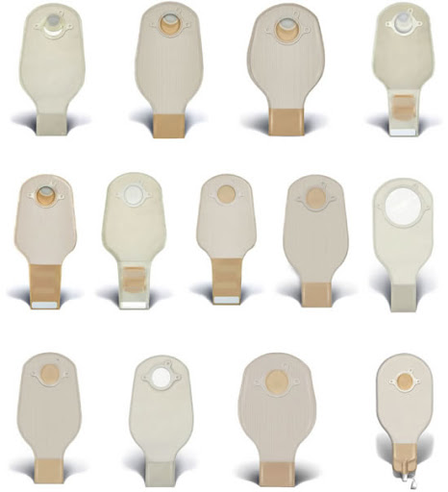
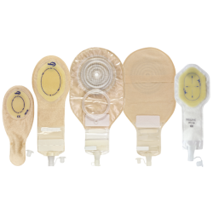
Colostomy pouches

Slide 33
Complications

Slide 34
Complications
I. Intraoperative—occurring immediately in the operative room.
II. Early—occur 1–30 days after surgery.
III. Late—occur after more than 1 month of surgery.

Slide 35
Peristomal dermatitis
It is the most common stoma complication. It is characterized by skin irritation around the stoma.

Slide 36
Peristomal dermatitis (causes)
1- Irritation.
2- Contact with the products used in
colostomy.
3- Contact allergy.
4- Mechanical trauma.
5- Bacterial or fungal skin infection.

Slide 37
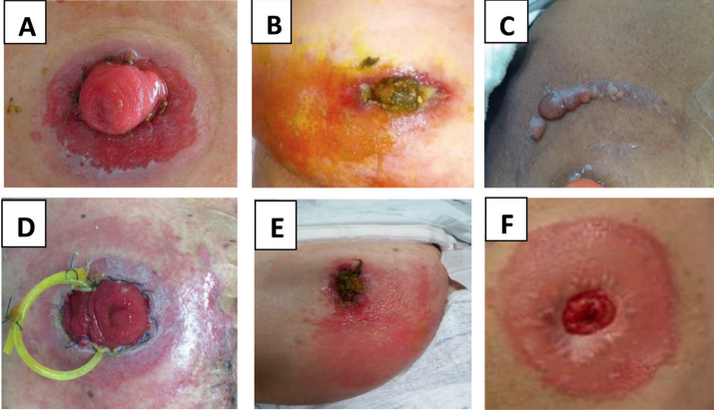
Peristomal dermatitis
The most common symptoms are itching, burning sensation, and pain.

Slide 38
Peristomal dermatitis (management)
The use of azoles is the best first-line treatment.
If antifungal treatment does not clear the problem, it is likely to be bacterial and an antibacterial powder is indicated such as sucralfate powder.

Slide 39
Necrosis/Ischemia
Necrosis may occur when the blood flow to or from the stoma is impaired or interrupted, resulting in severe tissue ischemia with impairment of stoma viability or tissue death.
Initially the mucosa turns pale evolving to a purple, brown, and black color. The consistency becomes soft or hard and dry with loss of the characteristic brightness of a normal mucosa.

Slide 40
Necrosis (causes)
tension or stripping .
Sutures too narrowly spaced, or constricting sutures.
embolization.
Abdominal structure anomalies

Slide 41
Necrosis (management)
In cases of superficial or partial mucosal necrosis observation is the best approach.
In cases of deep mucosal necrosis, a surgical intervention is indicated.

Slide 42
Necrosis
Partial necrosis
Extensive necrosis

Slide 43
Retraction
A retraction of the stoma occurs when the stoma lays flat to the skin or below the skin surface level.
Can be partial or complete.
can occur early or late.

Slide 44
Retraction (causes)
Exteriorization of intestinal loop under tension, insufficient stomal length, poor fixation of the loop to the abdominal wall, or lack of stoma support.
Secondary to abdominal structure anomalies.
The premature removal of the loop device to support the intestine outside the abdominal wall.
later scar formation

Slide 45
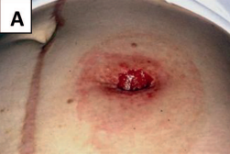
Retraction (consequences)
Patients with retracted stomas present with effluent undermining the pouching system, persistent leakage, shortened pouch wear time, and resultant peristomal irritant dermatitis.

Slide 46
Retraction (management)
Conservative treatment with convex devices attached to the belt and protective skin pastes.
Surgical intervention (stoma revision).

Slide 47
Prolapse
Is the telescoping of the bowel out through the stoma.
Prolapse can be partial or complete, and either the distal or the proximal segment of the loop ostomy may prolapse.
Can be classified as sliding or fixed.

Slide 48
Prolapse (causes)
Weak abdominal wall
Creation of excessively large opening in the abdominal wall.
Positioning the stoma out of the rectus abdominal muscle.
Postoperative increase of the abdominal pressure.
Bowel edema.
Inadequate fixation.

Slide 49
Prolapse (clinical manifestation)
Makes the stoma longer and more susceptible to abrasion or infection.
Makes the patient’s ability to conceal the stoma beneath clothing difficult.
Makes the stoma more susceptible to bleeding and more prone to trauma.
A prolapsed stoma could also become obstructed.

Slide 50
Prolapse (management)
Conservative management.
Surgical correction of prolapse.

Slide 51
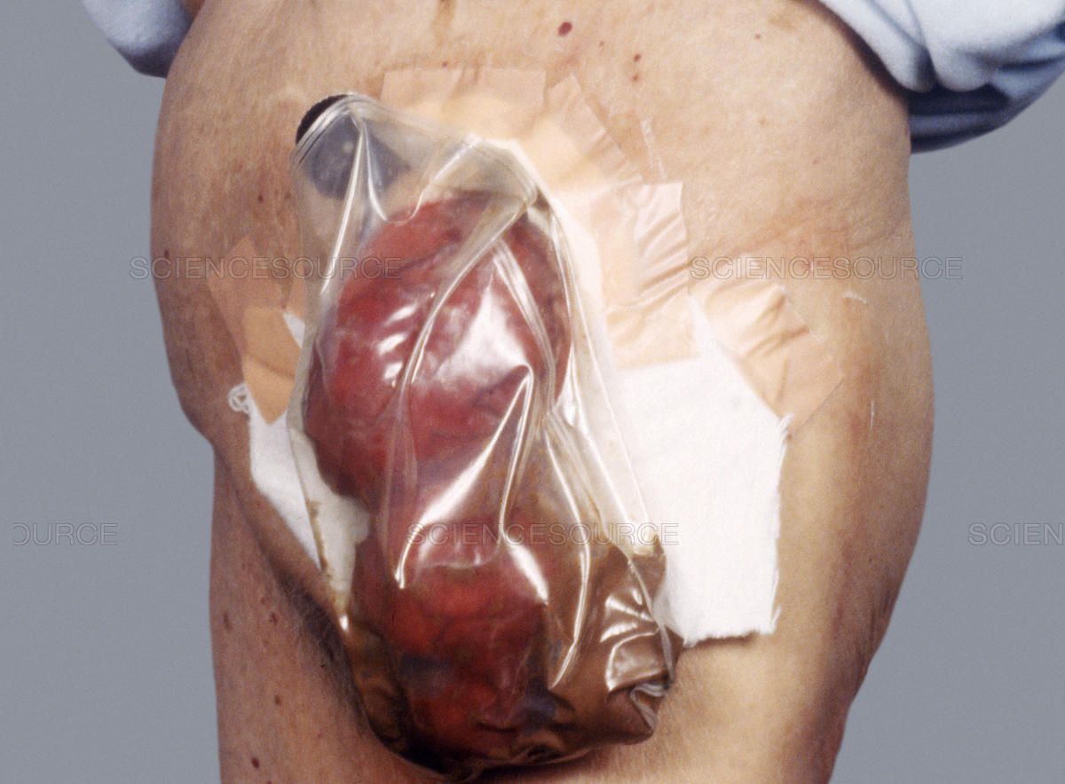
Prolapse

Slide 52
Parastomal hernia (PSH)
A protrusion of the bowel or loops of intestine through the fascial opening into the subcutaneous tissue around the stoma.
may be partial or circumferential.
The hernia change in position.
Occurs months to years after surgery because of surgical technical error or following gradual enlargement of the fascial defect.

Slide 53
PSH (risk factors)
Intra-abdominal pressure.
Advanced age.
Obesity.
Chronic cough.
Long-term use of corticosteroids.

Slide 54
PSH (clinical manifestation)
Most patients are asymptomatic.
Symptoms include mild peristomal discomfort, stoma appliance issues with leaks and skin irritation , obstruction, and strangulation.

Slide 55
PSH (management)
CT scan with oral contrast confirms the diagnosis.
Asymptomatic patients can be treated conservatively.
If signs of obstruction, incarceration, perforation, or recurrent pouching difficulties are present, the patient should be referred to a surgeon.

Slide 56
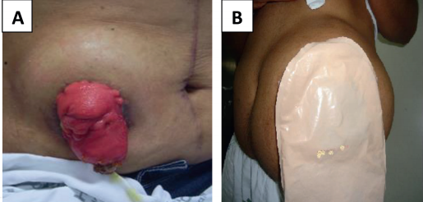
PSH (management)
Surgery repair of parastomal hernia can be done by fascial repair, prosthetic mesh, or stoma relocation.

Slide 57
stenosis
Is a stricture or retraction of the stomal opening.
The symptoms include abdominal excess of gases, frequent cramps and diarrhea, as well as thin feces.

Slide 58
Stenosis (causes)
Inadequate excision of the skin during construction of a stoma or poor stoma site.
Stomal ischemia, necrosis, or retraction.
Recurrent disease.
Recurrent episodes of skin irritation.
Weight gain.
Radiotherapy.

Slide 59
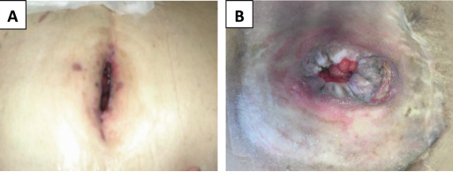
Stenosis (management)
The best option for the treatment of this complication is surgery.

Slide 60
Thank you

