Slide 1
Excitation contraction coupling
DR. Arwa Rawashdeh

Slide 2
Skeletal Muscle Structure
Muscle = group of fascicles

Slide 3
Muscle fiber components
Sarcolemma: muscle cell membrane
Sarcoplasma: muscle cell cytoplasm
Motor end plate: contact surface with axon terminal
T tubule: cell membrane extension into the sarcoplasm (to reach the myofibrils)
Cisternae: areas of the endoplasmic reticulum dedicated to Ca++ storage (located on each side of the T-tubules)
Myofibrils: organized into sarcomeres

Slide 4
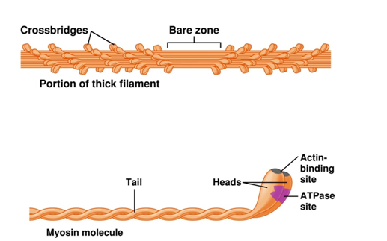
Muscle contraction: Cell events Myosin structure
Many myosin molecules per filament, golf club shape
Long tail topped by a thickening: the head → forms crossbridges with the thin filament
Presence of the enzyme, ATPase in the head → release energy for contraction

Slide 5
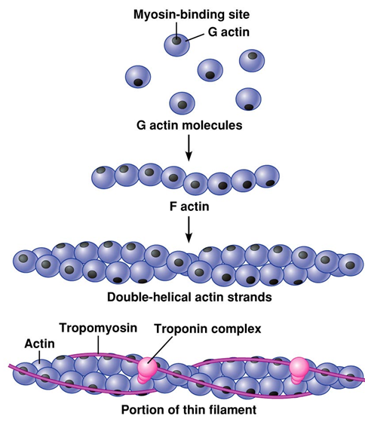
Actin structure
Formed by 3 different proteins:
globular (G) actins: bind to myosin heads
tropomyosin: long, fibrous molecule, extending over actin, and preventing interaction between actin and myosin
troponin: binds reversibly to calcium and able to move tropomyosin away from the actin active site

Slide 6
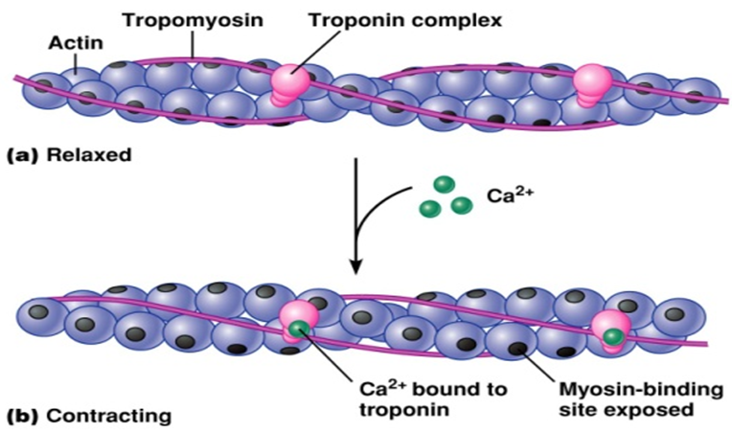

Slide 7
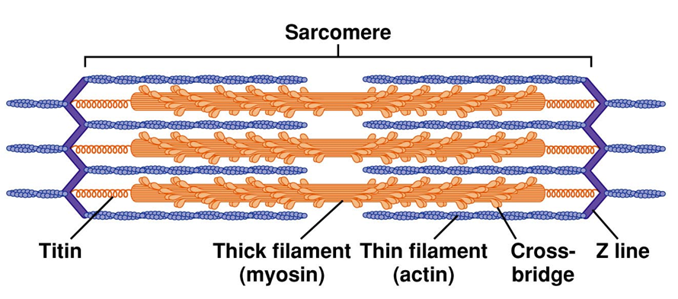

Slide 8
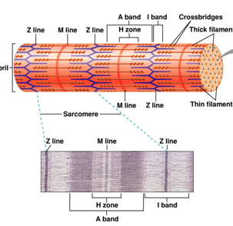
The sarcomere
The myofibrils are organized into a repetitive pattern, the sarcomere
Myosin: thick filament
Actin: thin filament
Bands formed by pattern: A and I and H bands
Z line: area of attachment of the actin fibers
M line: Myosin fiber centers

Slide 9
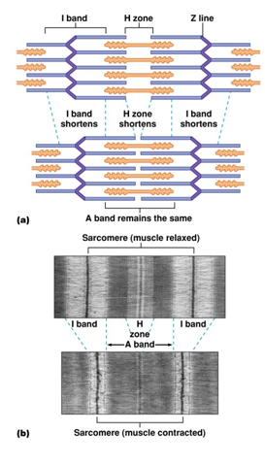

Slide 10
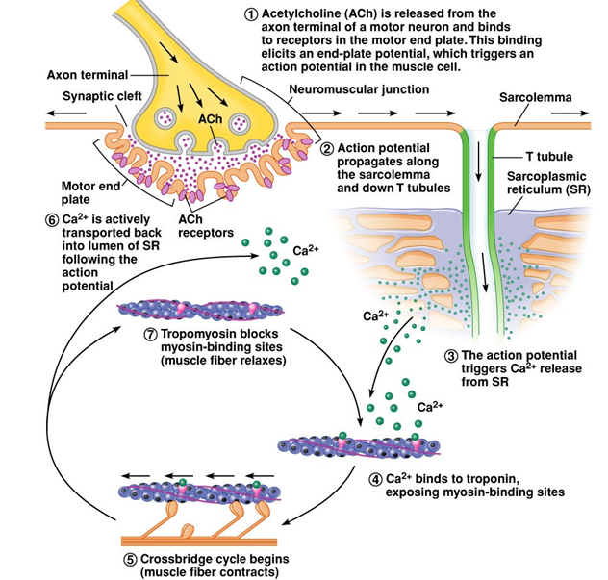
The mechanism of force generation in muscle

Slide 11
