Slide 1
Systemic Lupus Erythematosus
Supervised by: Dr. Walid AlWadi
Presented by: Shukri AlOmari and Mohammad AlTorman

Slide 2
Introduction
DDX of Syndrome came with:
joint pain, swelling, limitation of movement & rash.
1)Infection: usually viral and short-lived HBV , HAV , HCV
Parvovirus B19
( causes arthritis that
mimic RA , but it is short-
lived (1-2weeks) .
Enteroviruses
( Coxsackie virus )
Herpes viruses
(EBV , CMV , Varicella.)
2)allergy.
3) SLE.

Slide 3
Clinical Mimicers/Pictures
➢psoriatic arthritis: Psoriatic plaque, onycholysis, DIP arthritis and nail pitting
- If this patient came w. Manifestation of
Psoriatic arthritis+ septic arthritis + reactive arthritis Make a hint for HIV
➢Adult-onset still’s disease: Triad of:
1) Arthritis 2) Rash which is salmon pink colored , non-itchy 3) fever
- usually rash and fever come and go together
- the disease also associated with hepatosplenomegaly,luekocytosis
- Diagnosed by : High serum ferritin and high liver enzymes

Slide 4
Clinical Mimicers/Pictures - Continued
Lyme disease (Borreliosis )
-make rash: Erythema chronicum migrans: (ECM) or (bulls eye rash)
- change in ECG :
.first degree Av block .second degree AV block . Degree AV block (pt. Came w syncope bradycardia)
Causative microbe: Spirochetal bacteria
called Borrelia burgdorferi
Erythema chronicum migrans (bull’s eyes rash )

Slide 5
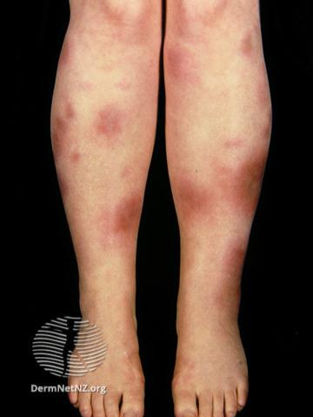
Clinical Mimicers/Pictures – Continued pt.2
➢Erythema marginatum :
-nonpruritic, nontender rash (caused carditis)
• Erythema nodosum (painful ,tender ,indurated: you can fell mass)
Ddx: sarcoidosis ,TB, Bechet disease and IBD

Slide 6
Systemic Lupus Erythematosus (SLE)
Systemic: involve multiple Sys.
• Lupus: wolf like ugly looking rash
• Erythematosus: redness

Slide 7
Pathophysiology
B cell – mediated
Autoreactivity
Immune complexes formation
Tissue destruction

Slide 8
Risk Factors: 1) female: -hormone (that’s why inc. In reproductive age ) age F > M (10- 15 :1) High prevalence in men with Klinefelter(XXY) disease 2) genetic: HLA-DR2 & HLA-DR3 - Concordance rate in monozygotic twins is 25-75%. - If a mother has SLE, her daughter’s risk of developing the disease is 1:40 , and her son’s risk is 1:250 3) Environmental: - UV light –viruses –smoking 4) pregnancy ☹details in down pages) ❑ Age at onset : from Menarche to Menopause

Slide 9
Clinical features: Malar rash: over cheeks and bridge of the nose -Difference between “Discoid lesion and malar rash”: 1.Malar rash(regular): go w/o scar ,benign lesion , little edema no raised edge , no hypo or hyper pigmentation no dermal atrophy . 2.Discoid lesion: can leave scar , treat it as a vital organ raised edge , hypo or hyper pigmentation , dermal atrophy .

Slide 10
Clinical Features – Cont.
Alopecia: hair loss more than 100
Oral ulcer, Painless , 2-3 days will heal , superficial lesion .
Arthritis: No erosion, but can be deformity (tendon and ligament affect), deformity it can be corrected by prior sign , migratory , mostly symmetrical , MCP – PIP could be involve .
Raynaud phenomenon: vascular response to cold or emotion, White ( vasospasm ) then blue ( deoxygenation) then red (local tissue acidosis will cause reactive vasodilatation ) painful stage , if it unilateral most likely scleroderma
Petechiae (Thrombocytopenia& vasculitis)
Vasculitis: Elevated rash, Painful, lower limbs
Thrombocytopenia: Non –raised rash , Painless , Diffuse

Slide 11
Livedo reticularis (net-like dilated blood vessels) -Ddx: 1.SLE 2. Vasculitis 3. Anti-phospholipids syn. 4.Mixed CT disease Renal finding → the most common cause of mortality and morbidity and affect 50% of the cases. Immune complex mediated . ✓Glomerulonephritis: 1)minimal changes disease 2) proliferation mesangial 3) focal segmental 4) Diffuse 5) membranous (heavy protein) 6)advanced (sclerosing) . Used for prognosis. -oliguria – proteinuria – edema – HTN –hematuria (RBC cast) so we have to do urine analysis for SLE patients. Fever (so exclude infection). Serositis: pleurisy (stabbing pain ,local, inc. With inspiration .) Seizure ( it happen because of renal( nephritic) , BP , so patient get HTN encephalopathy . Hemolytic anemia and anemia of chronic disease: (HSR II) ( incr. Bilirubin , incr. Reticulocyte , diagnosed also by combs test) , leukopenia (decr. Lymphocyte) Ddx. (HIV). Aseptic endocarditis (Libman-Sacks Endocarditis). nonbacterial, thrombi usually on mitral or aortic valve and can be present on either surface of the valve Psychosis. (Ddx. Steroid overdose (rare).

Slide 12
DIAGNOSIS AND TREATMENT OF SLE
SUPERVISED BY : Dr. Waleed Al-Wadi
Presented by : Mohammad Al-Torman

Slide 13
DIAGNOSIS

Slide 14
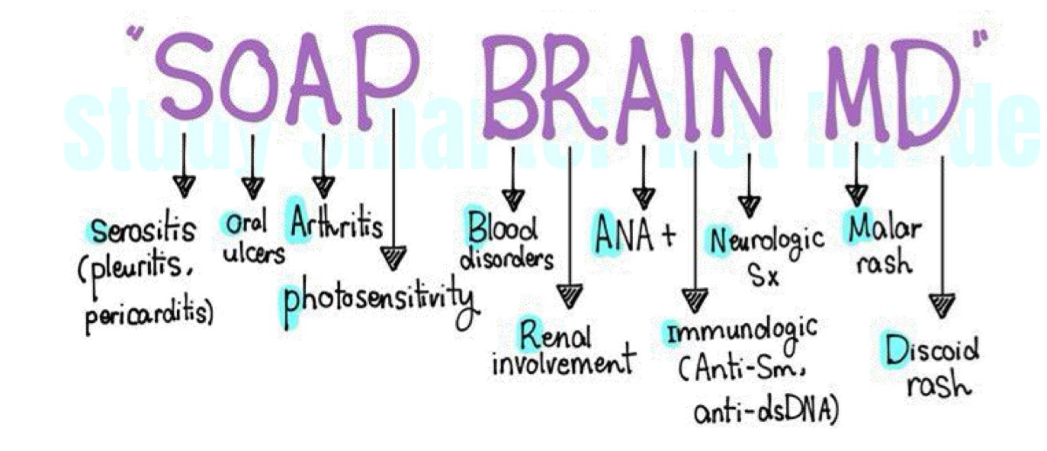
Diagnosis of SLE :
SLE is A CLINICAL DIAGNOSIS
SOAP BRAIN, MD:
Serositis
Oral and/or nasal ulcers
Arthritis
Photosensitivity
Blood disorders
Renal involvement
ANAs
Immunological phenomena (anti- dsDNA, anti-Sm, antiphospholipid antibodies)
Neurological disorders
Malar and Discoid rash

Slide 15
Diagnosis of SLE : LABS :
These are part of a minimum diagnostic workup if SLE is clinically suspected :
1) Antinuclear antibodies ( ANAs) :
Positive titers of >1:80 have approximately 98% sensitivity for SLE
2) Antigen-specific ANAs : ( Request it only if ANAs are positive )
A) Anti DsDNA antibodies :
- Positive in 60-70% of patients
- Highly specifc for SLE
- Levels correlate with disease activity
B) Anti-Sm antibodies :
- Positive in <30% of patients
- Highly specifc for SLE

Slide 16
Others ……
4) Laboratory markers of disease activity and/or organ damage in SLE
o Complement levels: ↓ C3 and/or ↓ C4 in patients with active disease .( due to consumption )
o Inflammatory markers
✓ ESR: may be elevated in patients with active disease.
✓ CRP: often normal (may be elevated in patients with serositis, arthritis, or infections).
o CBC: may show leukopenia, thrombocytopenia, and/or autoimmune hemolytic anemia or anemia of chronic disease .
o CMP: may show ↑ BUN and/or creatinine, and/or electrolyte abnormalities .
o Urinalysis and urine microscopy: may show proteinuria, hematuria and/or urinary casts

Slide 17
Summary of diagnosis :
At least 2 CLINCAL CRITERIA , ANA ( + ) and another serological markers
A MARKER USED FOR DIAGNOSIS ? Anti Nuclear Antibody ( ANA ) ( but not for follow up )
A MARKER USED FOR FOLLOW UP ? Anti Double-stranded DNA Antibody (Anti-DsDNA)
ANAs have the highest sensitivity but low specificity for SLE.
Anti-dsDNA and anti-Sm antibodies are the most specific

Slide 18
Causes of death in SLE :
✓ Acute renal failure (renal involvement most prognostic factor)
✓ Infections
✓ Thrombosis
✓ Sepsis and septic shock
✓ Pulmonary hemorrhage
Risk of death 3 times more than healthy person

Slide 19
Cont. Cause of death in SLE :
Patients with SLE have double the cardiovascular risk compared to patients without SLE. Cardiovascular disease is among the most common causes of death ( the first is renal failure)
Patients with SLE are at increased risk of developing infections because of disease-related factors (e.g., pancytopenia) and immunosuppressive treatment
“Redness In Cheeks” (malar rash): Renal disease, Infections, and Cardiovascular complications are the three most common causes of death in SLE

Slide 20
Disease Severity :-
Disease severity can be classified based on the presence of clinical features and laboratory markers of disease activity and/or organ damage in SLE.
Mild disease (no vital organs affected): e.g., constitutional symptoms, mild arthritis rash and/or cytopenias .
Moderate disease (no vital organs affected): e.g., cutaneous vasculitis, serositis, RA-like arthritis, moderate rash and/or cytopenias, or no response to standard therapy .
Severe or organ-threatening disease: e.g., nephritis, myelitis, pnemonitis , mesenteric vasculitis and severe cytopenias

Slide 21
TREATMENT

Slide 22
Treatment : in general
Patients with SLE usually require life-long immunosuppressants.
o Management is guided by disease severity and the systems or organs affected .
o Patients should be frequently monitored for medication-induced adverse effects.
NSAIDs can provide symptomatic relief. ( better avoid it )
Nonpharmacological measures include:
o Lifestyle modifications for ASCVD prevention (e.g., smoking cessation, aerobic exercise) .
o Avoidance of UV light .
If applicable, optimize management of ASCVD and offer precoception counseling

Slide 23
Treatment : more specific
ALL PATIENTS
MILD TO MODERATE DISEASE
SEVERE OR ORGAN THREATENING

Slide 24
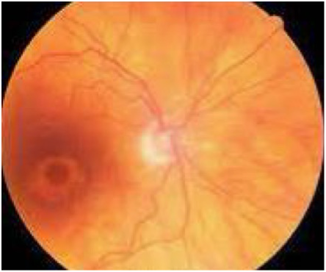
Treatment : ALL PATIENTS
Hydroxychloroquine is the cornerstone of therapy (regardless of disease activity).
To Keep the patient in remission by :
▪ Reduce inflammation.
▪ Remission joint, skin and Blood vessels involvements.
▪ Anti-lipidemic.
▪ Safe in pregnancy.
Side effects of hydroxychloroquine:
▪ Hyperpigmentation.
▪ Myopathy in Renal Failure.
▪ Retinal and corneal toxicity (halos around lights and photophobia, annual fundoscopy is necessary )

Slide 25
Treatment : MILD TO MODERATE
Oral glucocorticoids +\- other immunosuppressive agents to achieve remission

Slide 26
Treatment : SEVERE
Induction therapy ( for a recent attack )
o High-dose IV glucocorticoids and other immunosuppressive agents .
o Used until symptom remission or low disease activity is achieved .
Maintenance of remission :
o Hydroxychloroquine with or without lower dose glucocorticoids .
o AND/OR immunosuppressants or biological agents ( rituximab , belimumab )

Slide 27
Some notes about treatment :
Steroid and immune suppression → CNS and Renal involvement ( organ involvement )
Treat infection (aggressively), no infection in lupus should go home.
Malar rash → 1. Avoid sun exposure 2. local steroid
Avoid NSAID: cause interstitial nephritis , diagnosed by eosinophil in urine
Vaccination ( immunosuppressed )

Slide 28
Prevention and monitoring for medication-induced adverse effects :
All patients: Offer influenza and pneumococcus immunizations.
Glucocorticoids and immunosuppressants
o Assess for infection.
o Monitor for side effects of glucocorticoid therapy.
Hydroxychloroquine: request ophthalmologic screening at baseline, after 5 years and yearly thereafter

Slide 29
DRUG-INDUCED SLE

Slide 30
Examples of drugs :
HYDRALAZINE
PROCAINAMIDE
QUINIDINE
METHYLDOPA
CHLOROPROMAZINE
ISONIAZID
ALL OF THESE MAY PRODUCE LUPUS LIKE SYNDROME

Slide 31
About DRUG-SLE INDUCED
Better than other SLE .
Affect male and female (equal ratio) .
No CNS and Renal involvements .

Slide 32
LAB FINDINGS IN DRUG-INDUCED SLE :
Anti-histone antibodies are always present
(Negative -ANA and Negative –Anti ds-DNA)
Treatable with cessation of the drug - (remission within 3-6 months )

Slide 33
SLE AND PREGNANCY

Slide 34
SLE worsens with pregnancy
Doesn’t affect fertility but have higher rates of abortion, premature labor and intrauterine death (esp. with Anti-Phospholipid Syndrome) .
If the female is stable (4-6 months S & S free before conception) , can get pregnant but if develop symptoms , the fetus should aborted .
If the female unstable → pregnancy is prevented

Slide 35
Management of SLE pregnancy :
Pregnancy planning and counseling .
Medical treatment should not be discontinued but the drug regimen may be changed.
Preconception, pregnancy, and breastfeeding: hydroxychloroquine and/or azathioprine .
Disease flares: hydroxychloroquine and/or prednisolone
Low-dose aspirin from 12 weeks' gestation reduces the risk of preeclampsia.
Teratogenic immunosuppressive drugs (e.g., methotrexate, mycophenolate, cyclophosphamide) Should be avoided
Avoid estrogen- containing hormonal contraceptives as it increase the risk of APS

Slide 36
NEONATAL SLE

Slide 37
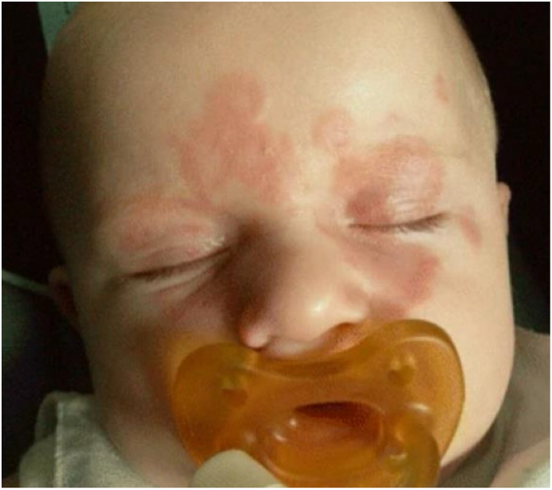
Neonatal lupus in the babies of mothers affected .
Less than 1% .
Congenital AV-block (bradycardia) IN ICU .
Neonatal rash .
Treated by antibiotics and vaccines .
+Anti-jo 1 antibody

Slide 38
THANK YOU

