Slide 1
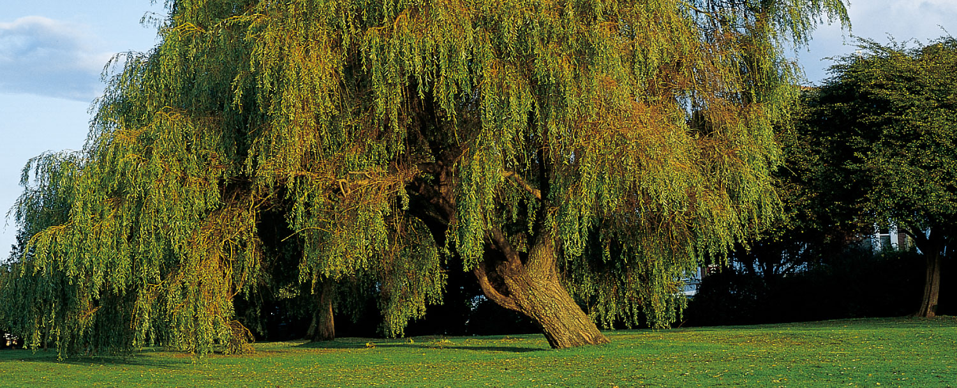
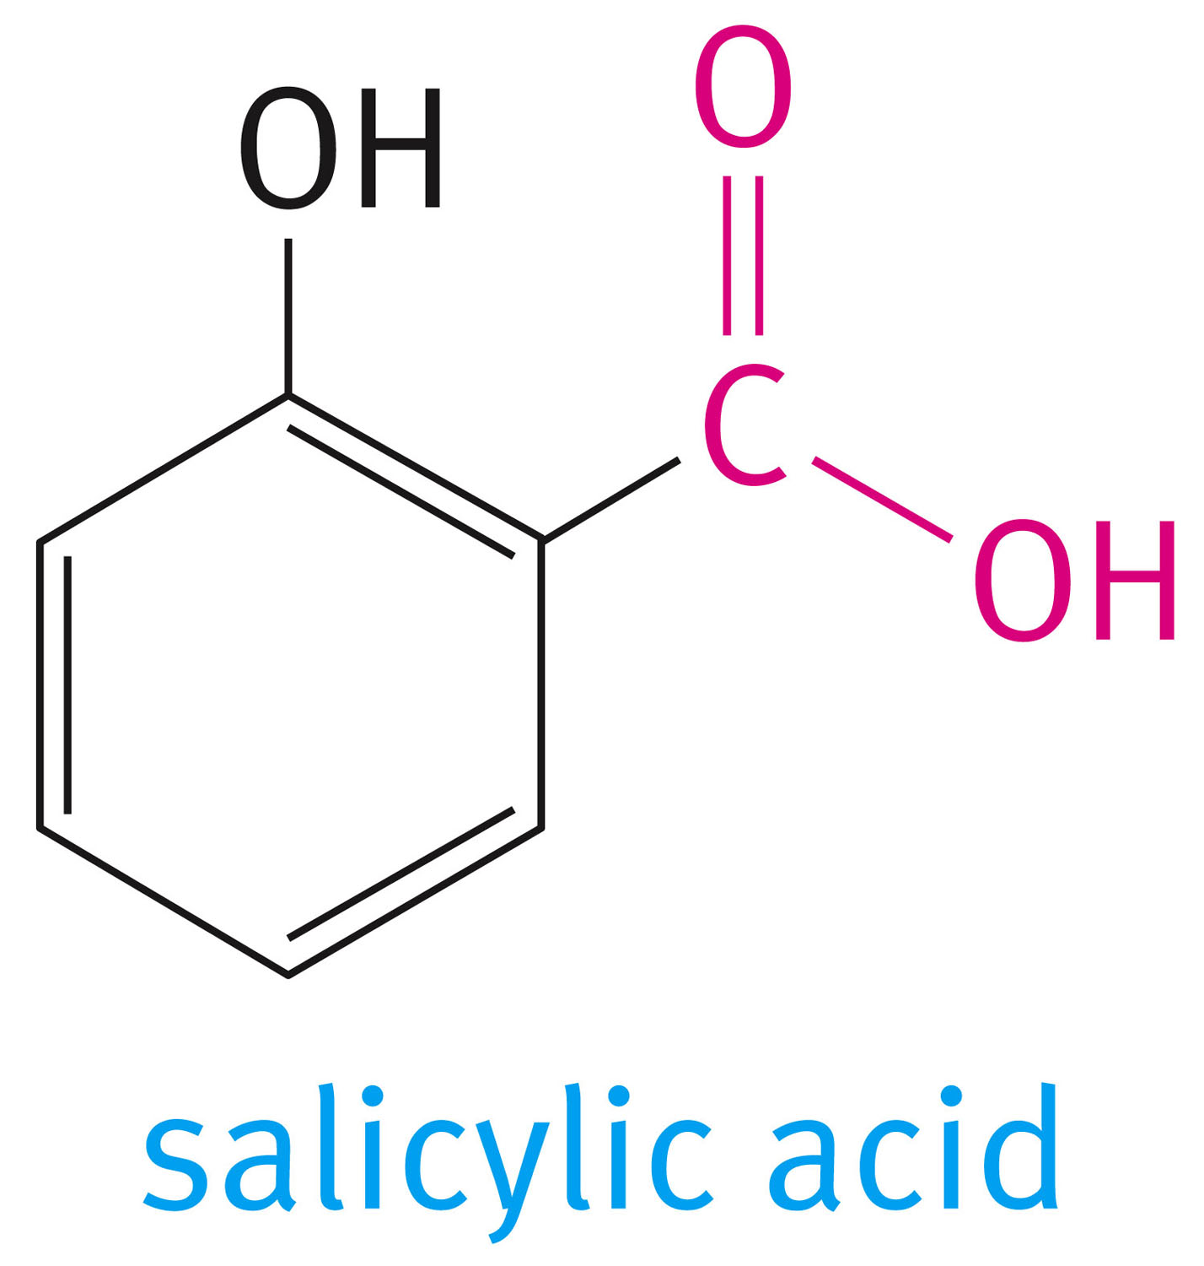
Chapter 10: Carboxylic Acids and Their Derivatives
The back of the white willow tree (Salix alba) is a source of salicylic acid which is used to make aspirin (acetylsalicylic acid)

Slide 2
The functional group common to all carboxylic acids is the carboxyl group. The name is a contraction of the parts: the carbonyl and hydroxyl groups. The general formula for a carboxylic acid can be written in expanded or abbreviated forms.

Slide 3
10.1 Nomenclature of Acids
To obtain the IUPAC name of a carboxylic acid, we replace the final e in the name of the corresponding alkane with the suffix -oic and add the word acid.
Substituted acids are named in two ways.
In the IUPAC system, the chain is numbered beginning with the carboxyl carbon atom, and substituents are located in the usual way.
If the common name of the acid is used, substituents are located with Greek letters, beginning with the a-carbon atom.

Slide 4
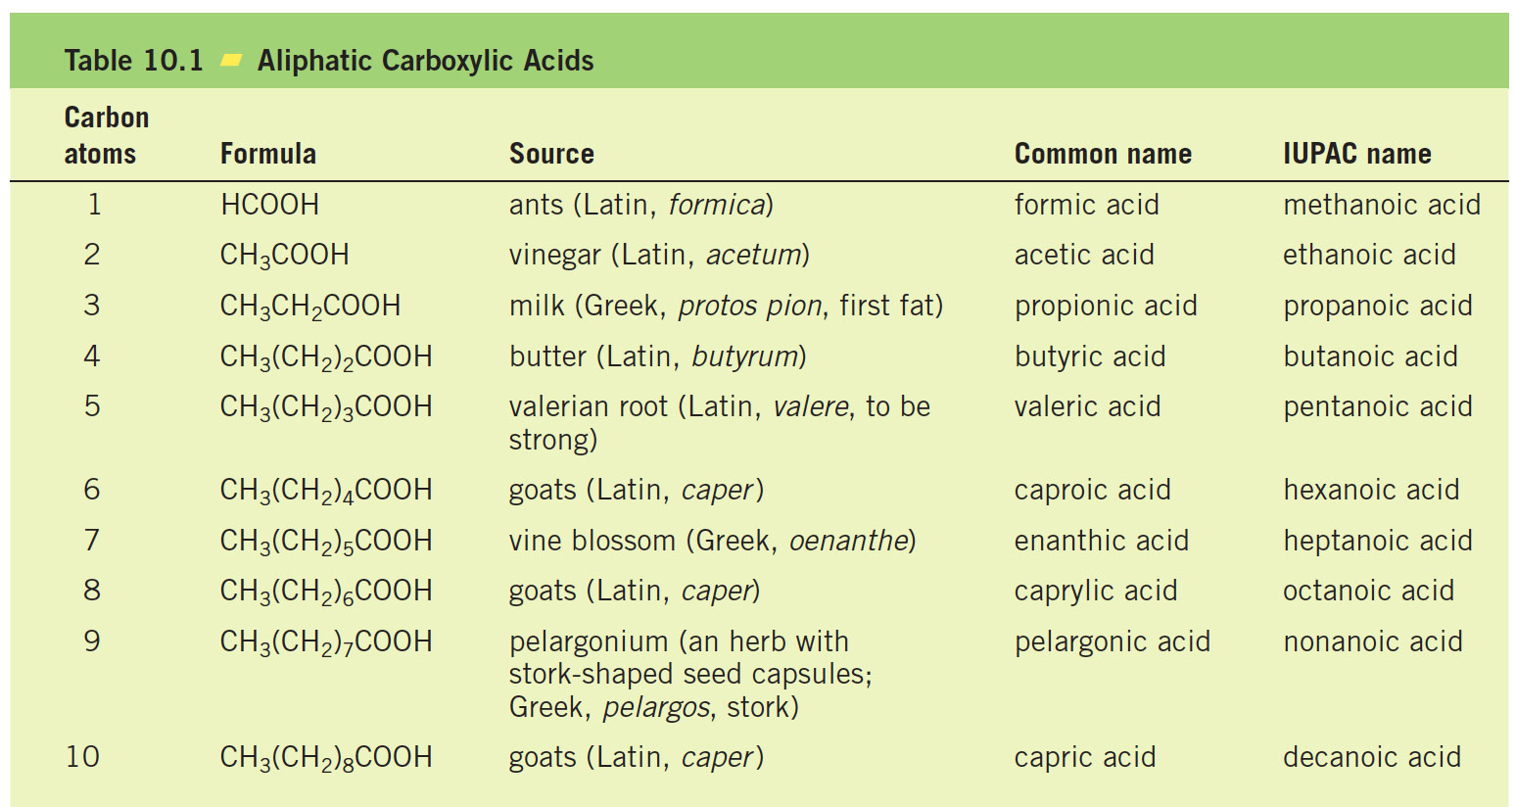

Slide 7
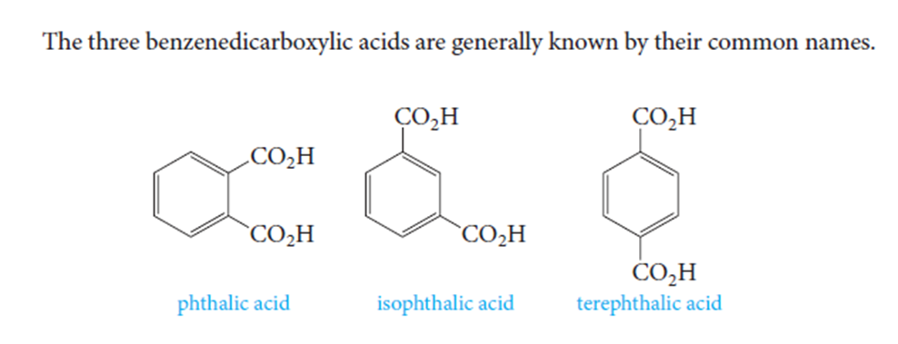

Slide 9
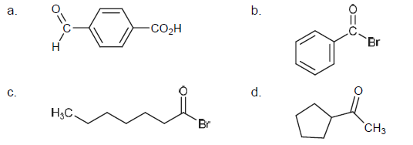

Slide 10
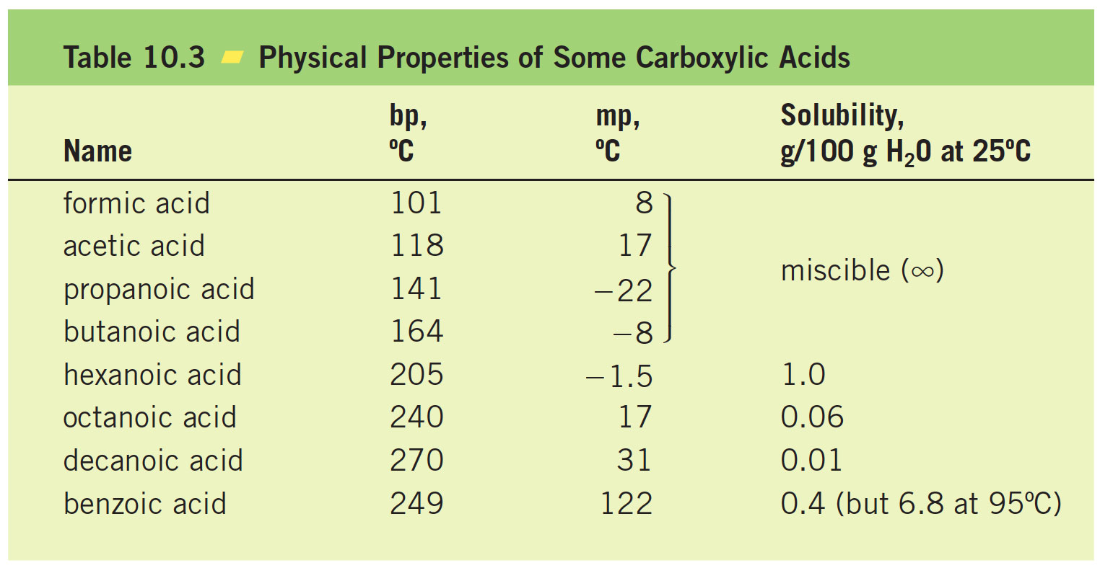
9.2 Physical Properties of Acids

Slide 11
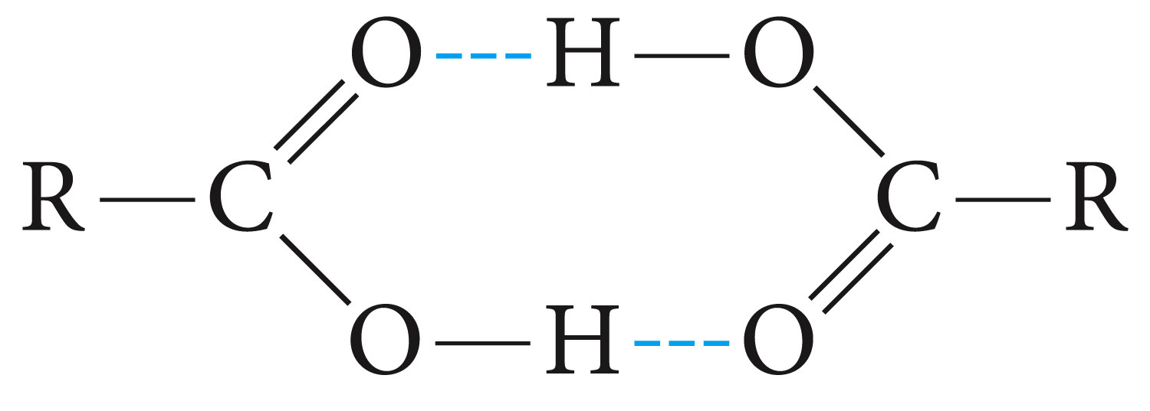
Carboxylic acids are polar. Like alcohols, they form hydrogen bonds with themselves or with other molecules .Therefore, they have high boiling points for their molecular weights—higher even than those of comparable alcohols.
For example, acetic acid and propyl alcohol, which have the same formula weights (60 g/mol), boil at 118°C and 97°C, respectively.
Carboxylic acids form dimers, with the individual units neatly held together by two hydrogen bonds between the electron rich oxygens and the electron-poor hydrogens.
Hydrogen bonding also explains the water solubility of the lower molecular weight carboxylic acids.

Slide 12
10.3 Acidity and Acidity Constants
Carboxylic acids (RCO₂H) dissociate in water, yielding a carboxylate anion (RCO₂²⁻) and a hydronium ion.
Their acidity constants Ka in water are given by the expression

Slide 13
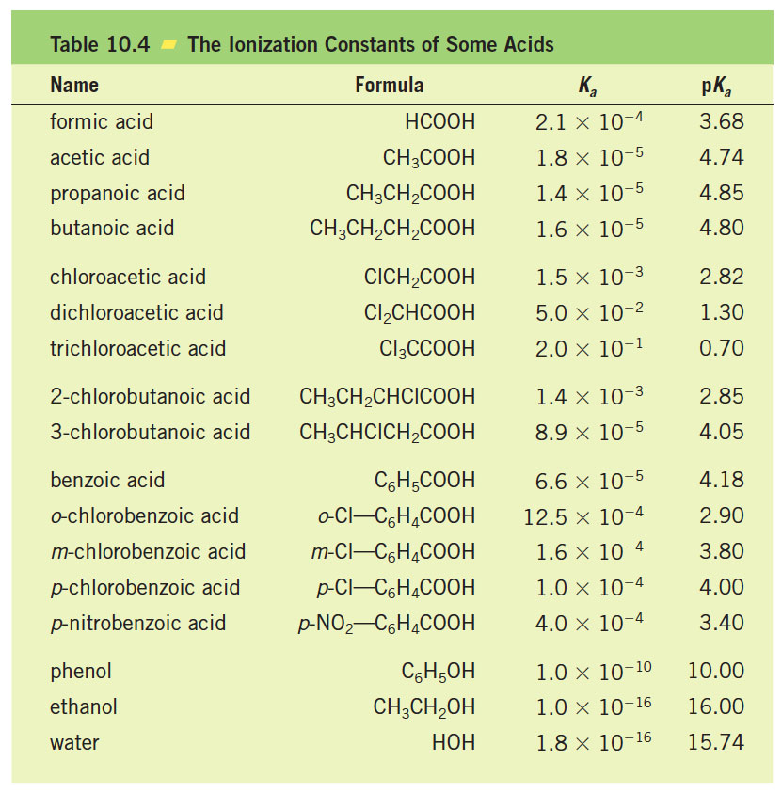

Slide 14
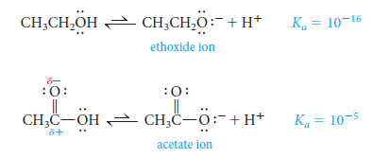
10.4 What makes carboxylic acids acidic?
1-The only difference between the structures of acetic acid and ethanol is the replacement of a CH₂ group (in ethanol) by a carbonyl group (in acetic acid). But carbonyl carbon atom carries a substantial positive charge (δ⁺). This charge makes it much easier to place a negative charge on the adjacent oxygen atom which is exactly what happens when we ionize a proton from the hydroxyl group.

Slide 15
2- In ethoxide ion, the negative charge is localized on a single oxygen atom. In acetate ion, on the other hand, the negative charge can be delocalized through resonance.

Slide 16
10.5 Effect of Structure on Acidity
Compare, for example, the K_{a} of acetic acid with those of mono-, di-, and trichloroacetic acids, and note that the acidity varies by a factor of 10,000.
The most important factor operating here is the inductive effect of the groups close to the carboxyl group. This effect relays charge through bonds, by displacing bonding electrons toward electronegative atoms, or away from electropositive atoms.
Remember that electron-withdrawing groups enhance acidity, and electron-releasing groups reduce acidity .

Slide 17
10.6 Conversion of Acids to Salts
Carboxylic acids, when treated with a strong base, form carboxylate salts. For example
Carboxylate salts are named as shown in the following examples:
The cation is named first, followed by the name of the carboxylate ion, which is obtained by changing the -ic ending of the acid to -ate.

Slide 18
10.7 Preparation of Acids
a. Oxidation of primary alcohol and aldehyde
The most commonly used oxidizing agents for these purposes are potassium permanganate (KMnO₄), chromic acid anhydride (CrO₃), nitric acid (HNO₃), and, with aldehydes only, silver oxide (Ag₂O).

Slide 19
b. Oxidation of Aromatic Side Chains
The reaction involves attack of the oxidant at a C-H bond adjacent to the benzene ring. Longer side chains are also
oxidized to a carboxyl group.

Slide 20
If no C-H bond is in the benzylic position, however, the aromatic ring is oxidized , although only under severe reaction conditions.
With oxidants other than potassium permanganate, this reaction is commercially important. For example, terephthalic acid

Slide 21
c. Reaction of Grignard Reagents with Carbon Dioxide
Grignard reagents add irreversibly to the carbonyl group of carbon dioxide to give acids, after protonation of the intermediate carboxylate salt with a mineral acid like aqueous HCl.
Note that the acid obtained has one more carbon atom than the alkyl or aryl halide from which the Grignard reagent is prepared, so the reaction provides a way to increase the length of a carbon chain.

Slide 22
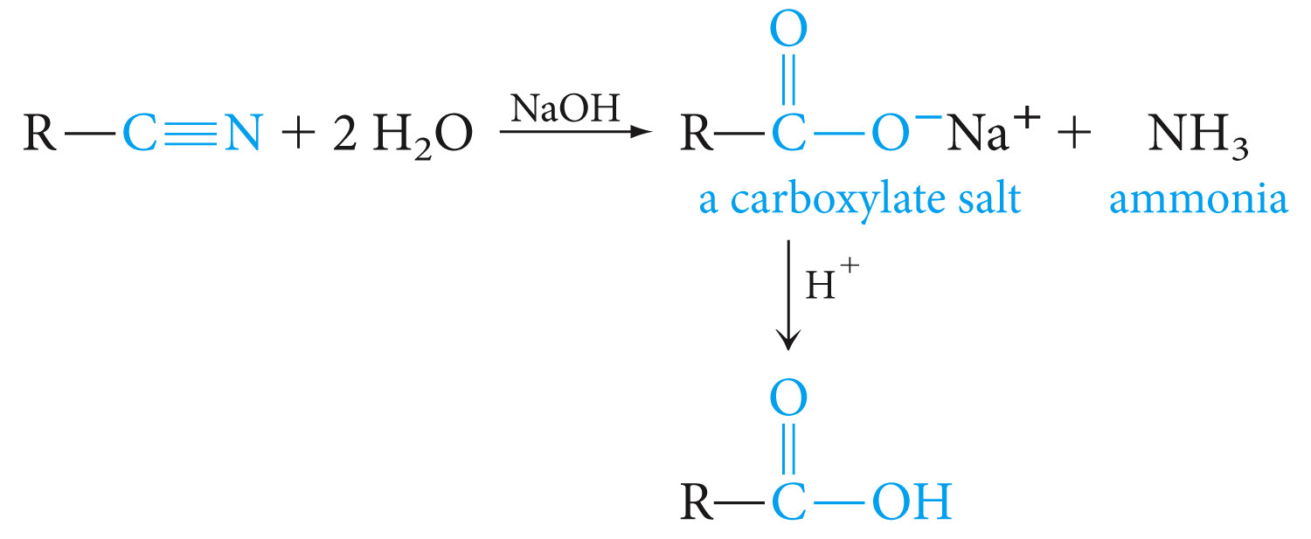
d. Hydrolysis of Cyanides
The carbon–nitrogen triple bond of organic cyanides can be hydrolyzed to a carboxyl group. The reaction requires either acid or base. In acid, the nitrogen atom of the cyanide is converted to an ammonium ion.

Slide 23
Alkyl cyanides are generally made from the corresponding alkyl halide (usually primary) and sodium cyanide by an S_{N}2 displacement, as shown in this synthesis of an acid:

Slide 24
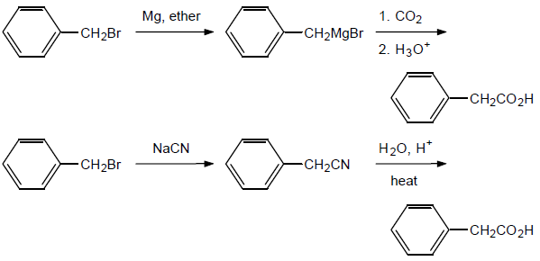

Slide 25
10.8 Carboxylic Acid Derivatives
Carboxylic acid derivatives are compounds in which the hydroxyl part of the carboxyl group is replaced by various other groups. All acid derivatives can be hydrolyzed to the corresponding carboxylic acid.

Slide 26
10.9 Esters
Esters are derived from acids by replacing the -OH group by an -OR group. They are named in a manner analogous to carboxylic acid salts. The R part of the -OR group is named first, followed by the name of the acid, with the -ic ending changed to -ate.

Slide 27
10.10 Preparation of ester, Fischer Esterification
When a carboxylic acid and an alcohol are heated in the presence of an acid catalyst (usually HCl or H₂SO₄), an equilibrium is established with the ester and water.
Although the reaction is an equilibrium, it can be shifted to the right in several ways. If either the alcohol or the acid is inexpensive, a large excess can be used. Alternatively, the ester and/or water may be removed as formed (by distillation , for example), thus driving the reaction forward.

Slide 28
10.12 Lactones
Hydroxy acids contain both functional groups required for ester formation. If these groups can come in contact through bending of the chain, they may react with one another to form cyclic esters called lactones. For example,

Slide 29
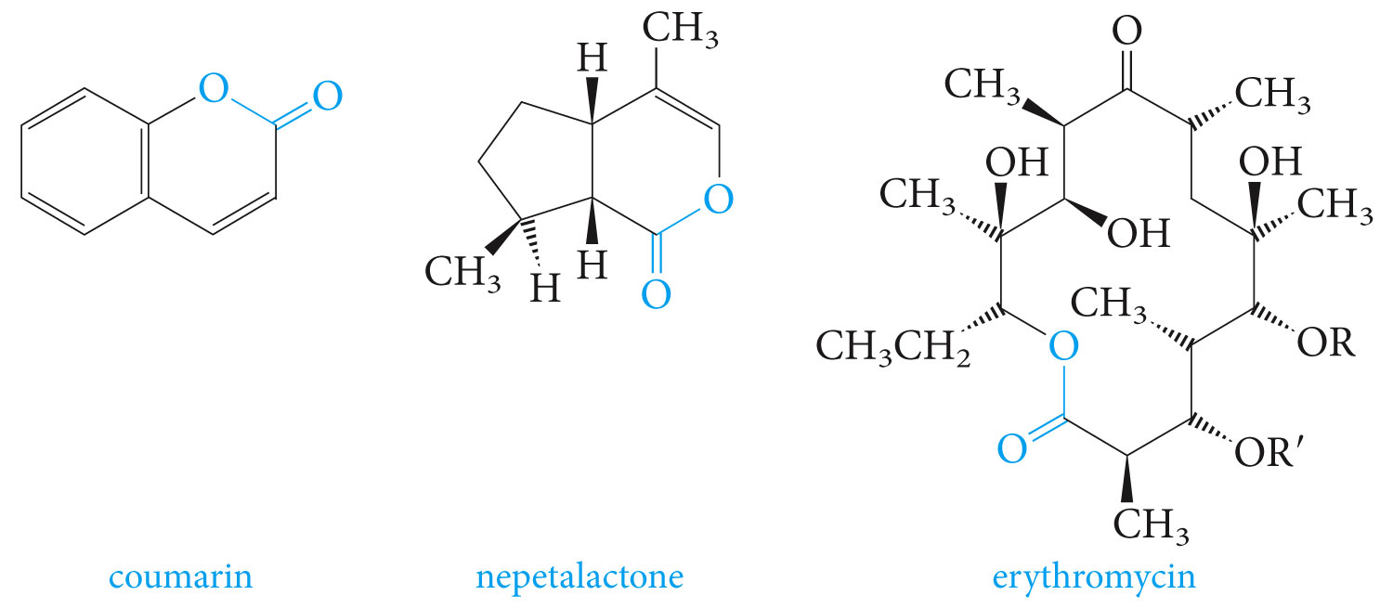

Slide 30
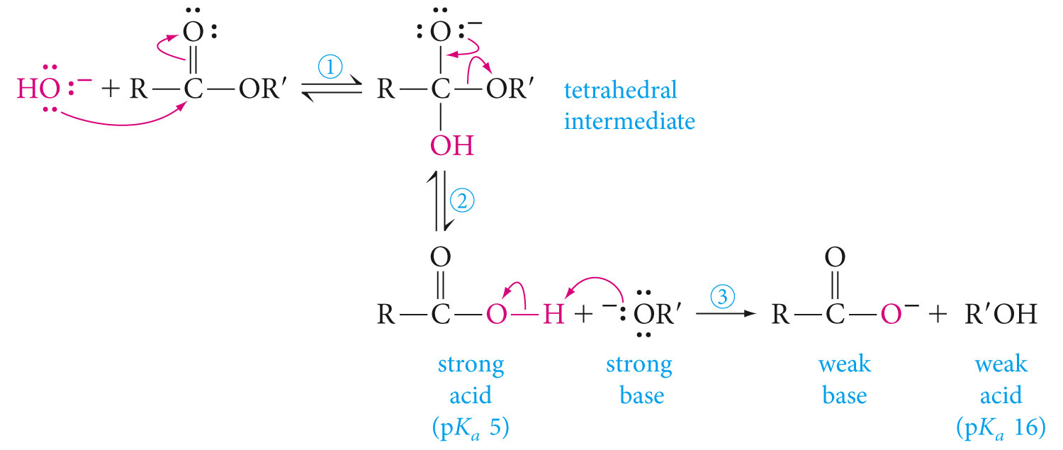
10.13 Saponification of Esters
Saponification is the hydrolysis of an ester with a base.
Mechanism

Slide 31
10.16 Reduction of Esters
Esters can be reduced to primary alcohols by lithium aluminum hydride (LiAlH₄).

Slide 32
10.18 Acyl Halides
Acyl halides are among the most reactive of carboxylic acid derivatives. Acyl chlorides are more common and less expensive than bromides or iodides. They can be prepared
from acids by reaction with thionyl chloride.
Phosphorus pentachloride and other reagents can also
be used to prepare acyl chlorides from carboxylic acids.

Slide 33
Reactions
Acyl halides react rapidly with most nucleophiles.
1.hydrolysis by water.
Reaction mechanism

Slide 34
2. Acyl halides react rapidly with alcohols to form esters.
3.Acyl halides react with ammonia to form amides

Slide 35
4. Acyl halides are used to synthesize aromatic ketones, through Friedel–Crafts acylation of aromatic rings.
5. Acyl halides also react with Grignard reagents to give tertiary alcohols.

Slide 36
PROBLEM 10.25 Devise a synthesis of 4-methylphenyl propyl ketone from toluene and butanoic acid as starting materials.

Slide 37
10.19 Acid Anhydrides
Acid anhydrides are carboxylic acid derivatives formed by condensing two carboxylic acid molecules.
The name of an anhydride is obtained by naming the acid from which it is derived and replacing the word acid with anhydride.

Slide 38
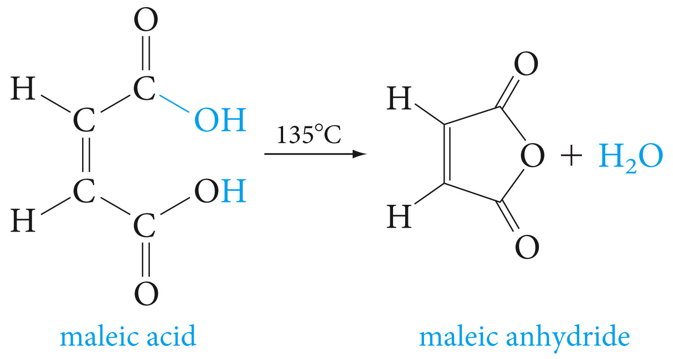
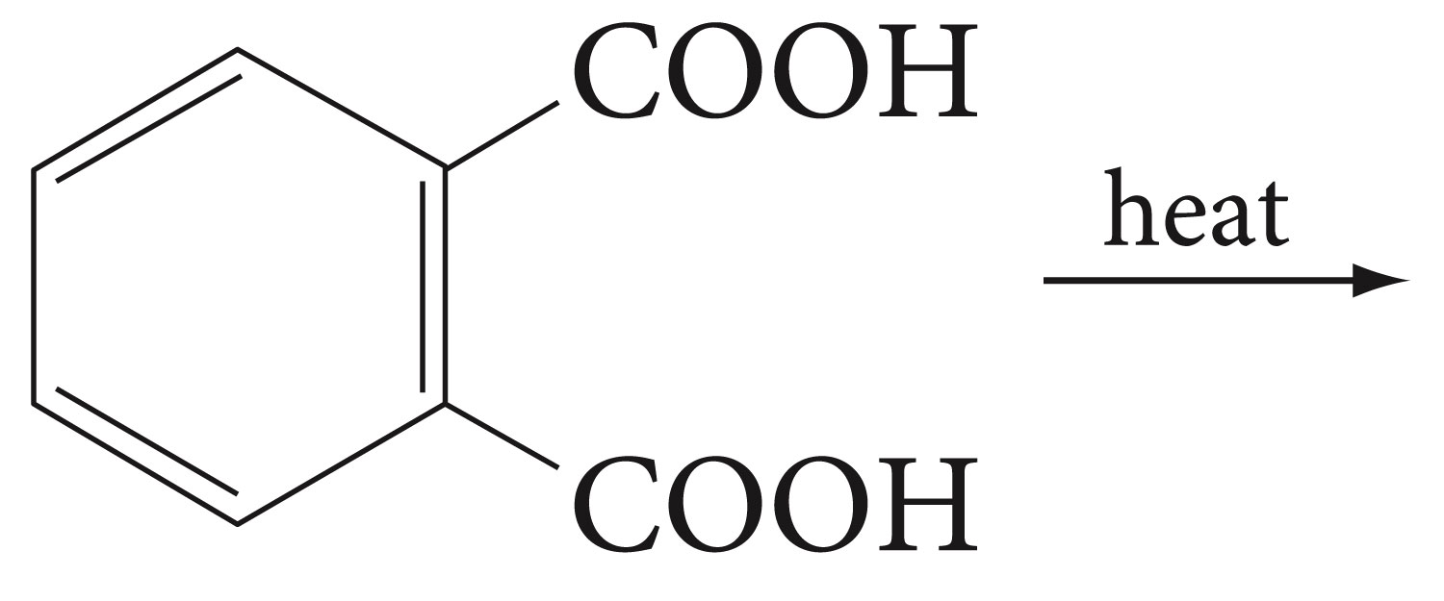
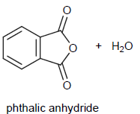
Preparation
1. Anhydrides are prepared by dehydration of acids.
Predict the structure of the anhydride product of the reaction below.

Slide 39
2.Anhydrides can also be prepared from acid chlorides and carboxylate salts.
Mixed anhydrides are prepared from two different carboxylic acids.

Slide 40
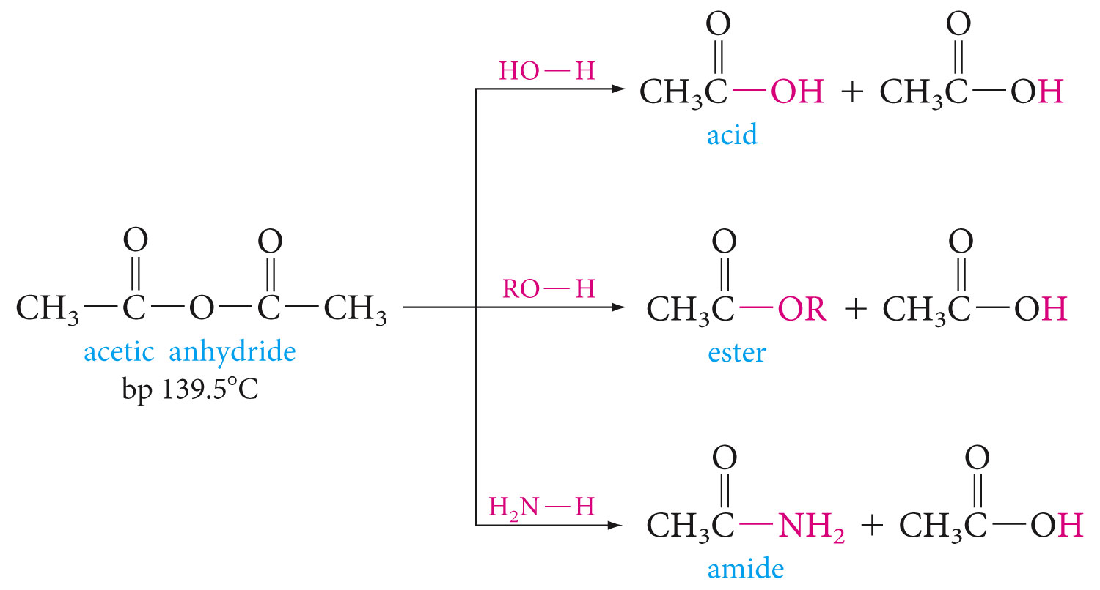
Reactions
Anhydrides undergo nucleophilic acyl substitution reactions. They are more reactive than esters, but less reactive than acyl halides, toward nucleophiles. Below are some typical reactions with acetic anhydride

Slide 41
Aspirin can be prepared by the reaction of acetic anhydride with salicylic acid (o-hydroxybenzoic acid).
PROBLEM 10.29 Write an equation for the reaction of acetic anhydride with 1-pentanol (CH₃CH₂CH₂CH₂CH₂OH).

Slide 43
10.20 Amides
Amides are carboxylic acid derivatives in which the -OH
group is replaced by -NH₂, -NHR, or -NR₂.
Amides are the least reactive of the common carboxylic acid derivatives.

Slide 44
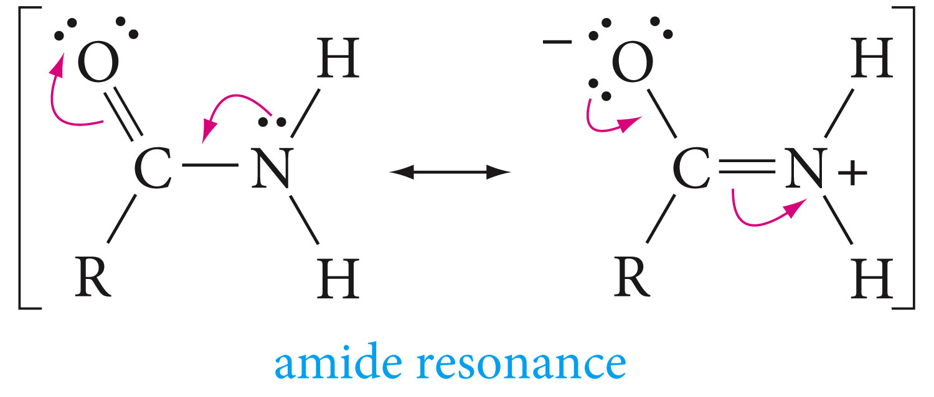
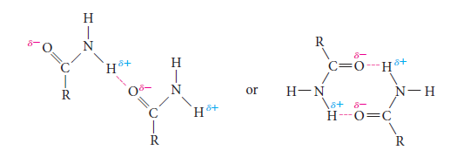
Amides have planar geometry, this is because of the C-N double bond character resulting from the resonance.
As the dipolar resonance contributor suggests, amides are highly polar and form strong hydrogen bonds.

Slide 45
Amides have exceptionally high boiling points for their molecular weights, although alkyl substitution on the nitrogen lowers the boiling and melting points by decreasing the hydrogen-bonding possibilities, as shown in the following two pairs of compounds:

Slide 46
Reactions of amides:
-Like other acid derivatives, amides react with nucleophiles. Above is an example of hydrolysis of an amide
- Amides can be reduced to primary amines by Lithium aluminum hydride

Slide 47
