Slide 1
Cesarean section
Presented by:
Jonaid Jaradat
Heba Sarayreh
Noor Athamneh
Forat Thnaibat
Seema Tarawneh
Doa’a Qatawneh

Slide 2
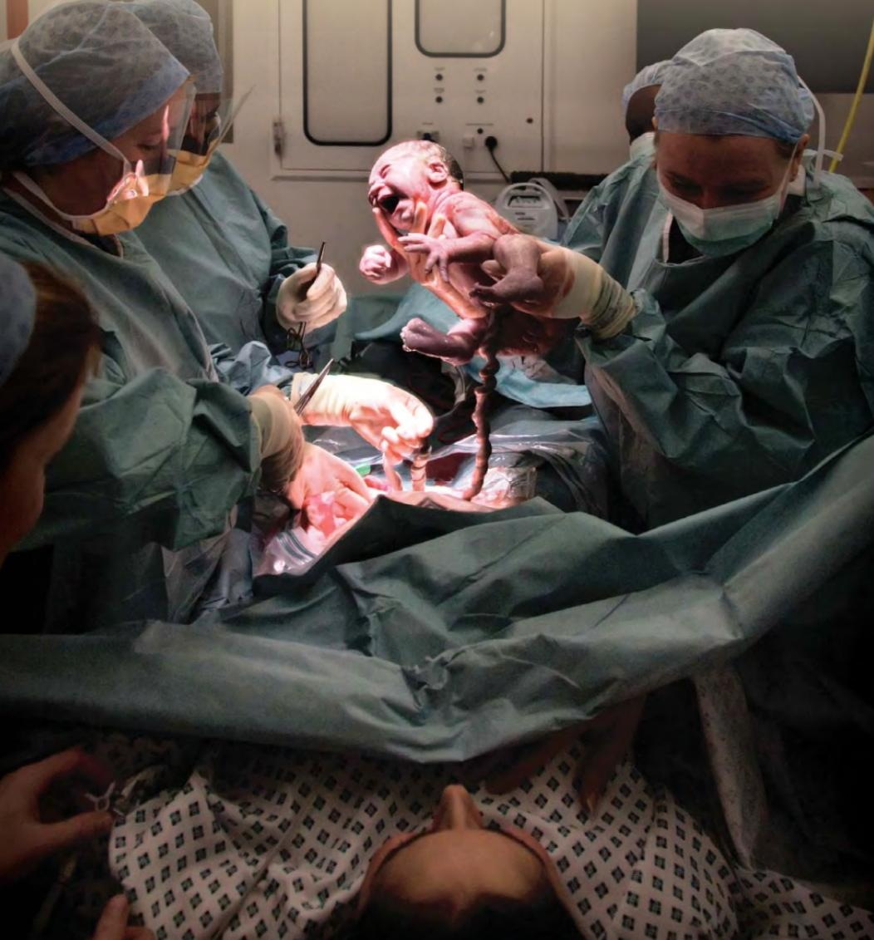
Caesarean section

Slide 3
Caesarean section
Definition:
is a surgical procedure in which incisions are made through a woman’s abdomen (laparotomy) and uterus (hysterotomy) to deliver one or more babies ,placenta and membranes.usually carried Out after the age of viability (24 w)
Classification:
Elective: CSs are planned in ahead time.
Emergency: When the cesarean section is done because of sudden deterioration in maternal or fetal condition during labor or due to non-progress, failed induction or failed trial.

Slide 4
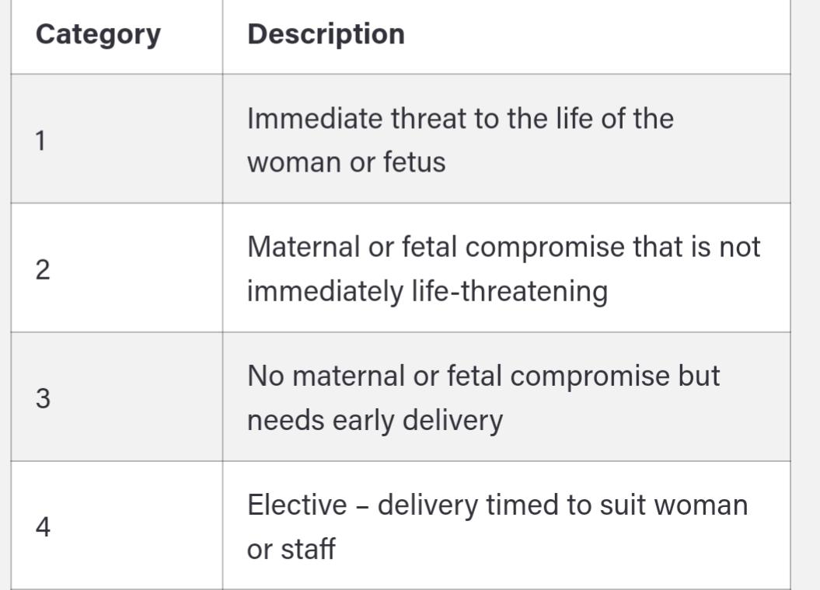
Subclassification
Classification according to the urgency:
immediate threat to life of woman or fetus (requiring immediate delivery)
maternal or fetal compromise which is not immediately life- threatening (requiring urgent delivery)
(needing early delivery) but no maternal or fetal compromise
at a time to suit the patient and maternity team (elective delivery)

Slide 5
Maternal Complications
Complications of emergency caesarean section
200 000 emergency caesareans per year in UK
Straightforward until it goes wrong
10% at full dilatation
In the majority (55%) there has been no attempt to deliver vaginally
Factors that might influence this…
Fetal complications
Extensions
access and visualisation is key
reducing blood loss
reaching difficult apex
broad ligament
Damage to bladder/ureter
Haemorrhage/blood transfusion
Reducing the risk of thrombosis/sepsis
Difficulty delivering the baby
Skull fractures
Limb fractures
Advanced initial resuscitation
Maternal mortality rate for all Caesarean sections is 5 times that for vaginal delivery, especially with
emergency cesareans performed in

Slide 6
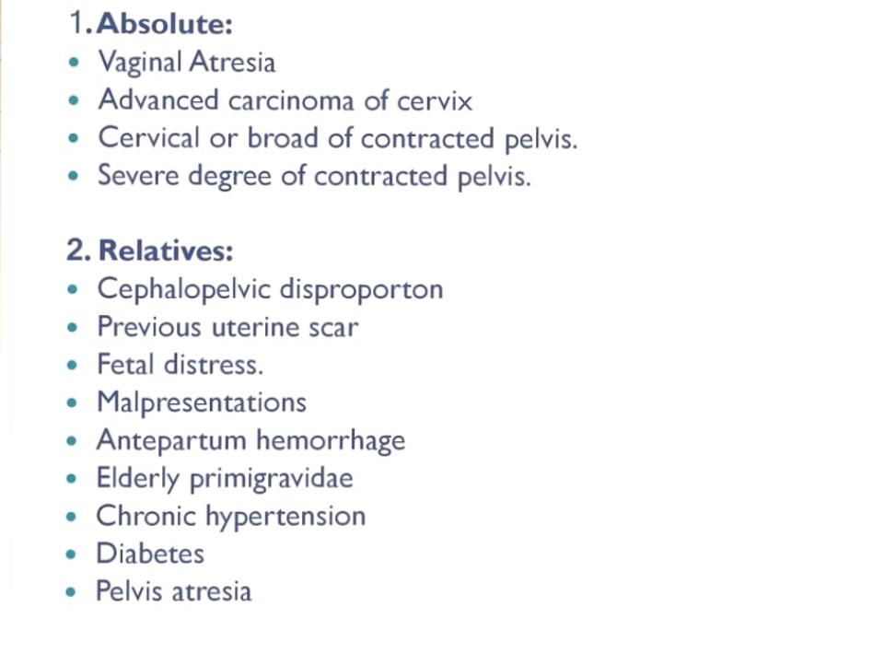
Indication:

Slide 7
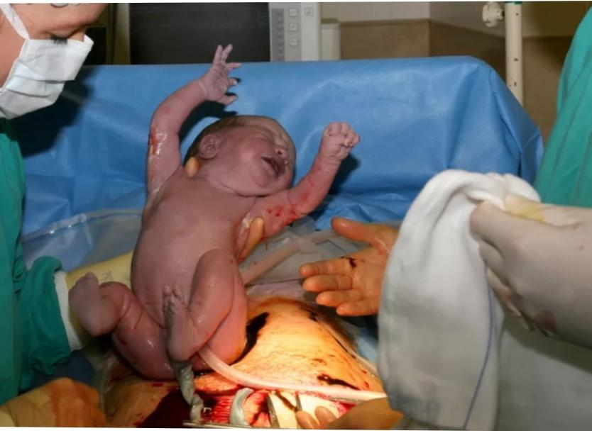
Indication:
Fetal:
. Cord prolapse
. fetal distress
. Fetal macrosomia > 4500 gm 4. Multiple pregnancy
. Transverse lie and Malpresentation brow, mentoposterior, shoulder & compound presentations, breech
. Failed induction, obstructed labor and Failure to progress in labor (Dystocia) (CPD)
. Severe PET-relative contraindication

Slide 8
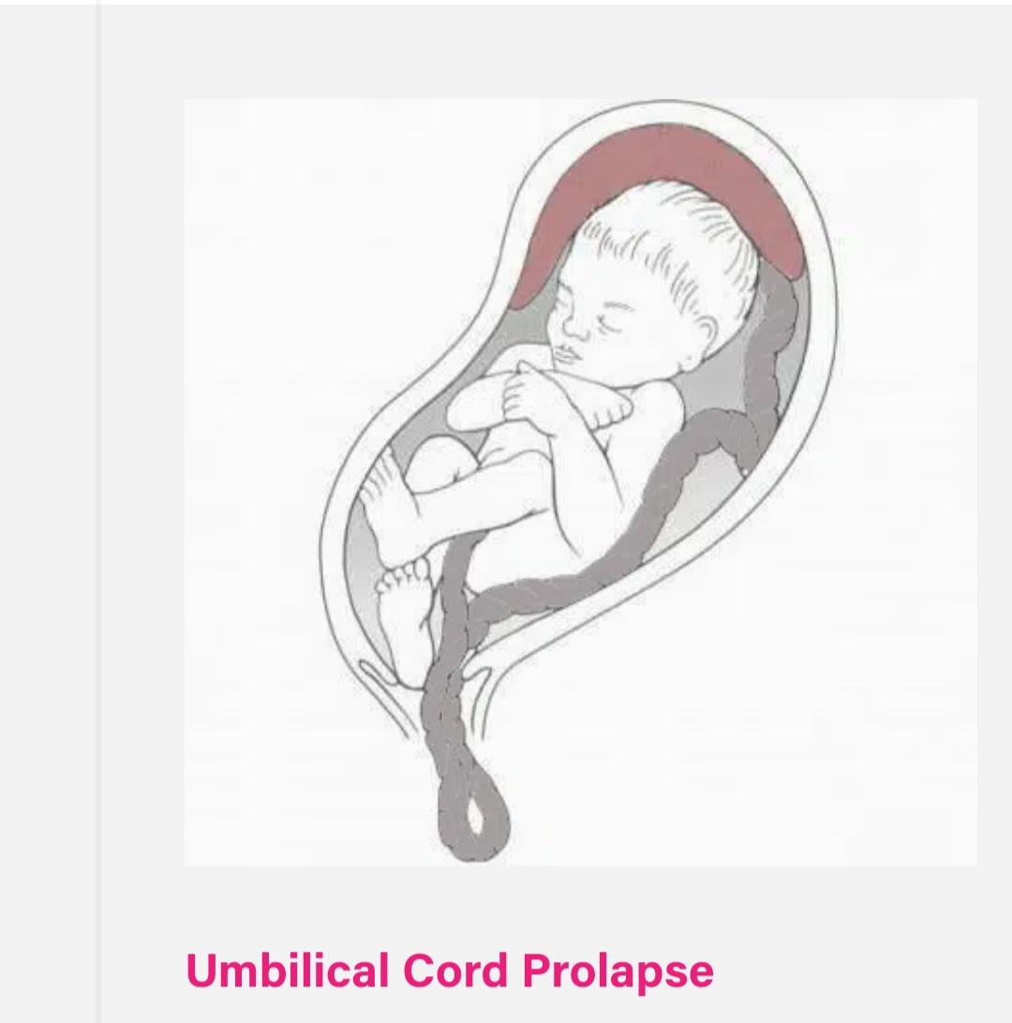
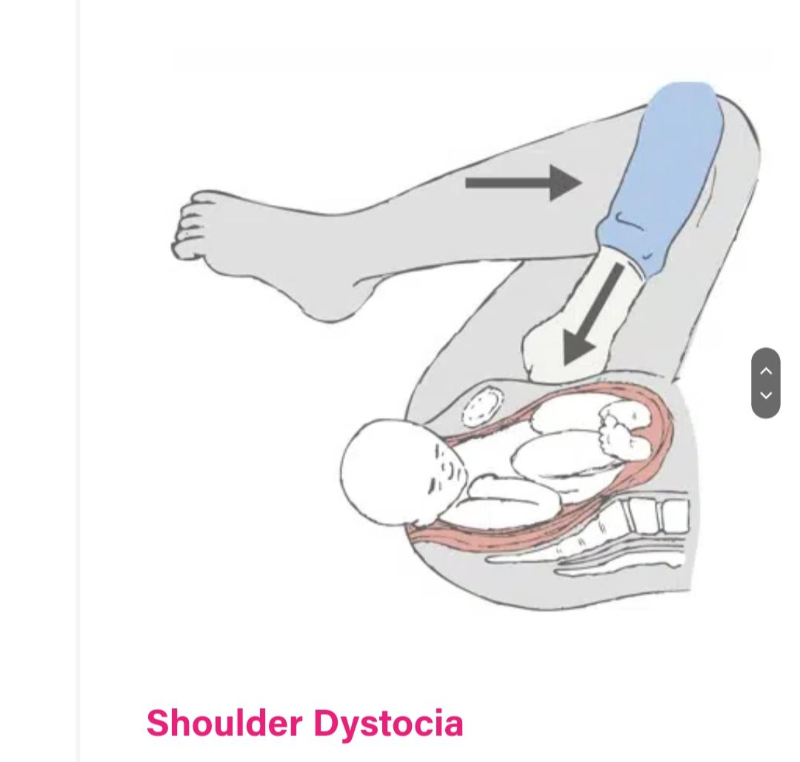

Slide 9
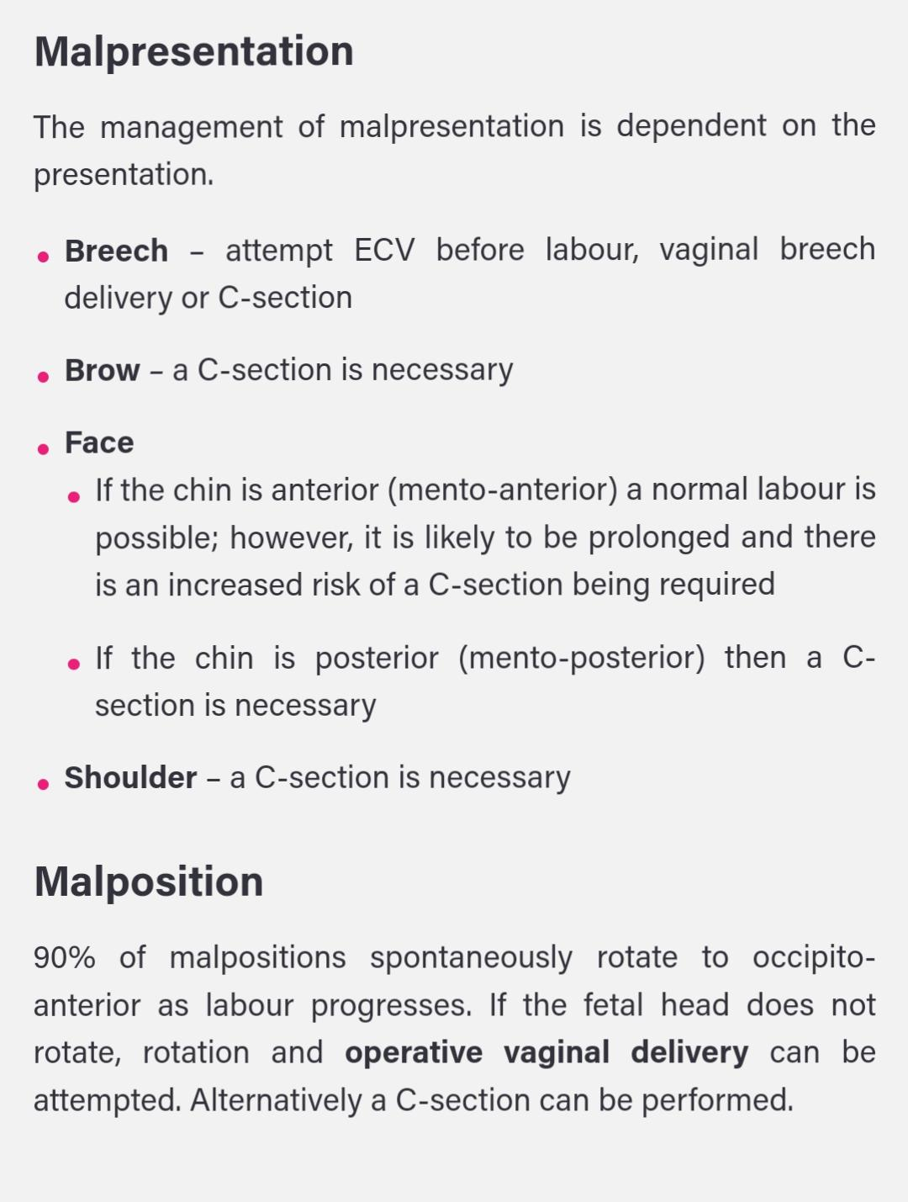

Slide 10
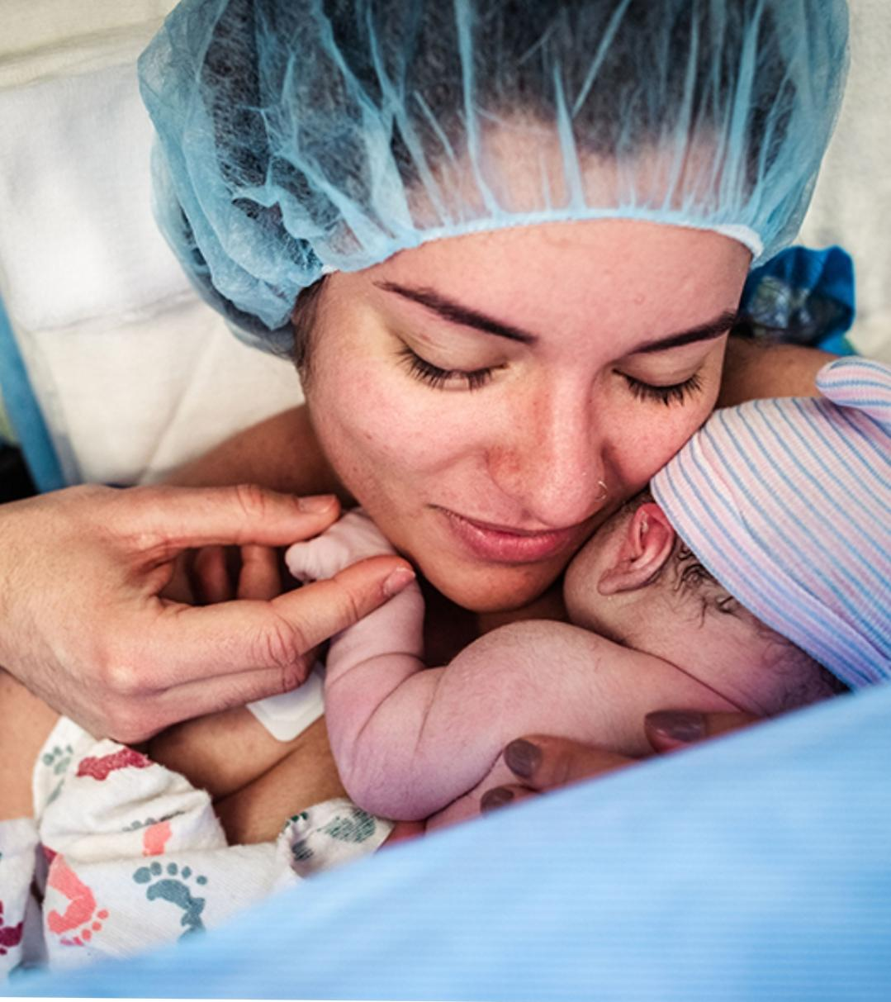
maternal:
. Repeat cesarean delivery
. Abnormal placentation (eg. placenta Previa, placenta accrete).
. Obstructive lesions in the lower genital tract, including leiomyomas of the lower uterine segment that interfere with engagement of the fetal head
. Pelvic abnormalities that preclude engagement or interfere with descent of the fetal presentation in labor.
5. Active genital herpes infection or maternal HIV infection
6. Maternal medical conditions (e.g. cardiomyopathy) – where labour would be dangerous for the mother.

Slide 11
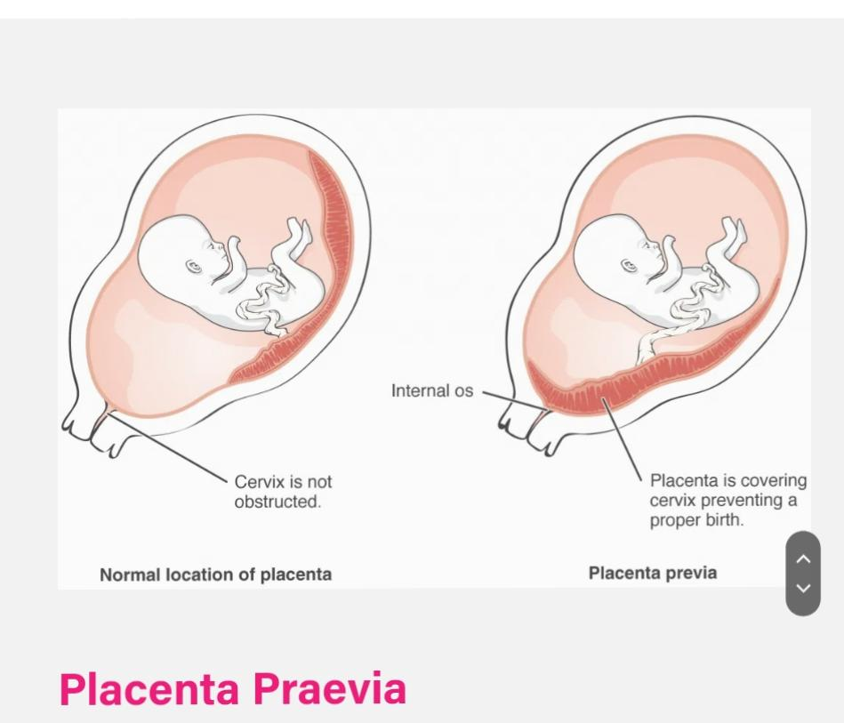
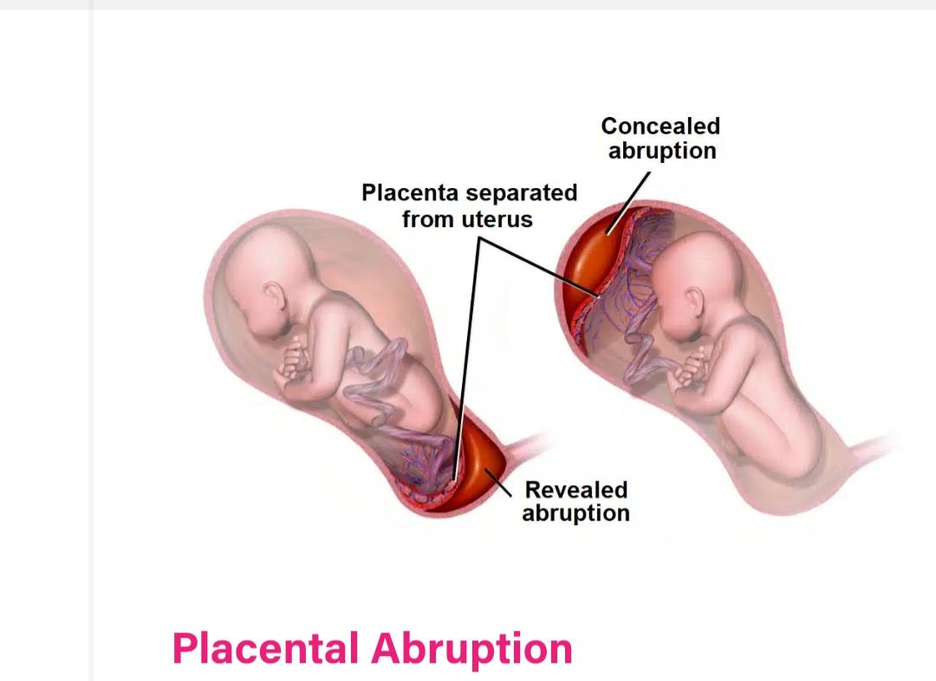
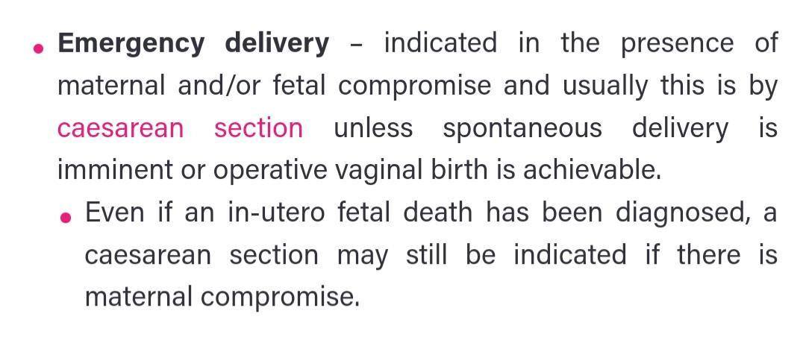

Slide 12
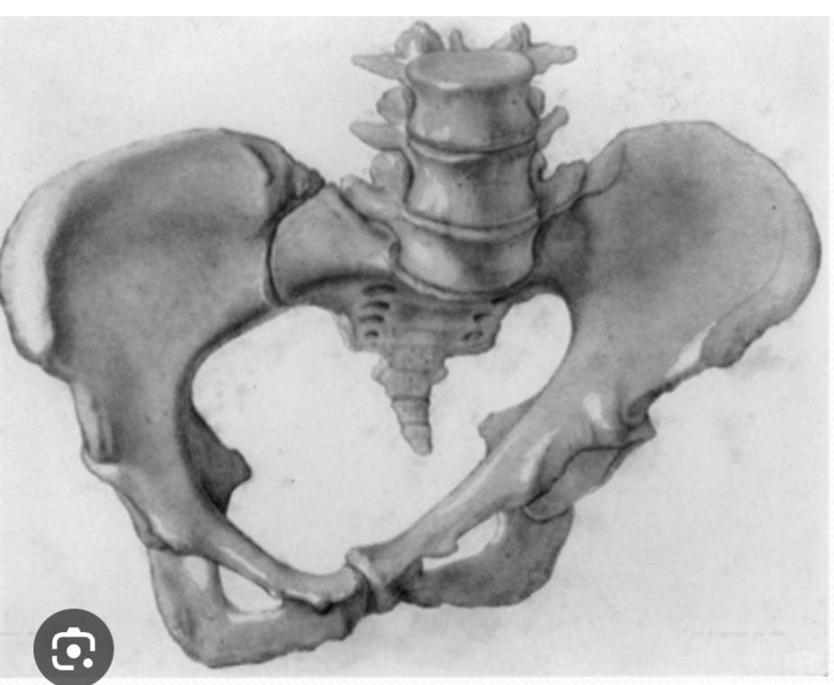
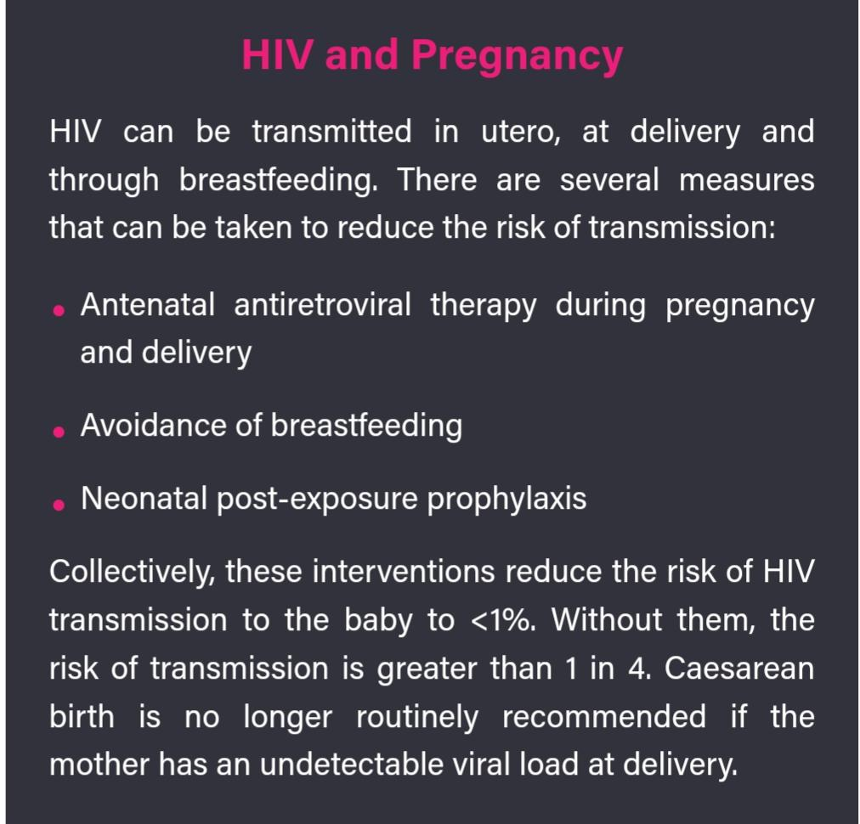
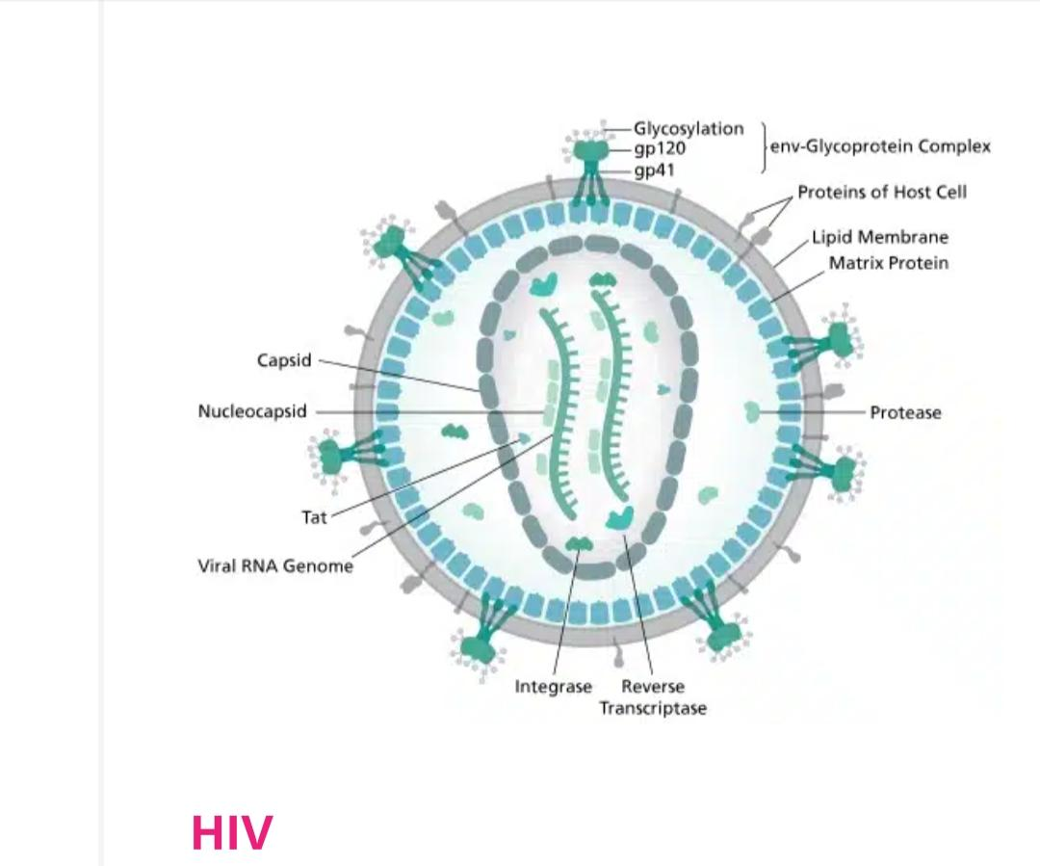
Pelvic deformities

Slide 13
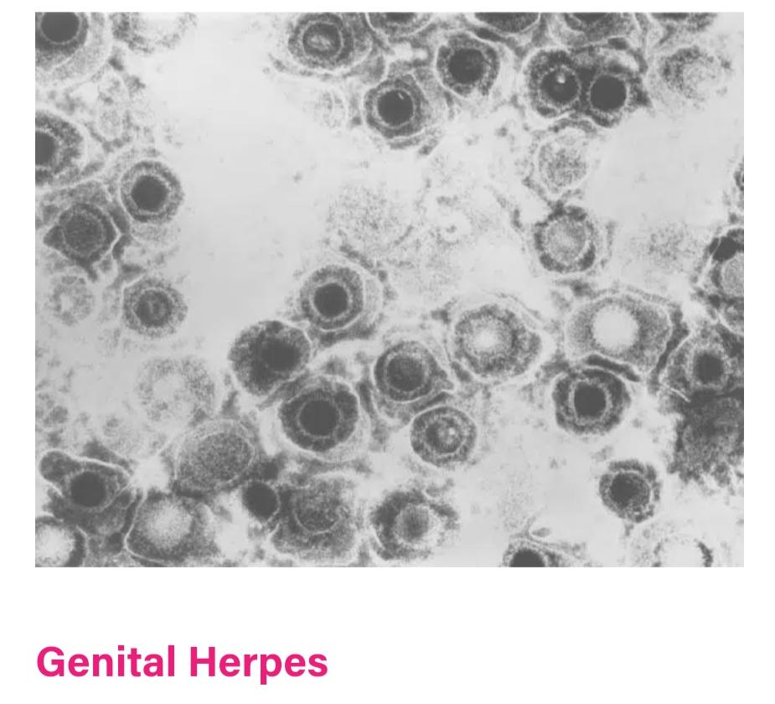
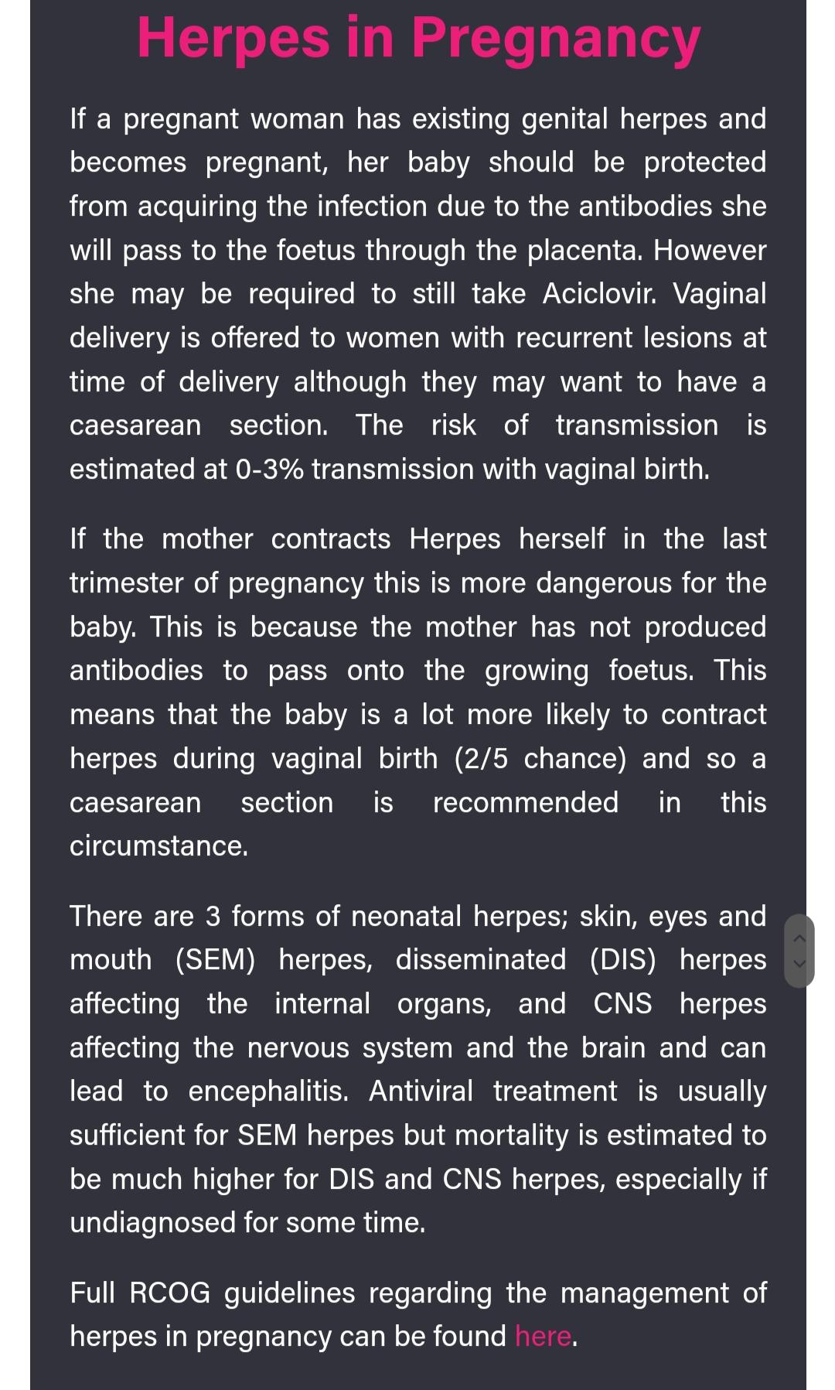

Slide 14
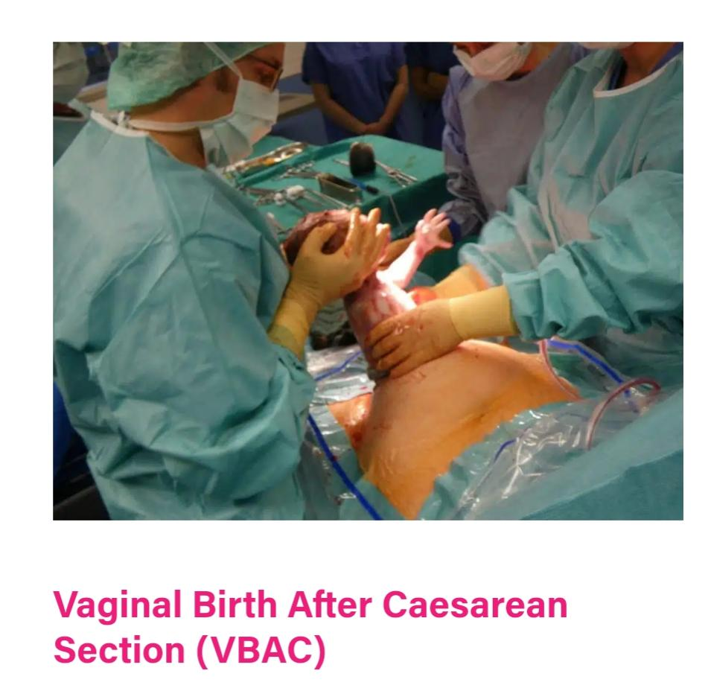
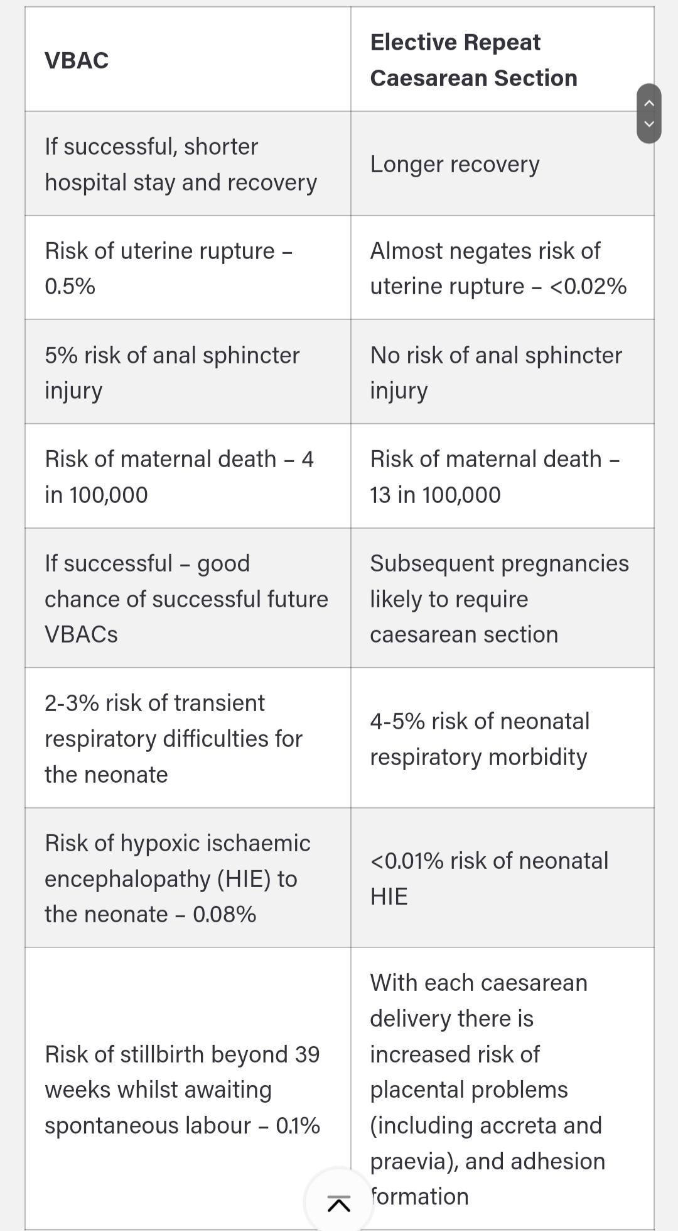
VBAC

Slide 15
If there is a previous CS can we try with vaginal delivery?
Yess (trial of labor)
Successful vaginal delivery rate is up to 80% in carefully selected patients.
Criteria for trial of labor include:
patient consent
non-repetitive cesarean indication (e.g., breech, placenta Previa), 3.previous low segment transverse uterine incision
4.clinically adequate pelvis.

Slide 16
Maternal Request
Unless there are Maternal or Fetal indications for C/S, Vaginal delivery should be recommended.
Should NOT be performed before 39 weeks gestation without verifying fetal lung maturity (due to a potential risk of respiratory problems for the baby).
It is NOT recommended for women who want more children (increase risk for placenta previa and accreta and gravid hysterectomy with each C/S).

Slide 17
Operation Steps
Pre-operative preparation
Anesthesia
Abdominal Incision
Uterine Incision
Fetal Delivery
Placental Delivery
Uterine Repair (Exteriorization)
Abdominal Closure

Slide 18
1. Pre-operative Preparation
Usually, she is asked to be Fasting 12 hours pre-operative
IV-line and Fluids.
Foley catheter.
External Fetal and Maternal Monitors.
Antibiotic Prophylaxis.
Antacids.
Lab tests; CBC, Blood type and Cross Match and Coagulation study.
Ultrasound : document fetal position and estimated fetal weight and site of placenta.

Slide 19
2. Anesthesia
Spinal anesthesia
Injection of a local anesthetic into the subarachnoid space through a fine needle 9 cm long.
Advantages:
Simple and Rapid onset
Minimal fetal exposure to drug
Allow time for careful abdominal wall incision and good hemostasis
Avoidance of complication of general anesthesia as uterine atony and pulmonary aspiration

Slide 20
Disadvantages:
Hypotension
Intrapartum nausea and vomiting
Spinal headache
Post-operative shivering

Slide 21
Epidural anesthesia
Advantages
Less incidence of hypotension because of slow onset of sympathetic block
Less incidence of spinal headache
Allow repeated administration through epidural catheter if the surgery is prolonged
Epidural catheter allow administration of post-operative analgesia

Slide 22
General anesthesia
Advantages
Can be given quickly (suitable for emergency CS)
Blood pressure and breathing are easily controlled
Better in patient with psychological problems
Disadvantages
Extraction of the fetus should be within 15 min. Nitrous oxide can cross placental blood barrier cardio depressant effect on the fetus
Acid aspiration syndrome
High incidence of uterine atony (Effect of halothane)
The patient doses not take apart in birth occasion

Slide 23
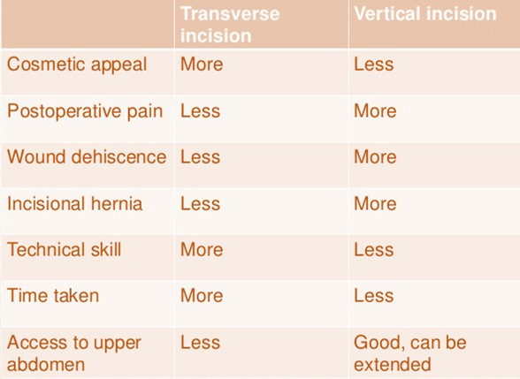
Abdominal wall incisions two type
Vertical –in the midline extends from below the umbilicus to 2cm above the symphysis pubis indicated in cases of extreme maternal obesity and in significant intra-abdominal adhesion (emergent incision).
Transverse(pfannenstiel)-extends transversely for 15cm above symphysis pubis nearly 2cm..the incision is cephalad at the level of the pubic hair decreased analgesic requirements. (other names: maylard, Joel Cohen ...)

Slide 24
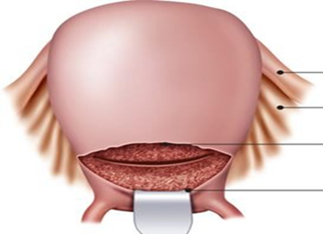
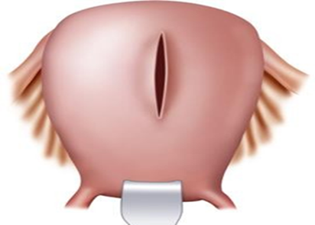
Low segment transverse incision
(Monroe-Kerr)
Classical upper segment
incision
(Kronig or Delee)
Uterine incision:( according to the GA, fetal presentation, placental location and the presence of well-developed uterine segment.)

Slide 25
 | Low segment transverse incision (Monroe-Kerr) | Classical upper segment incision (Kronig or Delee)
general | Most common uterine incision 90% Low transverse incision is smaller, horizontal and made near the bikini line made in the noncontractile portion of the uterus. The bladder must be dissected inferiorly to expose the lower segment, and the bladder blade has been placed. | less commonly performed. Larger vertical incision made in the contractile fundus of the uterus and (when the lower segment not developed, if an anterior placenta Previa is present, or if the fetus is in a transverse lie or in a preterm nonvertex presentation) Again, the bladder has been dissected inferiorly to expose the lower segment, and the bladder blade has been placed.
+ves | 1.trial of labor in subsequent pregnancy is safe 2. Less likely to rupture in next pregnancy (.5-1.5%) 3.Less risk of bleeding 4.Less adhesions 5.less uterine infection 6.Easy to repair | 1. any fetus(es) regardless of intrauterine orientation can be delivered 2. lower segment varicosities or myomas can be bypassed
-ves | 1.fetus must be longitudinal lie 2. lower segment must be developed 3. varicosities or myomas in the lower segment. 4.because of smaller incision the obstetricians may need vacuum or forceps for delivery | 1.trial of labor in a subsequent pregnancy is unsafe?? Higher risk of rupture in subsequent pregnancies 1.5% - 5% 2. More bleeding 3. Difficult to repair 4. High risk for adhesion

Slide 26
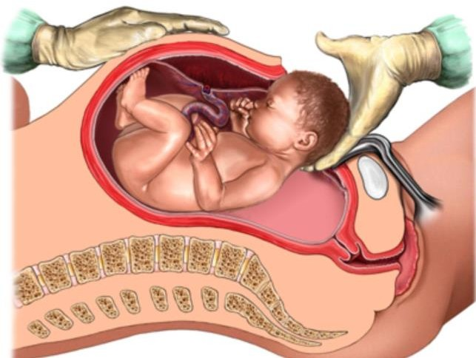
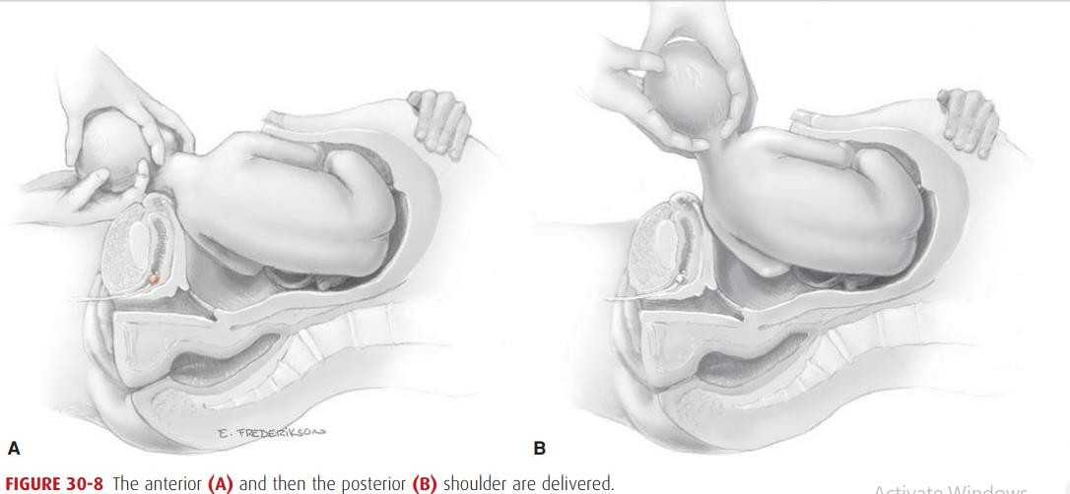
Delivery of the Fetus:
In a cephalic presentation, a hand is slipped into the uterine cavity between the symphysis and fetal head.
The head is elevated gently with the fingers and palm through the incision.
Once the head enters the incision,
delivery may be aided by modest transabdominal fundal pressure
After head delivery, a finger should be passed across the fetal neck.
The head is rotated to an occiput transverse position,
The sides of the head are grasped with two hands, and gentle downward traction is applied until the anterior shoulder enters the hysterotomy incision
Next, by upward movement,
the posterior shoulder is
delivered.

Slide 27
Two important aspects of the delivery are
the incision to delivery time (especially in previously compromised fetuses): Longer incision to delivery times are associated with worsening neonatal outcomes
delivery of the impacted fetal head: can be delivered either through pushing the head up from the vagina and elevating it up through the incision or by pulling it up as if it were a breech delivery.
After the fetus is delivered, the umbilical cord is doubly clamped and cut

Slide 28
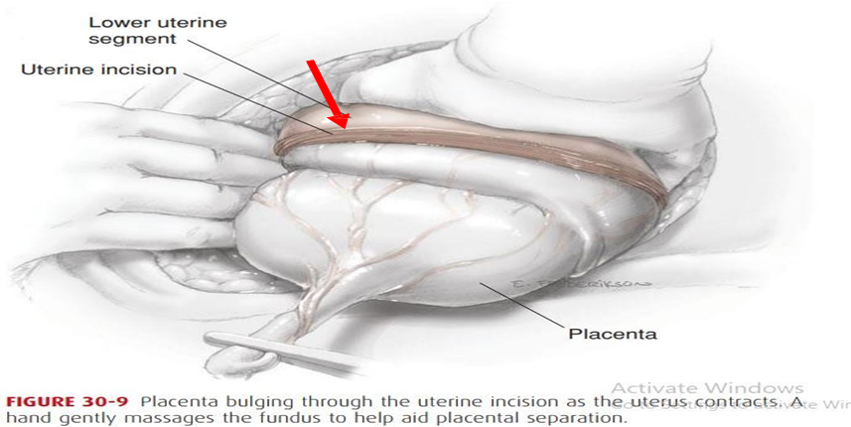
Placental Delivery:
After delivery, oxytocin (20 U) is placed in the intravenous (IV) fluid to increase contractions of the uterus.
The placenta is then delivered spontaneously, or manually along with some cord traction may reduce the risk of operative blood loss and infection
Fundal massage may begin as soon as the fetus is delivered to hasten placental separation and delivery.
Immediately after delivery and gross inspection of the placenta, the uterine cavity is suctioned and wiped out to remove avulsed membranes, vernix, and clots.
The average blood loss in CS is approximately 1000ml

Slide 29
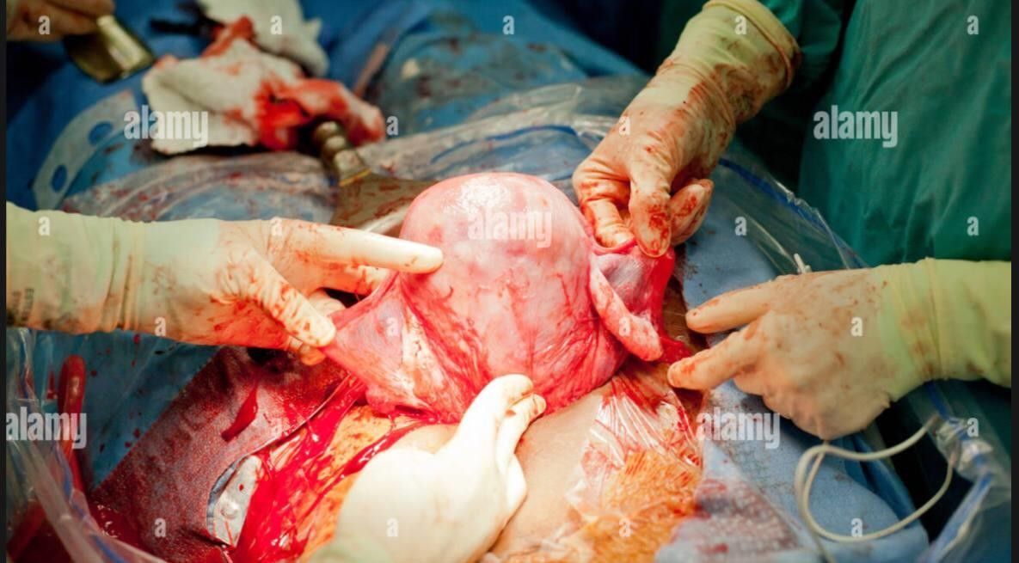
Repair of Uterus
Repair of the uterus can be facilitated by manual delivery of the uterine fundus through the abdominal incision (Externalizing): facilitates uterine massage, the ability to assess whether the uterus is atonic, and the examination of the adnexa.
Inspection of:
The incision is inspected for other bleeding vessels
any extensions of the incision
the bladder and lower segment inferior to the incision.
The principal disadvantage is discomfort and vomiting caused by traction in cesarean deliveries performed under regional analgesia.

Slide 30
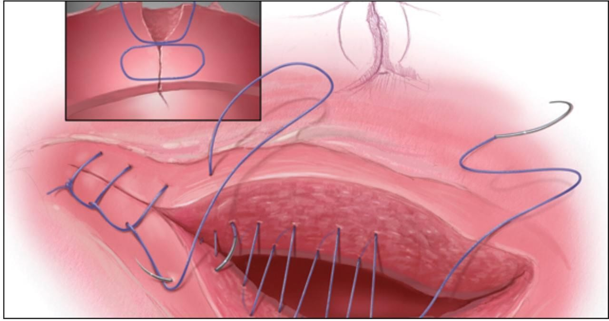
Repair of a low transverse uterine incision should be performed in either a 1-layer or 2-layer fashion with 0 or 2-0 chromic or polyglactin suture (absorbable sutures).
The first layer should include stitches placed lateral to each angle,
with prior palpation of the location of the lateral uterine vessels. Most physicians use a continuous locking stitch.
If the first layer is hemostatic, the second layer (Lembert stitch) (continuous or interrupted)
Single-layer closure is typically faster and is not associated with higher rates of infection or transfusion

Slide 31
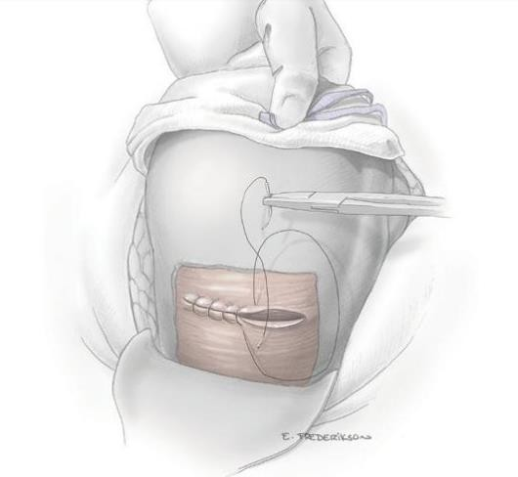
Postoperative care:
Maternal monitoring in the immediate postoperative period:
vital signs, uterine tone, vaginal and incisional bleeding, and urine output are monitored closely.
pain relieving:
analgesia followed by oral nonsteroidal anti-inflammatory drugs.
Bladder catheter:
Removing the catheter as soon as possible minimizes the risk of infection.
Diet and activity:
Early ambulation (when the effects of anesthesia have abated) and oral intake (within six hours of delivery) are encouraged
Breastfeeding:
can be initiated in the delivery room.
Wound care:
Dressings can be removed, and patients may shower within 48 hours of surgery.

Slide 39
Post operative Fever :
Short after the onset of the Anesthesia : Malignant hyperthermia.
Within 30-45 min : Bacteremia.
On first day : Atelectasis.
On 3rd day : Pneumonia or UTI.
On 5th day : DVT
On 7th day : Wound infection.
On 10-15 day : Deep abscesses.

Slide 40
Long Term complication and risks to future pregnancies :
1. Adhesion formation:
Adhesions are bands of scar tissue that join two, usually separate, parts of your body together. They can develop as a few thick fibrous bands or as a web of thin, nylon-strength collagen threads covering multiple organs and tissues.
2. Uterine Rupture:
The incidence of uterine rupture is higher in women who undergo a trial of labour after cesarean delivery .higher risk in upper segment insicion

Slide 41
3. Abnormal placentation : placenta Previa or morbidly adherent placenta
placenta Previa : The presence of placental tissue that extends over or lies proximate to the internal cervical os ( in the lower uterine segment ). Placenta previa increases the risk of antepartum, intrapartum , and postpartum hemorrhage
Morbidly adherent placenta :
abnormal deep implantation of the placenta. There are three types according to the depth of invasion :

Slide 42
4. Scar complications:
Long-term abdominal scar complications include numbness, pain [ Branches of the ilioinguinal nerve and the iliohypogastric nerve are severed by transverse abdominal incisions].

Slide 43
Uterine scar complications include :
cesarean scar pregnancy( type of ectopic pregnancy) implantation of gestational sac at the uterine incision scar
2. uterine scar dehiscence : herniation of intact amniotic membrane into an existing uterine scar

Slide 44
Neonatal Complication:
Respiratory Difficulties (increasing incidence with cs more than vaginal delivery )
Iatrogenic injury: cuts, scrapes and other similar injuries to an infant that can occur during a C-section procedure. In most cases, fetal lacerations occur due to a surgeon improperly making incisions or scraping the baby with surgical tools during
Failure to Breastfeed.

Slide 45
Thank you

