Slide 1
Upper respiratory tract infections

Slide 2
Definition

Slide 5
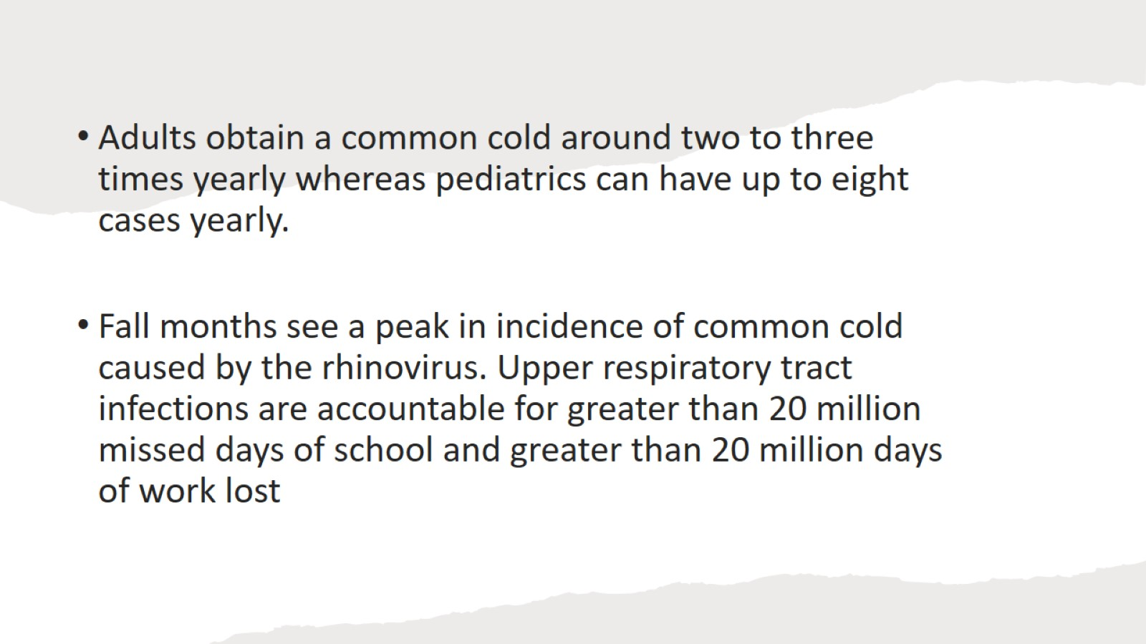

Slide 6
Pathophysiology

Slide 7
Risk factors

Slide 8
Common cold

Slide 10
How can we distinguish common cold from others URTI

Slide 11
Management

Slide 12
Complications and red flags

Slide 13
Influenza

Slide 14
Important notes

Slide 15
Acute pharyngitis

Slide 16
Viral and bacterial pharyngitis cannot be distinguished based on the presentation, but some clues can aid the diagnosis. Details in Table 3

Slide 17
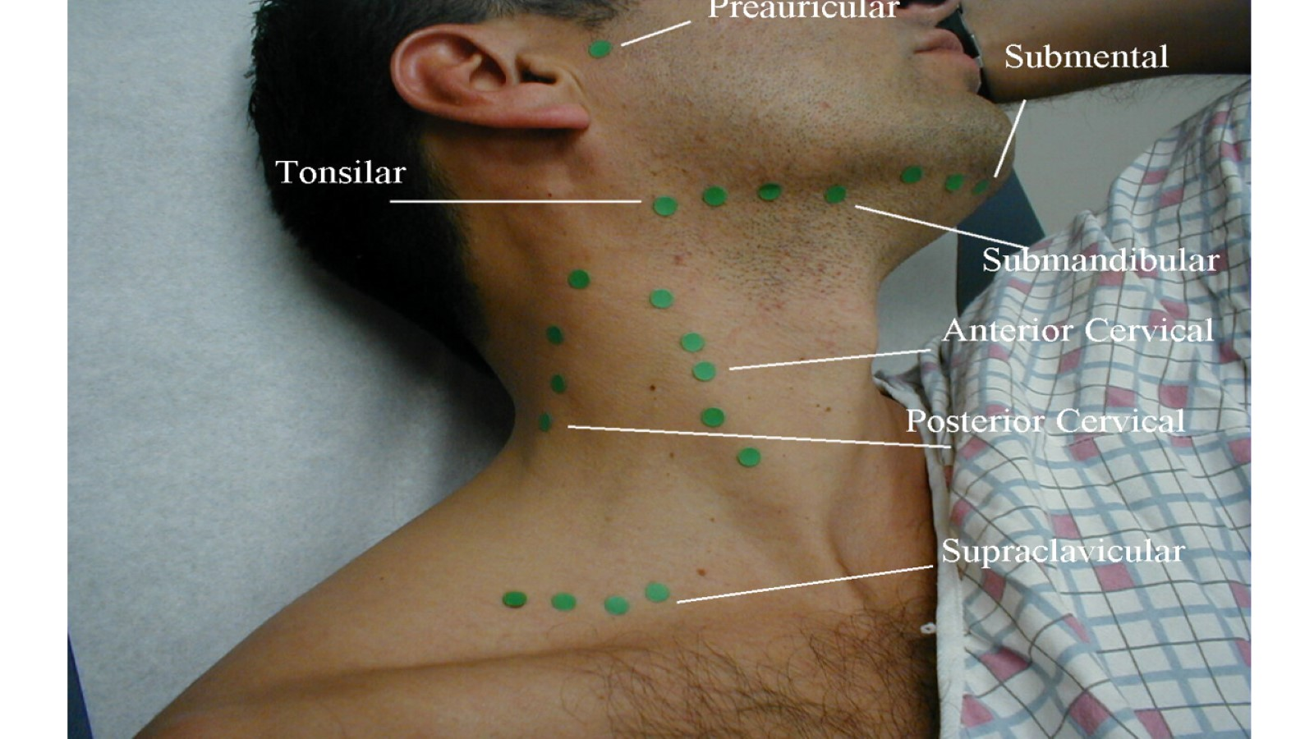

Slide 18
It was important to develop a clinical tool to differentiate the probability of having bacterial vs viral pharyngitis. Hence why, (modified/McIsaac) Centor’s criteria (streptococcal score) was founded

Slide 19
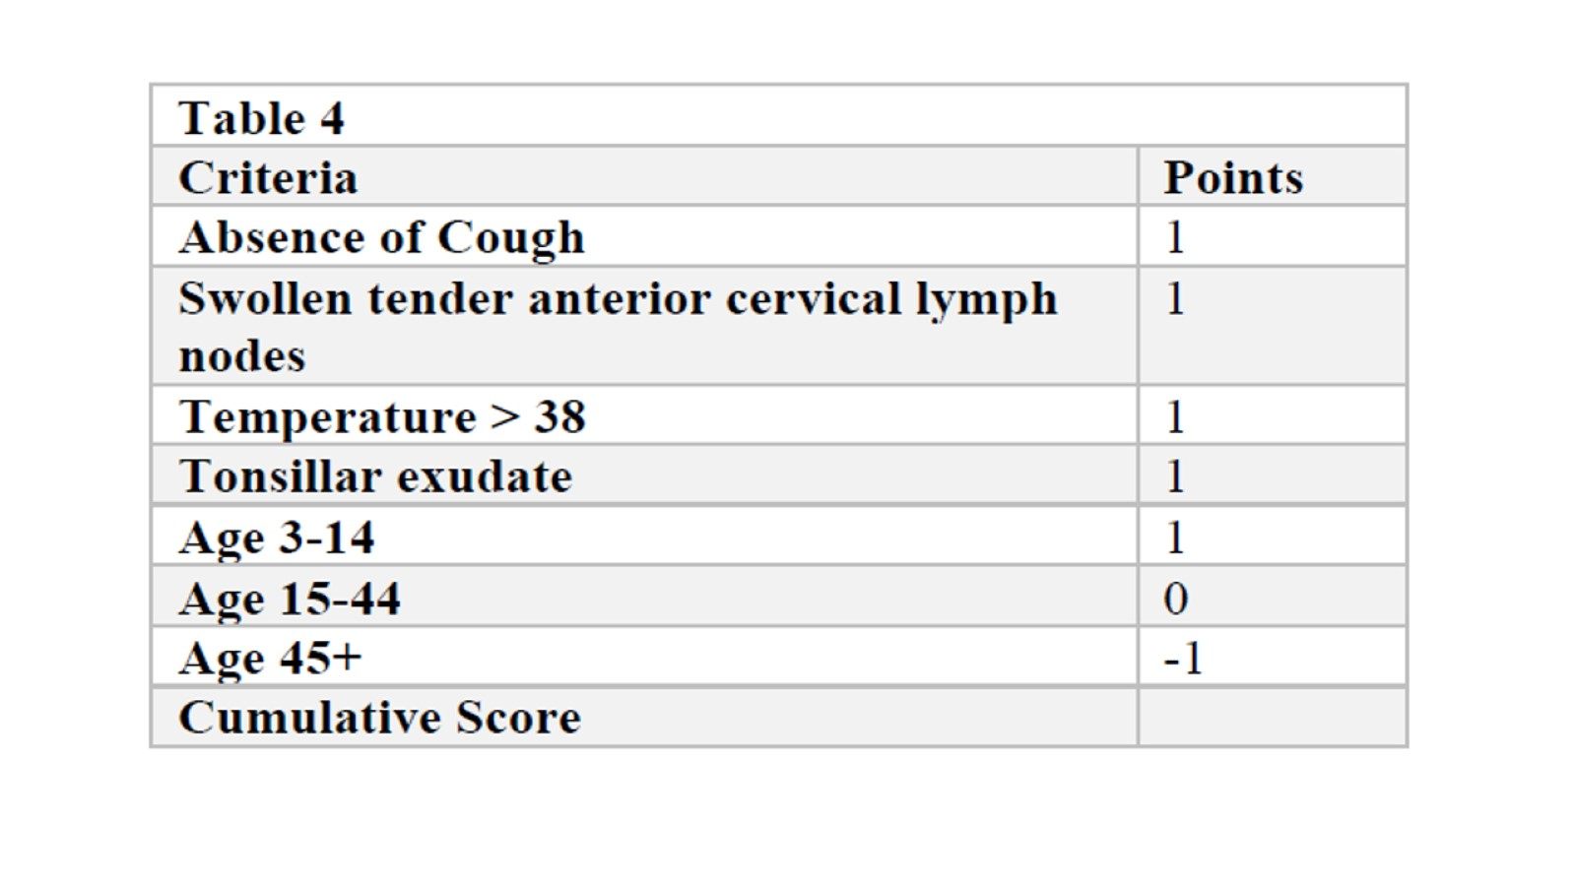

Slide 20
Investigations

Slide 21
Why is it important to detect bacterial pharyngitis?

Slide 23
Strept. Pharyngitis vs mononucleosis

Slide 24
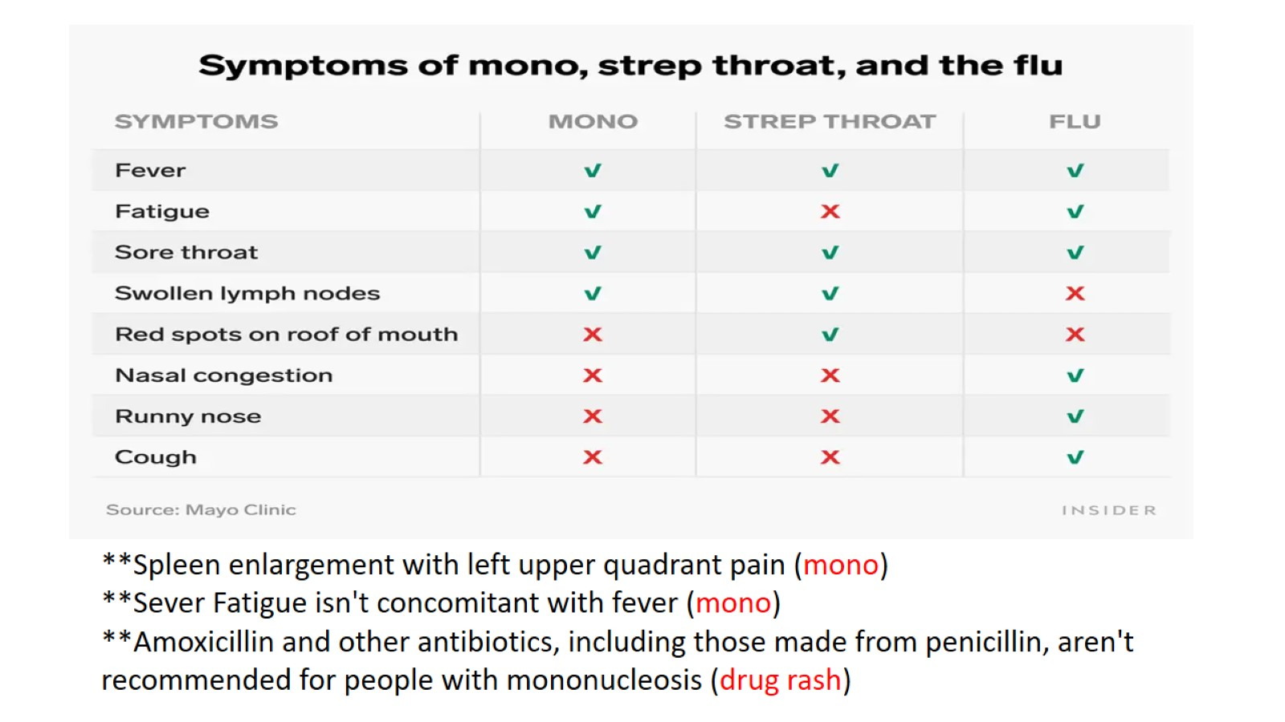

Slide 25
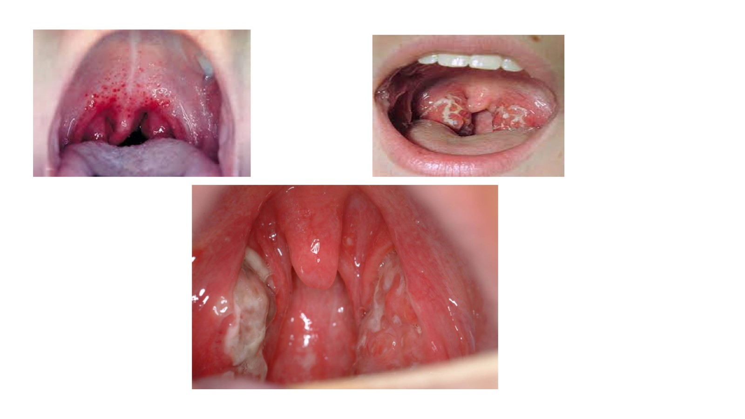

Slide 26
Treatment

Slide 27
For patients who are allergic to penicillin:

Slide 28
When tonsillectomy is indicated

Slide 29
Epiglottitis

Slide 31
Symptoms

Slide 33
Examination

Slide 36
Management

Slide 38
Pertussis

Slide 40
Croup

Slide 41
Croup

