Slide 1
Urolithiasis

Slide 2
Epidemiology
The lifetime prevalence of Urolithiasis is approximately 12% for men and 7% for women in the United States, and it is rising.
Peak incidence occurs in people aged 35-45 years.
male-to-female ratio of 3:1.
Calcium stones represent about 80%.

Slide 3
Pathophysiology
supersaturation of the urine by stone-forming constituents, including calcium, oxalate, and uric acid.

Slide 4
Etiology
Environmental: A low fluid intake, with a subsequent low volume of urine production, produces high concentrations of stone-forming solutes in the urine.
Metabolic: Hypercalciuria is the most common metabolic abnormality.

Slide 5
The four main chemical types of kidney stones are:
Calcium stones
Uric acid stones
Struvite stones
Cystine stones

Slide 6
Calcium stones
Calcium oxalate, calcium phosphate, and calcium urate are associated with the following disorders:
Hyperparathyroidism
Increased gut absorption of calcium
Renal calcium leak
Hyperoxaluria (fat malabsorption)

Slide 7
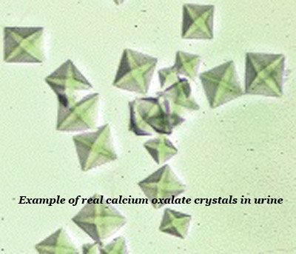

Slide 8
Struvite stones
Struvite stones account for 15% of renal calculi. They are associated with chronic urinary tract infection (UTI) with gram-negative, urease-positive organisms that split urea into ammonia, which then combines with phosphate and magnesium to crystalize into a calculus. Usual organisms include Proteus, Pseudomonas, and Klebsiella species. Escherichia coli is not capable of splitting urea and, therefore, is not associated with struvite stones.

Slide 9
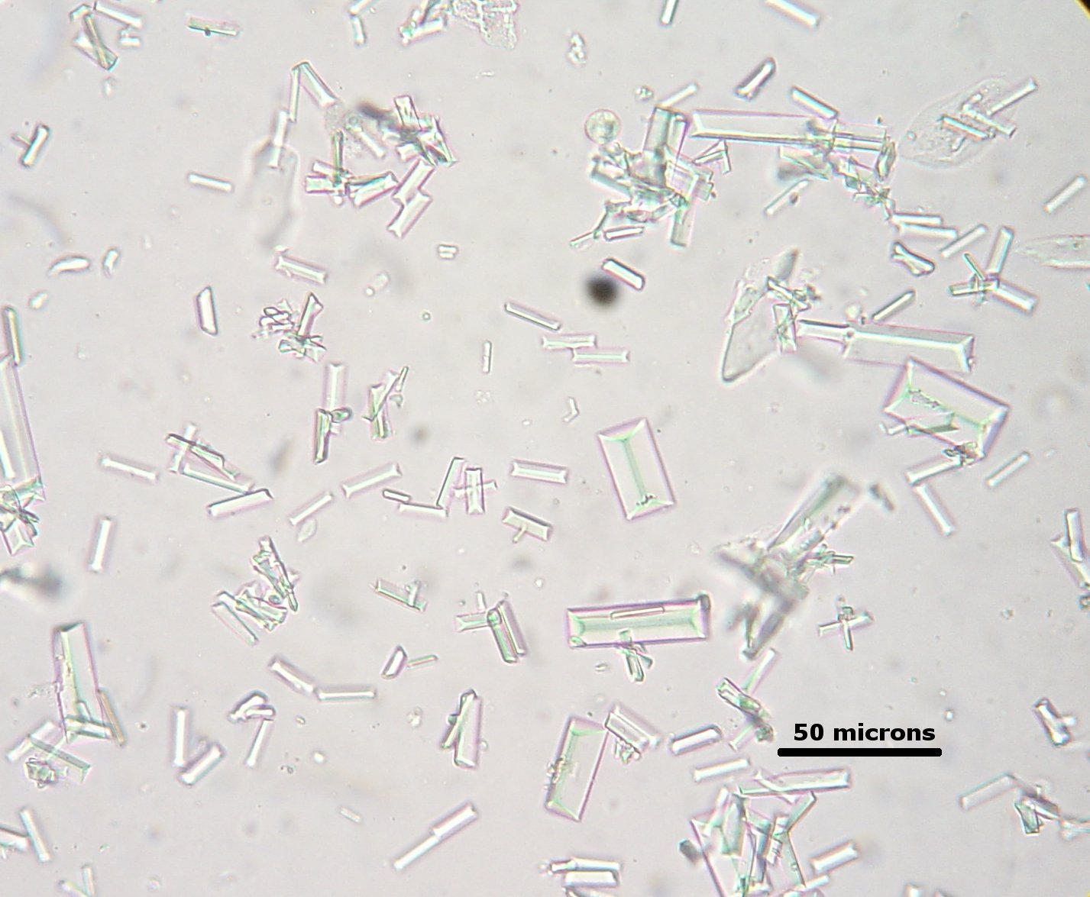

Slide 10
Uric acid stones
Uric acid stones account for 6% of renal calculi. These are associated with urine pH less than 5.5, high purine intake (eg, organ meats, legumes, fish, meat extracts, gravies), or malignancy (ie, rapid cell turnover).
Approximately 25% of patients with uric acid stone have gout.

Slide 11
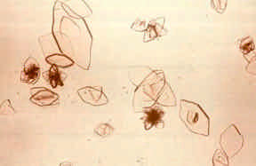

Slide 12
Cystine stones
Cystine stones account for 2% of renal calculi. They arise because of an intrinsic metabolic defect resulting in failure of renal tubular reabsorption of cystine, ornithine, lysine, and arginine. Urine becomes supersaturated with cystine, with resultant crystal deposition.

Slide 13
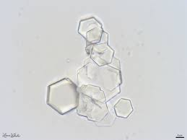

Slide 14
Risk factors
Patient habits: lower calcium intake, higher oxalate intake, higher animal protein intake, lower potassium intake, higher sodium intake, or lower fluid intake.
History of prior urolithiasis
Family history

Slide 15
Clinical manifestations
Asymptomatic
Acute onset of severe colicky flank pain radiating to the groin
gross or microscopic hematuria
nausea, and vomiting
Physical examination is often unremarkable

Slide 16
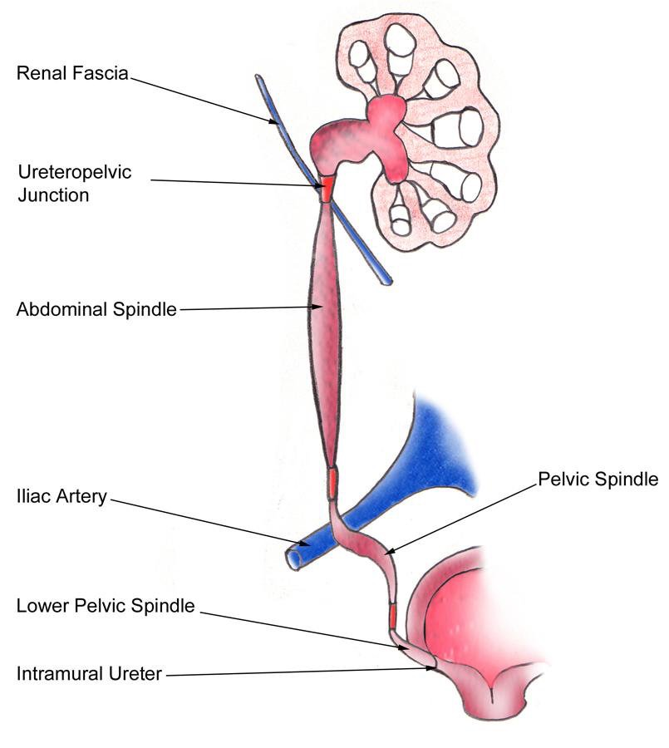

Slide 17
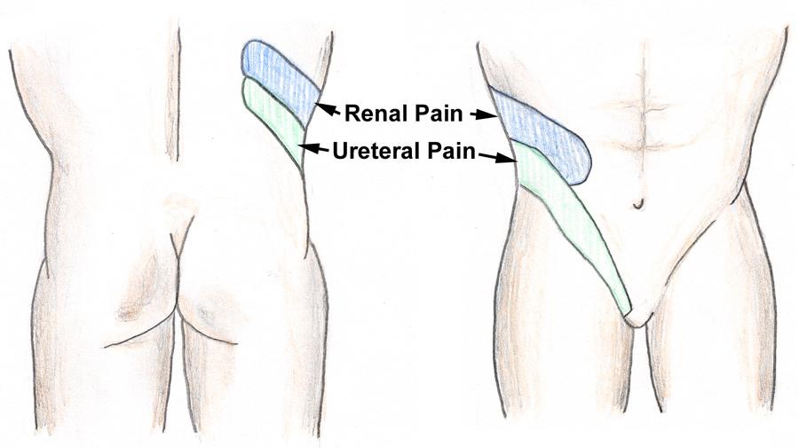

Slide 18
Diagnosis
STONE score
Low probability (0-5)
Moderate probability (6-9)
High probability (10-13)

Slide 19
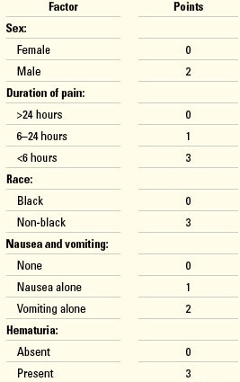

Slide 20
Imaging:
Gold standard: non-contrast spiral CT.
Ultrasound, especially in pregnant cases.
KUB

Slide 21
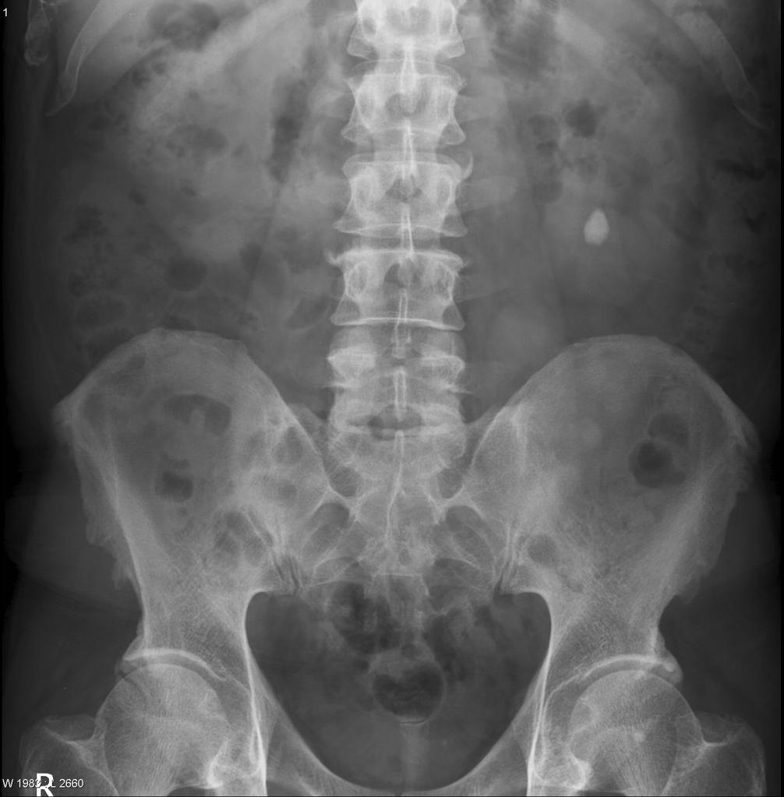

Slide 22
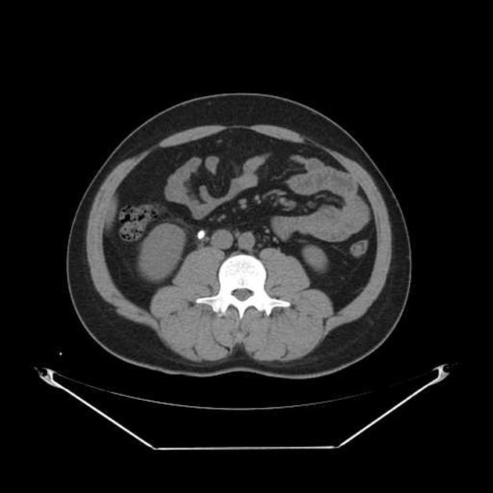

Slide 23
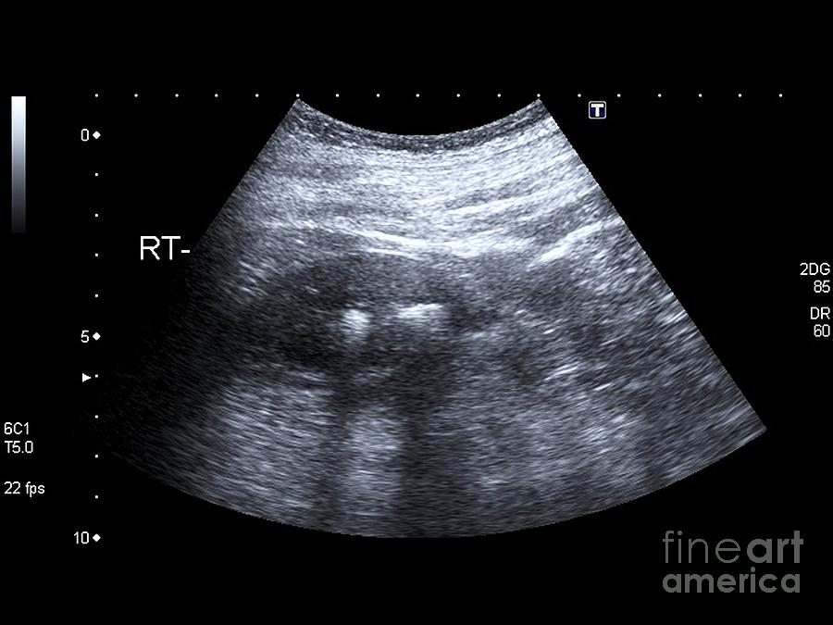

Slide 24
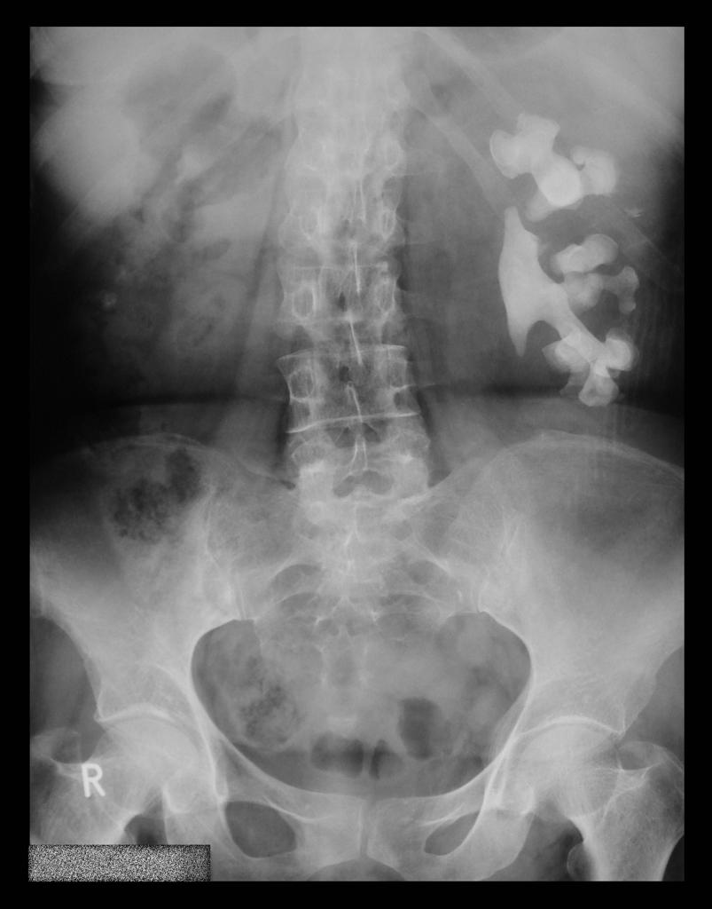

Slide 25
Presentation
Incidentally
Symptoms:
- Pain sudden severe flank pain that is colicky (waves of increasing severity are followed by a reduction in severity, but it seldom goes away completely). It may radiate to the groin as the stone passes into the lower ureter.
- Hematuria (microscopic or occasionally macroscopic)
- Malaise, weakness, and loss of appetite can also occur.

Slide 26
acute management

Slide 27
1- Pain relief
NSAID (diclofenac or ketorolac tromethamine) IM or IV ,Orally or per rectum, provides rapid and effective pain control. Its analgesic effect is partly anti-inflammatory, partly by reducing ureteric peristalsis.
Opiate analgesics When NSAIDs are inadequate, such as morphine are added.

Slide 28
Calcium channel antagonists (nifedipine) may reduce the pain of ureteric colic by reducing the frequency of ureteric contractions upper ureteral stones, whereas Alpha-blockers (Tamsulosin) may be used for distal ureteral stones.
Antiemetic drug (metoclopramide)
Antibiotic therapy Only if the patient has clinical evidence of a UTI

Slide 29
No need to encourage the patient to drink copious amounts of fluids or to give them large volumes of fluids intravenously in the hope that this will flush out the stone. Excess urine output will tend to cause a greater degree of hydronephrosis in the affected kidney, which will make ureteric peristalsis even less efficient than it already is. Peristalsis, can only occur if the walls of the ureter above the bolus of urine can coapt, i.e., close firmly together. If they cannot, as occurs in a ureter distended with urine, the bolus of urine cannot move distally.

Slide 30
2-watchful waiting
Chances of spontaneous stone passage depend principally on stone size .
Many ureteric stones are 4 mm in diameter or smaller and most such stones (90%+) will pass spontaneously, given a few weeks ( 3weeks ) with analgesics for exacerbations of pain.
Stones that have not passed in 2 months are much less likely to do so, though large stones do sometimes drop out of the ureter at the last moment.

Slide 31
Therefore,accurate determination of stone size (on plain abdominal X-ray or by CTU) helps predict chances of spontaneous stone passage.
Calcium channel blocker (nifedipine) and Alpha-blockers may assist spontaneous stone passage and reduce frequency of ureteric colic.

Slide 32
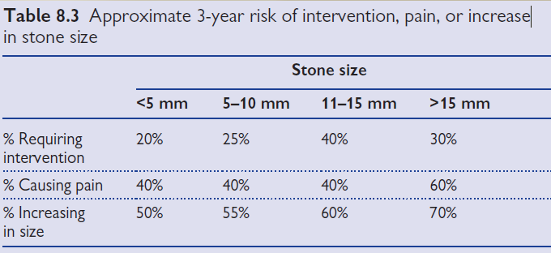
Asymptomatic stones followed over a 3-year period are more likely to require intervention or to increase in size or cause pain if they are >4 mm in diameter and if they are located in a middle or lower pole calyx. The approximate risks, over 3 years of follow-up, relative to stone size.

Slide 33
Some stones are definitely not suitable for watchful waiting. Untreated struvite (i.e., infection related) staghorn calculi will eventually destroy the kidney if untreated and are a significant risk to the patient’s life unless patient comorbidity is such that surgery would be a higher risk than watchful waiting.

Slide 34
Indications for stone removal
Pain that fails to respond to analgesics or recurs and cannot be controlled with additional pain relief
Impaired renal function (solitary kidney obstructed by a stone, bilateral ureteric stones, or pre-existing renal impairment that gets worse as a consequence of a ureteric stone)
Prolonged unrelieved obstruction (generally speaking, ~4–6 weeks)
Social reasons.

Slide 35
These indications need to be related to the individual patient—their stone size, their renal function, presence of a normal contralateral kidney, their tolerance of exacerbations of pain, their job and social situation, and local facilities (the availability of surgeons with appropriate skill and equipment to perform endoscopic stone treatment).

Slide 36
Emergency temporizing and definitive treatment of the stone
When the pain of a ureteric stone fails to respond to analgesics or renal function is impaired because of the stone, then temporary relief of the obstruction can be obtained by insertion of a JJ stent or percutaneous nephrostomy tube(Percutaneous nephrostomy tube can restore efficient peristalsis by restoring the ability of the ureteric wall to coapt)
but the stone is still present
subsequent definitive treatment is still required

Slide 37
Kidney stone treatment options:
*Stone fragmentation techniques
*Flexible ureteroscopy and laser treatment
*Percutaneous nephrolithotomy (PCNL)
*open stone surgery
(*medical therapy (dissolution therapy

Slide 38
Stone fragmentation techniques;
extracorporeal lithotripsy
Intracorporeal techniques of stone fragmentation

Slide 39
extracorporeal lithotripsy
The technique of focusing externally generated
( shock waves at a target (the stone
Three methods of shock wave generation are commercially available:—
electrohydraulic, electromagnetic, and piezoelectric

Slide 40
Efficacy of extracorporeal lithotripsy
fragmentation with ESWL depends on
stone size and location,
anatomy of renal collecting system,
degree of obesity
stone composition.
Notes:
extracorporeal shock-wave lithotripsy

Slide 41
It is less effective for
*stones >2 cm diameter
*lower-pole stones in a calyceal diverticulum (poor drainage)
*composed of cystine or calcium oxalate monohydrate (very hard).

Slide 42
: complications after ESWL
Common
- Bleeding on passing urine for short period after procedure
- Pain in the kidney as small fragments of stone pass after fragmentation
- UTI from bacteria released from the stone, needing antibiotic
treatment.
Occasional
- Stone will not break as too hard, requiring an alternative treatment
- Repeated ESWL treatments may be required
- Recurrence of stones
Notes:
Alternative therapy
Endoscopic surgery, open surgery, or observation can be used to allow
spontaneous passage.

Slide 43
Intracorporeal techniques of stone fragmentation
Electrohydraulic lithotripsy (EHL)
A high voltage applied across a concentric electrode under water generates as a spark. This vaporizes water, and the subsequent expansion and collapse of the gas bubble generates a shock wave.

Slide 44
Intracorporeal techniques of stone fragmentation
Electrohydraulic lithotripsy (EHL)
EHL is an effective form of stone fragmentation. The shock wave is not focused, so the EHL probe must be applied within 1 mm of the stone to optimize stone fragmentation.
Principal uses are for bladder stones (wider safety margin than in the narrower ureter)
Notes:
EHL has a narrower safety margin than that of pneumatic, ultrasonic, or
laser lithotripsy and should be kept as far away as possible from the wall of
the ureter, renal pelvis, or bladder to limit damage to these structures, and
at least 2 mm away from the cystoscope, ureteroscope, or nephroscope
to prevent lens fracture.

Slide 45
Pneumatic (ballistic) lithotripsy
A metal projectile contained within the handpiece is propelled backward and forward at great speed by bursts of compressed air.
It strikes a long, thin, metal probe at one end of the handpiece at 12Hz
(12 strikes/second) transmitting shock waves to the probe, which, when in contact with a rigid structure such as a stone, fragments the stone.

Slide 46
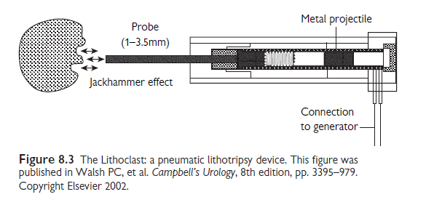
This technique is used for stone fragmentation in the ureter or kidney

Slide 47
advantage
*Pneumatic lithotripsy is very safe
The device is low cost and requires low * maintenance
disadvantage
*Its ballistic effect has a tendency to cause stone migration into the proximal ureter or renal pelvis, where the stone may be inaccessible to
further treatment
*The metal probe cannot bend around corners, so it cannot be used for ureteroscopic treatment of stones within the kidney or with a flexible ureteroscope

Slide 48
Ultrasonic lithotripsy
An electrical current applied across a piezoceramic plate located in the ultrasound transducer generates ultrasound waves of a specific frequency (23,000–25,000 Hz).
The ultrasound energy is transmitted to a hollow
metal probe, which in turn is applied to the stone

Slide 50
The stone resonates at high frequency and this causes it to break into small fragments that are then sucked out through the center of the hollow probe.
Soft tissues do not resonate when the probe is applied to them and thus are not damaged.
This technique can only be used down straight, rigid instruments.
Principal uses include fragmentation of renal calculi during PCNL.

Slide 51
Laser lithotripsy
The holmium:YAG laser is principally a photothermal mechanism of action, causing stone vaporization.
It has minimal shock-wave generation and therefore less risk of causing stone migration .
The 200-micron fiber is very flexible and can be used to gain access to stones even within the lower pole of the kidney

Slide 52
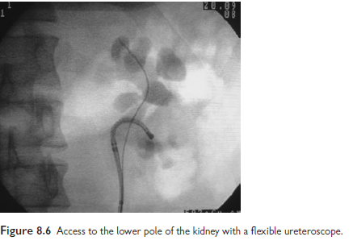
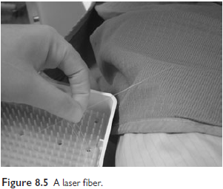
Principal uses are for ureteric stones and small intrarenal stones

Slide 53
Flexible ureteroscopy and laser treatment
Indications
*ESWL failure.
*Lower pole stone
*Cystine stones.
*Obesity such that PCNL and ESWL is difficult

Slide 54
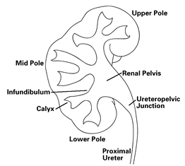
*Musculoskeletal deformities such that stone access by PCNL or ESWL is difficult or impossible (e.g. kyphoscoliosis).
*Stone in a calcyceal diverticulum
*Stenosis of a calcyceal infundibulum or at angle between renal pelvis and infundibulum.
*Bleeding diathesis
*Horseshoe or pelvic kidney
*Patient preference

Slide 55
percutaneous nephrolithotomy
PCNL is the removal of a kidney stone via a track developed between the surface of the skin and the collecting system of the kidney.
Steps of PCNL
1)inflation of the renal collecting system (pelvis and calyces) with fluid or air by ureteric catheter .
2) percutaneous puncture of a renal calyx with a nephrostomy needle

Slide 56
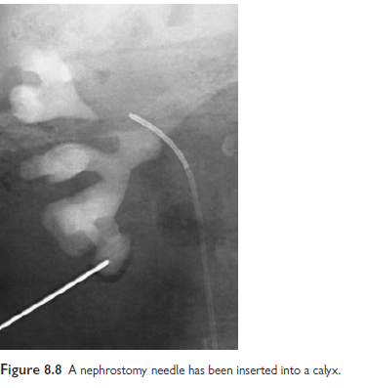

Slide 58
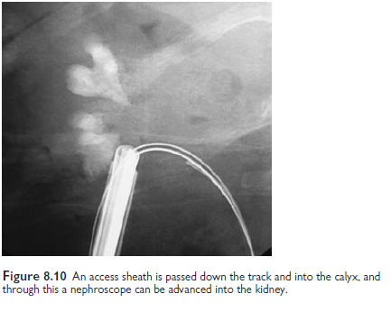
a

Slide 59
Indications for PCNL
stones >3cm in diameter, those that have failed ESWL and/or an attempt at flexible ureteroscopy and laser treatment.
It is the first-line option for staghorn calculi
For stones 2-3cm in diameter, options include ESWL ,flexible ureteroscopy and laser treatment, and PCNL. PCNL gives the best chance of complete stone clearance with a single procedure, but this is achieved at a higher risk of morbidity.

Slide 60
open stone surgery
Complex stone burden (projection of stone into multiple calyces, such that multiple PCNL tracks would be required to gain access to all the stone)
Failure of endoscopic treatment
Anatomic abnormality that precludes endoscopic surgery (e.g. retrorenal colon)
Body habitus that precludes endoscopic surgery (e.g. gross obesity, kyphoscoliosis)
Patient request
Non-functioning kidney

Slide 61
Specific complications of open stone surgery
*wound infection (the stones operated on are often infection stones)
*flank hernia
*wound pain
*stone recurrence

Slide 62
medical therapy (dissolution therapy)
Uric acid stones
Dissolution therapy is based on
hydration,
urine alkalinization➔ sodium bicarbonate or potassium citrate
Allopurinol,
dietary manipulation

Slide 63
Cystine stones
The aim is to do the following:
- Reduce cystine excretion (dietary restriction of the cystine precursor amino acid methionine and also of sodium intake to <100 mg/day)
- Increase solubility of cystine by alkalinization of the urine to >pH 7.5, maintenance of a high fluid intake, and use of drugs that convert cystine to more soluble compounds.

Slide 64
D-penicillamine , N-acetyl-D-penicillamine, and mercaptopropionylglycine
bind to cystine—the compounds so formed are more soluble in urine

