Slide 1
Atrial fibrillation
Presented by Shaden AL Dala`in
Supervisor : Dr Ahmad khalil

Slide 2
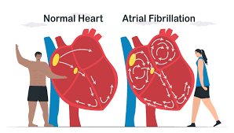
Atrial fibrillation definition
Rapid, irregular and unsynchronized beating of the atrial chambers of the heart. (origin thought to be around pulmonary veins)

Slide 3
Atrial fibrillation causes
1. Left atrial dilatation: HTN, HF, and mitral valve diseases
2. Direct damage to the atrium: alcohol, smoking, pericarditis, sepsis, and coronary artery diseases
3. Increase basal metabolic rate: hyperthyroidism and hyperadrenergic state (Stress, pheochromocytoma, amphetamine and cocaine )
4. Hypoxia (Lung diseases): pneumonia, COPD, and pulmonary embolism

Slide 4
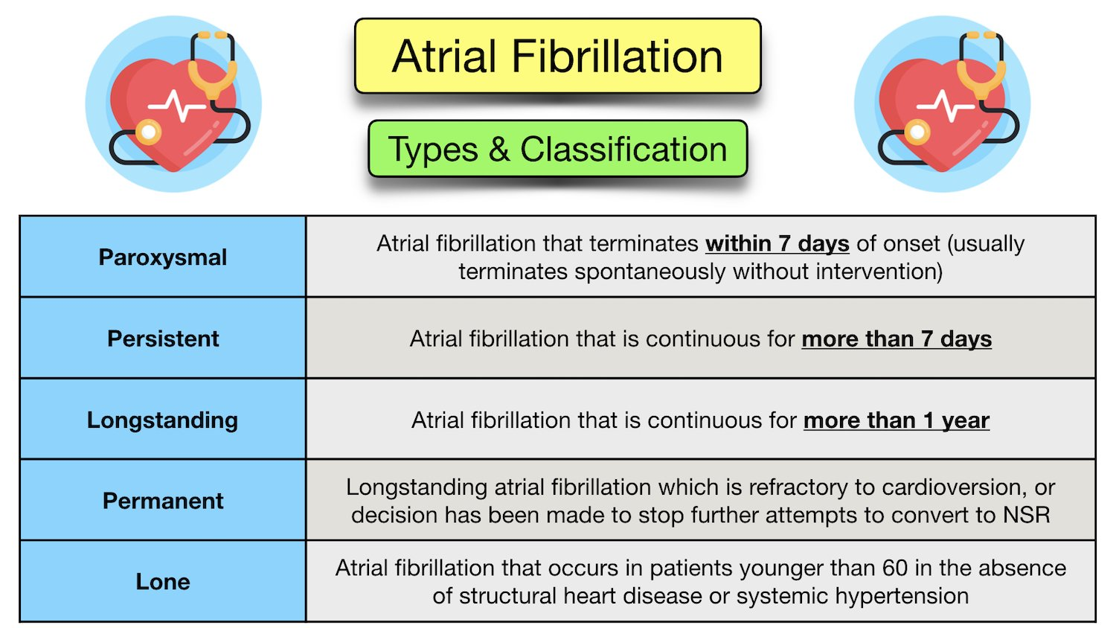

Slide 5
Atrial fibrillation pathophysiology
1. Multiple foci in the atria fire continuously in a chaotic pattern, causing a totally irregular, rapid ventricular rate. Instead of intermittently contracting, the atria quiver continuously. 2. Atrial rate is over 400 bpm, but most impulses are blocked at the AV node so ventricular rate ranges between 75 and 175. (if >110 is called atrial fibrillation rapid ventricular response). Note: rapid ventricular response > less time in the filling of the ventricles > less end-diastolic volume > less stroke volume (may lead to heart failure)

Slide 6
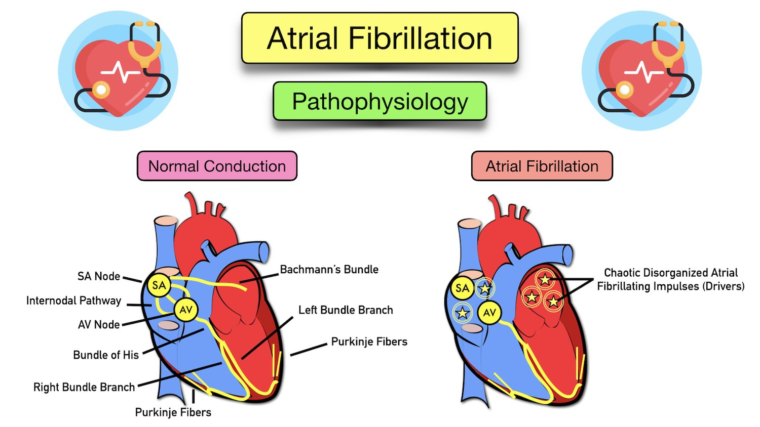
Atrial fibrillation pathophysiology
3. Decrease simultaneous contraction of atrium makes the blood stagnant > formation of thrombi (more at left atrial appendage) > emboli to different organs. (Stroke, MI, Mesenteric ischemia, and acute lower limb ischemia)
- Treatment: anticoagulant and if contraindicated ? Left atrial appendage (LAA) closure

Slide 7
Atrial fibrillation clinical manifestations
Symptoms: 1. Palpitation, fatigue and exertional dyspnea 2. Low output symptoms: dizziness, syncope and angina 3. Emboli manifestations: stroke, ischemic limbs .. Etc.
Signs: irregularly irregular pulse, signs of heart failure if it occurs.
Investigations:
ECG: diagnostic test.
Cardiac enzymes and echo: ischemic heart diseases diagnosis as a cause
TSH, T4 and T3: hyperthyroidism should be excluded.

Slide 8
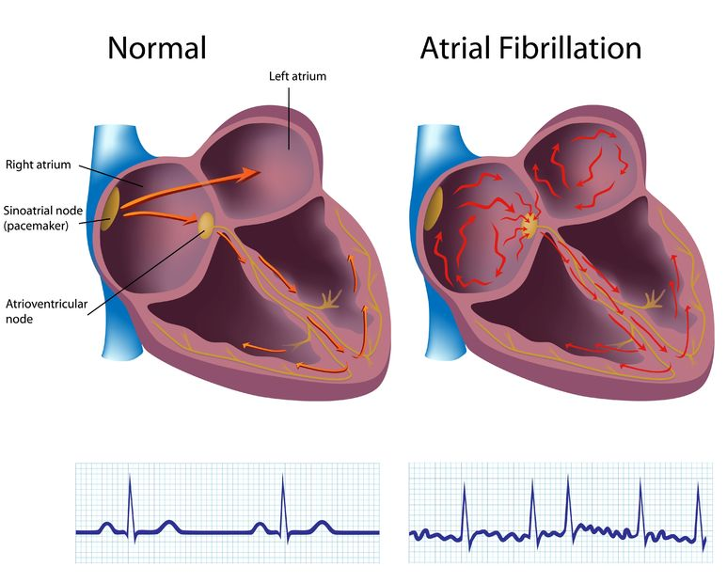
Atrial fibrillation ECG findings

Slide 9
Management Of Atrial Fibrillation

Slide 10
.1.Rate control:
The target is 60 to 100. HR 110 is acceptable if good EF .
Use beta blockers.
Ca channel blockers
digoxin

Slide 11
2.Anticoagulation
Anticoagulation to prevent cardioembolic cerebrovascular accident (CVA)
Risk stratify patients for bleeding complications with the CHA2DS2 -VASc score.
This is a scoring calculator used to estimate annual stroke risk in a patient with AFib or atrial flutter.

Slide 12
Chronic anticoagulant
0 point : no need
1 point : warfarin or Aspirin
2 or more : warfarin

Slide 13
For patients with CHADSVASC score >1, anticoagulation is generally indicated unless high bleeding risk.
Choice of anticoagulant depends on etiology of AFib or atrial flutter.
For patients with mechanical valves, mitral valvular disease, or ventricular assist devices, warfarin is the only oral anticoagulant available.
For other patients, direct oral anticoagulants (DOACs) can be used.
DOACs approved for AFib include factor Xa inhibitors (apixaban, rivaroxaban, edoxaban)
and direct thrombin inhibitors (dabigatran).
These agents do not require lab monitoring. Dabigatran is the only DOAC with an FDA-approved reversal agent.
An INR of 2 to 3 is the anticoagulation goal range for warfarin.
Acute warfarin-associated bleeding can be reversed with fresh frozen plasma (FFP), prothrombin complex concentrate (PCC).

Slide 14
3.Rhythm control :
Candidates for cardioversion is
.1. hemodynamically unstable.
2. who are symptomatic,
3. who are having their first ever case of AFib.
If rhythm control is selected as a treatment strategy, electrical cardioversion is preferred over pharmacologic cardioversion. Attempts should be made to control ventricular rate before attempting DC cardioversion.
If AFib present for >48 hours (or unknown period of time), risk of embolization during cardioversion is significant (2% to 5%). Anticoagulate patients for 3 weeks before and at least 4 weeks after cardioversion.
To avoid waiting 3 weeks for anticoagulation, obtain a transesophageal echocardiogram (TEE) to image the left atrium (LA). If no thrombus is present, start IV heparin and perform cardioversion within 24 hours. Patients still require 4 weeks of anticoagulation after cardioversion.

Slide 15
Use pharmacologic cardioversion only if electrical cardioversion fails or is not feasible: Parenteral ibutilide, procainamide, flecainide, sotalol, and amiodarone are choices.
AFib ablation is a newer therapy for rhythm control, which is usually reserved for symptomatic patients refractory to electrical and pharmacologic cardioversion, or those with HFrEF and high AFib burden.

Slide 16
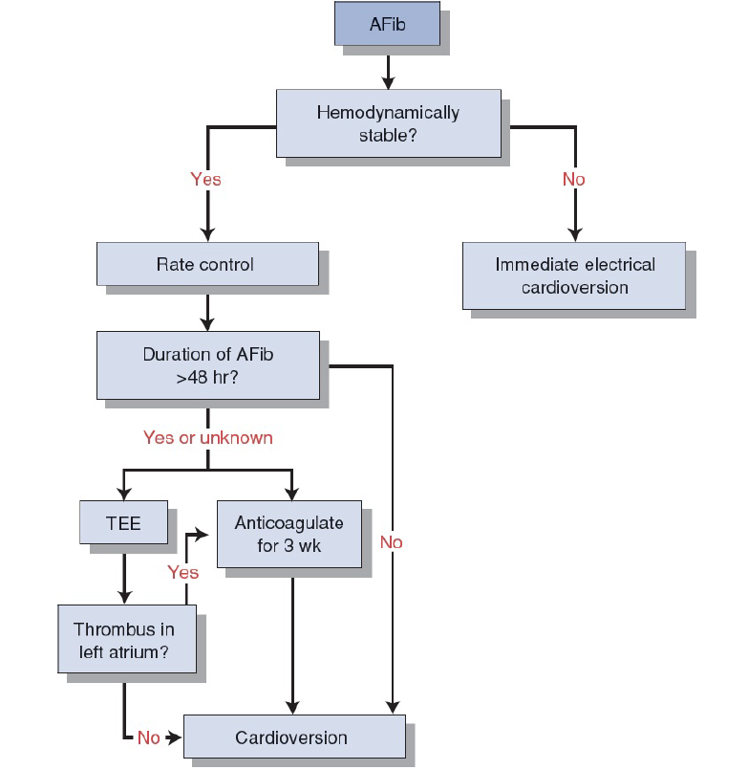
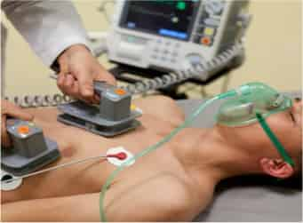
Management of atrial fibrillation
Resistant cases of AF: AF ablation

