Slide 1
Peripheral Nervous System
THE FACE
Dr. Aiman Qais Al-Maathidy
Surgical Anatomist
College of Medicine / University of Mutah
2022-2023

Slide 2
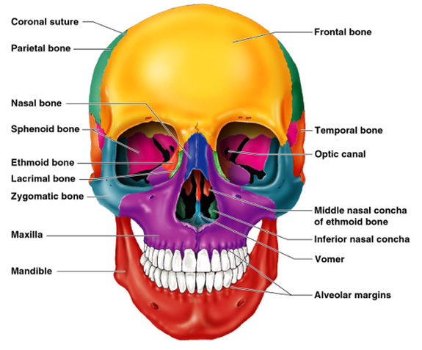
Bones of the Face
The superior orbital margin formed by the frontal bone, which contains the frontal air sinuses.
The lateral orbital margin is formed by the zygomatic bone and the inferior orbital margin is formed by the zygomatic bone and the maxilla.
The root of the nose is formed by the nasal bones, which articulate below with the maxilla and above with the frontal bones.
The important central bone of the middle third of the face is the maxilla, containing its teeth and the maxillary air sinus.
The bone of the lower third of the face is the mandible, with its teeth.

Slide 3
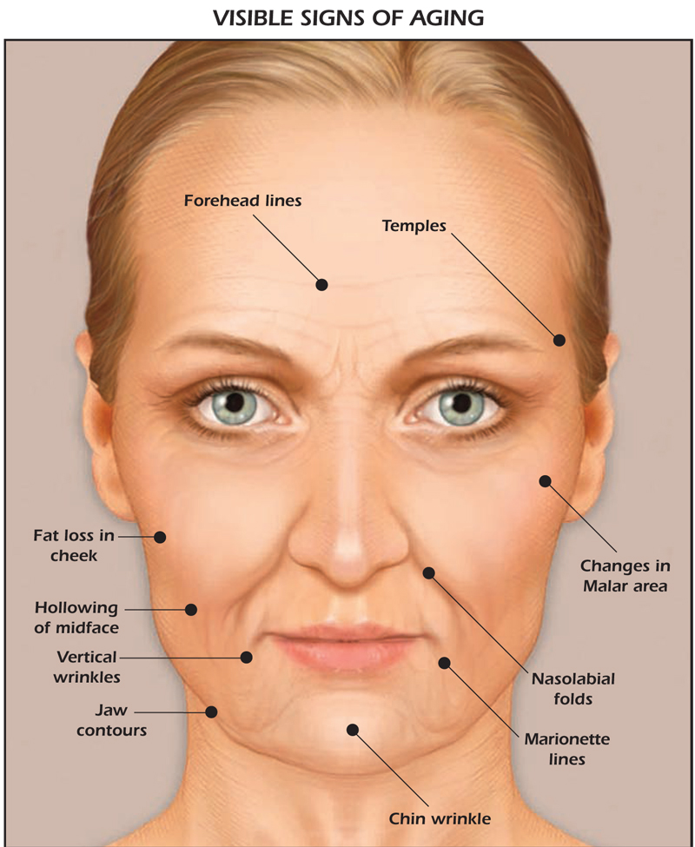
Skin of the Face
The skin of the face possesses numerous sweat and sebaceous glands.
It is connected to the underlying bones by loose connective tissue, in which are embedded the muscles of facial expression.
No deep fascia is present in the face.

Slide 4
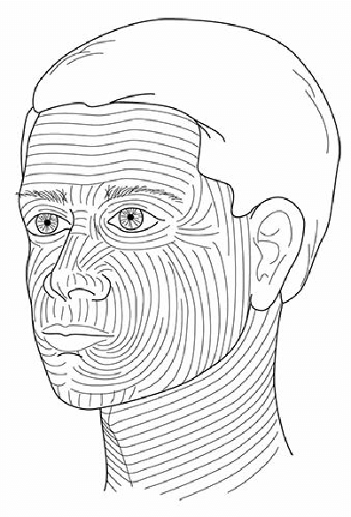
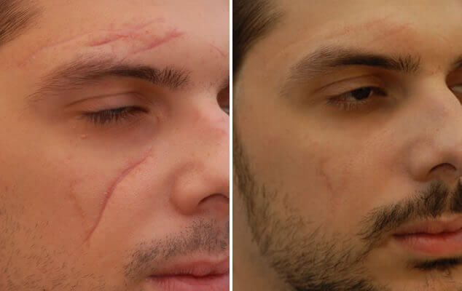
Skin of the Face
Wrinkle lines of the face result from the repeated folding of the skin
Surgical scars of the face are less conspicuous if they follow the wrinkle lines

Slide 5
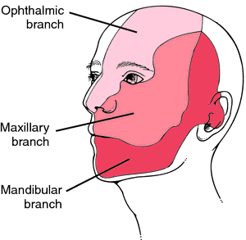
Sensory Nerves of the Face
The skin of the face is supplied by branches of the three divisions of the trigeminal nerve, except for the small area over the angle of the mandible and the parotid gland which is supplied by the great auricular nerve (C2 and 3)
These nerves not only supply the skin of the face, but also supply proprioceptive fibers to the underlying muscles of facial expression.
They are, in addition, the sensory nerve supply to the mouth, teeth, nasal cavities, and paranasal air sinuses.

Slide 6
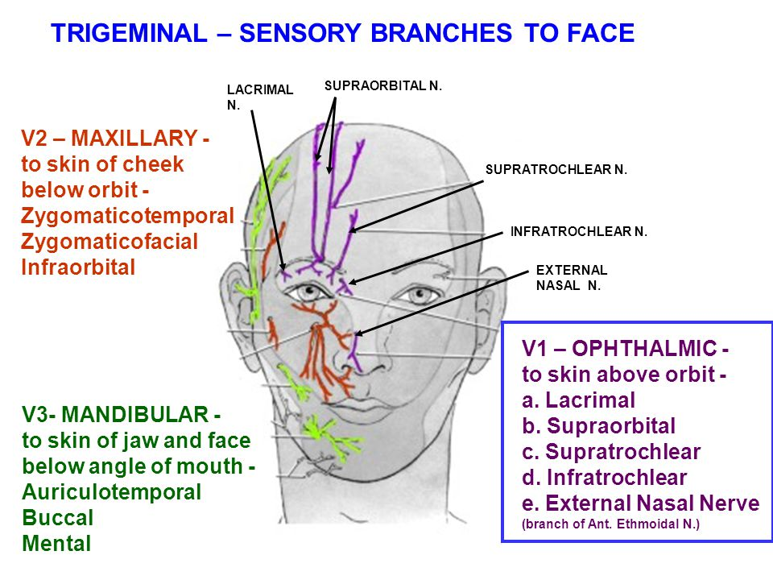
Sensory Nerves of the Face
The ophthalmic nerve V1: supplies the skin of the forehead, the upper eyelid, the conjunctiva, the side of the nose down to and including the tip.
Five branches of the nerve pass to the skin:
■ The Lacrimal nerve
■The supraorbital nerve
■The supratrochlear nerve
■The infratrochlear nerve
■The external nasal nerve

Slide 7
Sensory Nerves of the Face
Maxillary Nerve V2: Supplies the skin on the posterior part of the side of the nose, the lower eyelid, the cheek, the upper lip, and the lateral side of the orbital opening.
Three branches of the nerve pass to the skin:
The infraorbital nerve
The zygomaticofacial nerve
The zygomaticotemporal nerve

Slide 8
Sensory Nerves of the Face
Mandibular Nerve V3: supplies the skin of the lower lip, the lower part of the face, the temporal region, and part of the auricle. It then passes upward to the side of the scalp.
Three branches of the nerve pass to the skin.
■The mental nerve
■The buccal nerve
■The auriculotemporal nerve

Slide 9
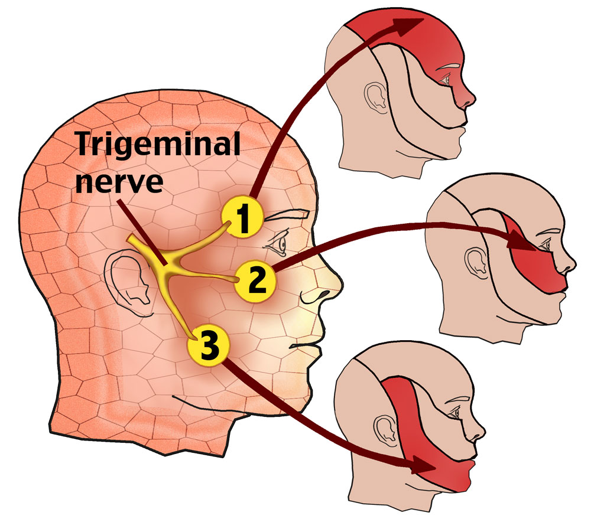
Sensory Nerves of the Face
Trigeminal neuralgia: is a relatively common condition in which the patient experiences excruciating pain in the distribution of the mandibular or maxillary division, with the ophthalmic division usually escaping.

Slide 10
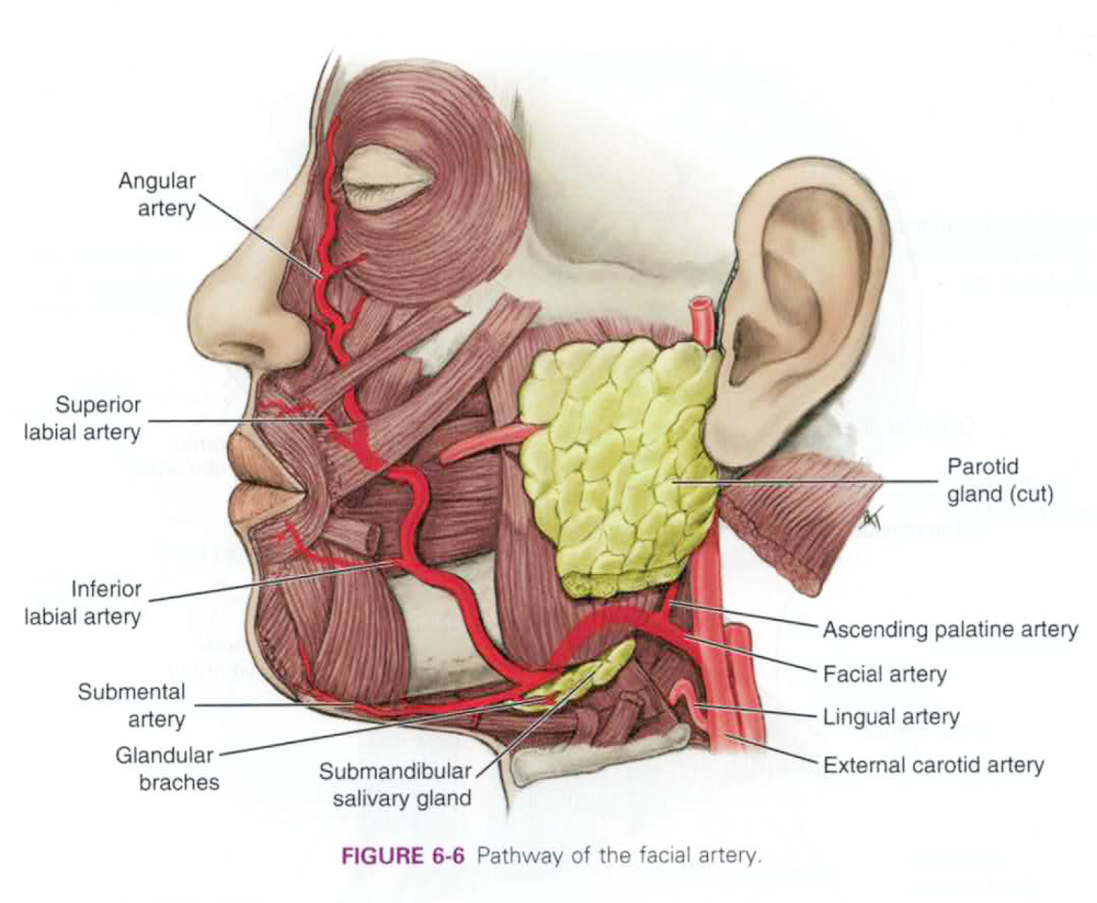
Arterial Supply of the Face
The face receives a rich blood supply from two main vessels: the facial and superficial temporal arteries
The facial artery:
arises from the external carotid artery it curves around the inferior margin of the body of the mandible at the anterior border of the masseter muscle.
It is here that the pulse can be easily felt.

Slide 11
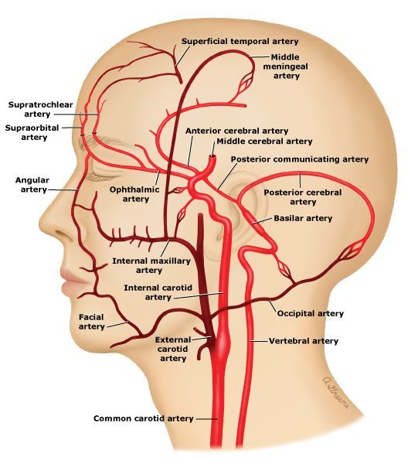
The facial artery:
It runs upward in a tortuous course toward the angle of the mouth
It then ascends along the side of the nose to the medial angle of the eye (angular artery), where it anastomoses with the terminal branches of the ophthalmic artery

Slide 12
Branches of the facial artery:
■■ The submental artery It supplies the skin of the chin and lower lip.
■■ The inferior labial artery It runs medially in the lower lip and anastomoses with its fellow of the opposite side.
■■ The superior labial artery It runs medially in the upper lip and gives branches to the septum and ala of the nose.
■■ The lateral nasal artery It supplies the skin on the side and dorsum of the nose.

Slide 13
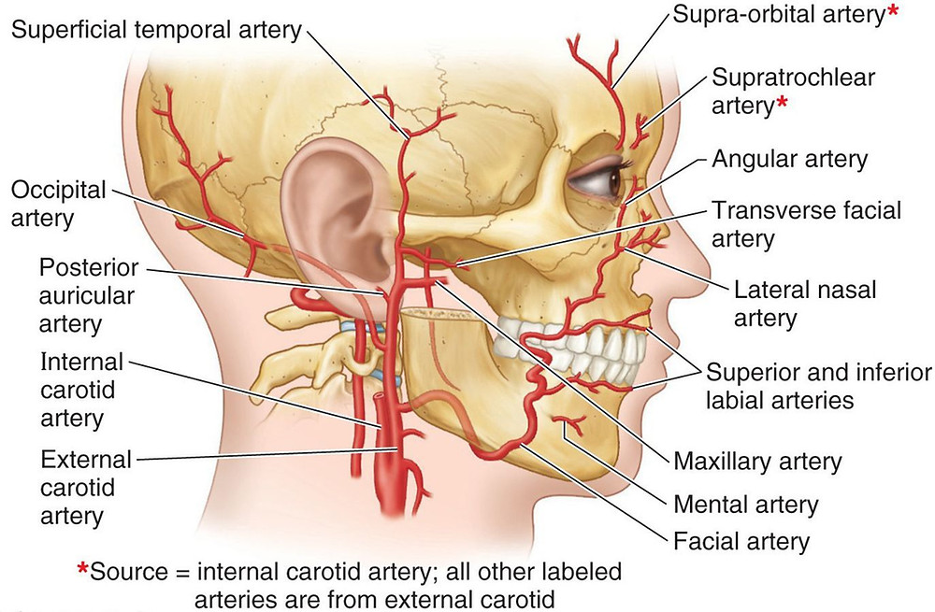
Arterial Supply of the Face
■The superficial temporal artery
The smaller terminal branch of the external carotid artery, commences in the parotid gland. It ascends in front of the auricle to supply the scalp)
■The transverse facial artery
A branch of the superficial temporal artery, arises within the parotid gland.
It runs forward across the cheek just above the parotid duct
■ The supraorbital and supratrochlear arteries
branches of the ophthalmic artery, supply the skin of the forehead

Slide 14
Venous Drainage of the Face
The facial vein is formed at the medial angle of the eye by the union of the supraorbital and supratrochlear veins
It is connected to the superior ophthalmic vein directly through the supraorbital vein.
By means of the superior ophthalmic vein, the facial vein is connected to the cavernous sinus this connection is of great clinical importance because it provides a pathway for the spread of infection from the face to the cavernous sinus.
The facial vein descends behind the facial artery to the lower margin of the body of the mandible. The facial vein ends by draining into the internal jugular vein.

Slide 15
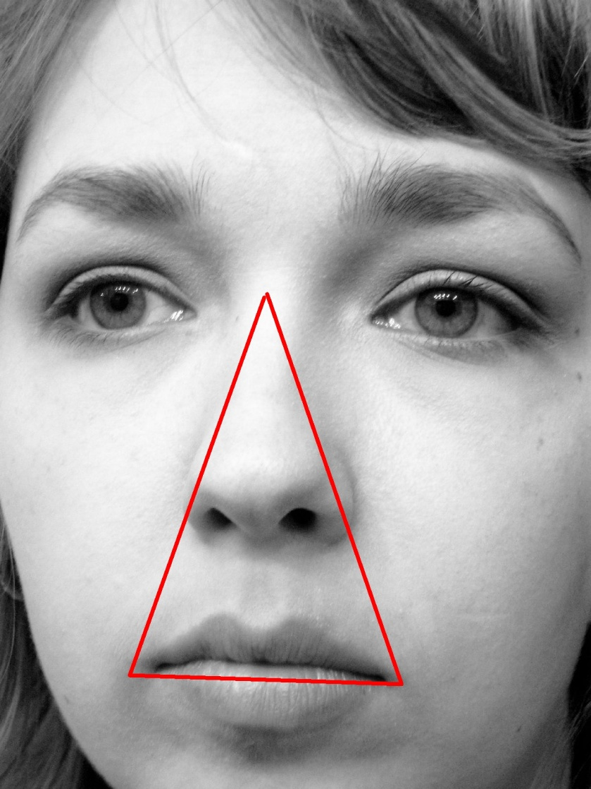
Facial Infections and Cavernous Sinus Thrombosis
The area of facial skin bounded by the nose, the eye, and the upper lip is a potentially dangerous zone to have an infection.
For example, a boil in this region can cause thrombosis of the facial vein, with spread of organisms through the superior ophthalmic veins to the cavernous sinus.
The resulting cavernous sinus thrombosis may be fatal unless adequately treated with antibiotics

Slide 16
Lymph Drainage of the Face
Lymph from the forehead and the anterior part of the face drains into the submandibular lymph nodes
A few buccal lymph nodes may be present along the course of these lymph vessels.
The lateral part of the face, is drained into the parotid lymph nodes.
The central part of the lower lip and the skin of the chin are drained into the submental lymph nodes.

Slide 17
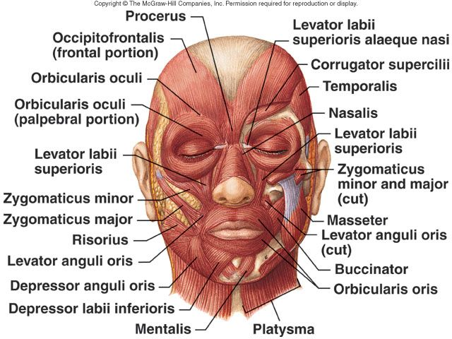
Muscles of the Face (Muscles of Facial Expression)
The muscles of the face are embedded in the superficial fascia, and most arise from the bones of the skull and are inserted into the skin
Muscles of the Eyelids
The sphincter muscle of the eyelids is the orbicularis oculi, and the dilator muscles are the levator palpebrae superioris and the occipitofrontalis
Muscles of the Nostrils
The sphincter muscle is the compressor naris and the dilator muscle is dilator naris
Muscles of the Lips and Cheeks
The sphincter muscle is the orbicularis oris. The dilator muscles consist of a series of small muscles that radiate out from the lips.

Slide 18
Muscles of the Face (Muscles of Facial Expression)
■■ Levator labii superioris
■■ Zygomaticus minor
■■ Zygomaticus major
■■ Levator anguli oris (deep to the zygomatic muscles)
■■ Risorius
■■ Depressor anguli oris
■■ Depressor labii inferioris
■■ Mentalis
Muscle of the Cheek
Buccinator
■■ Nerve supply: Buccal branch of the facial nerve
■■ Action: Compresses the cheeks and lips against the teeth

Slide 19
Muscles of the Face (Muscles of Facial Expression)

Slide 20
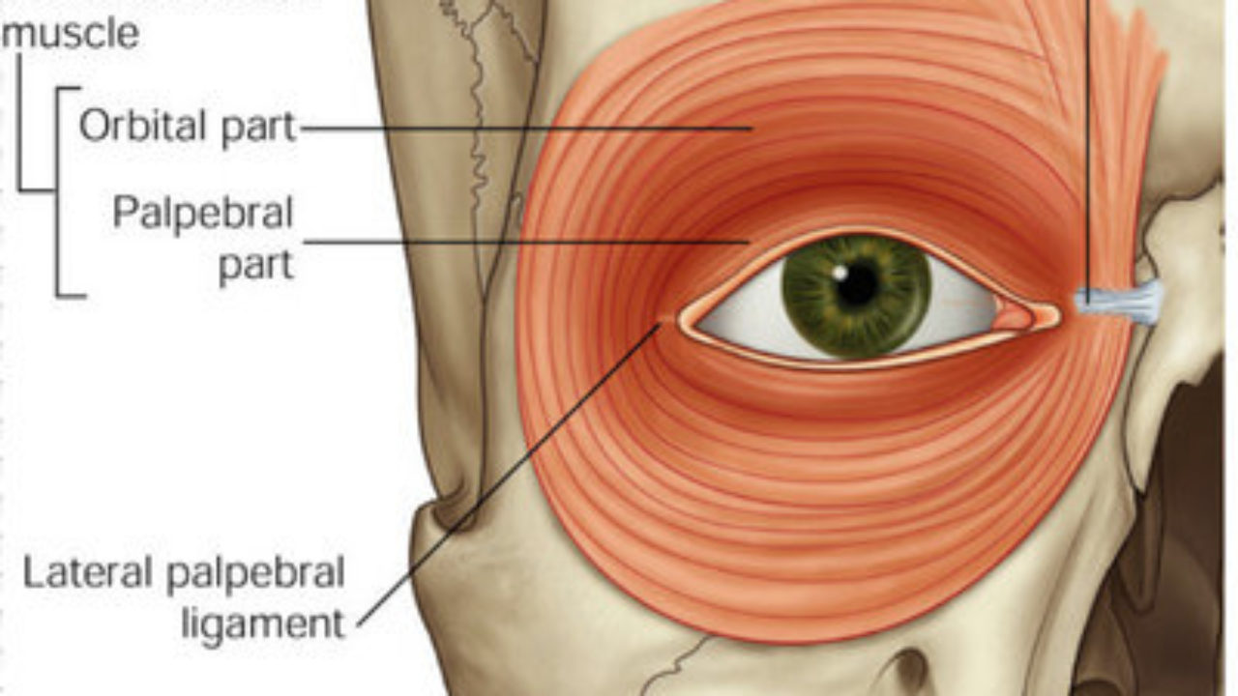
The orbicularis oculi
- It is the sphincter of the eye.
- It is formed of 3 portions.
1- Orbital portion;
- It is a thin sheath surround the orbital cavity.
* Origin; from the medial palpebral ligament and adjacent bones.
- Its fibers form complete circle around the orbit without bony attachment on the lateral side.
* Insertion, into the lower border of the medial palpebral ligament.
2- Palpebral part: a thin sheet related to the eye lids.
Origin from the medial palpebral ligament.
* Insertion into the lateral palpebral ligament.

Slide 21
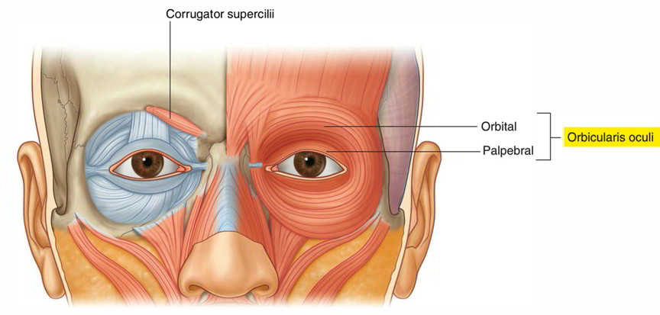
The orbicularis oculi
3- Lacrimal part:
* Origin, from the lacrimal crest, floor of the lacrimal fossa and fascia covering the lacrimal sac.
* Insertion, into the tarsi of the eye lids and lateral palpebral ligament.
* Nerve supply, temporal and zygomatic branches of the facial nerve.

Slide 22
The orbicularis oculi
* Actions:
1- Orbital part, acts as sphincter of the eyelids (it contracts reflexly to protect the eye against danger).
2- Palpebral portion closes the eyelids during blinking and sleeping.
3- Lacrimal portion dilates the lacrimal sac and pulls the eye lid medially

Slide 23
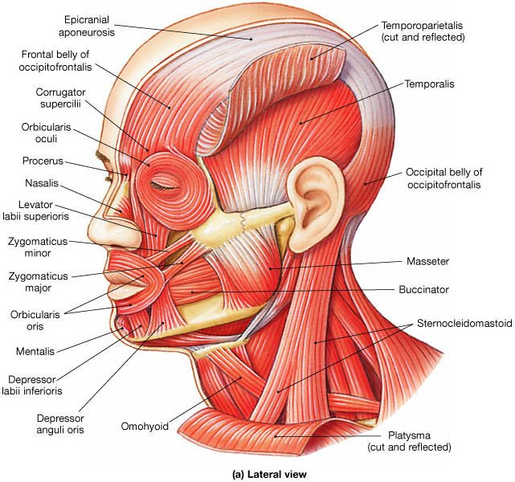
Buccinator Muscle
* Origin;
a- Upper fibres from the outer surface of the maxilla opposite the molar teeth.
b- Middle fibres from the pterygo-mandibular ligament.
c- Lower fibres from the oblique line in the outer surface of the mandible opposite the molar teeth.
* Insertion;
a- The upper fibers are inserted into the upper lip.
b- The lower fibers are inserted into the lower lip.
c- The middle fibers decussate at the lateral angle of the mouth and are inserted into the upper and lower lips.

Slide 24
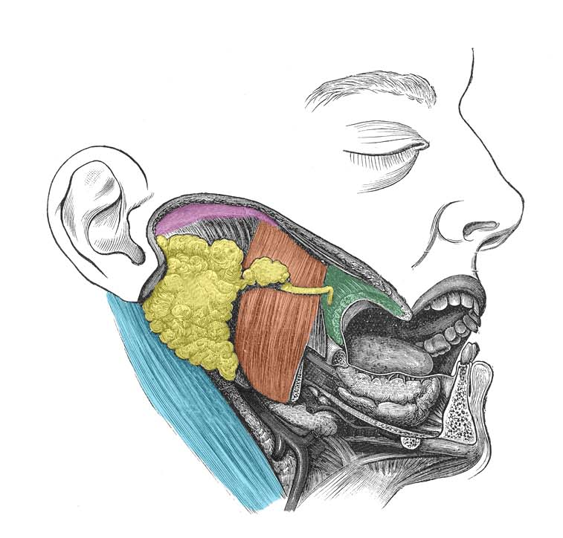
Buccinator Muscle
* Nerve supply, buccal branch of the facial nerve.
* Actions;
1- It compresses the cheek against the teeth to prevent food from falling into the vestibule of the mouth during mastication of food.
2- When the cheeks are distended with air, they contract to blow out the air, as in whistling (buccina =trumpet).
* Relations;
- It is covered by buccal pad of fat and facial artery.
- Its deep surface is lined by the buccal mucosa.
- It is pierced by 1) Parotid duct at the anterior border of the masseter muscle.
2) Buccal branch of the mandibular nerve (sensory) to supply the mucosa on the inner surface of the muscle

Slide 25
Facial Nerve
As the facial nerve runs forward within the substance of the parotid salivary gland it divides into its five terminal branches:
The temporal branch, supplies the frontal belly of the occipitofrontalis & the orbicularis oculi
The zygomatic branch supplies the orbicularis oculi.
The buccal branch supplies the buccinator muscle and the muscles of the upper lip and nostril.
The mandibular branch supplies the muscles of
the lower lip.
The cervical branch supply the platysma muscle

Slide 26
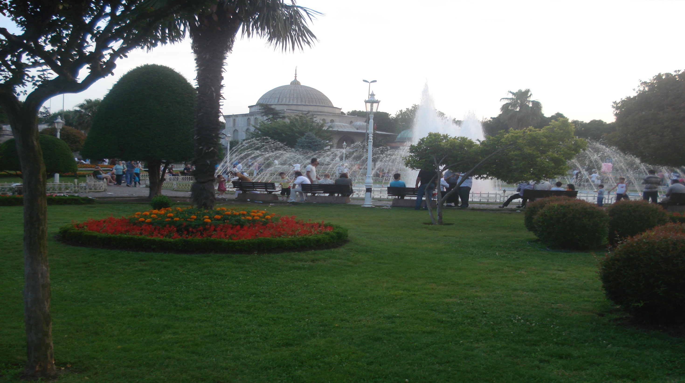
Dr. Aiman Al Maathidy
Monday 27. 2. 2023

