Slide 1
Acute dermatosis
Dr.Eman Kreishan, M.D.

Slide 2
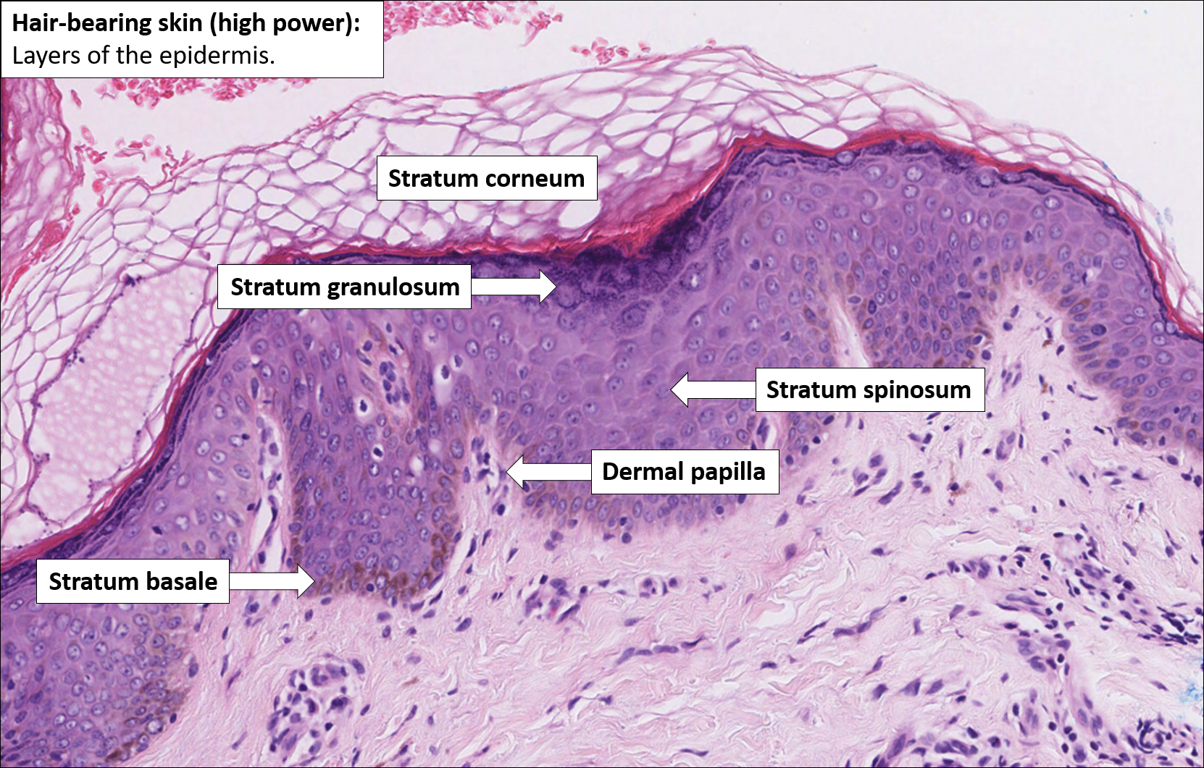
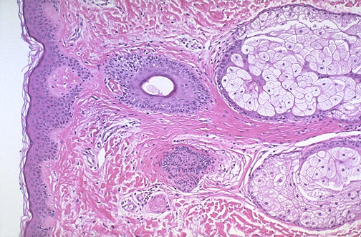

Slide 3
Functions of skin
1. Squamous cells (keratinocytes) help maintain skin homeostasis by providing a physical barrier to environmental insults.
2. Has a major role in immunity.
dermis contain: CD4+ and CD8+ cells.
epidermis contain: γ/δ T cells.

Slide 4
Acute inflammatory dermatoses.
Chronic Inflammatory Dermatoses.
Blistering (Bullous) Disorders.

Slide 5
1. Acute inflammatory dermatoses.
Acute lesions, defined as:
days to several weeks in duration.
characterized by inflammation, edema, and sometimes epidermal, vascular, or subcutaneous injury.
Marked by infiltrates consisting of mononuclear cells rather than neutrophils, (unlike acute inflammatory disorders at most other sites).
Some acute lesions may persist, transitioning to a chronic phase, while others are self-limited

Slide 6
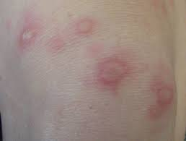
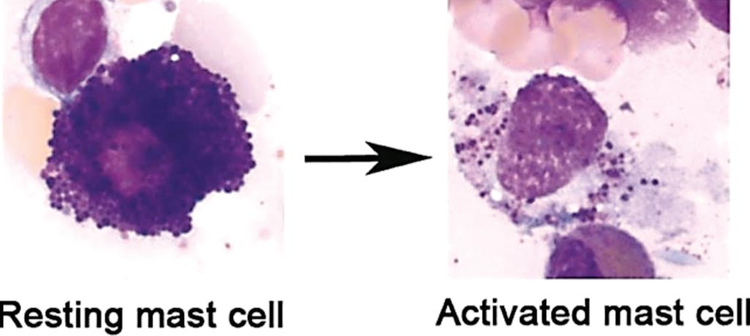
A. Urticaria.
a common disorder mediated by localized mast cell degranulation, which leads to dermal microvascular hyperpermeability.
The resulting erythematous, edematous, and pruritic plaques are termed wheels.

Slide 7
pathogenesis
**IgE-dependent urticaria
Responsible antigens
include viruses, pollens, foods, drugs, and insect venom.
**IgE-independent urticaria
result from exposure
to substances that directly incite mast cell degranulation,
such as opiates and certain antibiotics

Slide 8
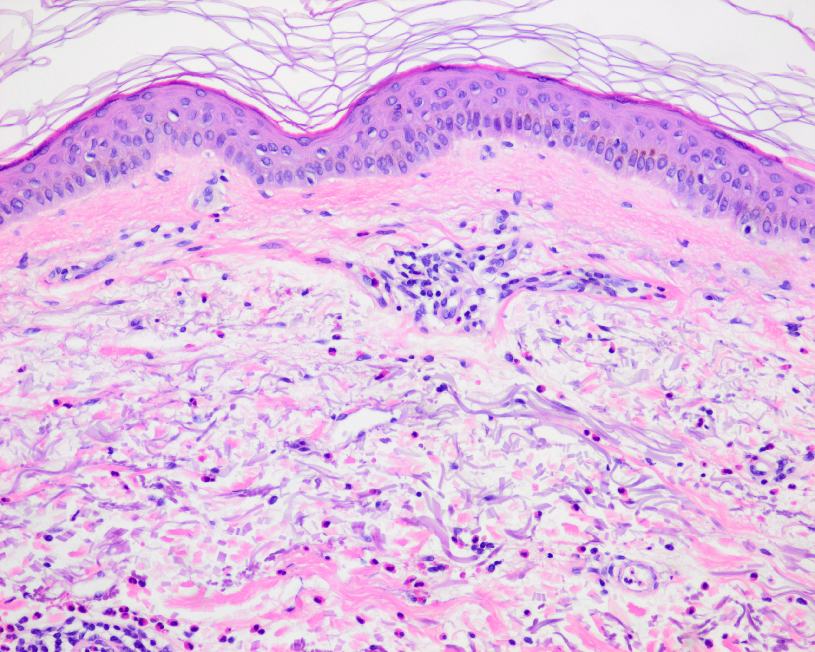
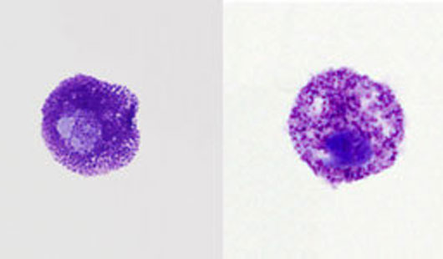
Histologic features of urticaria
*sparse superficial perivenular infiltrate of mononuclear cells, rare neutrophils, and sometimes eosinophils.
*dermal edema causes splaying of collagen bundles.
*Degranulation of mast cells, can be highlighted using a Giemsa stain.

Slide 9
Clinical Features
typically affects individuals between 20 and 40 years of age.
Individual lesions usually develop and fade within hours, but episodes can persist for days or even months.
Lesions range in size and nature from small, pruritic papules to large, edematous, erythematous plaques.
Treatment:
Antihistamines.
leukotriene antagonists.
monoclonal antibodies that block the action of IgE.
immunosuppressive drugs

Slide 10
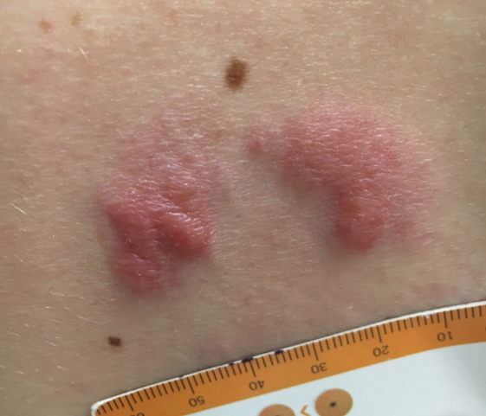
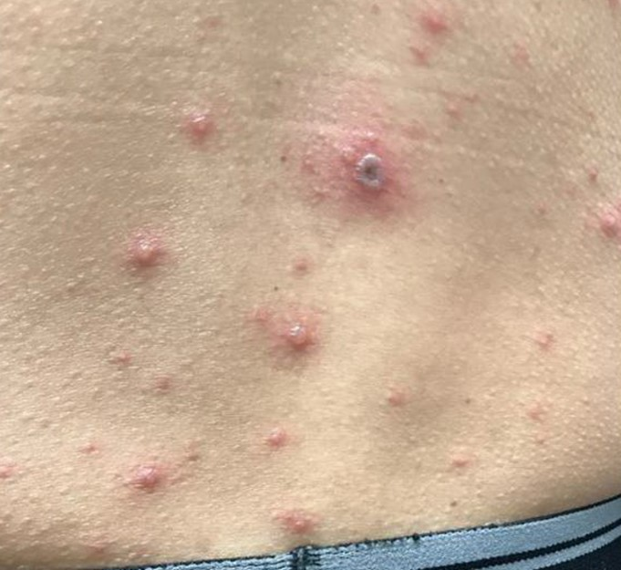
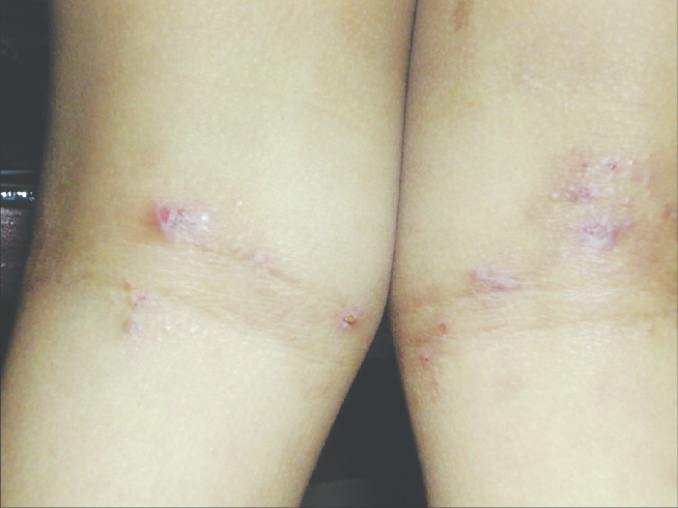
B. Acute Eczematous Dermatitis.
Eczema is a clinical term that embraces a number of conditions with varied underlying etiologies.
Clinically the patient may has:
erythematous papules with overlying vesicles, which ooze and become crusted.
Pruritus is characteristic.
With persistence, these lesions coalesce into raised, scaling plaques.

Slide 11
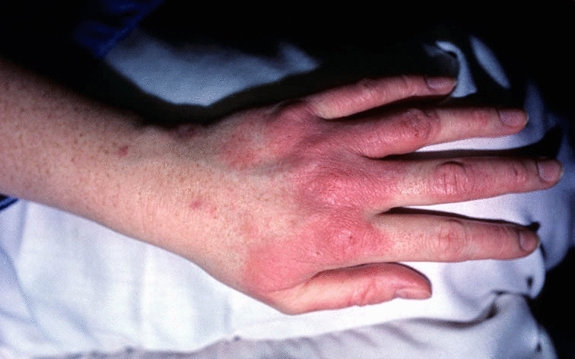
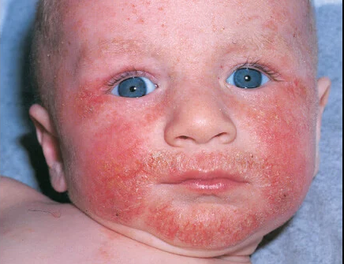
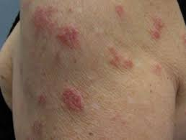
The clinical subtypes include :
1. Allergic contact dermatitis:
stems from topical exposure to an allergen and is caused by delayed hypersensitivy reactions.
2. Atopic dermatitis:
stem from defects in keratinocyte barrier function, defined as skin with increased
permeability to substances to which it is exposed, such as potential antigens
3. Drug-related eczematous dermatitis:
Hypersensitivity reaction to a drug.

Slide 12
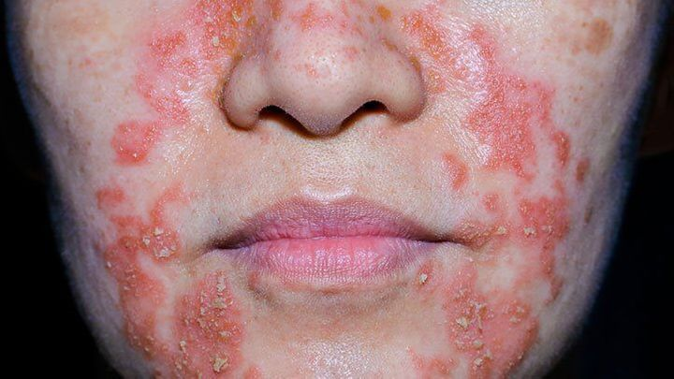
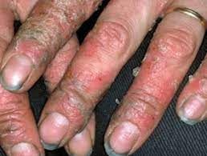
4. Photoeczematous dermatitis:
appears as an abnormal reaction to UV or visible light
5. Primary irritant dermatitis:
results from exposure to substances that chemically, physically, or mechanically
damage the skin.

Slide 13
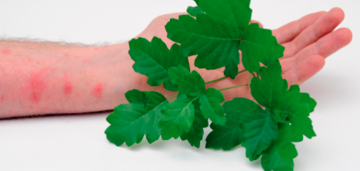
Allergic contact dermatitis
Allergic contact dermatitis is triggered by exposure to an environmental contact-sensitizing agent, such as poison ivy, that chemically reacts with self-proteins, creating neoantigens that can be recognized by the T cell arm of the adaptive immune system.

Slide 14
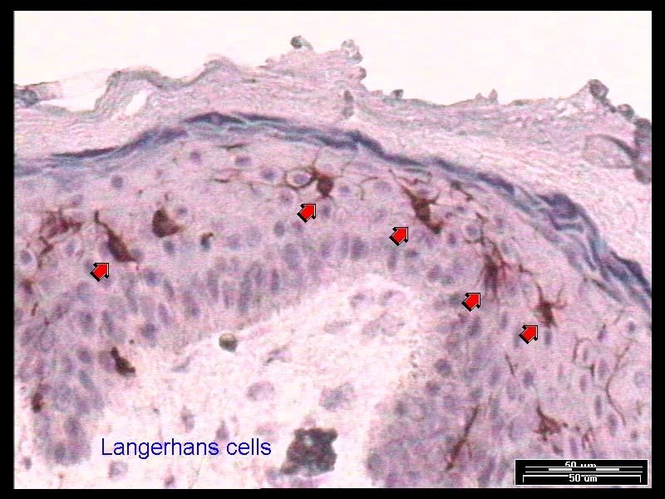
The self-proteins modified by the agent are processed by epidermal Langerhans cells
which migrate to draining lymph nodes and present the antigen to naïve T cells.
This sensitization event leads to acquisition of immunologic memory
on reexposure to the antigen, the activated memory CD4+ T lymphocytes migrate to the affected skin sites during the course of normal circulation

Slide 15
Histology
Spongiosis or epidermal edema, Edema fluid seeps into the
epidermis, where it splays apart keratinocytes .
Intercellular bridges are stretched and become more prominent and are easier to visualize.
superficial perivascular lymphocytic infiltrate
edema of dermal papillae.
mast cell degranulation.

Slide 16
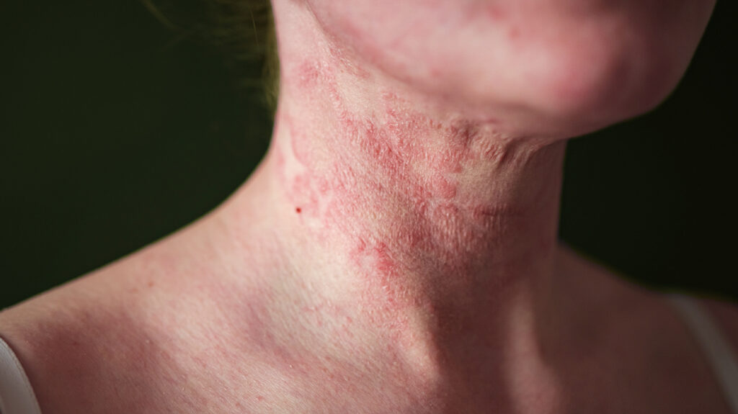
Clinical Features
Lesions of acute eczematous dermatitis are
pruritic, edematous, oozing plaques, often containing vesicles and bullae.
With persistent antigen exposure, lesions may become scaly (hyperkeratotic) as the epidermis thickens (acanthosis).
It usually appears in early childhood and remits spontaneously as patients mature into adults. Children with atopic dermatitis often have asthma and allergic rhinitis, termed the atopic triad.

Slide 17
Erythema Multiforme
Erythema multiforme is characterized by epithelial injury mediated by skin-homing CD8+ cytotoxic T lymphocytes.
The cytotoxic T cell attack is focused on the basal cells of cutaneous and mucosal epithelia, presumably due to recognition of still unknown antigens
self-limited disorder that appears to be a hypersensitivity response to
certain infections herpes simplex, mycoplasma, and some fungi,
drugs.
sulfonamides, penicillin, salicylates, hydantoins, and anti-malarials

Slide 18
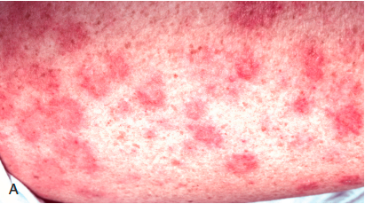
MORPHOLOGY
Affected individuals present with a wide array of lesions, which may include macules, papules, vesicles, and bullae (hence the term multiforme)
Well-developed lesions have a characteristic “targetoid” appearance

Slide 19
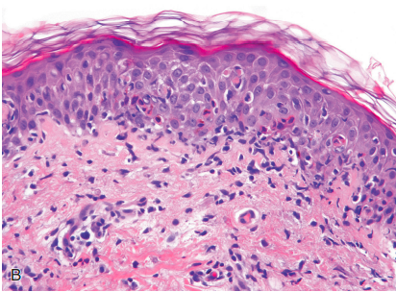
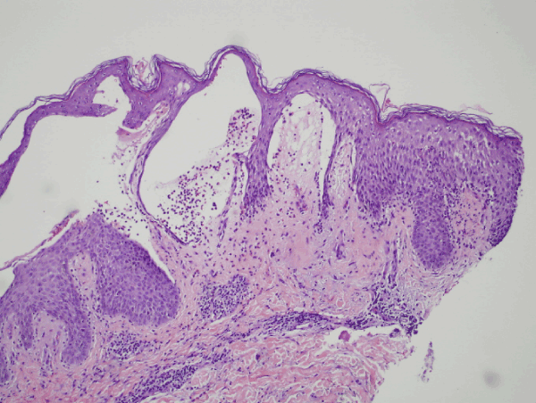
Early lesions show
superficial perivascular lymphocytic infiltrate
dermal edema
margination of lymphocytes along the dermoepidermal junction with apoptotic keratinocytes
With time
discrete, confluent zones of basal epidermal necrosis appear, with concomitant blister formation.

Slide 20
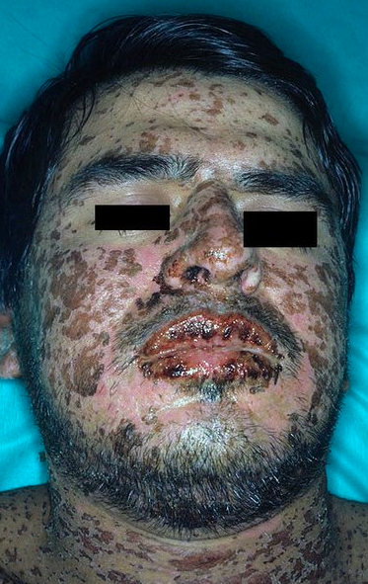
Clinical Features
Erythema multiforme caused by medications may progress to more serious eruptions, such as
Stevens-Johnson syndrome
toxic epidermal necrolysis.
These forms can be life-threatening, as they may cause sloughing of large portions of the epidermis, resulting in fluid loss and infections complications

Slide 21
