Slide 1
Dizziness: Approach to Evaluation and Management
Dr.We’am Zayadneh

Slide 2
Dizziness is a common yet imprecise symptom often encountered by family physicians.
Primary care physicians see at least one-half of the patients who present with dizziness.
The differential diagnosis is broad ( table 1 )
Each of the common etiologies accounting for no more than 10% of cases.
Because the symptoms are vague, physicians must distinguish benign from serious causes that require urgent evaluation.

Slide 5
Dizziness was traditionally classified into four categories based on the patient’s description:
(1) vertigo
(2) presyncope?
(3) disequilibrium
(4) light-headedness?

Slide 6
Patients often have difficulty describing their symptoms
Symptom quality does not reliably predict the cause of dizziness.
Attention to the timing and triggers of dizziness is preferred over the symptom type because patients more consistently report this information.

Slide 7
General Approach
- Questions regarding :
1. Timing (onset, duration, and evolution of dizziness)
2. Triggers (actions, movements, or situations) that provoke dizziness
can categorize the dizziness as more likely to be
1. peripheral or 2. central in etiology.
- Findings from the physical examination can help confirm a probable diagnosis.

Slide 8
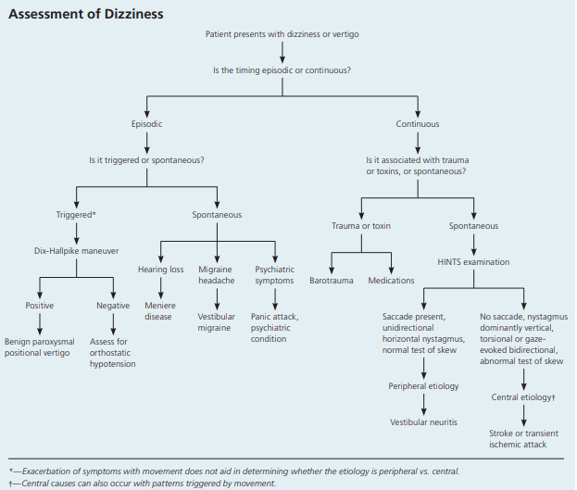

Slide 9
TITRATE THE EVALUATION
TiTrATE is a novel diagnostic approach to determining the probable etiology of dizziness or vertigo.
The approach uses the Timing of the symptom, the Triggers that provoke the symptom, And a Targeted Examination.
The responses place the dizziness into one of three clinical scenarios :
episodic triggered
spontaneous episodic
continuous vestibular

Slide 10
episodic triggered symptoms
-Brief episodes of intermittent dizziness lasting seconds to hours.
-Common triggers are head motion on change of body position (e.g., rolling over in bed).
-Consistent with a diagnosis of benign paroxysmal positional vertigo (BPPV).

Slide 11
spontaneous episodic symptoms
-(no trigger)
-patients have episodes of dizziness lasting seconds to days
-the patient’s history establishes the diagnosis.
-Common diagnostic considerations for spontaneous episodic symptoms include Meniere disease, vestibular migraine, and psychiatric diagnoses such as anxiety disorders.
-Symptoms associated with lying down are more likely vestibular.

Slide 12
continuous vestibular symptoms
- Patients have persistent dizziness lasting days to weeks.
- The symptoms may be due to traumatic or toxic exposure.
- Classic vestibular symptoms include continuous dizziness or vertigo associated with nausea, vomiting, nystagmus, gait instability, and head-motion intolerance.
- If no trauma or exposures → these findings are most consistent with vestibular neuritis or central etiologies.
- Central causes can also occur with patterns triggered by movement !!

Slide 13
HISTORY: TIMING, TRIGGERS, AND MEDICATIONS
Vertigo
a sensation of self-motion when not moving
Vertigo is the result of asymmetry within the vestibular system or a disorder of the peripheral labyrinth or its central connections.
The distinction between vertigo and dizziness is of limited clinical usefulness.
ask about hearing loss, which could suggest Meniere disease.
Diagnostic criteria
1.episodic vertigo (at least two episodes lasting at least 20 minutes) associated with documented low- to medium-frequency 2.sensorineural hearing loss by audiometric testing in the affected ear and 3.tinnitus or aural fullness in the affected ear. initially unilateral

Slide 14
Is it triggered by a specific position or change in position ?
BPPV is triggered with sudden changes in position, such as a quick turn of the head on awakening or tipping the head back in the shower.
Orthostatic hypotension occurs with movement to the upright position.
dizziness that worsens with movement does not aid in determining whether the etiology is peripheral vs. central (benign vs. dangerous).
Medications were implicated in 23% of cases of dizziness in older adults in a primary care setting.
The use of five or more medications is associated with an increased risk of dizziness.
Older patients are more susceptible to medication adverse effects.

Slide 15
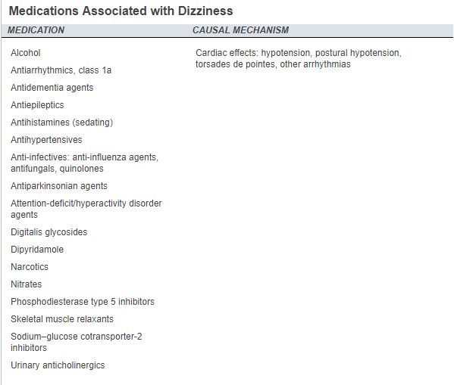

Slide 16
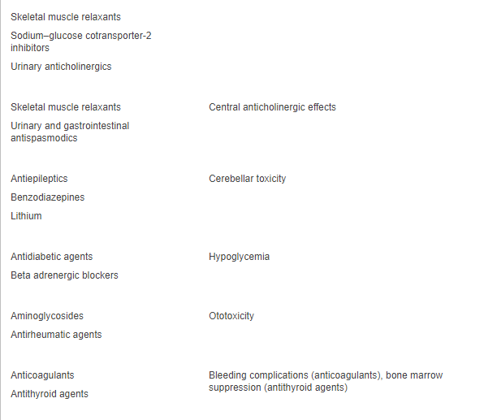

Slide 17
pHYSICAL EXAMINATION
Findings from the physical examination—including a cardiac and neurologic assessment, with attention to the head, eye, ear, nose, and throat examination—are usually normal in patients presenting with dizziness.
Blood pressure should be measured while the patient is standing and in the supine position. Orthostatic hypotension ?
A full Neurologic examination should be performed in patients with orthostatic dizziness but no hypotension or BPPV.
The gait should be observed and a Romberg test performed.
The use of the HINTS (head-impulse, nystagmus, test of skew) examination can help distinguish a possible stroke (central cause) from acute vestibular syndrome (peripheral cause)

Slide 18
HINTS exam
http://www.kaltura.com/index.php/extwidget/preview/partner_id/797802/uiconf_id/27472092/entry_id/0_b9t6s0wh/embed/auto

Slide 19
Head-Impulse. While the patient is sitting, the head is thrust 10 degrees to the right and then to the left while the patient's eyes remain fixed on the examiner's nose. If a saccade (rapid movement of both eyes) occurs, the etiology is likely peripheral.No eye movement strongly suggests a central etiology.
Nystagmus. The patient should follow the examiner's finger as it moves slowly left to right. Spontaneous unidirectional horizontal nystagmus that worsens when gazing in the direction of the nystagmus suggests a peripheral cause (vestibular neuritis).
Spontaneous nystagmus that is dominantly vertical or torsional, or that changes direction with the gaze (gaze-evoked bidirectional) → central etiology

Slide 20
Test of Skew. Test of skew is assessed by asking the patient to look straight ahead, then cover and uncover each eye. Vertical deviation of the covered eye after uncovering is an abnormal result which is fairly specific for brainstem involvement.

Slide 21
BPPV is diagnosed with the Dix-Hallpike maneuver .
Transient upbeat-torsional nystagmus during the maneuver is diagnostic of BPPV if the timing and trigger are consistent with BPPV.
Nystagmus may not develop immediately, and a sense of vertigo may occur and last for one minute.
A negative result does not rule out BPPV if the timing and triggers are consistent with BPPV.
Nystagmus with the maneuver may be due to a central etiology, especially if the timing and trigger are not consistent with BPPV.

Slide 22
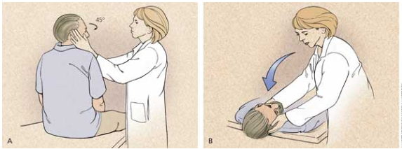

Slide 23
LABORATORY TESTING AND IMAGING
Most patients presenting with dizziness do not require laboratory testing.
Patients with chronic medical conditions (e.g., diabetes mellitus, hypertension) may require blood glucose and electrolyte measurements.
Patients with symptoms suggestive of cardiac disease should undergo electrocardiography, Holter monitoring, and possibly carotid Doppler testing.
However, in a summary analysis of multiple studies that included 4,538 patients, only 26 (0.6%) had a laboratory result that explained their dizziness.
Routine imaging is not indicated. However, any abnormal neurologic finding, including asymmetric or unilateral hearing loss, requires CT or MRI to evaluate for cerebrovascular disease.
Hearing loss with vertigo and normal neuroimaging suggests ???

Slide 24
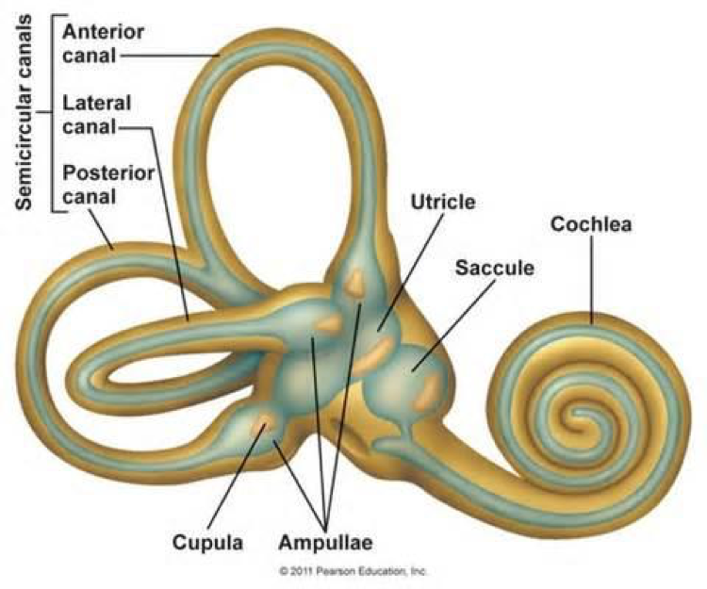
Peripheral Etiologies
peripheral vestibular system, which is comprised of the semicircular canals, the saccule, the utricle, and the vestibular nerve

Slide 25
BENIGN PAROXYSMAL POSITIONAL VERTIGO
- BPPV occurs when loose otoconia, known as canaliths, become dislodged and enter the semicircular canals, usually the posterior canal.
- at any age, but is most common between 50 and 70 years.
- No obvious cause is found in 50% to 70% of older patients, but head trauma is a possibility in younger persons.

Slide 26
Treatment :
-canalith repositioning procedure such as the Epley maneuver
The success rate is approximately 70% 1st attempt, and 100% on successive maneuvers.
-Home treatment with Brandt-Daroff exercises (http://www.youtube.com/watch?v=voZXtTUdQ00) can also be successful.
-If there is no improvement with repeated repositioning maneuvers, or if atypical or ongoing nystagmus with nausea is present, another cause should be considered
-Pharmacologic treatment has no role in the treatment of BPPV.

Slide 27
VESTIBULAR NEURITIS
- the second most common cause of vertigo
- is thought to be of viral origin.
- It most commonly affects persons 30 to 50 years of age.
- Men = women
- diagnosed on the basis of the clinical history and physical examination.
- It can cause severe rotatory vertigo with nausea and apparent movement of objects in the visual field (oscillopsia), horizontally rotating spontaneous nystagmus to the nonaffected side, or an abnormal gait with a tendency to fall to the affected side.

Slide 28
-Hearing is not impaired in this condition.
-The Dix-Hallpike maneuver is not useful
As vestibular compensation occurs, the patient's vertigo resolves slowly over a few days.
-In 50% of patients, the underlying nerve damage may take two months to resolve. disequilibrium may persist for months
-If the attacks do not become successively shorter, another diagnosis should be considered.

Slide 29
-Reassurance, explanation, and advice are essential, in combination with symptomatic treatment for the first few days.
-The prognosis is excellent, but development of BPPV after an attack of vestibular neuritis may occur in 15% of patients.

Slide 30
Treatment:
-medications and vestibular rehabilitation
-Antiemetics and antinausea medications should be used for no more than three days because of their effects in blocking central compensation.
-Vertigo and associated nausea or vomiting can be treated with a combination of antihistamine, antiemetic, or benzodiazepine.
-systemic corticosteroids ? insufficient evidence for their routine use.
-Antiviral medications ? ineffective

Slide 31
MENIERE DISEASE
-vertigo and unilateral hearing loss.
-Although it can develop at any age, it is more common between 20 and 60 years.
-The vertigo associated with Meniere disease is often severe enough to necessitate bed rest and can cause nausea, vomiting, and loss of balance. Other symptoms include sudden slips or falls, and headache with hearing loss worsened during an attack.
-The underlying pathology is excess endolymphatic fluid pressure leading to inner ear dysfunction; however, the exact cause is unknown.
-Patients manifest a unidirectional, horizontal-torsional nystagmus during vertigo episodes.

Slide 32
Treatment:
-1st line : lifestyle changes, including limiting dietary salt intake to less than 2,000 mg per day, reducing caffeine intake, and limiting alcohol to one drink per day.
-Daily thiazide diuretic therapy can be added if vertigo is not controlled with lifestyle changes.
-Transtympanic injections of glucocorticoids and gentamicin ?? can improve vertigo.
-Vestibular suppressant medications may be used for acute attacks.
-Surgery
-Vestibular exercises

Slide 33
Central Etiologies
The vestibular nuclei, cerebellum, brainstem, spinal cord, and vestibular cortex make up the central vestibular system.
cause approximately 25% of dizziness experienced by patients.
may present with disequilibrium and ataxia rather than true vertigo. However, vertigo can be a presenting symptom of an impending cerebrovascular event.
may mimic a more benign peripheral disorder, and a stroke may present with no focal neurologic signs.
CT does not have adequate sensitivity to distinguish stroke from benign causes of acute vestibular syndrome.
The HINTS examination is highly sensitive and specific in identifying stroke in patients with acute vestibular syndrome, and it is superior to diffusion-weighted magnetic resonance imaging in ruling out stroke!

Slide 34
VESTIBULAR MIGRAINE
Episodic vertigo in a patient with a history of migraine headaches suggests vestibular migraine.
VERTEBROBASILAR ISCHEMIA
The blood supply to the brainstem, cerebellum, and inner ear is derived from the vertebrobasilar system.
Diagnosis usually relies on a history of brainstem symptoms, such as diplopia, dysarthria, weakness, or clumsiness of the limbs.
Vertigo is the initial symptom in 48% of patients, although fewer than one-half will have an associated neurologic finding.

Slide 35
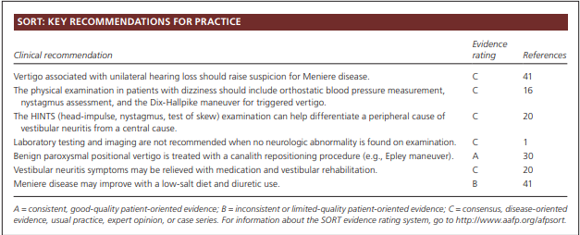

Slide 36
Reference :
-AAFP
Dizziness: Approach to Evaluation and Management HERBERT L. MUNCIE, MD, Louisiana State University School of Medicine, New Orleans, Louisiana SUSAN M. SIRMANS, PharmD, University of Louisiana at Monroe School of Pharmacy, Monroe, Louisiana ERNEST JAMES, MD, Louisiana State University School of Medicine, New Orleans, Louisiana
Thanks !

